Slide 1



Sprint 005
How to Know Your Customer’s Mood

Slide 2
Buying Gifts for Customers
Who?
What?

Slide 3
Best Practices

Slide 4



Slide 5
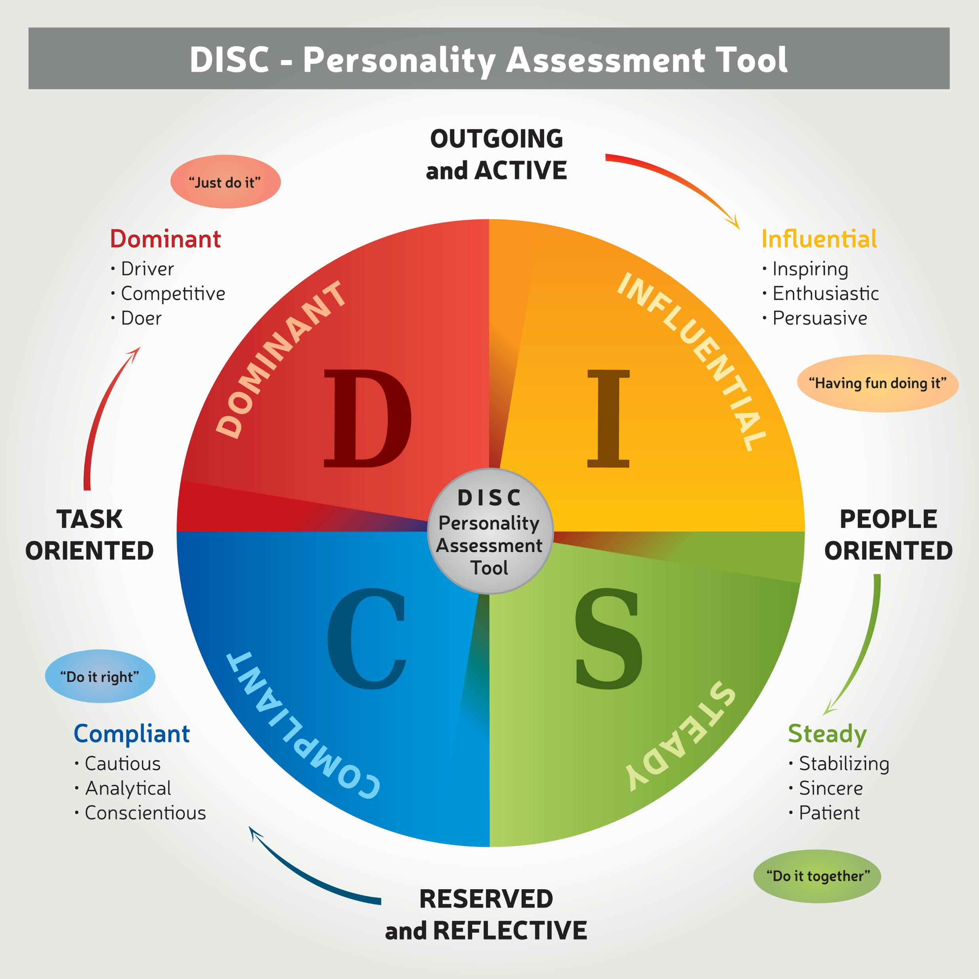
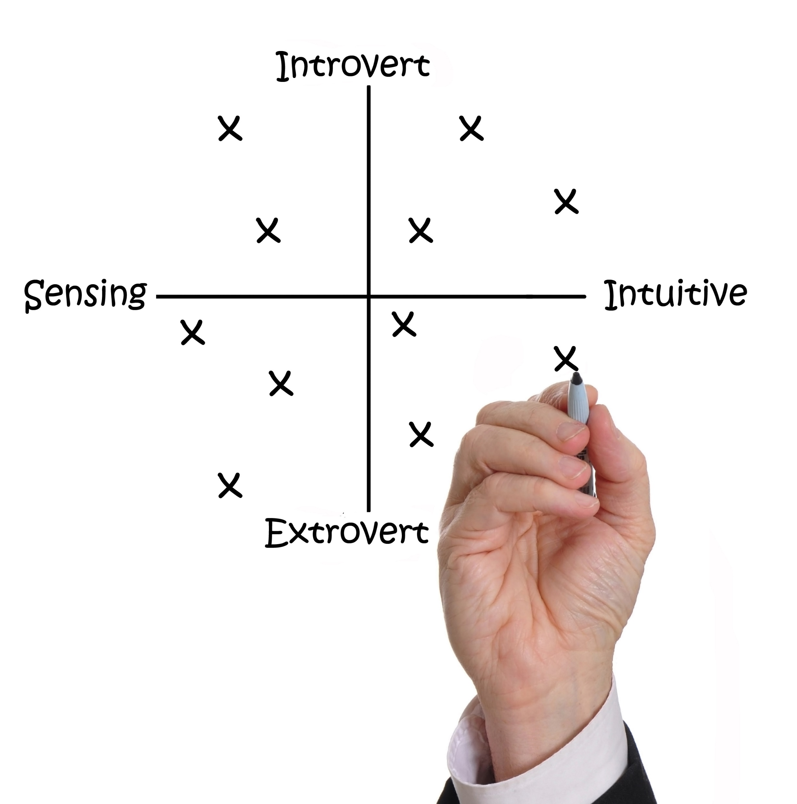
How?

Slide 6
How?

Slide 7
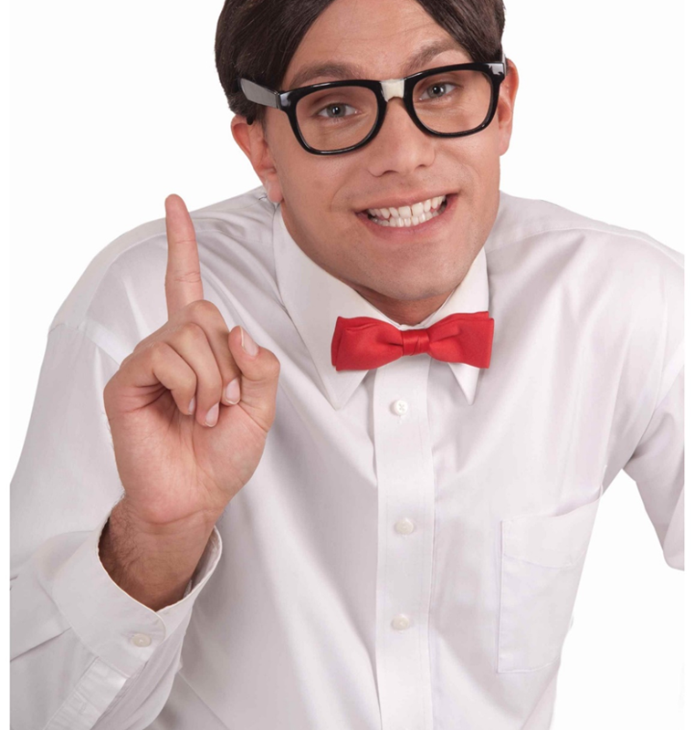
We’re not interested in personality

Slide 8

We Care About Mood

Slide 9

Mood

Slide 10
How?

Slide 11
One Question
Are you ready for … ?

Slide 12
What do you do?
Task
Social
Let them know the end time and set your alarm for 10-minute warning.
Get to the point.
End early.
Let logic do your selling.
Get outta there.
Ask about personal things.
Let them talk.
Compliment their people.
Be vulnerable and transparent.
Let stories do your selling.

Slide 13

Time to act…

