Slide 1
Athletic Training
Healthcare Networking and Game Day Preparation Amy Garrison MS LAT ATC Pullman Regional Hospital and Ross Dexter MS MKin LAT ATC CSCS Gritman Medical Center and University of Idaho
Notes:
Amy and Ross

Slide 2
What is an Athletic Trainer?
“Athletic training encompasses the prevention, examination, diagnosis, treatment, and rehabilitation of emergent, acute, or chronic injuries and medical conditions. Athletic training is recognized by the American Medical Association (AMA), Health Resources Services Administration (HRSA) and the Department of Health and Human Services (HHS) as an allied health care profession.” - NATA
Education - Commision on Accreditation of Athletic Training Education (CAATE)
Bachelor’s Degree - Ending in 2022
Professional Master’s Degree
Post Professional Doctoral Degree
Nationally Certified by the Board of Certification (BOC)
State Regulated - 49 States and DC
Texas - Independent Certification Process
California - Regulatory Legislation in Committee
Professional Organization - National Athletic Trainers’ Association (NATA)
Internationally Recognized - World Federation of Athletic Training and Therapy (WFATT)
Biokinetics Association of South Africa
British Association of Sport Rehabilitators and Trainers
Canadian Athletic Therapists’ Association
Japan Athletic Trainers’ Organization
Taiwan Athletic Trainers’ Association (Republic of China)
Athletic Rehabilitation Therapy (Ireland)
Korean Athletic Trainers’ Association
Notes:
Ross

Slide 3
Athletic Training Clinical Practice
Athletic Training Education Programs
University of Idaho
Washington State University
Professional Sports
Seattle Seahawks
Portland Trail Blazers
Seattle Mariners
Intercollegiate Athletics
University of Idaho
Washington State University
College and University Recreation and Club Sports
Georgia Southern University
Secondary Schools Athletics
Troy Idaho
Garfield-Palouse Washington
Fire, Law Enforcement, and Military
FBI Training Academy
Corporate, Occupational, and Industrial Environments
Boeing
Briotix
Performing Arts
NYU School of Medicine - Harkness Center for Dance Injuries
Cirque du Soleil
Outpatient Orthopedic
The Stone Clinic - San Francisco
Physicians and Specialist Offices
Steadman Clinic and Steadman Philippon Research Institute
Hospital/Emergency Department
Notes:
Ross

Slide 4
Athletic Training Network
Korey Stringer Institute
Athletic Training Locations and Services (ATLAS)
Create a real-time directory and database of athletic training services in secondary schools
Promote and assist states in moving toward full-time athletic training services
Provide useful data to each state’s athletic training association and high school athletic association
Identify common factors associated with increased athletic training services across the country
Provide data to assist with legislative efforts to improve healthcare for high school athletes
Notes:
Ross

Slide 5
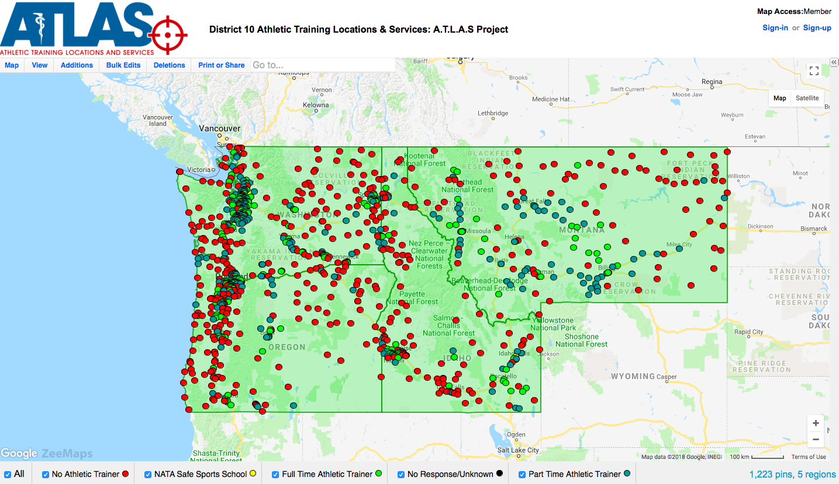
Regional Communities with Athletic Training Services
NWATA - District 10
Notes:
Ross

Slide 6
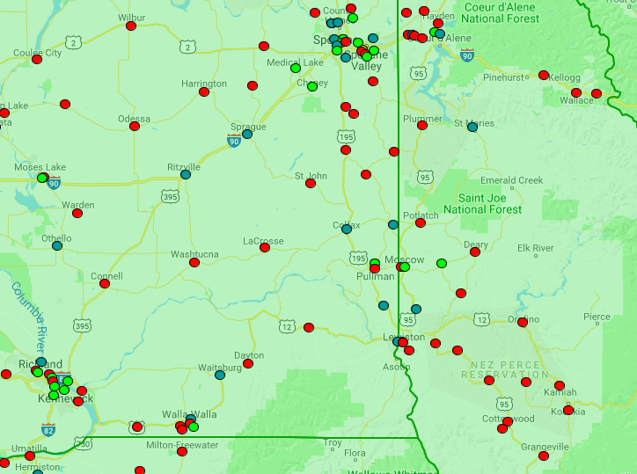
Regional Communities with Athletic Training Services
Pullman-Moscow
Red- no ATC contracted
Blue- ATC part time
Green- ATC full time
***Data retrieved from ATLAS August 22, 2018
Notes:
Ross

Slide 7
Athletic Training Local Secondary School Environments
Washington
Garfield-Palouse (Pullman Regional)
Oakesdale
Pullman (Pullman Regional)
Colton (Pullman Regional)
Colfax
Clarkston
Idaho
Troy (Gritman Medical Center / University of Idaho Fellowship)
Moscow (Gritman Medical Center / University of Idaho Fellowship)
Genesee
Potlatch (Pullman Regional)
Notes:
Ross

Slide 8
Athletic Training
Game Day
Facility Safety
Athletic Trainers work with facilities managers to ensure the safety of all practice and competition facilities.
Facility Preparation
Athletic Trainers develop Emergency Action Plans (EAPs) to ensure the safety and wellbeing of spectators, participants, and staff.
EAPs are communicated with other medical staff and emergency medical services.
Athletic Training set up may including medical kits, treatment tables, evaluation tents, courtesy supplies for visiting teams, hydration stations, etc.
Athlete Preparation
Equipment
Injury Prevention
Treatment
Continuation of rehabilitation/training plans.
Manual therapies and interventions.
Networking
Athletic Trainers
Coaches
Administration
EMS
Other Medically Trained Individuals
Game Time
Ensure the safety of participants
Evaluation/Treatment/Referral
Post-Game
Evaluation/Treatment/Referral
Notes:
Amy

Slide 9
Athletic Training
Focus on Networking
As part of the sports medicine and performance team, and the greater medical community, Physicians, Athletic Trainers and other allied health professionals should maintain active and collaborative relationships.
Athletic Trainers (General)
Develop relationship with directing Physician and associated medical groups.
Establish working relationships with other allied healthcare providers. (Physical Therapists, Massage Therapists, Chiropractors etc.)
Collaborate with local emergency medical services prior to and during athletics seasons.
Athletic Trainers (Game Day)
Seek out and and introduce yourself to:
Host or visiting Athletic Trainer
Host or visiting coaching staff and administration
Emergency Medical Services
Notes:
Amy

Slide 10
Sports Medicine Team
Communication and Collaboration
ATC
Initial point of contact
Guide/facilitate care
Carry out treatment plan as prescribed by medical provider
Collaborate care plan
Share progress
Student Athlete
Parent/Guardian
School Administrators
Coaches
Counselors
Allied Health Care Provider
Medical
Provider
PT/OT, Massage Therapists,
Chiropractors
Primary Care Providers, Medical/Surgical Specialists
Notes:
Amy

Slide 11
Specific Questions

Slide 12
References
What is Athletic Training? https://www.nata.org/about/athletic-training - Accessed August 22, 2018
Athletic Training Locations and Services (ATLAS) https://ksi.uconn.edu/nata-atlas/ - Accessed August 23 2018

