Slide 1
Sports physical exam update
Edward D. Smith MD
Pullman Family Medicine

Slide 2
Learning objectives
Discuss important aspects of PPE
Discuss different approaches and methods
Controversies
CV screening
When to refer patients for further care

Slide 3
How can I make this interesting…
30 million younger than 18yo every year have sports physical exam (SPE)
4th edition AAP PPE recommendations
Goal to

Slide 4
Initial considerations
Is this exam same well-child check?
Could be important and exam for a healthy children and athletes.
Are there restrictions to playing?
Individual vs mass screening exams?

Slide 5
Intensity of specific sports

Slide 6
History
Thorough history could pick up 88% of medical conditions, 67% of MSK issues
Ask FMH of cardiovascular issues
Time considerations, what to concentrate on?

Slide 7
Exam
AHA recommendation 12 pt exam
Concentrate on CV, MSK, concussions?
Labs usually not necessary
Review state rules: every year? Every two years?
Hypertension guidelines
Visual acuity exam

Slide 8
Reasons for exclusions:
Reasons why you might advise against certain activities?
Early surgeries?
Spine issues?
High risk youth?

Slide 9
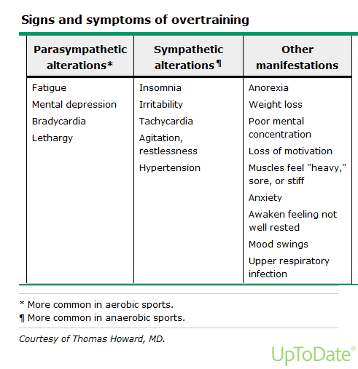

Slide 10
Choosing Wisely Campaign
BEST PRACTICES IN PREVENTIVE MEDICINE: RECOMMENDATIONS FROM THE CHOOSING WISELY CAMPAIGN
Recommendation | Sponsoring organization
Do not order annual electrocardiography or any other cardiac screening for asymptomatic, low-risk patients. | American Academy of Family Physicians and American College of Physicians
Do not screen adolescents for scoliosis. | American Academy of Family Physicians

Slide 11
Mass physicals?
Can screen and clear large numbers of youth in one day
Offers chance to collaborate with colleagues
Community appreciates
Eases load of patients at office
Last second requests!

Slide 12
Individual SPE’s?
Offers more time with patient
Easier to ask sensitive issues
Vaccines
Better environment to discuss abnormal findings

Slide 13
Case!!:
This is scary
Walk on, 6-3 320lbs
Syncopal episode practicing
Told me didn’t eat breakfast, I’m fine
Normal ecg…..I pushed for echo
CT surgery 2 months later
‘yeah felt way more alert in class after’…..

Slide 14
Sudden cardiac death
Definition: Death in young person under age 35 years old
Caused by immediate physical demands of intense physical activity
Or certain patients with structural changes resultant from prolonged activity vs. underlying structural abnormalities or
Incidence unknown, 1:50,000-1:100,000?

Slide 15
SCD
Cause of SCD in athletes less than 35yo:
36-50% hypertrophic cardiomyopathy
10-19% coronary artery anomalies
6% myocarditis
5% ruptured aorta (Marfans syndrome)
<5% CAD, aortic stenosis, right ventricular dysplasia, ion channel disorders

Slide 16
SCD continued
Long QT syndrome
Myocarditis
Marfans

Slide 17
ECG screening
Remains controversial
Some countries require
Goal to catch
USPSTF rec against in asymptomatic adults

Slide 18
Cons ECG screening
Far too many false positives
Can lead to further uneccesary testing
Restricting play causes nightmares
SCD 1.06 per 100,000 persons per year 12-25yo?
At WSU participated in UW screening program
Cost?

Slide 19
Cost of ECG screening

Slide 20
Athletes heart aka athletic bradycaria, exercised induced cardiomegaly
Increase QRS voltage
Mild right or left axis deviation
Bradycardia
Repolarization abnormalities

Slide 21
If there is CV abnormality
Does not mean exclusion automatically
Recent NCAA player with defibrillator
Have to have to staff in place, training for team, coaches etc

Slide 22
HCM vs Athletes Heart
HCM
assymetric | concentric
Wall thickness>15mm | <15mm
 | <40mm
LVEDD | >45mm
Diastolic function: always abnormal | Normal

Slide 23
AED
Should be near all stadiums, arenas
Goal within 3-5 min of all sporting events
Train staff!

Slide 24
Underrated MSK issues?
Foot exam?
- CB with rhino toe…
Gait analysis?
Scoliosis check?
Flexibility exam?

Slide 25
What should you not ask about?
In group settings +/- vaccines, sensitive, social issues
In office do those aspects of history and exam get in way of CV exam and MSK exam?

Slide 26
Sickle cell
Still controversial
Results in abnormal shaped red blood cells
Can appear as quarter-moon or ‘sickle shaped’
Trait or carrier usually not issue, except periods high intensity exteme physical exertion
Can lead to rhabdo, splenic infarct, papillary necrosis
8% AA are carrier of trait

Slide 27
Anectodotal stories traveling with oxygen etc
Stay hydrated, avoid extreme training methods
Widespread testing at NCAA level
Might save 7 deaths every ten years
Ethical concerns

Slide 28
Worst outcomes
Shopping for clearance:
- NM wide receiver ACL, got cleared to play, worse injury first catch of year
Personal vs team docs
Less control in high school and below
Lack of ATC! Especially problem in rural, underserved areas

Slide 29
Bibliography continued
Incidence of sudden cardiac death in athletes: a state-of-the-art review.
AU
Harmon KG, Drezner JA, Wilson MG, Sharma S
SO
Br J Sports Med. 2014;48(15):1185. Epub 2014 Jun 24.
Incidence of sudden cardiac death in athletes: a state-of-the-art review.AUHarmon KG, Drezner JA, Wilson MG, Sharma S SOBr J Sports Med. 2014;48(15):1185. Epub 2014 Jun 24.
Malhotra R, West JJ, et al. Cost and yield of adding electrocardiography to history and physical screening Division I intercollegiate athletes: a 5-year experience. Heart Rhythm. 2011;8(5):721-7.

Slide 30
Concussions
Most controversial issue last decade or longer?
When to hold?
When to refer?
Pre/post testing options

Slide 31
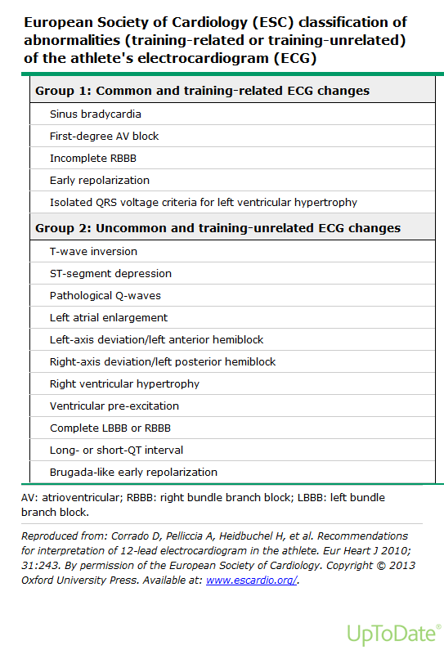

Slide 32
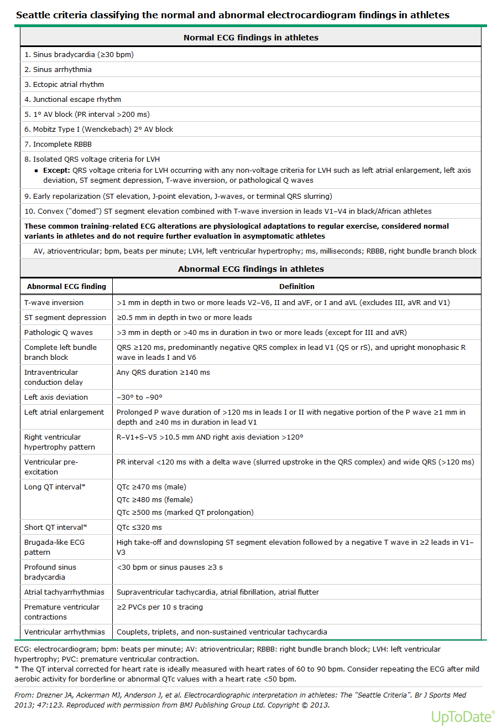

Slide 33
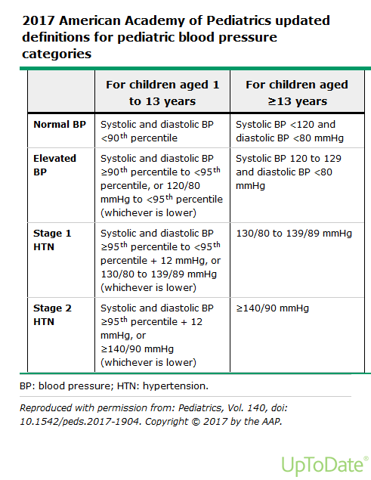

Slide 34
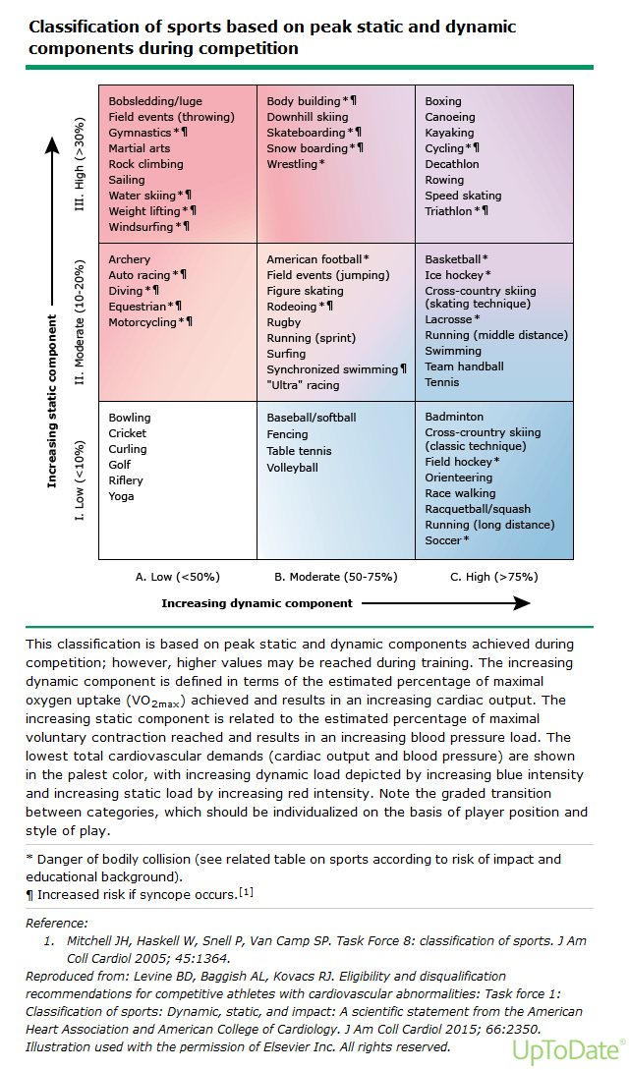

Slide 35
Other patient populations
Adults? Most cases of SCD due to CAD
High level recreational athletes?
Patients with physical disabilities?
Military?
L&I/Workman’s comp/disability?

Slide 36
Thank you!

Slide 37
bibliography
J Genet Couns. 2015 Dec;24(6):873-7. doi: 10.1007/s10897-015-9849-1. Epub 2015 Jun 5.
Sudden Cardiac Arrest during Participation in Competitive Sports. AU Landry CH, Allan KS, Connelly KA, Cunningham K, Morrison LJ, Dorian P, Rescu Investigators SON Engl J Med. 2017;377(20):1943.
Sickle Cell Trait Screening of Collegiate Athletes: Ethical Reasons for Program Reform.
Ferrari R¹, Parker LS², Grubs RE², Krishnamurti L^{3,4}.
Shephard RJ¹.J Sports Med Phys Fitness. 2016 Dec;56(12):1562-1573. Epub 2016 Feb 3.Sickle cell trait: what are the costs and benefits of screening?

