Slide 2
Sports Medicine Update Biologics – Stem cells, platelet rich plasma(PRP), progenitor cells, stromal vascular fraction How they can help us?
Edwin M. Tingstad, MD
Inland Orthopaedics
Assistant Professor – Washington State Univ. and University of Washington Medical Schools

Slide 3
Goals
Provide a framework for understanding the use of biologic therapies in musculoskeletal conditions
Outline the recent literature and media information – marketing or medicine?

Slide 4
What are we talking about? - options available, what are they?
Stem cells – (embryonic, induced pluripotent or adult stem cells.)
Bone Marrow-Derived Mesenchymal Stem Cells (BM-MSCs)
Human Umbilical Cord Blood-Derived Mesenchymal Stem Cells (huCB-MSCs)
Platelet rich plasma
Bone Marrow Aspirate Concentrate (BMAC)
Adipose Tissue-Derived Stromal Vascular Fraction(ADSVF)
Peripheral Blood-Derived Progenitor Cells
Amnion based products

Slide 5
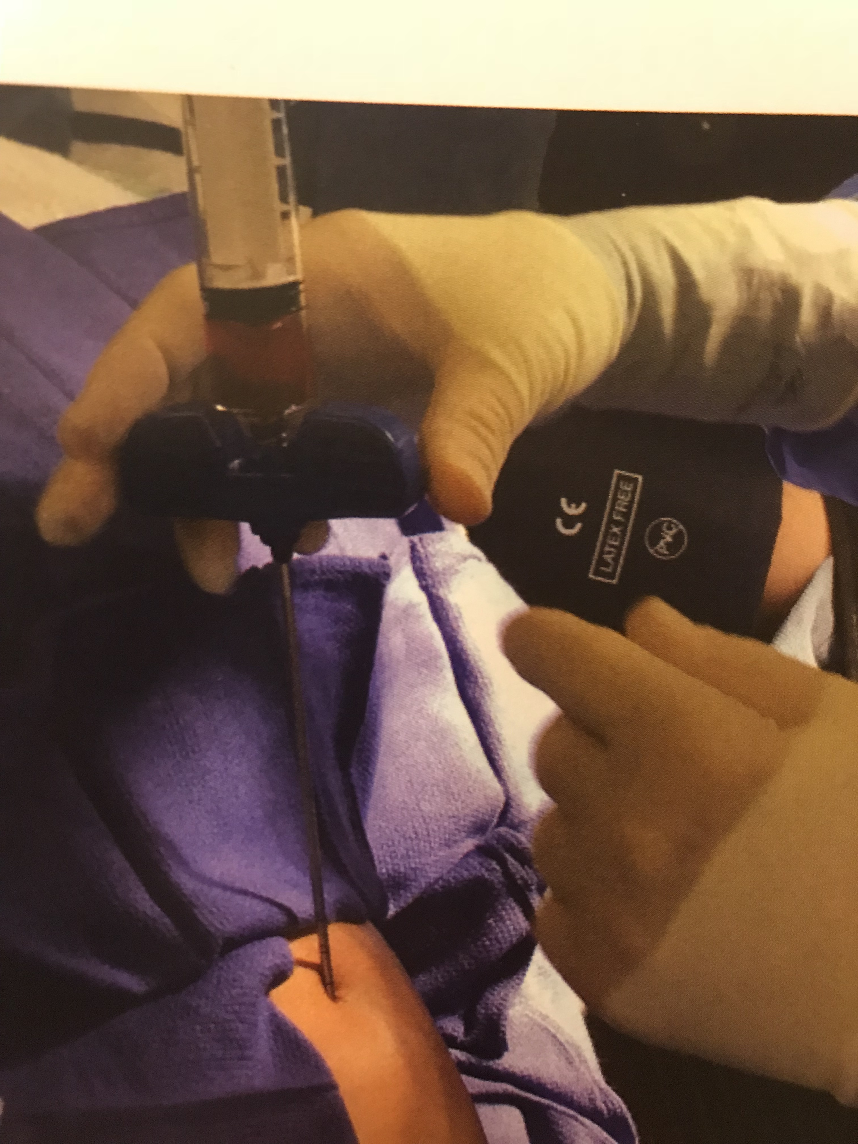

Slide 6
What is a stem cell? A class of undifferentiated cells that are able to become specialized cells types and can divide to produce more of the same type of cells. They can grow into one of the body’s more than 200 cell types.

Slide 9
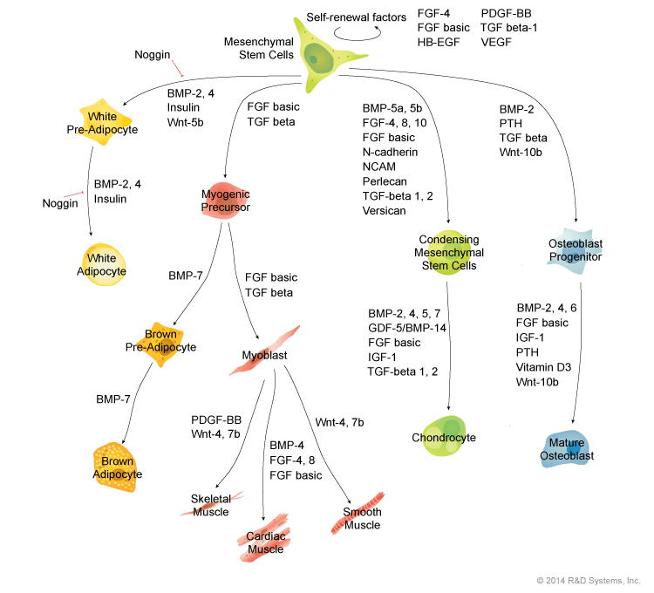

Slide 17
BIOLOGICS IN SPORTS MEDICINE

Slide 20
Mesenchymal stem cells
Mesenchymal stem cells, or MSCs, are multipotent stromal cells that can differentiate into a variety of cell types, including: osteoblasts (bone cells), chondrocytes (cartilage cells), myocytes (muscle cells) and adipocytes (fat cells)
In addition, MSCs can migrate to sites of inflammation and exert potent immunosuppressive and anti-inflammatory effects
Where can we use it?–
Ligament/Tendon/Muscle/Fascia
Bone/ Fusions
Nerve
Cartilage / Joint capsule
Lumbar Disc
Lumbar and Cervical Facet

Slide 21
What do we use today - BMAC is most commonly used and advertised
Bone marrow aspirate concentrate (BMAC)
- this does not equal stem cell therapy
- only a small fraction of cells are mesenchymal stems cells, seems to be good for bone and cartilage defects as it has a variety of cells.
Bone Marrow - Derived Mesenchymal Stem Cells
- can isolate MSCs and expand in culture 100 – 10,000 fold over several weeks in culture. (BM- MSCs)
- this seems to work well when embedded in a matrix such as a gel for
limited defects.
19 studies using culture expanded BM-MSC – mixed results for cartilage lesion and osteoarthritis

Slide 22
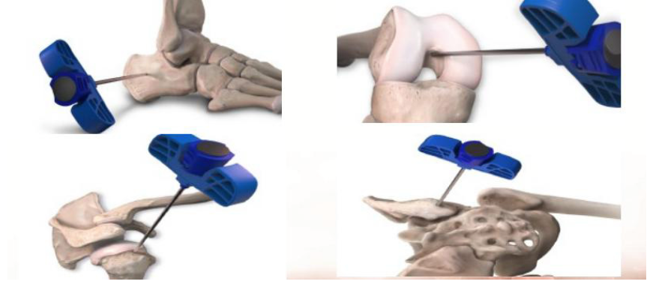
BMAC Harvest Sites
Calcaneus, distal femur, proximal Humerus, posterior iliac crest.

Slide 23
Adipose Tissue Derived Mesenchymal Stem Cells (Ad-MSCs)
A better source (500 fold greater yields for stem cells) than from bone marrow
- easier to obtain (abdomen or buttock)
-seem to be poorer for stimulating cartilage growth
Only two small studies both with positive outcomes in osteoarthritis in decreasing pain and improving function.
Large ongoing trial at Stanford (Dragoo) – should have data soon, still enrolling patients.

Slide 24
Adipose Tissue – Derived Stromal Vascular Fraction (ADSVF)
- obtained by centrifugation of a lipoaspirate, gives a heterogenous cell population (pericytes,endothelial cells, smooth muscle cells, fibroblasts, macrophages and MSCs.)
19 studies (some mislabeled as Ad-MSCs) – most showed favorable outcomes in treating cartilage defects especially when done with other procedures such as tibial osteotomy.

Slide 26
Synovial Derived Mesenchymal Stem Cells (Sy- MSCs)
Isolated from synovial membrane, have been used for over fifteen years.
Seem to be better for cartilage lesions, most studies are in animals
Recent human study (Akgun 2015) comparing Sy-MSCs versus implanted chondrocytes shows better outcomes for the MSCs

Slide 27
Human Umbilical Cord Blood-Derived Mesenchymal Stem Cells (hUCB-MSCs)
- has been used for many years to treat hematological disorders
Avoids ethical concerns as seen for embryonic stem cells and little morbidity to harvest. Low immunogenicity.
Seem to proliferate easier and high chondrogenic potential compared to other types of MSCs.
Only one study (7 - patients with osteoarthritis) – using a hydrogel/hyluronic acid composite saw good outcomes at seven years. (Park – 2017)

Slide 29
Notable potential

Slide 30
The Biology of Blood

Slide 31
Peripheral Blood-Derived Progenitor Cells (PBPCs)
- contains a variety of cells and very few MSCs
Progenitor cells are early descendants of stem cells that can form several kinds of cells, but cannot divide and reproduce indefinitely like a stem cell.
Progenitor cells that lead to tissue regeneration are attracted to injury sites.
-animal studies show may be good for cartilage regeneration.

Slide 32
Platelet rich plasma
- readily available, many formulations

Slide 33
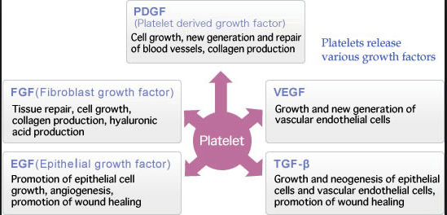
PRP delivers growth factors
A Growth Factor is a protein molecule made by the body; it functions to regulate cell division & cell survival. Growth factors can also be produced by genetic engineering in the laboratory and used in biological therapy.
Growth factors are stored in the alpha granules on platelets.
They are released through platelet degranulation- when platelets become activated and are delivered to an injury site.
Notes:
•Platelet-derived growth factor(PDGF) is known to be involved in regulating the mitosis of connective tissue cells, and recent studies have also shown that it may function in mediating cellular transformation.
TGF-B

Slide 34
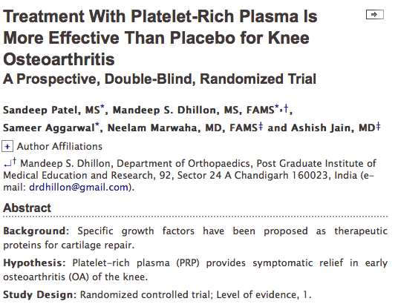
*Study found that those with PRP injections did better than those with saline alone

Slide 35
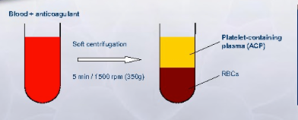
Buffy Coat vs. Plasma System
Plasma system (ACP)
Single centrifugation
Separates RBC’s from WBC’s; concentrates platelets and GF’s in plasma layer
2x3 platelet concentration above baseline
White and red blood cells are NOT concentrated in a plasma system

Slide 36
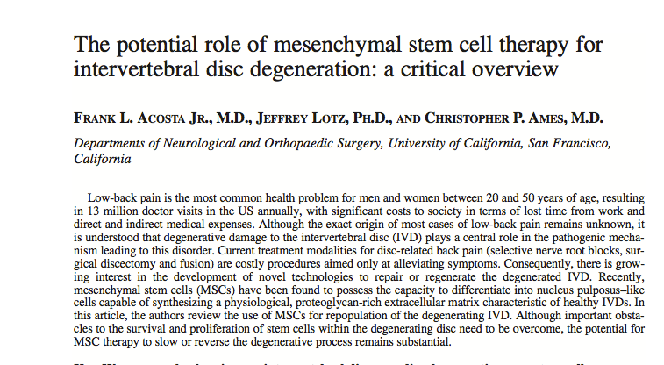
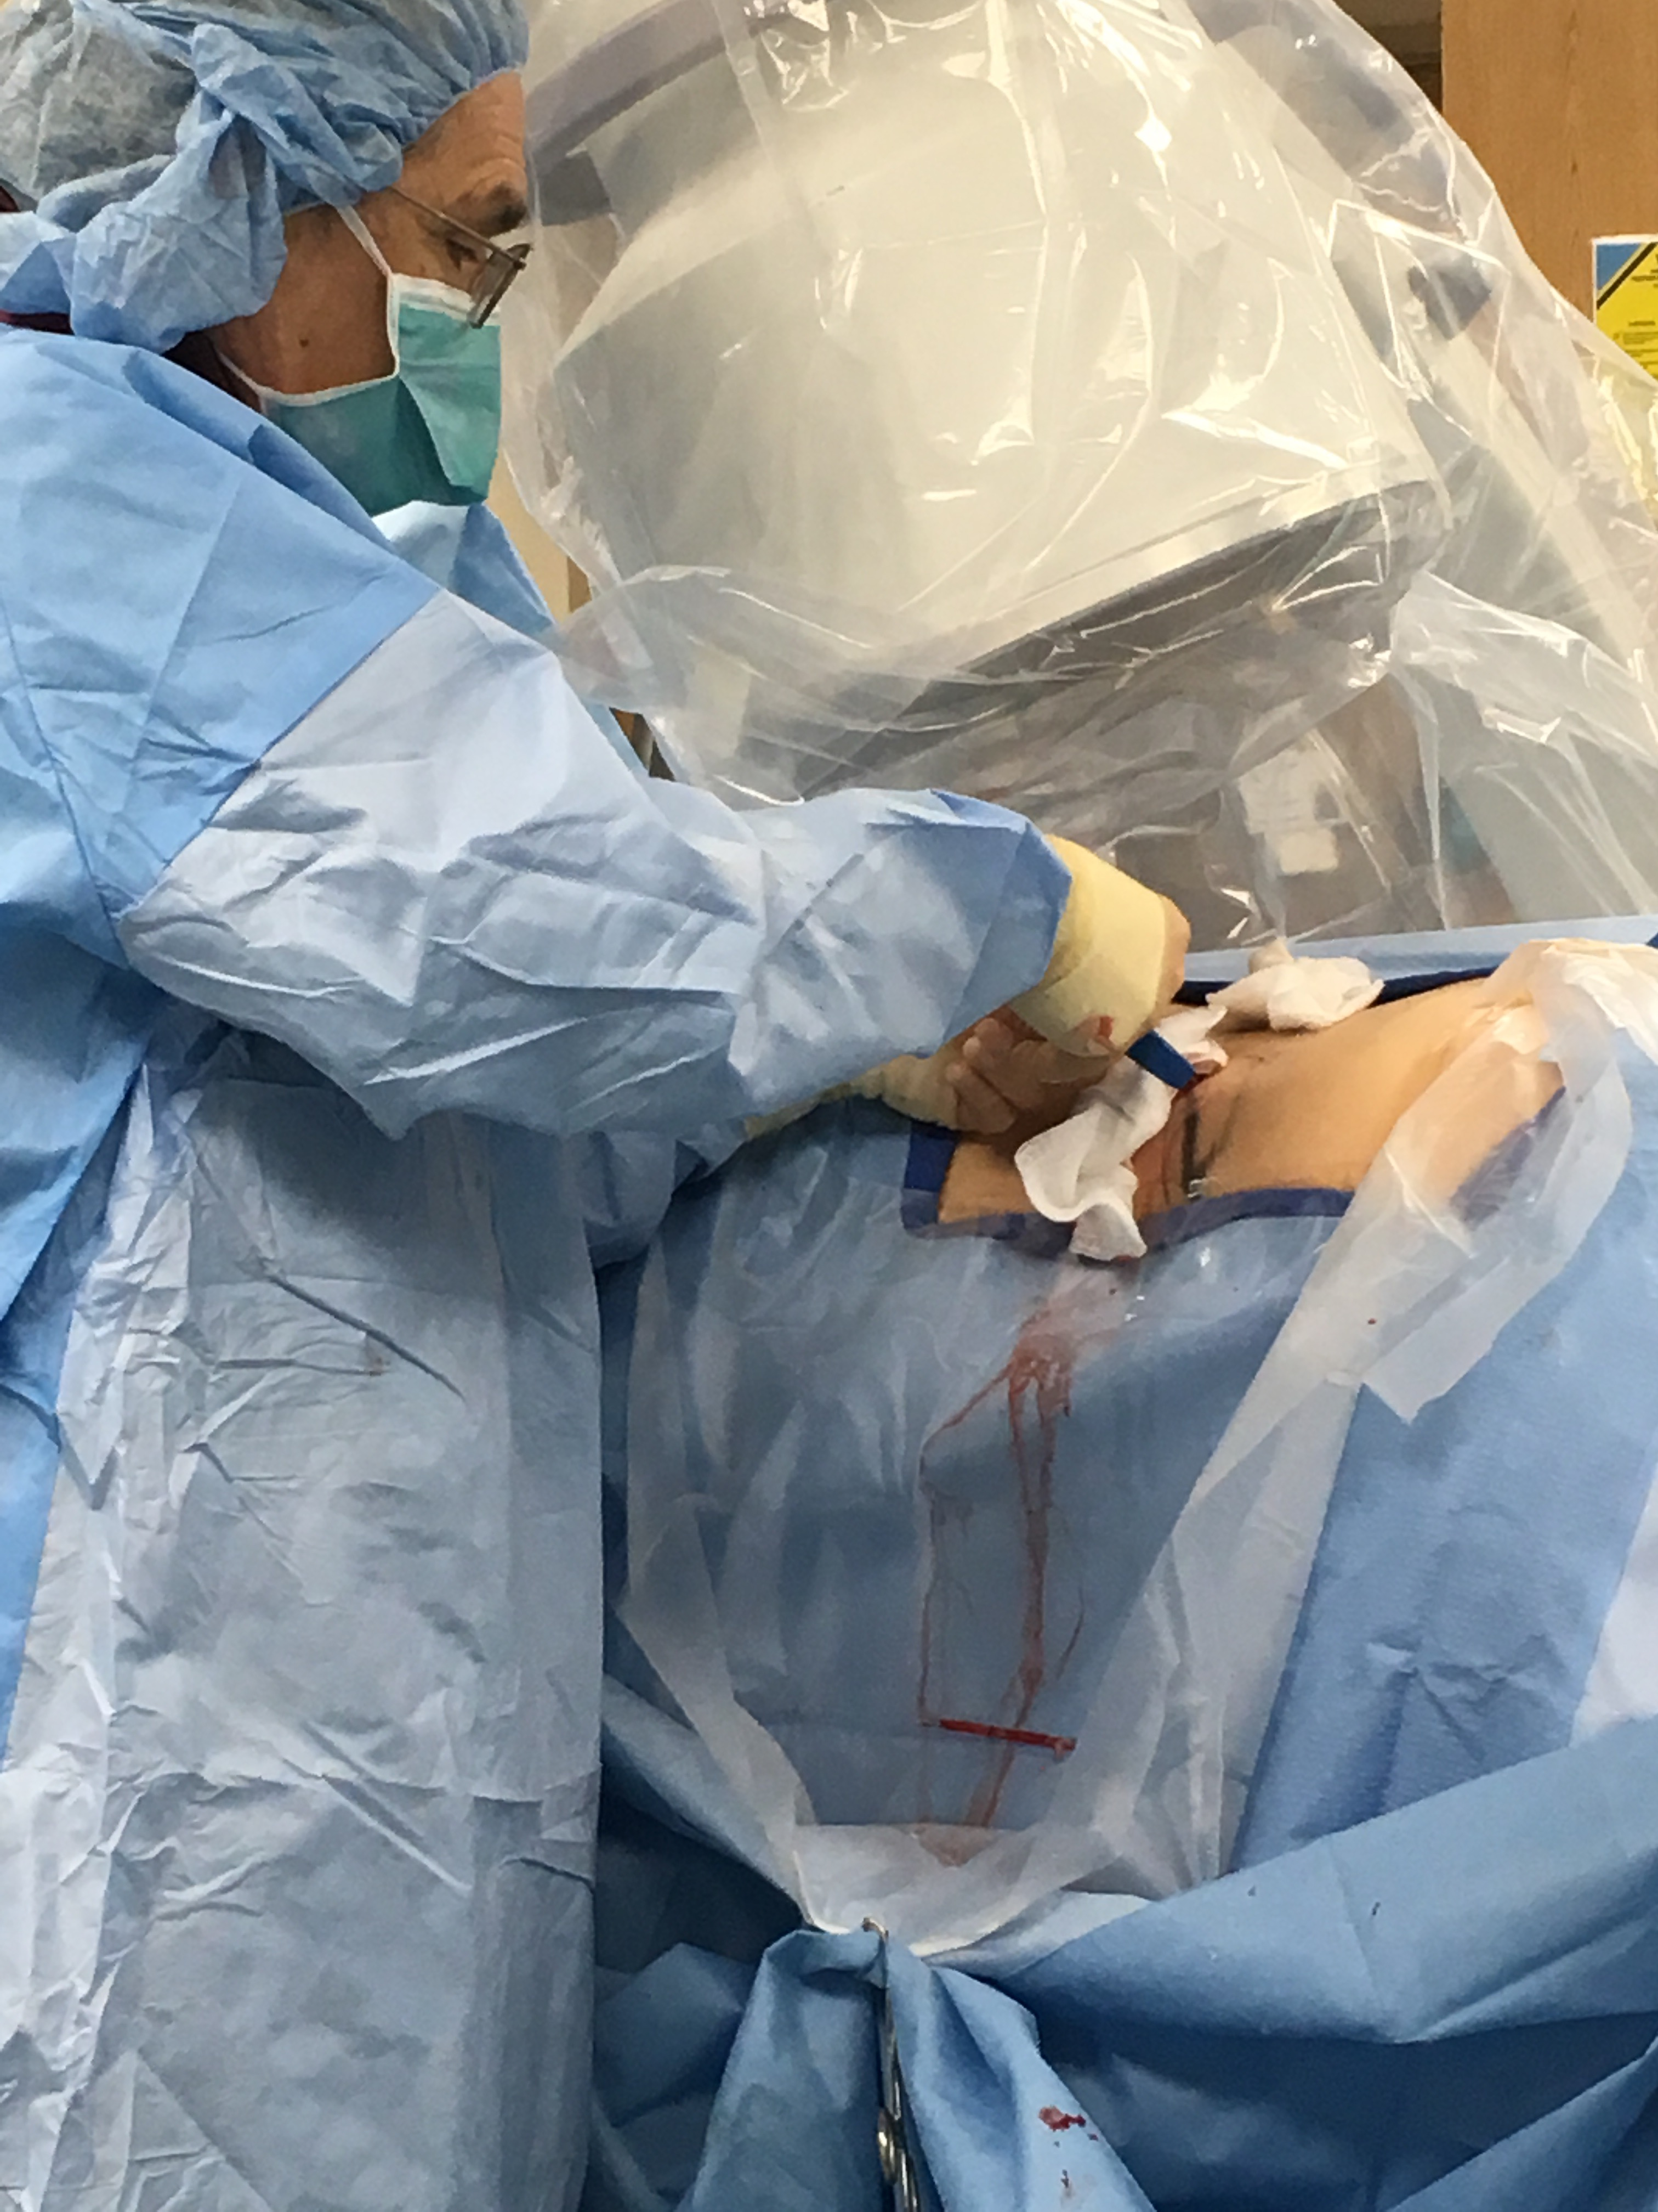
Discectomy cases with Dr. Steingart
NeuroSurg Focus 2005 Conclusion: Advancements in under- standing the cellular basis of IVD degeneration and stem cell biology have led to significant progress in the field of tissue engineering to repair, reverse, or regenerate diseased tissue. As uncommitted precursor cells, MSCs have the potential to differentiate into NP-like cells with the ability to proliferate and repopulate the degenerated IVD directly, activate native NP cells, or deliver gene products of interest.
Dr. Steingart in action
Stem Cells International, Oct 2016
Conclusion: Evidence suggests that MSC’s may fufill the final major obejective of reversing disc tissue loss

Slide 38
What do we know today.
We are still learning.
Huge potential for minimally invasive biologic treatments.
- Cartilage defects, ligament and muscle, disc healing/regeneration.
Costly $$$ - most insurance does not pay for these treatments
Controversial – studies show wide range of results.

Slide 39
What I tell patients
Biologic treatments work.
PRP is good for tendinopathy, and some rotator cuff tears and PRP is good at relieving arthritis pain, but does not reverse arthritis.
Mesenchymal stem cells embedded in patch or gel seem to work well for cartilage defects less than quarter size (injected these are like spitting into a thunderstorm)
Best two studies in US is being done at Stanford (Dragoo and Chu)
Great things coming

Slide 40
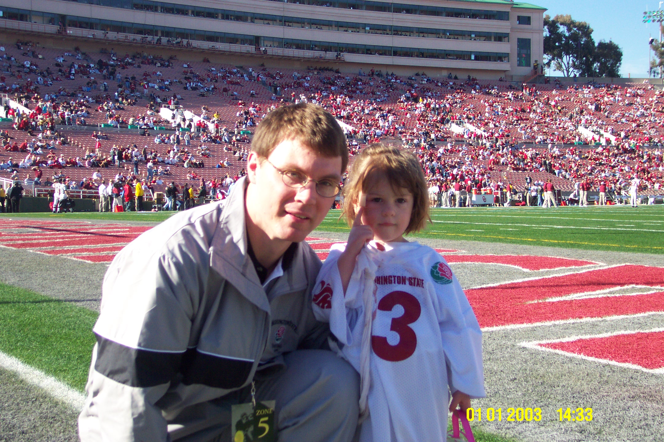

Slide 41
Thank you.

