Slide 1
The Impact of Cloud Technology on Multi-Unit Operators
Paul Rubin

Slide 2
Cloud POS
From Old to New…
For years POS systems were designed to run in the four-walls of one restaurant
Bolted on tools emulated enterprise capabilities
What would it look like if a solution were designed for the needs of a multi-unit restaurant operation?
How would it be different?

Slide 3
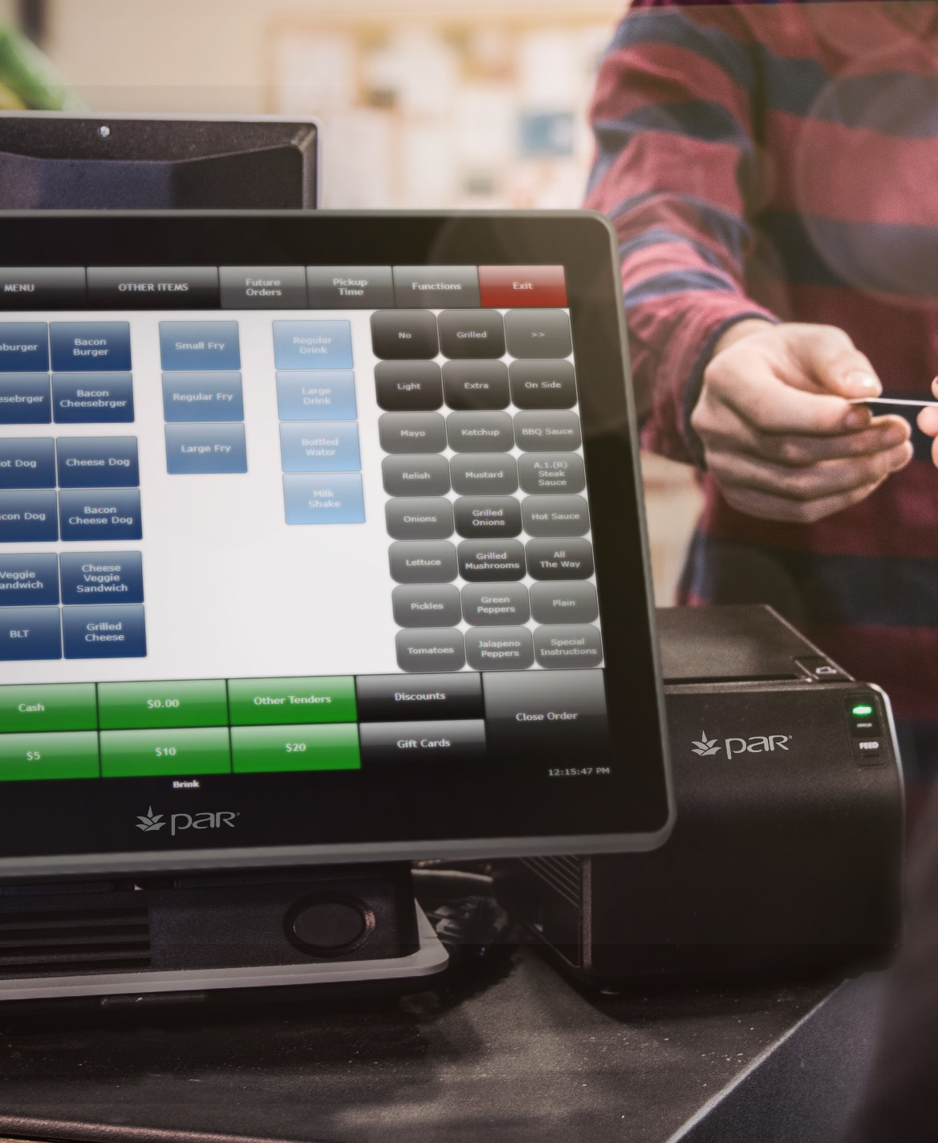
Cloud POS
What is Cloud POS?
A Cloud POS is a solution in which the authoritative source of configuration and sales history resides in a hosted database and not in the restaurant.
Only lightweight software runs in the restaurant.
Restaurants have the ability to operate, for an extended period of time, with or without an Internet connection but they are not the system-of-record.
Unified tools for above-store and in-store use

Slide 4
State of Cloud POS
How is a Cloud POS different from Client-Server POS?
No Back-Office Server – Turns out a restaurant makes a horrible home for a server-class computer!
Subscription Model - Today we buy Salesforce and Microsoft Office via SaaS
No Single Point-of-Failure
Above-Store Integrations
Most are Cloud-to-Cloud
No In-Store Agents
No Third-Party Access to Restaurants for Installation, Upgrades, Support, etc.
Mobile Access without Remote Access Tools
Real-Time, Enterprise Data

Slide 5
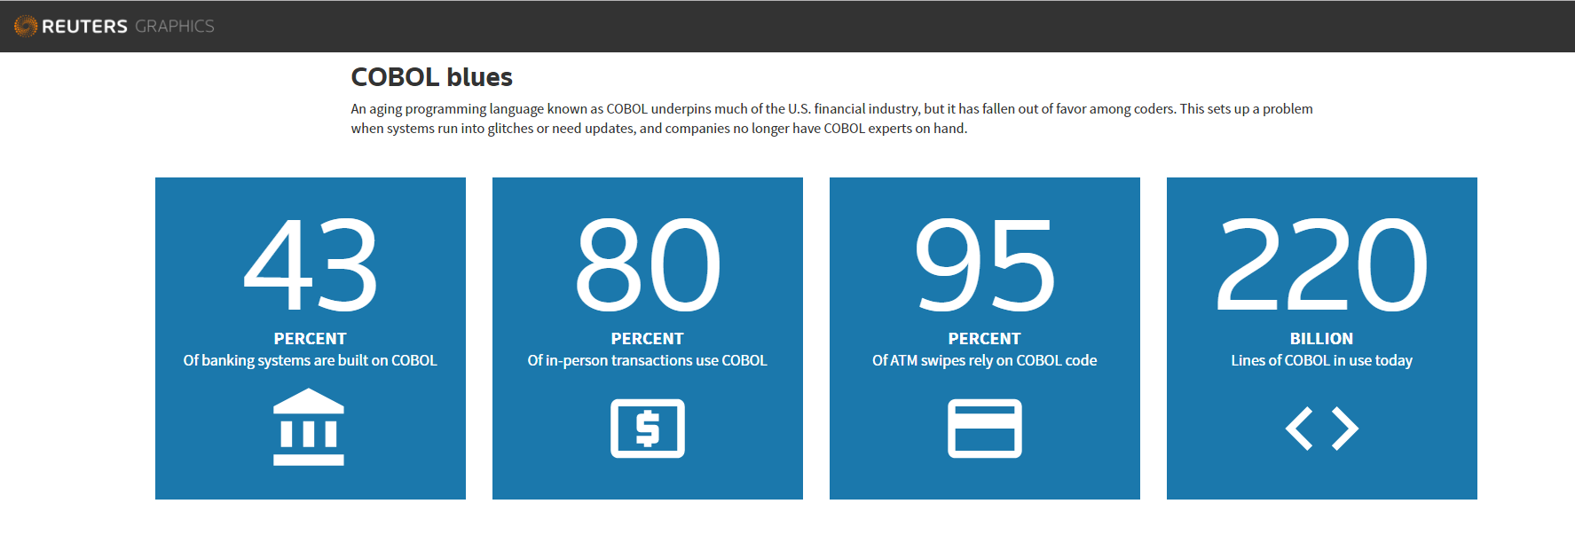
Technology Adoption
May 6, 2017 - Think COBOL is dead? About 95 percent of ATM swipes use COBOL code, Reuters reported in April, and the 58-year-old language even powers 80 percent of in-person transactions. In fact, Reuters calculates that there’s still 220 billion lines of COBOL code currently being used in production today, and that every day, COBOL systems handle $3 trillion in commerce.

Slide 6
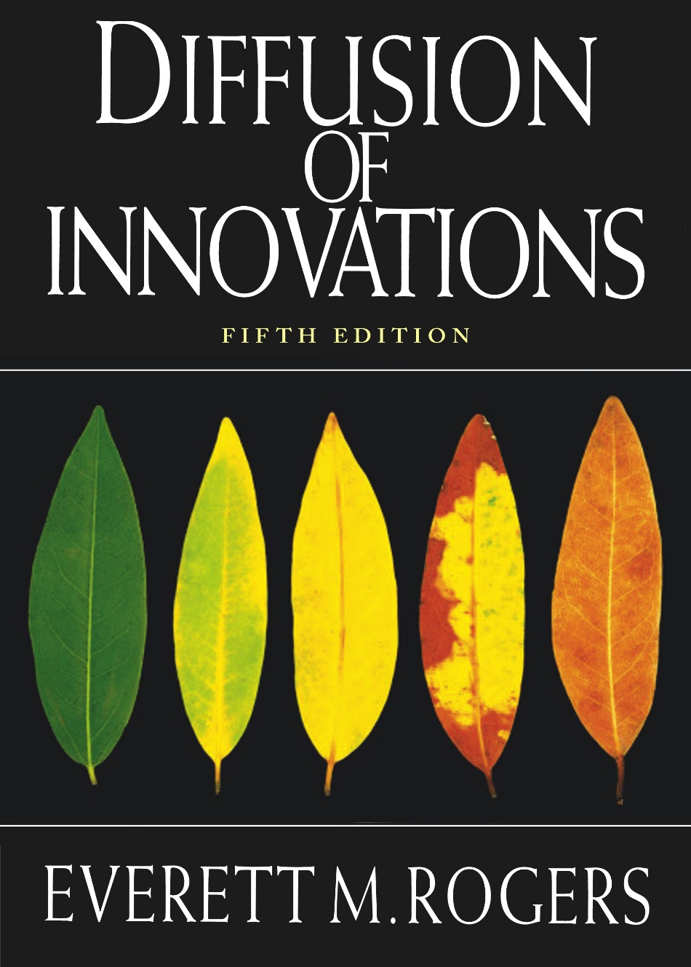
Technology Adoption
Diffusion of Innovations
is a theory that seeks to explain how, why, and at what new ideas and technology spread. Everett Rogers, a professor of communication studies, popularized the theory in his book Diffusion of Innovations; which was first published in 1962. Rogers argues that diffusion is the process by which an innovation is communicated over time among the participants in a social system. The origins of the diffusion of innovations theory are varied and span multiple disciplines.

Slide 7
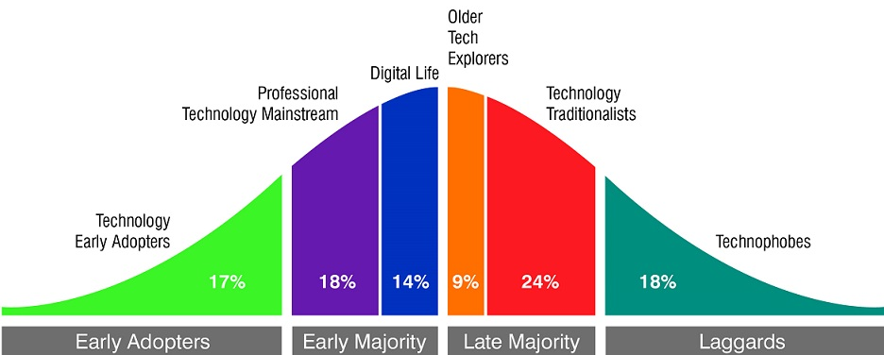
Technology Adoption
Technology Adoption Segmentation

Slide 8
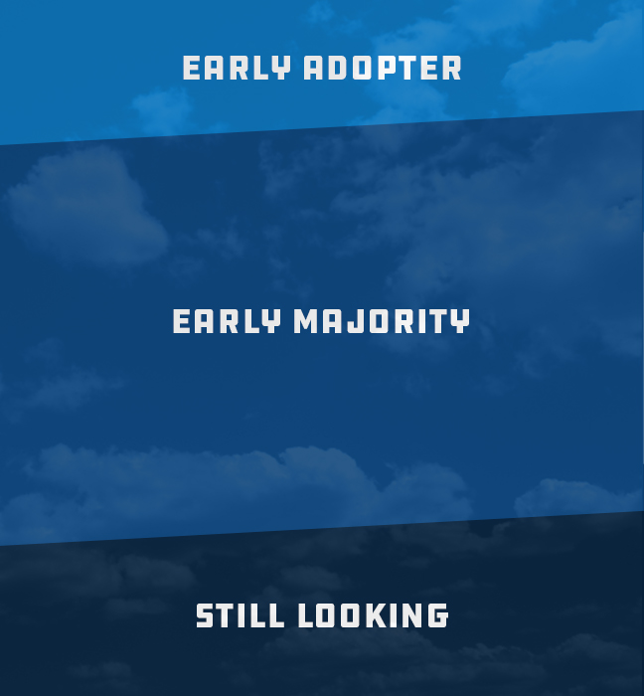
Market Assessment
Where is your organization?
Statistically everyone here will be one of:
Early Adopter
Early Majority
Still Looking
What are the considerations you need to be thinking about?
Who wants to be a laggard?

Slide 9
Planned Obsolesce
What is Planned Obsolescence?
Planned obsolescence is a policy of producing goods that rapidly become obsolete and so require replacing, achieved by frequent changes in design, termination of the supply of spare parts, and the use of nondurable materials
A Cloud POS should be the last one you need!

Slide 10
Restaurant Technology Innovation
Cloud POS offers access to Agility and Innovation
Steady Cadence of New Features
Access to New Features as the Market Evolves
Software Updates are Deployed Automatically
New features can be enabled when you are ready
New Payment Technologies
Analytics (Big Data)
Streamlined User Interfaces
Specialized Workflows

Slide 11
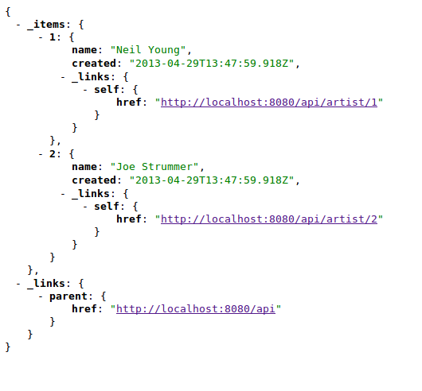
API Integrations
Cloud POS architecture provides:
The ability to move a variety of types of data
The ability to move data bi-directionally
The ability to move data in near real time
Integrations without the need for In-Store Agents running on a Back-Office server
Open Access and Standards
Important for:
Home Grown Innovation
Accessing Expertise in a large Ecosystem
Enterprise Integration

Slide 12
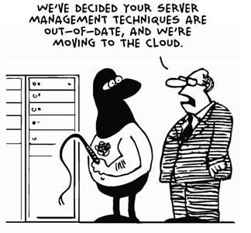
Support Model Changes
Client-Server POS Systems
Use an In-Store Server
Are a system-of-record for Configuration and Sales
Require Support to Access In-Store Resources using Remote Support Utilities
Cloud POS Solutions
Server-less In-Store - No Single Point-of-Failure
Unified Tools for Local and Above-Store Access
Does NOT require In-Store Access or Resources
Up to 80% reduction in call volumes
No Third-Party Access for Integrations

Slide 13
Data Access and Security
Cloud Benefits
Data lives in one location (Data Center - Cloud)
Sales history not stored in the restaurant!
Hourly Off-Site Backups
Enterprise Reporting from Native Data
Access via Standards-Based API
Disaster Recovery (Harvey, Irma)
PCI-DSS, PA-DSS, SOC 1 & 2

Slide 14
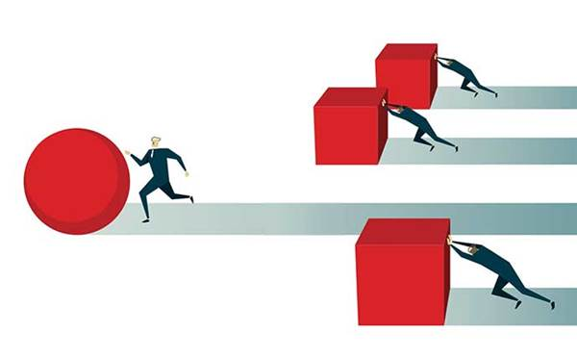
How To Drive Adoption
Client-Server POS Systems
Use an In-Store Server
Are a location system-of-record for Configuration and Sales
Requires Support to Access In-Store Resources
Cloud POS Solutions
Server-less In-Store with No Single Point-of-Failure
Unified Tools for Local and Above-Store Access
Does NOT require In-Store Access or Resources

Slide 15
Impact of Cloud for Multi-Unit Operators
Reduced Hardware Expense
Software Always Up-To-Date
Automatic Updates
No Additional Cost
Lower Call Volume
Simplified Support Processes
Access to Live Data
Standards-based API
Choice of Best-of-Breed vs. All-in-One Models

Slide 16
Questions?
Questions?

