Slide 1
Food Safety in the Information Age
Tal Spirer – Director of Sales, SureCheck
FSTEC 2017 – September 19th, 2017

Slide 2
Agenda
Set The Table for a Discussion Around Restaurant Industry and Food Safety
Food Safety and The Information Age
Technology
Consumer Trust
Questions and Discussion

Slide 3
48 Million People are Sickened in US by food each year
48 MILLION PEOPLE = 1 in 5
Notes:
319 Million People in US. - 20 % of US or 1 in 5 people become ill from food. Every year (Go to emergency room / Dr. visit and then are released)

Slide 4
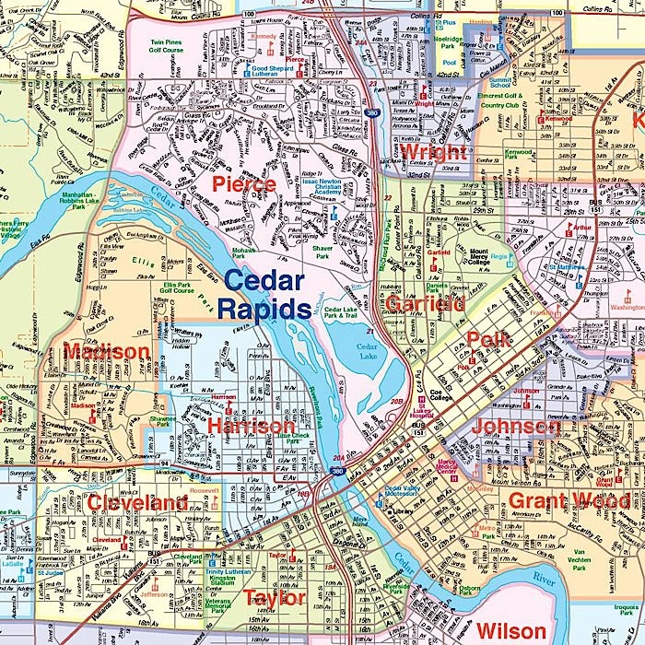
128,000 People are Hospitalized Each Year – Cedar Rapids, Iowa
Notes:
Cedar Rapids IOWA 130,000

Slide 5
3,000 in the U.S. - Die Every Year From Foodborne Sickness - MET Opera House
Notes:
In the US over 3,000 people lose their lives to food poisoning. (MET).

Slide 6
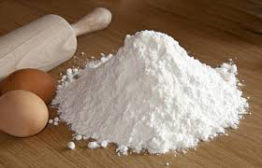
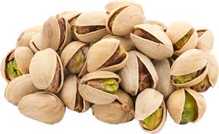
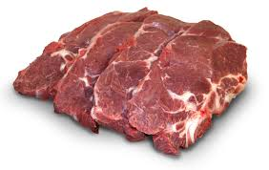
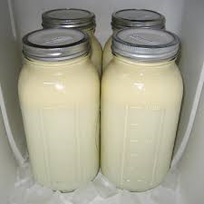
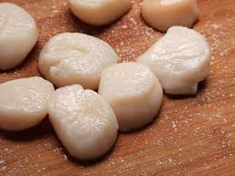
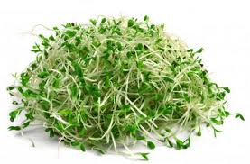
2016 - These Products Caused Deaths
Notes:
Eggs – Salmonela outbreak
Flour that was responsible for E. Coli outbreak
Strawberries from Egypt that weren’t properly cooled during transportation
Sprouts that caused Salmonella

Slide 7
Costs of Foodborne Illness

Slide 8
Reported Cases of Foodborne Illness and the Information Age
Notes:
24 years of “reported” food poisoning cases at a state level here in the US. *Question – do you think in the last 10 years there was an 81% increase in food poisoning, or does this reflect something different.*
Industrialized Agriculture
Technology – Easier to track
AND FINALLY – more scrutiny on food safety

Slide 9
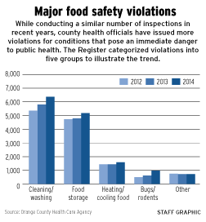
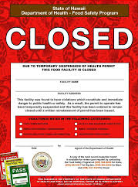
Inspections
Notes:
All Food Safety Issues are either prevented or promulgated by human behavior. Majority of food safety violations are centered around cleanliness, Food Prep, and Food Storage.

Slide 10
REGULATIONS – US FDA
FSMA Reporting Requirements and Enforcement
(a) “You must establish and maintain the following records documenting implementation of the food safety plan”:
(1) Records that document the monitoring of preventive controls;
(2) Records that document corrective actions;
(3) Records that document verification, including, as applicable, those related to:
(i) Validation;
(ii) Verification of monitoring;
(iii) Verification of corrective actions;
(iv) Calibration of process monitoring and verification instruments;
(v) Product testing;
(vi) Environmental monitoring;
(vii) Records review; and
(viii) Reanalysis;
Notes:
US LAW- Food Safety Modernization Act has many definitive requirements around the recording and monitoring of FS plans.
Enacted in 2011

Slide 11
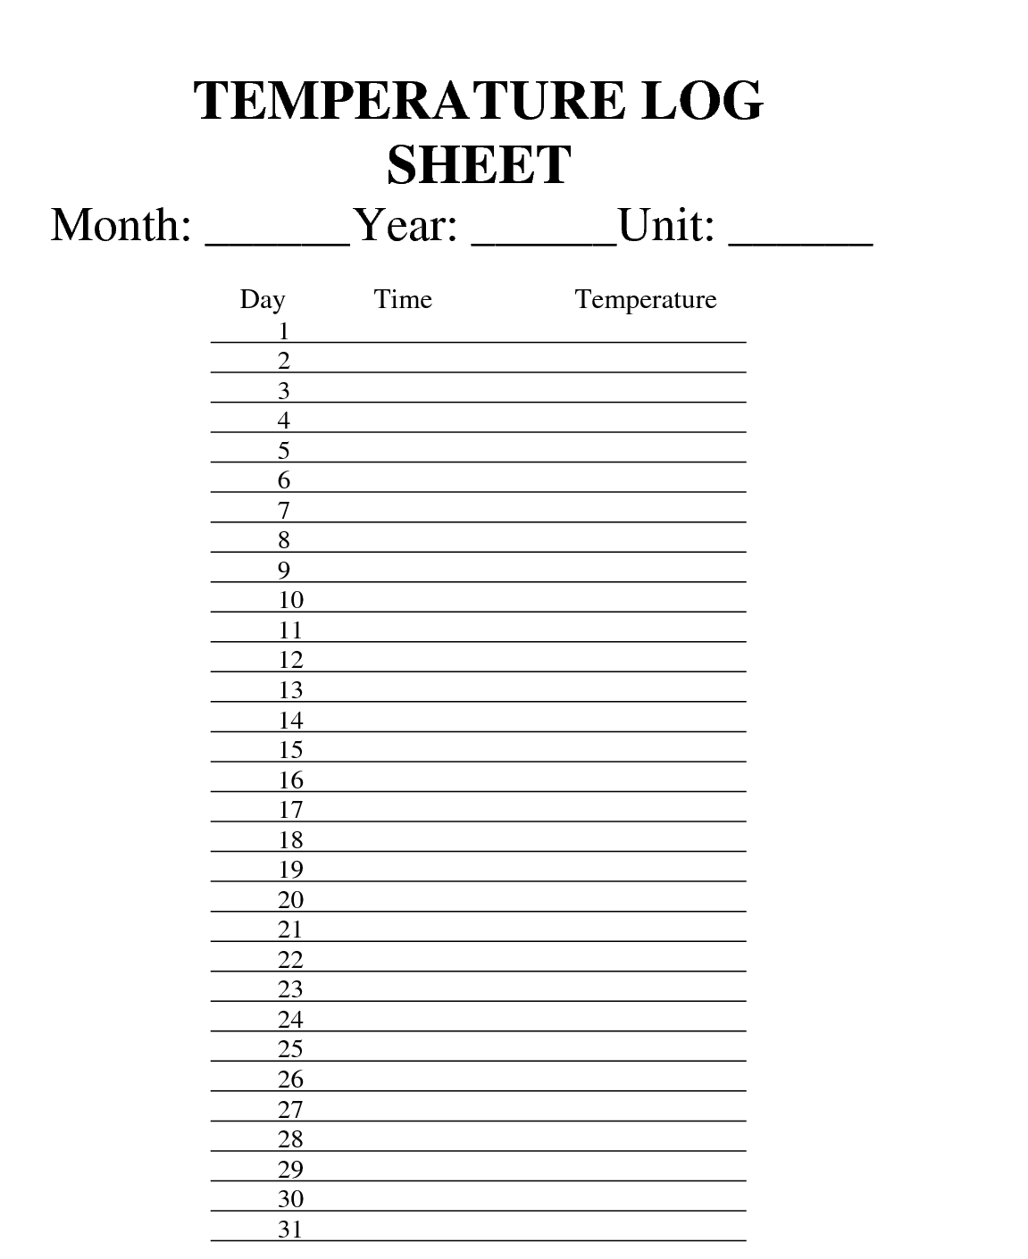
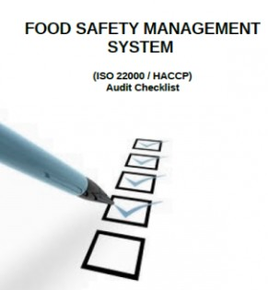
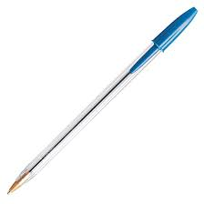
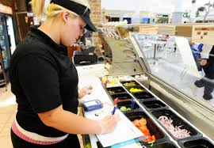
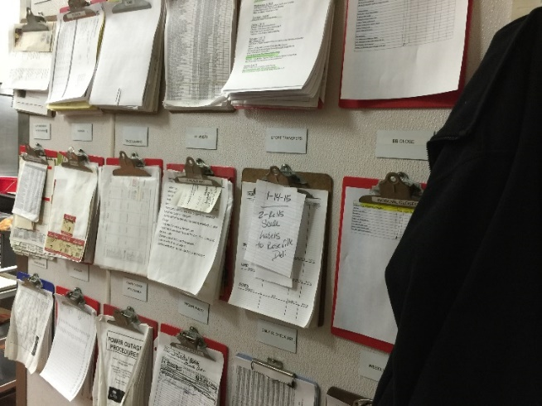
Food Safety “HACCP” Process
+
+
+
+
=
Notes:
So how does “Food Safety” and food outlets look today?

Slide 12
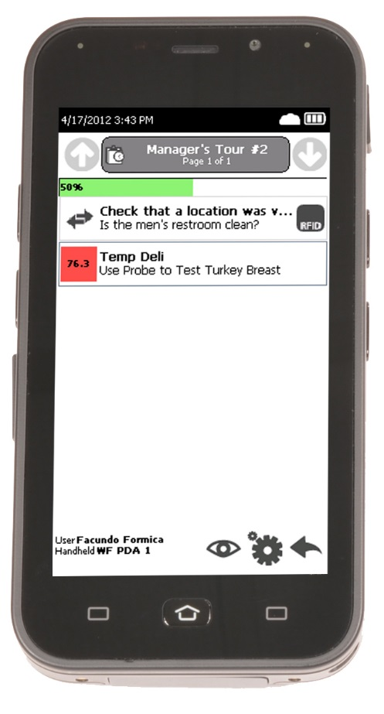
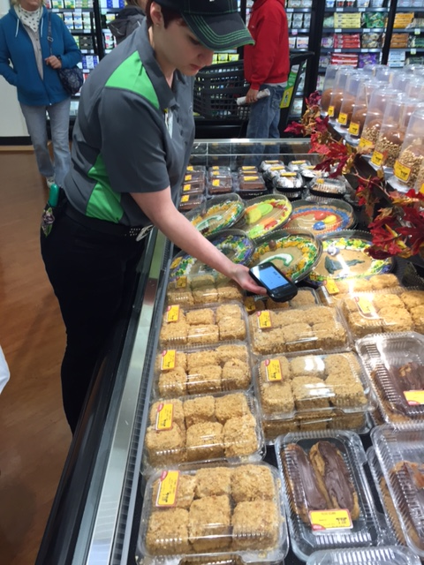
SureCheck
Notes:
Device is called SurerCheck Advantage with a suite of sensors which manages and monitors employee behavior with respect to each and every product. Checklists reflect specific elements that make up the food safety program while maintaining a digital record of safe and prudent practices.

Slide 13
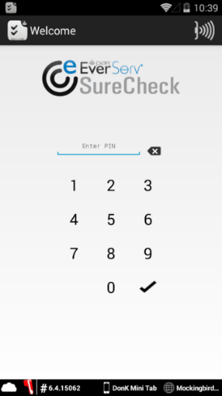
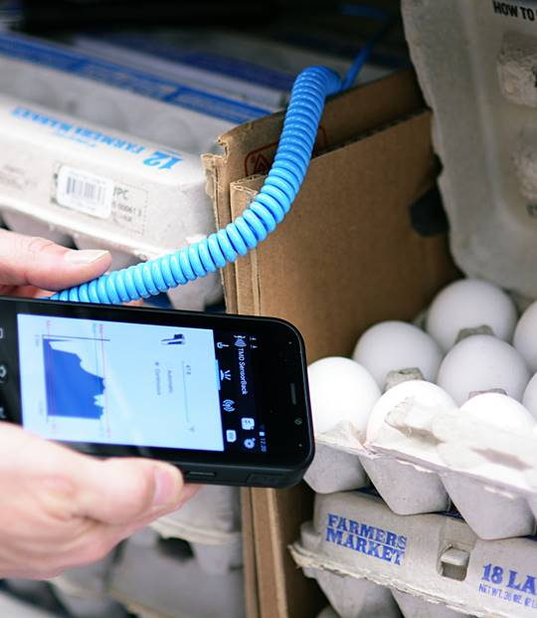
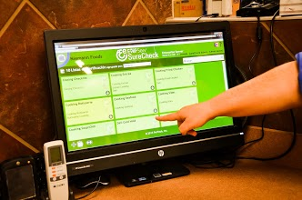
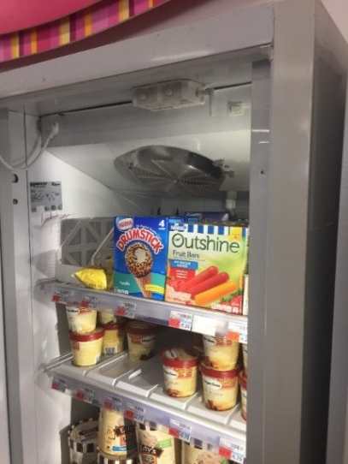
Overview - What is SureCheck™
Automated solution that provides intelligent checklist-based logging and monitoring for food safety and management of employee-assigned tasks
Task Management
Measurement
Monitoring
Improvement

Slide 14
SureCheck – Intelligent Checklist Solution
Business- began in 2012 (Operational Saving coupled with Food Safety)
Smartphone Handheld – “SureCheck Advantage”
MDM, USB tethered probe, Infrared Temp, 3D barcode scanner, product lookup barcode scanning, and internet, Camera, RFID temp & location
Installed in > 15,000 locations across 12 countries
17 different languages
Technologies include: Amazon Cloud hosting, Intel chip processing, Bluetooth, Common Client architecture, Node j.s, Mongo db, & Jira
PAR Technology: hardware design and process development, firmware, internet reporting, hosting subscription and system implementation solution. All in one.
Notes:
Food Safety in the Information Age

Slide 15
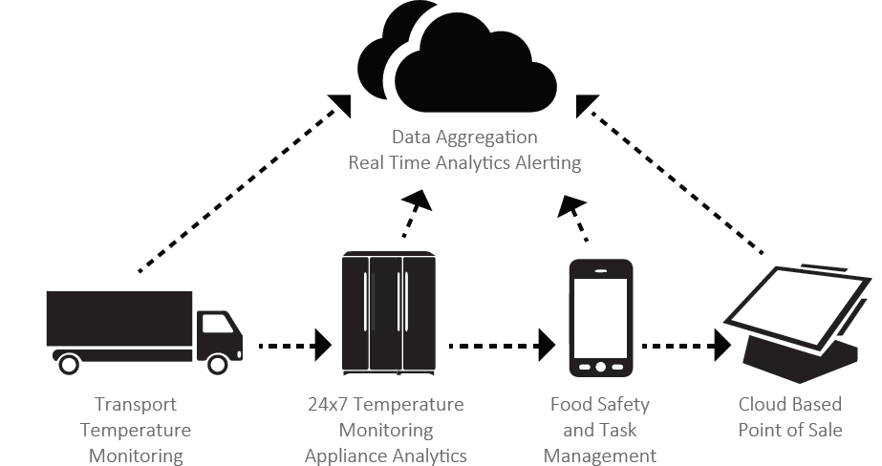
SureCheck Technology Architecture
Amazon and Azure Cloud Hosting
Mobile platforms – Android & iOS support (Windows slated for release Q1)
Flexibility through API Integration
Business Intelligence (BI) Extract Capability
Non-proprietary integration with Sensors

Slide 16
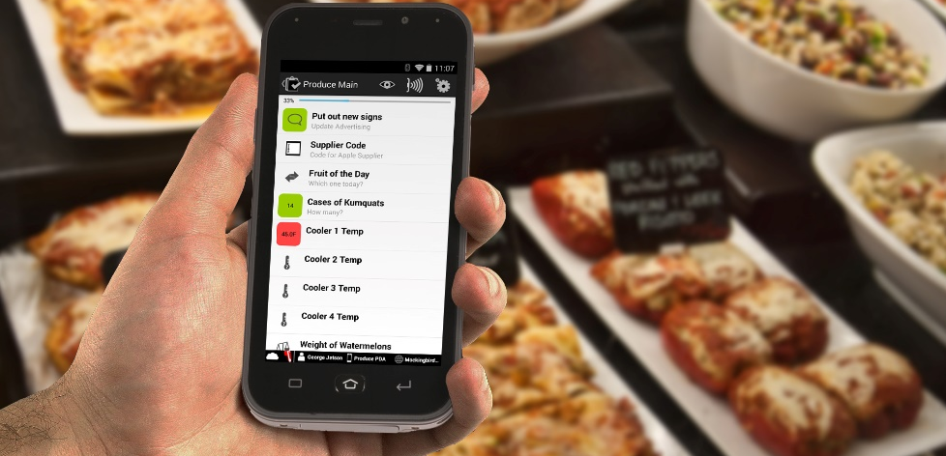
Snapshot of Business
SureCheck Snapshot- Sept. 2017
Installed in 15,000 locations
24,000 individual devices on the system
785,000 unique users in SC enterprise
39M observations
262,000 violations
Business Drivers
ROI- operational efficiency
Major time and labor savings
Regulatory Compliance
Liability Reduction
Ancillary values
Training, Visibility, Loss Prevention, & Verification
Notes:
JWS 3 Slide

Slide 17
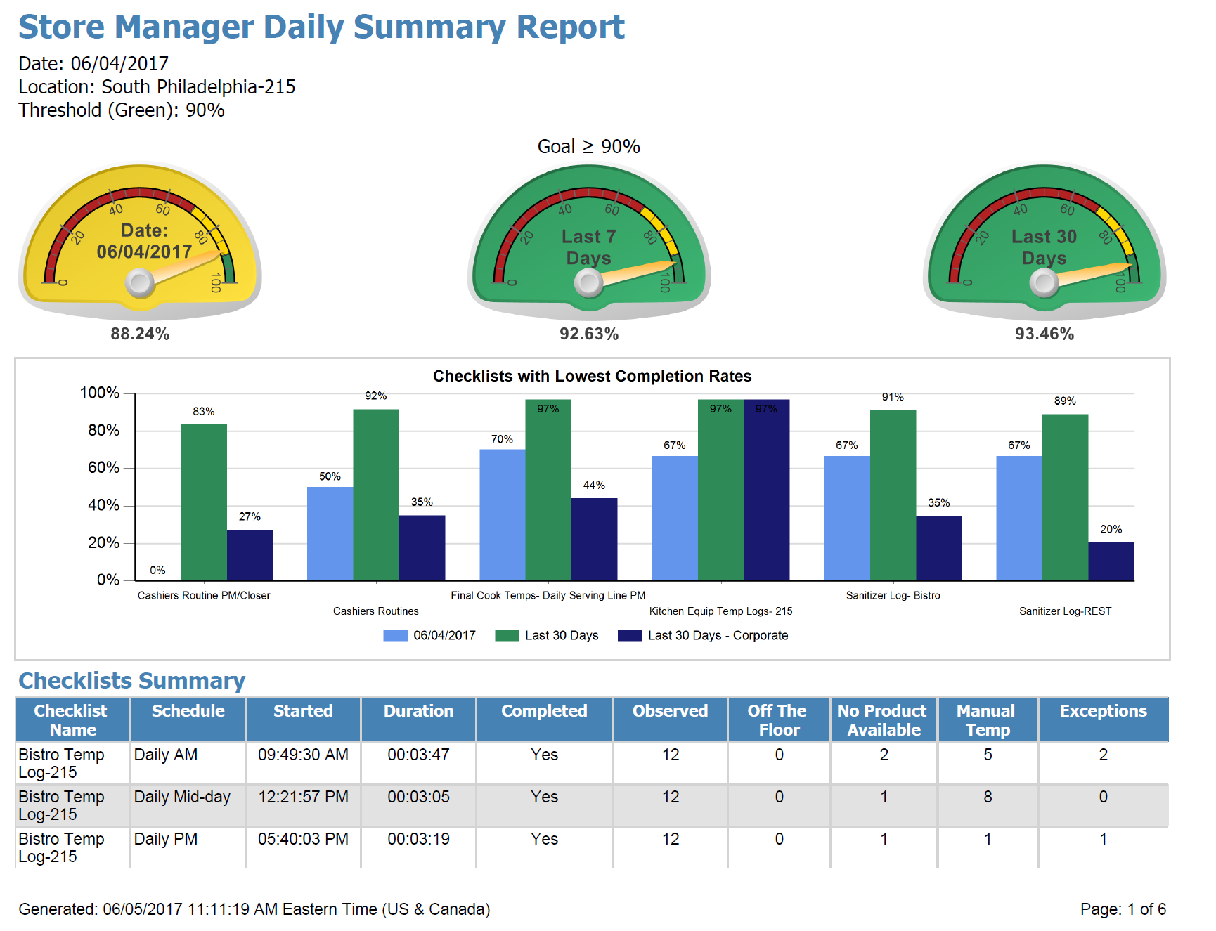
Daily Compliance Metrics – 2020 Vision
Notes:
Additional 30% increase in execution after manager report

Slide 18
Traditional Checklist VS. Intelligent Checklists
Traditional Checklist
Paper & Pencil
Potential for fraud – Able to change history
Must remember to complete
Difficult to find historical information
Almost impossible to spot trends
Storage space required
Intelligent Checklist
Electronic
Electronically secured and verifiable
Reminder/alert to complete
Easy to query, data available in real-time
Valuable decision support data
Data stored in the “cloud”
VS

Slide 19
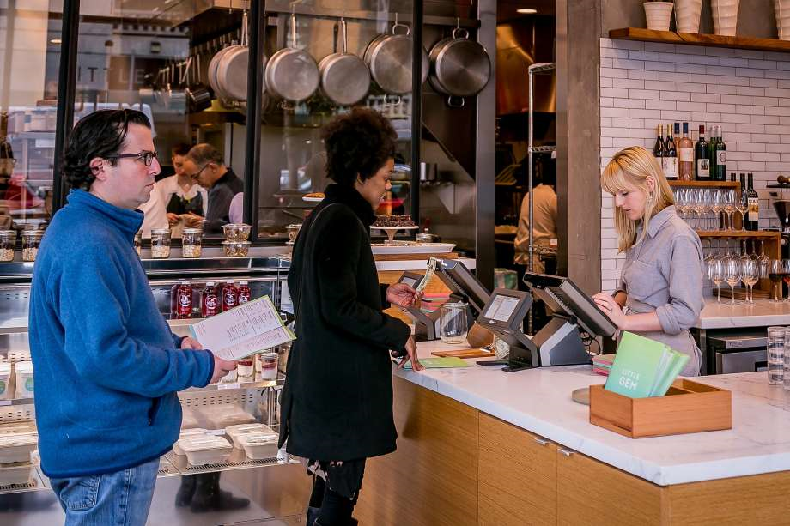
Trust is like Paper. Once it is crumpled up, it can never be perfect again

Slide 20
Questions and Answers?

