Slide 1
Grace Engineered Products
Name:
Title:

Slide 2

WHO IS GRACE?
Making Maintenance Smarter, Safer and More Productive
Founded in 1991 by Phil Allen, CEO
2nd Generation Family Business
Global Distribution
Follow Us on the Socials!
Davenport, IA

Slide 3
Did You Know…
24,000 Electrical Injuries in a 10 year period (2003-2012)
35% due to direct contact with wiring, transformers or other electrical components
60% occurred on 3 phase low voltage systems
Testing with Meter is a leading cause of Arc Flash
Costs range from $50,000- $10,000,000+
Notes:
Misconception in the market on Arc Flashes.
Testing with meter is the biggest risk for Electrician

Slide 4
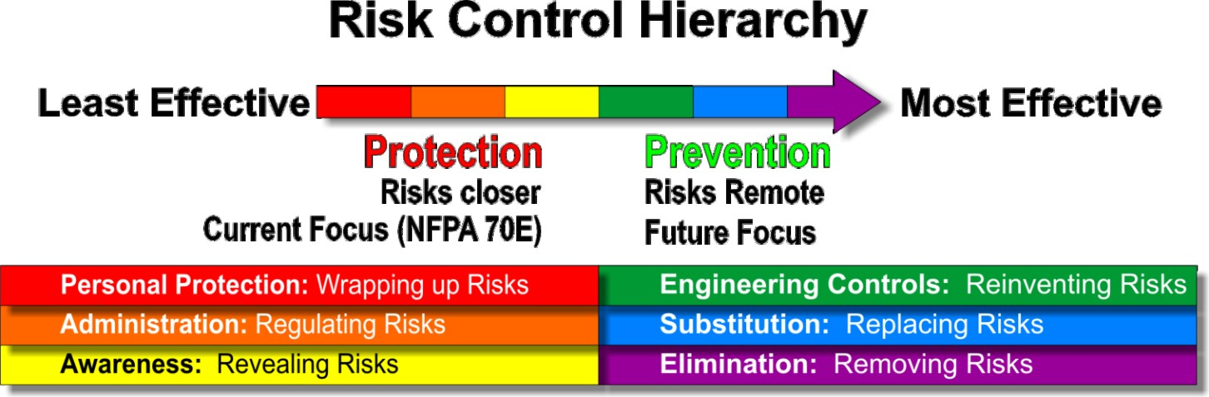
Risk Control Hierarchy
Safety is the reduction of risk, not the absence of risk.
Means of Controlling Risk | Relative Effectiveness
Eliminating the risk | 100%
Substituting a lower risk | <100
Engineering around the risk | 70-90%
Awareness of every risk | ?
Administrating and governing actions while exposed to risk | 10-50%
Protect workers while exposed to risk | <20%
Risk = Hazard * Probability
1. Keane, J., “Preventing Major Losses – Changing OSH Paradigms and Practices”, Professional Safety, Journal of the American Society of Safety Engineers, vol. 60, no. 1, January 2015, pp 42-48
Notes:
Have you guys ever seen the Risk Control Hierarchy?
Eliminating, substituting and engineering around the risk is our main focus at Grace.

Slide 5


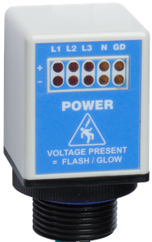
Grace PESDs® - Voltage Indicators
Safer and more productive Lockout-Tagout for Mechanical
No-exposure to live conductors
Decreasing risk by adding redundancy to the try test
Enhance Compliance with NFPA70E
Pre-verify isolation on field mount disconnects, switches, and circuit breakers found in MCCs, switchgear, and control panels!
1999
2009
2014
2016
5
Notes:
*Bullet 2: Allows task qualified personnel no exposure to live conductors*
Class I Div II (blue face indicator)
Fiber optic no power to panel door
Flex mount easily mounts to (motor mount) disconnects in any direction/labels (3/4”)
Verifies the operation of the disconnect (monitoring)
Ask Brook if it is ® or TM
Add dates and verify correct. Remove STP and add Flex-Mount Indicator (R-3D2)

Slide 6
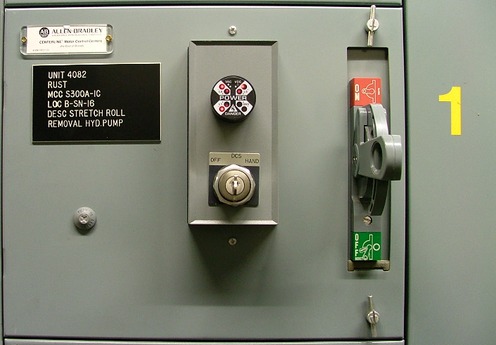


GracePESD®
Voltage Indicator
For Mechanical LOTO Purposes
Fused Disconnect
Voltage Range: 40-750 VAC
30-1000 VDC
Options: Flashing/Solid on/Class 1 Div 2/Fiber Optic
No batteries needed - line voltage powered
High surge immunity CAT III/CAT IV (8kV)
Potted Construction
Various mounting options – 20 minute install
CE, UL Listed (61010), Type 4X, 12, 13 IP65
Ex: MCC Bucket
Notes:
Voltage indicators have a wide range of voltage detection

Slide 7
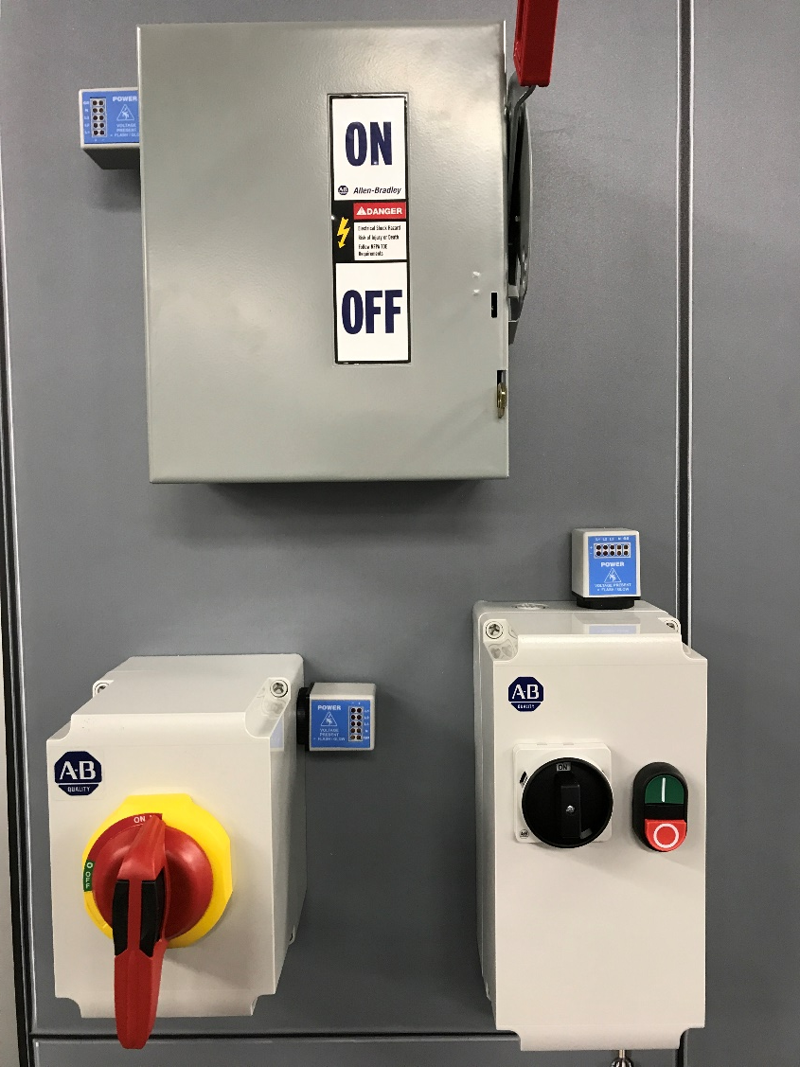
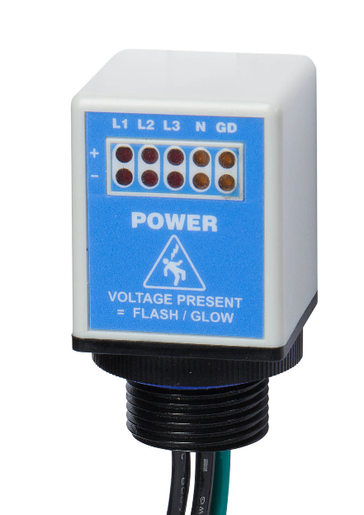

GracePESD®
Flex-Mount Voltage Indicator
For Motor mount disconnects and smaller electrical panels.
4 and 5 wire configuration
  4 wire for Delta configuration
  5 wire for Y-configuration
Voltage Range: 20-600 VAC
20-1000 VDC
Various mount options
Conduit hole installation M20 or ¾”
CE, UL Listed, Type 4X, 12, 13, IP67
CAT III/CAT IV- UL 61010

Slide 8
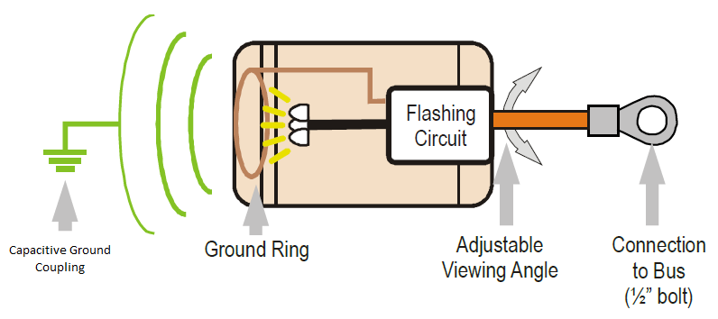
GracePESD®
Medium Voltage Indicators
Qty. (3) long life LED’s per unit
2KV to 43KV operating range
½” bolt hole mounting
Viewing angle adjustability
Notes:
Only one lead is connected to power
Gets its ground from capacity coupled ground
Has to have a viewing window (GracePort)

Slide 9

What is Safe-Test Point™?
A Permanent Electrical Safety Device (PESD)
Engineering control (Safety-by-design)
Allows Electrically qualified personnel to perform the voltage absence test through closed doors for electrical LOTO
Minimize the risk of arc flash and shock hazard
Enhances Lockout/Tagout (LOTO) productivity
Notes:
Fix bullet format

Slide 10
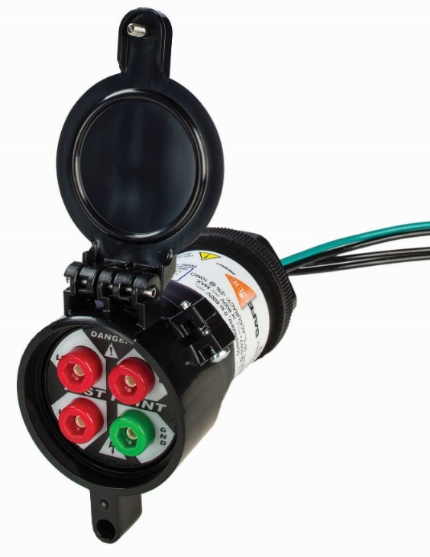
GracePESD®
Safe-Test Points
For Electrical LOTO Purposes
Voltage Range: 0-600 VAC
0-600 VDC
High impedance protected test points (102KΩ)
  480V/√3/(102kΩ)= 2.71mA
  600V/ √3/(102kΩ)=3.40mA
IP2X & UL 600 V Touch Safe
CE, UL Listed 12, 13
CAT III/IV
Measures full voltage with -2% accuracy
Feature Dust Cap
Notes:
OHMs law (calculation) – 3 phase system you have to divide it by three
V = I/R (Formula for Ohms law)
Double check the formula and calculation format

Slide 11
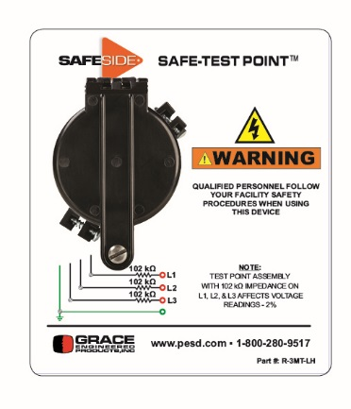


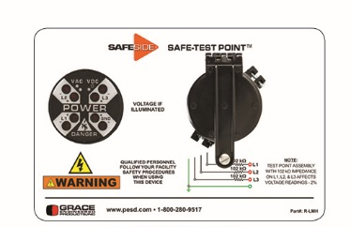
Configurations
UL Type 12
Mechanical LOTO
Electrical LOTO
Special configurations available upon request.
Notes:
Fix format

Slide 12
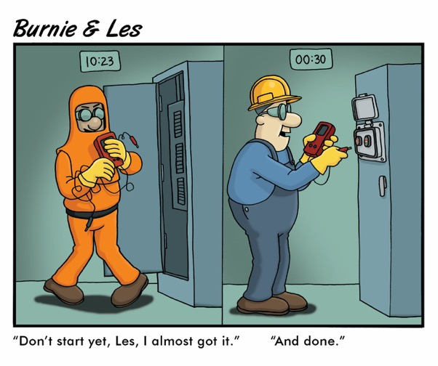
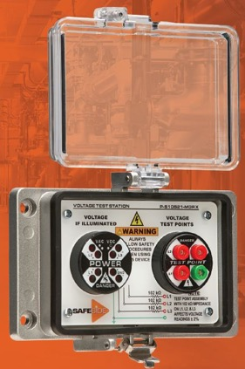
Grace PESD®
Voltage Test Station
For Electrical and Mechanical LOTO Purposes
Voltage Range: 0-600 VAC
0-600 VDC
Lockable, clear cover- Limited Access
Visual and Meter voltage check.
Line Side or Load Side or BOTH!
Allow for higher UL Type environments.
  UL 12, 4, and 4X

Slide 13
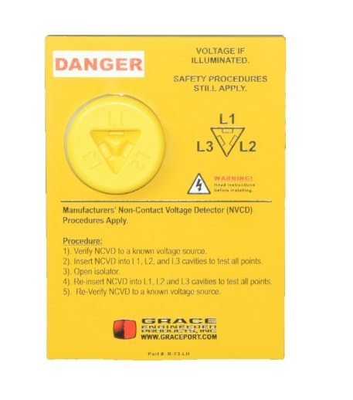
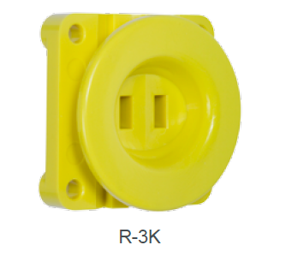
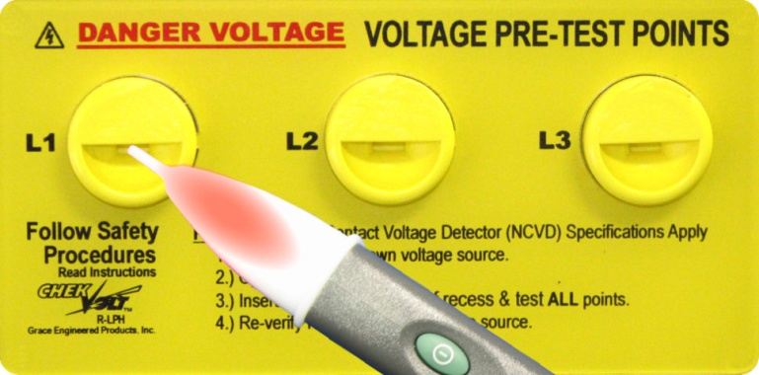
Voltage Portals – Non Contact Voltage Testing
Rugged polycarbonate construction for safety and various C-UL listed, RoHS, and CE
Triple Check Voltage Portal (R-T3)
  Flange, Door or side mount
  Quick install
  Each phase of power
  Interactive label
CheckVolt Voltage Portal (R-1A)
  Integral 6’ Lead Wire
  Reduces arc flash risk while increasing electrical safety by providing no-touch portal
  Provides ability to pre-verify electrical isolation before opening a panel
Easy Install Pass-Thru Voltage Portal (R-3K)
  Allows workers to safely validate electrical energy from outside the enclosure w/NCVD pen
  All three phases are wired thru one device, improving accuracy during energy verification.
Notes:
Remove the rugged polycarbonate construction and various C-UL Listed, RoHS, CE and have it at the header level.
NCVD (non-contact voltage detecting) pen

Slide 14
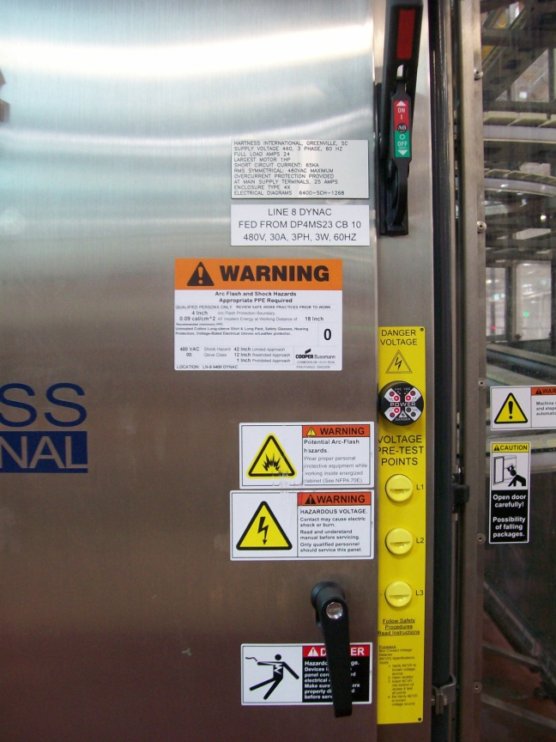
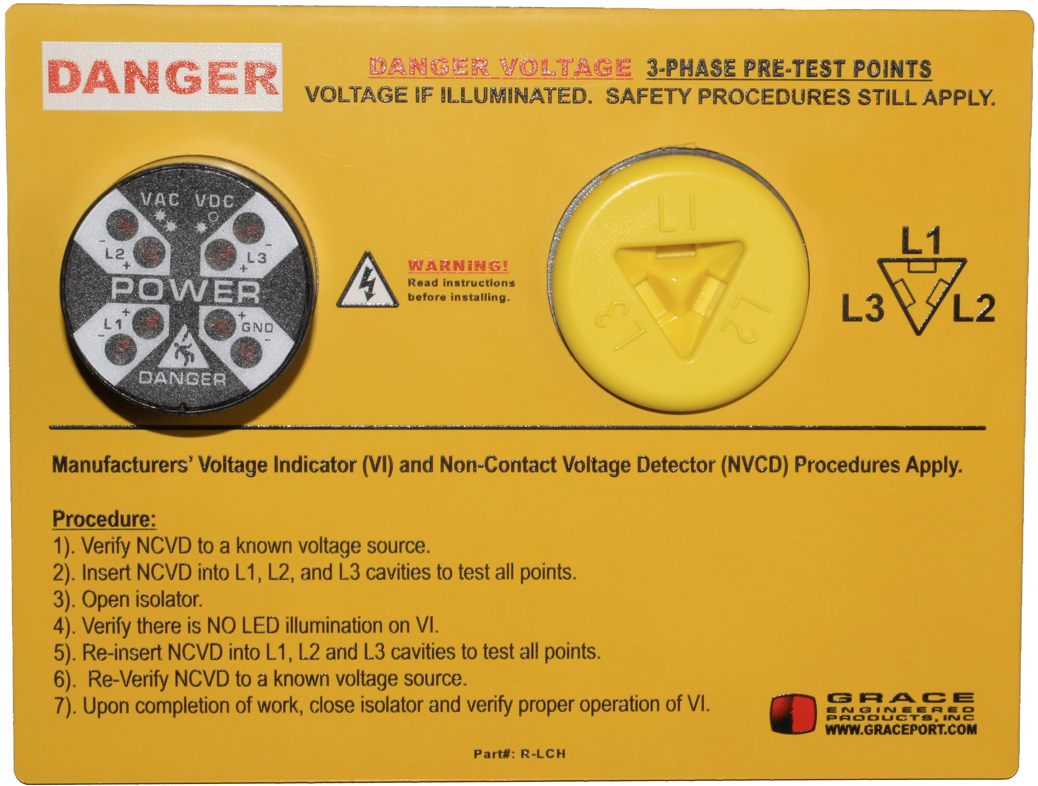
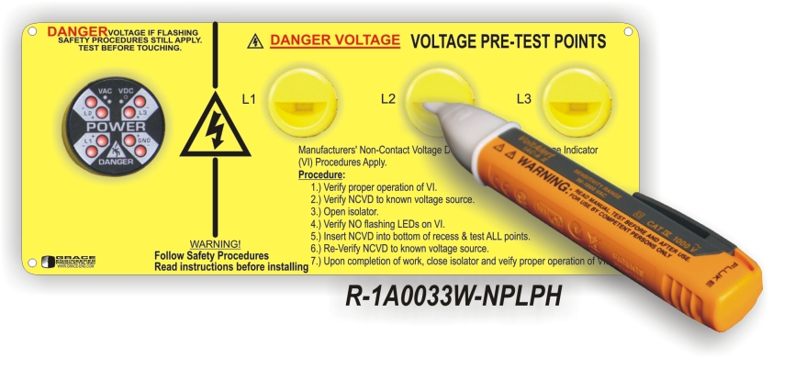
Combo Units: Voltage Indicator + Voltage Portal
Voltage Indicator + Voltage Portal
Redundant Visual and Measured Indication
Various Mounting Options
  Vertical/Flange
  Horizontal
Increased Risk Reduction for Mechanical LOTO
Great for corrosive environments!
Notes:
Use combo units from slide 21 (voltage portal images – ask Brook)
Ask if they use a lot of noncontact pens in their facility? If no, skip slides.
Are you planning on using our products for electrical?

Slide 15
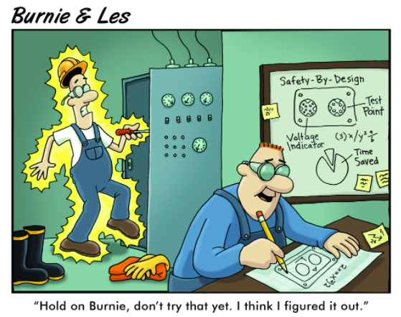
Why use Grace PESD™?
Safer and Faster LOTO for Maintenance and Electrically qualified workers
Payback in less than 5 LOTOs
Applications?

Slide 16
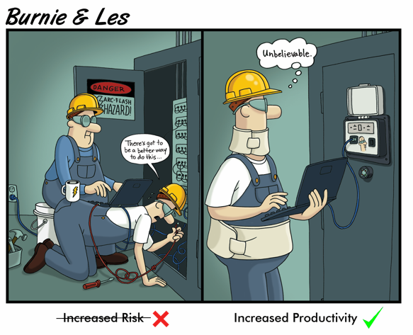
GracePort®

Slide 17

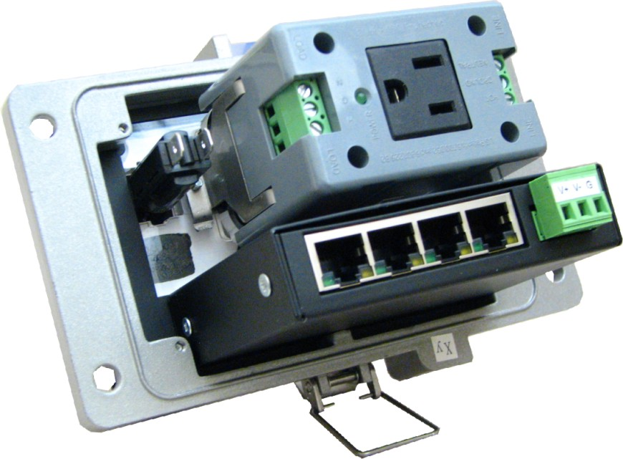
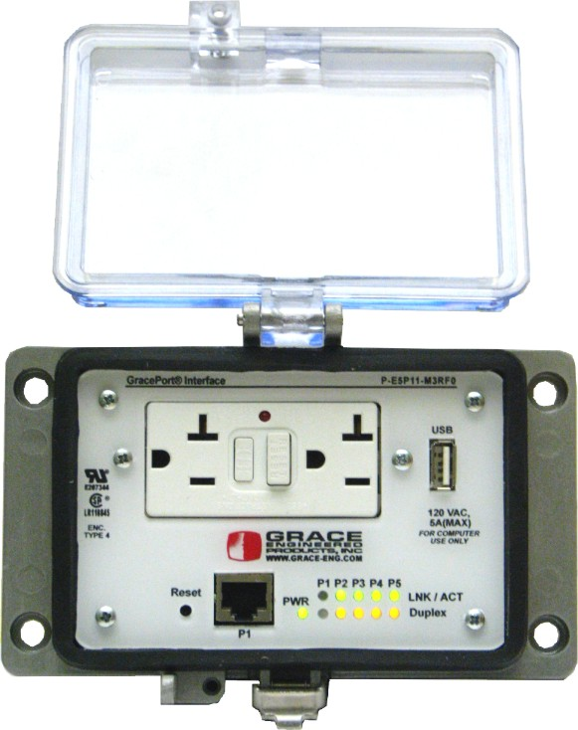
GracePort®
Keep people away from live Voltage!
Through-the-door safety
Elimination of hazard to electrical energy
Keep unauthorized employees out of critical cabinets
GracePorts® are made in Davenport, IA

Slide 18
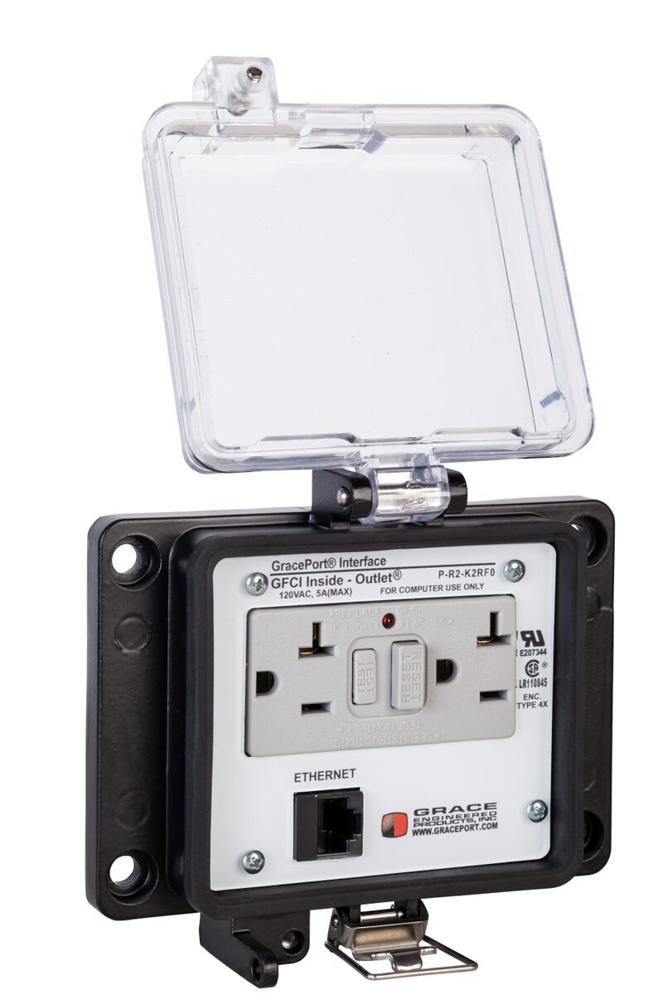
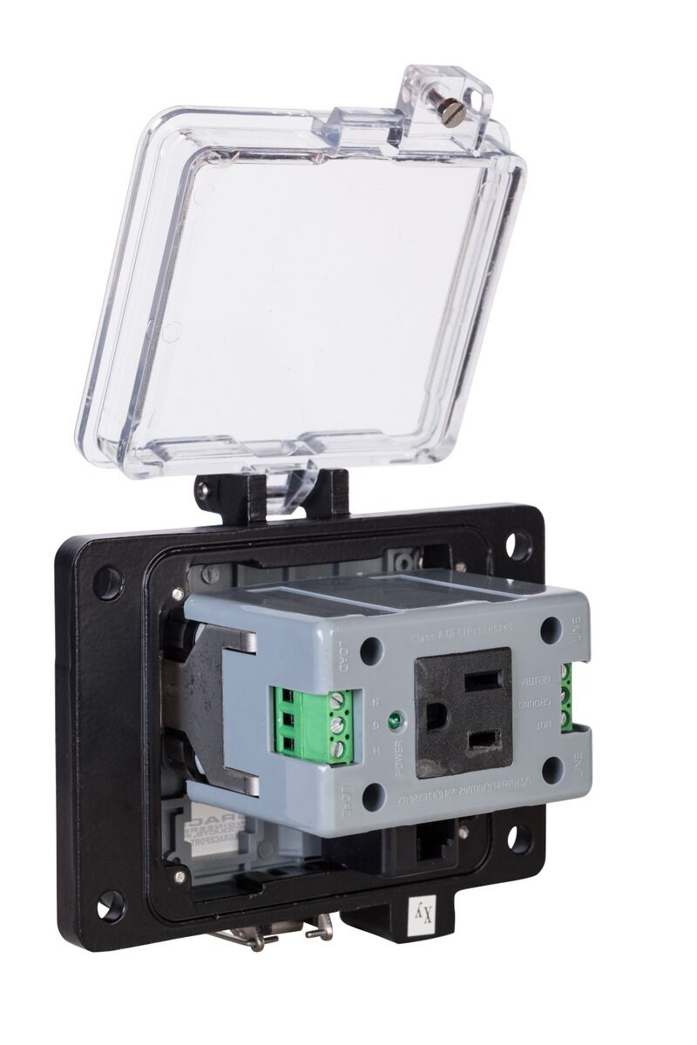
GracePort®
2-3 days build to ship
15,000 unique part numbers and growing
100’s of components including Rockwell Automation, Siemens, Schneider, Omron, Mitsubishi and ABB specific
UL recognized products, CSA, and CE
  Types 1, 3R, 4, 4X, and 12
Ideal for troubleshooting and programming!
Ease of installation – door or side panel!
  Works with Greenlee punch sizes for retrofit
  3D drawings also available
Any Connection • Cable • Combination
Notes:
Change heading

Slide 19
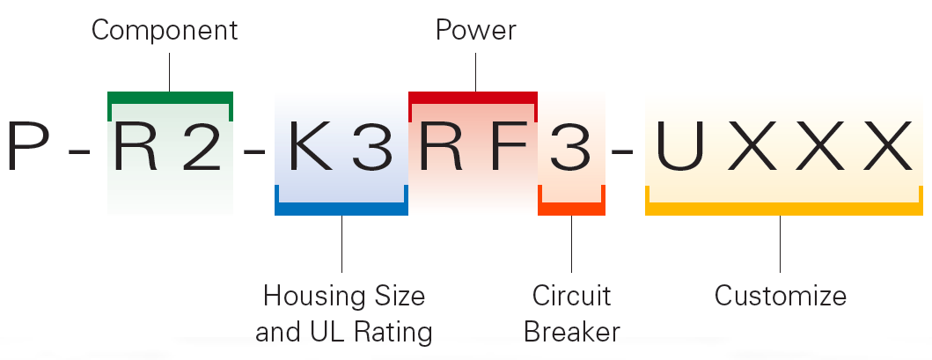
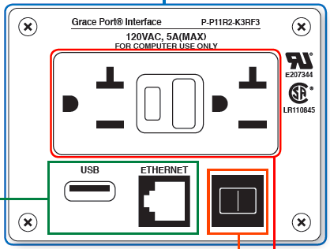
GracePort® Part Configuration
Notes:
Get Brook to grab me the updated GracePort® configuration

Slide 20
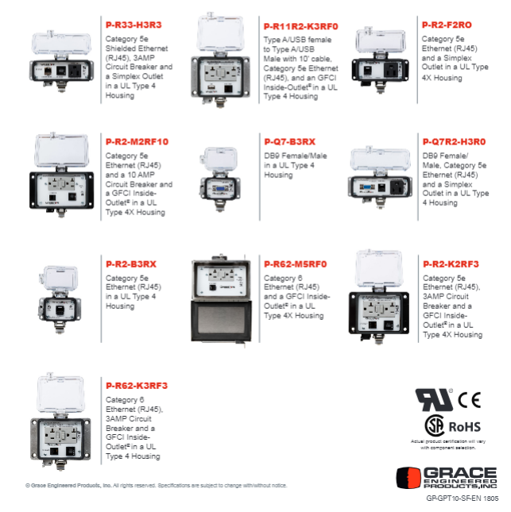
Top 10 GracePorts®
Notes:
Find better images for top 10

Slide 21
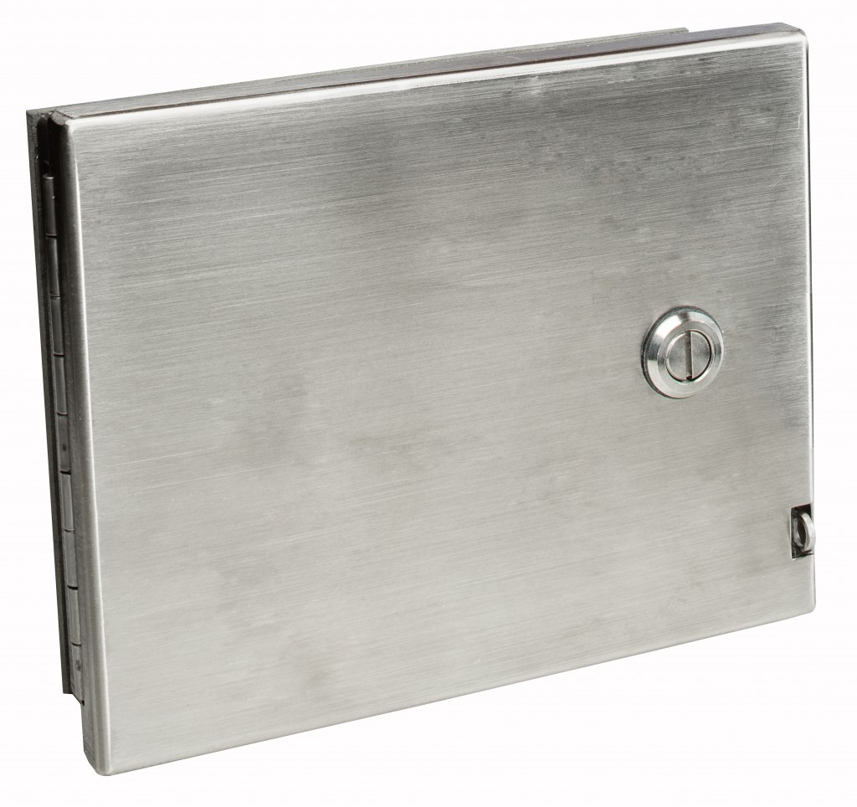
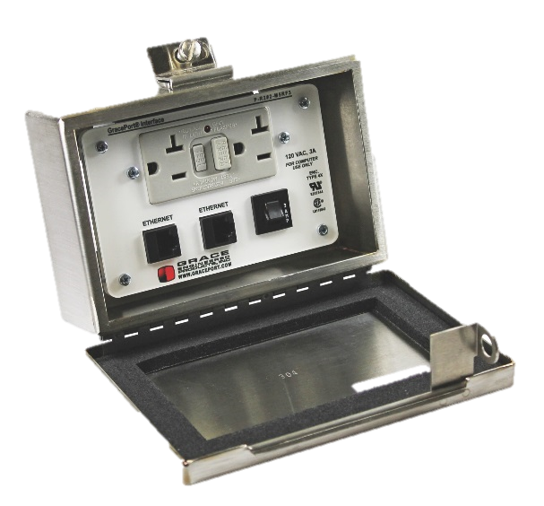
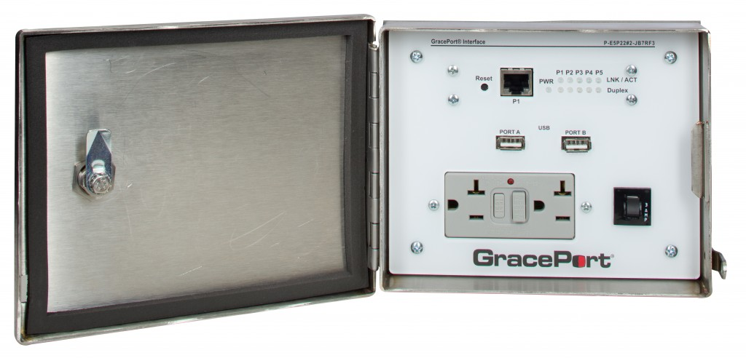
GracePort® Stainless Steel Housing
#304= M5 Housing Code
#316= M6 Housing Code
  Padlockable to meet FDA #21CFR211
JB7 stainless steel port offers lower profile for tight spots
Protects all the components, circuit breakers, and power options that are available
Built for corrosive, harsh enviroments
UL Type 4X / NEMA 4X
7.10" (L) X 5.63"(H) X 1.38" (D)
Any Connection • Cable • Combination

Slide 22

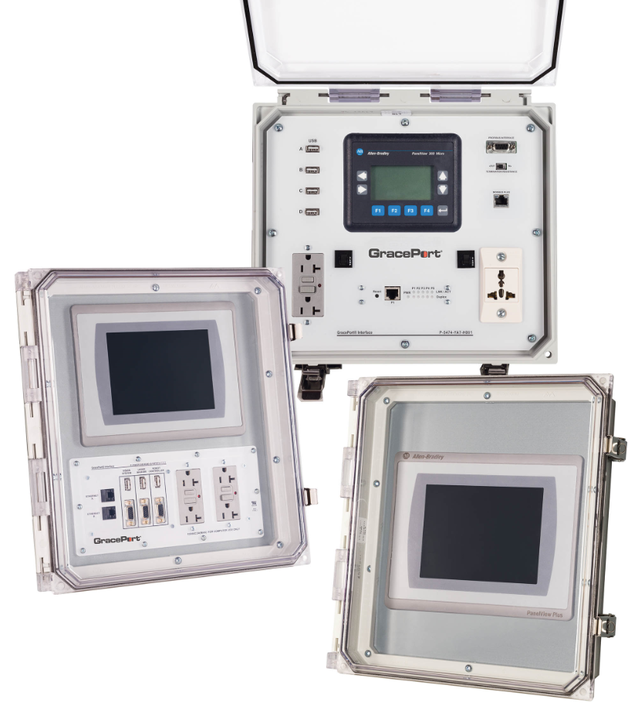
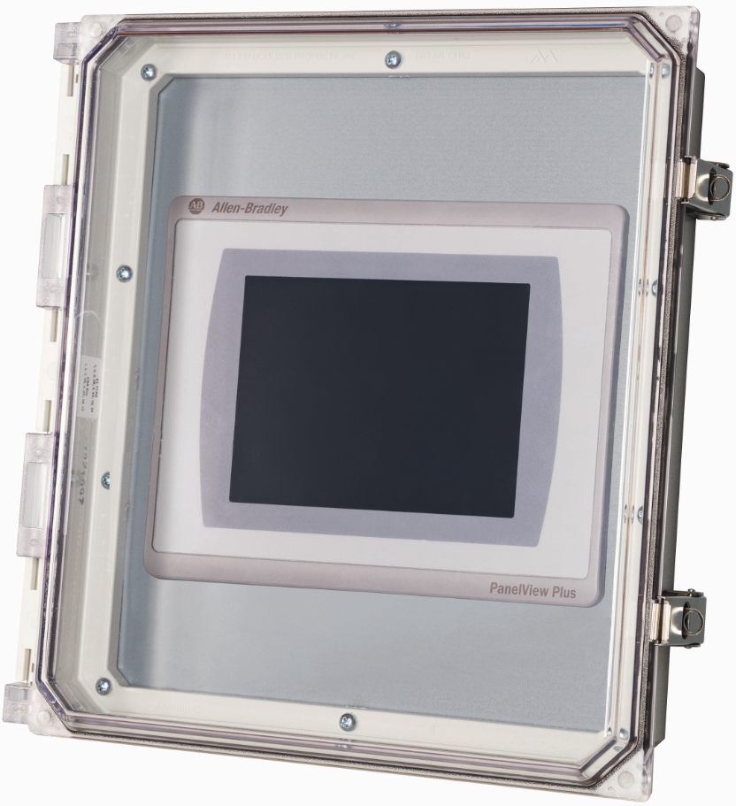
GracePort+®
+
HMI Protection against:
  UVA Radiation
  Dust
  Wash-Downs
Ease of Installation!
Easy to exchange the lid!
Sold as a cover or customizable.
UL Types 1, 3, 3R, 4, 4X, 12 or 13 IP 66
Any Connection • Cable • Combination
Notes:
List all dimensions of the Graceport +

Slide 23
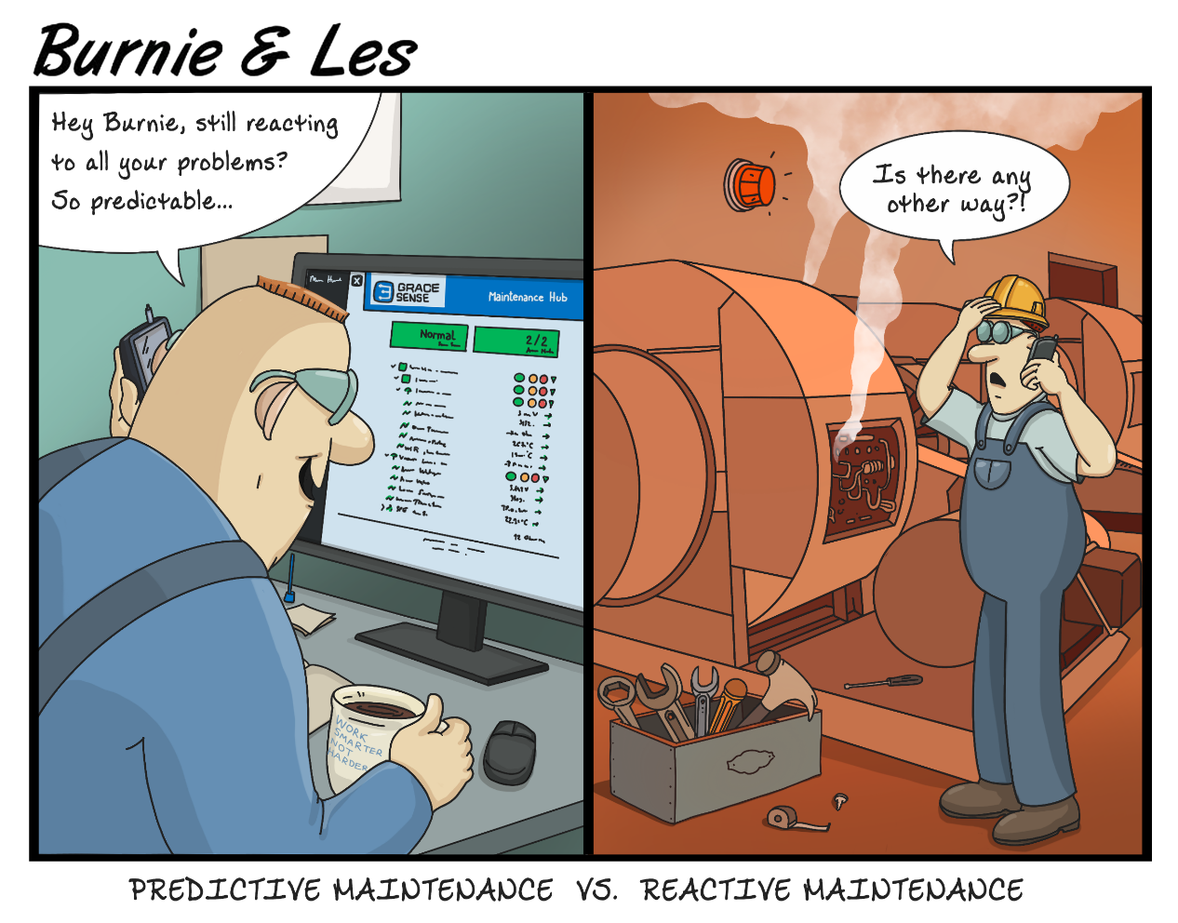

GraceSense™ Predictive Maintenance

Slide 24
The Maintenance Spectrum
Run-to- Failure
Schedule-Based
Risk- Based
Condition-Based
Predictive
There are many approaches to maintaining equipment
  No one-size-fits-all solution
  Every situation is different
However, the goal of any maintenance program is:
Optimal Maintenance Budget Allocation

Slide 25
The Maintenance Spectrum
Run-to- Failure
Schedule- Based
Risk- Based
Condition-Based
Predictive
What is a Run-To-Failure Maintenance Strategy?
  Wait for a machine or process to misbehave, then either fix or replace
When is Run-To-Failure Maintenance Optimal?
  Cost of downtime is less than cost of any maintenance activity
  Example: Light bulbs

Slide 26
The Maintenance Spectrum
Run-to-Failure
Schedule- Based
Risk- Based
Condition-Based
Predictive
What is a Schedule-Based Maintenance Strategy?
  Equipment is maintained or replaced on a pre-determined interval
  Timing is often based on manufacturer's recommendations
When is Schedule-Based Maintenance Optimal?
  When failure mechanism is well understood and the cost of replacement is relatively low
  Examples: Smoke detectors, lubrication systems

Slide 27
The Maintenance Spectrum
Run-to- Failure
Schedule- Based
Risk-Based
Condition-Based
Predictive
What is a Risk-Based Maintenance Strategy?
  An assessment is done to list all possible failures by cost and probability
  Schedule-based maintenance is then prioritized based on this risk matrix
When is Risk-Based Maintenance Optimal?
  When failure mechanism is well understood, conditions are relatively constant, and the assumption of some risk is acceptable
  Examples: Road repair, plant-wide prioritization

Slide 28
The Maintenance Spectrum
Run-to- Failure
Schedule- Based
Risk- Based
Condition-Based
Predictive
What is a Condition-Based Maintenance Strategy?
  Equipment is continually monitored to determine real-time performance level
  Risk-matrices are updated with quantitative failure probability data
  NOTE: Often called predictive, but no predictions are made
When is Condition-Based Maintenance Optimal?
  When equipment condition can vary and when downtime is expensive
  Examples: Gas tank status, motor vibration status

Slide 29
The Maintenance Spectrum
Run-to- Failure
Schedule-Based
Risk- Based
Condition-Based
Predictive
What is a Predictive Maintenance Strategy?
  Data-driven and/or physics-based models are used to estimate time-to-failure
  Anomalous behavior is detected and used to pre-empt unexpected failures
When is Predictive Maintenance Optimal?
  When downtime is very expensive and redundancy is not feasible
  Example: Gas tank miles to empty, motor vibration trending/anomaly detection

Slide 30
Maintenance, Reliability & Safety
Safety
Reliability
Maintenance
Proper maintenance strategies improve the overall equipment effectiveness
Improving equipment reliability results in higher productivity and plant uptime and less reactive maintenance.
A Reliable Plant is a Safe Plant, and a Safe Plant is a Profitable Plant

Slide 31
GraceSense™ Predictive Maintenance
We enable asset managers to monitor critical equipment:
  Modular data acquisition hardware handles almost any industrial application
  Cloud-based data storage, analysis, and visualization
  Real-time alerts contain customizable remediation instructions
Unique data insight through intelligent data processing:
  High-rate data is processed down into actionable information
  Battery life is maximized by minimizing wireless radio usage
We save our customers money by minimizing unplanned downtime and enabling optimal maintenance budget allocation

Slide 32
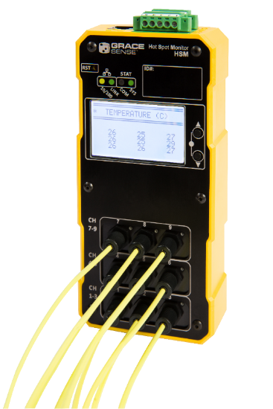
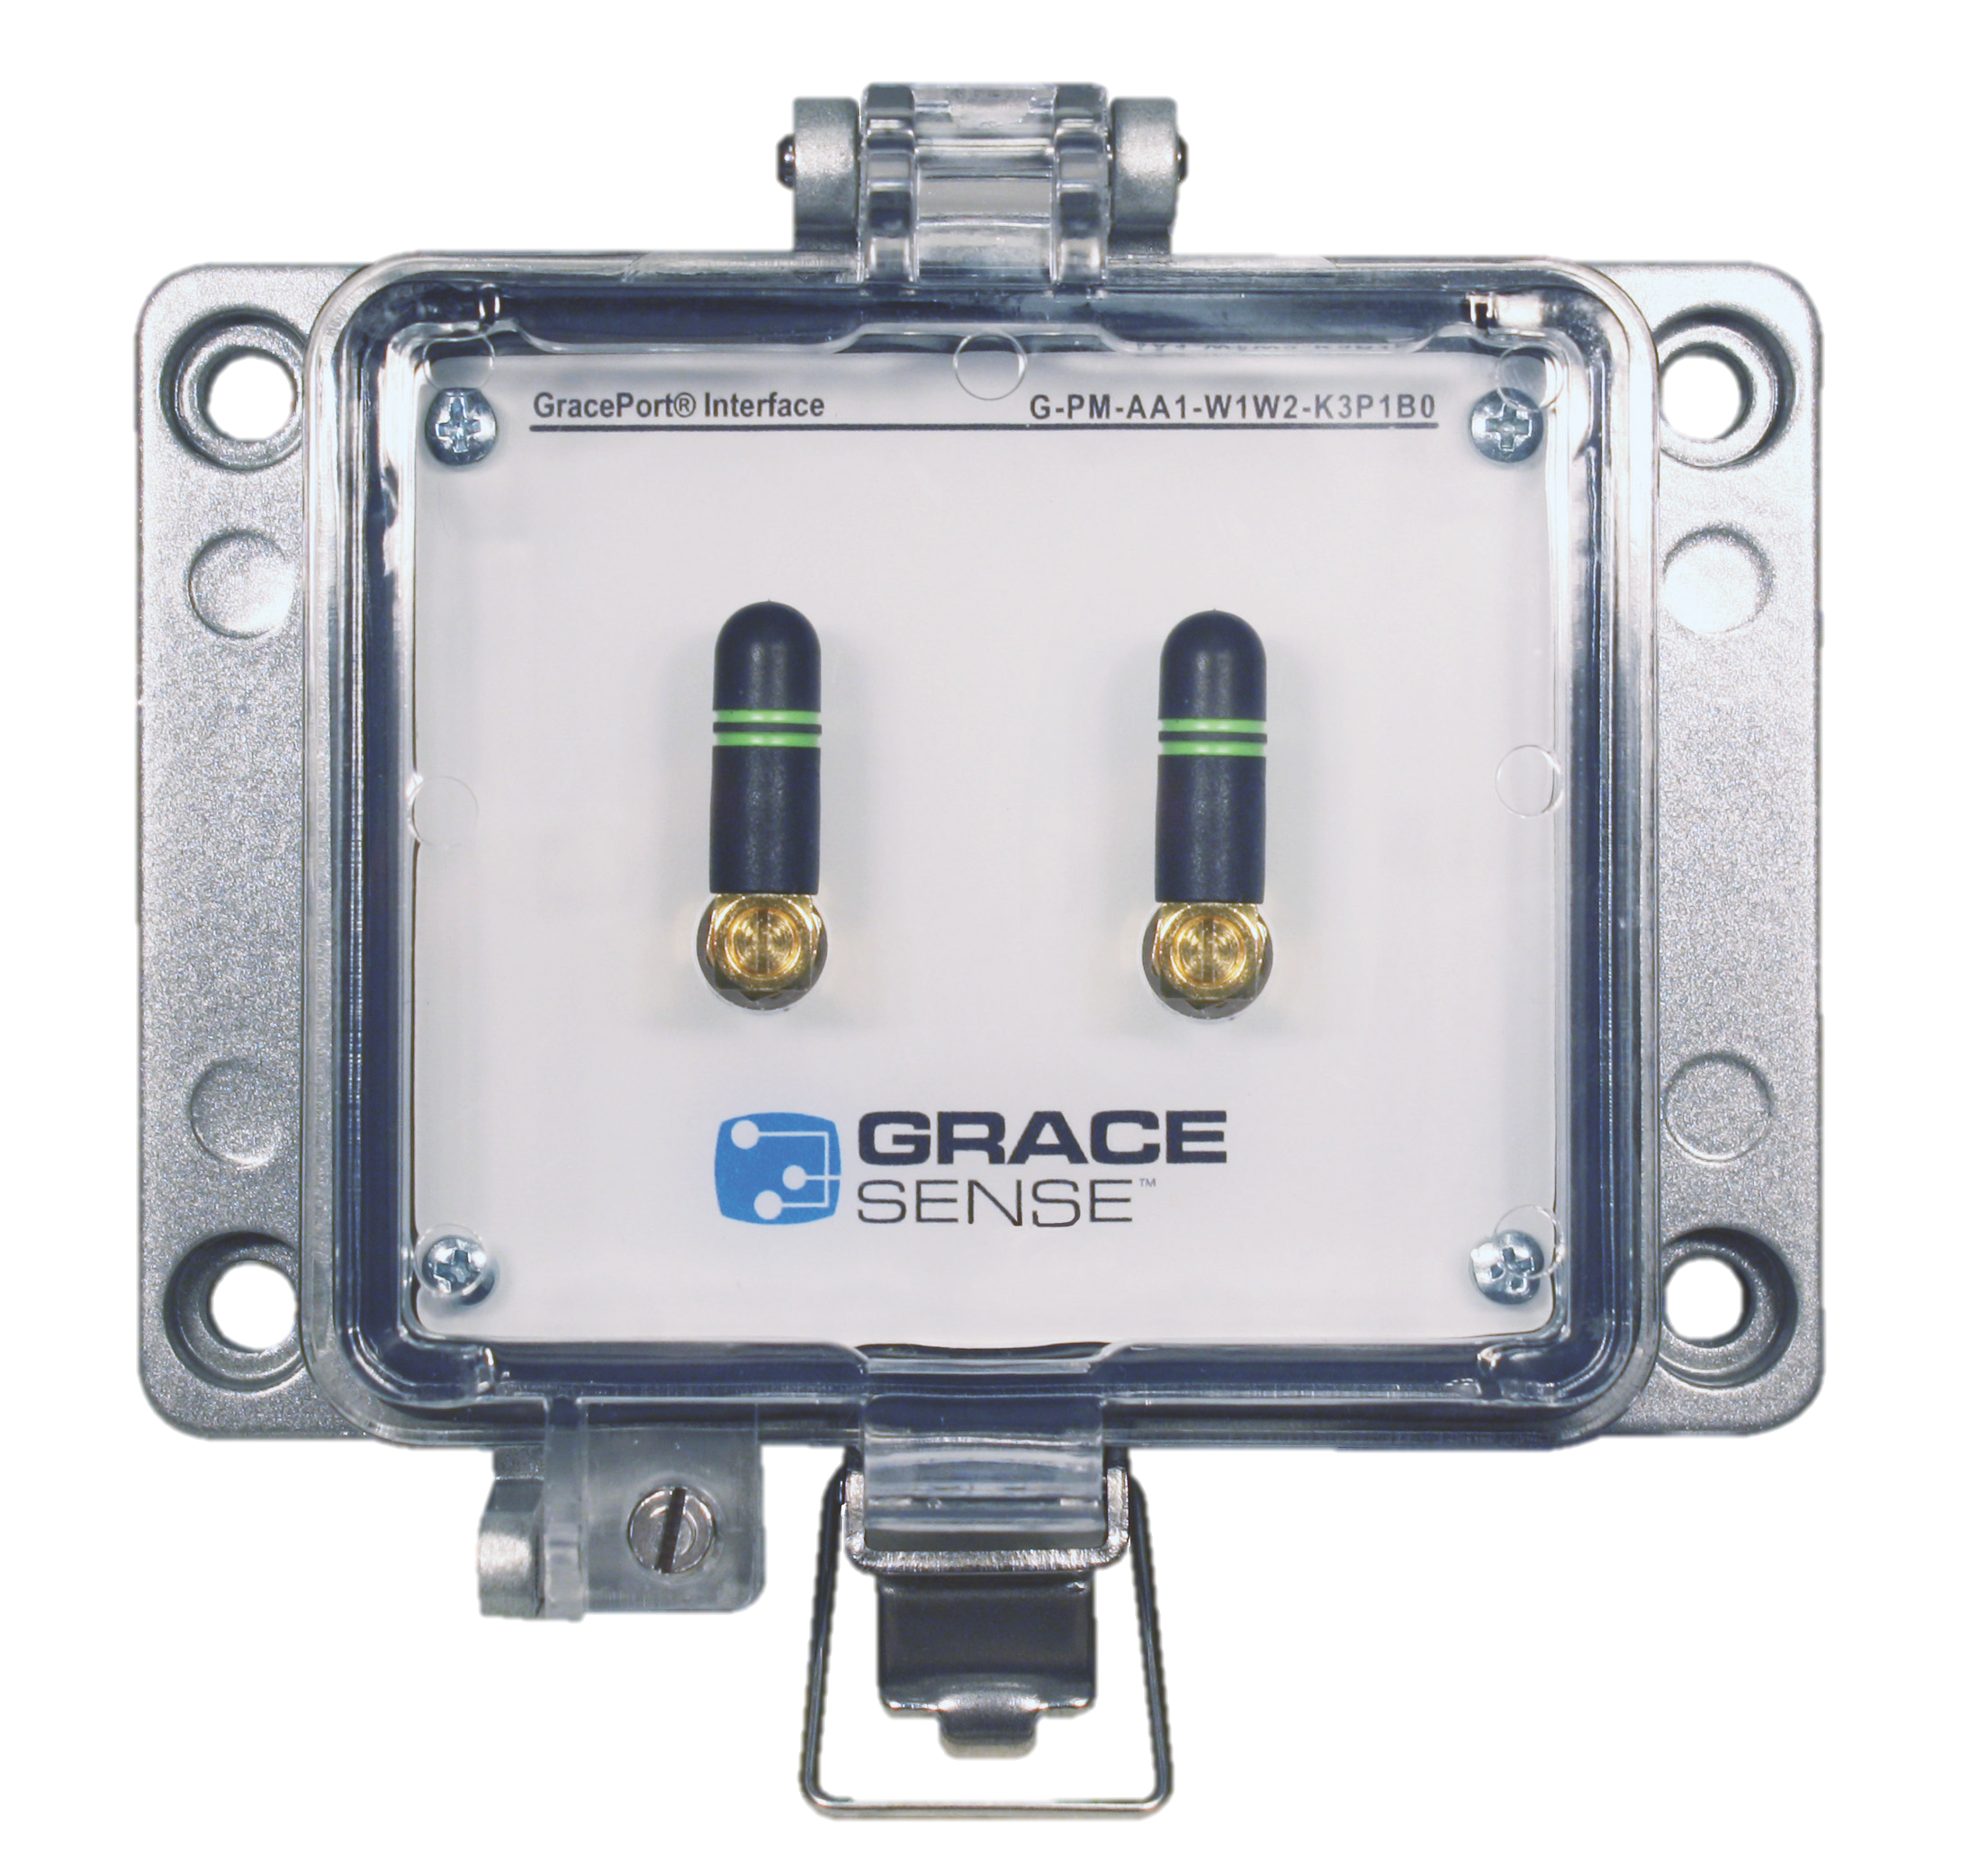
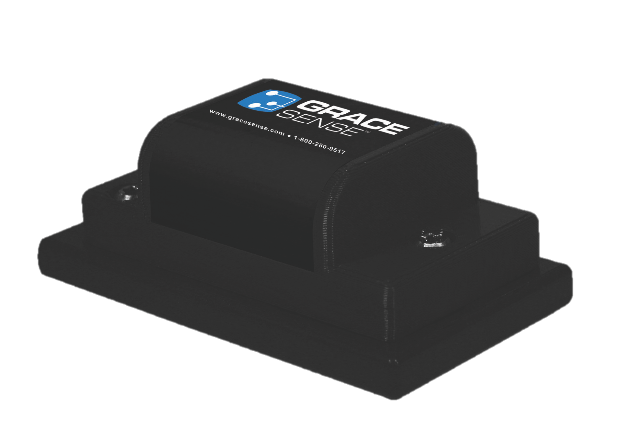
GraceSense™ Predictive Maintenance
Hot Spot Monitor
Non-conductive temperature
Field Mount
Vibration & Temperature
Panel Mount
Customizable Node and CloudGate
Maintenance Hub
Data visualization, analysis, and alerting

Slide 33
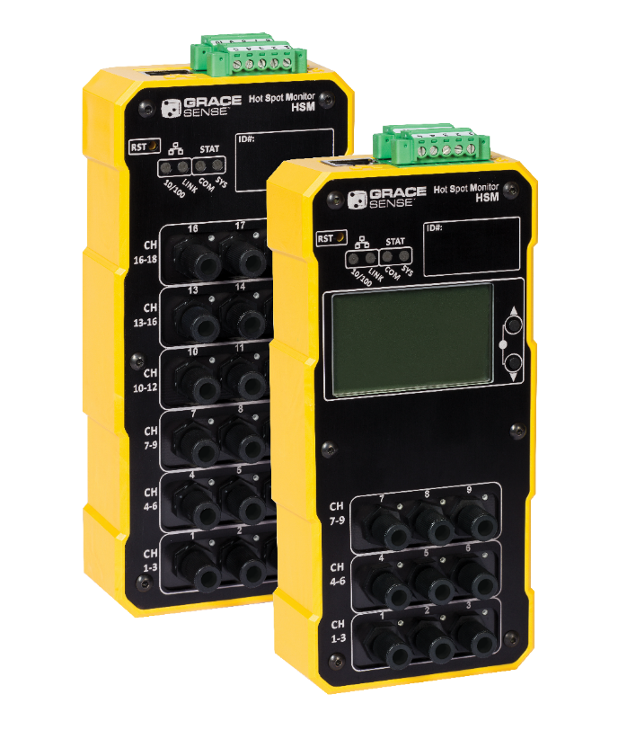
GraceSense™ Hot Spot Monitor (HSM)
No Power = No Motion
Non-conductive, fiber-optic temperature sensing
Continuous monitoring
Inaccessible locations
Reduce downtime and safety risk
Better maintenance planning on your highest risk assets
Low / medium / High voltage systems

Slide 34
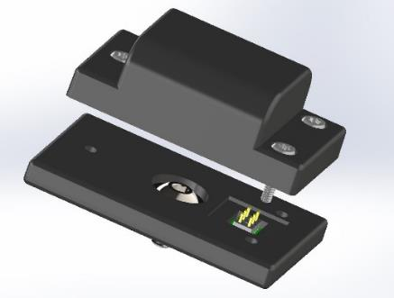
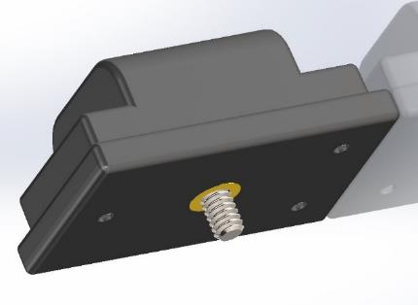
GraceSense™ Predictive Maintenance
Field Mount Nodes (1.5”x 1.5”x 2.5”)
  3 axis acceleration and/or temperature
  Replaceable long-life battery (5+ year life)
  ZigBee-compatible wireless connectivity
  IP67, Nema Type 4, 4X, 12 & 13
  Stud, epoxy, fin and magnetic mounts
  Wireless range- 30m
  Over-the-Air Updates

Slide 35
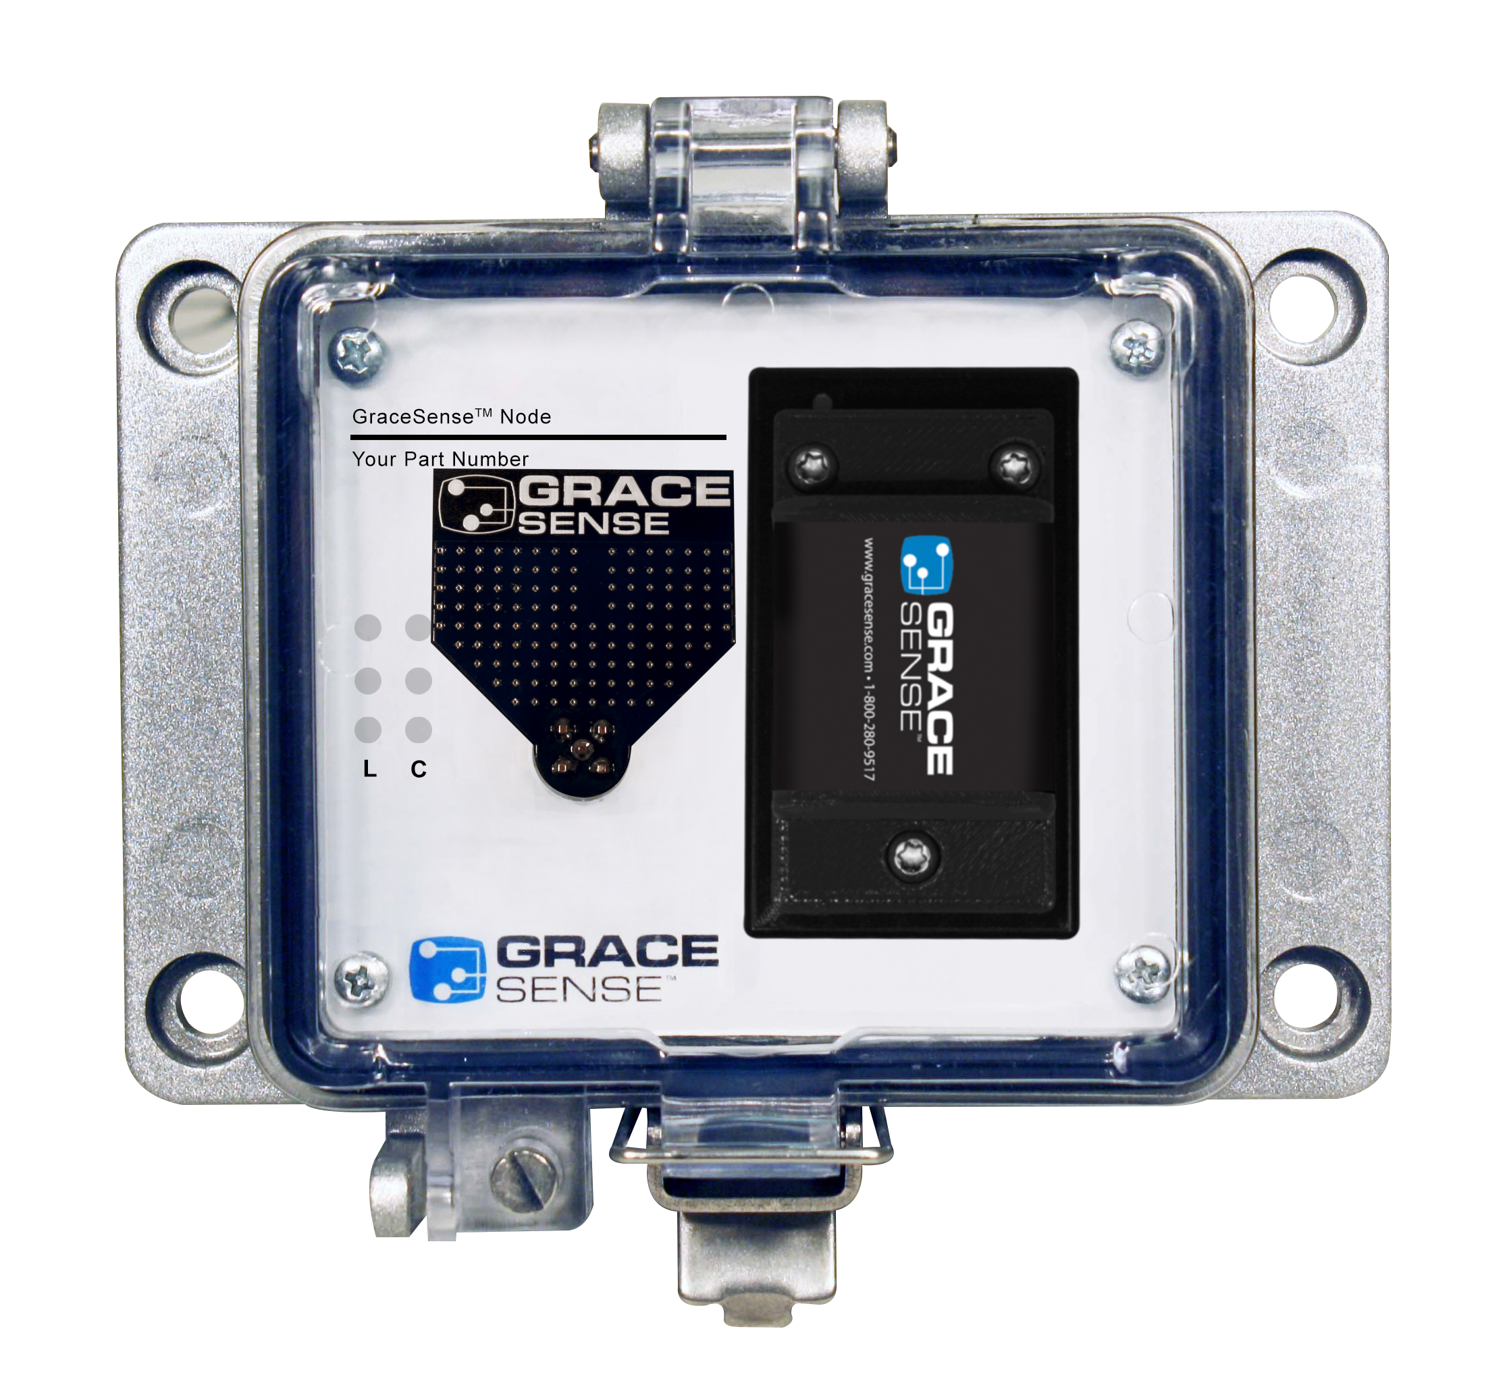
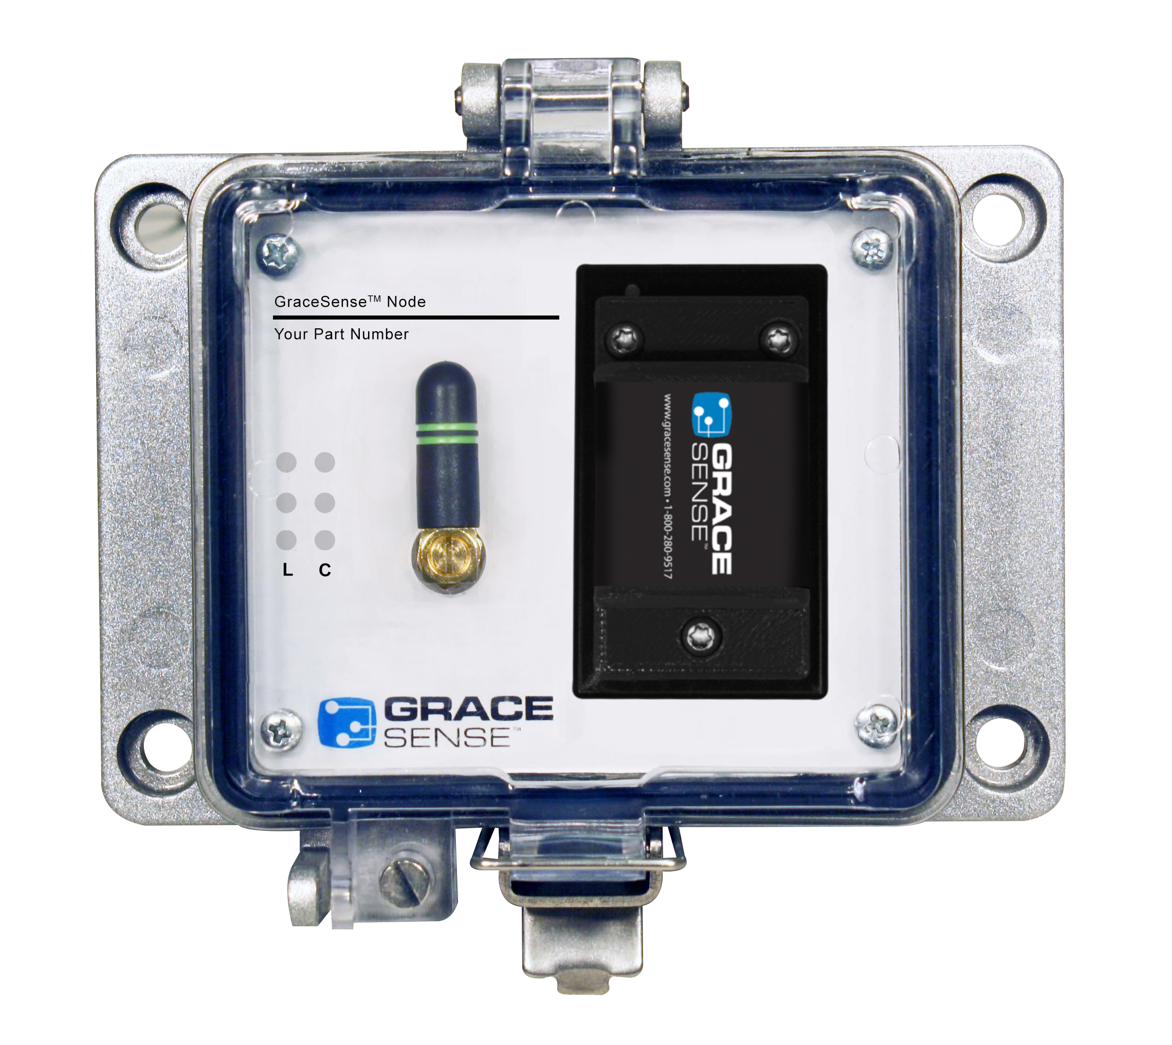
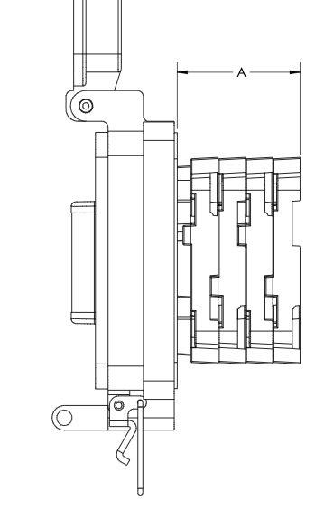
GraceSense™ Predictive Maintenance
Panel Mount Nodes
  Familiar, easy-to-install K size GracePort® housing or other enclosures
  Replaceable long-life battery (5+ year life), 24VDC, 120VAC
  Completely customizable transducer options
    Accelerometers, RTD, CT, Rogowski Coils , Flow,
    Pressure, Strain, Humidity, Fluid Level
  IP65, UL Type 4, 4X, 12 & 13
  Bidirectional Modbus and Ethernet/IP interfaces (Coming Q3)
  Special analytics for GraceSense™ Hot Spot Monitor
CoudGates
  Can add Zigbee, LTE and WiFi wireless to all PM Nodes

Slide 36
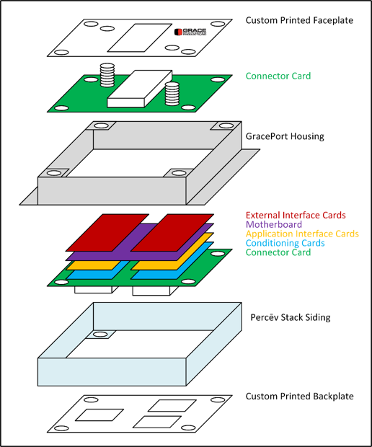
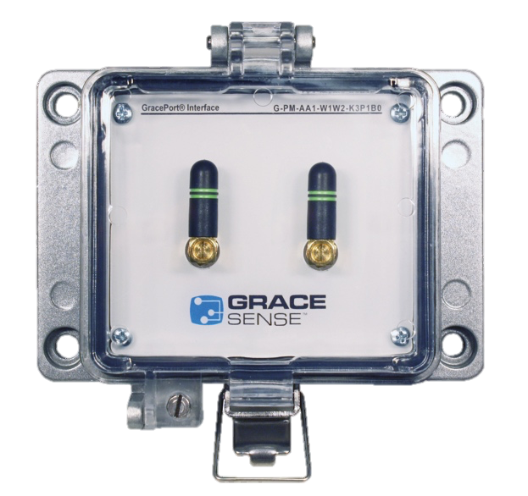
Complete Customization
Temperature
Current
Voltage
Pressure
Strain
Flow
Ethernet/Modbus Devices
Other Sensors
PM

Slide 37
GraceSense™ Predictive Maintenance
Focus on Intelligent Edge / Embedded Processing
  Statistical Oversampling for energy-efficient high-rate investigations
  Patented Stream Processing Engine (SPE) for embedded analysis
    Programmable edge processor can convert high-rate data into actionable information
  Burst Mode
    Sampling full data for short bursts= better diagnostics

Slide 38
Scalability
Huge number of nodes per Cloudgates (65,000+)
Low bandwidth consumption due to edge processing-won’t crash networks supporting large installs
Self-healing network
Large number and types of transducers for panel mount nodes
No per user or per location cost
Open Architecture- Free your data

Slide 39
White Glove Delivery
Grace works with customers to set up account, data structure and connect nodes to assets before they arrive
Each node comes fully labeled with the customer’s asset location for quick and painless deployment
Cloud sales and plan renewals are sold through local distributors for easy purchasing

Slide 40
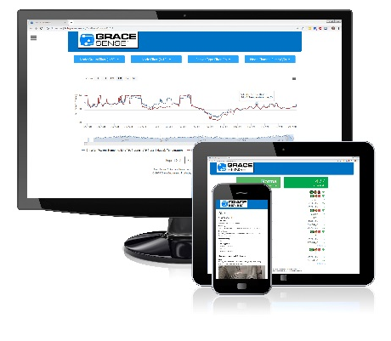

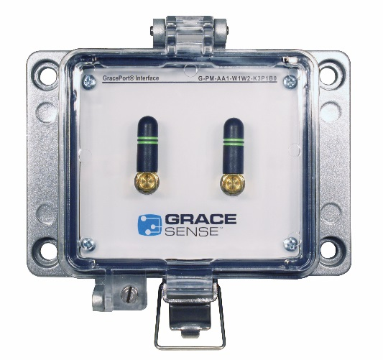
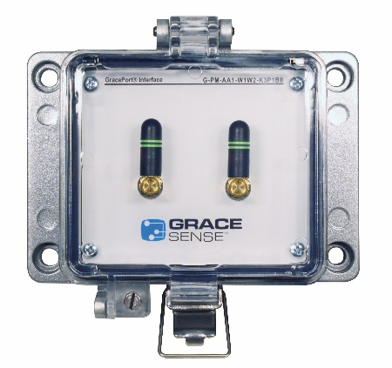
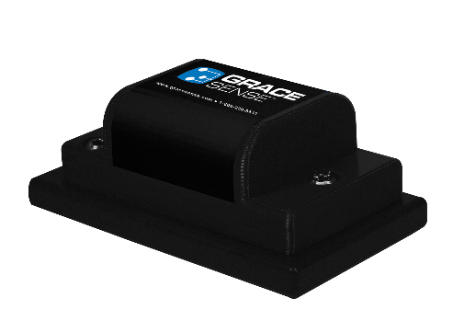

Cloud/On-Prem Architecture
Other Transducers
Hosted on
Azure/AWS or locally
Modbus/Ethernet
Devices
WIFI or LTE
802.15.4 (ZigBee)
802.15.4 (ZigBee)
Other Transducers

Slide 41

Cloud/On-Prem & DCS/SCADA
Via API (Best of Both Worlds)
SCADA/DCS
Hosted on
Azure/AWS or locally
Other Transducers
Modbus/Ethernet
Devices
WIFI or LTE
Node
Node
802.15.4 (ZigBee)
802.15.4 (ZigBee)
Other Transducers
CloudGate

Slide 42
Direct Control/SCADA
SCADA/DCS/Control System
Other Transducers
Ethernet or Modbus
Modbus/Ethernet
Devices
Node
Node
CloudGate
802.15.4 (ZigBee)
802.15.4 (ZigBee)
Other Transducers

Slide 43

Cloud Vs. On-Premise
Cloud | On-Premise
Data Hosted on vendor’s servers and accesses through web browser, Apps | Data Hosted locally on company’s own servers and accessed through local UI
Pay as you go, per user, per month, per node etc. | High upfront investment for hardware, software, licensing, tech support
Run many applications and provide deeper analytics and data insights | Limited analytics capability, rely on company’s resources
Easy access from any device, any computer | Difficult access through firewalls and network security
OPEX | CAPEX
Access to information through internet that could pose some security risks | Higher security control over internal servers and networks
Easy to scale as the business need changes (Nodes, users, data storage) | Requires change to infrastructure and licenses
Updates and patches done by 3rd party vendor | Must rely on internal resources that could be time consuming or expensive tech support
Notes:
What’s optimal?

Slide 44
GraceSense Maintenance Hub
Data Visualization
Alerts/Alarming
Access and Severity levels
Secure Transmission
Scalable Architecture
Multiple dashboards
Specialized analytics being developed
Open API
On-Premise Solutions available

Slide 45
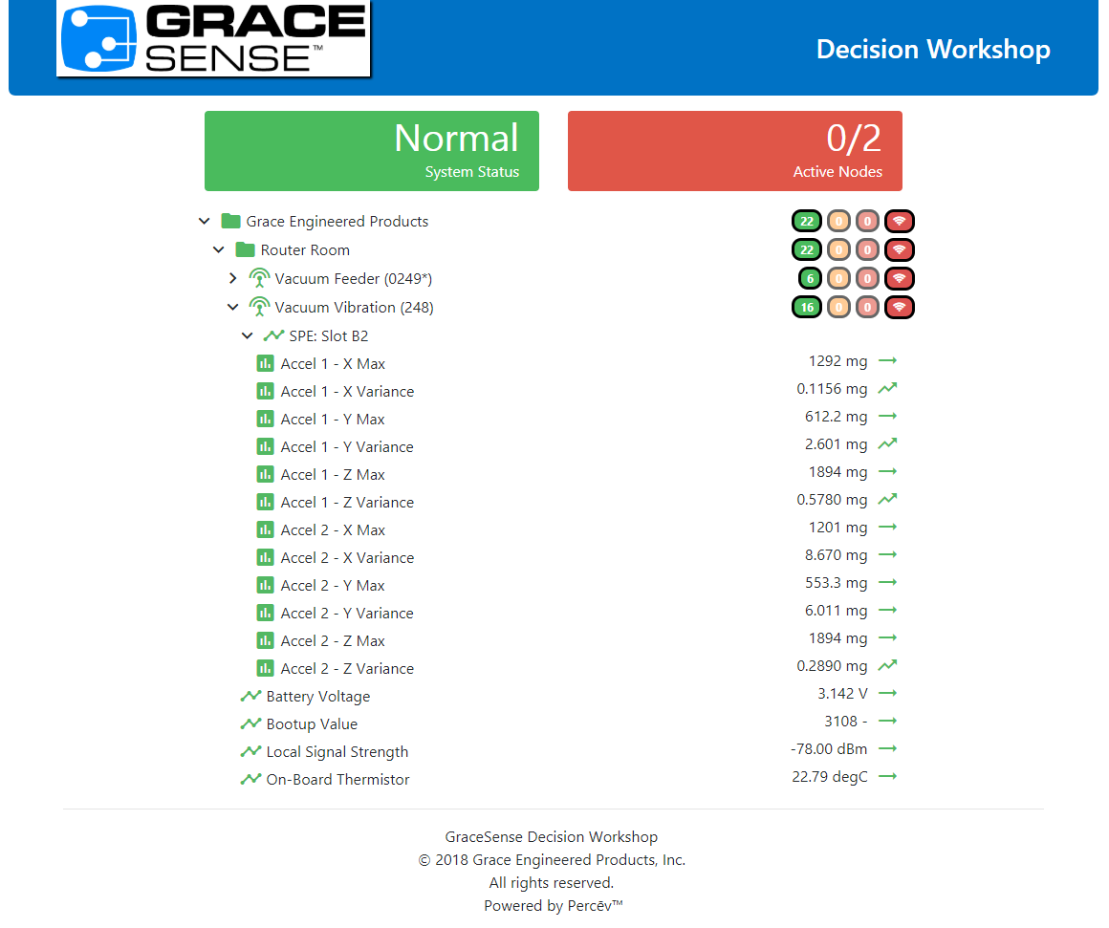

Slide 46
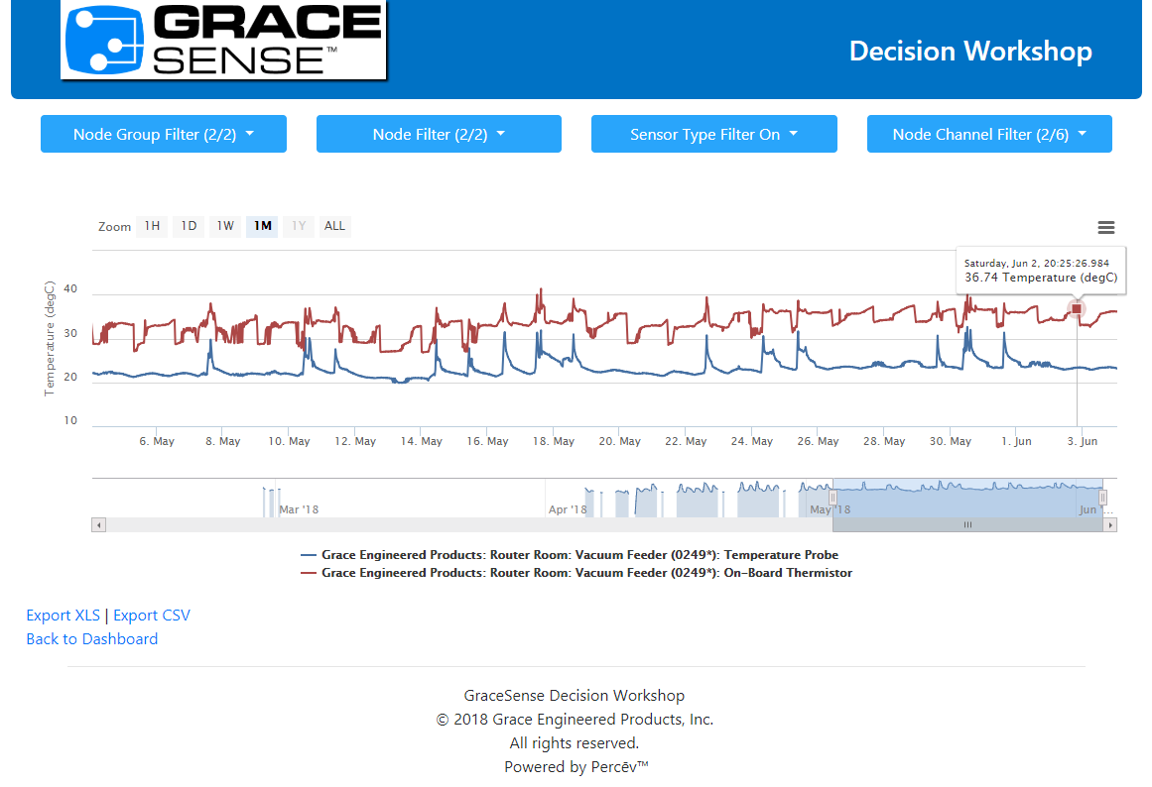

Slide 47
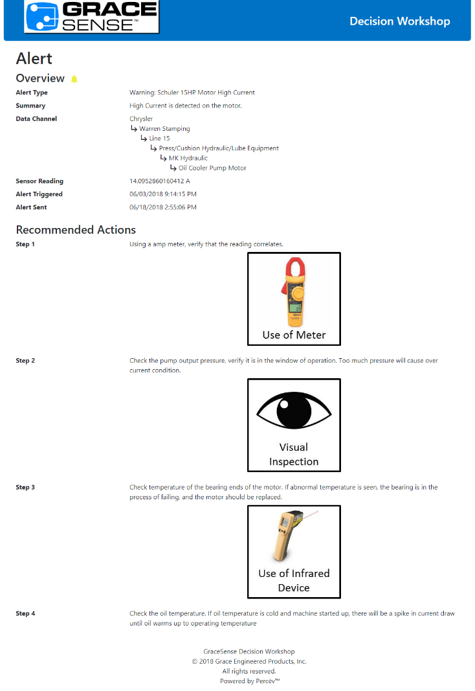

Slide 48



Slide 49
Cloud Pricing
Prices are based on number of years and channels
Free 25 channel package for 1 year for pilot programs

Slide 50

Case Study: FCA Warren Stamping
Optimizing Maintenance Budget Allocation using IIoT Technology
FCA Stamping Lines Represent Expensive Downtime
  $1M+ in revenue per hour
In Summer 2014, FCA was looking to improve press maintenance
  Motor Acceleration, Temperature, Current
  Drive Acceleration, Temperature, Current
  Panel Temperature
  Frame, Gear, Rail Acceleration

Slide 51
Case Study: FCA Warren Stamping
Optimizing Maintenance Budget Allocation using IIoT Technology
Pre-existing maintenance approaches:
  Gear Vibration: Either run-to-failure or schedule-based
    Gears fail roughly every two years (lead to very expensive downtime events)
    Audible signal alerts presence of an issue
  Panel Temperature: Schedule-based
    Single temperature point manually taken on a monthly basis
    Looking for failure of air conditioners
    Excessive heat can cause both downtime and safety issues (arc flash)
  Risk-Based Maintenance: Some issue prioritization

Slide 52
Case Study: FCA Warren Stamping
Optimizing Maintenance Budget Allocation using IIoT Technology
Initial Condition-Based Rollout (January 2016):
  Focus on monitoring temperature and current in two lines
    Presses, Robots, Reoilers, Destackers
  Temperature Monitoring:
    Panel-mounted thermistor, samples taken every ten minutes
  Current Monitoring:
    Single-phase CT, statistically oversampled
    10Hz, 7 seconds every 10 minutes (mean/max)

Slide 53
Case Study: FCA Warren Stamping
Optimizing Maintenance Budget Allocation using IIoT Technology
Initial risk assessment + condition monitoring = Success
8 probable downtime incidents have been prevented
  Two panel AC outages (temperature spikes) - $500K saved
  Six motor issues (elevated current consumption) - $1.5M saved
“Our experience over the course of our project has been excellent. The [GraceSense System] has allowed us to improve the efficiency of our maintenance operations”
- Daniel Tunis, Professional Maintenance Lead at the Warren Stamping Plant

Slide 54
Case Study: FCA Warren Stamping
Optimizing Maintenance Budget Allocation using IIoT Technology
Future Plans for Condition-Based Maintenance at FCA
  575 data channels currently active
  Corporate-level energy auditing
  Expand to assembly operations
  Vibration and fluid levels

Slide 55

Vibration and Temp Applications
Obviously pumps, motors, fans, gear boxes, compressors rotating equipment
Non-obvious
  AGV’s
  Great for conveyor applications
    Belts
  Semiconductor
    Vibration during crystal growth and etching
  HVAC
  Structural systems

Slide 56


Temperature Only Applications
Flash Freezer applications
Bus Duct (Outside mount)
Tank temperature monitoring

Slide 57


Panel Mount Applications
Information collection from Modbus/ Ethernet/IP devices
  Downtime monitoring
Current (CT, Rogowski Coils)
Energy Monitoring/Auditing
Simple Temp/Humidity
Air Conditioner Monitoring (air flow across filters)
Door Open Monitor
Can mount hardware in smaller enclosures for easy deployment close to important monitoring points
  Heat Exchanger efficiency

Slide 58

MCC/Switchgear Applications
Hotspot monitoring for conductive PFP’s I.e. Incoming feeder
Ambient bucket measurements (ΔT)
CT, Rogowski Coil or PowerMonitor info
Create detailed analytic profile to predict failures
Energy Monitoring

Slide 59


Technical Specifications
cUL Recognized, CE, FCC
20° C to 120° C
  Resolution: 1°C
  Accuracy: 2° C
High Temperature probe 160 °C (optional)
Power: 24 VDC / 0.2 A
16MB Internal Memory for Data Logging- 100+ years
Communication: Modbus RTU, Modbus TCP/IP, Ethernet IP
Notes:
Rated Voltage Withstand = 80kV
Rated Power Frequency = 60 Hz
16 Mb of Internal Memory (up to 120 years of data logging)

Slide 60



Fiber-optic Non-Conductive Sensing
LED tunnels through polymer fiber, reflects off probe tip compound and attenuation is measured at the HSM module.

Slide 61




Installation
Dark Fiber
STEP 2: INSULATE
STEP 1: MOUNT PROBE & ROUTE FIBER
Notes:
Create awareness in the market for “Point of opportunity” Dark Fiber
Example is an unplanned outage.
Have prepped up the conversation and have the fibers kits on hand so when their gear is down for the first time in years they can install the fibers and not “Light” until a planned shutdown.

Slide 62




Installation
STEP 3: ROUTE FIBER TO
LOW VOLTAGE COMPARTMENT
STEP 5: FINAL TERMINATIONS
STEP 4: CONTROL WIRING
Suggestion:
Flexo PTN0.50YL - FLEXO PET - 1/2“
Notes:
HIGHLY RECOMMENDED
When Routing fibers to a different compartment use conduit or some sort of protection to protect the fibers.

Slide 63
HSM Case Study
Large Food and Beverage Ingredient Manufacturer
Downtime= $178,000/Hour
Active Thermography and PM program developed after severe incidents that took the plant down for 31+ hours

Slide 64
IR Isn’t Good Enough
Ensuring equipment is at 90%+ load during inspections is difficult for biannual inspections
Accuracy of IR inspection is ± 10 C when properly calibrated with the window, often not the case
$32,000/year in contractor costs alone
Can’t get a full picture of the gear

Slide 65
Safety
Implementation of NFPA 70e made it impossible to open up cabinets for IR inspection
Many pieces of 40 Cal + gear removes ability to open even with PPE

Slide 66
ROI
HSM detected a preventable breaker failure.
“By me catching it and being able to have a controlled shutdown instead of an unplanned shutdown, we were back up in 45 min.”
No damage to the breaker.
If it was unexpected shutdown it could have taken between 4-6 hours. Easily could have been a $500,000+ dollar failure without the HSM catching it.

Slide 67
Data-Driven Design
“Pictures are worth a thousand words and so is data. I was able to capture this data and go to the engineers and show them that we have a problem.”
Discovered with HSM that 2-3 motors starting in succession led to rising breaker temperatures above spec leading to premature failures
Result: Redesigned start-up procedure to extend the time in which they powered up the motors to prevent the temperature rise.
Without the HSM, they would not have had the temperature data to make this change.

Slide 68
Thank-you!

