Slide 1
Adding Value for HNW Clients An Overview of the CPWA® Certification
Devin Ekberg, CFA®, CPWA®, CIMA®
Chief Learning Officer | Managing Director of Professional Development
Investments & Wealth Institute

Slide 3
92%
of HNW clients
are loyal
95%
of HNW clients
are satisfied
Source: Investments & Wealth Institute Research 2019

Slide 4
Source: Investments & Wealth Institute Research 2019

Slide 5
It Starts With Understanding:
What do HNW clients value?

Slide 6
What Matters Most to Clients?
 | It’s a ‘5 out of 5’ on importance
My advisor has high ethical standards | 80%
My advisor is trustworthy | 80%
My advisor is knowledgeable | 77%
I am comfortable with the level of risk in my plan/portfolio | 77%
My advisor fully understands my financial needs | 75%
I am satisfied with my long-term investment performance/returns | 75%
Q:How would you rate the importance of each of the following when it comes to working with a financial advisor?
Source: Investments & Wealth Institute Research 2019

Slide 7
Satisfaction Gaps
 | Satisfaction | Importance | Gap
I am satisfied with my long-term investment performance/returns | 60% | 75% | -15%
I receive high value relative to the fees I pay my advisor | 53% | 67% | -14%
I am comfortable with the level of risk in my plan/portfolio | 67% | 77% | -10%
Source: Investments & Wealth Institute Research 2019

Slide 9
Q: Which of the following does your advisor provide to you? Please select all that apply.
Q: Please rate the importance of each of the types of support your advisor provides to you. (n=those receiving service)
Source: Investments & Wealth Institute Research 2019

Slide 10
Drivers of Engagement
 | Engaged | Not Engaged | Gap
My advisor provides me with cutting edge investment strategies | 57% | 27% | 29%
My advisor helps coach me with respect to savings and spending discipline | 54% | 26% | 28%
My advisor keeps me up-to-date on the latest tax law changes | 58% | 33% | 25%
My advisor has strong technical expertise | 70% | 49% | 21%
I receive high value relative to the fees I pay my advisor | 64% | 46% | 19%
Source: Investments & Wealth Institute Research 2019

Slide 11
67% of high net worth investors said the designations or credentials held by his/her advisor set the advisor apart.
1/3 of clients actively sought out an advisor with specific designations.
75% of those clients said they would not have worked with the advisor if he/she did not hold those designations.
76% of high net worth investors said the designations/credentials held by an advisor would play a role if they were looking for an advisor today.

Slide 12
Q: Did the information your advisor shared about his/her designations influence your decision to work together (n= Respondents whose Advisors shared credential information)?

Slide 14
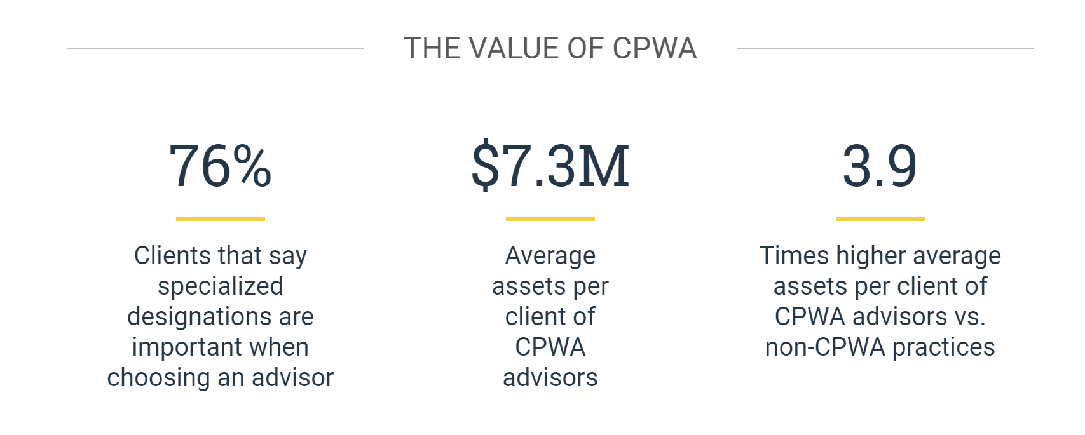

Slide 15
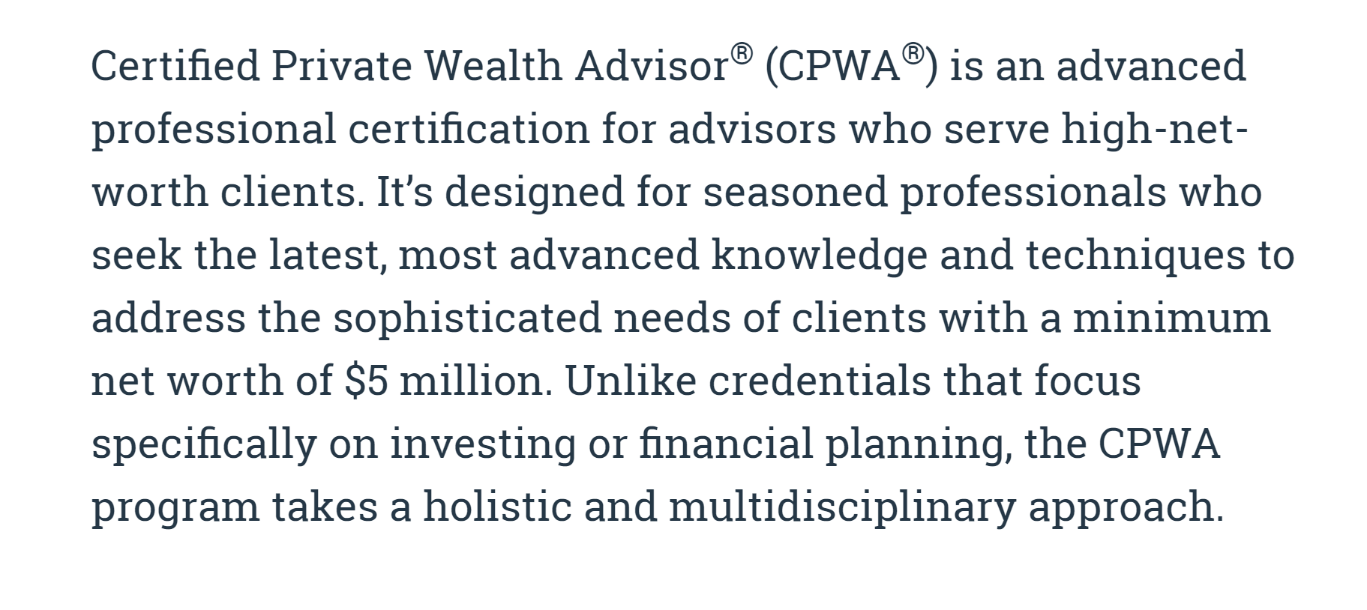

Slide 16
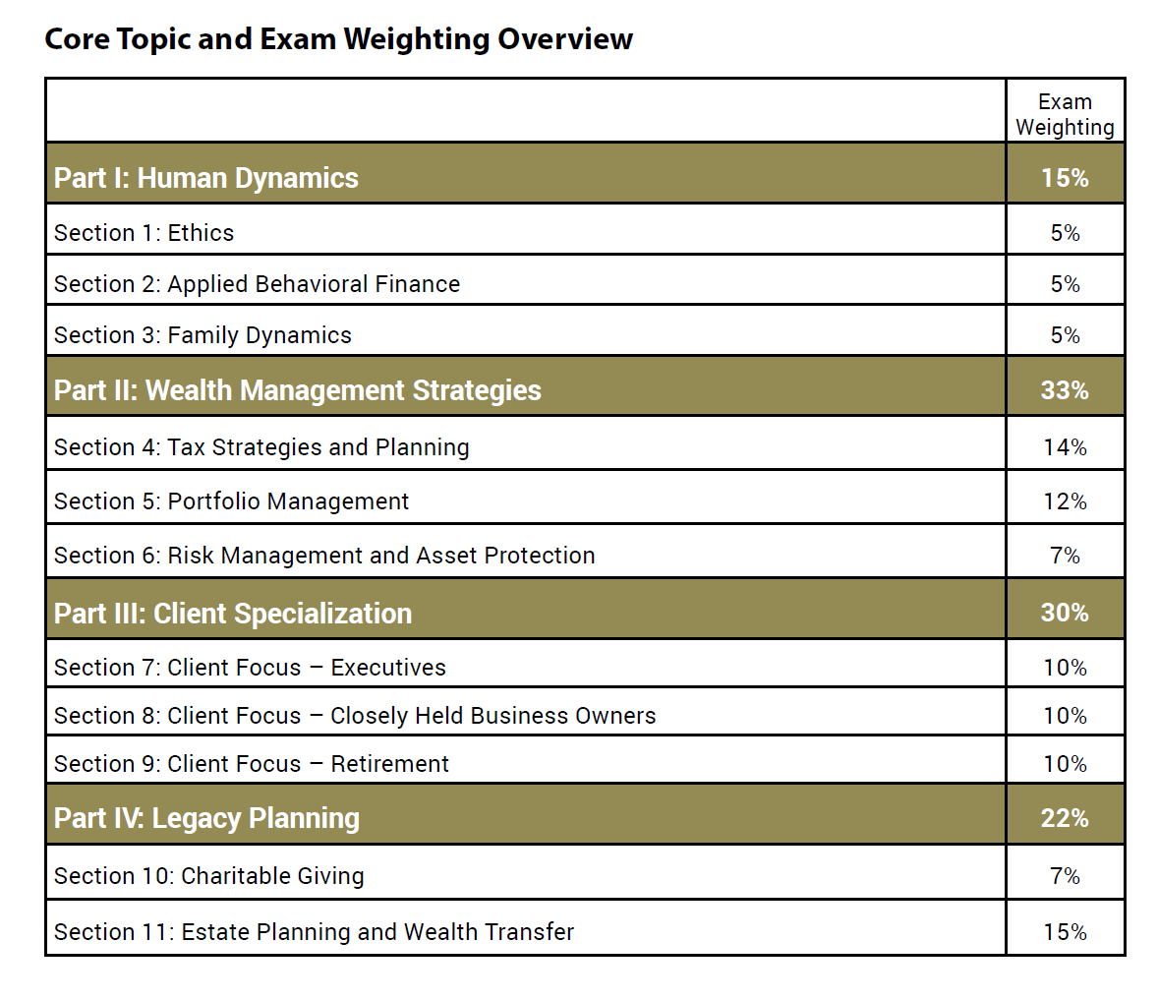

Slide 17
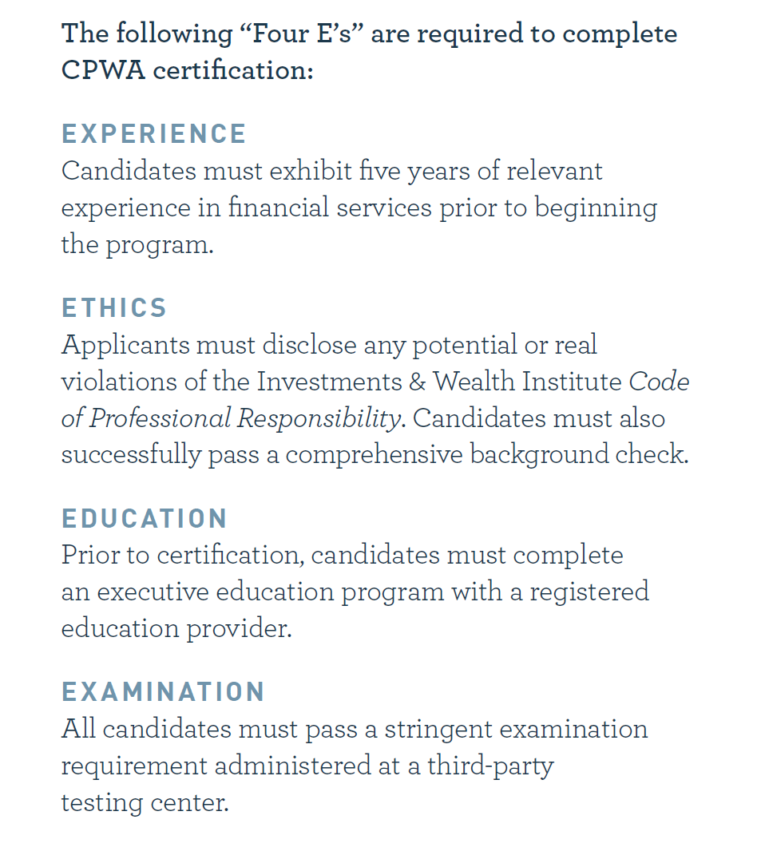

Slide 19
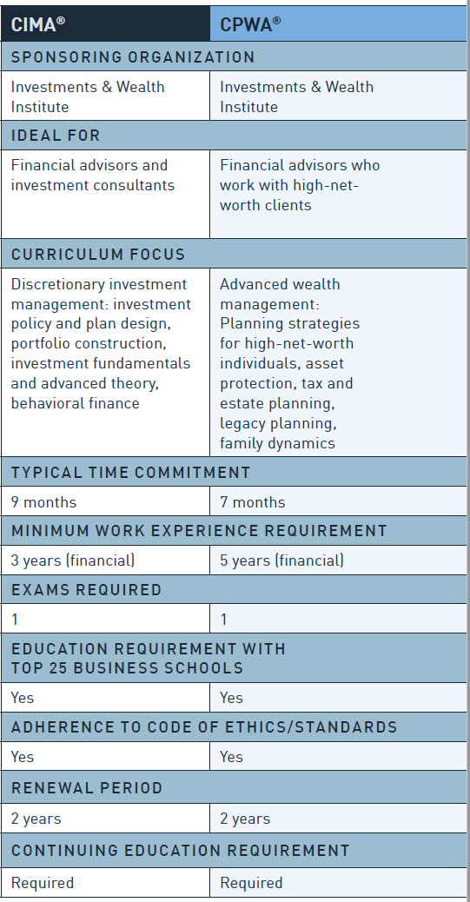
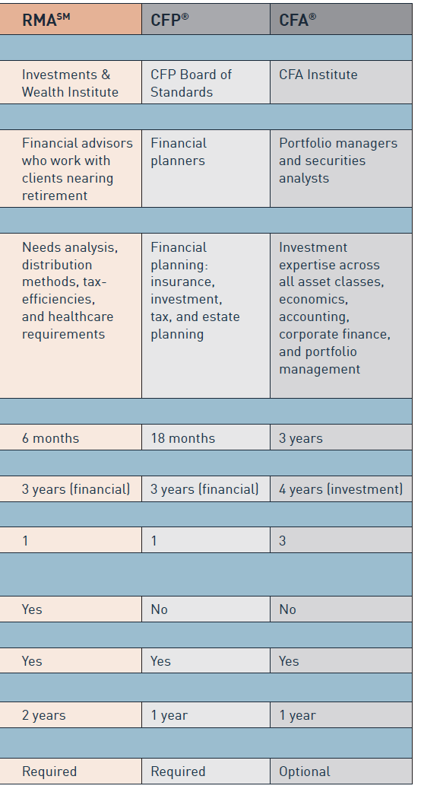

Slide 20
Key Points
Develop specialized skills and knowledge
Differentiate from other advisors
Earn Ivy League education with practical application (and CE!)
Align your services with what HNW clients need and value

Slide 21
Contact:
Cheryl Brandes
Associate Director, CPWA Programs
cbrandes@i-w.org
303-850-3078

