Slide 1
For over 75 years, WPS has been the leading independent publisher of educational and psychological assessments and related intervention resources in the areas of autism, speech and language, school and clinical psychology, and occupational therapy.
wpspublish.com
Notes:
When we develop a new test, we bring an author’s idea to life, answer a researcher’s question, meet a clinician’s need, and, ideally, change an individual’s life for the better.

Slide 2

Sustaining Your Resilience in Stressful Times Part II: Understanding and Addressing the Cascade of Youth Risk
Sam Goldstein, PhD
Director, Neurology, Learning and Behavior Center
Assistant Clinical Professor of Psychiatry, University of Utah
www.samgoldstein.com
info@samgoldstein.com
@drsamgoldstein
@doctorsamgoldstein
Notes:
Bio points:
Author, Co-author or Editor of 54 trade and science books including the Encyclopedia of Child Development and Handbook of resilience in Children
Co-author of seven neuropsychological and psychological tests including the Risk Inventory and Strengths Evaluation
Editor in Chief of the Journal of Attention Disorders
Clinical Faculty Un overstay of Utah School of Medicine
Director Neurology, Learning and Behavior Center

Slide 3

The purpose of life is to prepare the next generation for their future.

Slide 4
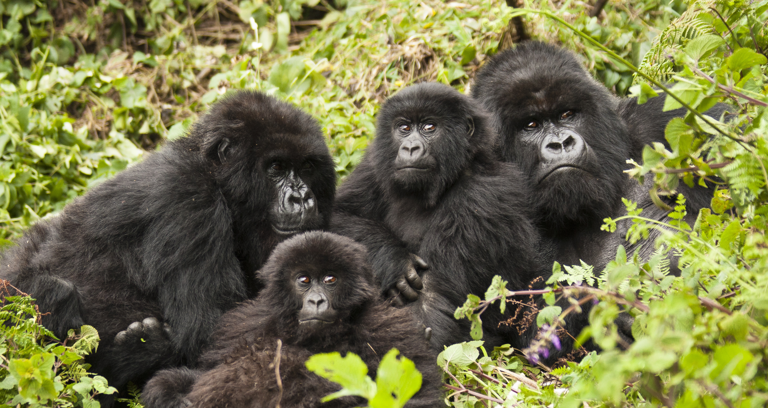
Survival of the Species
Salmon and snakes are born with sufficient instincts to survive.
Bear cubs require at least one or
two years with their mother to
ensure survival.
Higher primates require three or
four years.
Humans require at least ten years.

Slide 5

We have perpetuated the 19th century perception that raising children is a process by which information is dumped into a black box lying mysteriously within the human brain.

Slide 6

We have also assumed a Stepford Wives model that all black boxes are identical.

Slide 7
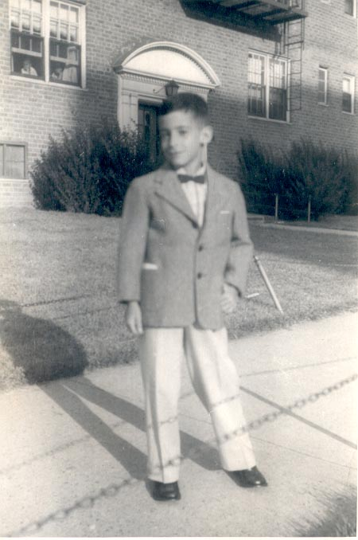
Through the Eyes of Innocence

Slide 8
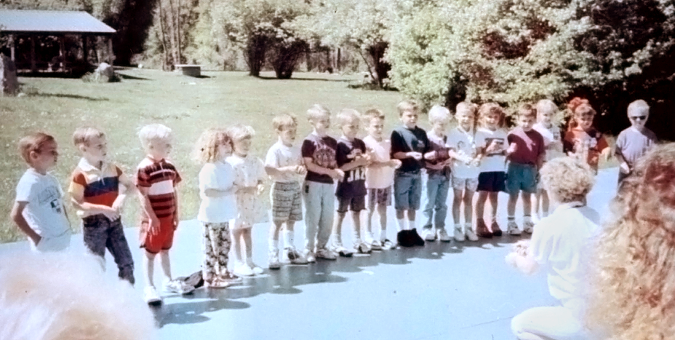
Preschool Graduation Part I

Slide 9
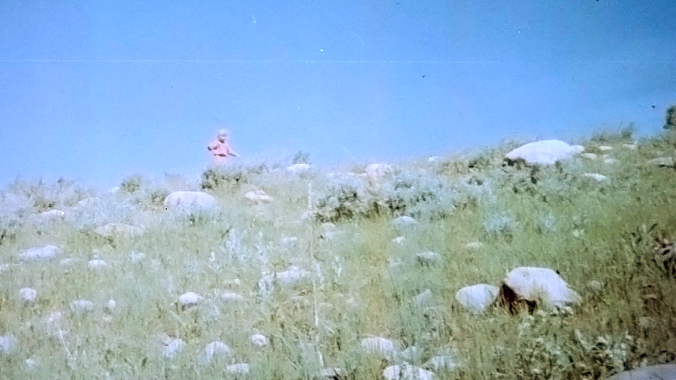
Preschool Graduation Part II

Slide 10
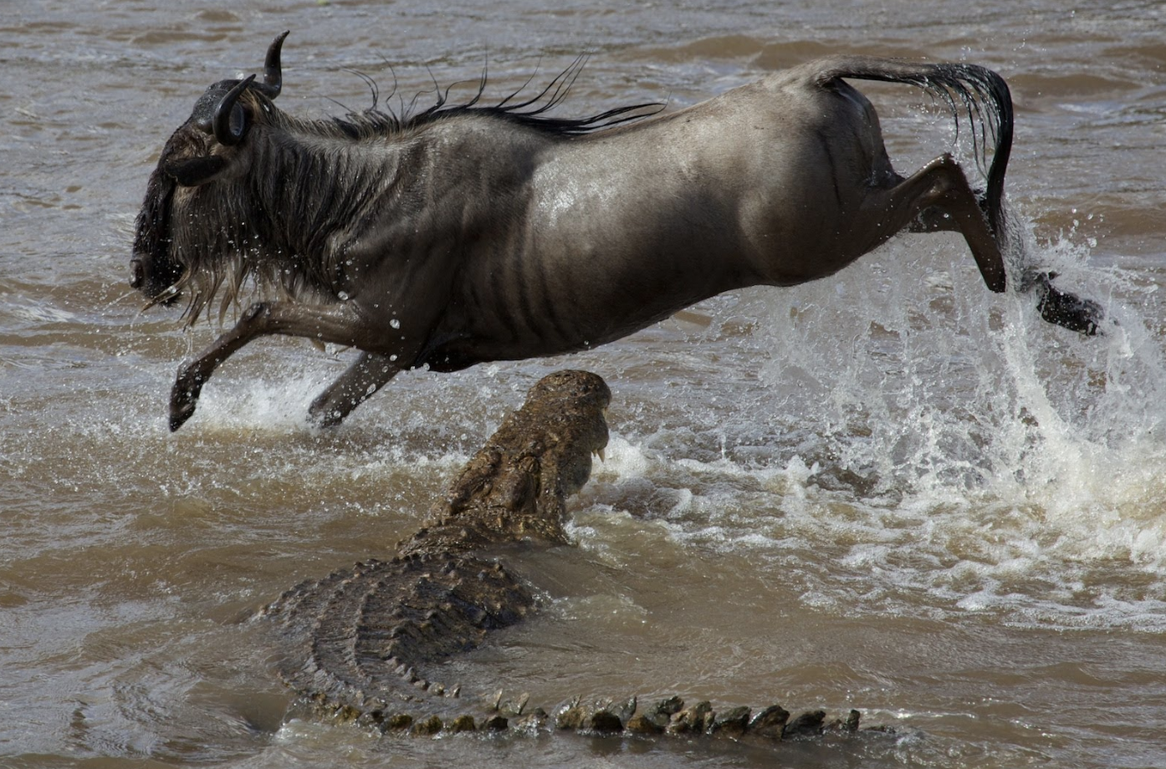
Biology is not destiny, but it does affect probability. In every risk group, there are those who manage to transition successfully into adult life despite their adversities.

Slide 11

We fail to appreciate that children are genetically endowed with certain patterns of behavior and thought. We call these instincts.

Slide 12
What are examples of these instincts?
The drive to help
The drive to mastery
Intrinsic motivation
Intuitive optimism
Altruism
Problem-solving
Social connection
The drive to acquire knowledge
Fairness

Slide 13

I’m not afraid about my girlfriends and myself, we’ll squeeze through somehow, though I’m not too certain about my math.
- Anne Frank, June 21, 1942

Slide 14

I have lots of courage, I feel so strong and as if I can bear a great deal, I feel so free and so young! I was glad when I first realized it, because I don’t think I shall easily bow down before the blows that inevitably come to everyone.
- Anne Frank, July 15, 1944

Slide 15
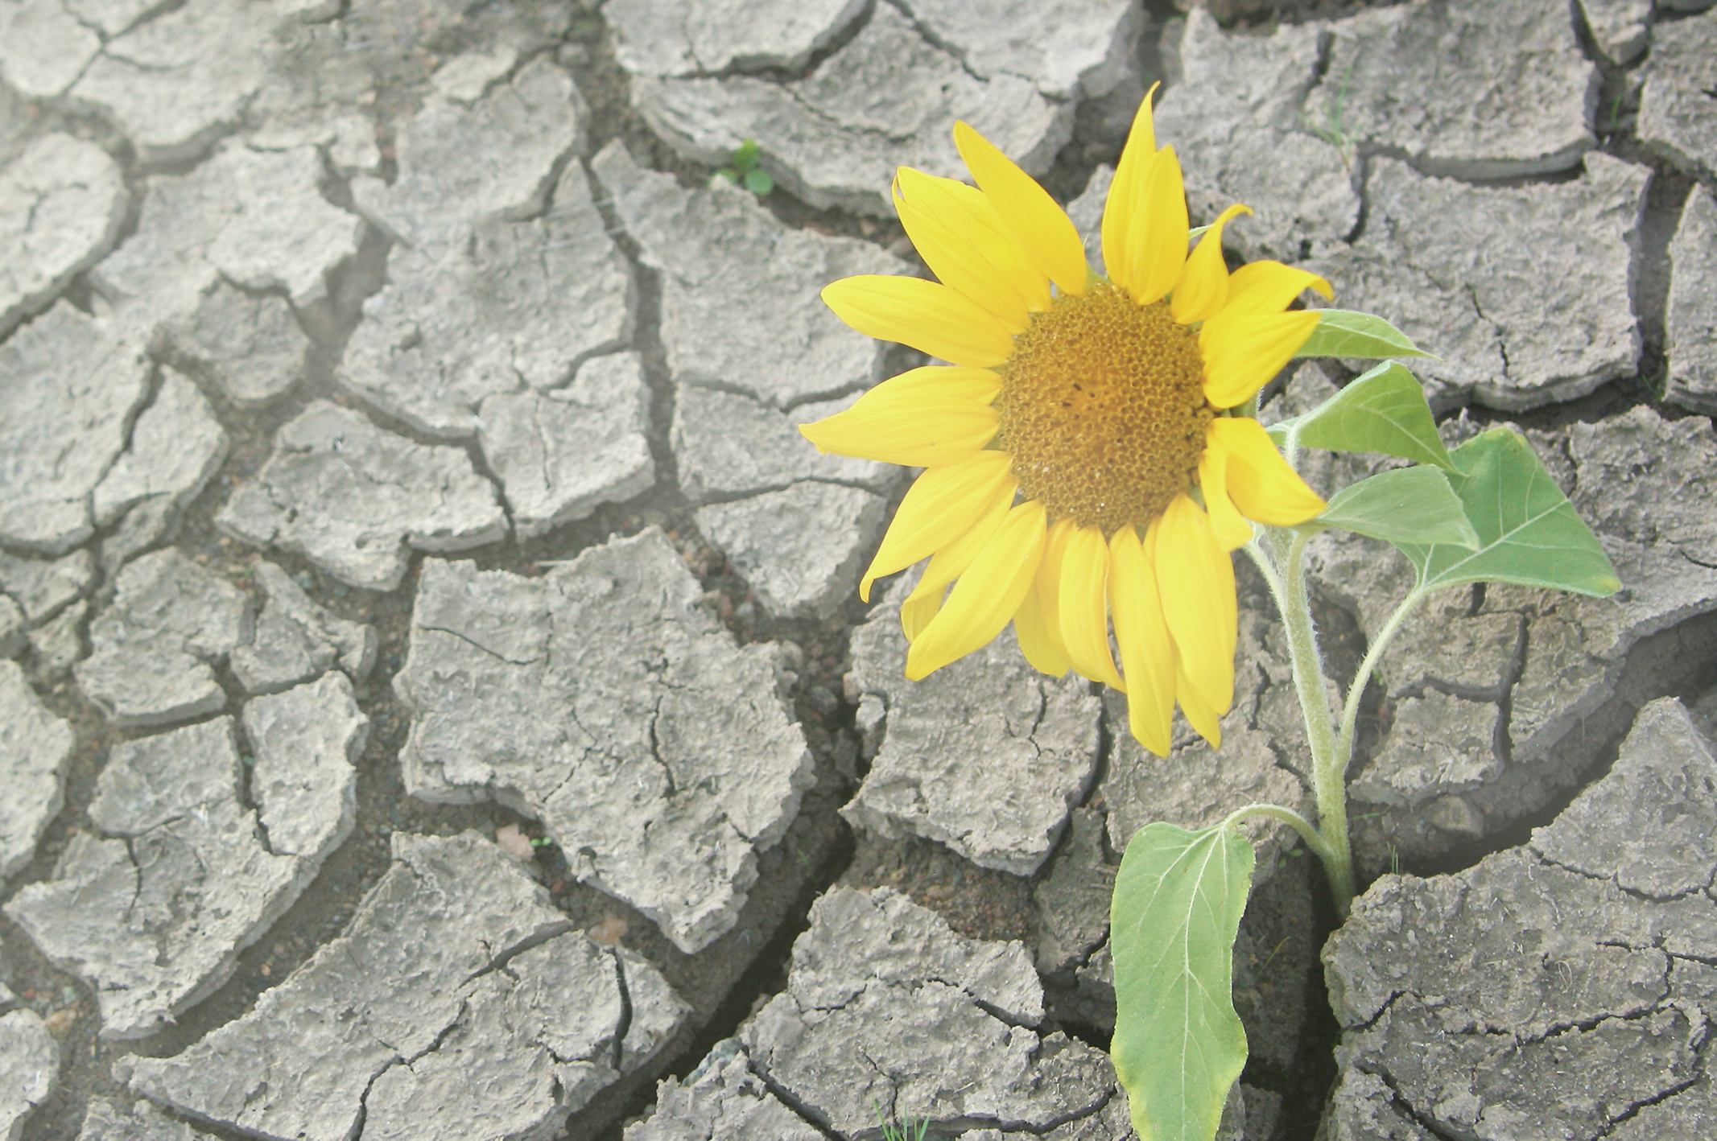
Resilience
A process leading to good outcome despite high risk
The ability to function competently under stress
The ability to recover from trauma and adversity

Slide 16
Four Waves of Resilience Research
Identifying person and variable-focused factors that make a difference.
Identifying and understanding the operation of these factors within systems with a process focus.
Intervening individually to foster resilience.
Creating community-wide programs.

Slide 17
Caregivers are the architects of the way in which experience influences the unfolding of genetically preprogrammed but experience-dependent brain development.
- Daniel Siegel, The Developing Mind

Slide 18


The secret of education lies in respecting the student.
- Ralph Waldo Emerson

Slide 19

The experience of growing up absent success steals away opportunities to develop a resilient mindset.

Slide 20
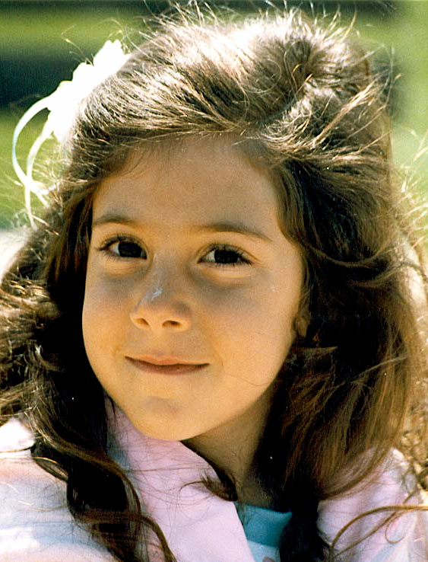
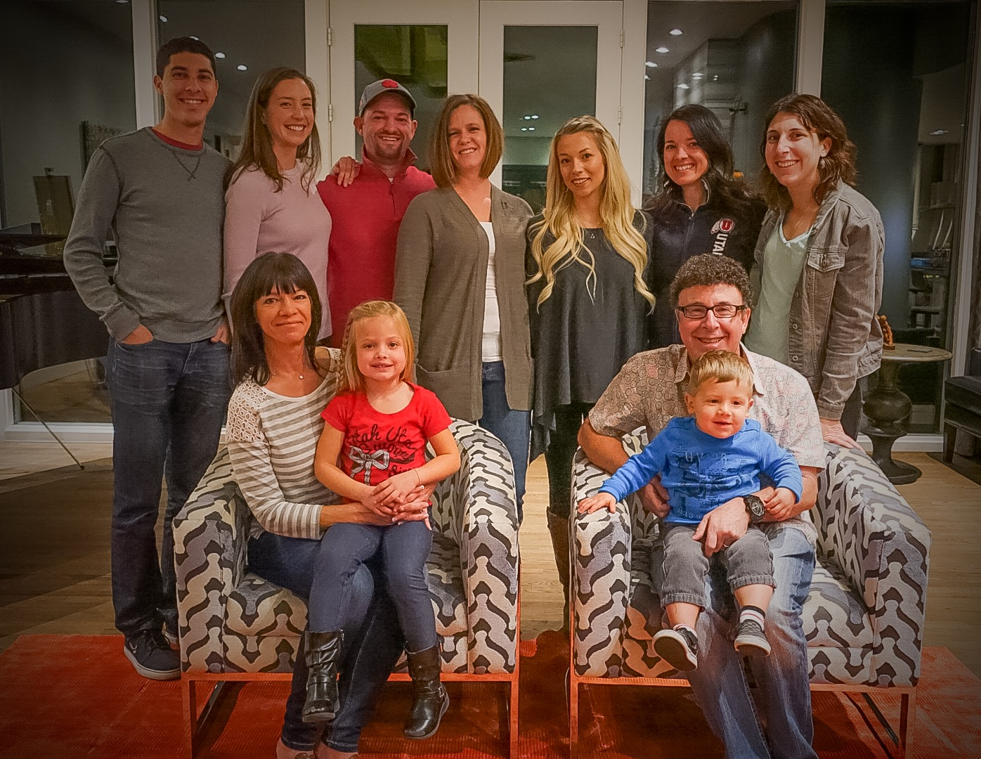

Resilience Is Predicted by Factors Within:
The Child
The Family
The Culture

Slide 21
Risk and Protective Factors: In the Individual
Risks
  Female gender
  Early puberty
  Difficult temperament: inflexibility, low positive mood, withdrawal, poor concentration
  Low self-esteem, perceived incompetence, negative explanatory and inferential style
  Anxiety
  Low-level depressive symptoms and dysthymia
  Insecure attachment
  Poor social skills: communication and problem-solving skills
  Extreme need for approval and
  social support
Protective
  High IQ
  Positive social skills
  Willingness to please adults
  Religious and club affiliations
  Positive physical development
  Academic achievement
Substance Abuse and Mental Health Services Administration (2009). Risk and protective factors for mental, emotional, and behavioral disorders across the life cycle. Summarized from:
http://dhss.alaska.gov/dbh/Documents/Prevention/
programs/spfsig/pdfs/IOM_Matrix_8%205x11_FINAL.pdf

Slide 22
Risk and Protective Factors: In the Individual
Risks
  Low self-esteem
  Shyness
  Emotional problems in childhood
  Conduct disorder
  Favorable attitudes toward drugs
  Rebelliousness
  Early substance use
  Antisocial behavior
  Head injury
  Marijuana use
  Childhood exposure to lead or mercury (neurotoxins)
Protective
  High self-esteem
  Emotional self-regulation
  Good coping skills and problem-solving skills
  Engagement and connections in two or more of the following contexts: school, with peers, in athletics, employment, religion, culture
Substance Abuse and Mental Health Services Administration (2009). Risk and protective factors for mental, emotional, and behavioral disorders across the life cycle. Summarized from:
http://dhss.alaska.gov/dbh/Documents/Prevention/
programs/spfsig/pdfs/IOM_Matrix_8%205x11_FINAL.pdf

Slide 23
Risk and Protective Factors: In the Family
Risks
  Inadequate or inappropriate child-rearing practices
  Home discord
  Maltreatment and abuse
  Large family size
  Parental antisocial history
  Poverty
  Exposure to repeated family violence
  Divorce
  Parental psychopathology
  Teenage parenthood
  A high level of parent–child conflict
  A low level of positive parental involvement
  Family dysfunction
  Poor parental supervision
  Sexual abuse
Protective
  Participation in shared activities between youth and family (including siblings and parents)
  Providing the forum to discuss problems and issues with parents
  Availability of economic and other resources to expose youth to multiple experiences
  The presence of a positive adult (ally) in the family to mentor and be supportive
  Family provides structure, limits, rules, monitoring, and predictability
  Supportive relationships with family members
  Clear expectations for behavior and values
Substance Abuse and Mental Health Services Administration (2009). Risk and protective factors for mental, emotional, and behavioral disorders across the life cycle. Summarized from:
http://dhss.alaska.gov/dbh/Documents/Prevention/
programs/spfsig/pdfs/IOM_Matrix_8%205x11_FINAL.pdf

Slide 24
Risk and Protective Factors: In Peers
Risks
  Spending time with peers who engage in delinquent or risky behavior
  Gang involvement
  Less exposure to positive social opportunities because of bullying and rejection
Protective
  Positive and healthy friends to associate with
  Engagement in healthy and safe activities with peers during leisure time (e.g., clubs, sports, other recreation)
Substance Abuse and Mental Health Services Administration (2009). Risk and protective factors for mental, emotional, and behavioral disorders across the life cycle. Summarized from:
http://dhss.alaska.gov/dbh/Documents/Prevention/
programs/spfsig/pdfs/IOM_Matrix_8%205x11_FINAL.pdf

Slide 25
Risk and Protective Factors:
School and Community
Risks
  Poor academic performance
  Enrollment in schools that are unsafe and fail to address the academic and social and emotional needs of children and youth
  Low commitment to school
  Low educational aspirations
  Poor motivation
  Living in an impoverished neighborhood
  Social disorganization in the community in which the youth lives
  High-crime neighborhoods
Protective
  Enrollment in schools that address not only the academic needs of youth but also their social and emotional needs and learning
  Schools that provide a safe environment
  A community and neighborhood that promote and foster healthy activities for youth
Substance Abuse and Mental Health Services Administration (2009). Risk and protective factors for mental, emotional, and behavioral disorders across the life cycle. Summarized from:
http://dhss.alaska.gov/dbh/Documents/Prevention/
programs/spfsig/pdfs/IOM_Matrix_8%205x11_FINAL.pdf

Slide 26

Can we create experiences in children’s lives to nurture these instincts?

Slide 27
Five Strategies to Reduce Teen and
Young Adult Risk-Taking Behavior
  Support positive behaviors of non-risk-taking individuals. Declines in risk-taking mean that the share of students taking no risks has increased. These youth need support and expanded opportunities to continue making responsible and healthy decisions as they mature.
  Target efforts to reduce specific risk behaviors toward multiple-risk students. Recent public health and policy efforts to reduce the prevalence of key risk behaviors, such as smoking or violence, cannot address these behaviors in isolation from other risk-taking.
  Encourage positive behaviors of risk-taking youth, such as time spent on extracurricular or faith-based activities. These behaviors connect students to adults and social institutions and offer opportunities to prevent risk-taking among some students or reduce risk-taking among others.
  Expand efforts to reach multiple-risk youth in nontraditional settings. Teen participation in settings such as the workplace, the criminal justice system, and faith-based institutions offers innovative opportunities for health services and education programs and the development of personal relationships with positive adult role models that can reduce risk-taking.
  Take new steps to reduce risk-taking among Hispanic students. Further research is needed to better understand both risk-taking and development of this growing group of youth. Programs that are responsive and sensitive to the current ethnic and social diversity of Hispanic youth need to be developed and implemented.

Slide 28

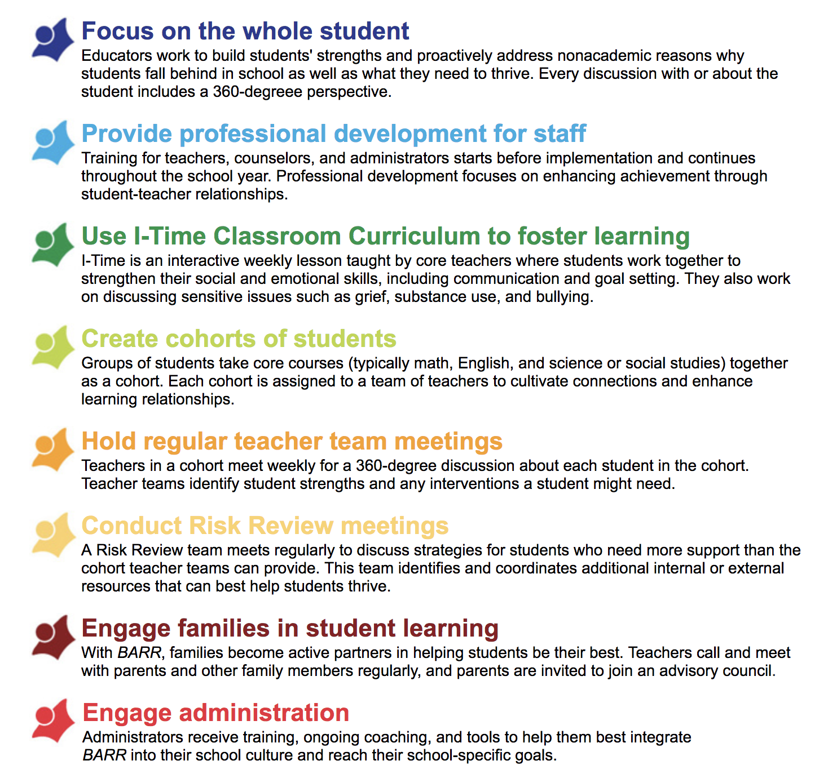
School-Wide Programs

Slide 29
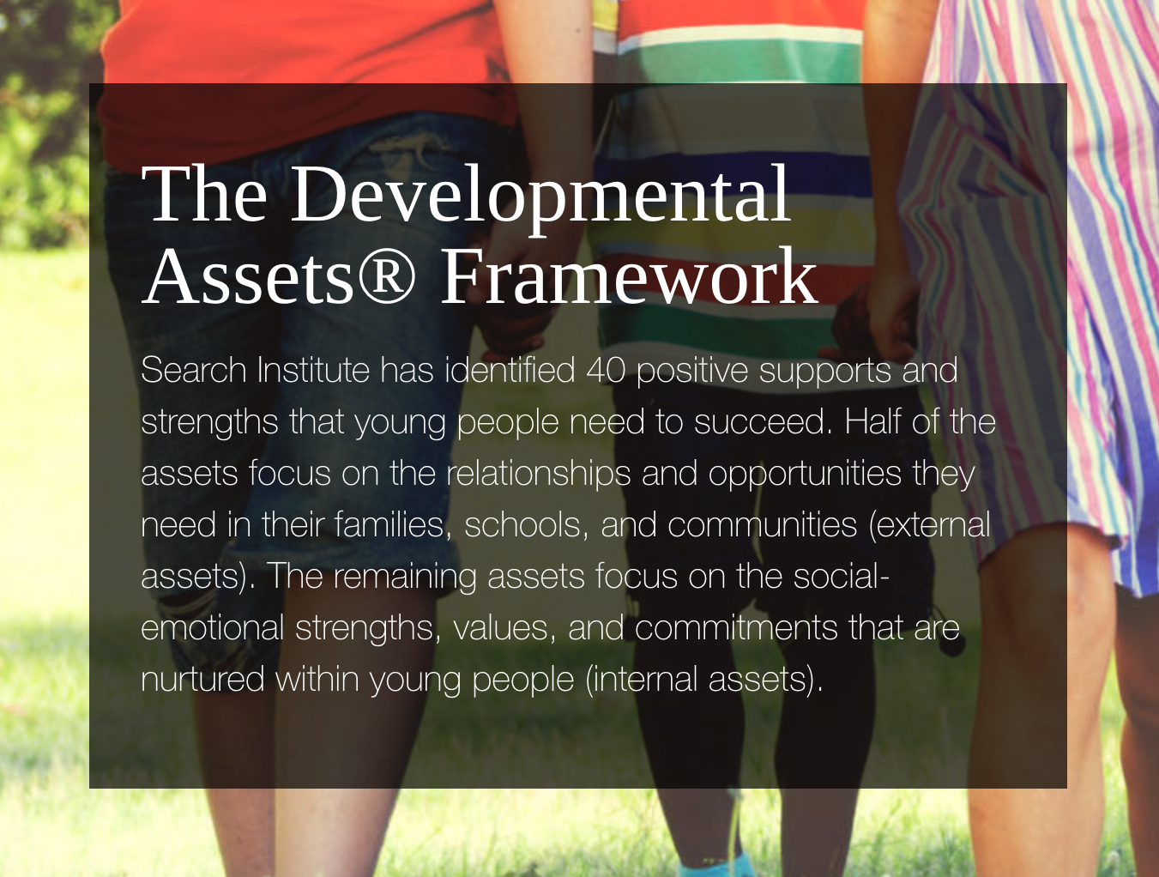

Slide 30
The Mindset of a Resilient Youth
Are optimistic and hopeful.
Feel special and appreciated in the eyes of others.
Set realistic goals and expectations.
View mistakes, hardships, and obstacles as challenges.
Solve problems and make decisions.
Have internal locus of control.
Believe you can and set out to solve problems.
Possess empathy.

Slide 31
General Conclusions
An early history of developing competence, along with supportive, consistent care, serves as a powerful and enduring buffer throughout childhood and increases probability of resilience.
The pathways that lead to resilience are complex.
There is a great need to map the interaction of personal and environmental factors.

Slide 32
General Conclusions
Longitudinal research needs to be conducted on a large scale and gene–environment focused.
We require a broader cross-cultural perspective.
We need to know more about individual dispositions and temperament as well as sources of family support.
(cont.)

Slide 33

Only then will we begin to know what makes the young of our species survive and thrive despite life’s adversities.

Slide 34

Adopt a Learning-To-Swim Mindset!

Slide 35

Goldstein’s Axiom
Through intelligent and ethical educational and therapeutic practices, we can foster self-discipline, mental health, resilience, and build educational proficiency in all children without stealing away their dignity and hope.

Slide 36

Our ancestors raised the next generation by drawing upon seven important instincts that evolved over tens of thousands of years in our species. Today, these instincts are more important than ever in preparing children for tomorrow’s successes.

Slide 37

We call these the Seven Critical Instincts of TENACITY!

Slide 38

TENACITY is defined as perseverance, doggedness, resolution, patience, endurance, and stamina.

Slide 39
Tenacity provides the mental and emotional fuel driving resilience and self-discipline.

Slide 40
These instincts are:
Intrinsic motivation
Intuitive optimism
Practical intelligence
Compassionate empathy
Virtuous responsibility
Genuine altruism
Measured fairness

Slide 41

A tenacious mindset may be comprised of seven instincts, but for these to develop and flourish, they require the nurturing and support of caring adults.

Slide 42


Questions?
Sam Goldstein
www.samgoldstein.com
info@samgoldstein.com
@drsamgoldstein
@doctorsamgoldstein
https://www.youtube.com/watch?v=isfw8JJ-eWM

Slide 43
Additional Resources Available by WPS:
  Telepractice Page: https://pages.wpspublish.com/telepractice-101
  WPS Content Hub: https://www.wpspublish.com/content-hub
  WPS Video Resources: https://www.wpspublish.com/webinars
  Part 1: Sustaining Your Resilience in Stressful Times: Guidelines for Pediatric Mental Health Professionals: https://www.youtube.com/watch?time_continue=3&v=vjBpcidSCs8&feature=emb_logo

