Slide 1
SERVING INDIVIDUALS WITH AUTISM Carrie Rogers-Whitehead | Niche Academy

Slide 2
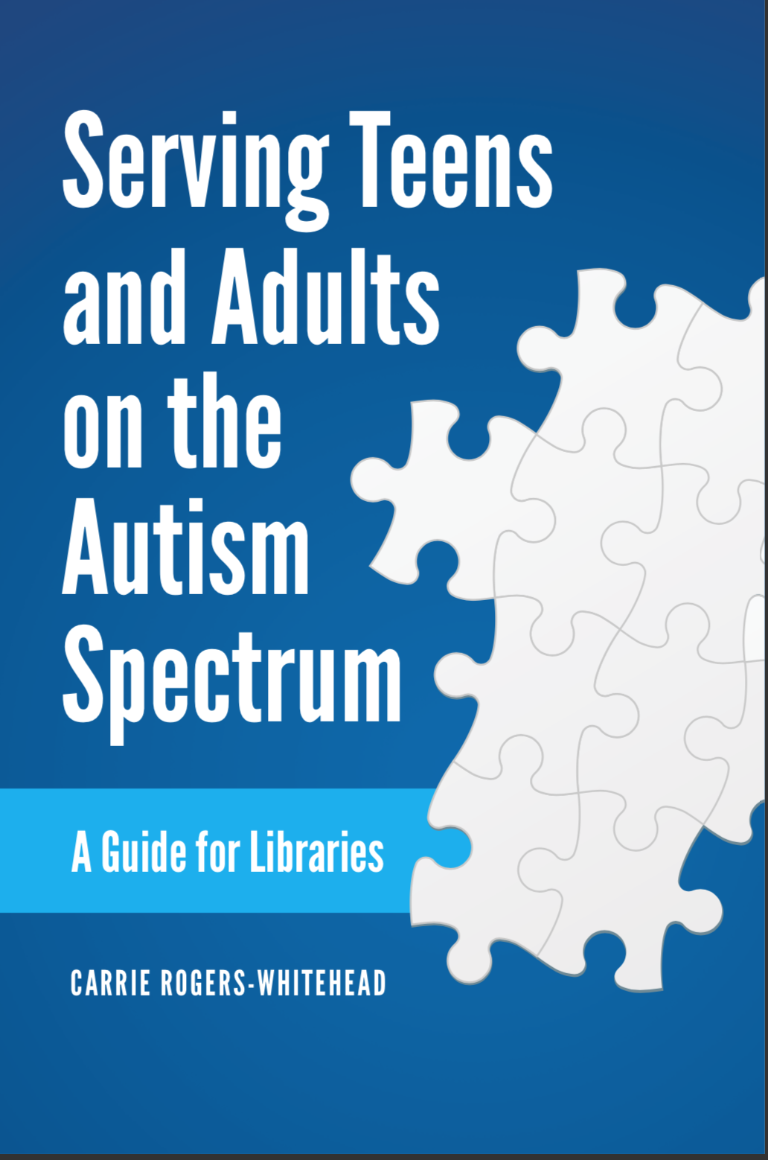
About Me
I created and ran both sensory story times and programs for older individuals. Libraries Unlimited will release my book to help librarians in June 2020.

Slide 3
What this webinar covers
What is autism? Comorbidity
Trends with older individuals on the spectrum
Comparing different ages and genders on the autism spectrum
Library programming ideas
Employment and volunteering
Resources and references

Slide 4
1.
What is autism?
Comorbidity

Slide 5
What causes autism
Vaccines do NOT cause autism
Some researchers estimate that over 1000 genes contribute to autism
Epigenetics
Older parents
Certain exposure to pregnancy in the womb

Slide 6
“Autism can’t define me. I define autism.” –Kerry mago
“Why should I cry for not being an apple, when I was born an orange, I’d be crying for an illusion, I may as well cry for not being a horse.” --Donna Williams

Slide 7
Comorbidity
Individuals with autism are more likely to have multiple health issues than the average population
Comorbidity refers to simultaneous conditions. One does not necessarily cause another.
Autism can mask other health issues.
Common comorbid conditions are: obesity, intellectual disability, epilepsy, depression, anxiety and more
Mental health conditions typically increase with age

Slide 8
6 out of 10
Adults with autism take medication for behavioral challenges such as depression, anxiety or psychosis

Slide 9
Service needs
Service Coordination
Health Care- particularly dental care
Transportation
Benefits/Insurance help
Social relationships
Education/Training
Residential Services
Employment Services
Communication Technology
Other services: including respite care, day programming with longer hours, recreation, in home supports
Service needs from the 2017 National Autism Indicators Report and listed in order of greatest need to less needs

Slide 10
2.
Trends in autism
The coming demographic wave

Slide 11
About half a million adults on the autism spectrum will legally become adults in the next decade.
--National Autism Indicators Report, 2017

Slide 12
2015 study out of the American Journal of Medical Genetics (AJMG) found that study after analyzing enrollment data of over 6 million children between 2000 and 2010 they found a 331% increase of autism

Slide 13
THE CLIFF
At age 21 adults with autism become ineligible for many federal services under the IDEA Act.

Slide 14
Lack of services
There is no federal agency that coordinates developmental disability services, it is a mix of local, public and private services
Medicaid and Supplemental Security Income fund some resources for adults. But there is little funding and many do not qualify for Medicaid.
This Photo by Unknown Author is licensed under CC BY-NC
Only about 2% of federal and private funding goes into research of transition and adults with ASD

Slide 15
3.
How does autism present?
Male vs. Female and Old vs. Young

Slide 16
Older individuals with autism present differently

Slide 17
Older VS. Younger
Older
Alexithymia- Struggling with identifying one’s own emotional states and others
Restricted interests- but more age appropriate. i.e. computer hardware vs. Thomas the Train Engine
Comorbidity, particularly mood disorders and anxiety
Younger
More likely to engage in repetitive “traditional” autistic behaviors like flapping, twitching, stimming etc.
Less likely to engage in eye contact
Decreased verbal ability

Slide 18
Older children and teens do not develop autism, although they may be diagnosed later in life if they are high-functioning. Since autism diagnostic tools are still relatively new, many adults never received a diagnosis as children. Some adults may choose not to share their autism diagnosis.
This Photo by Unknown Author is licensed under CC BY-NC-ND

Slide 19
Male VS. Female
Female
Females diagnosed with autism tend to be more severely affected than males. Researchers theorize this is because more mutations are required to produce autism in females
Girls are harder to diagnosis than boys and researchers recommend more sex- specific norms for diagnoses
Male
More likely to have restricted interests than girls and their interests may be less socially appropriate. i.e. An interest in old coins vs. an interest in pop music
More likely to have repetitive characteristics i.e. hand flapping, stimming etc.
More likely to be socially isolated than girls

Slide 20
Neurodiversity movement

Slide 21
4.
Library programs and services
How can libraries meet the needs?

Slide 22
What can libraries provide? Education/Training Employment Services Day Programming – from the 2017 National Autism Indicators Report

Slide 23
THREE SKILLS
TO FOCUS LIBRARY PROGRAMS
Teamwork
Transitions
Social Skills

Slide 24
INCORPORATING THESE CONCEPTS
TRANSITIONS
Set a timer
Use a visual clock
Create a picture schedule (look into Boardmaker)
Give reminders and warnings
TEAMWORK
Divide into small groups
Think. Pair. Share.
Set a common goal for the group (i.e. creating something together)
Share a piece of equipment like a computer
SOCIAL SKILLS
Ask them to share what they are doing
Inquire and check in on their feelings
Have them introduce themselves to the group
Communication can be nonverbal as well as verbal

Slide 25
Other program ideas
Next Chapter Book Clubs
Developmental councils around the country offer volunteer-run Next Chapter Book Clubs. Libraries can host them.
Autism Social Clubs
Provide a safe place where people on the spectrum can gather and talk.
Interest-specific clubs
These don’t have to be autism-specific, but a class on a specific type of interest can attract individuals on the spectrum which share that interest.
Host classes on guardianship
Guardianship and legal issues are important issues for caregivers of adults with autism. Also, navigating all the services for adults with autism are confusing.. Host a nonprofit or navigator that can help people navigate this.

Slide 26
Advice from an adult with autism, Eric Stoker
“Take them on a tour and stuff and explain"
With big crowds and stuff people with autism get nervous sometimes”
Talking slowly and explaining it a simple way. This is a fiction section and this is call numbers. Give examples”
“Have an acronym sheet for people with autism”

Slide 27
5.
Employment and volunteering
Beyond attending programs

Slide 28
55%
Approximate percentage of adults with autism that are employed

Slide 29
“We need to be a really good observer of an individual of where they have strengths, where are they at their best, what are their interests. We have a tendency with those students to put them in these menial jobs...we don’t want to limit our students with disabilities to those three areas.”—Lavinia Gripentrog, Transition Specialist
The 3Fs: Food, Filth and Flowers- the 3Fs
Students with autism can get pushed into these areas
This Photo by Unknown Author is licensed under CC BY-SA-NC

Slide 30
HOW CAN WE MAKE EMPLOYMENT MORE INCLUSIVE?
NOISE CONCERNS
Libraries can be noisy, particularly in programs.
Library children’s programs can be additional noisy and frenetic
INTERVIEWING
Provide extra time for interviewing
Understand that things like writing with a pencil, or speaking to a group can be intimidating.
PARTNER
Partner with government and nonprofit services. There are programs that provide compensation for employing individuals with disabilities.

Slide 31
Volunteering
Volunteering Ideas
Program set up or take down
Storytime prep
Shelving, facing out books
Greeting at doors and at programs
Computer assistance
Co-presenting programs, serving on committees

Slide 32
THANK YOU!
Any questions?
You can find me at:
https://respons-ability.net
carrie@respons-ability.net

Slide 33
References
Remnick, Noah. “The Coming Care Crisis as Kids with Autism Grow Up,” The Atlantic Monthly, February 20, 2019 https://www.theatlantic.com/family/archive/2019/02/lack-services-adults-autism/582586/
Roux, Anne M., Shattuck, Paul T., Rast, Jessica E., Rava, Julianna A., and Anderson, Kristy A. National Autism Indicators Report: Transition into Young Adulthood. Philadelphia, PA: Life Course Outcomes Research Program, A.J. Drexel Autism Institute, Drexel University, 2015.
Roux, Anne M., Shattuck, Paul T., Rast, Jessica E., Anderson, Kristy A. National Autism Indicators Report: Developmental Disability Services and Outcomes in Adulthood. Philadelphia, PA: Life Course Outcomes Research Program, A.J. Drexel Autism Institute, Drexel University, 2017.
Gokul Ramaswami, Daniel H. Geschwind, Chapter 21 - Genetics of autism spectrum disorder, Editor(s): Daniel H. Geschwind, Henry L. Paulson, Christine Klein, Handbook of Clinical Neurology, Elsevier, Volume 147, 2018, Pages 321-329
Presentation template by SlidesCarnival
Some Photographs by Unsplash

Slide 34
References
Okyle, Carly, “Almost Adult, With Autism,” School Library Journal, October 31, 2015 https://www.slj.com/?detailStory=almost-adult-with-autism
Cottrell, Megan, “Aging Out of Sensory Storytime,” American Libraries, April 29, 2016 https://americanlibrariesmagazine.org/2016/04/29/libraries-autism-services-aging-sensory-storytime/
Roux, A. M., Shattuck, P. T., Cooper, B. P., Anderson, K. A., Wagner, M., & Narendorf, S. C. (2013). Postsecondary employment experiences among young adults with an autism spectrum disorder. Journal of the American Academy of Child and Adolescent Psychiatry, 52(9), 931-9.
DC Developmental Disabilities Council https://ddc.dc.gov/page/next-chapter-book-clubs
http://www.familyvoicesofca.org/wp-content/uploads/2017/06/Natl-Autism-Indicators-Report-2017_Final.pdf
U.S. Department of Health and Human Services. Report to Congress: Young Adults and Transitioning Youth with Autism Spectrum Disorder. October 2017. Retrieved from the U.S. Department of Health and Human Services website: https://www.hhs.gov/sites/default/files/2017AutismReport.pdf

