Slide 1
Optimizing Instruction For Online Learners
A Niche Academy Webinar

Slide 2
Hello!
Christina Mune, MLIS
Associate Dean of Innovation and Resource Management @ San Jose State University
Libraries Supporting Online Learning: Digital Literacy, Open Access, and Local Connectivity
christina.mune@sjsu.edu or @bibliopathic

Slide 3
1.
Online Learning Landscape
What’s going on out there?

Slide 4
So many modalities ...
Hybrid/Enhanced
Courses that meet in person but are enhanced through online content or some of the class sessions are held online, either synchronously or asynchronously.
Flipped
Video instruction is provided before class to allow for hands-on in-class work and live Q&A.
Online Course
A single course taught completely online. The student may also have on-campus courses.
Online Program
All courses are online. Cohort may meet once a year or term but instruction, group work and assistance is all done virtually.
Micro-credentialing
Micro or nano degrees are programs consisting of 2-5 online courses focusing on specific skills, usually related to technical professions.
MOOCs
Massive Open Online Courses can be offered by universities, non-profit or for-profit orgs. Large numbers of participants from around the world join a single synchronous or self-paced course.

Slide 5
33%
58.9%
633
100 million
of post-secondary students are enrolled in an online course
of high schools offer virtual courses
Micro-credentialing programs
MOOC participants so far

Slide 6
2.
Scanning
What’s happening where you are?

Slide 7
Know your surroundings
Instructors designing flipped courses?
Online degrees and certificates?
MOOCs or micro-credentialing?
What’s in the pipeline?
Do you have online learners in your community looking for access and help?

Slide 8
Principle of Least Effort
Let it guide you!

Slide 9
Principle of Least Effort
Keep it simple
Make it fast
Take it to them

Slide 10
3.
Engaging
Are you making content that speaks to online learners?

Slide 11
Content considerations
Learning Modules
Tutorials
eResources & Open Access
Adaptable learning modules that can be embedded in the LMS, LibGuides, open web.
Videos, GIFs, textual how-tos that are part of modules, in guides, on the web.
Collections and resources that are available in real-time to online learners with varying access privileges.
1
2
3

Slide 12
Learning modules
Adaptable, reusable, consistent
Create in all kinds of platforms
Small snippets of content that can be combined to address learning outcomes
Visual and textual
Should include self-assessment

Slide 13
Need to consider:
Accessibility (W3.org)
Transcripts and Translations (know your populations)
See: Universal Learning Design
Also …
Responsive Web Design

Slide 14
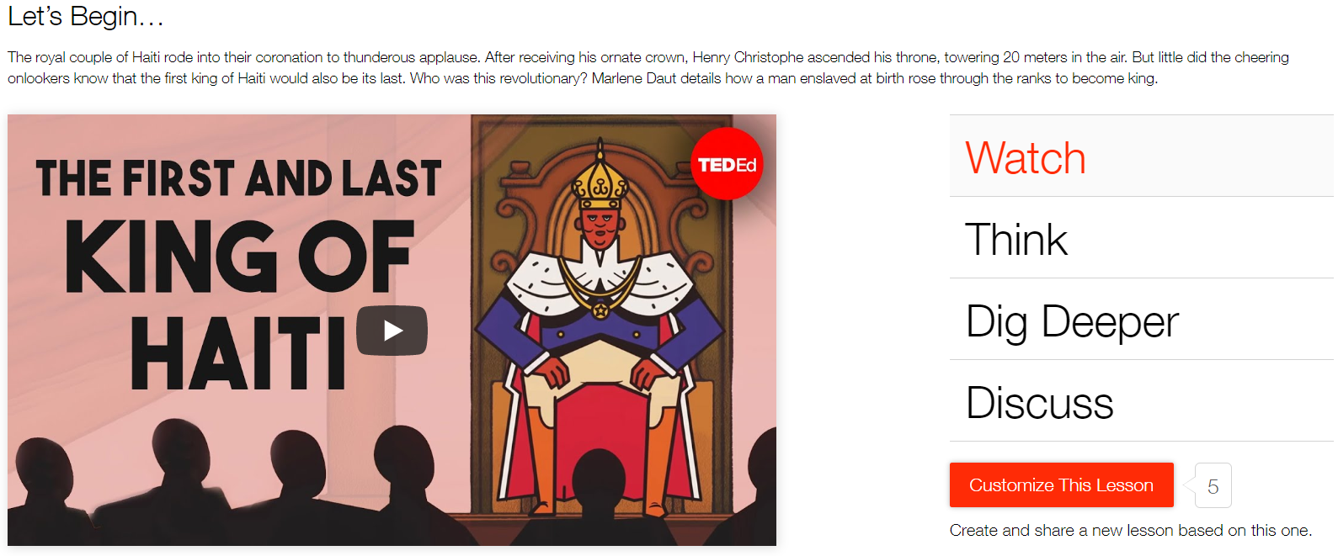
Ted-Ed module

Slide 15
Map to ACRL standards
Understand nature and extent of information needed
Writing a Thesis Statement
Finding a Topic
#1
Assess information effectively and efficiently
Searching Better, Faster
Finding Scholarly, Peer Reviewed Articles
Finding Primary Sources
#2
Critically evaluate information and its source; incorporate into knowledge and values
Scholarly vs Popular vs Trade/Professional
Identifying Bias and Fake News
Evaluating Sources
#3
Use information effectively to accomplish a specific purpose
Writing an Annotated Bibliography
Writing a Literature Review
Creating a Whitepaper
#4
Understand economic, legal and social issues around information and its usage
Citing Sources
Avoiding Plagiarism
Copyright and Fair Use
#5

Slide 16
Content considerations
Adaptable Modules
Tutorials
eResources & Open Access
Adaptable learning modules that can be embedded in the LMS, LibGuides, open web.
Videos, GIFs, textual how-tos that are part of modules, in guides, on the web.
Collections and resources that are available in real-time to online learners with varying access privileges.
1
2
3

Slide 17
Video tutorials hints
Fast
Between 45-90 seconds long
Less than 50% of viewers will get the end of a 3 min video
Easy
Array of short vids to choose from
No library jargon in the title - is “library research” a real thing?
“How to” comes first
Where they are
In the LMS with course content
On YouTube (searchable tags and titles!)
Niche Academy, TedED, LibGuides, websites

Slide 18
Considering GIFs
Fast
Very short, repeating moving images
Natural breaks between tasks
No scrubbing needed to find what they want
Easy
Does no rely on clicking a link or thumbnail
Loops until you move on
Easy to make - EZGif or ?
No voiceovers required; Can be made with existing videos
Where they are
GIFs are embedded almost anywhere as images - just plop them into any help site
Easy to share via social media

Slide 19
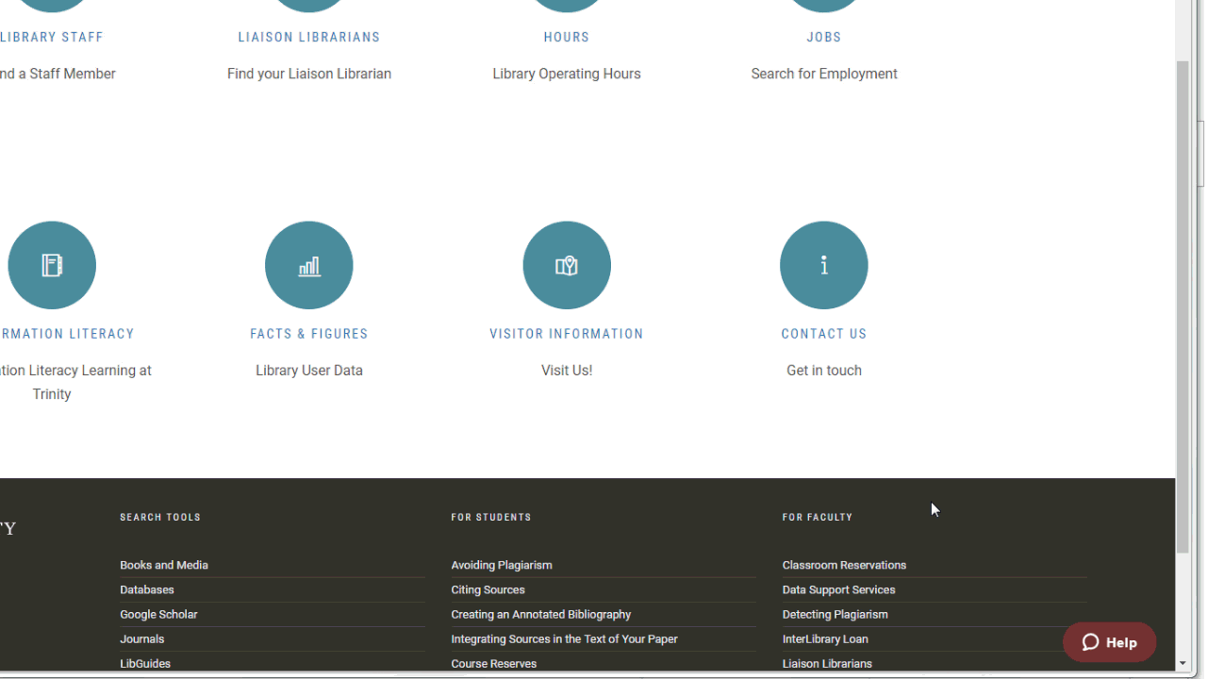
Coates Library, Trinity University https://lib.trinity.edu/contact-us/

Slide 20
Specific or Generic?
Specific
For very specific topics/databases/assignments
Great for LMS embedded content
Tool lit vs info lit
Dependent on access
Frequent updates
Can get very long
Generic
Info literacy not tool literacy
Does not depend on access
Less updates required
May not be enough for some users
Faculty may want more detail

Slide 21
Self-check quizzes
Self-check quizzes in the LMS, Guide on the Side, TedED or other platforms are great for self-efficacy
3-5 questions
Allow them to be repeated for 100%
Many can be made visual with images and GIFs
Collect stats, if at all possible

Slide 22
Gamification
Some student will respond to gaming engagement
Trivia and scavenger games (timed!) (flippity.net)
Retweets, likes, and # games
Points or prizes for answering peer questions

Slide 23
Content considerations
Adaptable Modules
Tutorials
eResources & Open Access
Adaptable learning modules that can be embedded in the LMS, LibGuides, open web.
Videos, GIFs, textual how-tos that are part of modules, in guides, on the web.
Collections and resources that are available in real-time to online learners with varying access privileges.
1
2
3

Slide 24
eResources and OA/OER
eResources
Purchase multi-user eBooks
Purchase online reference tools
Connect your ebook collection with assigned course materials (we publish a list of Library eBooks as Free Textbooks)
OA/OER
Catalog and promote OA resources such as OpenStax books, Directory of Open Access Journals; HathiTrust
Catalog and promote free government and non-profit resources and data sets
Help faculty find and incorporate this content as course materials

Slide 25
Copyright and Fair Use
Copyright
Understand Creative Commons licenses
Librarian certificates now available from CC
Challenge: Provide a video for faculty on copyright in under 90 seconds!
Fair Use
Many sites and LibGuides on Fair Use to reference and share
Suggest standards, with disclaimer
Important for eReader and eReserves consultations

Slide 26
3.
Communicating
How will online learners reach you?

Slide 27
“With the rise of the internet, the possibilities for studying at a distance have exploded. But the consequences for students are being ignored.
We are left to forge our own support networks and, feeling detached from our institutions, we struggle to motivate ourselves.
We must give ourselves a voice and force universities to acknowledge the existence and needs of isolated learners.”
Judith Vonberg, PhD Candidate, The Guardian, 2015
Notes:
Being ‘at’ university: the social topologies of distance
students
Sian Bayne • Michael Sean Gallagher • James Lamb
Published online: 3 September 2013
Springer Science+Business Media Dordrecht 2013

Slide 28
Communication channels
Website
LMS
Social Media
Indexed on Google, your website is where many learners will land with a simple search.
Integrated into course content where all the “important stuff” is.
Community space where learners are already spending a lot of time.
1
2
3

Slide 29
“Using a library web site to access resources should not be more trouble than it is worth; otherwise, users will have no qualms about turning to the open Web.”
Dominguez, et al., 2015

Slide 30
Website considerations
Easy to find on Google
Easy to make accessible
Links to all the good stuff
Best search box front and center
Google Scholar with library links set can be configured on the homepage

Slide 31
Website considerations
Beware the “Distance Services” page
Student don’t search for “distance services” on your website (check your analytics!)
Provide info on the right pages, where they go first
Target pages to online programs/courses, specifically - student identify with their program
Online Learners use mobile devices (like everyone else)
If the pages online learners use most often are not optimized for mobile, you may be doing it wrong

Slide 32
Virtual reference
Older studies show that far-campus users prefer email and LibAnswers for reference
Recent proactive chat widget case studies show that prompted virtual chat blows everything else out of the water

Slide 33
101%
74% versus 57%
93%
Increase in chat questions at UT Arlington after implementing a proactive widget (San Jose State experienced similar results).
High level reference questions using proactive versus patron-initiated at John Carroll Univ.
Of proactive chat widget users at Penn State found it helpful for database searching.

Slide 34
Answering virtual reference
Manage increase in services with peer reference help
Peer reference services have shown to be effective and have high rates of satisfaction
Virtual reference = virtual internships (may be better than 24 hour consortial reference because you train them yourself!)

Slide 35
UXing the target population
Test your site on online learners
Survey students in all-online programs
Ask instructors in that program or that teach online to distribute surveys
Hold virtual focus groups
Online learner UX
Make sure you’re using online-only user personas
UX with an employee or student that completed or is working on an online degree or course

Slide 36
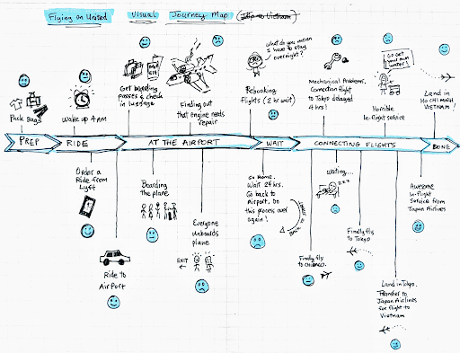
Journey map

Slide 37
Analytics hints ...
Analytics
Unique visitors, click paths, bounce rates
Internal analytics in LibGuides, Discovery system
Event tracking on web pages for external links like ILLiad and search boxes

Slide 38
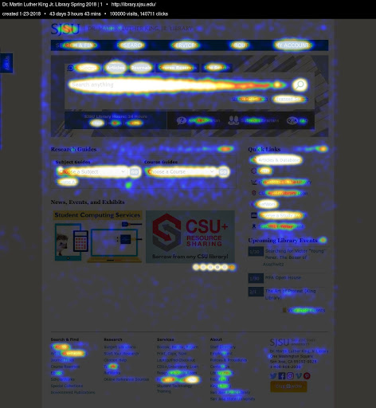
Heatmaps
See what’s hot on your website in a very visual medium that great for sharing

Slide 39
CrazyEgg
Get confetti maps by OS, device type, screen size, day of the week, etc.

Slide 40
Communication channels
Website
LMS
Social Media
Indexed on Google, your website is where many learners will land with a simple search.
Integrated into course content where all the “important stuff” is.
Community space where learners are already spending a lot of time.
1
2
3

Slide 41
LMS Pros and Cons
Pros
Interactions with librarian can be made for-credit
Q&A available with other course materials
Discussions can be reviewed by instructor for info lit assessment
Cons
Students don’t spend a lot of time in the LMS discussion boards. Most are 1 and done. Or post/reply and done!
Not optimized for mobile posts or alerts
Difficult to make available to later courses/cohorts. Does not contribute to the greater knowledge.

Slide 42
When discussing in the LMS
Answer as quickly as possible (alerts)
Post pre-emptive answers or have FAQs based on common questions per module/week
Get peers interacting by answering other student’s questions (maybe for credit!)
Ask for videos/GIFs/screenshots with their questions so the thread engages other learners

Slide 43
Communication channels
Website
LMS
Social Media
Indexed on Google, your website is where many learners will land with a simple search.
Integrated into course content where all the “important stuff” is.
Community space where learners are already spending a lot of time.
1
2
3

Slide 44
Social Media Pros and Cons
Pros
Real time communication
Media-centric (gifs, videos, screenshots)
Mobile-friendly
Part of users’ regular habits (where they are)
Can help create lasting sense of community; designed for peer learning
Available after class ends
Cons
May not fit student’s social media persona or reputation
Some users may not have/want an account for that platform
Instructors will likely not review or provide credit for social media interactions
Data and personal privacy concerns

Slide 45
Social media examples
YouTube | Create playlists for certain courses or skills; post links or embed in LMS and other platforms; answer questions in comments section; comes up easily in Google searches if tagged/titled correctly
Reddit | Create Q&A or FAQs on a private board that students vote on for usefulness; students can respond and discuss easily; can be made public after course for usage by later courses/cohorts
Twitter | Create course hashtag; answer questions fast and encourage peers to answer as well; easily searchable later; available for others to review
Mendeley/Zotero | Have students post useful citations in a group folder; link library resources; assess quality of citations after course; can be made available publically after the course ends

Slide 46
Build peer community
Have learners find evidence for their classmates opinions or observations
Create video responses to discussion posts to learn more about each other
Students can survey each other, review each other’s work or create assessments for the group.

Slide 47
Build peer community
Spark discussions or design assignments that encourage personal sharing of experience, culture, value or goals.
Design group activities that require roles. Every role is required to complete the project. This creates pride and trust in the group and self.
Leader, communicator, editor

Slide 48
4.
Assessment
You knew it was coming ...

Slide 49
Assessment hints ...
Pre-Assessment
Pre-surveys
Self-reflective statements
Peer evidence activities in discussion boards
Formative
Self-check quizzes
Citation managers
Peer review/editing
Summative
Post-Surveys
Quizzes
Term papers bibliographies
Citation managers

Slide 50
Thanks!
Any questions?
You can find me at:
christina.mune@sjsu.edu
@bibliopathic
Libraries Supporting Online Learning: Digital Literacy, Open Access, and Local Connectivity

