Slide 1
Thinking outside the collection box
How to Help Genealogists Now

Slide 2
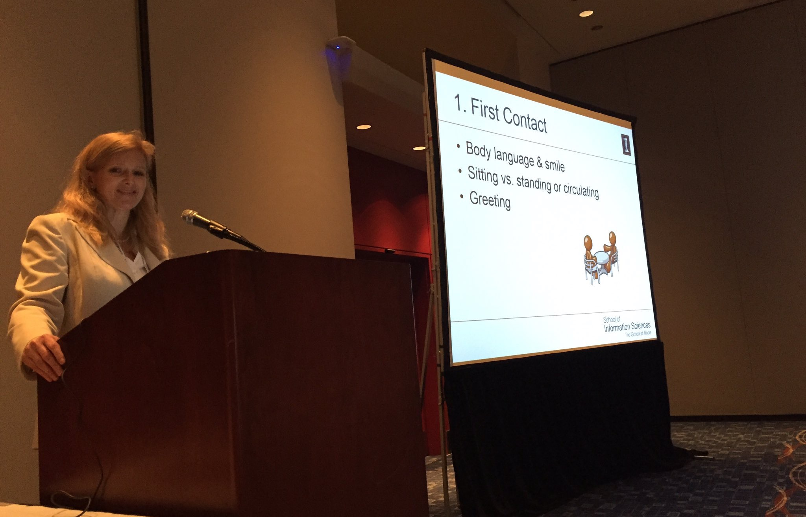
Presented by Nicole Wedemeyer Miller
Adjunct lecturer, School of Information Sciences, University of Illinois
Co-author of Fostering Family History Services: A Guide for Librarians, Archivists and Volunteers

Slide 3
Defining Genealogy and Family History

Slide 4
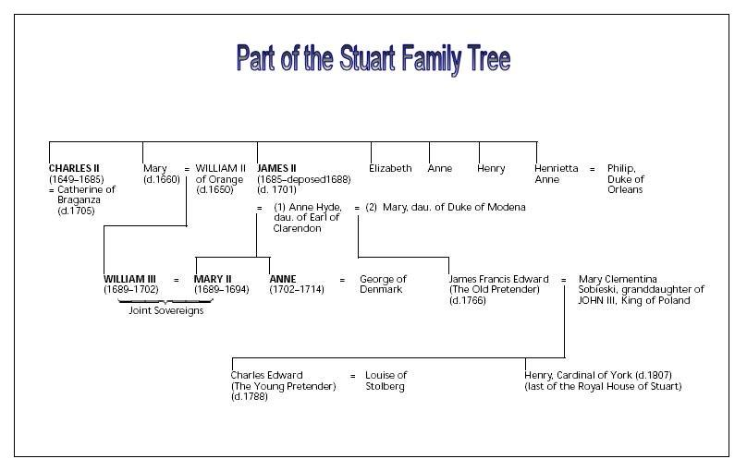
Genealogy
It’s the study of the vital events in a family that establish the family’s pedigree; or linkages between generations. It’s the who, what, and where.

Slide 5
Linear vs. Cluster
Pelagia Saitta
|
Dorothy Rita McAvin
|
George A. Wedemeyer IV
|
Nicole Alaine Wedemeyer

Slide 6
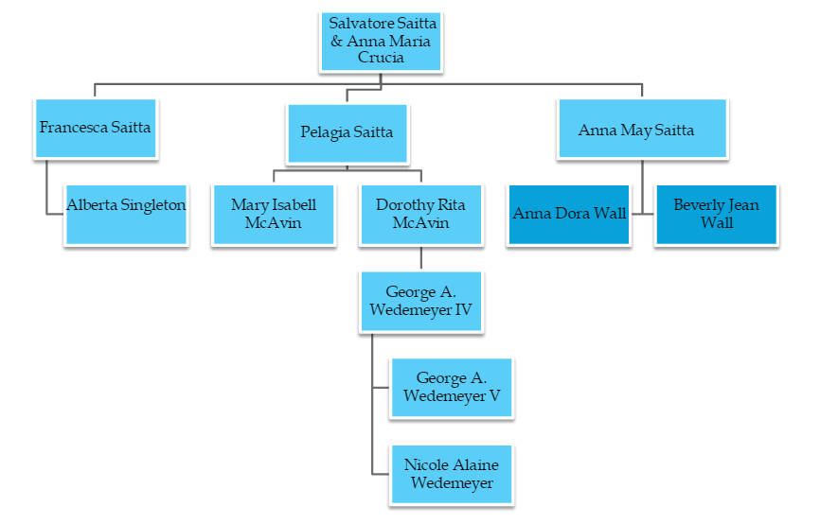
Cluster Approach

Slide 7
Best Practice
Work backwards.
Don’t skip generations.
Write down what you discover.
Seek information in sources, as many as possible.
Any source can be flawed—be skeptical.

Slide 8
What to help them with
Finding information
Understanding what they find—evaluating, analyzing, translating, etc.
Recording their conclusions

Slide 9
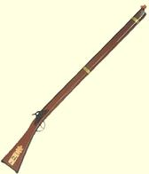

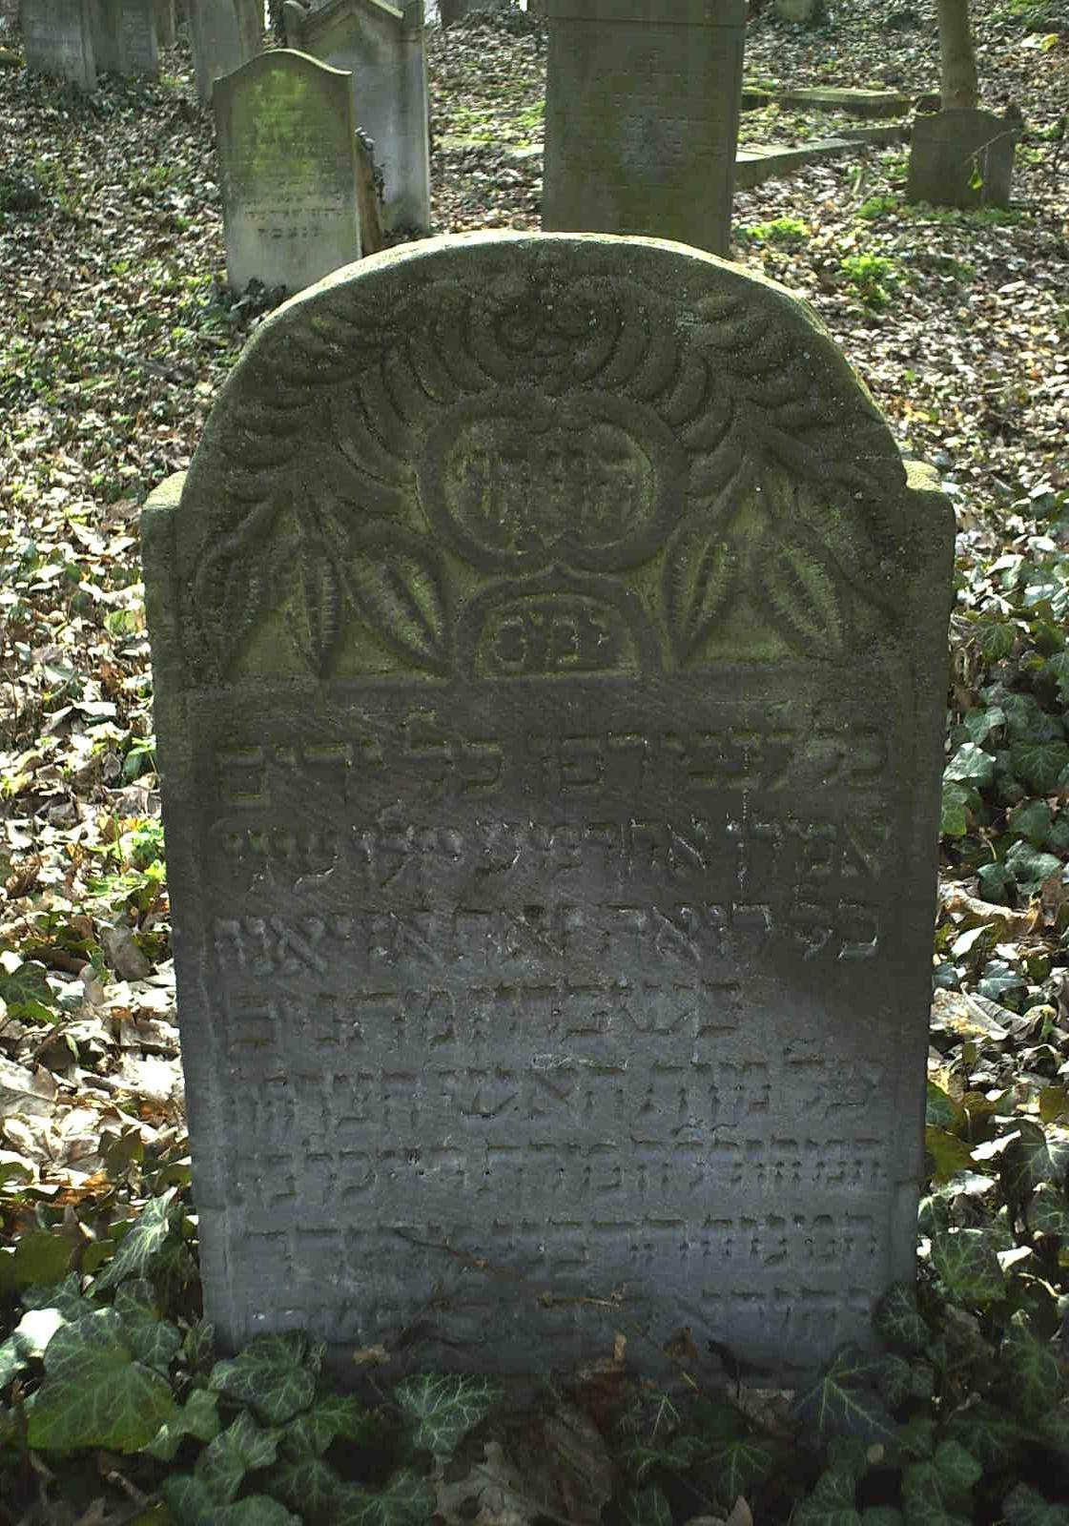
What’s a source?

Slide 10
Family history
It’s a more in-depth expression of genealogy. It interweaves information from a number of different fields into our ancestors’ life stories…It attempts to explain the how and why of our ancestors’ lives.
“Joseph "Horace" Ryburn was the second oldest of five brothers and attended University High School in Bloomington, Illinois. In 1892 he purchased 170 acres for $17,000 from Mr. Stewart, with a $5000 mortgage at four percent interest. He and his wife Estella moved to this property after they were married in 1895, and always called it "The Home Place." Horace and Estella's first two children were born there, Florence in 1898 and Madeline in 1900. In about 1902 the family moved to 1213 E. Washington in Bloomington, because Horace had heart problems and so gave up farming. He bought this house for $5000 and then made improvements such as installing French doors for the parlor, and hardwood floors upstairs. The home had gas lighting, but electricity was installed later. There was a water tank in the attic that used a hand pump from the basement to operate it. In the winter, the water went through the furnace to supply hot water. In summer, hot water was heated on the stove.”

Slide 11
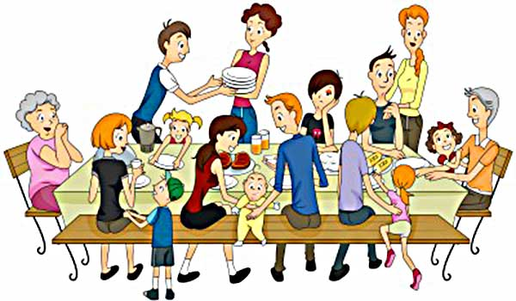
Asking relatives
Oral history interviews—try to prove the information.

Slide 12
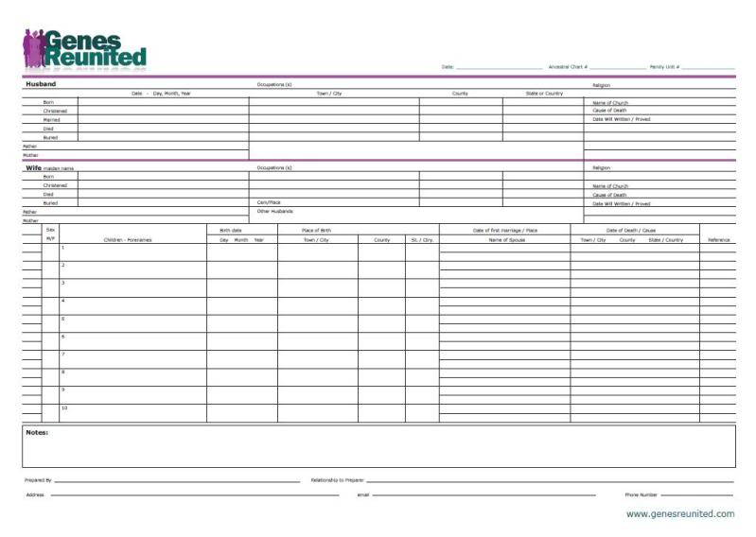
Recording & Organization
Traditional methods = printed forms
family group sheet

Slide 13
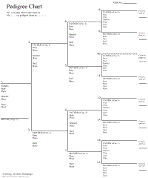
Pedigree chart

Slide 14
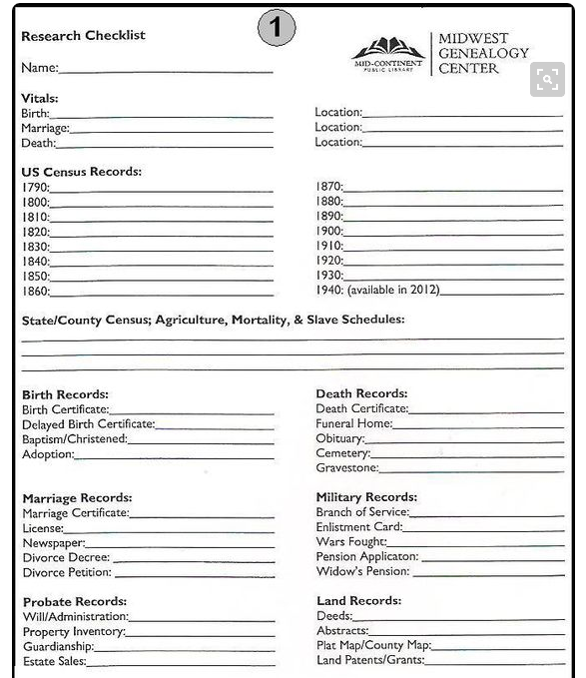
Source Checklist

Slide 15
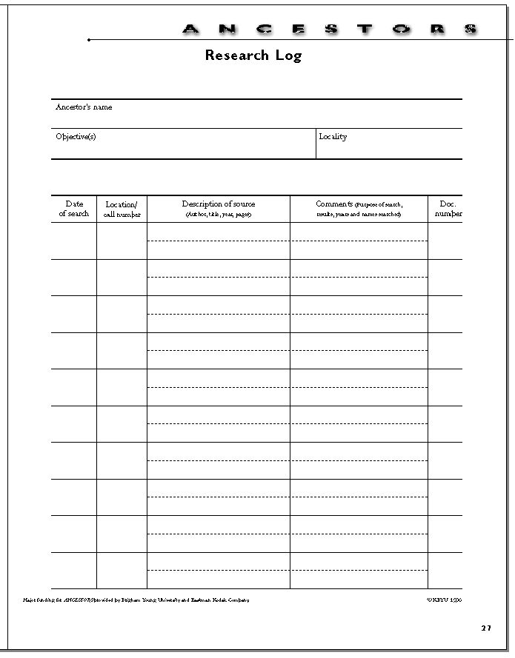
Research Logs

Slide 16
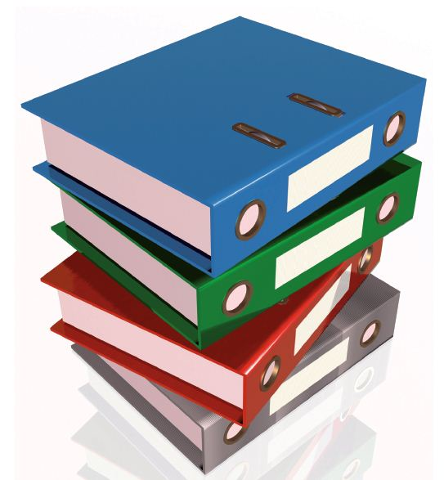
Two basic systems
binders

Slide 17

file folders

Slide 18
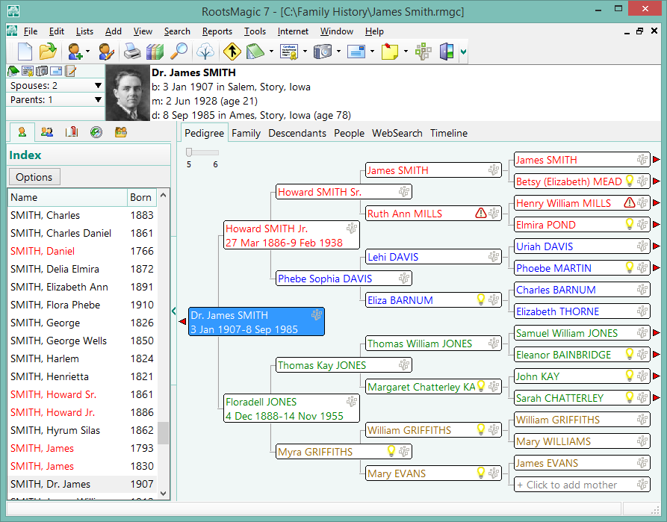
Digital Systems
Genealogical software programs

Slide 19





Online trees

Slide 20






Photo sharing & digital history sites

Slide 21
Much info on how to organize
Organize Your Genealogy: Strategies and Solutions for Every Researcher by Drew Smith
YouTube
Genealogy blogs

Slide 22
Beginning How-to genealogy books
United States—Genealogy—Handbooks, manuals, etc.
United States--Genealogy
Genealogy
Appendix A of Fostering Family History Services

Slide 23
Getting Them Started

Slide 24
Why isn’t my collection that important?
Most patrons initially need to know “How do I start?”
Patrons need to research in many, many locations and collections.
Patrons have some information at home.
Patrons can find some information online.

Slide 25
What to do with beginners
Give/sell FGS and pedigree charts.
Find them a basic how-to genealogy book.
Give them a list of genealogy links or show how to access online.
Refer to the Family History Center and other area research facilities.

Slide 26
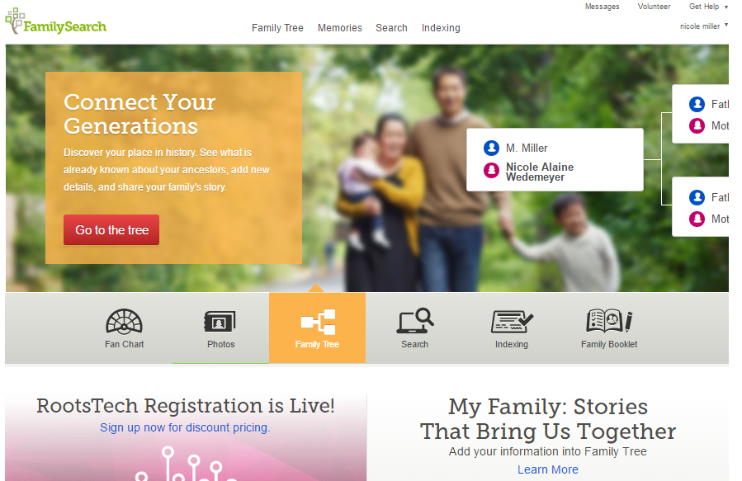
What does the LDS Church have to do with genealogy???

Slide 27
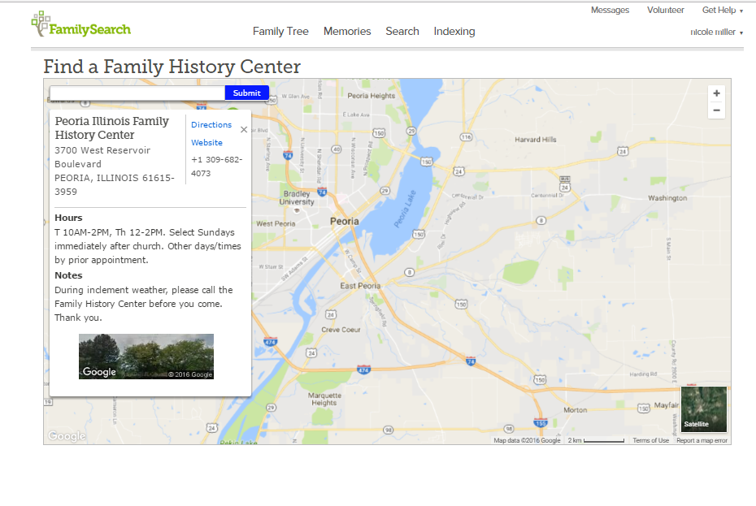
Click “Get Help” & “Contact us”

Slide 28
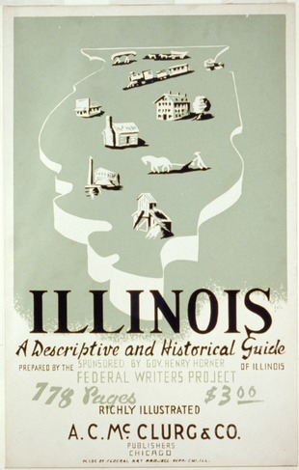
What else can you use besides the internet?
History
Encyclopedias, even old ones
American Heritage
973s, but also lurking in the travel books, 910s
Federal Writers’ Project American Guide Series

Slide 29
Biographical Sources
BGMI
Who’s Who in the…series
Professional & corporate directories
Specialized encyclopedias, such as those covering athletes, science, etc.
Full-length biographies, autobiographies, memoirs

Slide 30
Business & General Sources
City directories
Phone books
Vertical files
School yearbooks

Slide 31
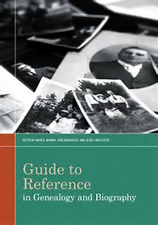
Guide to Reference in Genealogy and Biography

Slide 32

Government records and documents
Federal
State
County
Township/borough
Municipal

Slide 33
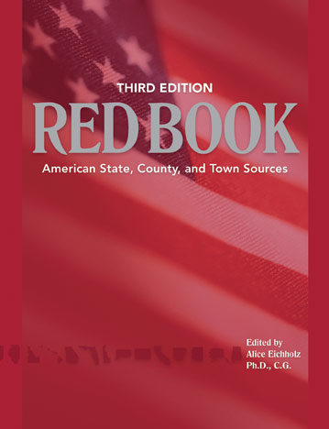
Ancestry Red Book, 3rd ed.
Accessible full text online on free part of Ancestry.com:
http://www.ancestrylibrary.com/wiki/index.php?title=Red_Book:_American_State,_County,_and_Town_Sources

Slide 34
Always check Red Book information online.

Slide 35

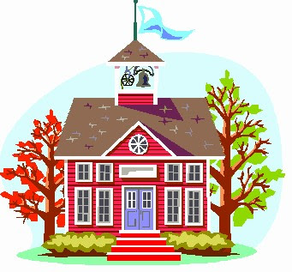

Non-governmental records
Religious institutions
Businesses
Social and fraternal organizations
Educational institutions
Commercially published books and periodicals

Slide 36

Questions?

Slide 37
Online information

Slide 38
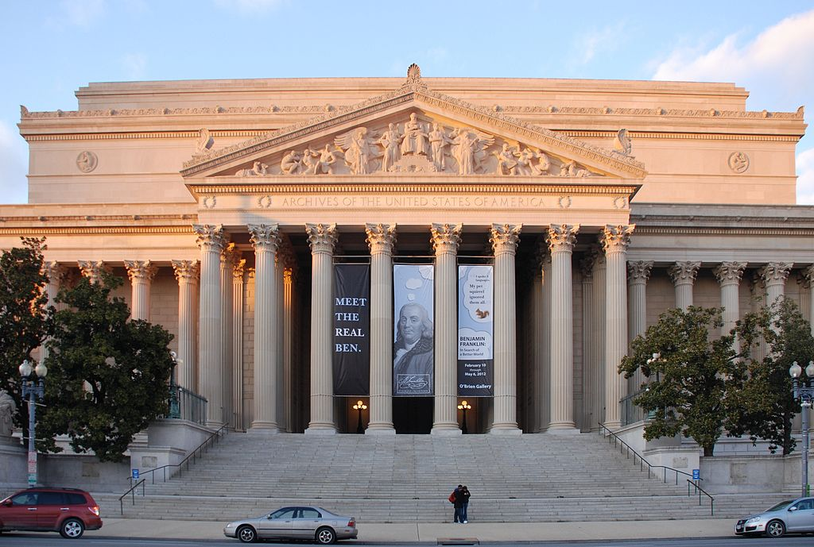
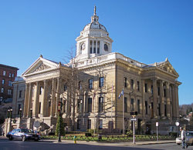
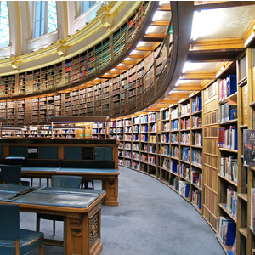
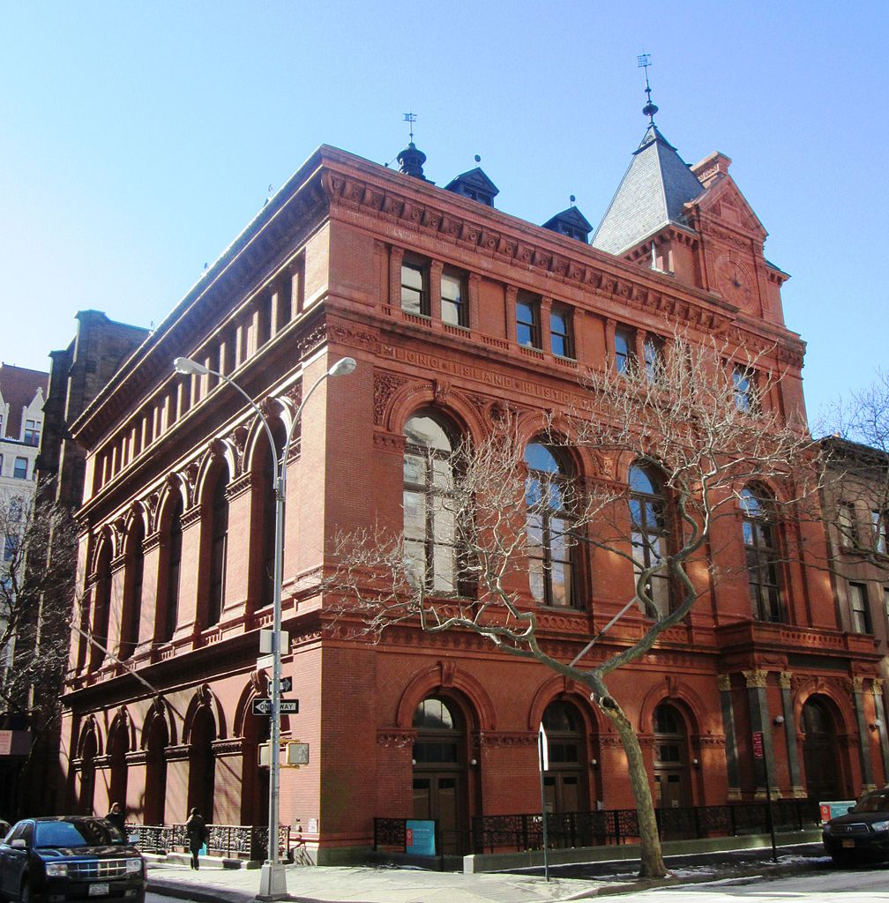
Online
Not everything is online.
Over 90 percent is still offline.

Slide 39
Major categories of websites
Subscription databases
Ancestry
Find my Past
My Heritage
There are many more…

Slide 40
Free websites--Institutional
FamilySearch
DAR
Newberry
Allen County Public Library in Ft. Wayne

Slide 41
Free websites—Volunteer & User-Input
Rootsweb
U.S. Genweb
Genealogy Trails

Slide 42

Free websites—by individuals
Joe Beine’s Death Records & Obit Index Listings
Tom Tryniski’s Digitized newspapers
Stephen Morse’s One Step Indexes

Slide 43
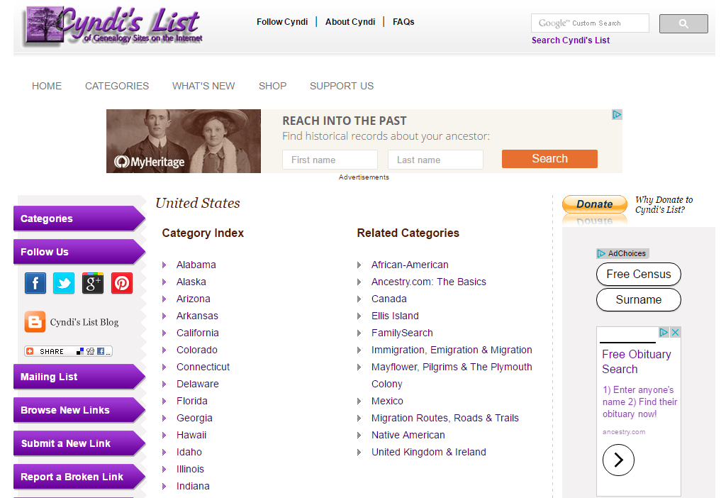
Best way to find websites?
Cyndi’s List

Slide 44
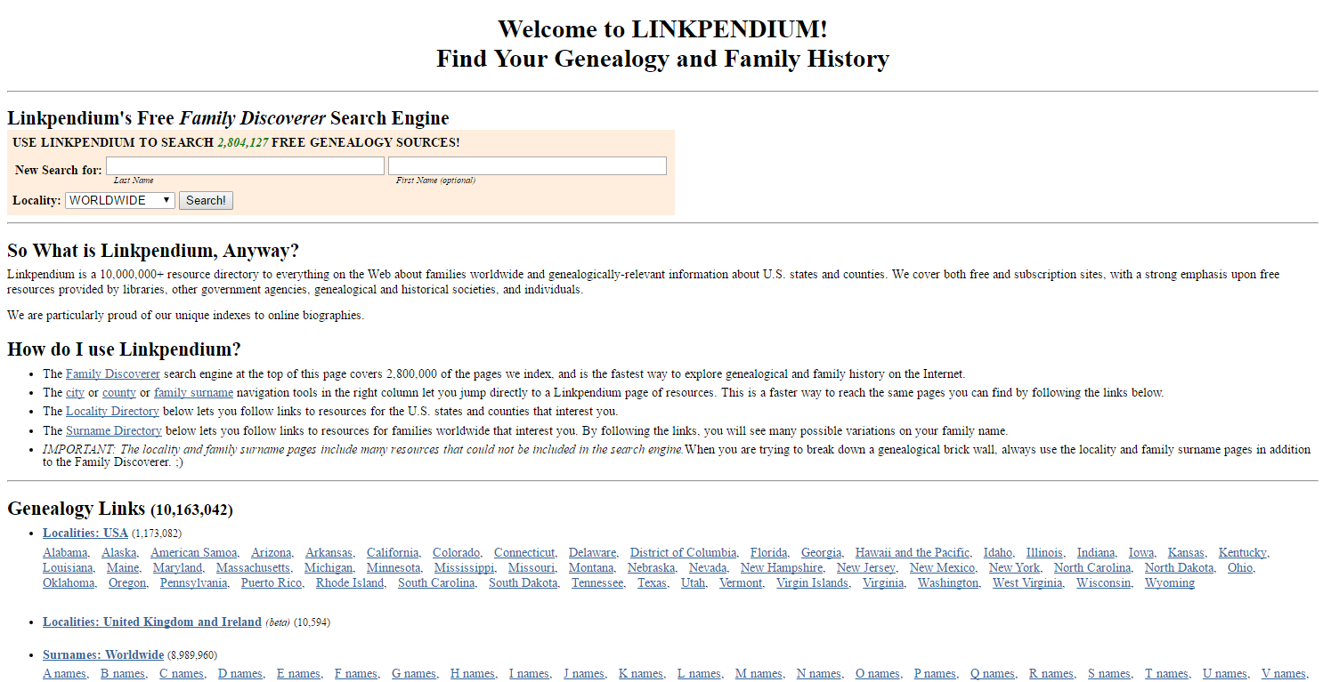

Slide 45
What else is there?
Federal Records
Immigration & naturalization
Military—www.archives.gov
Land patents—www.glorecords.blm.gov

Slide 46
Programming Ideas

Slide 47
Importance
It attracts attention to your genealogical reference service.
It is an efficient way to instruct several patrons at once—über reference.
It gets patrons in the door.
It can be low cost and low fuss.

Slide 48
“How to Grow Your Family Tree”
A basic how-to overview
Define genealogy & family history
Work backwards
Linear vs. cluster
Define a source
Discuss home sources
Recommend how-to titles and websites

Slide 49
Tell them about local & regional places to research
Presented by: a staff member, OR a volunteer from the genealogical society, DAR, or FHL.

Slide 50
The “Spotlight On” Program
Pick a resource: reference tool, archival collection, or online website/database
Teach how it’s best used
Present examples
Save 10-15 minutes for questions
Keep it at about an hour

Slide 51
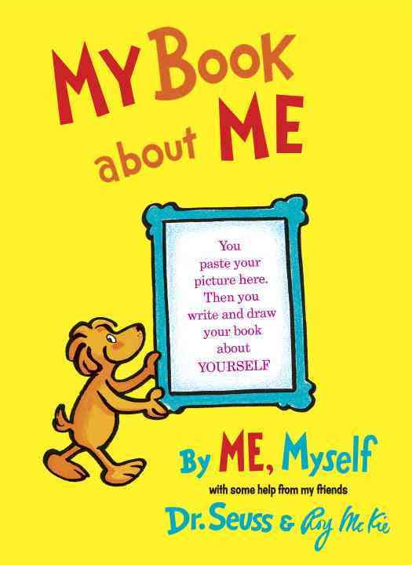
“The Story of My Life”
A children’s program
Create a template that kids fill in with information about themselves and their families
Use Dr. Seuss’ My Book about Me as inspiration.

Slide 52
“Ask Granny”
The materials for this program are free and will be emailed to you.
It can be held at the library, or at a senior center or nursing home.
If you encourage the participants to bring grandchildren, it’s an intergenerational event.

Slide 53
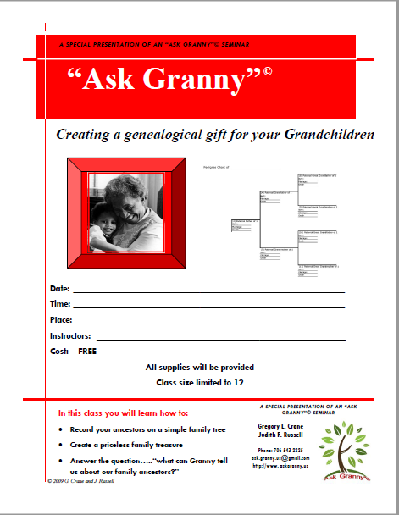
Ask Granny flyer

Slide 54
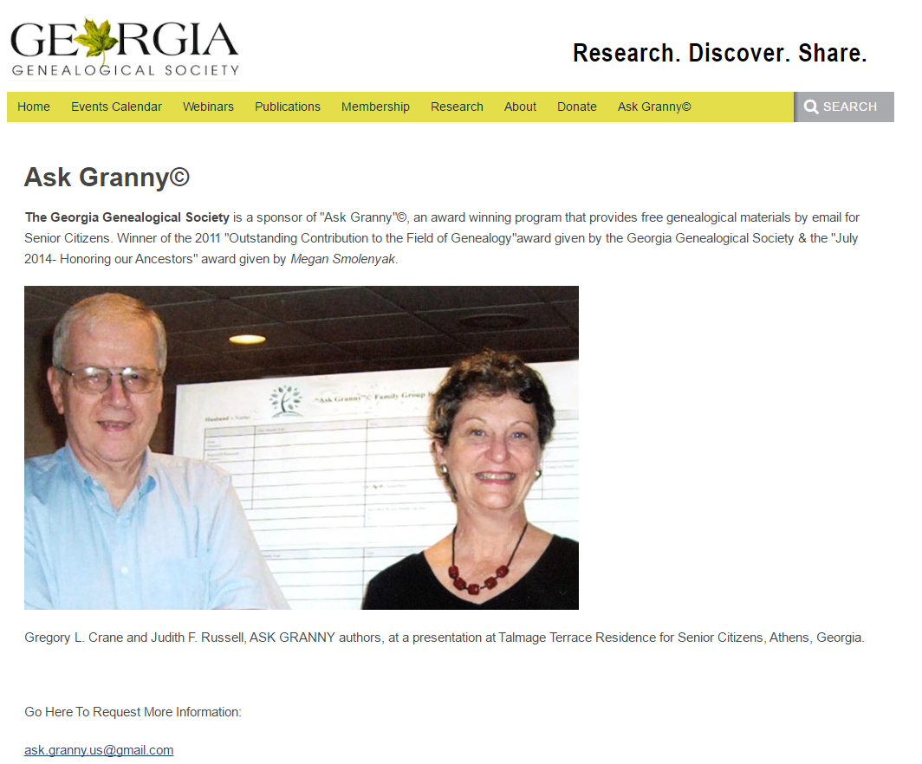
Email to request materials.
Ask.granny.us@gmail.com

Slide 55
Reaching Out to Ethnic Groups
Identify an ethnic group in your area, and design a program to help them to do their family history.
Identify where they can find information locally, and elsewhere in the U.S., such as an ethnic genealogical society.
Recruit someone to give an overview of record groups—religious officiant or a college instructor.

Slide 56
Sponsor with another local group.
Could lead to a fabulous oral history project.
Serve treats from ethnic restaurant/bakery.

Slide 57

Lagniappe
Genealib listserv
Dick Eastman’s blog
Adventures in Genealogy Education blog
Genealogy for Librarians Pre-conference

Slide 58
Questions?

