Slide 1
Mi-Corporation Mobility Panel
Lessons Learned…
Moderator: Gautham Pandiyan
Panelists: Chris DiPierro, Dir. Of Software Development
Dave Nakamura, Dir. Of QA
Mitch Hamelau, Prof. Svcs. Lead
April 9 -11
www.mi-corporation.com

Slide 2
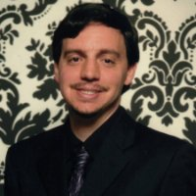
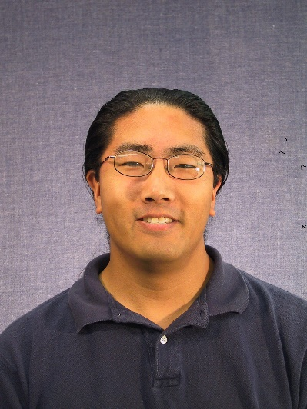
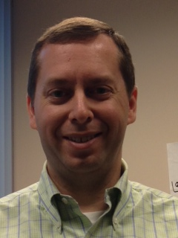

Slide 3

The Interrogation
Source: abacusmarketing.co.uk

Slide 4
Enterprise Mobility Exchange Survey

Slide 5
Thank you & Contact Us!
info@mi-corporation.com
919-485-4819
Keep the dialog going!

