Slide 1
New Release Announcements and Product Roadmap
Chris DiPierro, Director of Software Development
cdipierr@mi-corporation.com
April 9-11, 2014
www.mi-corporation.com

Slide 2
Overview
Product Announcements
Updated Products
Mi-Forms
New Products
Field Inspection Solution
Query Management Solution
Mi-Enterprise Apps
Notes:
Today I’m excited to have the opportunity to talk with you about the product announcements that Gautham’s touched on.
First we’re going to look at the updates to our forms platform Mi-Forms across the Client, Designer, and Server components.
And then we’ll start delving into the exciting new products that Mi-Co is announcing at the conference. This will include our field inspection solution, our query management solution, and our mobile application development platform called Mi-Enterprise Apps.

Slide 3
Mi-Forms v10
What’s new?
iOS / Android
Phone suitable UI option
Updates the current UI to be phone suitable
Batch finish from the menu
Windows
Improved touch support
Designer
Improved JavaScript editor
Improved FormBridge support
Notes:
Let’s start with Mi-Forms. If you’re new to Mi-Corporation, this is our forms platform that provides the ability to design a form in Mi-Forms Designer, deploy it to the Mi-Forms Server and then fill it in our iPad and Android clients, in our Windows client and on the web.
Today we’re announcing the launch of a phone based version of Mi-Forms for iOS and Android.
Additionally, as deployments have started to roll out on the iOS and Android platform, we’ve heard the need for users to send up multiple filled form sessions at once, and so we’re announcing the ability to do so in the next release of those clients
In Windows we took a bold approach to the UI to enable more screen real estate on tablet. This included initial support for touch based devices, but today we’re announcing improved support designed for touch only devices.
Finally, in the Designer we’re announcing a full featured JavaScript editor on par with the .NET editor and updates to our FormBridge support.

Slide 4
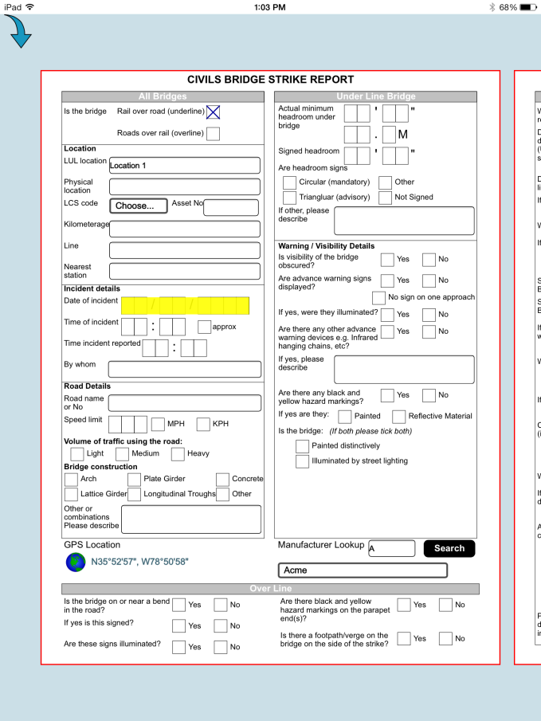
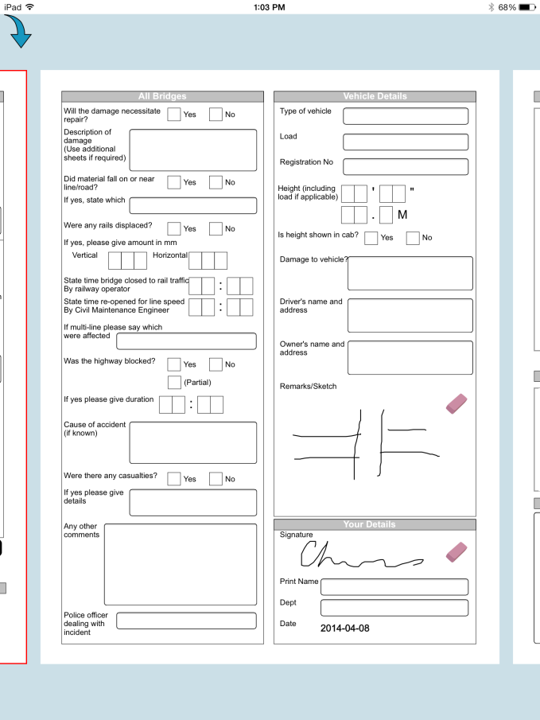
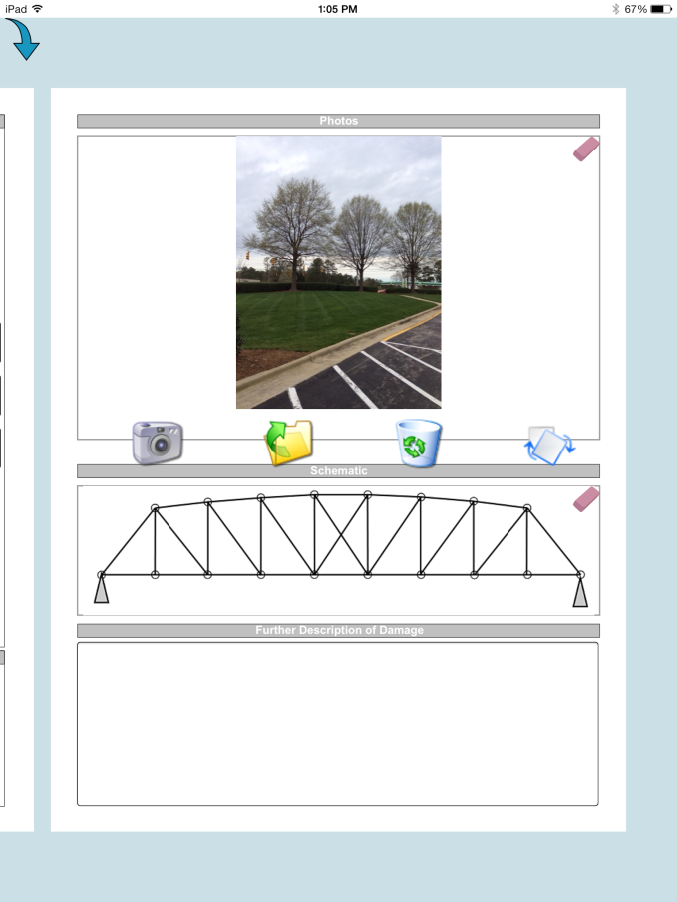
Mi-Forms v10
Notes:
First, let’s take a look at the UI changes for phone. If you’re familiar with Mi-Forms on the iPad and Android devices, then what you see here should be what you expect, an interface that we term “paper like”. However, if this is shrunk down on the phone, usability can be challenging.

Slide 5
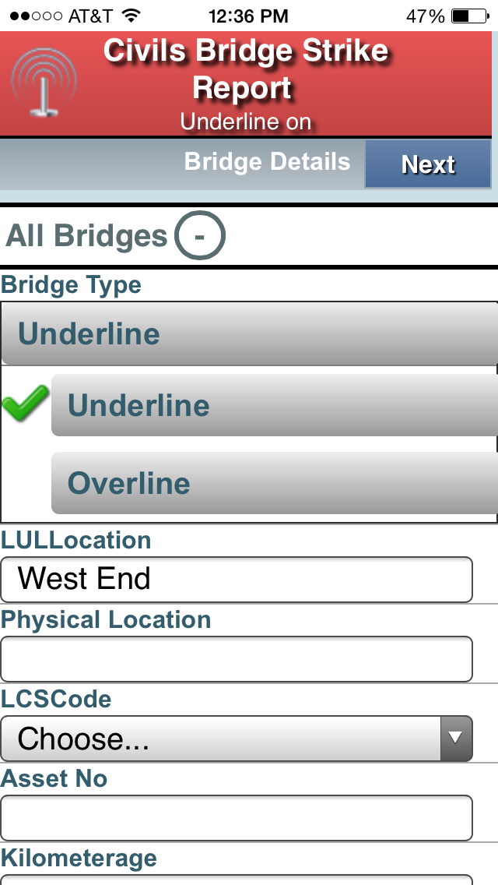
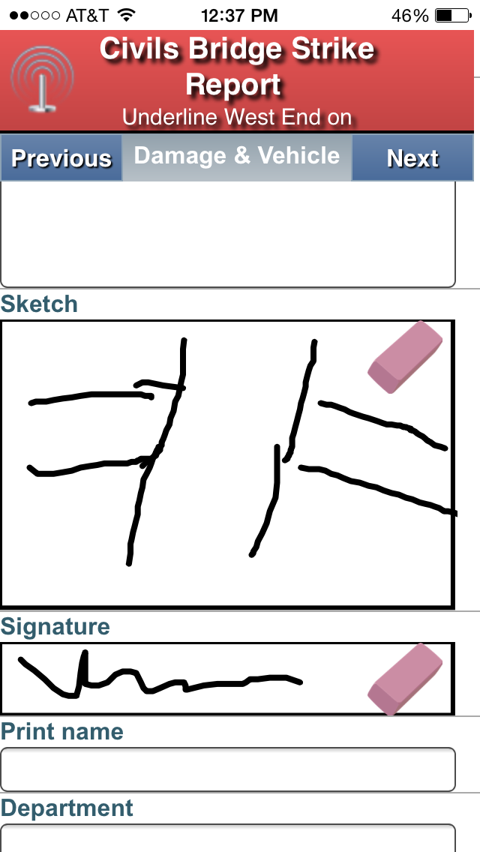
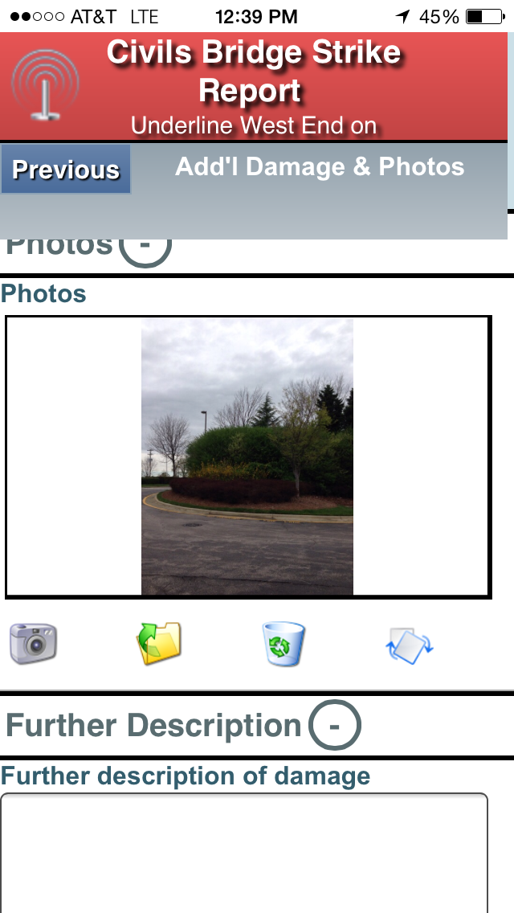
Mi-Forms v10
Notes:
And so instead what can now do is take that same form. You’ll see those same form pages here on this screen, but formatted in a way that is much more suitable for phone devices. There are large touch targets for checkboxes, suitable field sizes for text input, and there is the ability to group sections of a form’s page together to allow them to be collapsed. Overall a much better phone user interface experience.

Slide 6
Mi-Forms v10
App store
App will be available for iPhone!
Available for Android phones
User chooses the mode
Swap between paper-like and non-paper-like
Scripting
All JavaScript scripting works in both modes
Notes:
If we look at the details of how this works, first off the app will be available in the Apple app store for an iPhone. This is new in that until now you were only able to download it on an iPad. In the case of Android, if you have a suitable phone, it’s already available in the store, but obviously will now be better suited.
The actual display mode is chosen by the user. This means that even on tablets, users can use the non-paper-like interface if they’d like. This might be suitable for the smaller tablets, or just due to preference. And if they want on phones, they can use the paper like interface as well.
For those who saw our initial iPad offering, you may think this looks familiar, and indeed it is close to the same. But the big difference here is there’s no server dependency as there was in that initial release and all JavaScript scripting that works with the paper like layout works just the same here allowing for customization of forms.

Slide 7
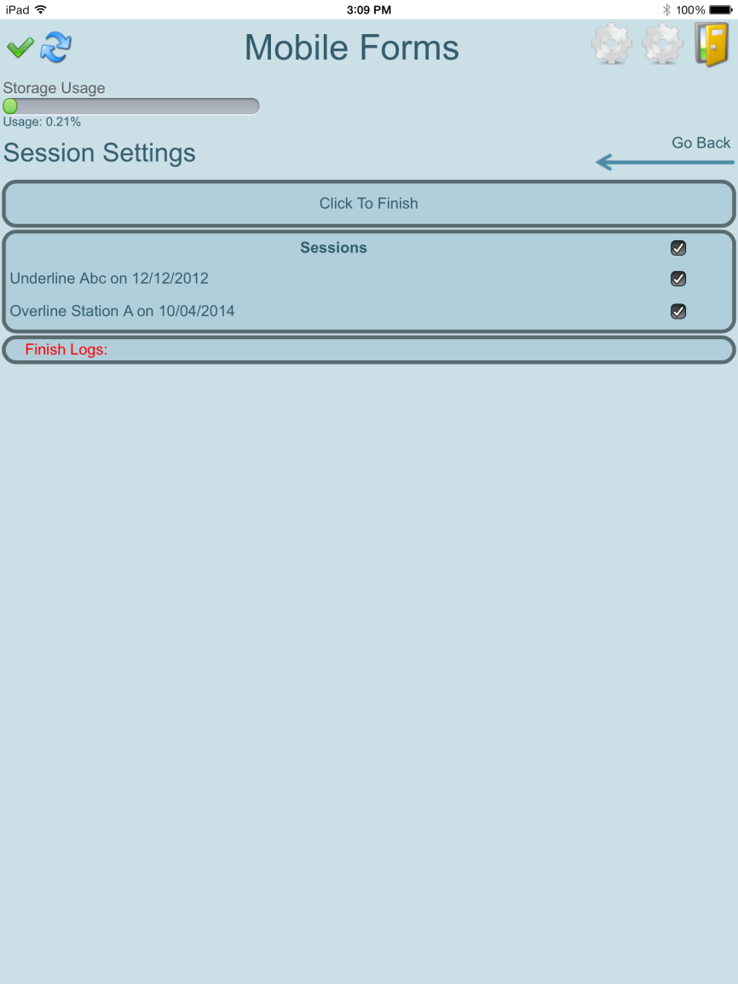
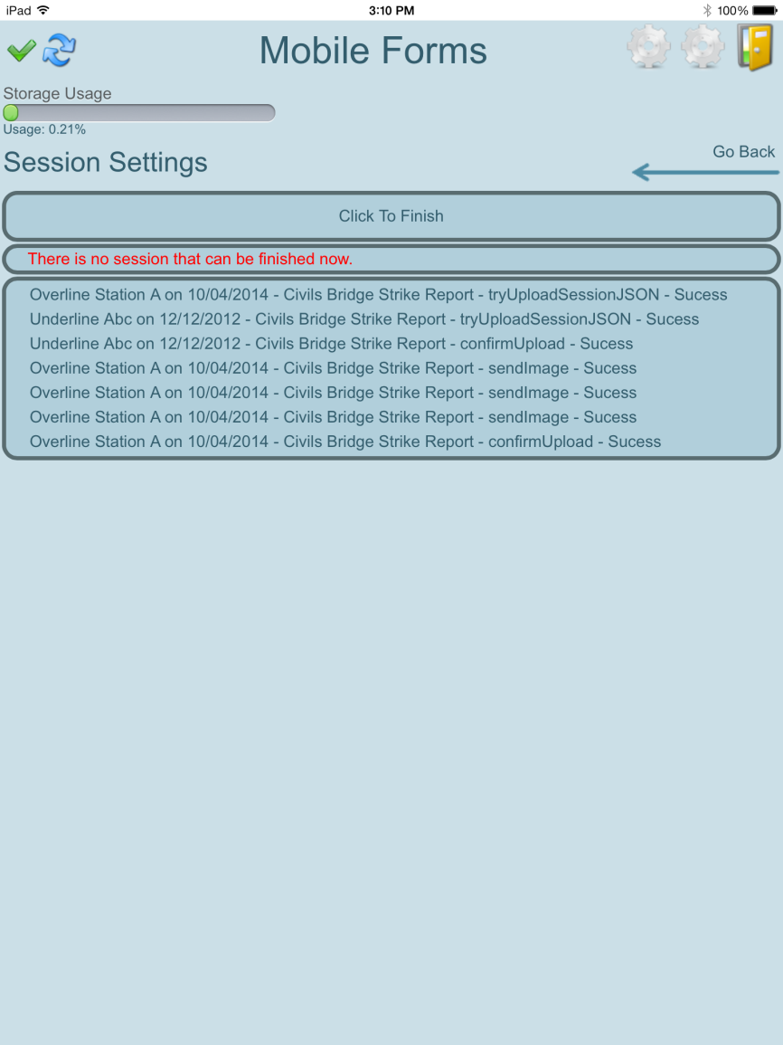
Mi-Forms v10
Notes:
Moving from the phone UI, we next look at the ability to better aid offline users. Currently, after capturing data in the field, if you want to submit them to the server for workflow and export, you have to navigate back to each one of them, tap finish and wait for it to upload. We can contrast that to the current Windows client where there’s a concept called “Finish Multiple” which uploads all applicable forms at once. We’ve expanded this same concept to iPad and Android.
While the UI here is preliminary, what we’re seeing is there are multiple sessions on the device available for finish. The eligible forms are those without validation rule errors. We can check one or more of them. In this case all of them are checked, and then click Finsih.
This takes us to a success/failure indicator showing in this case all the forms were successfully uploaded. The UI will be refined before release, but this should provide users with a better experience.

Slide 8
Mi-Forms v10
Current Windows touch methodology
Touch mode is selectable
Gesture mode allows zoom & pan
Mouse mode allows clicking on things
Ink mode allows ink anywhere
Current iPad/Android touch methodology
Touch behavior depends on where touch starts
Version 10 Windows touch methodology
Consistent with iPad/Android
Notes:
From iPad and Android we move to the world of Windows.
The current touch methodology is to allow the user to select which mode they want to use. Your finger starts in a gesture mode that supports zooming and panning. To change that, the user taps and holds, gets a context menu and then can choose either mouse or ink mode. In mouse mode, your finger checks boxes, sets the position of cursors in constrained text fields and generally just acts like a mouse. In inking mode, your finger is a pen across any field just like a stylus. This works, but it’s not conducive to switching modes quickly which can be necessary in a lot of forms.
By contrast on the iOS and Android client, where you start your touch determines what it does. If a text field is touched, it becomes focused. If a checkbox is touched, the value changes. If a freeform or image annotation is touched, ink is captured. And if you touch in an area with no fields, then you can zoom and pan.
With version 10 of Mi-Forms, the Windows client touch behavior will be the same. This will bring consistency across the platform and allow for efficient form filling using touch only devices.

Slide 9
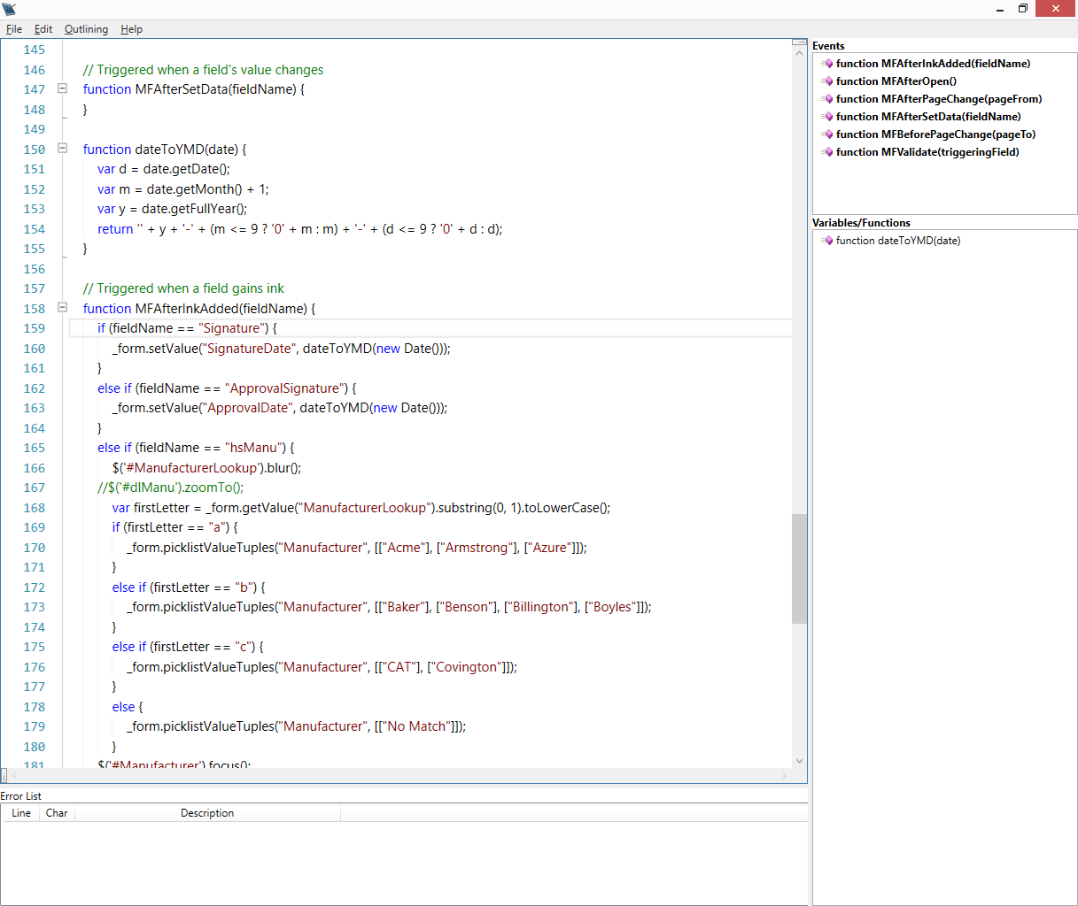
Mi-Forms v10
Notes:
Lastly in Mi-Forms, we visit the Designer. We have two improvements to talk about. Firstly, we’ve updated the JavaScript editor quite a bit. For those of you who have developed for the Mi-Forms platform for years, you know that we’ve had an embedded .NET script editor that included syntax checking for quite some time. For JavaScript scripting that’s possible with the iOS and Android deployments, we’ve been reliant on a simple text editor and realistically most of you have probably used Visual Studio or some other external editor.
Now in version 10 we’ve adopted the same technology used in the .NET editor to provide a full featured JavaScript editor. You’ll see there’s syntax highlighting, syntax checking, a tree view for event handlers and function navigation. This should make it much easier to work with form script for those platforms.

Slide 10
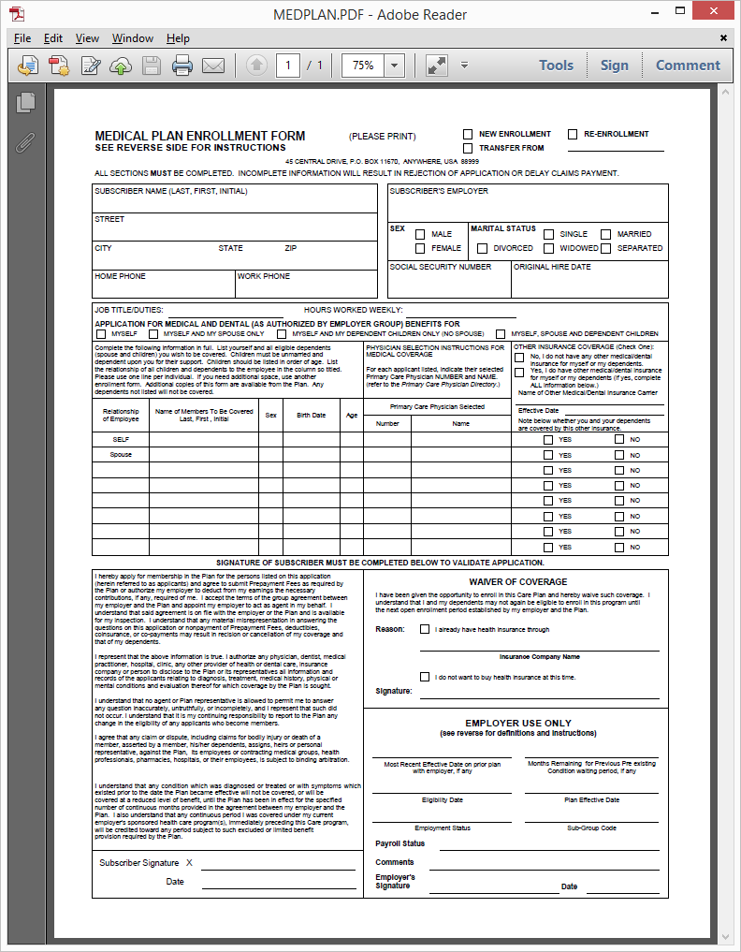
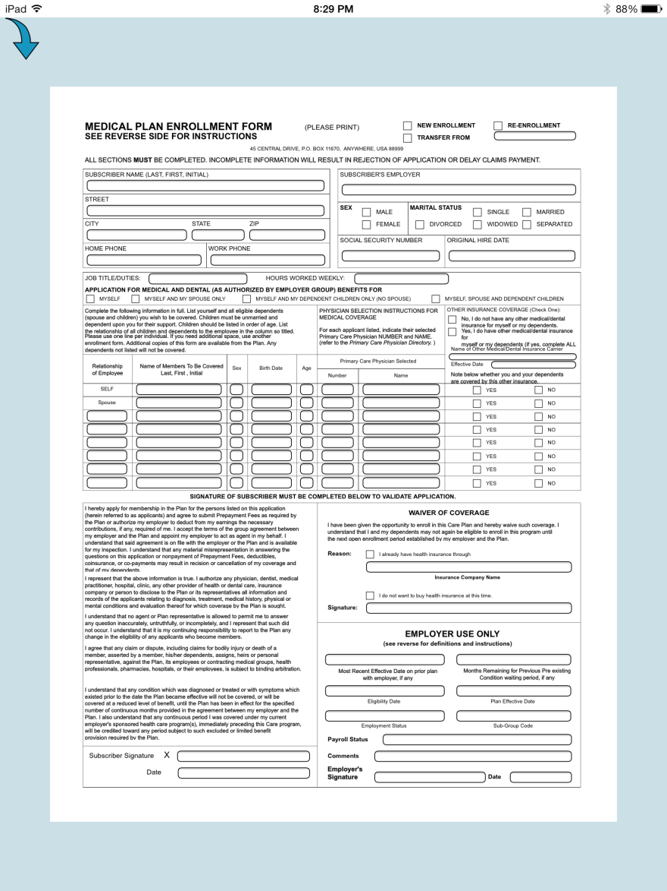
Mi-Forms v10
Notes:
Finally, we’ve updated our support for Texcel’s FormBridge. I won’t go too in depth here because Steve Myerow from Texcel will be talking to you later in the summit and has a demo booth over on the side where you can see it in action. But, basically we’ve supported some new features in our interface exchange language in order to provide a quicker and better experience importing forms, especially those targeted to iPad and Android devices. Please be sure to check out this offering from one of our long time partners.

Slide 11
New Products
Three new products from Mi-Co
Notes:
Ok, now that we’ve talked about Mi-Forms v10, let’s discuss our new product offerings.

Slide 12
Field Inspection Solution
What is it?
A data repository for collected inspection data with a mechanism to report on and chart this data
Solution components
Automated database creation from forms
Common database structure
Approval dashboard
Dashboard for charting and administration
Reporting tool set
Notes:
The first product I’m happy to announce is the Field Inspection Solution. This is a product targeted to the field inspection vertical whether it be government inspections, safety inspections, or really anything else that has a common structure where there’s a group of inspectors performing one or more inspection type.
What’s been created is a data repository for that collected inspection data designed to interoperate with Mi-Forms and a mechanism that enables reporting and charting of this collected data.
To do this, we’ve created five distinct components including a data repository that can be created through automation, an approval dashboard, a dashboard for charting and administration, and a reporting tool.

Slide 13
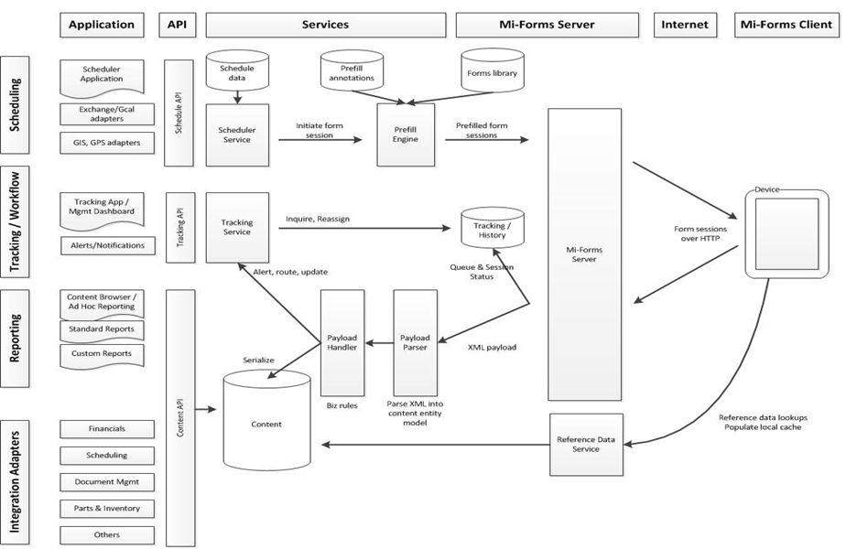
Field Inspection Solution
Notes:
First, if you look in you program you’ll see a diagram that looks something like this. This shows a block diagram vision of what we see this solution evolving to become. Most of what you see here should be familiar if it’s your industry. Data is captured via forms on a forms client on a mobile device, fed to the Mi-Forms Server and then distributed out into back-end databases and other similar systems. Most of the time reference data such as premises information is synchronized down to the devices as well. The rest of the diagram comes from integrations we’ve seen in this industry. Where we’ve chosen to concentrate for this first release is a data repository and reporting interfaces, but you’ll see that as we go forward scheduling and tracking mechanisms will fit into the picture as well.

Slide 14
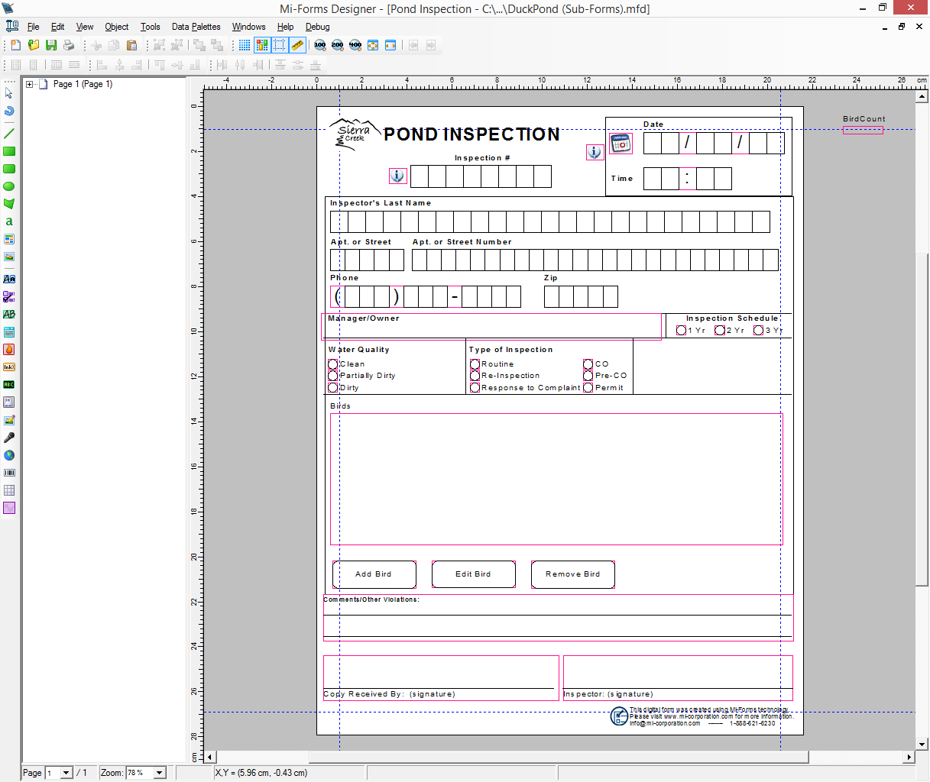
Field Inspection Solution
Notes:
So first off, an inspection will still start with the forms. In this case we’re looking at a sample environmental type of inspection. This will still be the mechanism of designing inspections of all types. Nothing is really changing here, and the expectation is that individuals within an organization will still be putting these together with their expert knowledge.

Slide 15
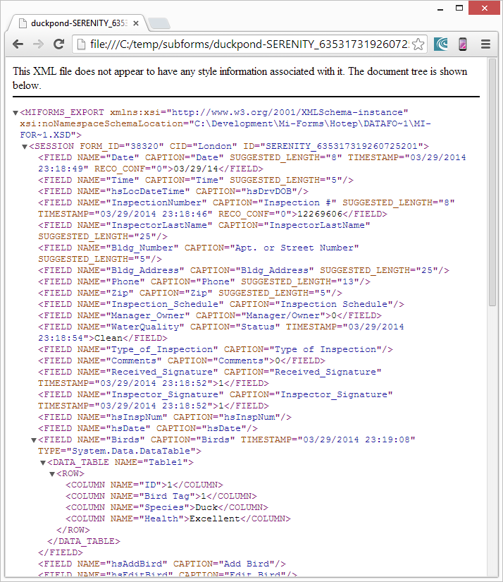
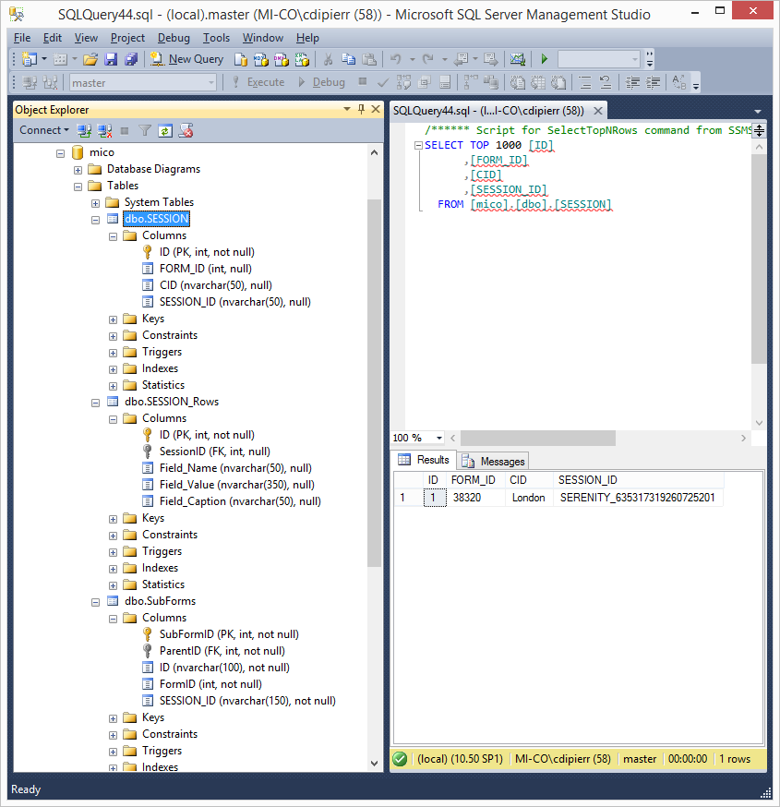
Field Inspection Solution
Notes:
Where things start to become new is here. On the left side of the screen what you’ll see is one of our standardized XML exports. This is a format that’s designed to provide a light weight version of form fields and data captured on those fields. It has traditionally supported and will continue to support fields of all types including grids and including embedded sub-forms. It has, in version 10 of Mi-Forms, been modified to provide a little bit more data that helps out the inspection solution.
This extra metadata is able to be processed by a database schema generator. This takes the XML and produces a suitable schema to store data for the inspection. The idea here is that the form’s designer would produce this file type, run it through our schema generator and find themselves with a database suitable for storing the data from the inspection. In the case where there are multiple inspection types, the form’s ID will be the unique key and multiple tables will be produced as needed.

Slide 16
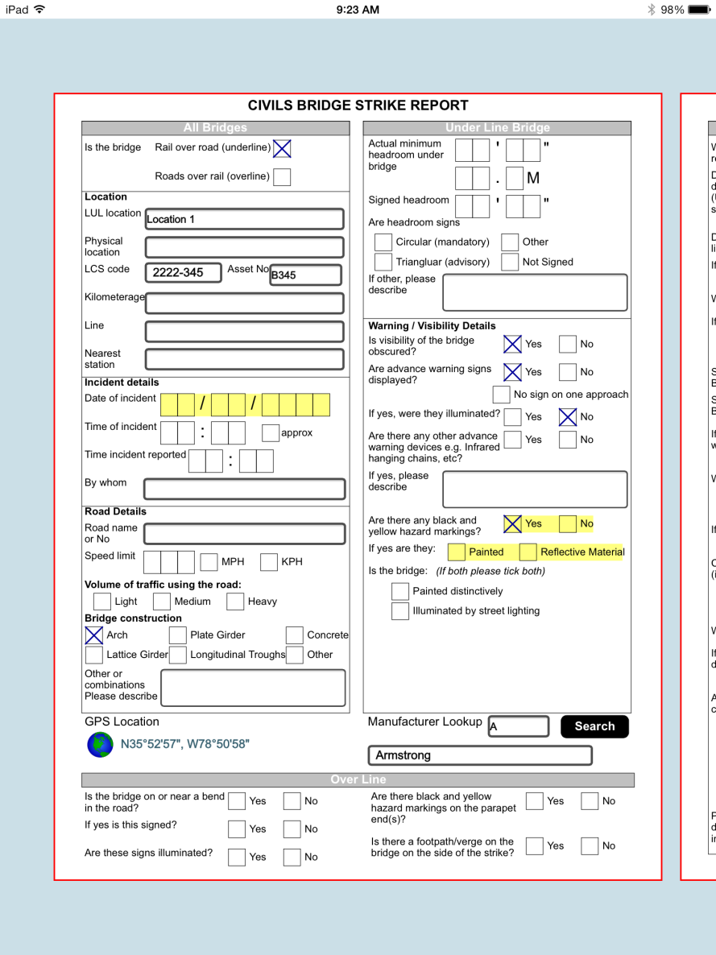
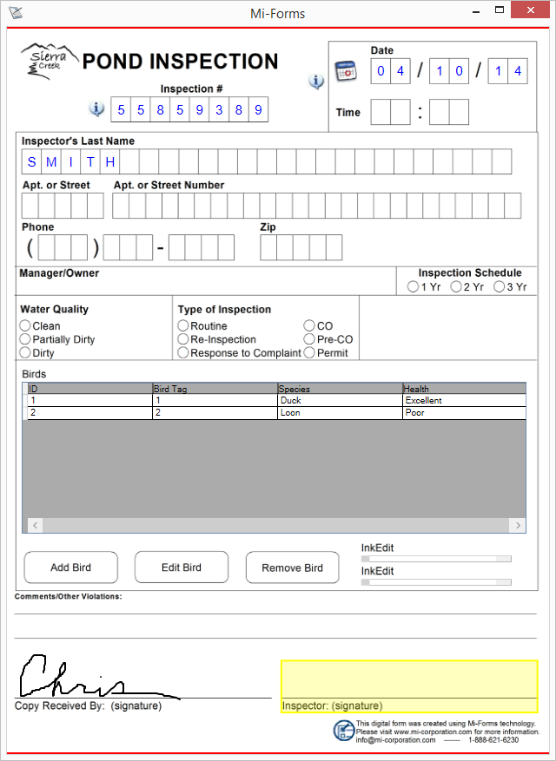
Field Inspection Solution
Notes:
Once that back end repository is setup, forms are deployed to devices as you’d expect. The solution is designed to work with any of our supported Mi-Forms platforms, whether it be iOS, Android, or Windows. Data is captured in these forms and uploaded to a Mi-Forms Server instance. This portion of the solution isn’t new, but there will be some guidelines for how export from the forms works to be compatible with the solution.

Slide 17
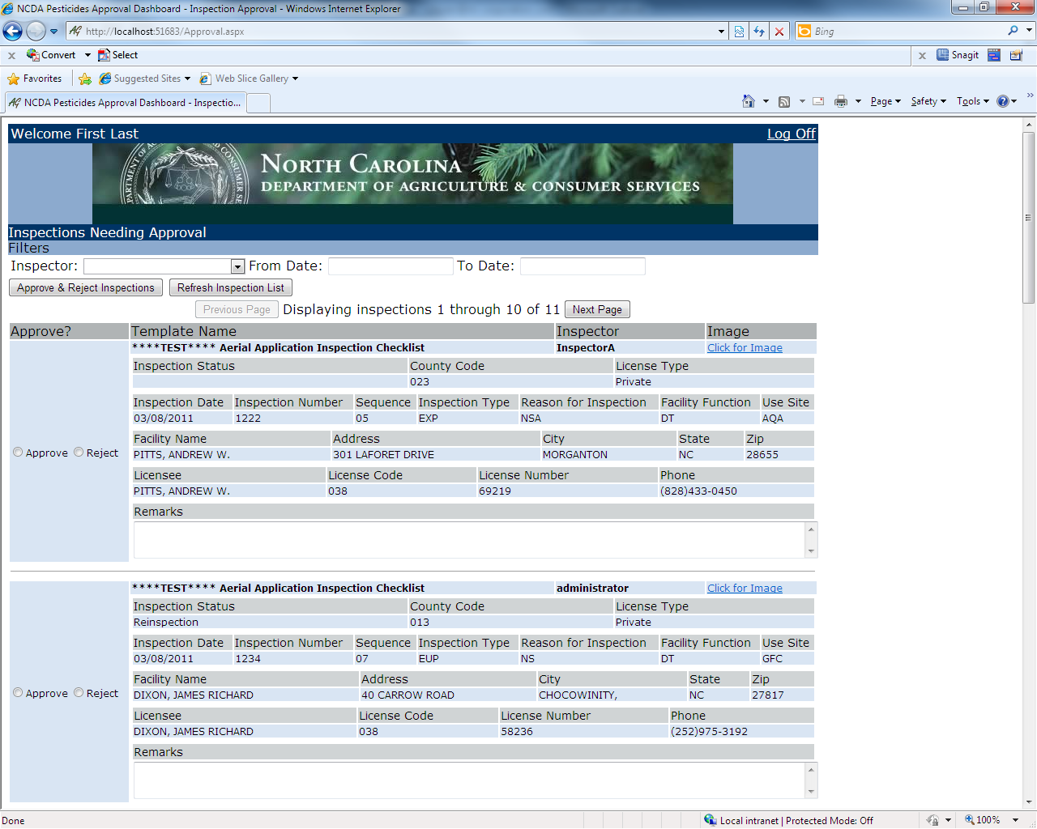
Field Inspection Solution
Notes:
After data capture, there’s typically some level of approval needed for the purposes of finalizing the inspection. What you see here is an approval dashboard we’ve custom developed for a couple of organizations in the past. We’re expanding this concept to allow for more flexibility and customization.

Slide 18
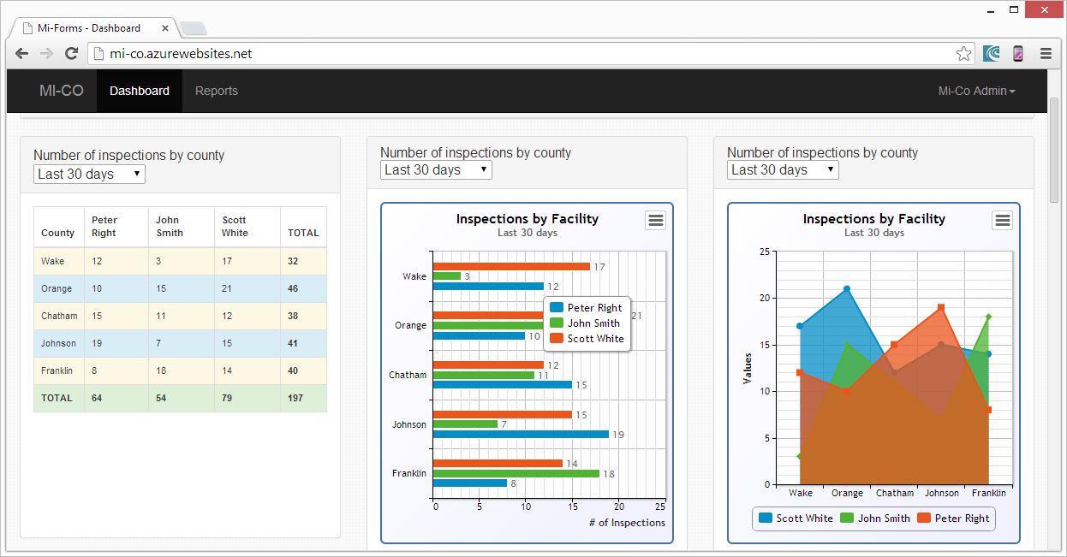
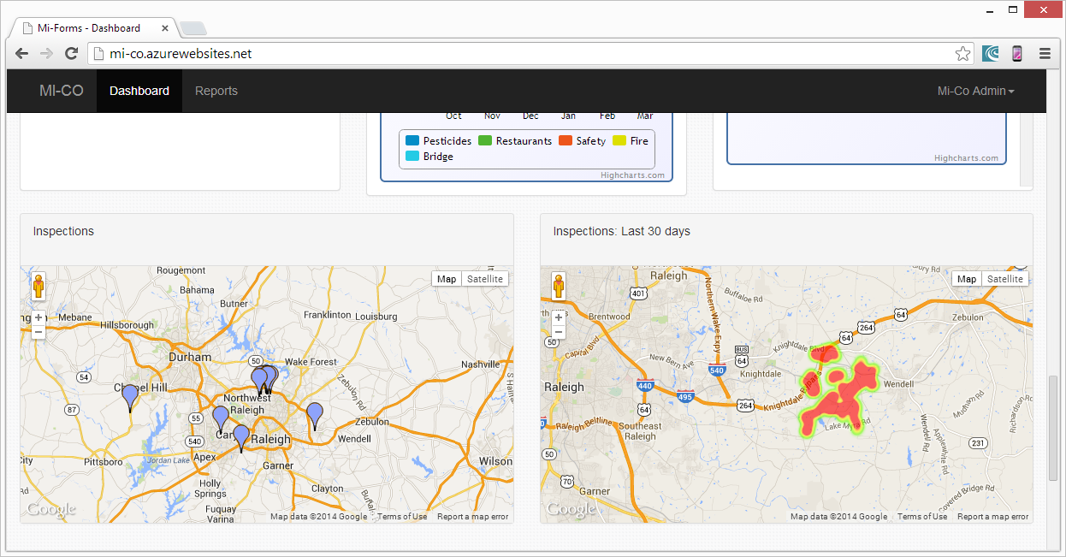
Field Inspection Solution
Standard Charts
By inspector
By location
By date
Custom Charts
Through configuring
data views and
admin dashboard
Notes:
And then where it gets new and interesting again is the visualization of the collected data. We are providing a web dashboard that will ship with a set of standard charts. We’re still working on what exactly those charts will look like, but you can imagine possible examples would be charting the inspections by inspector, location or by date. We have examples of these sort of charts at our demo booth, so be sure to stop by.
But, we’re not limiting the dashboard to just the charts we think are important, we’re providing a charting interface. This will allow an organization to develop or have developed a set of customized charts. These charts will pull data through views from the data repositories. An administrative portion of the dashboard will allow customization of the dashboard that other users see. In this case we’re looking at a quick Google Maps interaction, but we might expect a specific organization to prioritize inspection specific data.

Slide 19
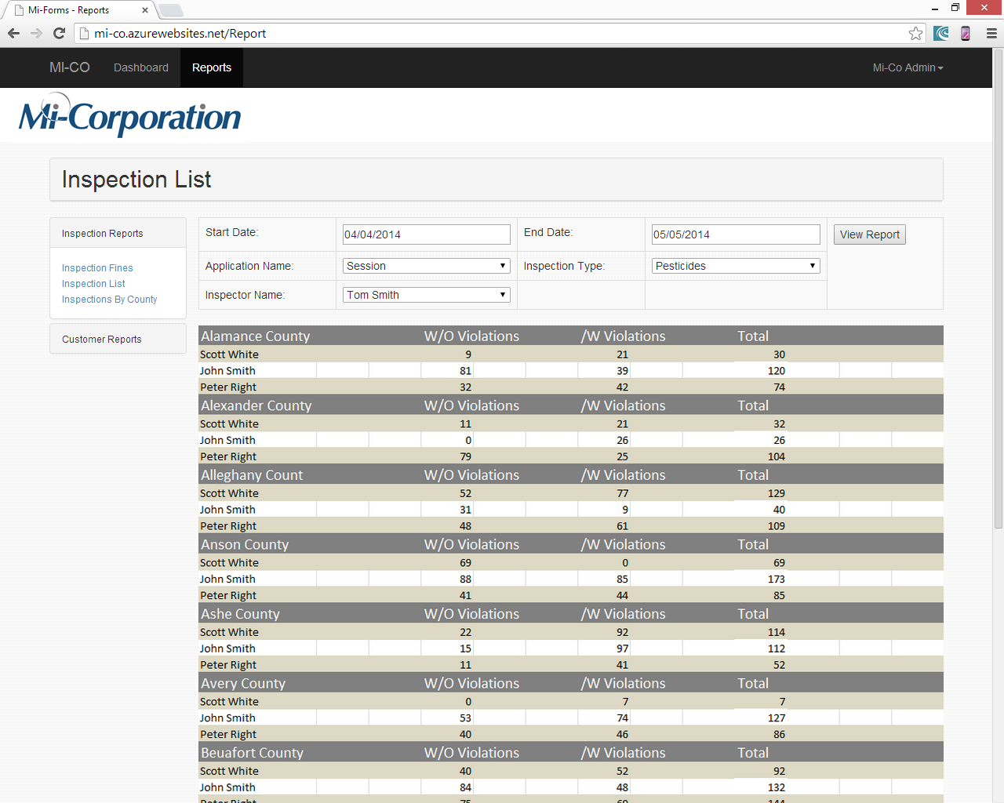
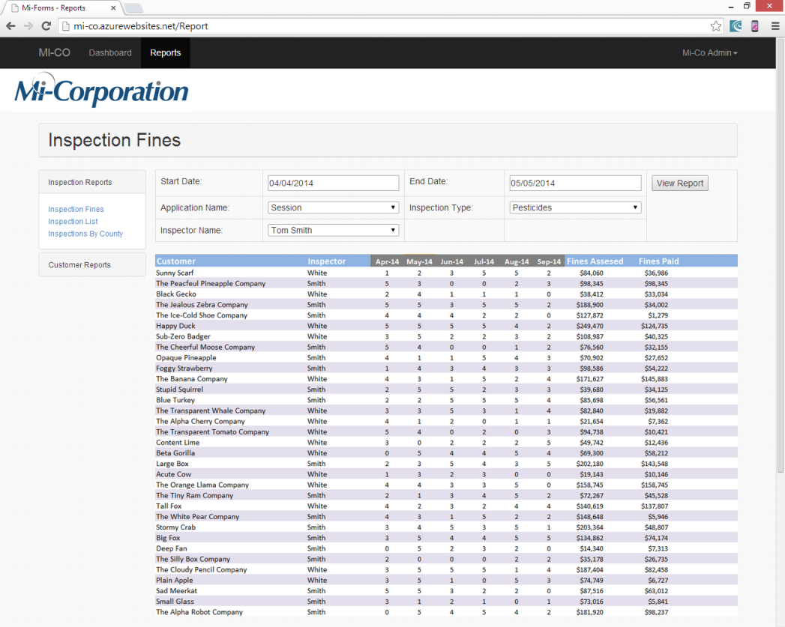
Field Inspection Solution
Reporting Tools
SQL Server Reporting Services
Export to PDF, Excel, Word
Dashboard customization
Setup links to report
Notes:
And then also on this dashboard you’ll see that there’s a link to reports. Since the data repository is being held in SQL Sever, we’re using SQL Reporting Services to provide a reporting interface to that data. These type of reports can be seen on the web of course, but also exported to PDF, Excel, and Word. Again we’ll provide a set of example reports as shown here.
But, also again we’ll provide a customization such that an administrator may customize links to reports that the organization has created.
Again we have a demo of the field inspection solution available at our booth. Please stop by and discuss it with me or any other Mi-Corporation team member and we’ll be glad to talk in more depth.

Slide 20
Query Management Solution
What is it?
A solution designed to track queries arising in clinical trial solutions from their creation to their resolution
Solution Components
Query tracking database
Web interface
Email notification system
Example query creation forms
Notes:
Now, from field inspection we move to life sciences. The second product we’re proud to announce today is our Query Management Solution.
A query can be thought of as a data discrepancy within a clinical trial. This can be isolated to a single patient visit, or it could be a difference in data between multiple visits. A very simple example could be a drastic difference in a patient’s weight or height from visit 1 to visit 2. It means that something has gone wrong in the capture of this data and a resolution or clarification is needed.
The Query management Solution is designed to track queries arising in clinical trial solutions from the point of that query’s creation through to its resolution.
Here, we see that we’re providing four main components, a tracking database, a web interface, an email notification system, and example query creation forms.

Slide 21
Query Management Solution
Important concepts
Study – What’s the name of the study?
Maps 1:1 to Mi-Forms customers
Site – The location applicable to the query
Roles – Users allowed access based on roles
Data Manager, Monitor, Site CRC, Investigator, Admin
Multiple input methods
Web UI
Mi-Forms form input
CSV Import (batch import)
Web services
Notes:
To understand this solution, there are a few concepts that I wanted to talk through with you first.
First is the concept of a study, in other words what’s the study studying. This can be thought of as the drug that’s being studied in a trial. In our world this maps 1 to 1 with a Mi-Forms customer. Multiple studies can live on the same server, but each has its own setup through a distinct customer.
A site is a location where the study is being conducted. Each study has multiple sites, and for the purposes of queries, we’re going to send the query to a site for the purposes of resolution.
Next we see that there is a concept of roles. While the Mi-Forms Server has a permissions based concept, these roles are specific to what can and cannot be done with a query. A data manager, a monitor, a site CRC and so forth can all do different things with queries. Some can create them, some can resolve them, and so on.
And then lastly, I wanted to draw attention to the fact that there’s multiple ways to actually create a query. The slides here will show one, and you can actually see three at our demos, but really there’s four distinct ways to create and work with queries. Users can use the Web UI directly, they can utilize a Mi-Forms form, they can batch import queries via CSV, which is really useful for integration with other logic check systems, and then there’s also a fully functional web service interface that a sophisticated programmer can use.

Slide 22
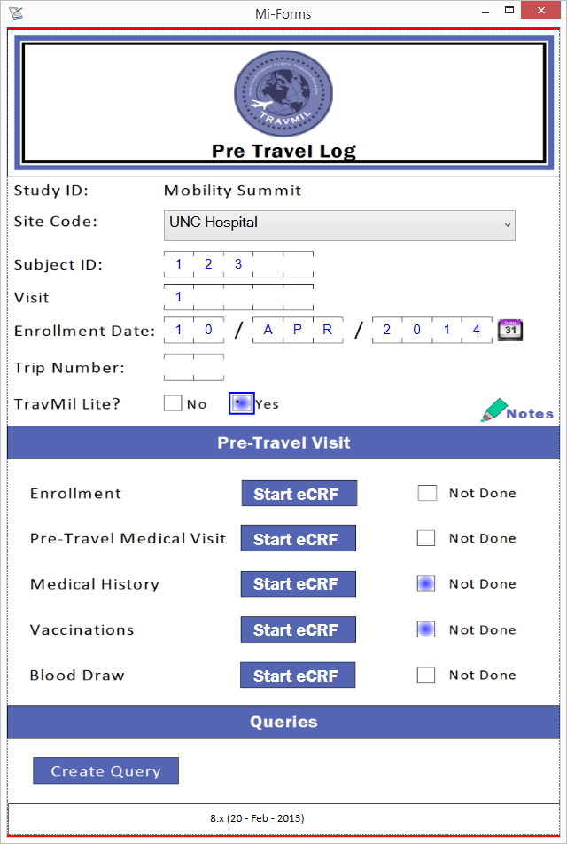
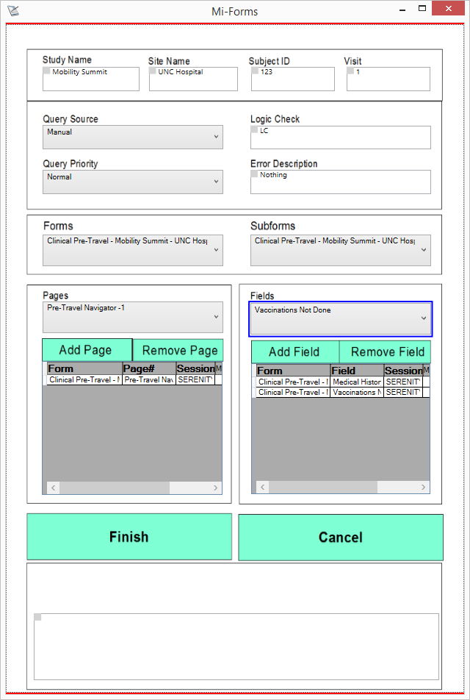
Query Management Solution
Fill Form
Create Query
Notes:
Ok, so let’s take a look at how this can work in practice. Here on the left, I have an example clinical trial form. It’s representative of a form that a user might fill for a subject within a clinical trial on a given visit. This works as you’d expect, but if you look near the bottom you’ll see there’s a hotspot that’s labeled “Create Query”.
If we tap on that hotspot, we’re shown an a sub-form. This sub-form is an example that we’re including with the solution that pulls information from the main form. It might be hard to see here in the slide, but we can enter information about the query itself, and we can then link it to specific fields from the main form. All of this will be aggregated into the query when it’s created. I should point out here too that while we provide this example sub-form, it can be modified to look and feel however you might want. All the code and all the UI is available for this example.

Slide 23
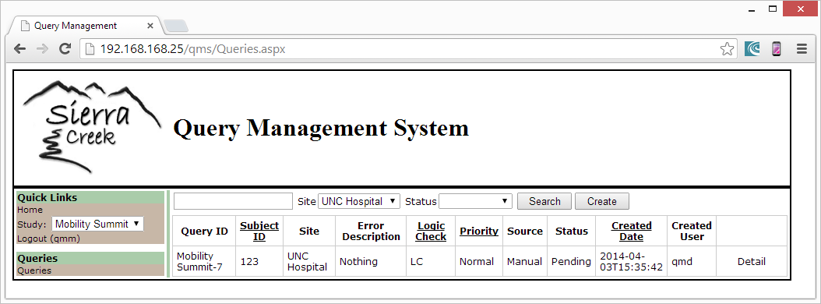
Query Management Solution
Identify Query
Notes:
Now we flip over to the web interface. What’s happened here is that the clinical trial form was finished and sent to a Mi-Forms Server. When that happened, the query was created in the Query Management Solution as an export from the form. We see that it’s been assigned a unique ID and we can see some high level information about the query. We can click the detail link though and see more.

Slide 24
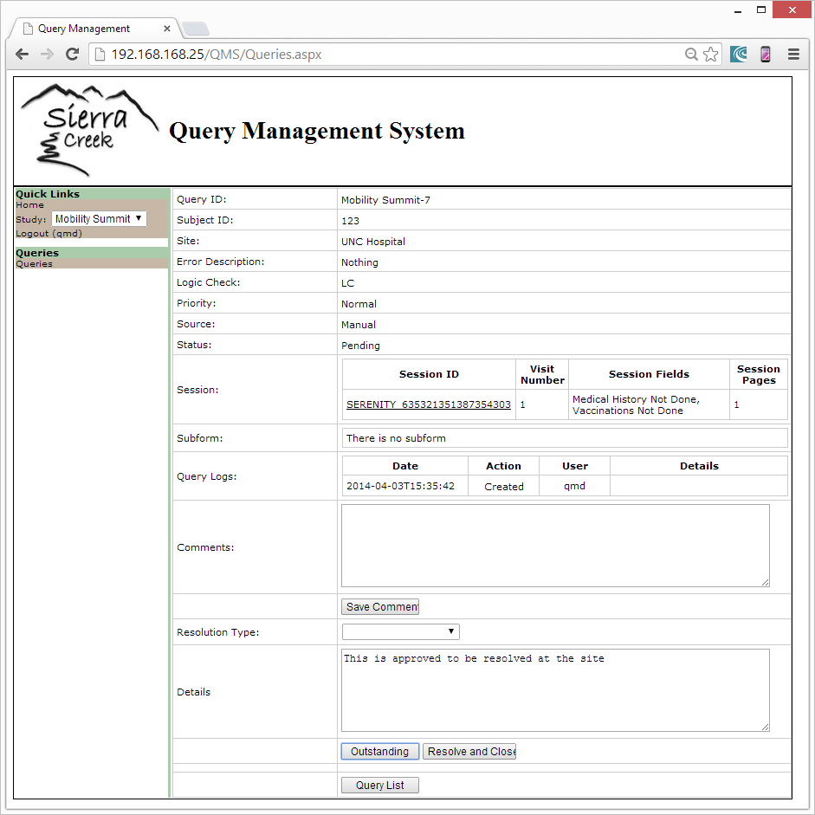
Query Management Solution
Dispatch Query
Notes:
Now we’re looking at the same query, but at its details. You might see that there’s a link to the session that created it, and there’s a log that shows an audit history of the query. That log tracks everything that happens to the query. It’s important in this industry to make sure to have an accurate tracking of what happened at what time and who did it. This tracks that.
Down below that you should see two buttons, “Outstanding” and “Resolve and Close”. These buttons will differ depending on the user’s role, but in this case we’re logged in as a data manager who has the permission to dispatch a query to a site for resolution or just resolve the query themselves.
In this case, the user enters a description as to what they’re doing and presses that button. Doing so sends it to the site for resolution. They’d get a notification about this that we’ll see in just a moment.

Slide 25
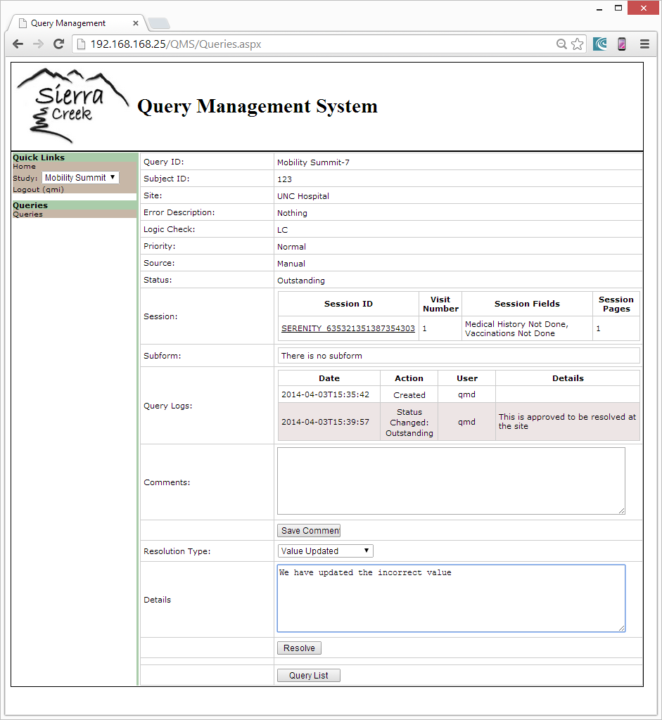
Query Management Solution
Resolve Query
Notes:
But eventually someone from the site, in this case an investigator is going to resolve the query. They have to pick a query resolution status, in this case indicating that a value has been updated, and then mark it resolved via the button down below. You can also see above that that there’s a 2nd entry in the query log. This log is an audit trail that tracks everything that happened to the query, when it happened and who caused it to happen.
I should point out here that resolving the query via the web interface is one option. The web service interface provides the same ability, so a separate interface can be developed if it’s suitable or resolution can be automated such as through a 3rd party.

Slide 26
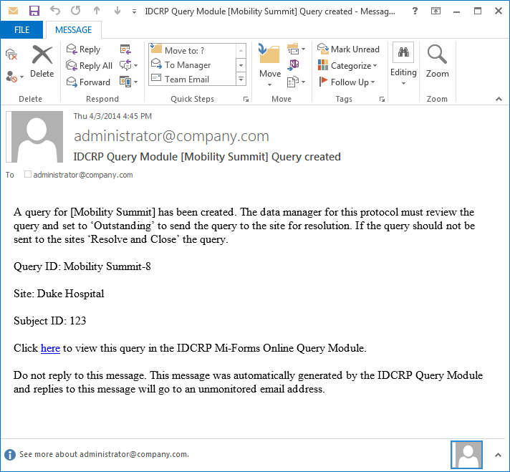
Query Management Solution
Notifications
Notes:
The last thing we’ll look at here is the notification interface. In this case we’re looking at a query creation notification, but the system notifies at every step. In the case we saw before there was a notification generated on creation, a notification on dispatching it, and a notification on resolving it. These go to the appropriate users in the organization with the appropriate roles. There’s information provided about the query and a link to work on it in the web interface.
Again we have the Query Management Solution available for demo at our booth. Please feel free to stop by and discuss it in further detail.

Slide 27
Mi-Enterprise Apps
What is it?
A middleware framework on which platform independent mobile apps connect and integrate through a set of commonly used services
Major components
Server
App Package
Mi-JS Layer
Data Adapter / Sync components
Notes:
The last new product we’ll announce here and talk about is Mi-Enterprise Apps. This will take us out of the realm of a specific vertical or use case and instead start exploring a broader platform.
Generally speaking, Mi-Enterprise Apps is a middleware framework on which platform independent mobile apps connect and integrate through a set of commonly used services. I realize that’s a pretty broad statement, so if I were to state it another way, what we want to do is to make it easier to deploy not just data capture applications like Mi-Forms to mobile platforms, but all sorts of mobile applications across an organization and we want to allow for development of these applications with different technologies while still utilizing services that make the experience easier.
If we look at the major components, we’ll see that there’s a server, the concept of an app package, a layer explicitly targeted to hybrid applications, and a robust data adapter and synchronization component that allows for pulling data from 3rd party sources to mobile devices.

Slide 28
Mi-Enterprise Apps
App Packages
Notes:
Let’s look at this from a high level.
We start by developing an app. This can be done in basically any toolset you want, but if we look at this diagram, we see a likely choice would be XCode for iOS, Eclipse for Android, Visual Studio for Windows, or HTML5 and JavaScript for the hybrid case. It doesn’t matter which of these toolsets you choose, ultimately you’ll have access to all of the server’s services.
A developer publishes an app package to the Mi-Enterprise Apps Server. This allows for authentication and administration of the app and allows for those service calls.
When the app needs it, it can invoke .NET code that’s a part of the app package. This is code that’s written to conform with a specific published interface. It allows communication back to the apps from the developers’ written .NET code.
This can of course be used to communicate with any number of backend systems that themselves have APIs and service interfaces. Here we’re showing SQL Server, Oracle, SalesForce, and SharePoint, but really this can be any sort of system that can be communicated with.

Slide 29
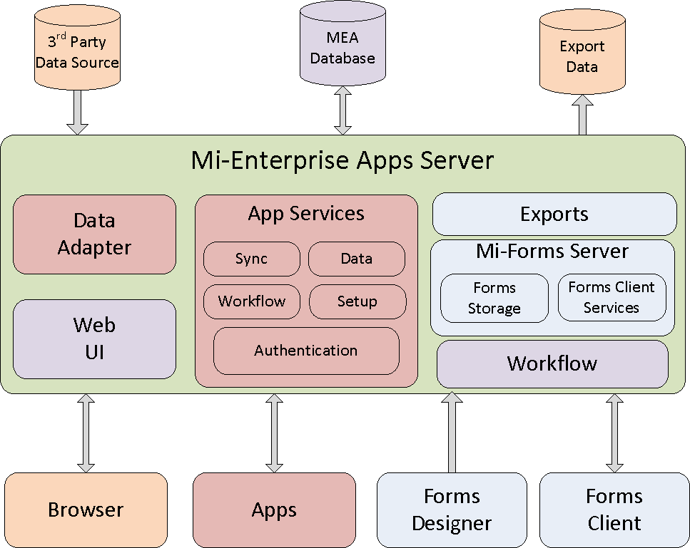
Mi-Enterprise Apps Server
Notes:
As we dive in, let’s first take a look at a block diagram of the server itself. The Mi-Enterprise Apps Server is built on the same framework as the Mi-Forms Server, and in fact if you look, you’ll see that the Mi-Forms Server is a sub-component of the broader server. The pieces that are in blue in this diagram are basically unchanged.
The red boxes are new concepts and modules within the server and outside of it. Most notably there’s a big box containing a set of services accessible by an app utilizing the framework. These communicate with the apps themselves. You’ll also see a red box labeled Data Adapter. We’ll talk about that in some depth in just a bit.
The purple boxes where you see Web UI, Workflow, and the MEA Database, are areas where we’ve expanded concepts from Mi-Forms. Obviously the UI has been updated to handle the whole app concept, but workflow has been updated as well. Now rather than passing form sessions around, we’re instead passing data bundles around as we’ll also see in just a bit.

Slide 30
Mi-Enterprise Apps Server
Server side concepts
Apps are analogous to forms
Permissions based on group membership
Each app is a collection of components (app package)
Data bundles are packages of data apps exchange
Each bundle has 1 or more app data item (file)
Bundles use queue based workflow
Services
Perform tasks for apps and forms
Setup and configure server & customers
90+ total, grouped by category
Notes:
Let’s talk server side concepts
Firstly, if you’re coming from the Mi-Forms world, it’s best to consider apps as analogous to forms. To be clear, when I say that, I don’t mean to say they’re constrained to data capture or the form UI at all. I just mean from the server’s point of view, an app is something that can be authorized to a specific group of users and is associated with concepts such as uploaded data. Each app itself is a collection of components in a package. We’ll talk about that in just a bit.
The second concept is data bundles. These are somewhat equivalent to sessions in the forms world in that they’re designed to collect and move data from user to user. Each bundle is a collection of 1 or more items or files and they use the same queue based workflow system that you see with form sessions.
And then when we talk about services, we’re talking web services. These are public interfaces that allow apps and forms to perform tasks. You might have noticed that the previous slide showed five separate boxes for services, that’s because they’re divided by category such as authentication, data, workflow, setup and so on. In total there are over 90 such services that allow you to do everything from creating a new customer through moving data through workflow and even logging audit events in an app’s life cycle.

Slide 31
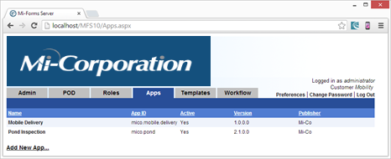
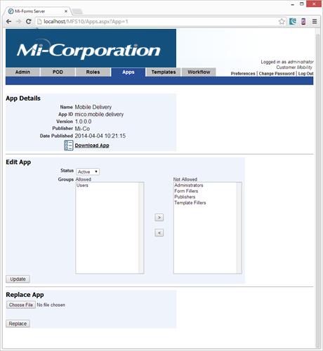
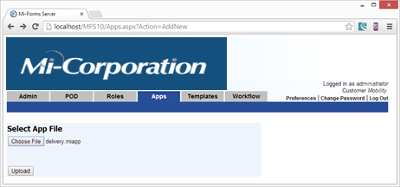
Mi-Enterprise Apps Server
Notes:
If we look at the UI at the app level, we see a new tab called “Apps” that enumerates the apps on the server and allows us to upload a new one.
If you click on one of these apps, you’ll see its details and an administrator can assign permissions to the app as needed. Again this is similar from a UI and permissions perspective to form templates.

Slide 32
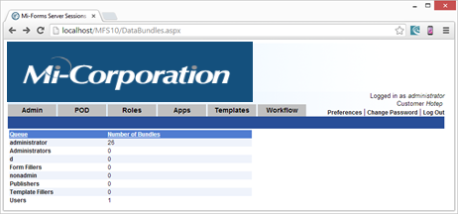
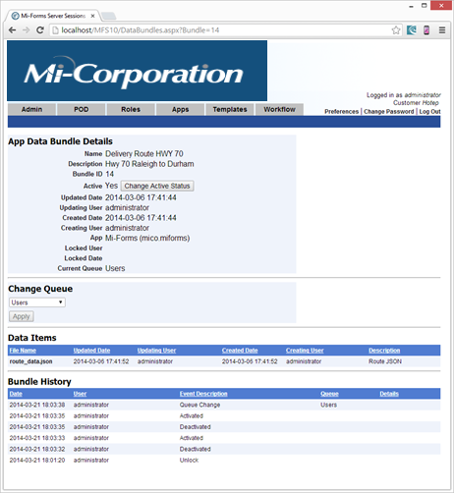
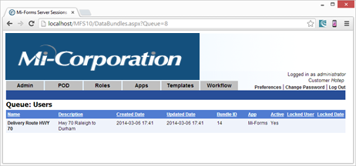
Mi-Enterprise Apps Server
Notes:
The other new UI is app data bundle UI. If we click on Workflow, and then on Data Bundles, we see a list of queues. Navigating to one of those queues we see app data bundles that exist in that queue.
And then of course we can see the details of the data bundle. We see who created it initially, who updated it most recently, and a list of files within the bundle as well as a history as to the bundle’s lifecycle. Again we can consider this similar to form sessions in that we’re passing data around, but there’s no form imposed constraint as to the type of format of this data.

Slide 33
Mi-Enterprise Apps
App package
Single file with multiple pieces
App information
Name
ID
Graphics
Hybrid UI & code
HTML
CSS
JavaScript
.NET code
Assembly
References
Notes:
Next, if we move past the server, we need to talk about the concept of an app package. This is a single file with multiple pieces that defines an app on the server.
There’s a set of app information such as the name, ID, and graphics such as icons and splash screens for the app.
In the case of a hybrid HTML5 and JavaScript app, the package contains those elements. This includes all developed UI and code for these apps as well as any other 3rd party pieces you might wish to include.
And then lastly, there’s a set of .NET code. This code is designed to be executed on the server at points in time in the app’s life cycle. For instance, the app can contact the server, ask it to perform a task and it will return a set of values. This too is packaged up in the single file.

Slide 34
Mi-Enterprise Apps
App Package Tools
API
.NET interface to manipulate it
Command line tool
Build a package from the tool
Security / Verification
File contents are hashed /w salt
Validation when re-opening package
Server encrypts these
Notes:
We talked about the app package concept already, but a question that might come up is how you put one together.
Well, first off if you’re building a Windows app or if Visual Studio is your preference in general, there’s a documented public .NET API that can manipulate the app packages.
If that’s not suitable, there’s also a command line tool. This allows you to build the package completely from the command line by inserting files, setting properties and so on.
And then it’s also worth pointing out that the contents of the app package help ensure security around the package contents themselves. The contents are hashed, and when the app is reopened, it’s verified to ensure integrity. The server also takes an extra step of encrypting the package as well.

Slide 35
Mi-Enterprise Apps
Mi-JS API
Usable in hybrid apps
Usable in Mi-Forms forms (iOS/Android)
Library layer for ease of use
Mi-Enterprise Apps server services interface
File system, camera, gallery, encryption API interface to improve PhoneGap
Written in TypeScript
Both TypeScript & JavaScript distributed
Notes:
The next component of Mi-Enterprise Apps is called Mi-JS.
This is usable both in hybrid apps and in Mi-Forms forms.
It’s a library layer that makes JavaScript a bit easier to use. It of course interfaces with the services I mentioned before, but it also enables easier interaction with things such as the camera, gallery, file system and encryption APIs
For the hard core developers in the room, I want to point out that this layer is written in TypeScript which is a superset of JavaScript. This allows for a structured interface if you need it. It’s distributed in JavaScript as well.

Slide 36
Data Adapter / Sync Details
Challenge
Get data sets from data sources to mobile devices
Allow access to data while offline
Keep the data “fresh”
Solution
Provide services for data administrators to utilize
Store the data in a centralized resource repository
Automatically “decide” what’s new for a device
Allow background sync
Provide common access
Notes:
The last component we’re going to explore is the data adapter and data sync component of Mi-Enterprise Apps. First off, I say that this is a part of Mi-Enterprise Apps, but this also applies to Mi-Forms. The same infrastructure that’s established for apps will also be available for forms on our form platforms.
The challenge that you face and that we face, really that everyone faces in the mobile app world is that we want to be able to get data sets from existing sources and provide them to mobile devices. This is true in the forms case where we might need lookup or prefill data. It’s true in the app world where we might want to provide access to back-end systems at a moment’s glance.
Obviously this has to be available offline. Despite great strides in the country and the world’s connectivity, mobile workers still find themselves in communication dead zones.
And of course the data has to be fresh. If we set our device down and then pick it up a few days later, we want the data to automatically be synced to the device, not be reflective of what it was when I last used the app or form.
With that in mind, we crafted a solution that aims to address all portions of the challenge. It provides services that data administrators can utilize to let the system know what data to sync.
It will store this data in a centralized repository even if you have multiple data sources.
It will “decide” what’s new for a device so that we can send small updates to mobile devices when possible.
Background sync is supported while the device is otherwise inactive.
And we provide common access. By that I mean the API to access data is the same across forms and apps and across platforms, utilizing a SQL query language.

Slide 37
Data Adapter / Sync Details
Repository
Data & Schema
Services
Notes:
Let’s again look at this from a high level.
Data resources we care about are stored in 3rd party databases such as SQL Server, Oracle, DB2, mySQL, PostgreSQL, or really any other data source so long as the data can be pulled.
Through a set of data and schema services, data is packaged up and moved to our data repository. These services allow a data administrator to define what the data looks like and to send periodic updates to the repository as needed. These refreshes can be either be full data pulls or updates such to rows, inserts and deletes.

Slide 38
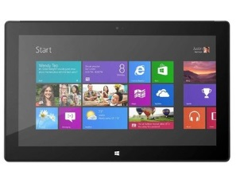
Data Adapter / Sync Details
Repository
Client Sync
Services
Apps
&
Forms
Client Data
API
Notes:
Once it’s in the repository, we need to get it to client devices.
The server exposes a set of sync services that allow client devices to register for data they’re interested in and then to pull that data from the repository.
This data is synchronized down to your tablets and phones and into the SQL Lite repository that exists on those devices.
Then once that data is on the device, it’s accessible by apps and forms through the client data API. This means that you can directly query data from those 3rd party sources on the device even while offline and expect it to be fresh data.
Again to recap, this will be available for both apps under Mi-Enterprise Apps and in forms through Mi-Forms. We have demonstrations of both Mi-Enterprise Apps as a whole and the data sync specifically at the Mi-Co demo tables for you to look at and play with.

Slide 39
Data Adapter / Sync Details
Concepts (Server)
Resource
One or more data tables from data sources
Central data repository
Houses multiple resources
Logic to determine what’s new for a device
Data Side Rows & Schema API
Put structure and data from sources into repository
Client Side Rows API
Download structure and data from repository
Notes:
One more time through concepts. First here on the server side.
We’re defining the term resource to mean one or more data tables from data sources. This is important because a form or an app will address the data by a resource name. This is essentially an identifier of what data is being synchronized.
As I mentioned, there’s a single central data repository. This is a place where all the synchronized data will be staged and changes to this data will be reconciled such that logic can determine what a device needs when it asks for a given resource.
There’s a data side schema and row API. This is what’s utilized to move data from 3rd party sources into the central data repository. It defines both the structure and the actual data.
And then there’s a client side row API. This is the API that client devices interact with to synchronize the data to the device.

Slide 40
Data Adapter / Sync Details
Concepts (Client)
Replicator
Communicates with server
Foreground trigger
Background capable (incremental)
Merge Agent
Pulls all replications together
SQL Lite DB
Client side repository
API
Sync, Data, Register
Notes:
If we look at the concepts on the client side. And I promise this is my last “concepts” slide, we’ll see four distinct components as well.
Firstly there’s the replicator. This is what’s doing the actual communication with the server. This is something we’re providing. It handles communicating with the data repository and grabbing data both in the background and in the foreground if it’s explicitly triggered.
The merge agent also lives on the client, pulling the replications together. We won’t go into depth on that here.
Where the rubber actually meets the road for you is the actual data repository on the client devices. The data is stored in SQL Lite, so you still have relational data access.
And then there’s an API to actually access the data, to register for resources, and to setup synchronizations.
If you come to our demo tables, we have an example of a mobile app running across multiple platforms backed by a Mi-Enterprise Apps Server. It utilizes data synchronization and shows how multiple users can collaborate across the application.

Slide 41
Roadmap Future
Mi-Forms Roadmap
Performance Improvements
Improved Phone Support
User Interface Improvements
Push Notifications
Improved Multi-User Support (single device)
Related Files Improvements
Mi-Enterprise Apps
Hybrid app containers (near future following MMS 2014)
Notes:
The last thing I want to leave you all with is a peak into the future of where we’re going beyond these updates and new products.
In Mi-Forms, we’ll continue to emphasize performance improvements, provide continued phone support enhancements, work down some user interface changes to help provide a better form filling experience. We’ll target push notifications, improve multi-user on a single device support, and we’ll take a look at related file improvements to help data sync down that channel as well.
With Mi-Enterprise Apps, we’ll be targeting the creation of a hybrid app container that allows apps to be synchronized within a sandbox like environment and launched directly.

Slide 42
Roadmap Future
Mi-Co Inspection Solution
Scheduling
Geolocation integration
Standardized reporting Module
Dashboard Module
Administrative Module
Query Management Solution
Notification template customizations
Notes:
In the inspection solution, we’ll be looking at integrating scheduling and geolocation. We’ll be working to further standardize the reporting module, provide greater dashboard flexibility and work on the administrative interface side of the dashboard.
And then lastly in query management, we’ll be enhancing our notification template methodology to allow administrators to customize the notifications per study and per site.

Slide 43
Questions?
Questions, comments?
Please remember to send questions and feature requests to: support@mi-corporation.com
Notes:
I want to conclude by saying that I really appreciate the ability to spend these few days with Mi-Co’s partners and customers. You all are as enthusiastic about mobile information as we are, and it’s great to be able to share time with you.
Please remember that when it comes to product development, we do not do it in a vacuum. If there’s something in this presentation or something you see at a demo that really intrigues you, or if you think we could improve something please don’t hesitate to let us know. We want to continue to prioritize building new products and features to existing products that help you provide mission critical success to your customers.
Thanks, and if we have time I’ll take questions.

