Slide 1
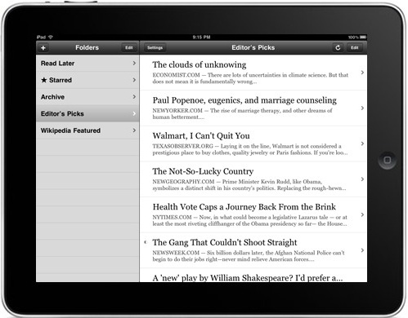
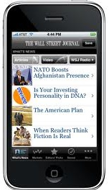
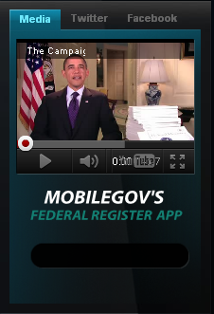

Slide 2
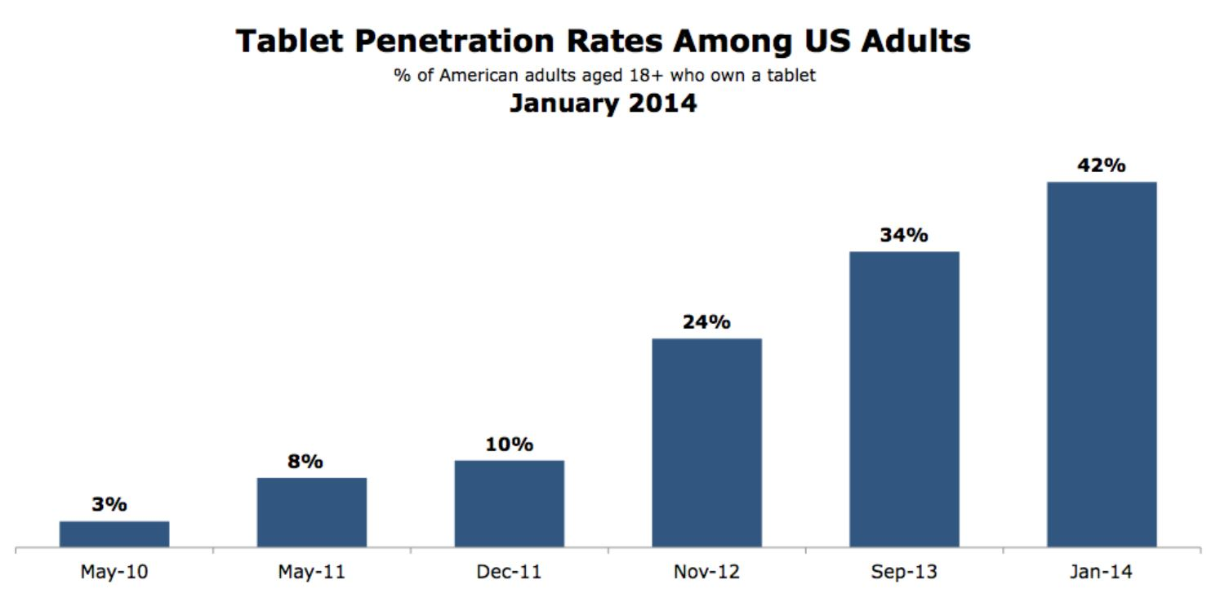

Slide 5
Digital Government Strategy

Slide 7
Highlights of the DGF
-Make Open Data, Content and Web API’s the new default
-Establish a Digital Services Innovation Center and Advisory Group. Gwynne Kostin
-BYOD Toolkit – came out early…pre-1.0 version
5.5 “Set up a government-wide MDM”. GSA Managed Mobility Group

Slide 8
Notional: System Architecture
Amazon Web Services
Cloud Based Storage and
Syncing
EHR
EHR
Telemetry
Mobile Data Presentation layer
PHR

Slide 9
Highlights of the DGF
Agencies had to identify two customer-centric services to mobilize.
Issue #1,#2,#3…money.

Slide 10
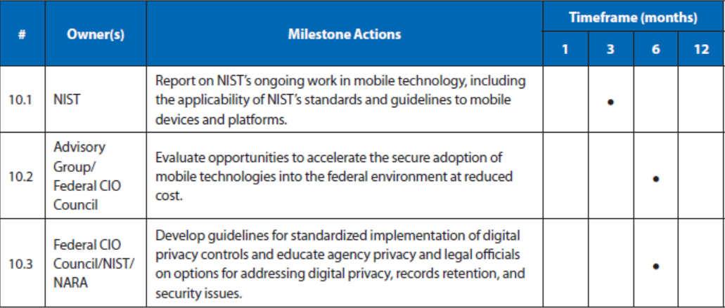
Digital Government Strategy Security and Privacy Deliverables

Slide 11
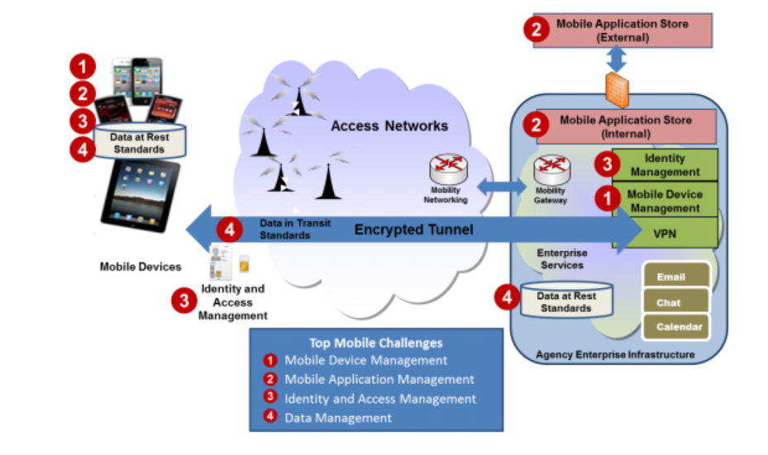
Government Mobile and Wireless Security Baseline Mobile Computing Architecture

Slide 12
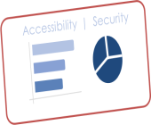
The “Car Wash” | An Automated One-Stop-Shop For Mobile App Testing
1
The Developer determines they’re ready to engage the DHS/OCIO platform by consulting the code library and/or starting the cycle
2
The orchestrator moves source code through each phase of the cycle. Each cycle outputs a results dashboard
The Developer reviews the results dashboard to see how the source code scored against accessibility and security measures
3
Engage Platform
Start Cycle
Review Results
ENTRANCE
EXIT
SETUP
INITIATE
BUILD
SCAN
RESULTS
Access reusable code and references
Access Library
Start Cycle
Source Code
Restart Cycle
Publish App
Source Code
The Mobile COE presents:
The Developer chooses to either make changes to the source code based on the results and restart the cycle, or publish their app
4
Choose Action
The “Car Wash”

Slide 13
Impact of the DGS
The idea of using APIs to leverage existing assets.
Getting Government to collaborate with Government.
Getting Government to Collaborate with Industry.
Accelerating the adoption of Mobile Technologies.

Slide 15
Additional Ideas
Need to concentrate on productivity and capabilities.
Mobile Version of “FedRAMP” for security controls on mobile apps. MobileCERT??
Bridge the disconnect between the folks that need the capability and IT.
More work in APIs.
Creating an environment that fosters innovation
Ubiquitous Wireless Connectivity

Slide 16
Targets for Mobility
General’s Briefing Books
Training
Field Work
Digital Publishing

Slide 17
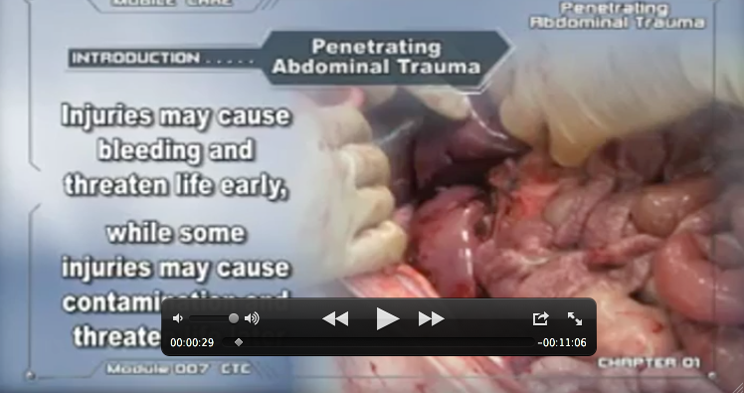
Trauma Training Videos
High impact training videos provide focused reviews for residents
Mobile devices are an ideal delivery mechanism

Slide 18
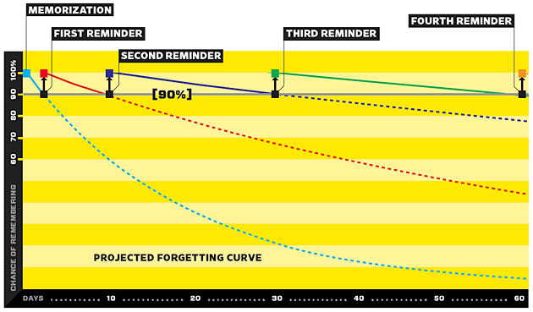
Learning

Slide 19
Beta Features
Records display
Integrated FaceTime
Mobile media player
Workflow tool
Workflow indicator

Slide 21
Messaging
Email
Text message
FaceTime

Slide 25
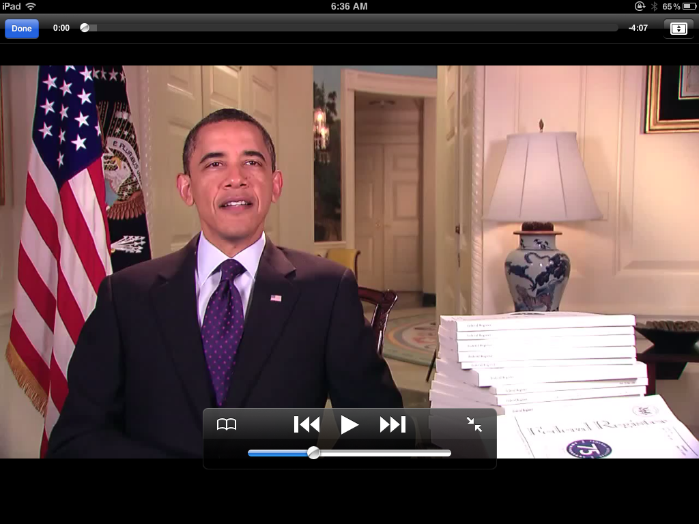

Slide 26
