Slide 1
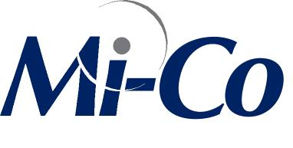
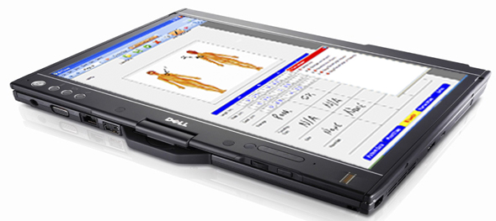
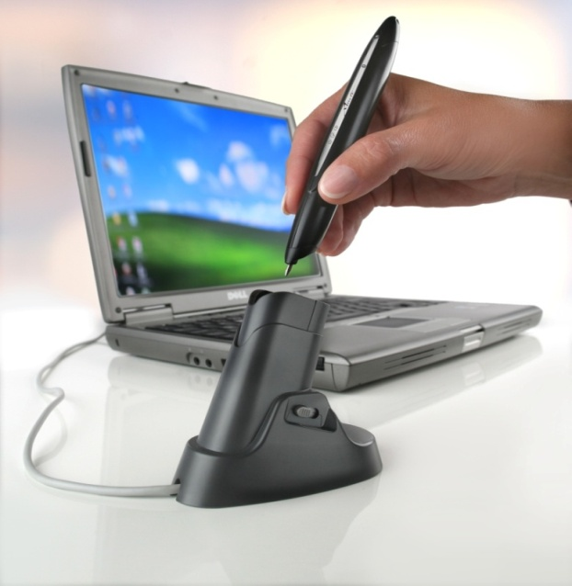
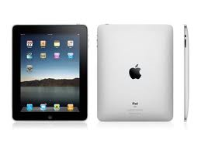
Mobile Data Collection Solutions for Healthcare www.mi-corporation.com

Slide 2
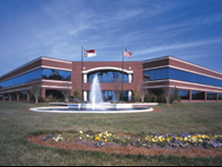
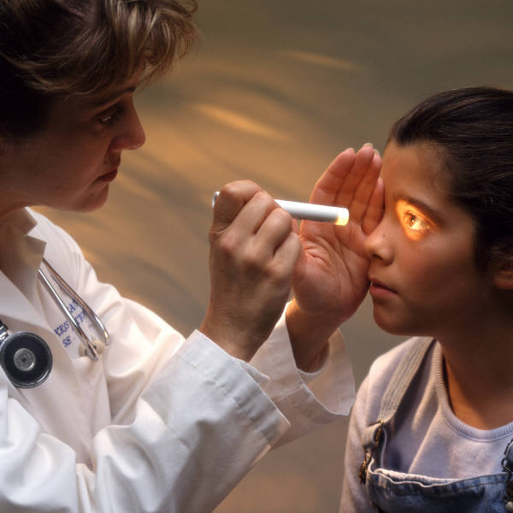
Corporate Overview
Founded 1999 in RTP, NC
Privately held software and services company
Healthcare/Life Sciences since 2001 with
Compliant with HIPAA, 21 CFR Part 11
Patented technology
Notes:
10 years of experience, lots of life sciences and healthcare customers, part 11 and hipaa compliant solutions

Slide 3
Mi-Co Commitment
12 years in business
• CEO & Founder from IBM, part of CrossPad team
• Experienced in Tablet-based solutions for businesses
Customers & Partners come first!
• From the top-down, emphasis on serving our customers/partners
Deep Bench of Data Capture Experts that want to solve YOUR problems
• Most of core technical team been with company an average of 7-10 years
Easy to work with, access to great support!
Mi-Co customers have rave reviews of our training, support, expertise

Slide 4
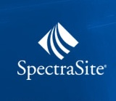
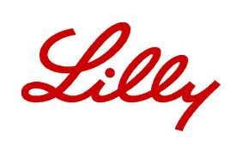
Selected Mi-Forms Customers

Slide 5
What is Mi-Forms
Mi-Forms Software System
Software that allows enterprises to build electronic forms applications for pen-based data collection
Build Any Form
Supports Tablet PC, Keyboard, Digital Pen, iPad, Windows Mobile
Implement Any Business Rule for Verification and Validation
Communicate with Any Backend System
Design
Forms
Capture
Data
Verify
Data
Communicate
Information
Notes:
10 years of experience, lots of life sciences and healthcare customers, part 11 and hipaa compliant solutions

Slide 6
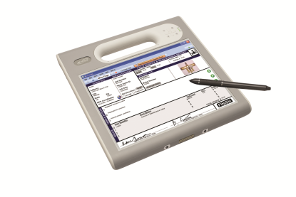
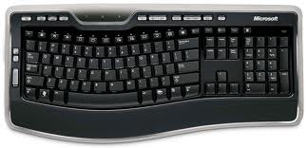
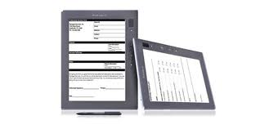
Mi-Forms Solution Components
Approval Workflow
PDF Forms Image
Viewer, Archive
DataPull:
ERP
CRM
Custom
Backend
Reports
Database
Dashboard
Mi-Forms Server
Standard Exports (XML, CSV,
PDF, others)
Billing
Scheduling
ERP System
Form Designer
Online/Offline Entry
Mi-Forms Client

Slide 7
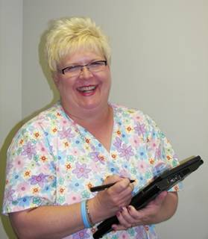
Home Health Nurses
Nurses saved one hour per nurse per day on paperwork!
Agency reduced late submissions from 31% to 8% in a month!
Data-entry errors down by 50%!
Productivity gain of $1,200/day!!
Debra Harris, Director
Wilson County Home Health
Notes:
In Wilson County, Debra Harris, Home Health Director, estimates that nurses are able to save one hour per nurse per day on paperwork*. Rather than increasing the number of visits nurses made each day, the nurses are given the time to provide more quality care to their patients. Harris concludes that the quality of care and patient satisfaction increases based on this use of the time.
During a six month time frame (and before a fully completed implementation of the Mi-Forms System), Wilson County saw a reduction in the number of late submissions from up to 31% in a month to 8% in a month.
*Current national salary surveys show an average of over $20 per hour for a home health nurse. Using this data, the Wilson County productivity gain is $1200 per day (or $24,000 per 4 week month, more than four times the monthly cost of the software, hardware and wireless systems currently being used by Wilson County).

Slide 8
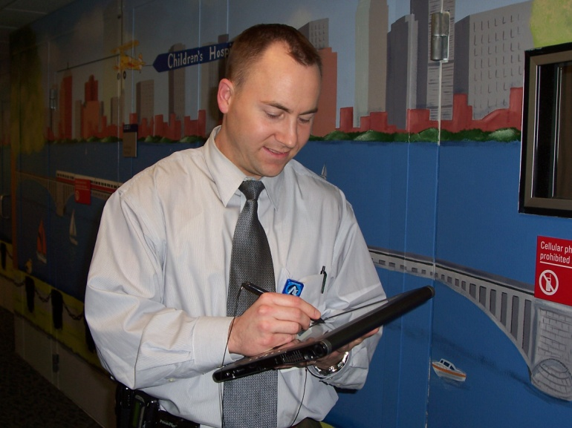
Children’s Hospital Boston
“Mi-Forms replaced our paper process with user-friendly, handwritten e-forms on Tablet PC which are very easy for staff to use. With Mi-Forms integrated to our diagnostic machine and the hospital's EMR, we have instant electronic data in the system for compliance and reporting. Mi-Forms shaves enough time from administrative and data entry duties to allow us to see an additional 800 patients a year with the same staff. We're providing more and better care at lower cost with Mi-Forms.”
Brian J. Fligor, ScD, CCC-A
Director of Diagnostic Audiology
Children's Hospital Boston
Instructor, Harvard Medical School

Slide 9
Benefits
Legible*
Copy quality
Common phrases, pull down & boxes
Speed of documentation
~4 min saved per patient = 800 hrs in 2008
Accessibility
Anywhere, anytime
Environmentally friendly*

Slide 10
Benefits cont.
Potential for improved accuracy
Connecting to our equipment for data transfer
Data collection
Time stamp
Excel spreadsheet with data
Research possibilities

Slide 11
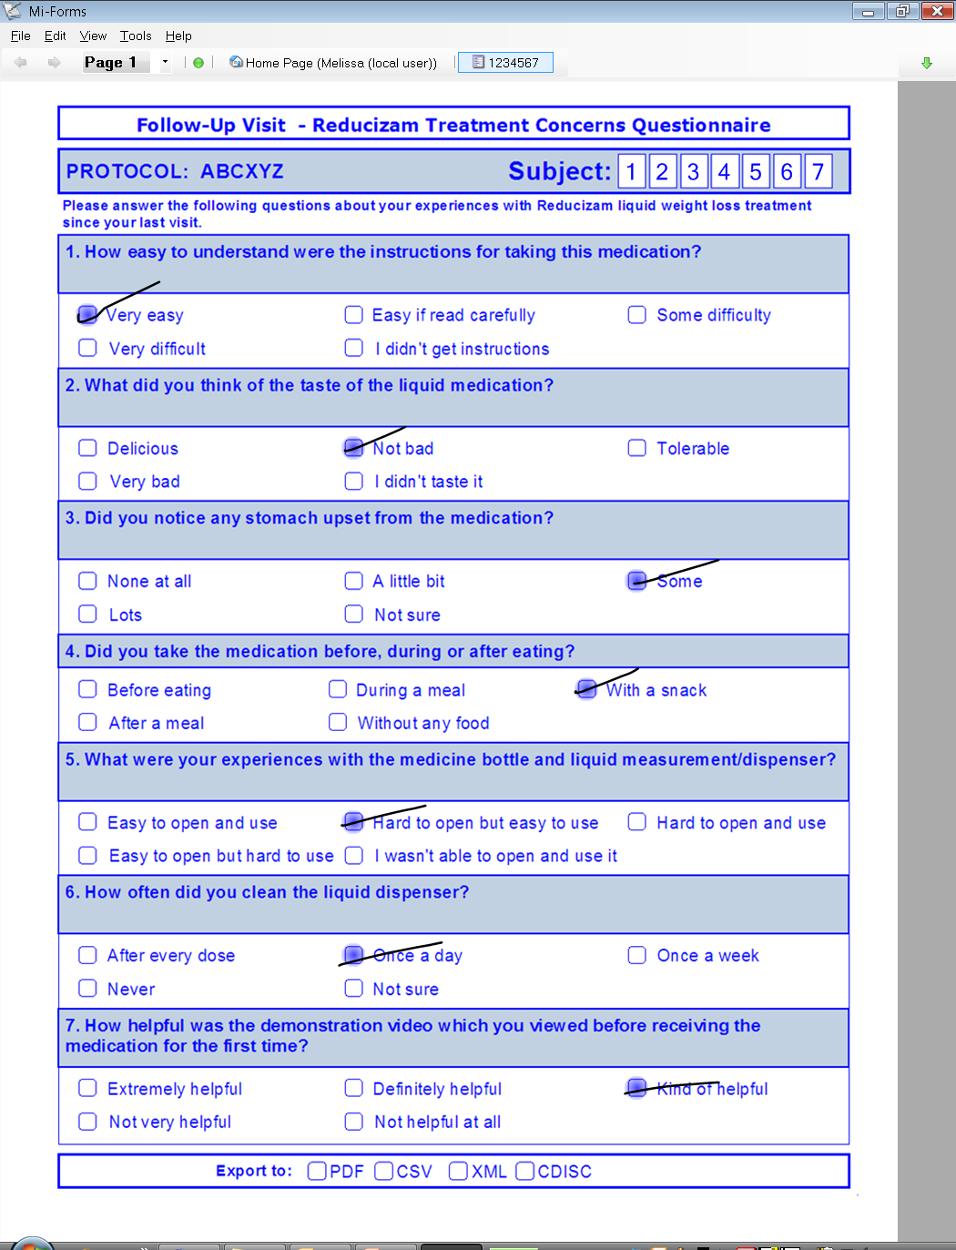
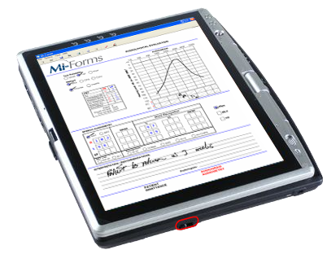
Collection Methods: Stylus
“We’ve simply replaced pen and paper with digital ink and Tablet PCs. With this change, we’re now in a position to collect an entire spectrum of data and deposit the data simultaneously in a clinical system or a national registry… It’s like zapping your paper form right into the database.” Richard E. Shaw, M.A., Ph.D., F.A.C.C, F.A.C.A ,Director of Research, Quality and Education, CPMC Heart and Vascular Center, California Pacific Medical Center, San Francisco, Sutter Health.
Notes:
Is everyone here familiar with tablet PCs?

Slide 12
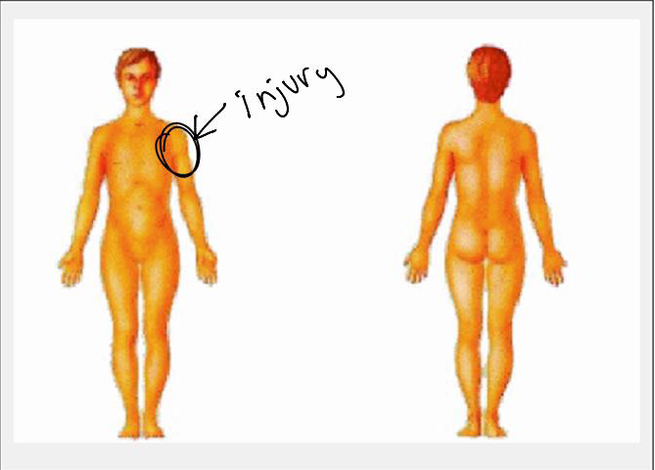
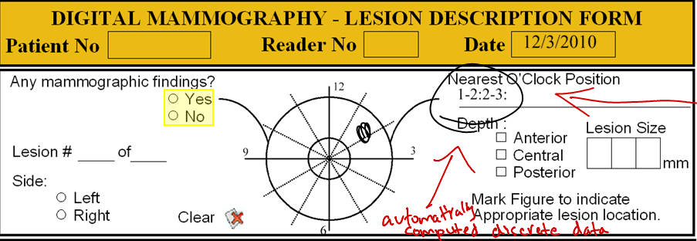
Mi-Forms Augments EMRs by…
Image capture
Annotations on images
Radiology
Dermatology
Opthalmology
Others….
Discrete data capture
From images
Powerful data in EHR/EDC Systems

Slide 13
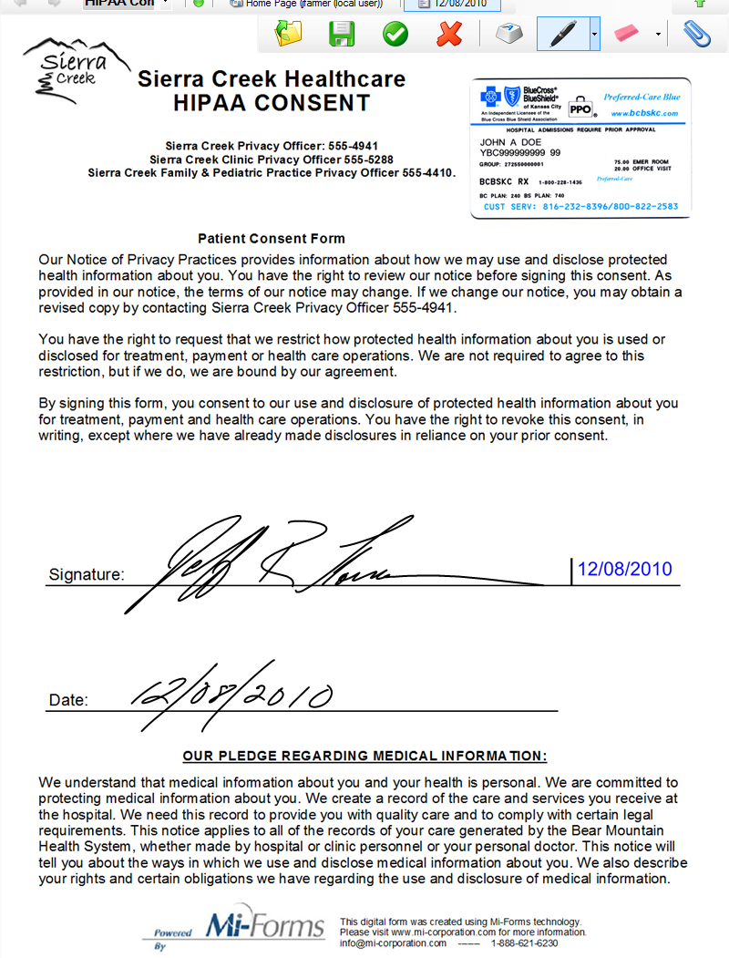
Consent and Advance Care Directive Forms
Legally accepted consent and advance care directive forms
Electronically stored
No losing paper
Attached to EMR
Track time patient read each page
Educational content can be included

Slide 14
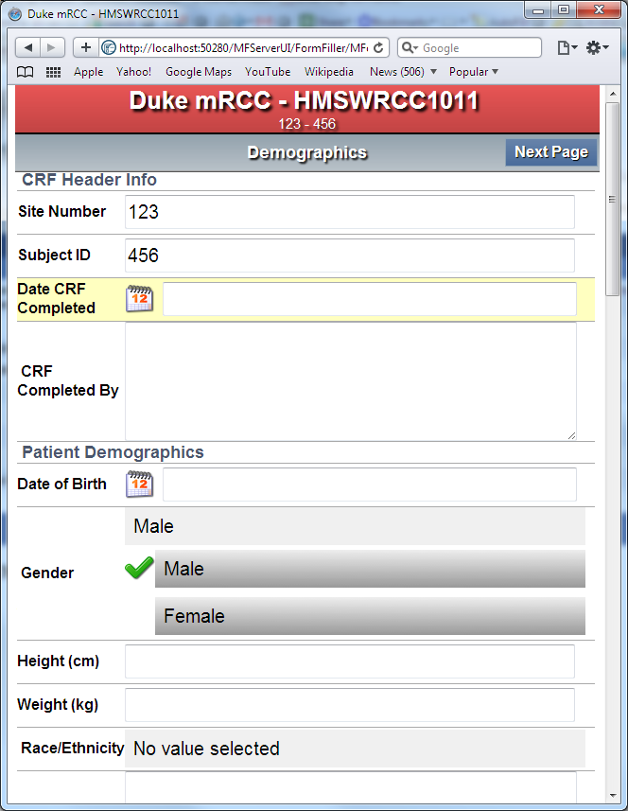
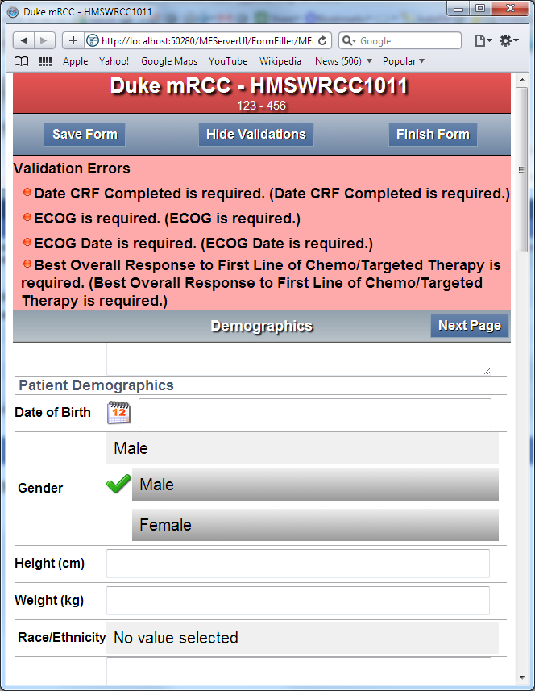
Collection Methods: Touch

Slide 15
Enterprise-Class Security
High levels of security and control - HTTPS and VPN communication, SSL certificates, hashing, full audit trails, unique IDs, password aging and encryption
In-process data contained in proprietary, encrypted XML format (64 bit DES tech)
Detailed session reports on any form-session stored:
U/N, device name, session open time, Mi-Forms versioning, O/S versioning, Memory availability, battery level remaining, session end time & potential session transmission time
Ink-Capture on form with Stylus: Each ink-stroke is time-stamped, each point’s pressure data recorded in the XML data
Session hashing: security tags against XML export & internal passwords for uploads
Authentication:
On Start of Mi-Forms & Finish/Upload of the form session
Lockout of accounts based on failed authentication
Active Directory Compatibility
Validated for FDA 21 CFR Part 11 compliance, HIPAA Compliance
Audited by Eli Lilly, Quintiles, Sutter Health
Notes:
High level overview of the technology, for the technical folks in the meeting. Is .Net technology a good fit for your existing infrastructure?

Slide 16
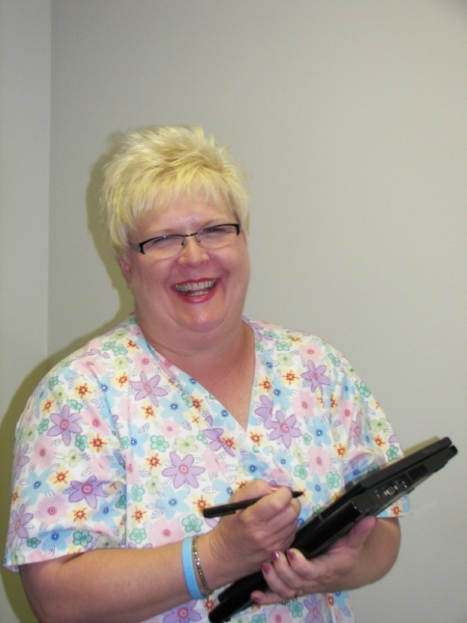
Mi-Forms Solutions – The Best of Both Worlds
Mi-Forms provides the ease of use of paper with the efficiency and accuracy of electronic data.
Key benefits:
Improved efficiency – eliminate manual keying tasks.
Improved effectiveness – reduce errors.
Improved availability – quicker access to electronic data.
User-friendly – minimizes training requirements.

Slide 17
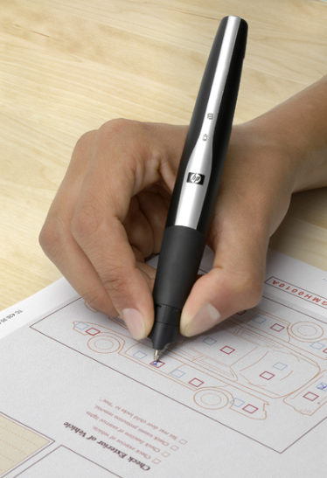
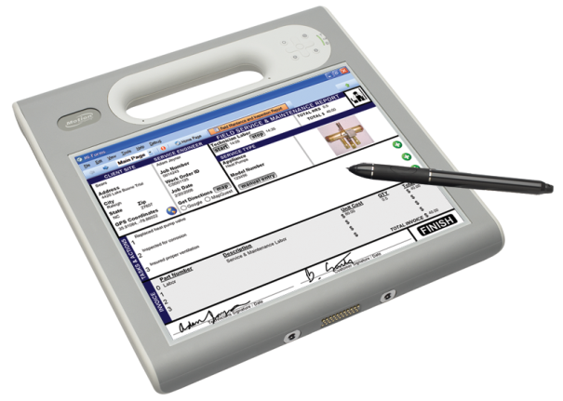
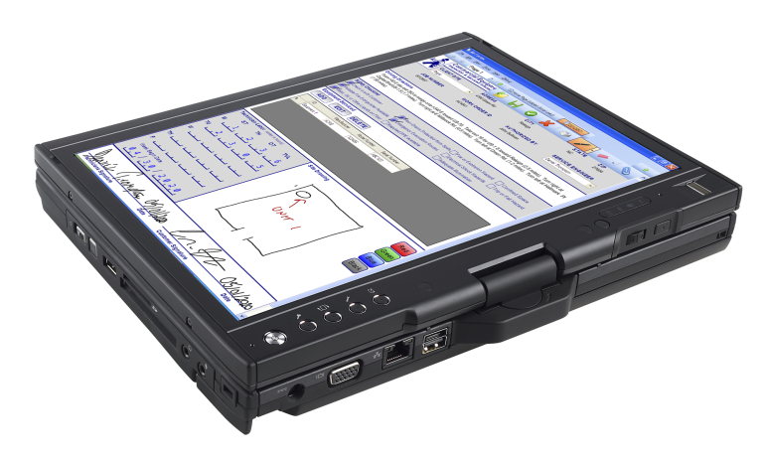
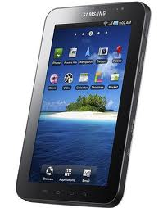
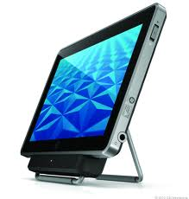
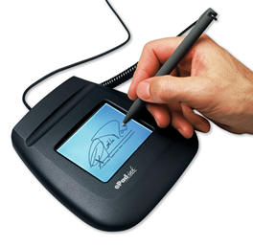
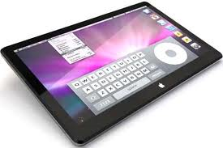
System Features –
Data Capture: It’s all about Options
Notes:
Once you have designed the form, the Tablet PC allows for the easy and natural collection of the data. To demonstrate the data capture interface of Mi-Forms I will be using a form from a hospital clinic.
During this demonstration, you will see examples of the following:
Business Rules Business rules may be added to a form to enforce quality data collection. Such rules may be used to flag potential errors or even prevent the user from submitting bad data. In Mi-Forms, business rules are written using a Microsoft .NET language.
Feedback The form designer can specify real-time feedback during data collection sessions. This feedback can be visual or audible. The feedback may occur when data is entered (for example, Mi-Forms can "speak" the value of a checkbox that is hit) or when business rules are violated.
Datapaths A Mi-Forms Datapath controls the export of data to an external database. Such exports can be simple file exports, like XML, CSV, or a variety of image file formats. In addition, a datapath can utilize ODBC to connect to a wide variety of data base management systems.

Slide 18
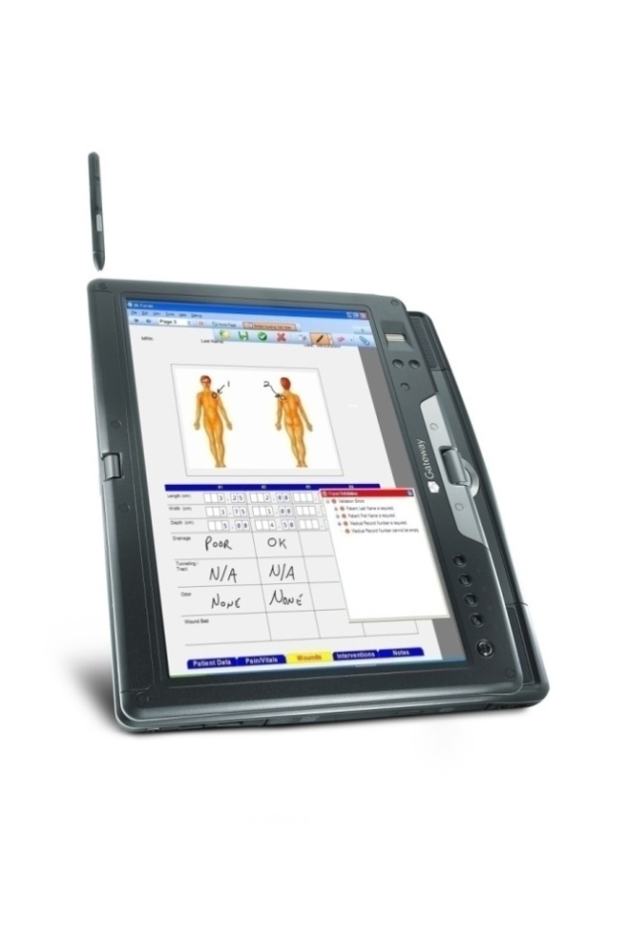
Questions and Demonstration…

Slide 19
Thank You

Slide 20
Backup Slides

Slide 21
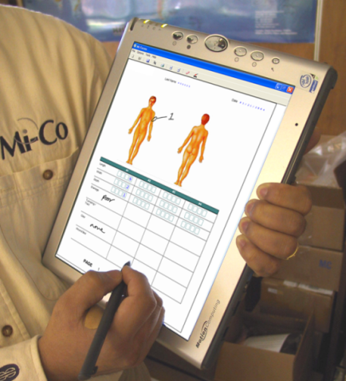
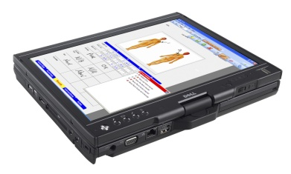
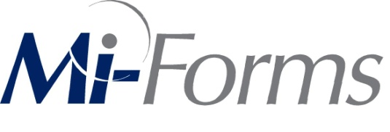
Flexible Integration and Communication
Data Paths
ACCESS
SQL Server
DB2
Oracle
Others
ODBC
XML
CSV
SMTP
PDF, PNG, TIFF
HL7
Enterprise Database

Slide 22
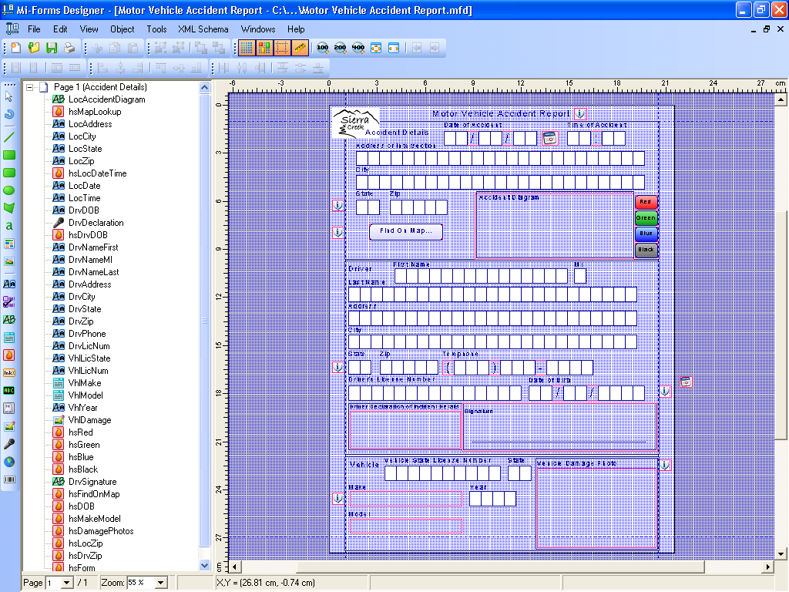
System Features: Forms Design
Easy Layout Using
Drop and Drag
Flexible Business
Rule Definition
Multiple Data Paths for Communication
Tutorials and Context
Sensitive Help

Slide 23
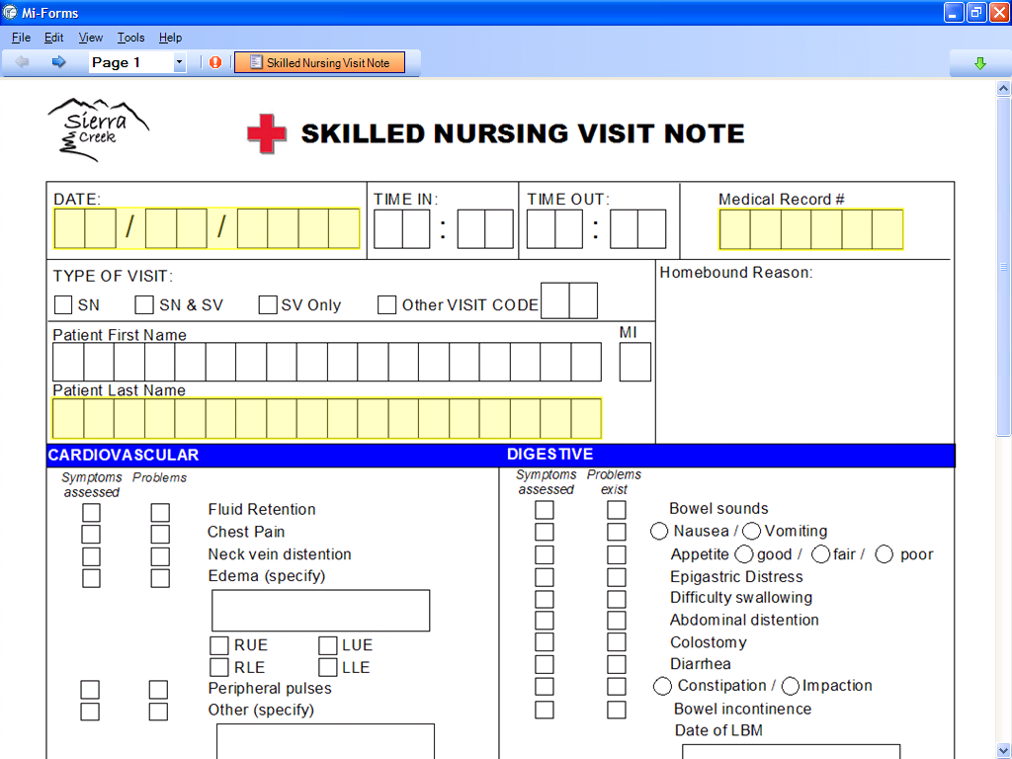
Data Capture and Verification –
Ink on Tablet PC

Slide 24
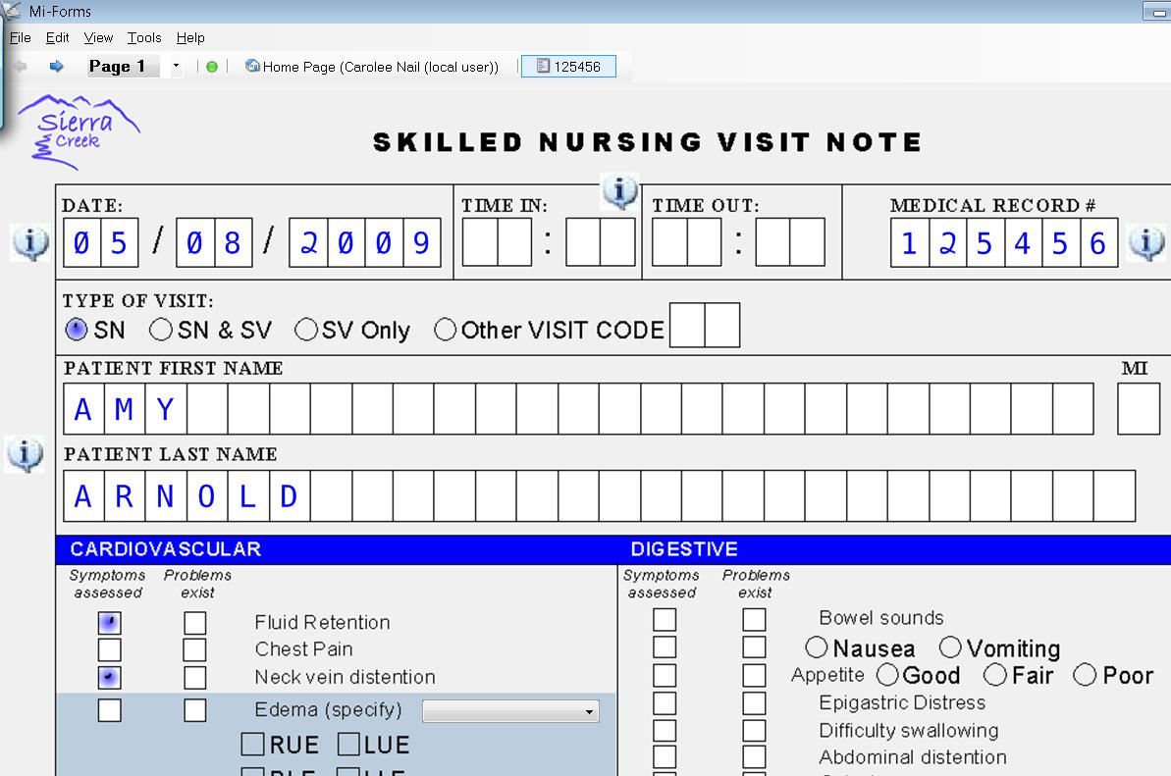
Data Capture and Verification

