Slide 1
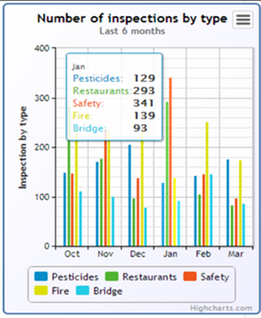

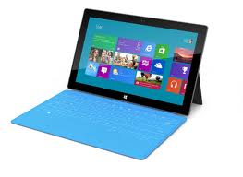

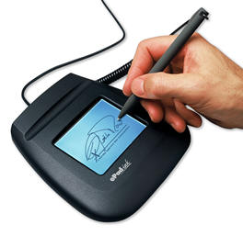
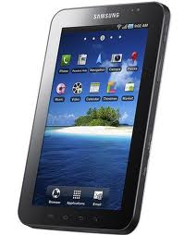
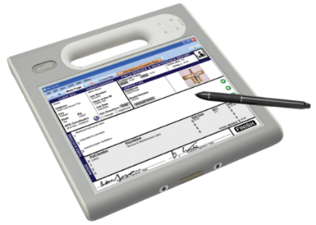

Mobilizing your Mission Critical Processes
Overview & Demo www.mi-corporation.com

Slide 2


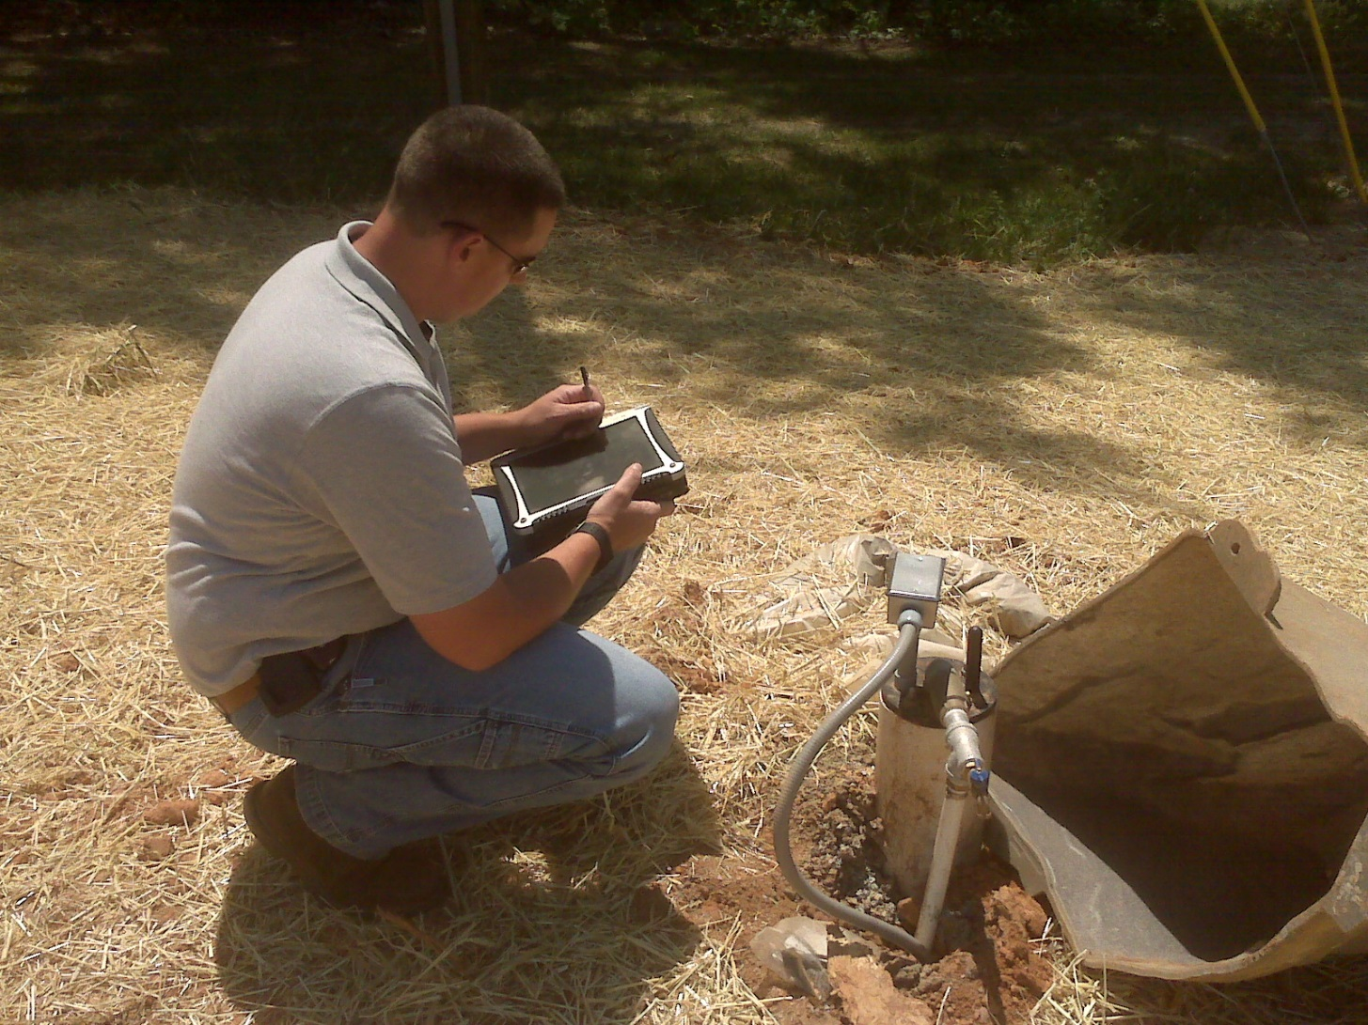


What is a Mission Critical Process?

Slide 3
Impact: NC Department of Agriculture
Parameters in old process:
  19 field inspectors, completing 5 forms/day….
  Cost of paper-process: ~ $6,254/month
Total investment with Mi-Co in Mi-Forms mobility project (software + services + other)
  ~$200,090 (over ~6 years)
Net Savings to date (after hardware cost, Mi-Co costs, training, travel, other items)
  $219,210.70 (and $72,791/year from here on ea. yr.)
2-4 week process reduced to 1 day, citizens happier too

Slide 4
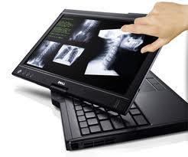
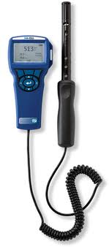
Impact: MS Department of Health
MS Early Intervention Program (2nd project)
  Infants & toddlers with developmental delays
  60+ Field Service Coordinators / Case Managers
  Over 2,000 Offline Individualized Family Service Plans per year
  Easy, fast data submission to managers & database
  State & Federal funds
  Windows Tablets
Restaurant inspections
  200 Tablets
  Integration with air quality testing meter!
  Instant lookups of database in field
  Improved data quality
  CDC funded project

Slide 5
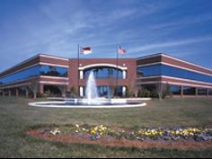
Mi-Corporation Corporate Overview
15 years of Enterprise Mobility Software Experience
  - Founded 1999
Enterprise Mobile Data Solutions to optimize mission-critical processes
  Mobile forms, mobile apps & dashboarding/reporting products
  Any data, Any Device, Anywhere!
  Flexible, scalable, secure & mature (v10)
Partnered with industry leaders
  - Intel, Microsoft Gold ISV, Panasonic, Motion Computing, Samsung,
  Anoto & more
Intellectual leadership
  10 issued US Patents, 3 more pending

Slide 6






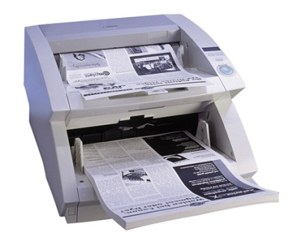


Business Case: Typical Paper Form Workflow
Design Form
Print Form
Distribute Form
Complete Form
File Original
Index & Route
Scan Form
Route Form
Approximate cost of a paper form: $4.95
- AIIM Whitepaper, 2012
Notes:
Part of rationale for mobile data capture projects. While this is an average across many industries & companies, can you afford to incur these types of costs for much longer? Mention our ROI tool that we will showcase at the end that can give them their specific process cost/KPIs

Slide 7
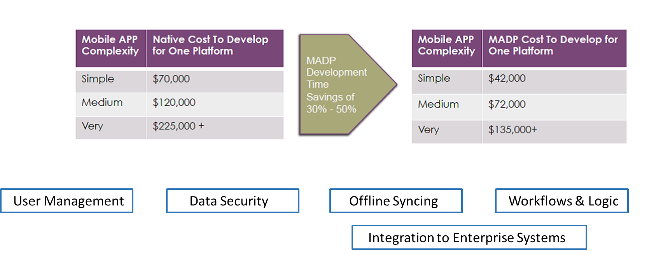
Business Case: Typical Mobile App Project
Notes:
70% of a B2B/B2E mobile app project cost & duration is in the above elements, not in building the UI

Slide 8



Business Case: KPIs, Dashboards & Analytics
What?
So what?
Now what?
http://www.actioncoach.com/Good-Decision-Making-in-Business?pressid=1282

Slide 9
Mi-Corporation Products: Mi-Forms
Mi-Forms Software System
Software that allows enterprises to build electronic forms applications for mobile data collection
Build Any Form App (however simple or complex) & deploy to any device
Implement Any Business Rule for Verification, Validation or data lookup (online or offline)
Communicate with any Backend Enterprise System (via 90 APIs & web services)
Design
Forms
Capture
Data
Verify
Data
Communicate
Information

Slide 10
Other Mobility Products Available from Mi-Corporation
Mobile Field Inspection System
  Field Inspection Dashboard/Database/Reporting system
  Database tables automatically created when forms created
  Pre-configured reports, dashboards, charts/graphs; on-premises or hosted
Mi-Enterprise Apps
  Server-based middleware platform for mobile app developers to use
  Manages users, integration, workflow, business logic, syncing, security etc.
  Allows for faster app deployment with proven technology in weeks not months
Notes:
Big Data Play for MISM; analytics refer back to the “So What?”
70% of B2B/B2E mobile app projects’ cost & effort is in the back-end pieces that MEA streamlines significantly

Slide 11
Service & Support Matter for Mission-Critical Processes
“The continued dedication the support team provides to their customers, acts as a cornerstone to their business model.”
- Trevor Cannon, Developer, CDP
Notes:
This is not a commodity purchase; the vendor you buy from should be fully vested in your project(s), highly responsive, proactive and have proven themselves before solving customer problems and being rated highly for it. ESPECIALLY for your MISSION CRITICAL PROCESS. Have you ever had a time when you had an issue with an important technology system?

Slide 12
Demo & Suggested Next Steps
Visit www.mi-corporation.com for more information about
Mi-Corporation software & services: Data Sheets, Case Studies, White Papers
Downloadable Demo software is available at www.mi-corporation.com
Look for Mi-Forms apps ON THE APP STORES (Apple, Android)!
Watch our Youtube videos: www.youtube.com/micortp & www.youtube.com/mobileforms
Arrange a Mi-Corporation best practices workshop - Vince Fuemmeler
vince@imssecure.com
573-303-0039

