Slide 1

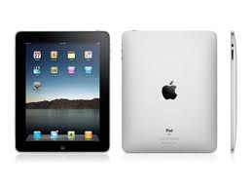
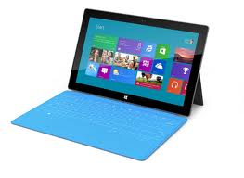

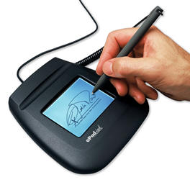
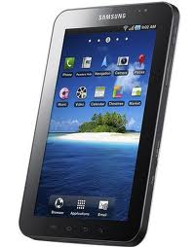
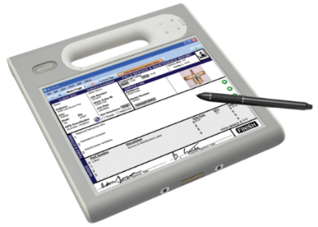
No Connectivity? No Problem:
Offline Mobile Data Solutions
Overview & Live Demo
Mi-Corporation
www.mi-corporation.com

Slide 2
Agenda
Speaker Introductions
Mi-Corporation background
The World of Offline Data Challenges
Offline Data Solutions seen in the Marketplace
The Mi-Corporation Offline Data Replicator Solution
Live Demo
Q&A, Discussion & Pop-Quiz!

Slide 3


Speaker Introductions
Gautham Pandiyan
David Nakamura
VP of Sales & Marketing
5 years at Mi-Corporation
Avoid at TSA lines!
Dir. Of Quality Assurance
13 years at Mi-Corporation
Just discovered Facetime

Slide 4
Why Do We Do What We Do?
“We strongly believe mobile information positively impacts the world”
- of our customers
- of their customers
- of their stakeholders
- and their communities

Slide 5

Mi-Corporation Corporate Overview
14 years of Enterprise Mobility Software Experience
  - Founded 1999
Enterprise Mobile Data Solutions to optimize mission-critical processes
  Mobile forms, Mobile Apps, Dashboarding products
  Any data, Any Device, Anywhere!
  Flexible, scalable, secure & mature (v10)
Partnered with industry leaders
  - Intel, Microsoft Gold ISV, Panasonic, Motion Computing, Samsung,
  Anoto & more
Intellectual leadership
  10 issued US Patents, 3 more pending

Slide 6
















Select Mi-Corporation Customers

Slide 7
Customer Problems We Solve
Employee productivity hampered by paper forms, data-entry, no historical context
Processes are redundant, not streamlined or efficient as could be
Costs are adding up with manual data-entry, printing, mailing, scanning forms etc.
Information is not reported quickly enough, slows billing, other processing
Data accuracy issues with the constant need to fix errors on the back-end
Competitive pressure to use technology for better customer service & turnaround
Notes:
Which one of these typical problems are you most concerned about or trying to solve?

Slide 8
POLL 1

Slide 9


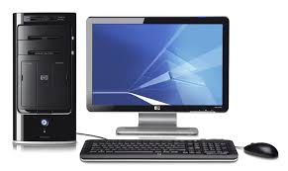

Mobility Solutions Highlight the Gaps
http://www.fashionleisure.com/image-of-a-desktop-computer/
http://en.wikipedia.org/wiki/Mobile_Web
http://www.bitrebels.com/technology/beer-glass-keeps-checking-smartphones/

Slide 10




Slide 11
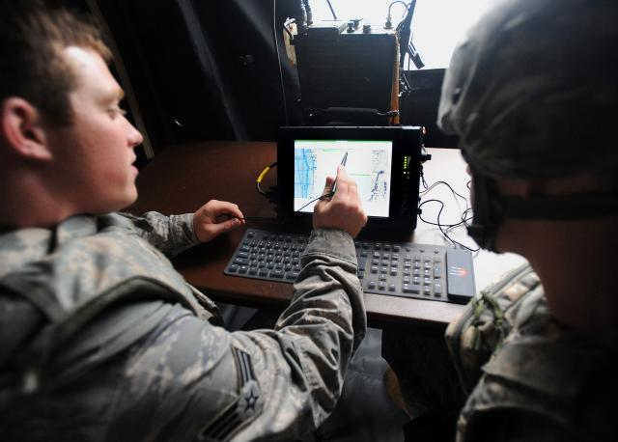

Connectivity & your Mission Critical Process

Slide 12
The World of Offline Data Challenges
Field Technologies Magazine (Field Mobility 2013)

Slide 13
Field Technologies Magazine (Field Mobility 2013)

Slide 14
Offline Data Solutions Seen & Heard…
HTML5 and leveraging its offline storage capabilities
  Limited storage in cache
  Device resource limitations
  Other…
  Plugins face similar issues
SQL Lite
  Great data store, but no sync
  Hard to define schema & maintain data on servers and to create client-side schema easily
  Asynchronous data replication to client difficult
  Integrated authentication challenges

Slide 15
POLL 2

Slide 16


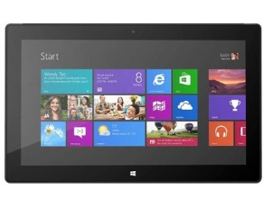

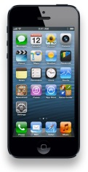


Repository
SQL Lite DB
Replicator
Sync Services
Available with Mi-Forms Enterprise & MEA

Slide 17
No Connectivity, No Problem:
Offline Sync
Challenge
  Get data sets from data sources to mobile devices
  Allow access to data while offline
  Keep the data “fresh” when back-end system updates are made
  Store data offline securely and sync it back to enterprise systems later
Solution – Mi-Corporation Offline Data Replication Module

Slide 18






Data & Schema
Services
Repository
Client Sync
Services
Replicator
Merge Agent
Data Side Schema & Row API
Resource(s) to be synced
Client Data
API
Apps
&
Forms
SQL Lite DB
Notes:
Let’s again look at this from a high level.
Data resources we care about are stored in 3rd party databases such as SQL Server, Oracle, DB2, mySQL, PostgreSQL, or really any other data source so long as the data can be pulled.
Through a set of data and schema services, data is packaged up and moved to our data repository. These services allow a data administrator to define what the data looks like and to send periodic updates to the repository as needed. These refreshes can be either be full data pulls or updates such to rows, inserts and deletes.
Once it’s in the repository, we need to get it to client devices.
The server exposes a set of sync services that allow client devices to register for data they’re interested in and then to pull that data from the repository.
This data is synchronized down to your tablets and phones and into the SQL Lite repository that exists on those devices.
Then once that data is on the device, it’s accessible by apps and forms through the client data API. This means that you can directly query data from those 3rd party sources on the device even while offline and expect it to be fresh data.
One more time through concepts. First here on the server side.
We’re defining the term resource to mean one or more data tables from data sources. This is important because a form or an app will address the data by a resource name. This is essentially an identifier of what data is being synchronized.
As I mentioned, there’s a single central data repository. This is a place where all the synchronized data will be staged and changes to this data will be reconciled such that logic can determine what a device needs when it asks for a given resource.
There’s a data side schema and row API. This is what’s utilized to move data from 3rd party sources into the central data repository. It defines both the structure and the actual data.
And then there’s a client side row API. This is the API that client devices interact with to synchronize the data to the device.
If we look at the concepts on the client side. And I promise this is my last “concepts” slide, we’ll see four distinct components as well.
Firstly there’s the replicator. This is what’s doing the actual communication with the server. This is something we’re providing. It handles communicating with the data repository and grabbing data both in the background and in the foreground if it’s explicitly triggered.
The merge agent also lives on the client, pulling the replications together. We won’t go into depth on that here.
Where the rubber actually meets the road for you is the actual data repository on the client devices. The data is stored in SQL Lite, so you still have relational data access.
And then there’s an API to actually access the data, to register for resources, and to setup synchronizations.

Slide 19
Feedback from Concrete Data
App Development Firm
Stephen Cole, President
  “(Your) Mobile Replication (Module) relieves the client developer of worrying about data replication concerns:
    Mechanics of data chunking, sequencing of updates, and retry logic
    Respecting server-side transaction boundaries
    Replicating logically related tables as a unit
    Optimizing network traffic, by automatically detecting which rows have changed
    Automatic synchronization with data changes that occur at the server
    adapts to new schema defined at the server and creates the appropriate client-side schema automatically”

Slide 21
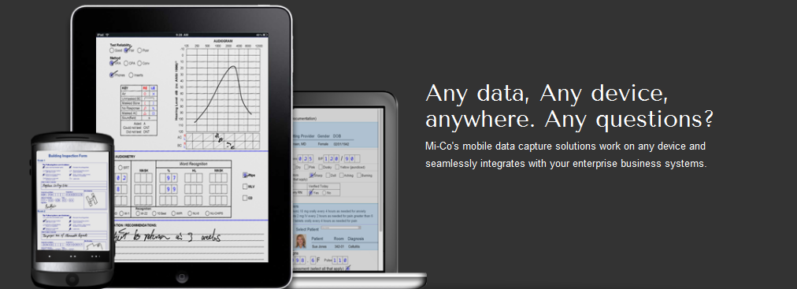
Mobility Products from Mi-Corporation that Leverage this Module
Mi-Forms Mobile Data Capture Software
  Best-of-breed, award-winning mobile forms software platform
  GUI Drag & Drop Design tool with 3rd party conversion engine options
  Client applications for iOS, Android, Windows XP/Vista/7/8, HTML5
  Server application for administrative control, user/form management & workflow
  Underlying .NET SDK allowing customization, embedding, 3rd party integrations etc.

Slide 22
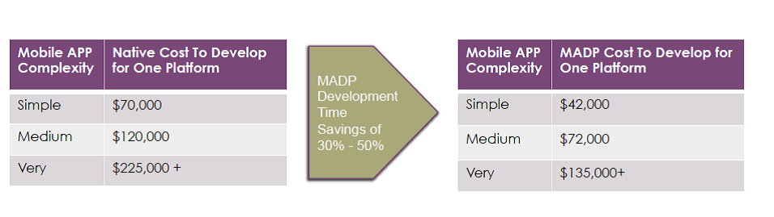
Mobility Products from Mi-Corporation that Leverage this Module
Mi-Enterprise Apps
  Server-based middleware platform for app developers to use
  Manages users, integration, workflow, business logic, syncing, security etc.
  Allows for faster, cheaper app deployment with proven technology
  Data replication

Slide 23
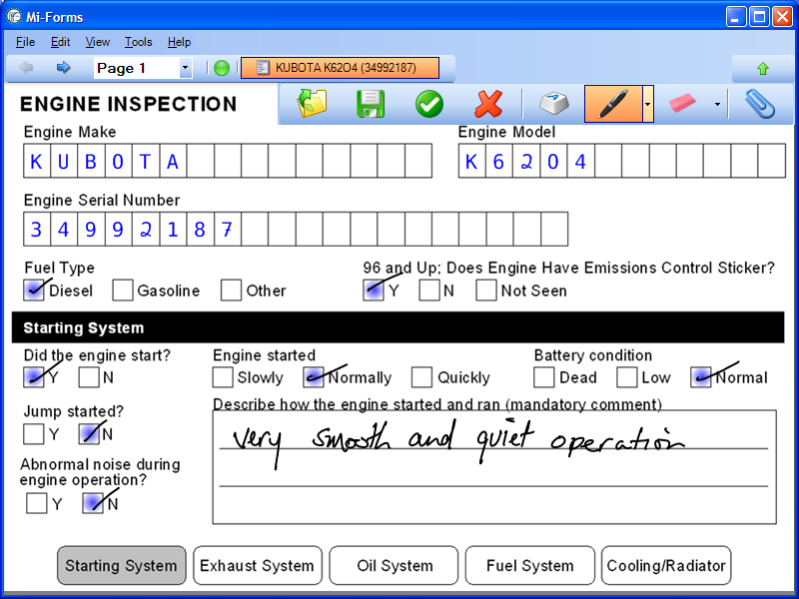

Let’s Demo!

Slide 24
POLL 3

Slide 25
POP QUIZ TIME!

Slide 26
Questions,
Comments,
Compliments?

Slide 27

Announcing….Next Month’s Webinar
Government Mobility Success Story & Interview: NC Dept. of Agriculture
Aug. 21, 11 am US ET (?)
- Featuring NC Dept. of Agriculture – Pesticides Unit
- Live Interview of NCDA by Tom Suder, Mobile Gov
- Audience Q&A, Discussion and Lessons Learned

Slide 28
POLL 4

Slide 29
Next Steps
Visit www.mi-corporation.com for more information about
Mi-Corporation Mobility Products: Data Sheets, Case Studies, White Papers
Downloadable Demo software is available at www.mi-corporation.com
Look for Mi-Forms ON THE APP STORES (Apple, Android)!
Watch our YouTube videos: www.youtube.com/micortp
Contact Mi-Co to SOLVE your Offline challenges!
Gautham Pandiyan
gpandiyan@mi-corporation.com
919-485-4819 x 1973

