Slide 1
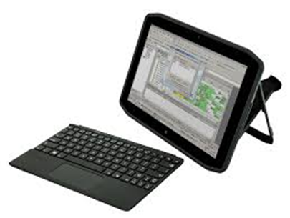
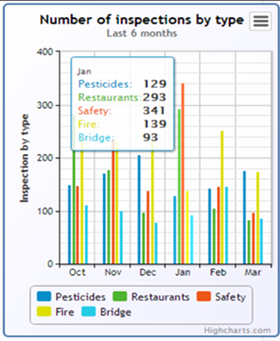
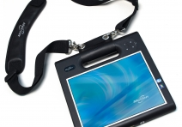


Tablet-Based Pipeline Inspections:
Boost Productivity
Overview & Demo www.mi-corporation.com

Slide 2


Speaker Introductions
Gautham Pandiyan
Cliff Adams
VP of Sales & Marketing
5+ years at Mi-Corporation
Avoid at TSA lines!
Need 1 ‘fun facts’

Slide 3
Poll 1

Slide 4
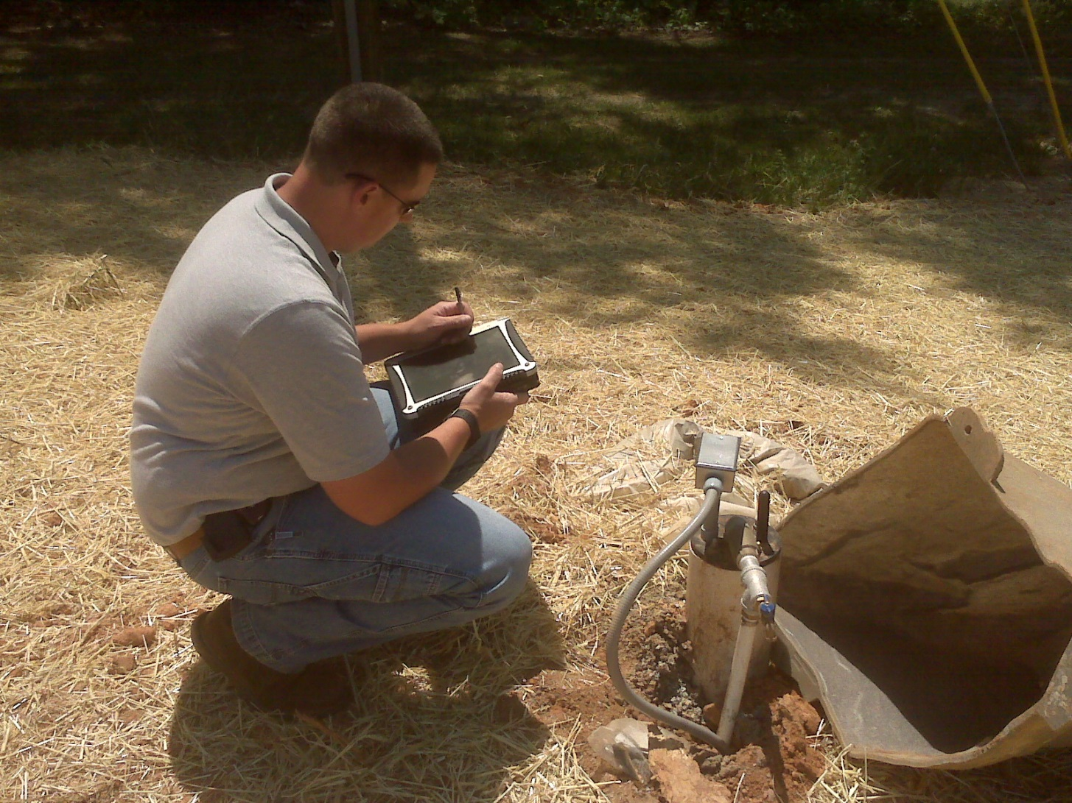





What is a Mission Critical Process?

Slide 5


Mi-Corporation Corporate Overview
15 years of Enterprise Mobility Software Experience
  - Founded 1999
Enterprise Mobile Data Solutions to optimize mission-critical processes
  Mobile forms, mobile apps & dashboarding/reporting products
  Any data, Any Device, Anywhere!
  Flexible, scalable, secure & mature (v10)
Partnered with industry leaders
  - Intel, Microsoft Gold ISV, Motion Computing, Anoto & more
Intellectual leadership
  10 issued US Patents, 3 more pending

Slide 6
Pipelines: the Arteries of the Oil & Gas Industry
Pipeline Facts
Pipeline Inspections
2.6 million miles in US alone
Covers remote, rugged areas
Rail safety pushes construction
Regulated by PHMSA
  135 federal inspectors, 375 state
  923 inspections in 2013
  Incidents down by 46% since 2009
  Operator Qualification, Safety
Construction, maintenance, safety
“Tribes” or “Family” of users
Informal notepads, memory
User adoption hurdles
Harsh, remote, rugged environment
Benefits to “Document Clerks”, Supervisors & execs more than users
No visibility at HQ for days, weeks

Slide 7

The Typical Pipeline Inspection Process
Inspector completes
Paper form, memory!
Mailed via USPS or
hand-delivered
Supervisor Review & Approval
Mailed, Faxed or
Scanned
Data Analyzed manually
Invoices, reports go out
Manually entered data
at HQ, other locations

Slide 8






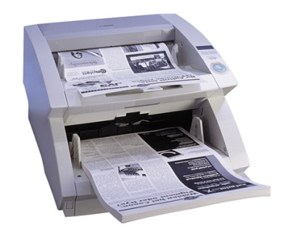


Business Case: Typical Paper Form Workflow
Design Form
Print Form
Distribute Form
Complete Form
File Original
Index & Route
Scan Form
Route Form
Approximate cost of a paper form: $4.95
- AIIM Whitepaper, 2012
Notes:
Part of rationale for mobile data capture projects. While this is an average across many industries & companies, can you afford to incur these types of costs for much longer? Mention our ROI tool that we will showcase at the end that can give them their specific process cost/KPIs

Slide 9


Imagine a Process that looked like this…
Engineer fills a Tablet-form/app
(prefills data from past
Inspection even offline)
Data Fetch
Data Fetch
Assignment of Inspections
Data pull from Ent. Systems
Data synced directly Into Enterprise Systems, Other systems like a Reporting Dashboard
No Rekeying
Approval dashboard & workflow for approval
Information hand-off
Invoices sent
faster
Instant KPIs, metrics,
analysis by executives,
managers
No Month-end scramble
Info passed to other Depts. Within same day

Slide 10

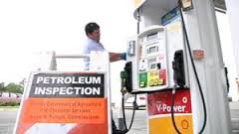
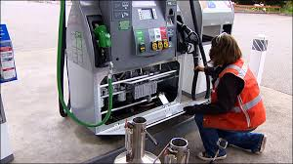
Impact of Mobilizing Inspections: The Kent Group
Petroleum Price Readers
  Nationwide field staff around Canada, Gas Station Readers
  Speed to customer delivery is critical for them
  RFP; Implemented solution in about 3 months
    Included use of handheld scanners to photograph receipts
  Cycle time down from weeks to few days
  Providing them competitive edge in market
  Extremely Satisfied with Field Tablet Solution

Slide 11
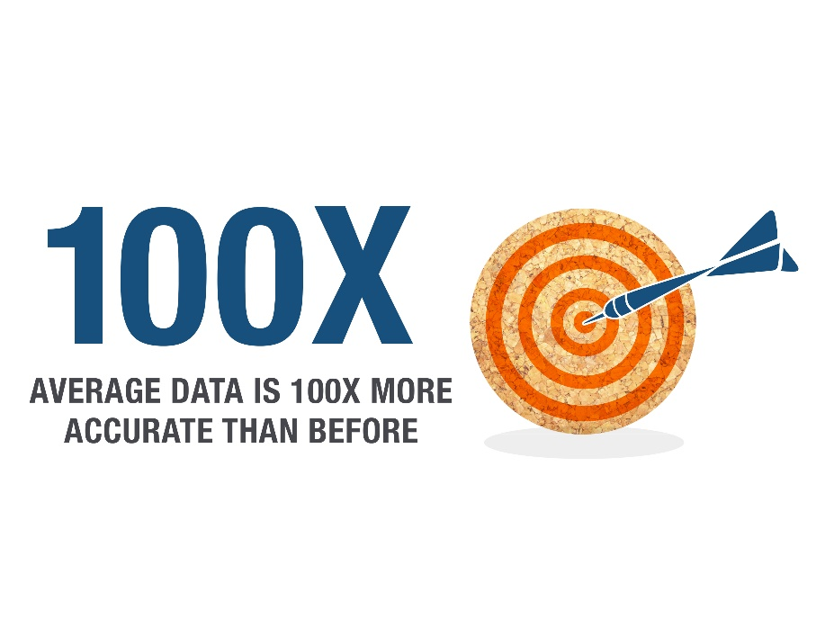
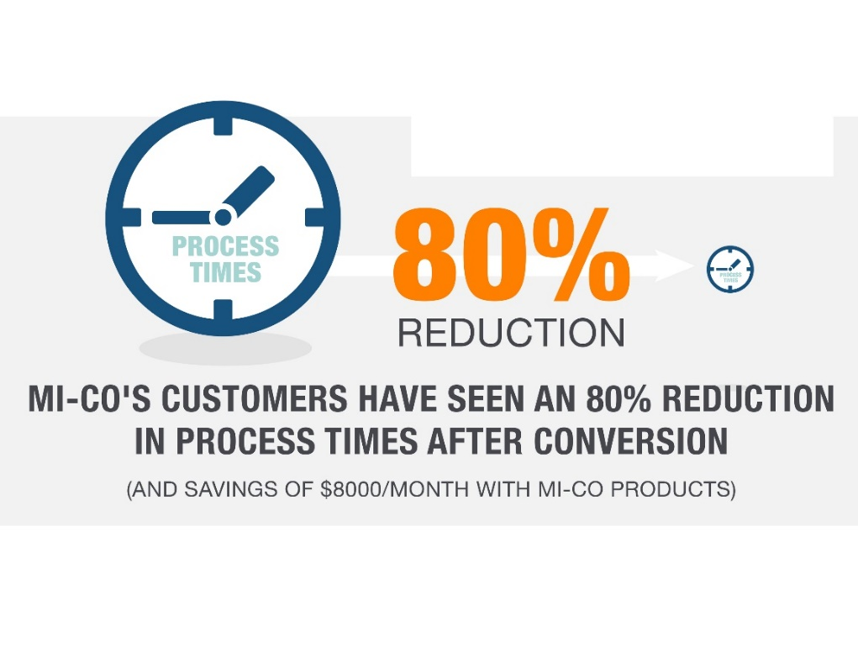
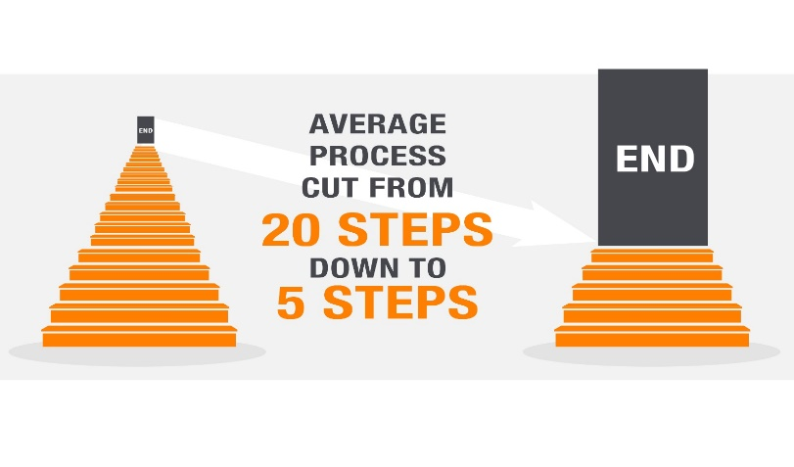
Real Results from Mi-Corporation Customers
Notes:
Real results from Mi-Corporation customers for 14+ years

Slide 12
Mi-Corporation Products: Mi-Forms
Mi-Forms Software System
Software that allows enterprises to build electronic forms applications for mobile data collection
Build Any Form App (however simple or complex) & deploy to any device
Implement Any Business Rule for Verification, Validation or data lookup (online or offline)
Communicate with any Backend Enterprise System (via 90 APIs & web services)
Design
Forms
Capture
Data
Verify
Data
Communicate
Information

Slide 13
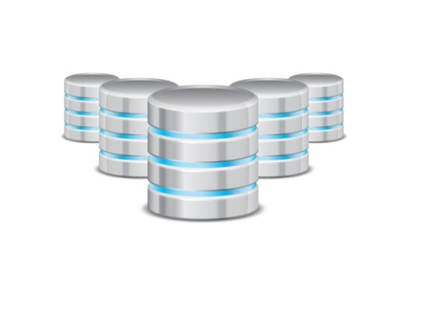
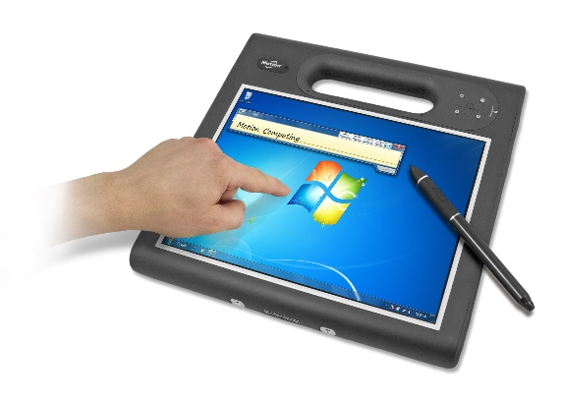















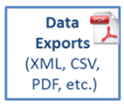






Mi-Corporation Products Architecture
Offline Data Replicator
Backend Database
Online/Offline
SQL Lite
Billing
Scheduling
ERP System
MISM Dashboard
SQL Server
Oracle
Others
Workflow
Notes:
Designer – like Powerpoint; FormBridge for Mi-Forms allows conversion into Mi-Forms format from Word, PDF, Infopath etc. etc.
Server – 4 roles
Version control & updates (automatic)
User management (compatible with AD out of the box)
Authentication (compatible with AD out of the box)
Workflow (approval routing, based on group membership & queues)
Offline – data lookups also possible using our new data replicator module that replicates a SQL Lite DB to any device for reference info; can also lookup from a CSV file traveling with the form

Slide 14
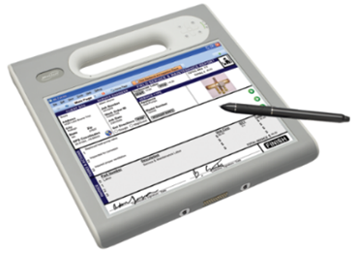


Repository
SQL Lite DB
Replicator
Sync Services
Available with Mi-Forms Enterprise & MEA

Slide 15
Other New Mobility Products Available from Mi-Corporation
Mobile Field Inspection System
  Field Inspection Dashboard/Database/Reporting system
  Database tables automatically created when forms created
  Pre-configured reports, dashboards, charts/graphs; on-premises or hosted
Mi-Enterprise Apps
  Server-based middleware platform for app developers to use
  Manages users, integration, workflow, business logic, syncing, security etc.
  Allows for faster, cheaper app deployment with proven technology

Slide 16
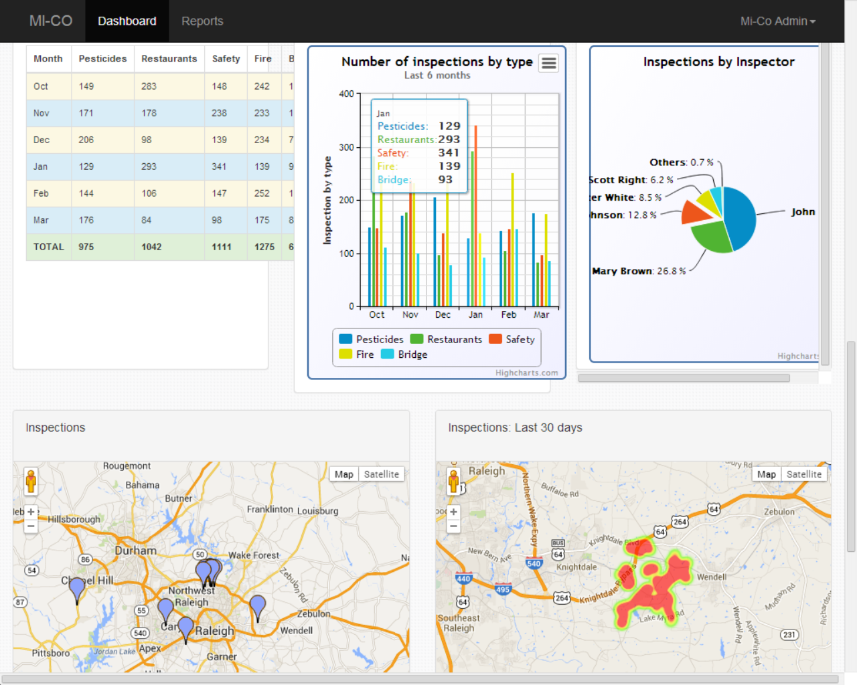

Slide 17
Service & Support Matter for your Inspection
“The continued dedication the support team provides to their customers, acts as a cornerstone to their business model.”
- Trevor Cannon, Developer, CDP
Notes:
This is not a commodity purchase; the vendor you buy from should be fully vested in your project(s), highly responsive, proactive and have proven themselves before solving customer problems and being rated highly for it. ESPECIALLY for your MISSION CRITICAL PROCESS. Have you ever had a time when you had an issue with an important technology system?

Slide 18
Maximizing User Adoption
Manage the Risks: “User Adoption is Everything” for Mobile Solutions
  Enthusiastic Users
    Right solution
    Right stakeholder involvement
    Right training programs
    Right incentives
    Repeat…
  Measure ROI, report

Slide 19



Business Case: KPIs, Dashboards & Analytics
What?
So what?
Now what?
http://www.actioncoach.com/Good-Decision-Making-in-Business?pressid=1282

Slide 20
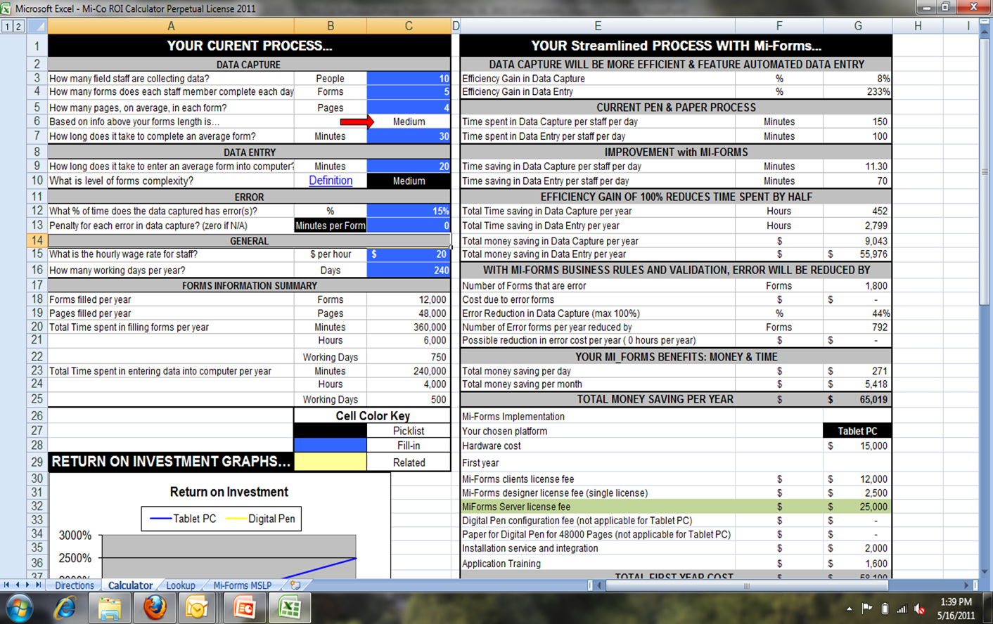

Know your current process cost
  Use tools like Mi-Corporation’s ROI calculator
  Account for hardware, software, services, support, TCO 3-5 years
Quantify the potential benefits
  Additional revenue
  Cost savings, time savings
  Better staff productivity
  Improved customer service
  Competitive edge in market
Communicate, communicate!

Slide 21
Suggested Next Steps
Visit www.mi-corporation.com for more information about
Mi-Corporation software & services: Data Sheets, Case Studies, White Papers
Downloadable Eval software is available at www.mi-corporation.com
Watch our Youtube videos: www.youtube.com/micortp & www.youtube.com/mobileforms
Arrange a Mi-Corporation best practices workshop - Mike Naugle
mnaugle@mi-corporation.com
123-456-7890
What device do you lean on? Stay tuned…
Stay tuned for a LIVE DEMO!

Slide 22
Poll 2

Slide 23



F5te Class 1 Division 2:
For Tablet-Based Pipeline Inspections

Slide 24
Motion: Target Sectors & Applications
Target Sectors
Oil and Gas
Utilities
Target Application
Plant safety and integrity
Process Manufacturing
Asset Management
Inspections and audits
Rig verification
Location track and trace

Slide 25
Motion: End User Investment Drivers
Safety Assurance Drivers:
Improved safety and compliance
Productivity Improvement:
Improve plant utilization tracking and time to market
Reduce risk of non-compliance
Improved operational reliability
Fast response to business process changes
Increased workforce productivity
Higher asset performance and availability
Improved process visibility

Slide 26
Motion: F5 CID2
Motion® Secures CID2 Certification for F5 Rugged Tablet and EasyConnect RFID Long-Range Reader
This ANSI/CSA North American certification enables Motion F5-Series Tablets
and RFID Readers to be used in hazardous locations across the Oil & Gas, Utilities, Process Manufacturing, and improving plant safety and integrity across process manufacturing. Expand the workflows your organization can efficiently and productively deliver with Motion F5 CID2 Certified mobile technologies.

Slide 27
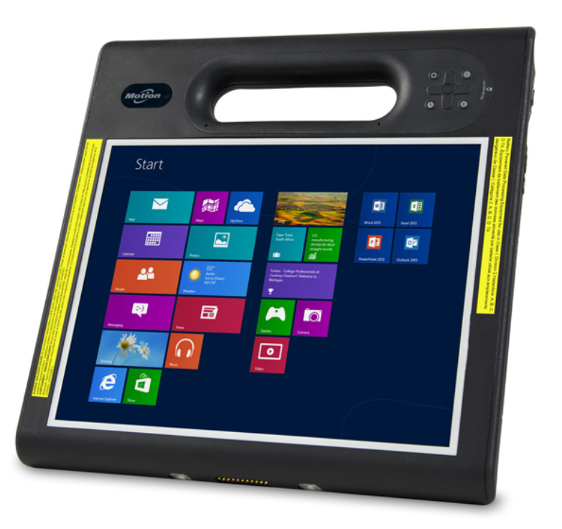
Motion: F5 CID2
  Class I, Division 2
  ANSI/ISA 12.12.01-2013
  Canada CSA 22.2 No. 213
www.motioncomputing.com
French Canadian and English Text

Slide 28
Demo, Q&A & Suggested Next Steps
Visit www.mi-corporation.com for more information about Mi-Corporation software & services: Data Sheets, Case Studies, White Papers
Downloadable Eval software is available at
www.mi-corporation.com
Watch our Youtube videos: www.youtube.com/micortp & www.youtube.com/mobileforms
Get STARTED & boost your productivity TODAY!
- Mike Naugle
mnaugle@mi-corporation.com
512-422-2558

Slide 29
Poll 3

