Slide 1



The Power of Open Book Management
It’s Money. It’s People. It’s Both.
Small Giants Conference | May 2018

Slide 2
Why?

Slide 3

Increase Gross Margin

Slide 4
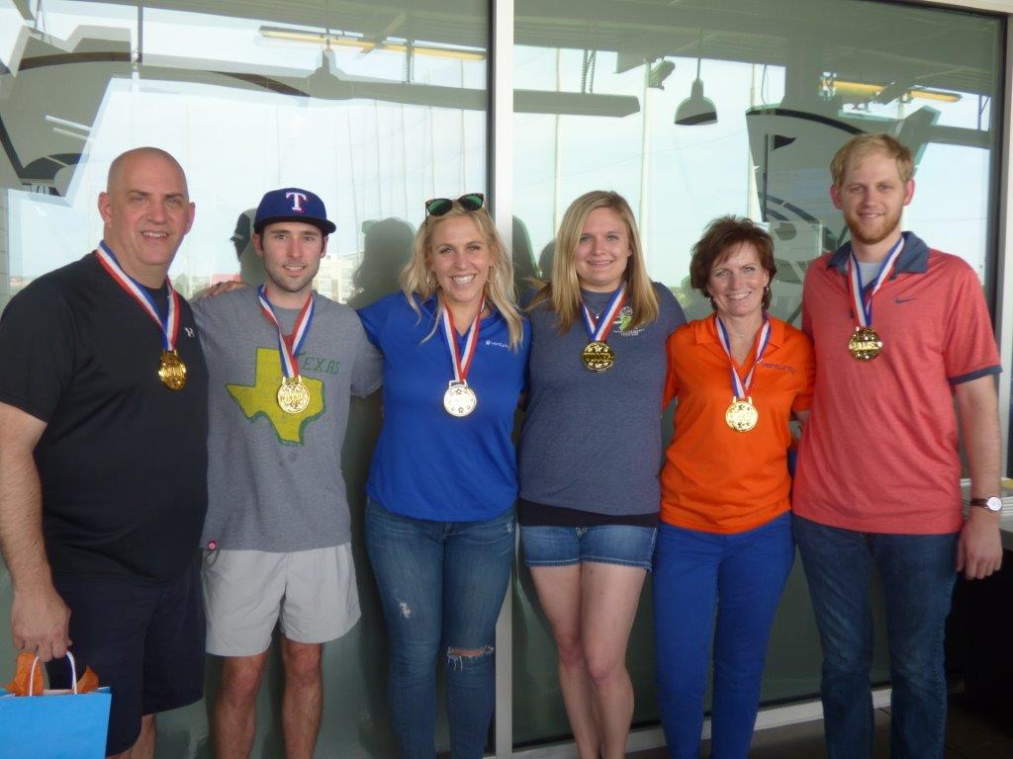
Solidify Culture

Slide 5





Values Alignment
Our
Passions

Slide 6
What?

Slide 7


Accomplish Our “Why”
?

Slide 8
How?

Slide 9
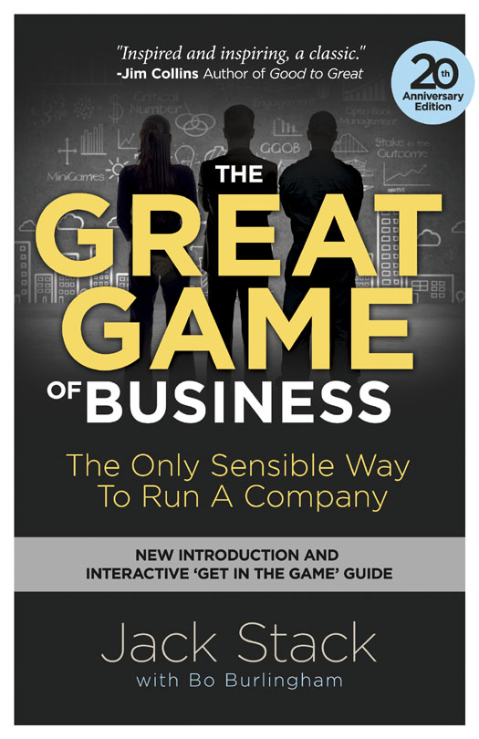

Read the Book

Slide 10
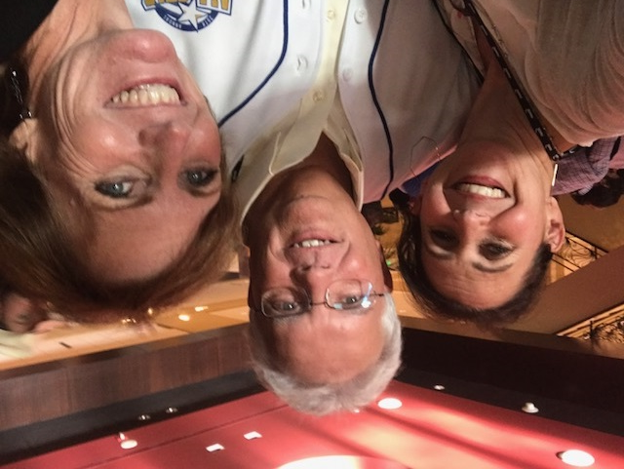
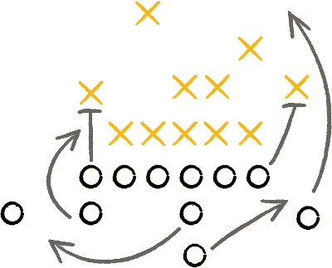
Hired a Coach

Slide 11

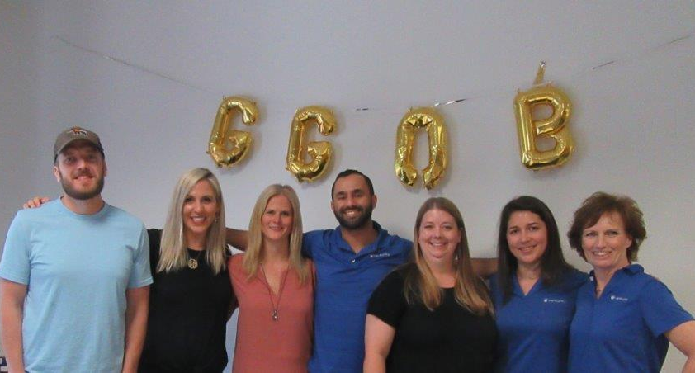
Picked a Design Team

Slide 12
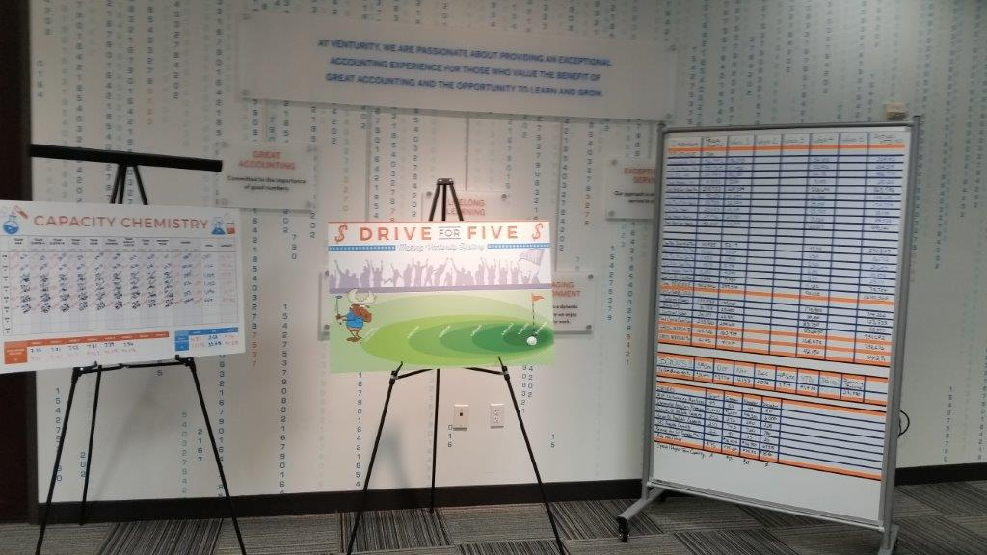
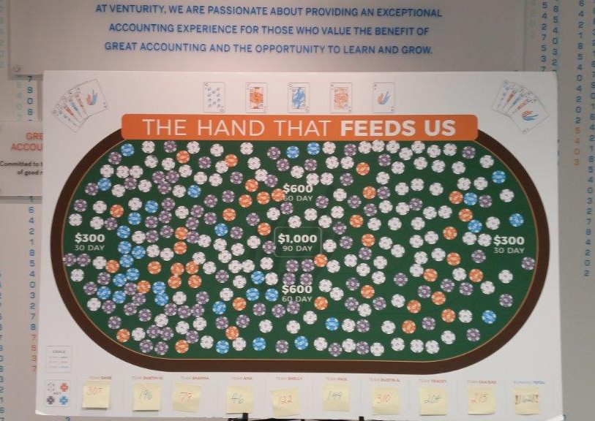
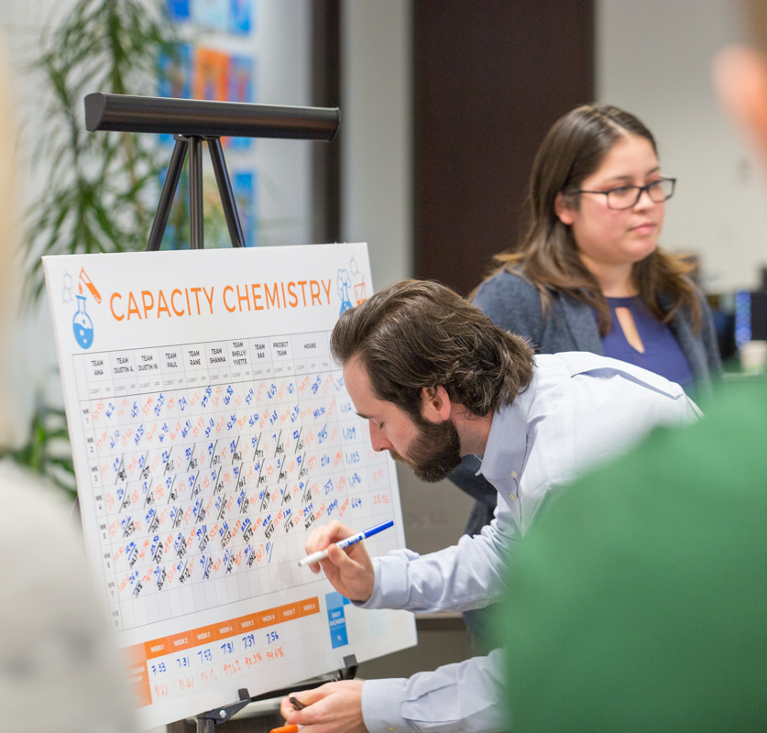
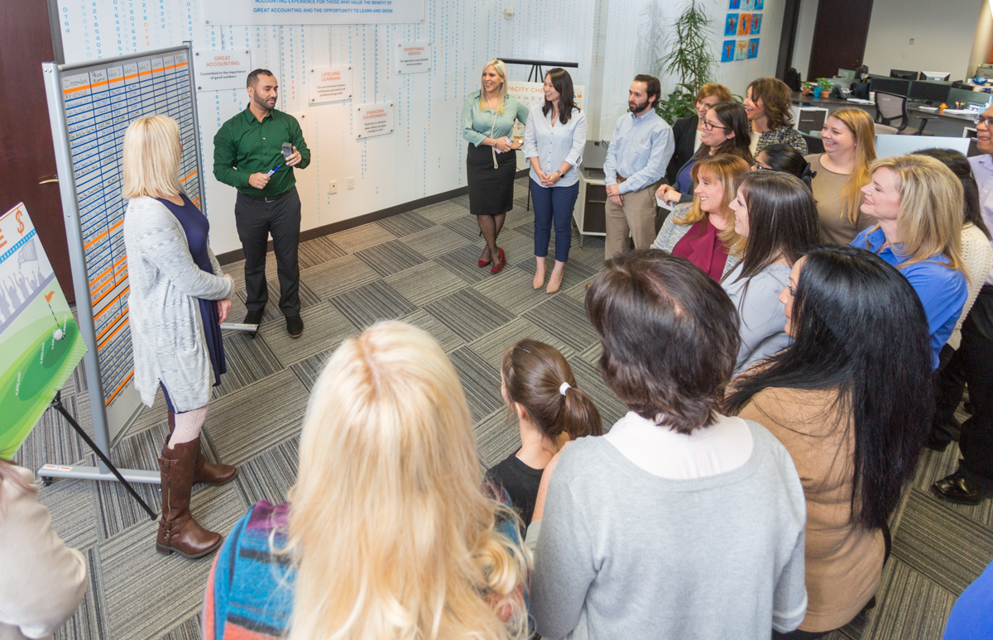
Played the Game

Slide 13
Accomplishments and Challenges

Slide 14

Gross Margin
Up 7%
7%

Slide 15


Exceeded $5 million mark!

Slide 16

Net Income DOUBLED in a year

Slide 17

Make an Impact
!

Slide 18


Stay the Course

Slide 19

m
What can I do on Monday?
Let’s Discuss.

Slide 20
For your complimentary audiobook and assessment: greatgame.com/smallgiants
Here’s where to go
Come join our huddle
Michelle Gardner | michelle@venturity.net

Slide 21


