Slide 1
Small Giants
Rethinking Employee Departures and
Eliminating Two Weeks Notice
ROBERT GLAZER | May 17, 2018

Slide 2


Meet “Diane” …
Notes:
I’d like to introduce you to someone we’ll call Diane.
She’s the Founder/CEO of a 100 person company; considered a strong leader with a strong company culture.
Good ratings on Glassdoor, good feedback from employees via TINYPulse, etc.
Very high on the culture index and works hard at having good employee relationships.
Many of you will recognize yourself and your company in Diane.

Slide 3

Notes:
It’s both surprising and disheartening to Diane when an employee – who she thought was happy and fulfilled in their job – gives their two weeks notice.
This has become the norm, even in great companies
An employee quits or gets a new job somewhere else and leaves the company. And, more often than not, they their current employer in the lurch.

Slide 4
A Broken Paradigm
EMPLOYER
Rush to fill the gap
No opportunity to fix the issue
EMPLOYEE
They leave on a bad note
Leave with a trust deficit
Don’t do their best work at the end
Notes:
The whole two weeks notice concept is an outdated, broken paradigm -- for both the employer and the employee.

Slide 5

Why does this exist?
Notes:
Honest conversation is not encouraged on both sides. Paradigm is to not talk about problems.
Why do we accept this in work when we would never accept in a relationships
Imagine telling someone that you are leaving them in two weeks and already have a new house and partner without even talking about it?

Slide 6

what Diane really wants …
no surprise, honesty, fix, support, respect
Notes:
Not to be surprised
Honest conversations with employees
Fix the issue before it becoming such a problem that the employee leaves
To be able to support them in their transition if they do still decide to move on
Respect on both sides

Slide 7

Out of Alignment
How? - Us Too >Time - Culture - Odds - Better Way
Notes:
How do we know this?
Because, like Diane, we’ve been through this process with many of our employees over the years.
We put a lot of time, effort, thought, and resources behind building a great culture at Acceleration Partners, yet we were still accepting the two-weeks-notice paradigm.
It was at odds with the culture we were building and the core values we were establishing, it was also painful, stressful and expensive.
I knew there had to be a better way that would align with our culture that encourages open communication and transparency.

Slide 8

Inspired by Netflix
Looking Building on Honesty 6-12 Months
Notes:
We started looking around at what other companies were doing and were really inspired by Netflix’s approach.
They were building their own culture based on honesty and respect and that extended to the way they handled transitions.
When people don’t work out, they’re given a generous 6-12 months severance package.

Slide 9
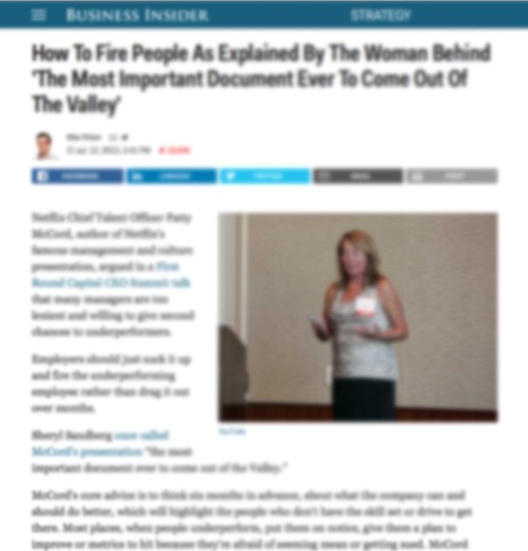
“Instead, I could have told the employee, ‘here’s what I’m going to need six months from now, and here’s the talent and skills I’ll need, she says” “Then you tell her, ‘It’s not you. I don’t want you to fail. I don’t want to publicly humiliate you.’”
Her point is that offering someone real feedback, a reference, and maybe some paid time to find a new job is far more helpful, and better for both parties than dragging things out for six months. Be generous, but be honest.
PATTY MCCORD
Netflix Chief Talent Officer
Notes:
I came across this passage 5 years ago from Patti McCord
Was the lightbulb for me, changed how I looked at things

Slide 10


Managing transitions
Loved the Netflix policy…
…don’t have their deep pockets.
Notes:
While Netflix’s transition practice was generous
We knew we couldn’t afford to do that being a small company.
But it got us asking, “what CAN we do?”

Slide 11

Rethinking The 2-Weeks Notice
Lineof? - Process - Frustrations - Stuck - 2 Years Name
Notes:
That line of questioning led to develop a new process for transitions/departures
In all transparency, there were definitely missteps and mistakes…
(Share what some of those were)
- employees walked out the door and it was just bad all-around
- things that didn’t work the way we anticipated
- challenges with implementation and communicating this new process effectively
But we stuck with it. It took us about three years to develop our solution to the 2-weeks notice problem and evolve it into the high-functioning system it is today.
And after implementing it for some time now, we honestly believe it’s the best system for any company to introduce within their organization, especially companies that truly care about their culture.
We call this new system…Mindful Transition

Slide 12
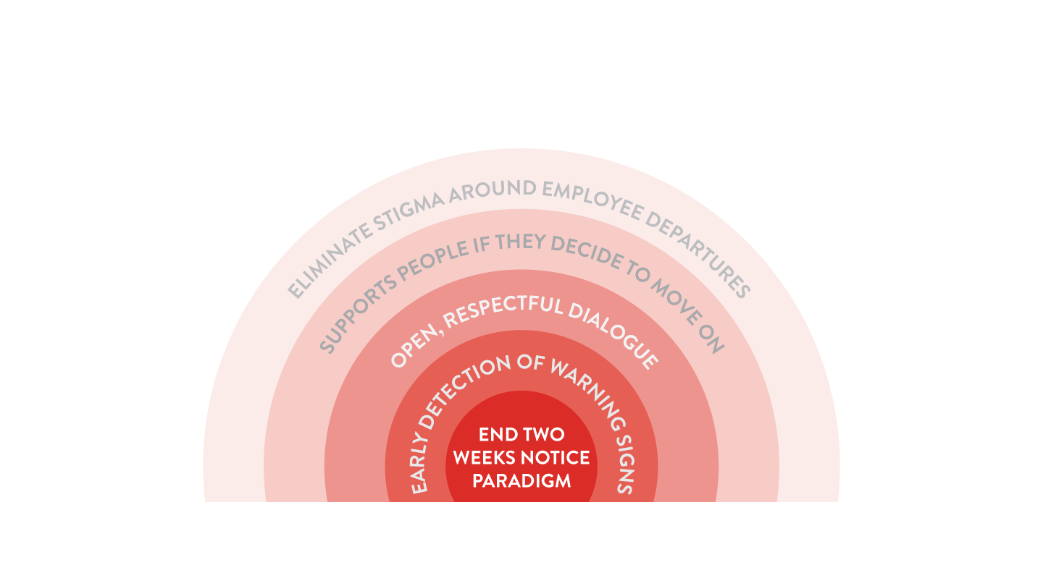
Mindful transitions™
Notes:
Mindful transitions are a better way to not only
And it’s especially designed to eliminate the negative stigma around leaving a company that currently exists, on both sides.

Slide 13

Patient zero
amazing change discuss open * still
Notes:
Amazing person, everyone liked, Underperforming
Decided we needed to make a change
Has a discussion that it was going to end
Encouraged an open transition
Got a great new job he is still in
We learned some lessons

Slide 14

Creating a Foundation of Safety
Foundation Talk Challenges Taboo Safe Violate
Notes:
Creating a foundation of safety
It all starts with creating an environment that gives people the opportunity to talk openly about their challenges
If they’re feeling happy or fulfilled in their role and, if they’re not, why not and to try and collaboratively come up with solutions.
It’s about removing the taboo around having these conversations and establishing the expectation that the employee will be safe and protected if, when they speak transparently about how they’re feeling.
If you violate this, you will lose all trust
This requires a focus on communication.

Slide 15

Training the stakeholders
mangers time natural won’t believe
Notes:
One of the thing we learned was just how important it is to consider who needs to be trained and where things could go wrong.
We had to do a LOT of training with managers – honestly more than we initially thought we’d need to do - to get them to recognize the warning signs when an employee was unhappy, and also to be ready to let people leave (twofold approach)
This will take time to get right.
It’s natural that employees won’t believe this right away

Slide 16

Ongoing Happiness Conversations
Direct
Quarterly reviews
Weekly 1:1s
Informal
Group/Anonymous
TinyPulse CultureAmp
Start/Stop/Continue
Town Hall
Notes:
Happiness is what we use as a proxy for engagement
The point is to always be mindful of the underlying, ongoing conversation and look for signs of trouble or discontent.
Good managers must have a finger on the pulse of their team.

Slide 17
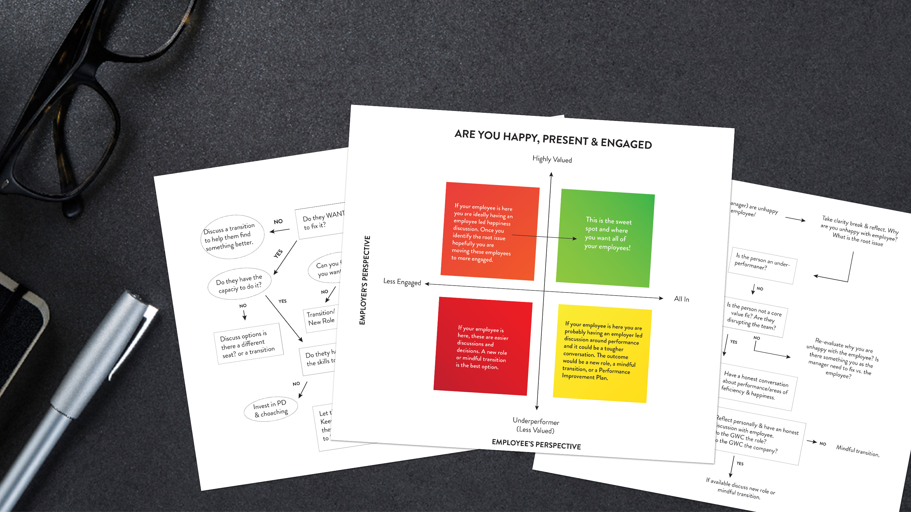
GETTING TO THE ROOT oF PROBLEM
symptoms headache
Notes:
Most issues are symptoms and not causes
Headache example

Slide 18

Reasons for Employee Unhappiness

Slide 19

Things the employee can change and wants to change
stress money. family heath, stagnant new skills
Notes:
Personal stress (money, family, health issue, etc.)
Underperforming b/c they’re a little beat down or stagnant
Need training or new stills

Slide 20

Things the company can change
boss underpaid challenged change
Notes:
Bad boss who isn’t supporting, challenging or properly rewarding/promoting them.
Feel underpaid, deserving of promotion
Not being challenged enough
Needs a change

Slide 21
Things that likely won’t change or don’t want to change
core values, promotion, different, role change
Notes:
Core value fit
Something bothering them that is not going to change
Not getting promoted, or seeing their peers getting promoted
Just want to do something different
Role is changing to something the don’t want or aren’t qualified for

Slide 22

“I suggest that AP implements an annual wage increase that at a minimum reflects the annual CPI inflation rate. The United States has an average 2% inflation rate (2.11% for the year of 2017, according to the CPI Index). If wages do not increase by this amount, our nominal wage decreases, and we are essentially earning less money each year”
not changing * benefits * if waited
Notes:
This is something we aren’t going to change and explained Why
We have also had employees who have been very vocal about an aspect of our benefits package – anonymously through TINYPulse.
We knew that the policy in question was not going to change and reached out to discuss.
If we had waited 9 months, the employee could have started acting out in all sorts of ways, in which case we’d have been dealing with the symptoms not the root cause.

Slide 23

Employee-Led Transitions
Recognize, enough trust, preferable, what do you want?
Notes:
The whole point of mindful transitions is to encourage people to recognize for themselves first that it’s time for them to move on
Have enough trust established that they feel comfortable having the conversation
Always preferable to have them drive it and feel like they are in control
“What do you want to do?”
“How can we support you”

Slide 24

Employer-Led Transition
Who starts (perf, change in needs, core values)
Notes:
Employer-Led Transition
The difference between an employee-led and an employer led transition is really more just about who starts the discussion
It’s not an option anymore
When it’s employer-led, it’s usually an issue of performance, a change in the needs for their role, or a misalignment of core values.

Slide 25

1. End in Mind 2. Root of Problem 3. Short Term
Notes:
What about PIP’s
Start with the end in mind, not as a legal strategy. Do you want them or not?
Don’t get at root of problem.
Usually see improvement in short term and dip back down if underlying issues is not solved.

Slide 26
MINDFUL TRANSITION IN ACTION

Slide 27
Components of a transition
Employer’s Commitment
Time
Support
Communication
Guidance/Conversations about Strengths
Third-Party Support
Specialized Training Support

Slide 28

Time
Notes:
60-90
Longer if its really early
Very clear on end date

Slide 29

Support
Notes:
Training
Coaching

Slide 30

Communication
Notes:
Two way commucation

Slide 31

Guidance
& real conversations
Notes:
Includes interview prep and networking support
Recommendations

Slide 32

Notes:
Includes job search strategy, resume & LinkedIn reviews, interview practice
Specialized training support

Slide 33

Components of
a transition
Employees’ Commitment

Slide 34

Engagement & Performance
Engaged, clients end any time
Notes:
They must stay engaged and performing
Stay focused on their clients
You can cut it at any time if their performance drops

Slide 35

Transparency
& Open communication
Keep the employer in the loop about their job search/progress
Communicate proactively to eliminate surprise factor
Must agree to a longer notice period
Once they find a job, must give as much notice as possible

Slide 36

Creating a win-win
Everyone has voice, employer brand, ecosystem, boomerang
Notes:
Mindful Transitions are all about creating the win-win – for you the employer and for the employee.
The reality today is that it’s a small world and everyone has a voice – both positive and negative.
A negative departure with an employee can come back to hurt you attracting high-quality candidates to your organization.
You want to create a healthy ecosystem of people who, when they move on from your company, still advocate for your business.
Boomerang and referrals

Slide 37
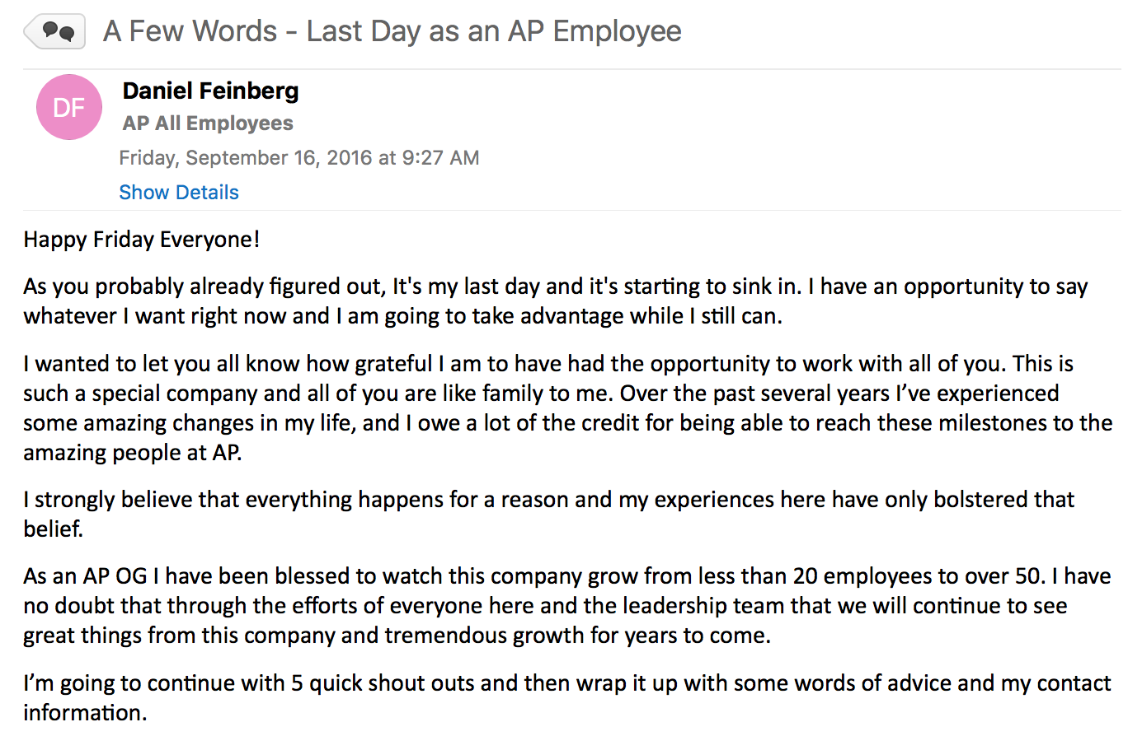
Mindful Transition Case Study
Notes:
Didn’t have the right role for him at AP but he felt comfortable being open and honest about the type of job he wanted.
Well, it just so happened that a job description came across my desk that he’d be perfect for. And it was a at Apple.
We did not want to lose him but we knew that he’d be happier there as this was exactly the type of job he wanted. So we did whatever we could to support him and help him land the job.
Ad he did.
Since then, he’s become an advocate for our company, and now, through him, we’re working with Apple
Small world, boomerang effect

Slide 38

The Mindful Transition Paradox
Notes:
The irony is, having a great culture can make it harder for people to realize they’re unhappy
Often, the biggest hurdle to overcome is getting employees comfortable with change.
The ideal is when the employee recognizes that they’re no longer a fit – or that they’ll be a better fit elsewhere.
However … this doesn’t always happen, esp. in a company with a really good culture.

Slide 39

CASE STUDY
WANTS/NEED DIVERGING
Notes:
Employee who loved working at AP company. She loved her coworkers, loved the culture.
And this was reciprocal. We loved having her as a part of our company. But she wasn’t in the job she really wanted. Ultimately, we had to have a radically candid conversation with her and say,
“Look, I know you love working here and don’t want to leave, but if you look at what you want to do and where we’re going, we don’t have the right job for you.”
We knew that if we didn’t have this conversation with her, that she’d eventually become an underperformer because she’d be doing work that didn’t fulfill her.

Slide 40

Making the Two Week’s Notice Abnormal
too many alignment early haters commitment communicate!
Notes:
There are too many companies out there – including yours - with good cultures but still don’t know how to deal with people leaving.
They haven’t brought their transition process into alignment
Above all, start incorporating into culture and having discussions early, when employees are still happy and new
You will have haters
Need real organizational commitment
Communicate more than you need to

Slide 41
THANK YOU!
ROBERt GLAZER
Founder & CEO
rglazer@accelerationpartners.com
Mindful Transition Book: Coming 2019

