Slide 1
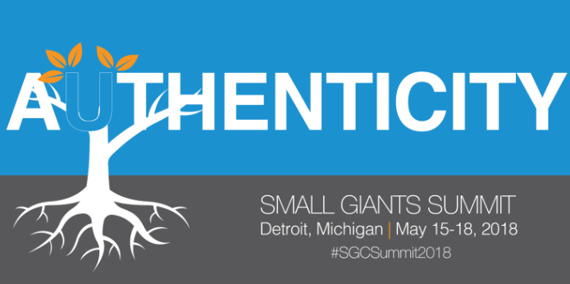
Authenticity is the Foundation of Culture
“It all starts with me. Here. Now.”
Tom Carmazzi
CEO, Tuthill Corporation
Notes:
Simple intro slide. Will discuss Culture. How this word is going in usage AND how we all have one: at home, in the community, and at work.

Slide 2
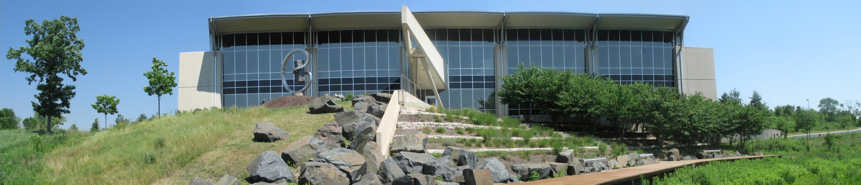

Company Overview
Privately held company established in 1892 – 4th generation; 5th in queue
Manufacturer of industrial products – Facilities in North America & UK
Started Lean journey in 1999 & Culture journey in 2006
Created Tuthill University in 2011; renamed Awaken U. in 2015
Financially, very Strong, - “Making Real Things That Really Make a Difference”!
Enhanced traditional Vision statement to “COMPASS” in 2015
Notes:
Traditional company background slide.

Slide 3
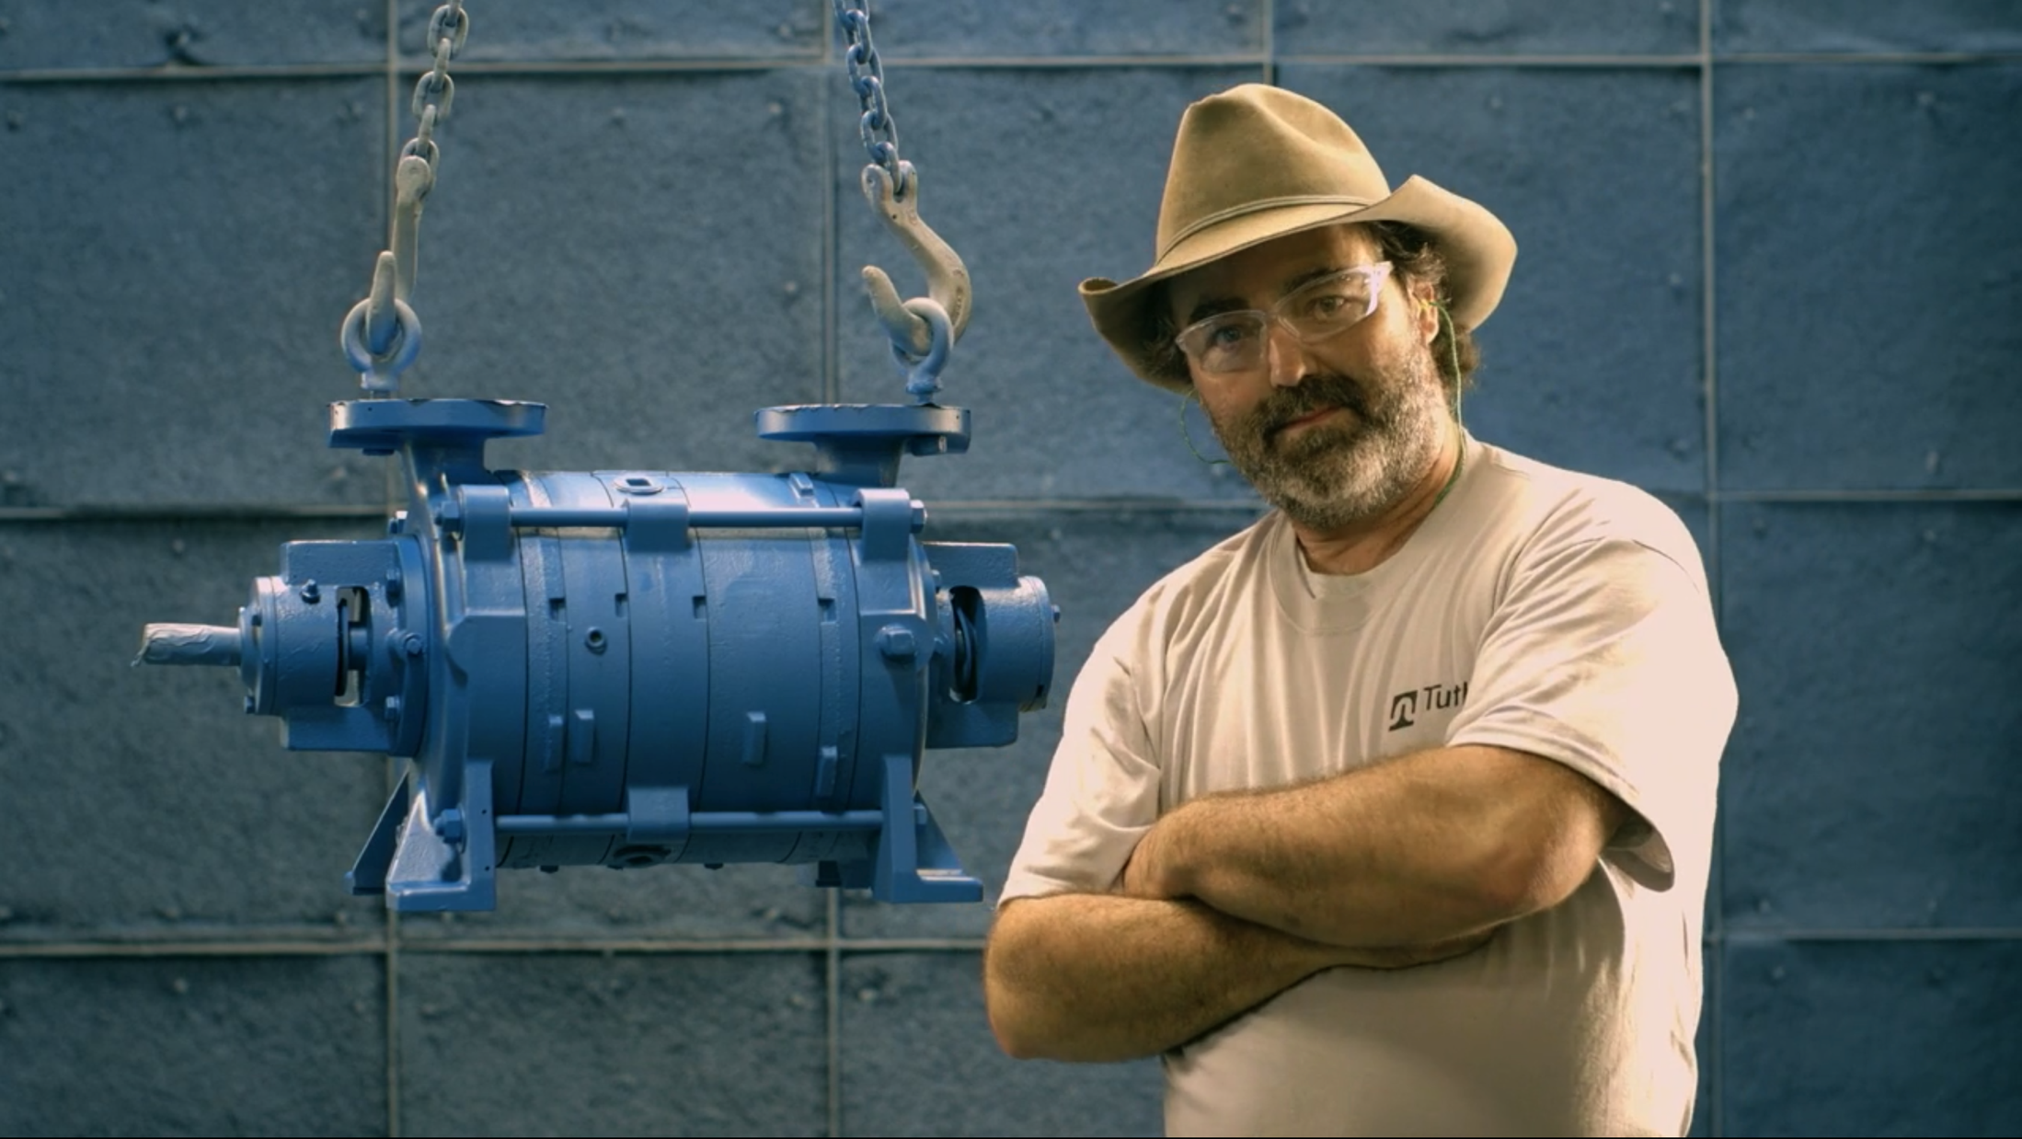
The Purpose of Tuthill
Our Purpose
Notes:
This is the slide that links to the video. You may want to consider downloading the video and having the link to the download. I will have a stick or my computer for the event if the link does not work.
The video is about Tuthill journey of the heart and aliveness. 3 minutes and 11 seconds.
I will ask questions about the video.
I will share that the voice is Jay Tuthill and the folks are Tuthill employees and customers.

Slide 4
Notes:
The Compass is our version of a Vision/Mission statement. In reality it is how we bring the video to life. You will note phrases from the video in this document.
This was created internally by a group of folks from all parts of the business.
I will ask the audience what is in the document for them. I will highlight some of the most impactful phrases.
This is also where I will start to describe my own journey. The union story of me not caring and that initial awakening.

Slide 5

Aliveness & Authenticity
Where your comes alive & you are your authentic Self
Where are you in your authenticity?
Let’s have some fun!
Notes:
I will ask this of the audience. I will have them stand up and create a visual. At the end of the day this will wake them up and engage them.
The intention is to get folks to get in touch with how authentic they are AND relate that to how alive they really are. Too much of our time is simply spent surviving and hiding from our true self! What would be possible if we came more alive and authentic!

Slide 6
WHY are Aliveness & Authenticity so IMPORTANT? – Impact on Culture!
Passionate
Disengaged
70%!!
Job Satisfaction – Gallup Poll
Notes:
Values are eroding; we read it every day!
Kids today face temptations unheard of 20 years ago
American Job Satisfaction is slipping to disengagement (Gallup Poll - 70%)
Younger workers are the most distressed and least loyal
Lost productivity of disengaged employees - $450 B
Senior HR managers believe the top challenge is employee engagement (Gallup); 75% of leaders have NO Plan
Almost 60% of folks don’t know what their company stands for (Gallup)
Much uncertainty: Leadership; Global Unrest; Job; Relationships

Slide 7
Impact of engagement
Firms of Endearment – Raj Sisodia
Notes:
The next three slides set up the foundation of authenticity and engagement. When we have a favorable culture, Authenticity and engagement are at the core.

Slide 8
ORGANIZATION HEALTH (CULTURE)
PATRICK LENCIONI – THE ADVANTAGE
Organization Health Level
(Culture)
Talent & Skill
Notes:
Over the long term, regardless of the talent you have, you will not outperform your culture.

Slide 9
Financial HEALTH
Gross Margin%; OWC %; & Debt %
2013
Notes:
AND for the capitalist in the room……… we are doing much better financially AND we can fund our own growth with ratio’s of this nature. None of our competitors can match this performance!!

Slide 10
Talent REQUIREMENTS AT TUTHILL
Opportunity for Growth
Notes:
Most companies hire folks based on the first bar, which is what is on the resume. At Tuthill we want all three. Our Hiring process focuses on all three; our Job Descriptions have all three; our employee evaluations have all three. Everything is linked back to the journey/COMPASS. And the most powerful employees go from right to left versus left to right.

Slide 11
THE JOURNEY TO SUSTAINABLE SUCCESS
Alive & Authentic Leadership
Alive & Authentic Leader
Success ($$ and Metrics )
Impact
Team
Structures
Sequence
Notes:
The key to sustainability is the people model versus the business model. So much of traditional strategies is based on information in the public domain – we all know it and have access to it. True competitive advantage is through the culture and the people – much more difficult to replicate!

Slide 12


Structures for the Uncommon
Leadership Training – Deep Invitation to
O.W.N. – Our Way Now Leadership Meetings
Performance Reviews – Blend of who you ARE & What you DO
Kaizens – Blend of Our Way behaviors & Rigorous CI spirit
Pulse – Monthly Video update on Journey – Highly Authentic
3x5 Cards – Open ended Questions for the Heart
Notes:
These are the various structures we use to help create aliveness & authenticity – the uncommon

Slide 13
WHAT IS REQUIRED OF ME????
The Easy Stuff to Support the Climb (Traditional CEO):
Hold folks accountable to Vision & Goals
Update Structures to align with Journey
Be Literate & Communicate on those things Important
The More Challenging Stuff (CAO – Chief Aliveness Officer):
Model the Culture I Want (Authenticity/Recovery)
Be the Real Me versus a CEO persona (Vulnerability/Fears)
Ask for Help (No Hero/Feels good)
Attract & develop talent (Start with the Heart)
Dialogue, Dialogue, Dialogue (Relationship/Journey)
Notes:
This slide is usually very powerful, because they hear a CEO be humble and vulnerable, versus “smartest guy in the room” or “person who has all the answers”. These are persona’s and not the real me. So I tell on myself. I share my failures and how people let me up; gave me grace.
Also the power of asking for help, when I really need it. My letting go of being the hero; I am only holding people small. AND I am a recovering HERO. It is an addiction I fight everyday!

Slide 14
QUOTES from the journey
“You saved my marriage”
“I have created deeper relationship in 3 weeks than last 3 years”
“You said you cared!”
“I thought being a ‘Hero’ was good; I have held people small”
“I am leaving; I now know what I want”
“Tuthill changed my life!”
“I left because of my head; I am returning because of my heart”
“I am quitting on Monday (working for Fortune 100 company)”
“The love I received from the team showed I am the solution not the problem”
Notes:
Verbatim from employees and outsiders. I will cover only the ones in blue.

Slide 15
ALIVENESS & AUTHENTICITY
Who are you?
Quickly record what popped into your head; don’t overthink this!
Notes:
Similar to previous question: a time for reflection. Folks are always asked “what do you do?”. Rarely are they asked “who are you”. This is a much deeper question. The next obvious question is……. “Is this who you want to be”? If not, “what are you going to do to become who you want to be?” Be your Authentic self.

Slide 16
SUMMARY – Authenticity is the foundation of culture
Focus on the People Model first!
Leadership “Goes First” with the culture they want
Stimulate Dialogue & Acknowledge perspectives
Go from , to , to . Repeat!
Be YOU, everyone already knows & it’s who they want!
Notes:
Please make sure the clip art aligns once it is on screen.

Slide 18
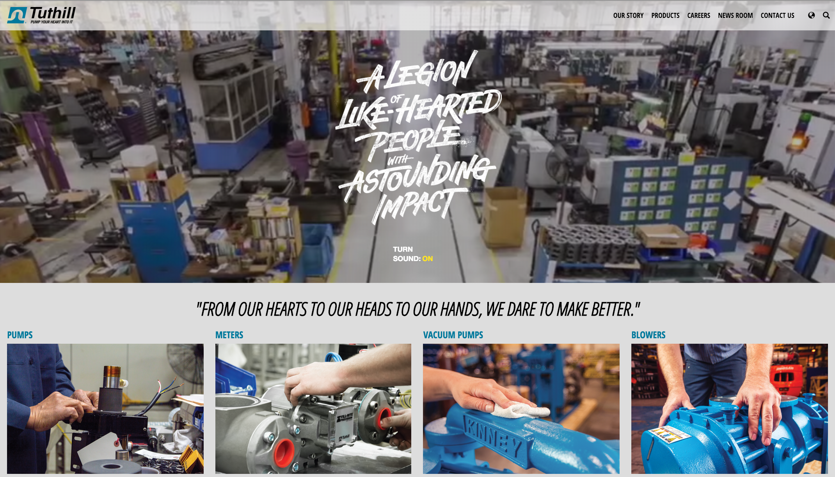
Learn more about tuthill
linkedin.com/company/tuthill-corporation
facebook.com/tuthillcorporation
@TuthillCorp
youtube.com/tuthillcorporation
instagram.com/tuthillcorp
www.tuthill.com
Tom Carmazzi
tcarmazzi@tuthill.com

