Slide 1
May 1, 2019

Slide 2
HALF
OUR
STAFF
LOTS
OF
REVENUE
SOME
OF OUR
HEART

Slide 3
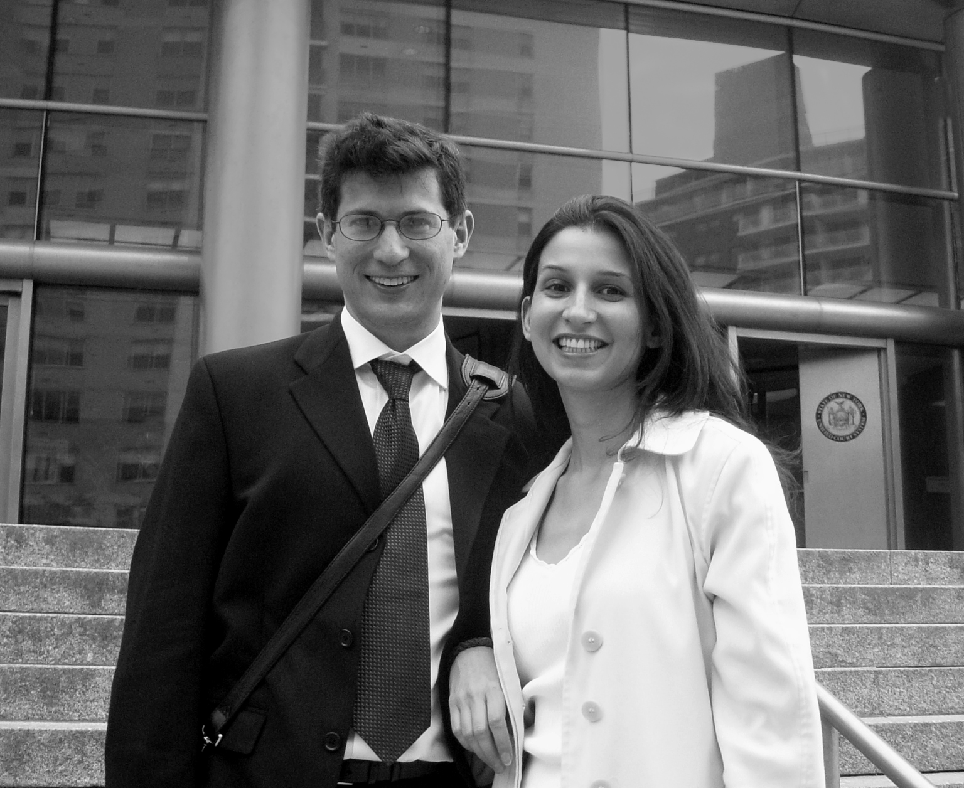
2001
Founded Arkadium
Notes:
So that’s what we did. At the start, we couldn’t afford to hire anyone in the states so we gave our earliest employees equity and hired an outsource team in Ukraine. . We grew to that $1 million at which point Strauss told us we’d be a real business when we hot $10 million. So that’s what we did. We grew organically, profitably off of our own steam and hit a peak of 150 real employees. We brought our Ukrainian oustource team on staff and opened a large office in NY
IN 2011 we partnered with MSFT to be the first game developer on their new OS

Slide 4
2005
Opened Ukraine Office
2001
Founded Arkadium
Notes:
So that’s what we did. At the start, we couldn’t afford to hire anyone in the states so we gave our earliest employees equity and hired an outsource team in Ukraine. . We grew to that $1 million at which point Strauss told us we’d be a real business when we hot $10 million. So that’s what we did. We grew organically, profitably off of our own steam and hit a peak of 150 real employees. We brought our Ukrainian oustource team on staff and opened a large office in NY
IN 2011 we partnered with MSFT to be the first game developer on their new OS

Slide 5
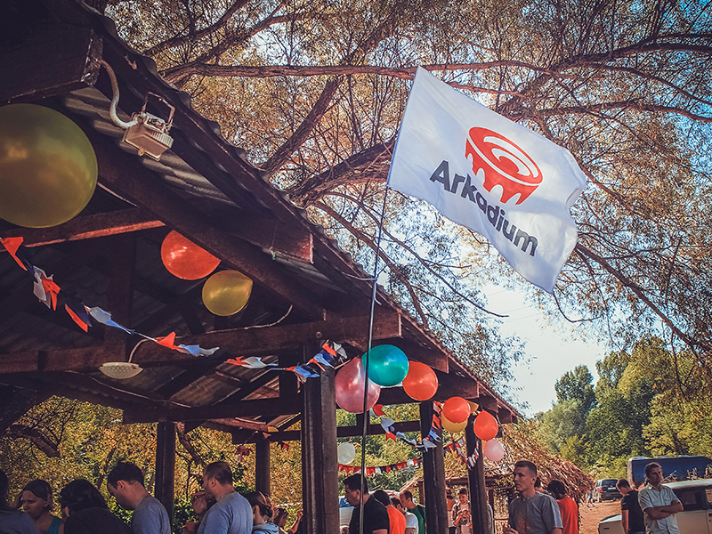
Fierce Drive
Positive Energy
Living Full Lives
Established Our
Core Values
Notes:
So that’s what we did. At the start, we couldn’t afford to hire anyone in the states so we gave our earliest employees equity and hired an outsource team in Ukraine. . We grew to that $1 million at which point Strauss told us we’d be a real business when we hot $10 million. So that’s what we did. We grew organically, profitably off of our own steam and hit a peak of 150 real employees. We brought our Ukrainian oustource team on staff and opened a large office in NY
IN 2011 we partnered with MSFT to be the first game developer on their new OS

Slide 6
Notes:
Remove red outline and show groeth from 6 – 100 employees “Arkadium crimea”

Slide 7
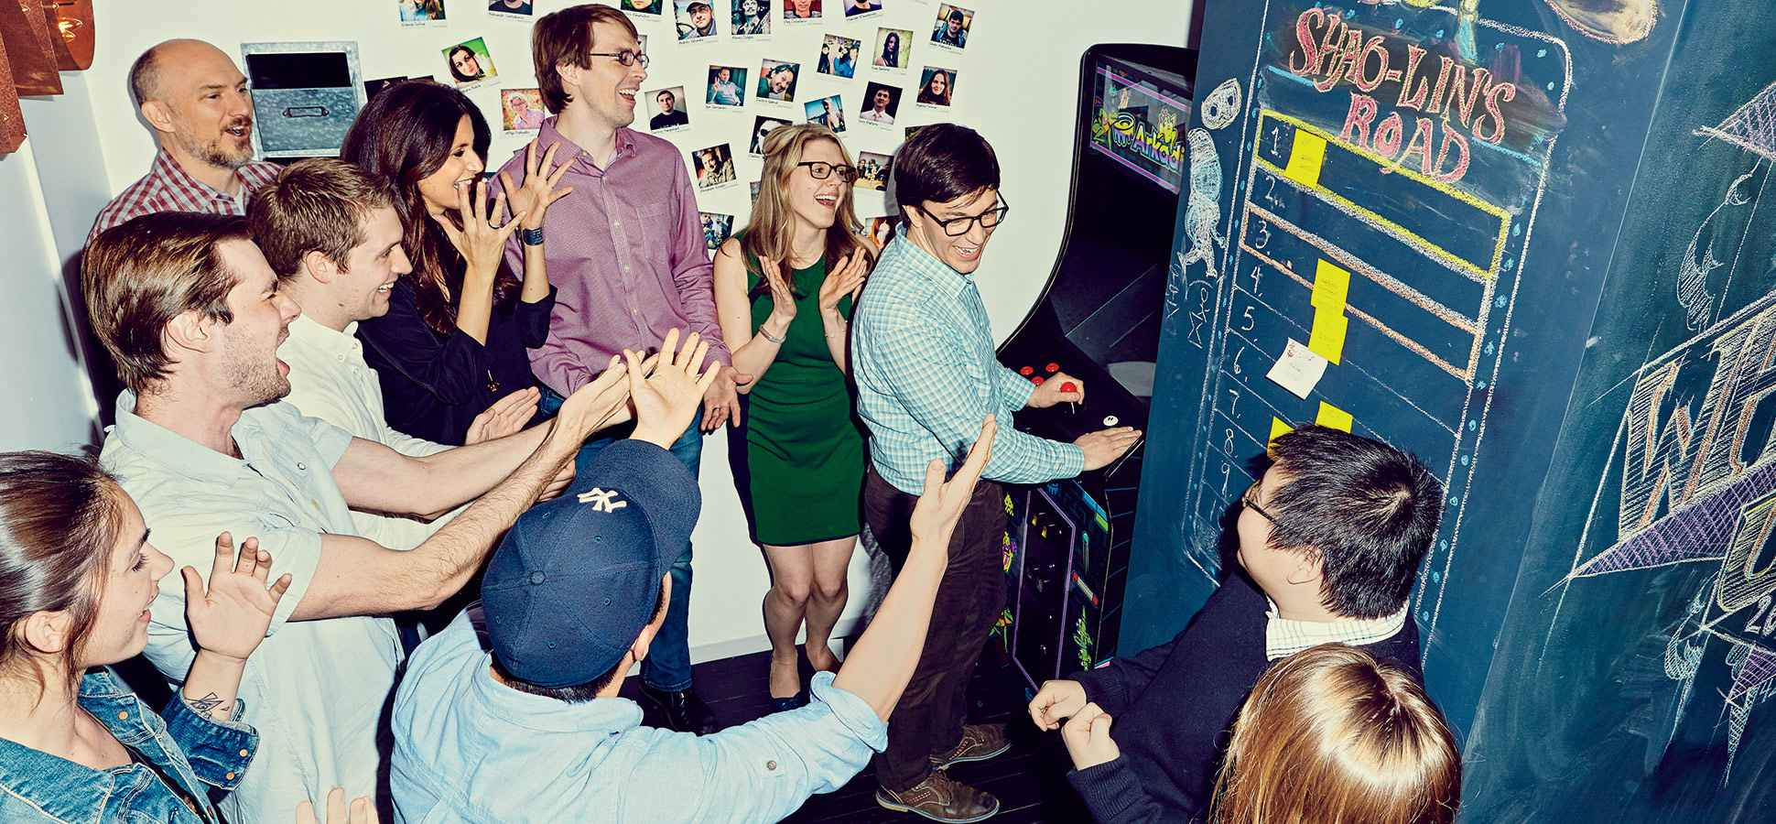
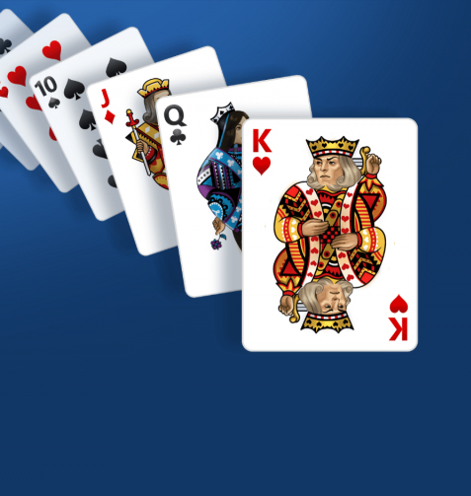
2011
Partnered
with Microsoft
2013
Accepted $5M
Series A funding
Notes:
So that’s what we did. At the start, we couldn’t afford to hire anyone in the states so we gave our earliest employees equity and hired an outsource team in Ukraine. . We grew to that $1 million at which point Strauss told us we’d be a real business when we hot $10 million. So that’s what we did. We grew organically, profitably off of our own steam and hit a peak of 150 real employees. We brought our Ukrainian oustource team on staff and opened a large office in NY
IN 2011 we partnered with MSFT to be the first game developer on their new OS

Slide 8
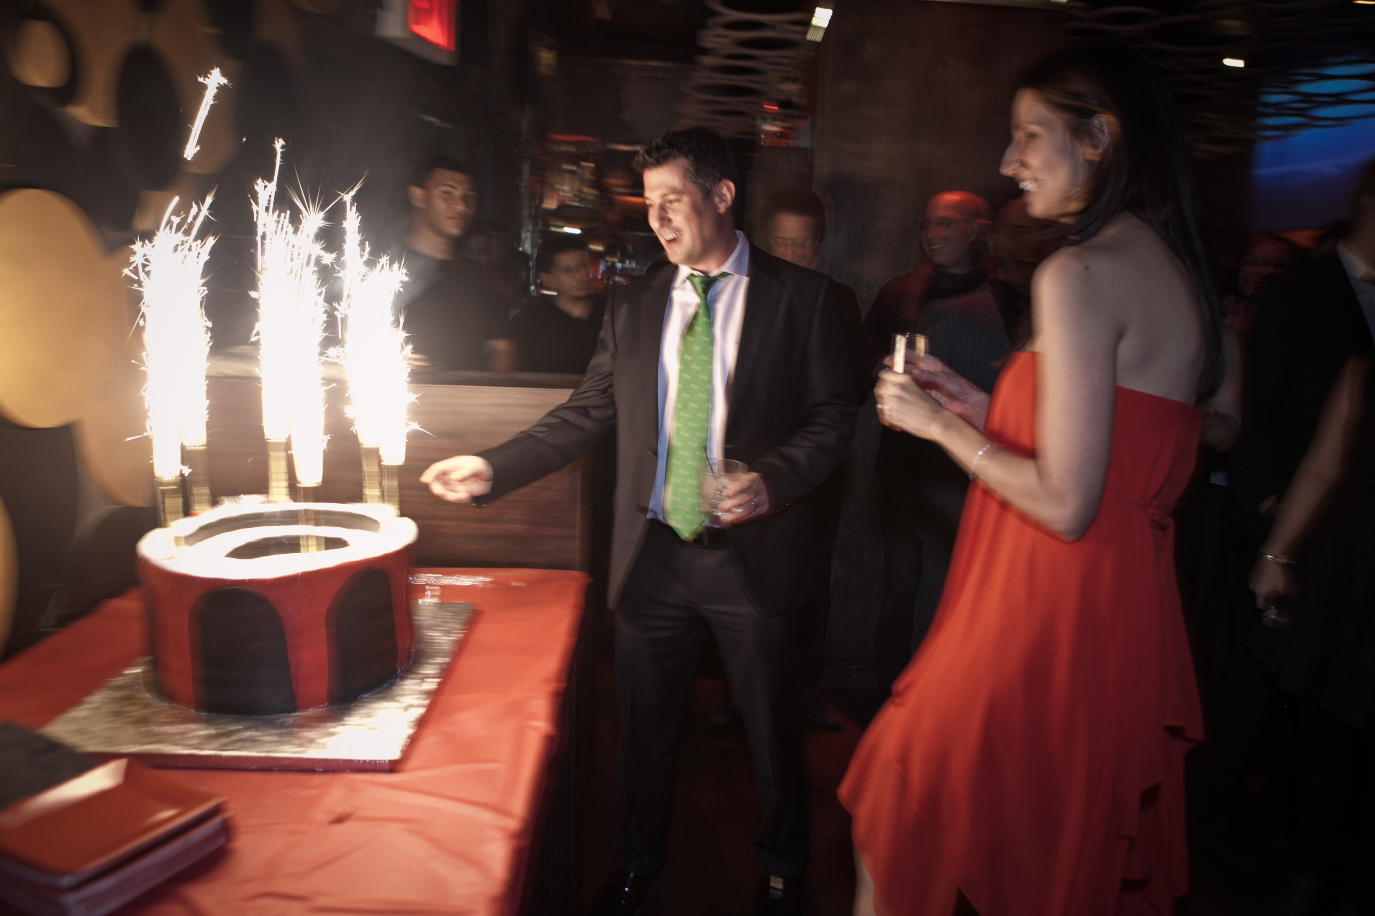
Notes:
Things were good, we had our ups and downs like all businesses, sure but the future was bright. Nothing could have prepared us for what came next

Slide 9
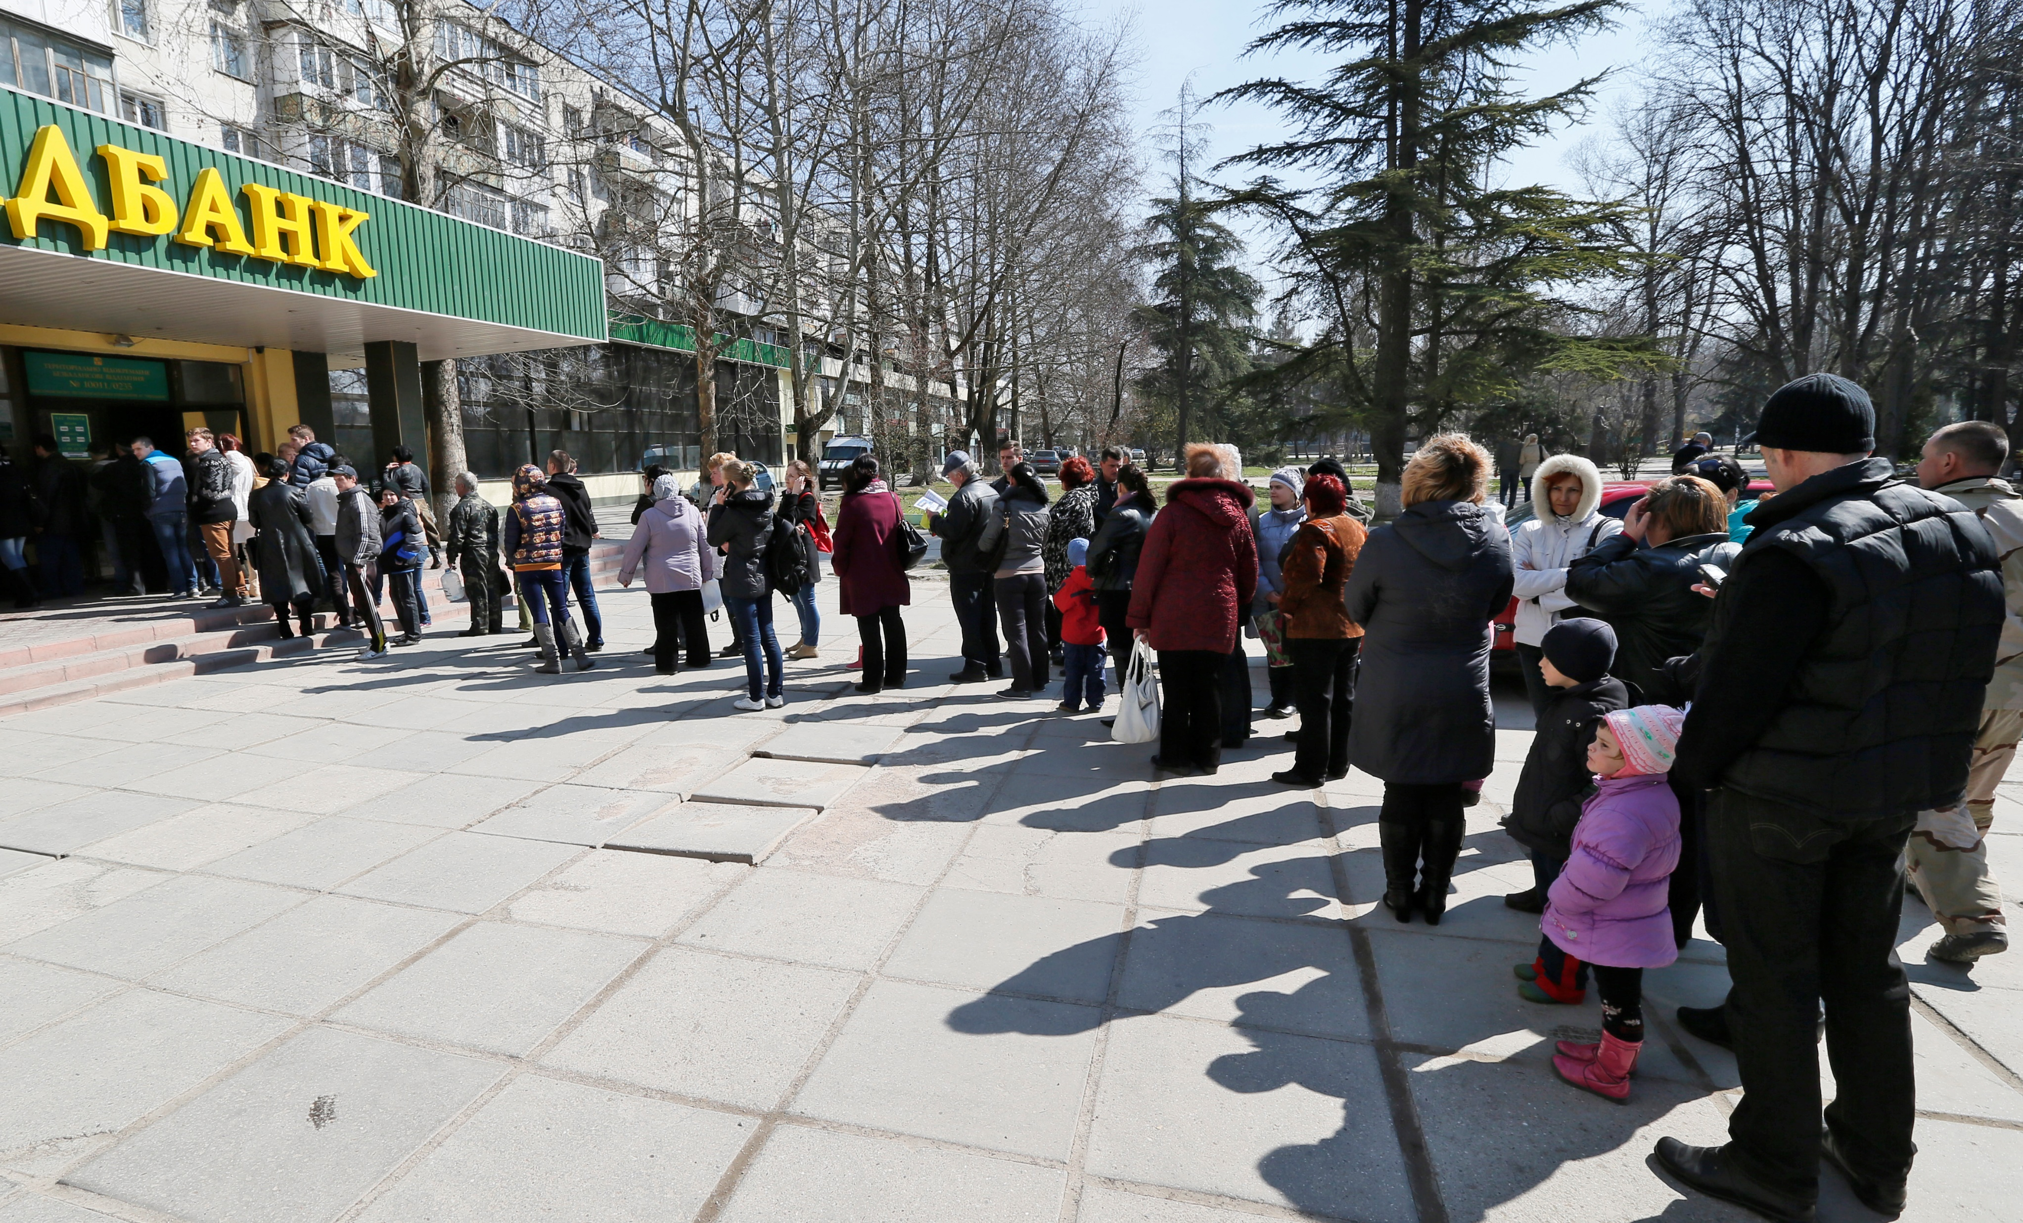
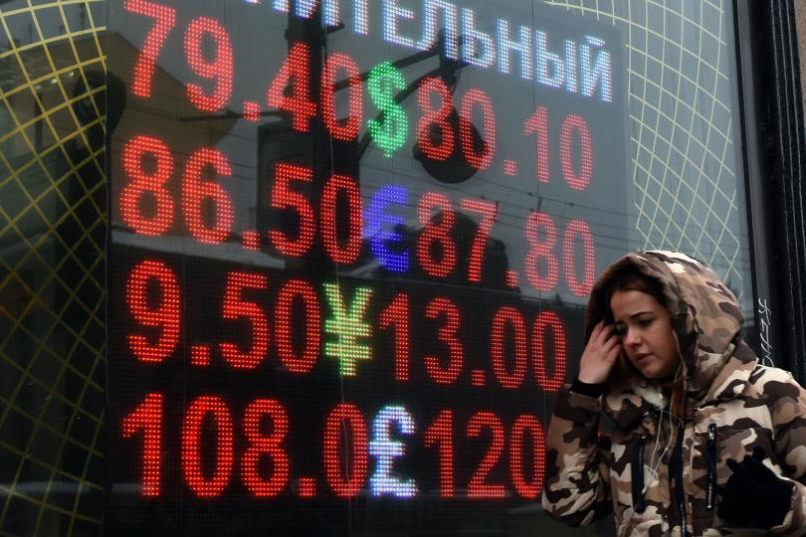
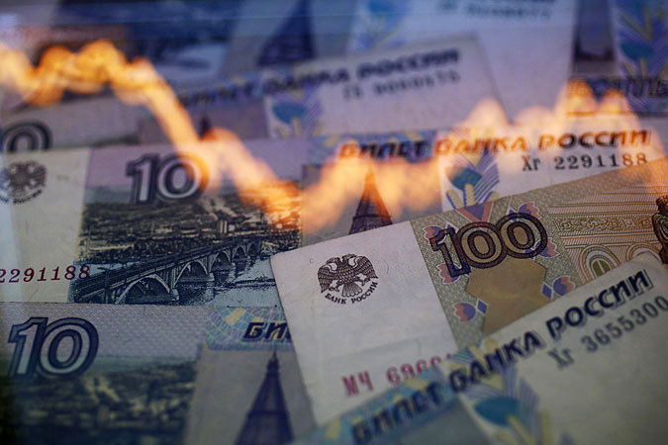
April-November 2014
March 2014
February 28, 2014
Notes:
CHECK FONT
If you follow the news and then you’ll know what happened in 2014 when I say my business was based in ukraine. Rioting started in Kiev at the beginning of the year which lead to the ousting of Ukrainian president Yanukovych the country is thrown in to chaos. One week later on Febuary 28, pro-Russian gunmen begin to seize government buildings in Simferopol a few blocks from our office. Tanks roll down the streets as my employees try to make their way to work and bring their kids to school. The airport is seized and all transportation into and out of the region stops.
By mid march Putin is authorized to use force to protect the region and the people of crimea vote to secede from Ukraine and join Russia
So within the course of 1 day we go from owning and operating a business in Ukraine to owning and operating a business in Russia, having necer moved.
Over the next 8 months our business all but stops as our Crimean employees spend weeks changing their working papers, citizenship, banks. Our our currency changes even our time zone changes. and our corporate bank account, which was in a Ukrainian bank, evaporates into thin air

Slide 10
December 19, 2014: By executive order, the President makes my business illegal overnight.
Notes:
CHECK FONT
It was tough. It was really tough but we were slowly working through it. All that changed however on December 19 when president Obama issued sanction on crimea making my business there immediately illegal. That day. No warning, no wind down period. And an interesting aside should you ever find yourself in this position, the american government dowsnt reach out and tell you with a certified letter or an email. We found out through a goofgle news alert.
So what do sanctions mean? If I speak to my employees about business, I can go to jail. If I send payroll I go to jail. If I pay my rent I go to jail. No contact, no money, no travel, no code, or we go to jail. Oh and its Christmas.

Slide 11
Notes:
What happened next was extraordinary. Within the next 3 weeks, with little to no ability to communicate and over the Christmas and new years holidays we surveyed all of our employees and then decided what to do. Approximately half of our staff were unwilling or unable to leave Crimea, but 55 agreed to move to save the business and their jobs.

Slide 12
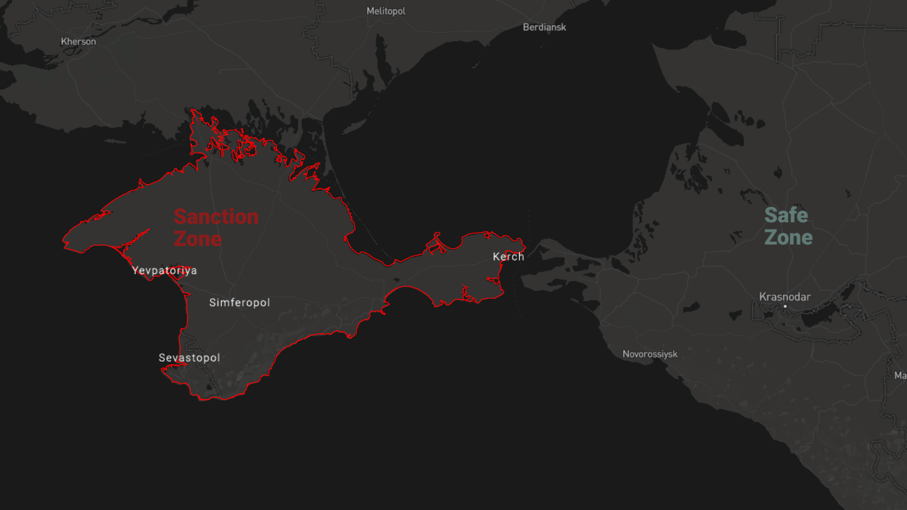
New York Employees
Crimea
Employees
Product
Suite
Notes:
ANIMATE AND CHANGE ICONS FOR PRODUCT SUITE
What happened next was extraordinary. Within the next 3 weeks, with little to no ability to communicate and over the Christmas and new years holidays we surveyed all of our employees and then decided what to do. Approximately half of our staff were unwilling or unable to leave Crimea, but 55 agreed to move to save the business and their jobs.

Slide 13
New York employees reduced by
50%
Crimea employees reduced by
50%
Product suite reduced by
50%
Notes:
ANIMATE AND CHANGE ICONS FOR PRODUCT SUITE
What happened next was extraordinary. Within the next 3 weeks, with little to no ability to communicate and over the Christmas and new years holidays we surveyed all of our employees and then decided what to do. Approximately half of our staff were unwilling or unable to leave Crimea, but 55 agreed to move to save the business and their jobs.

Slide 14
Notes:
ANIMATE AND CHANGE ICONS FOR PRODUCT SUITE
What happened next was extraordinary. Within the next 3 weeks, with little to no ability to communicate and over the Christmas and new years holidays we surveyed all of our employees and then decided what to do. Approximately half of our staff were unwilling or unable to leave Crimea, but 55 agreed to move to save the business and their jobs.

Slide 15
Notes:
On January 6, 2015 we moved 55 employees and there families to a city that they had never been to and we had never heard of before. It cost us hundreds of thousands of dollars, and of course many sleepless nights. I met them in Krasnodar Russia that day, all of their posessions squeezed into 3 box trucks. And we set a course on re-building.
In order to move our employees and continue on we had to lay off staff in NY as well. Overnight we went from 150 to 75 employees. This Necessitated the shuttering of our most exciting business line, adding insult to injury.

Slide 16
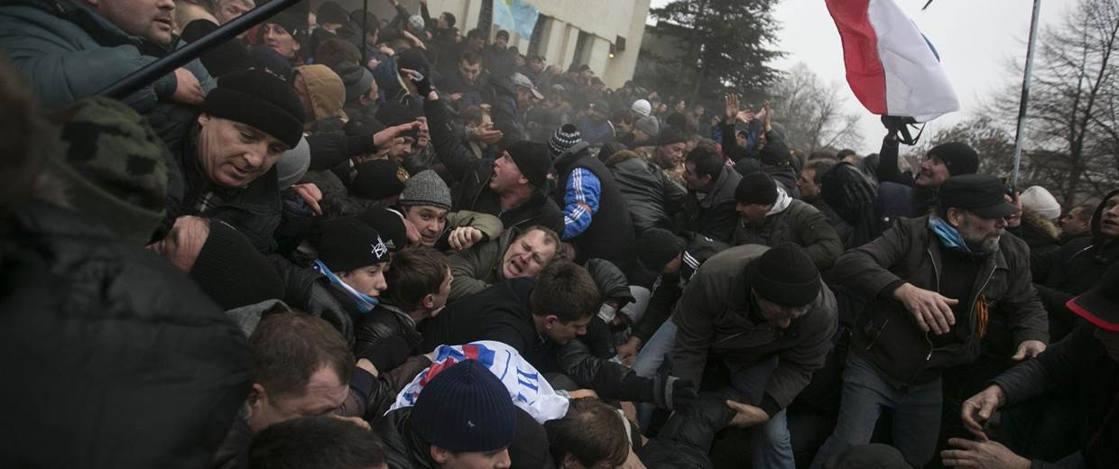
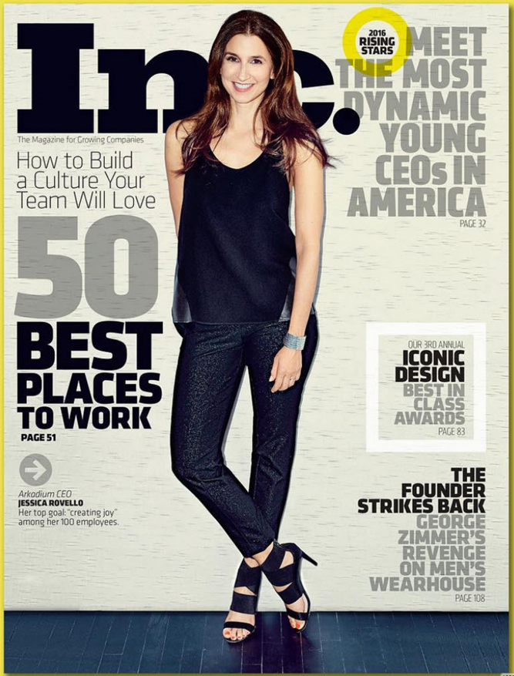
18 months later…
Best Place to Work
Notes:
But remember, I said this story has a happy ending. Within 18 months we wenr from utter chaos and disrepare to being named inc magazines first best place to work in america,. we also ended 2016 with our highest revenue and highest profit in the company’s 16 year history history. So let’s talk about how that happened, and the steps we took to engineer a corporate comeback.

Slide 17
$14.4M
$12.3M
$9.6M
2015
2016
2017
13.2%
23.3%
17.1%
EBITDA
EBITDA
EBITDA

Slide 18
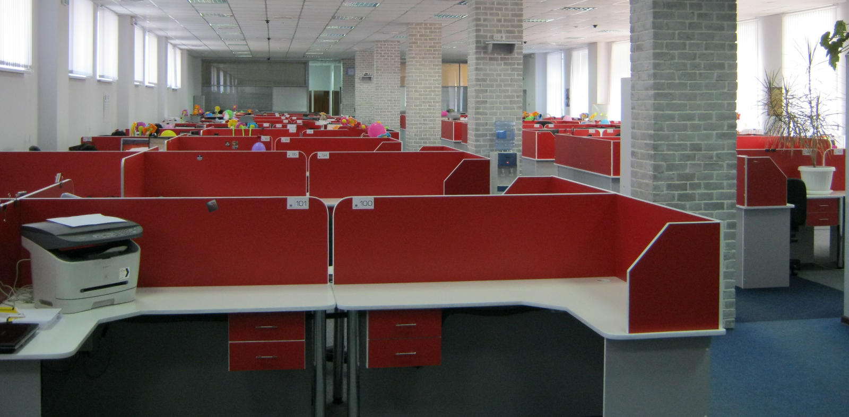
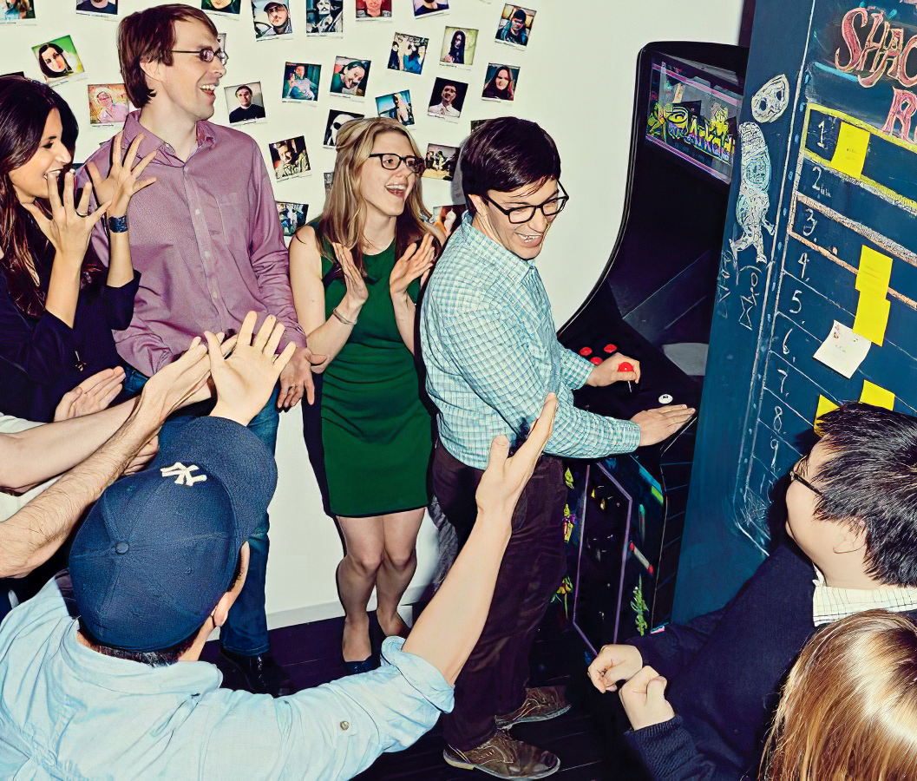
“Culture eats
strategy for
breakfast.”

Slide 19
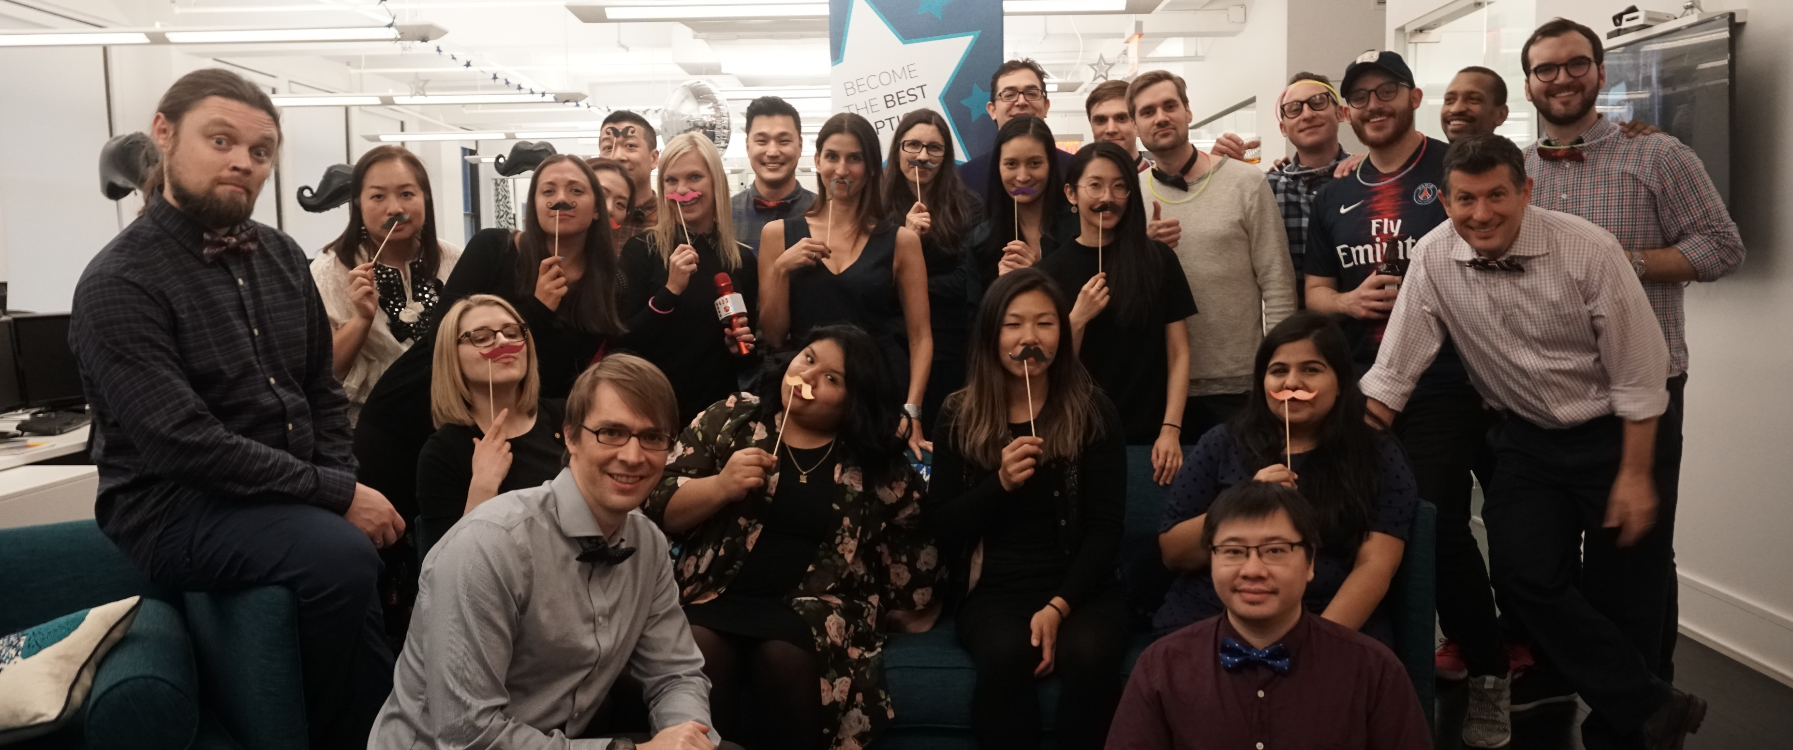
Our Cultural Foundation

Slide 20
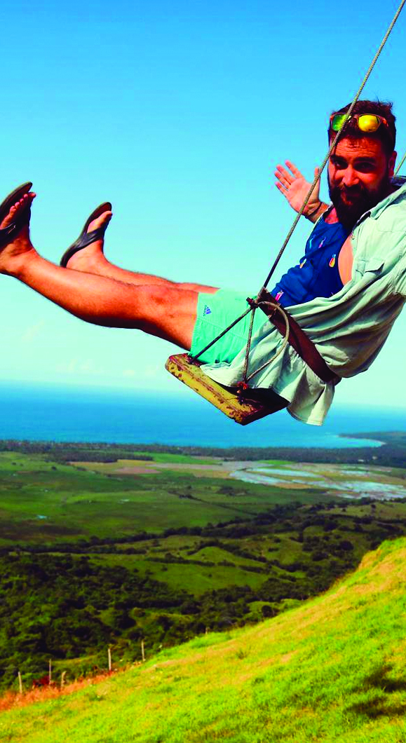
Fierce
Drive
Positive
Energy
Living
Full Lives
Notes:
ADD ICON NEXT TO EACH VALUE, IN FUTURE SLIDES PLACE ICON ALIOGNED WITH INITIATIVE ON THAT SLIDE
So that’s what we did. At the start, we couldn’t afford to hire anyone in the states so we gave our earliest employees equity and hired an outsource team in Ukraine. . We grew to that $1 million at which point Strauss told us we’d be a real business when we hot $10 million. So that’s what we did. We grew organically, profitably off of our own steam and hit a peak of 150 real employees. We brought our Ukrainian oustource team on staff and opened a large office in NY
IN 2011 we partnered with MSFT to be the first game developer on their new OS

Slide 21
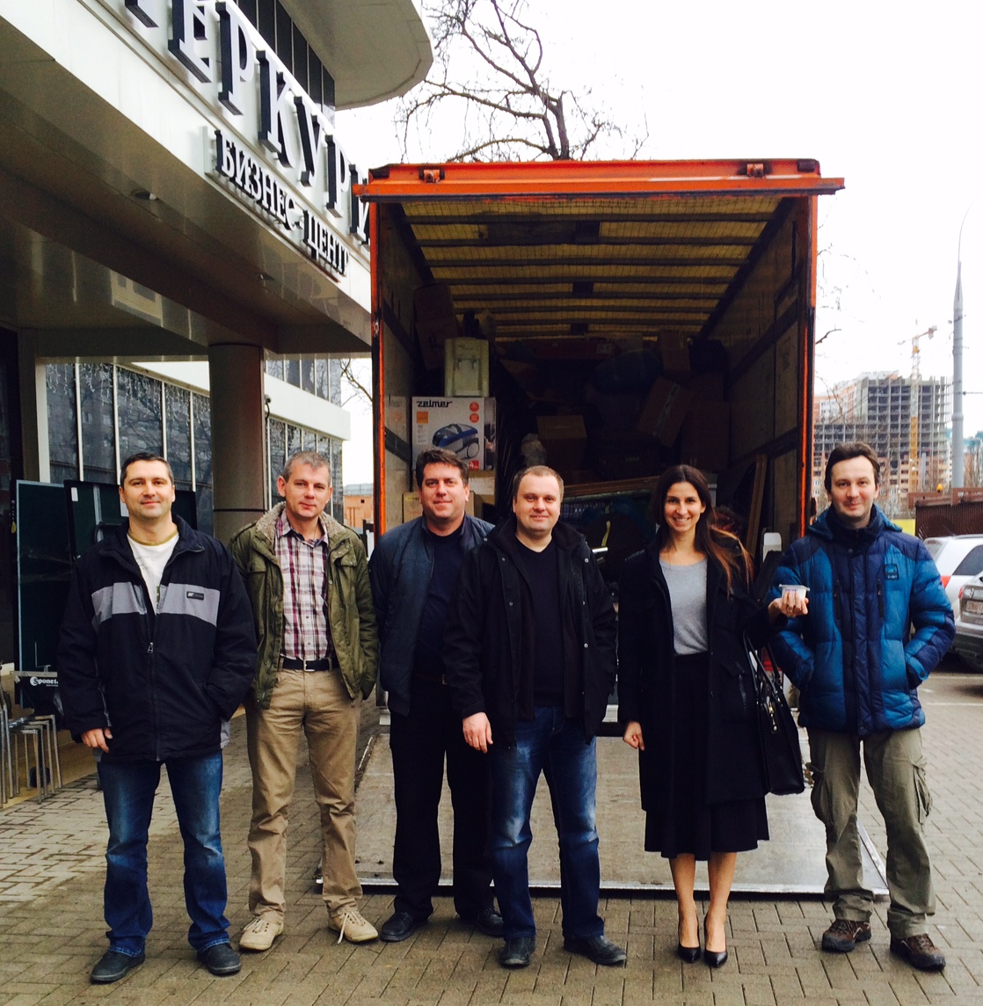
Short-Term
Decisions
Notes:
Providing short term housing, stipends for security deposits, moving costs, additional time off for travel back to simfy, real estate agent, office location, introduction of little wins.

Slide 22
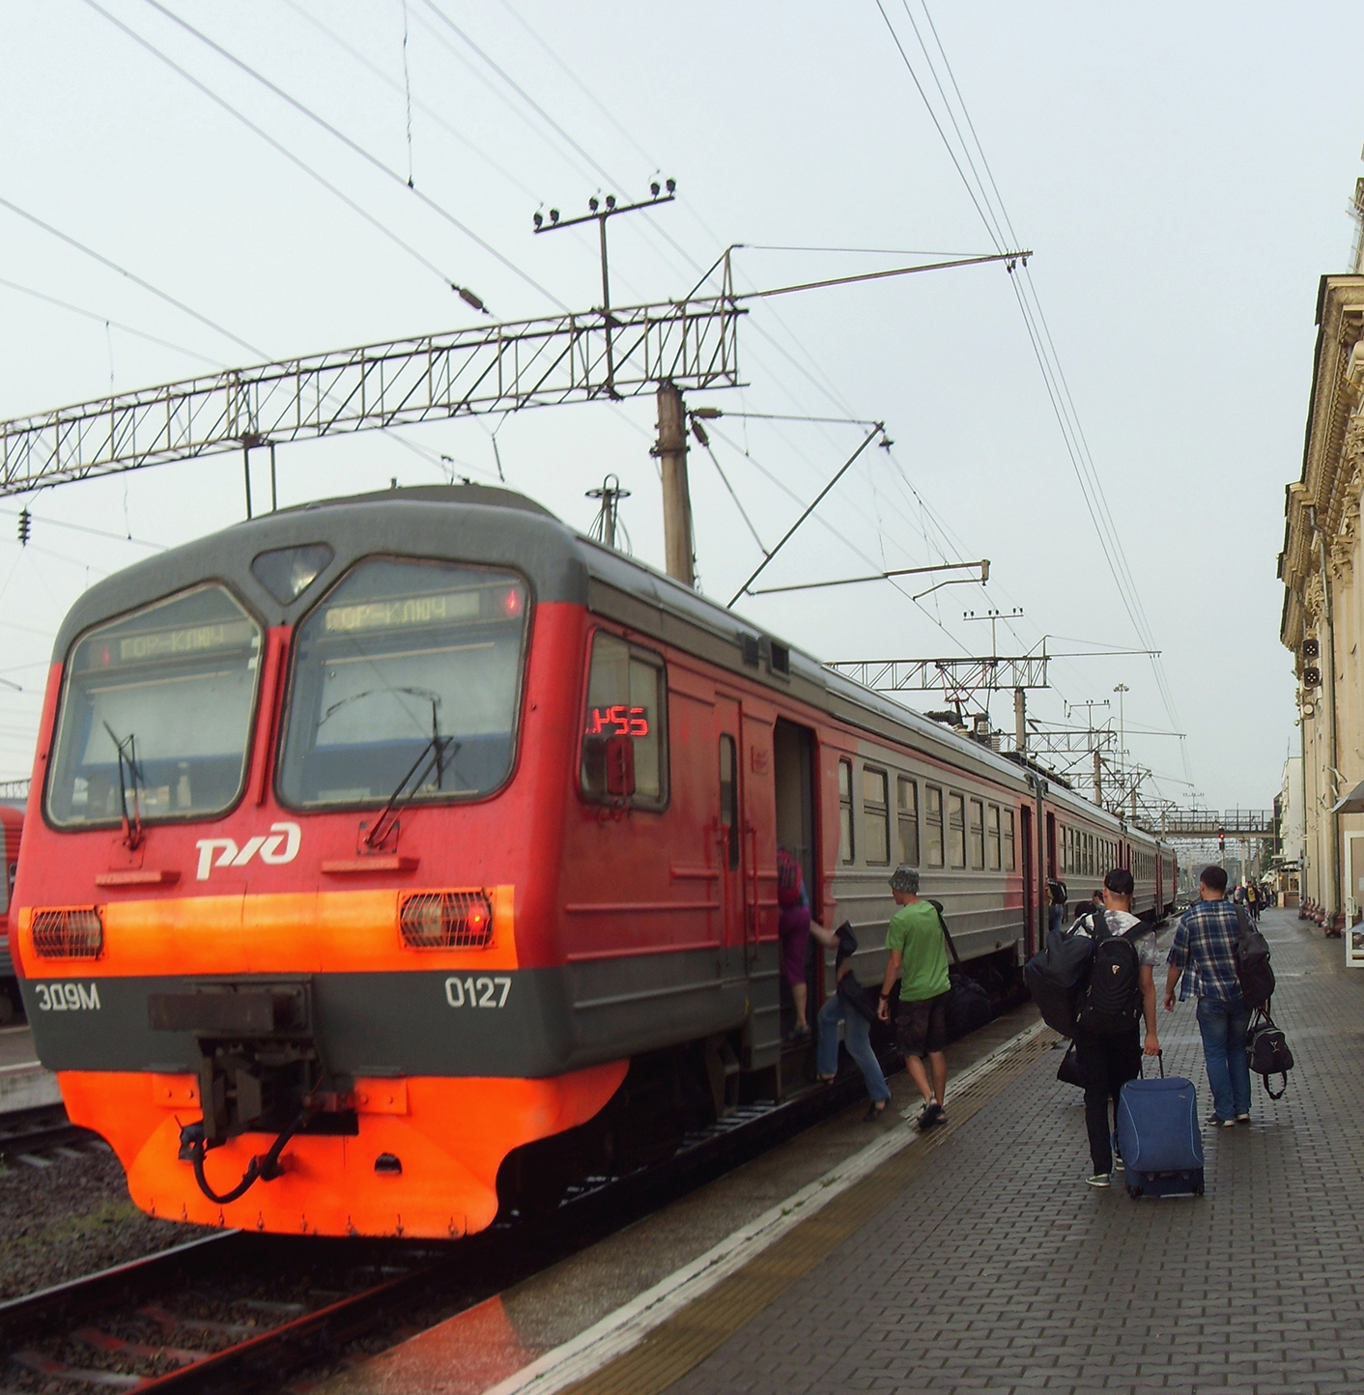
Housing assistance
Additional time off
Travel stipend for family
Relocation bonuses
Personal asset transfer
Notes:
Providing short term housing, stipends for security deposits, moving costs, additional time off for travel back to simfy, real estate agent, office location, introduction of little wins.

Slide 23
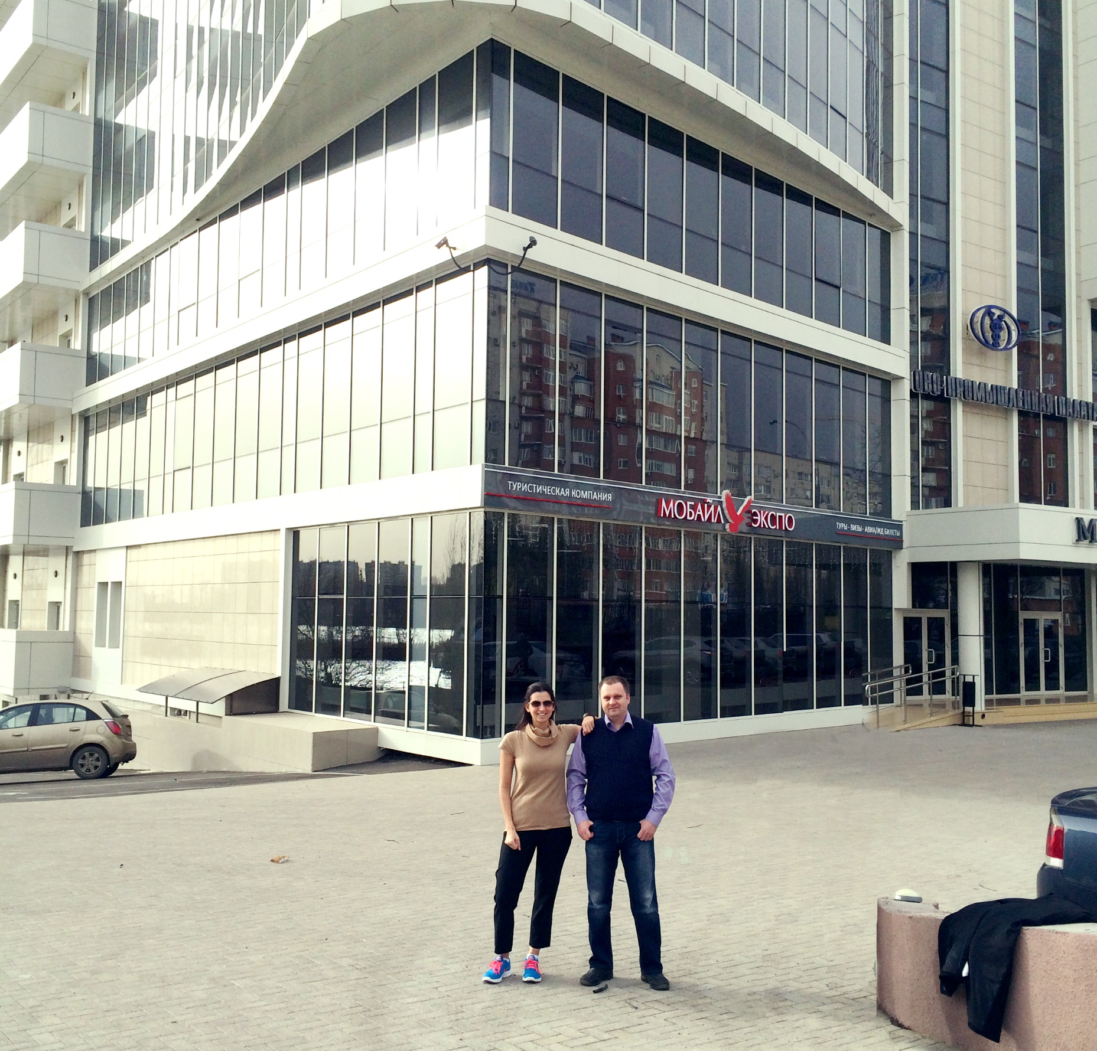
Beautiful
New
Office
Notes:
Providing short term housing, stipends for security deposits, moving costs, additional time off for travel back to simfy, real estate agent, office location, introduction of little wins.

Slide 24
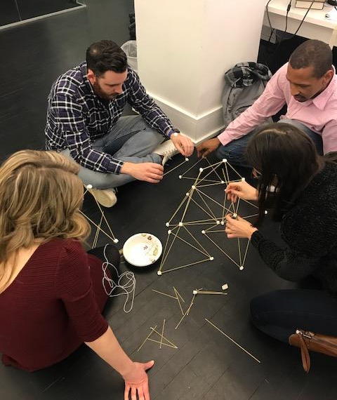
Long-Term
Changes

Slide 25
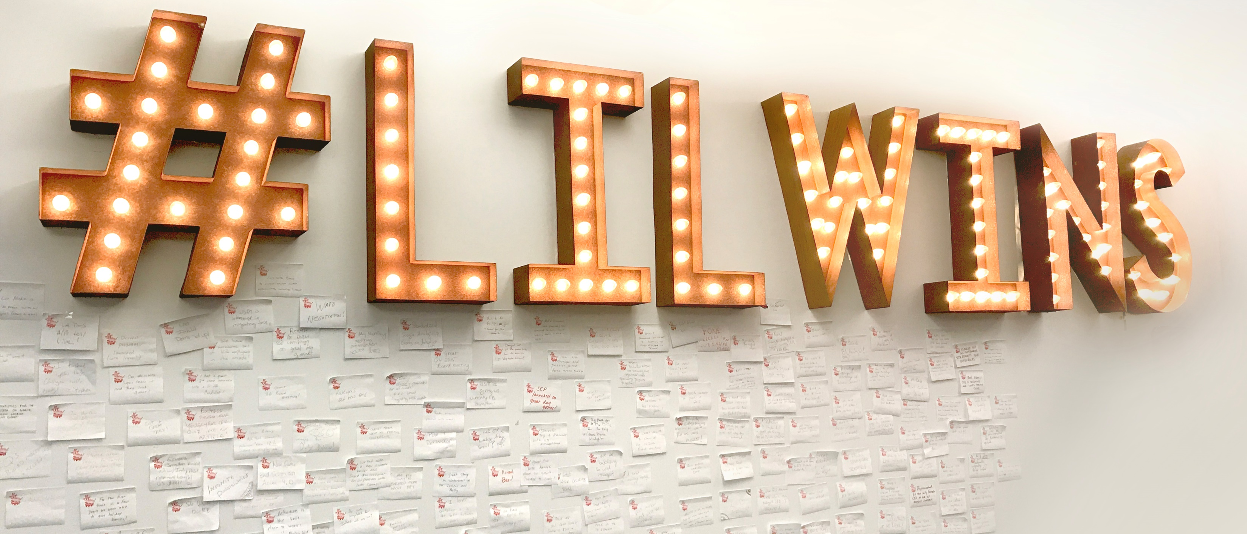
Display Tangible Progress

Slide 26
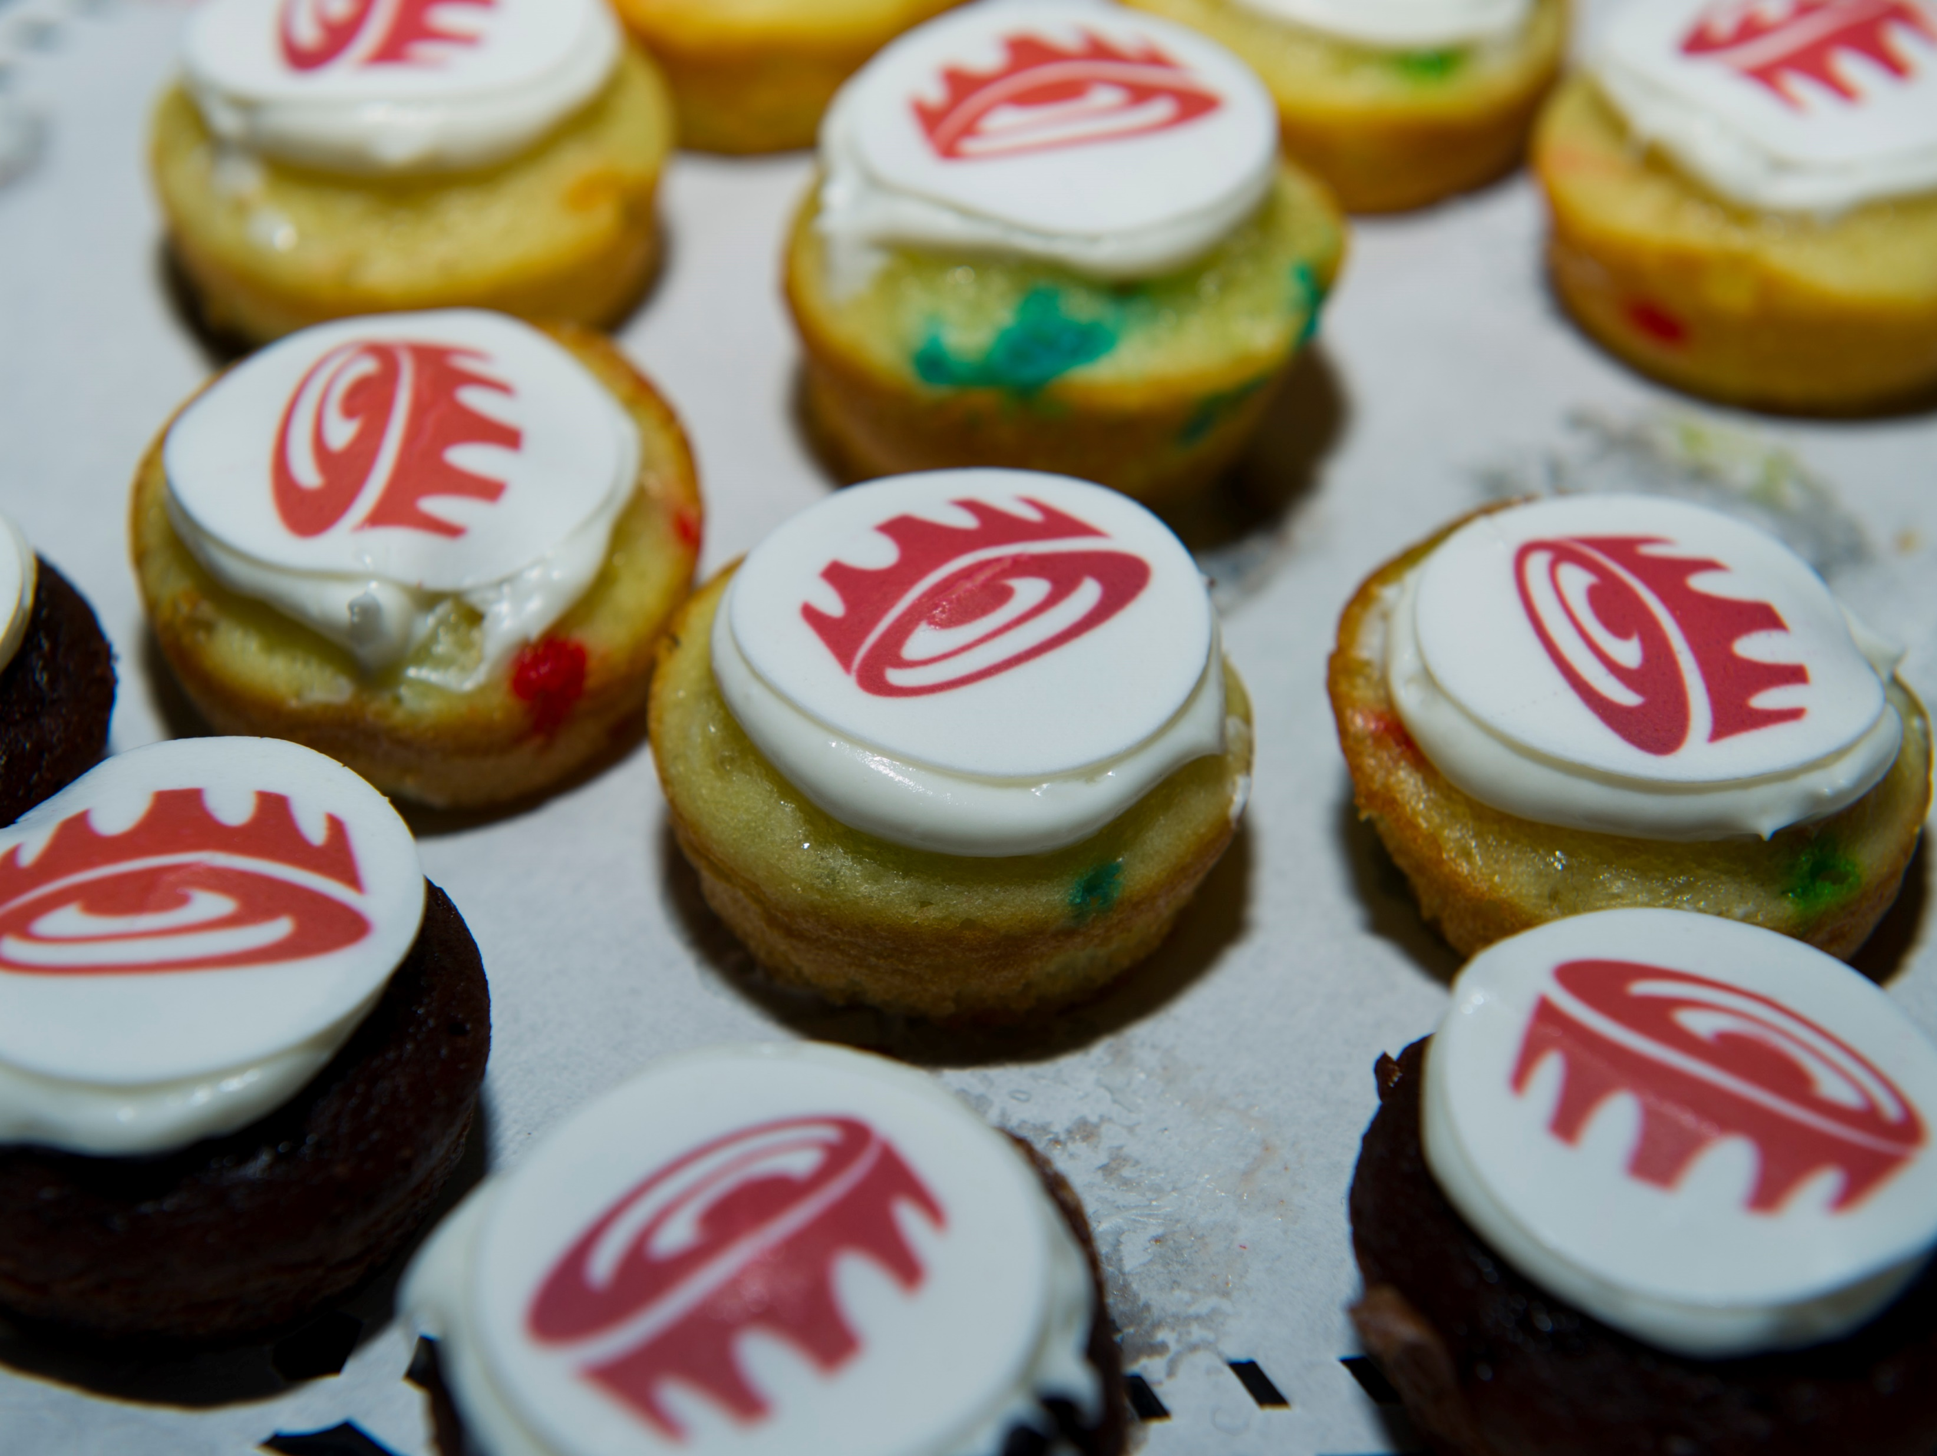
Revamped Compensation Program & New Quarterly Bonuses

Slide 27
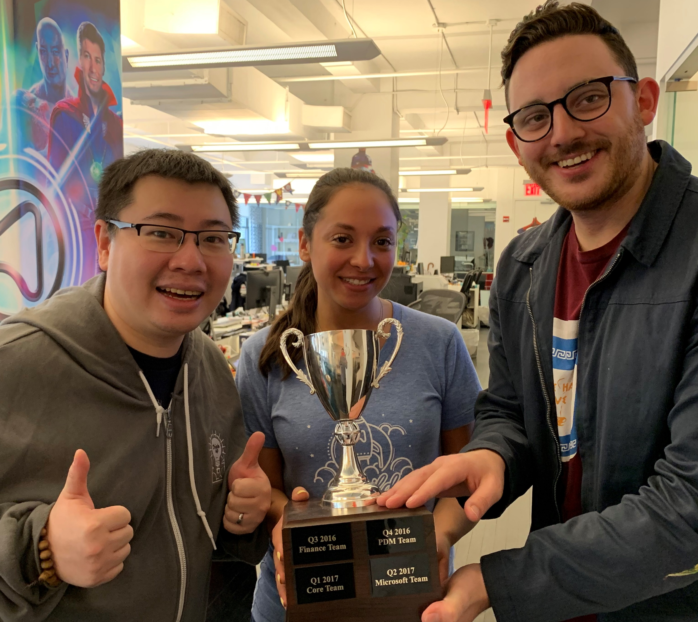
Established the
Arkadium
Cup

Slide 28
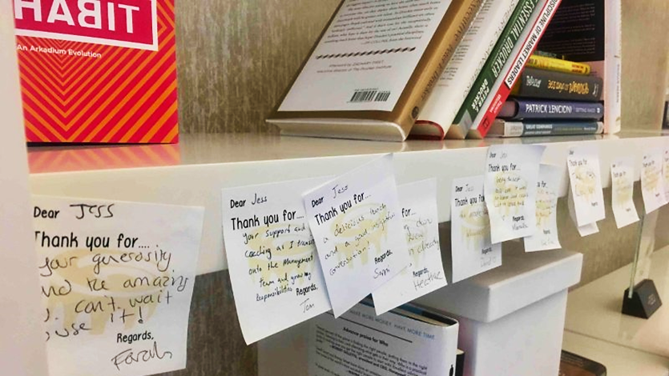
Systematized Gratitude In-Person…

Slide 29
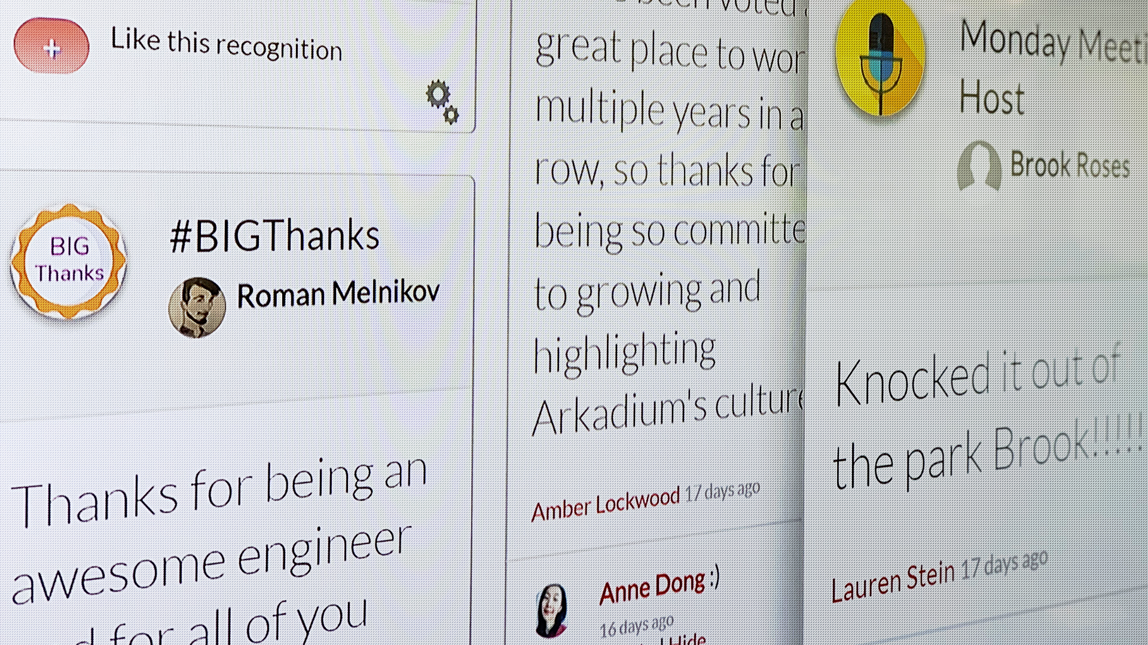
…And Online

Slide 30
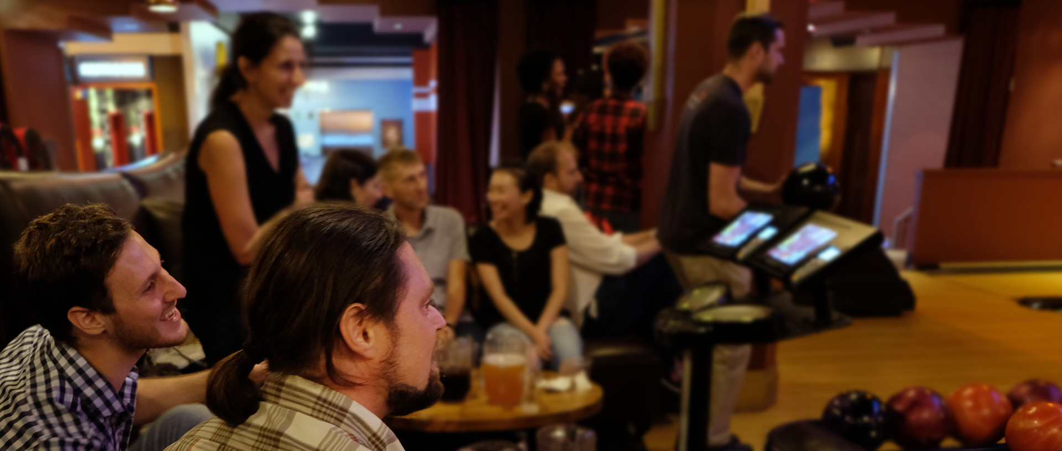
Started Monthly Fun Nights
Fun Nights

Slide 31
Developed Quarterly Themes

Slide 32
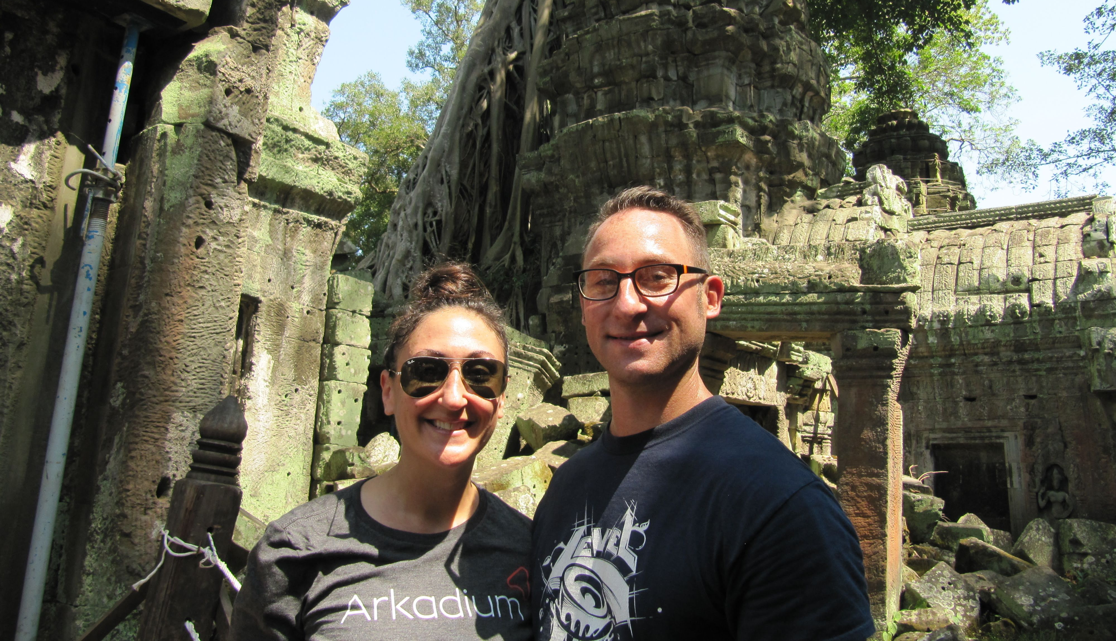
Developed the Infinite Possibilities
Prize

Slide 33
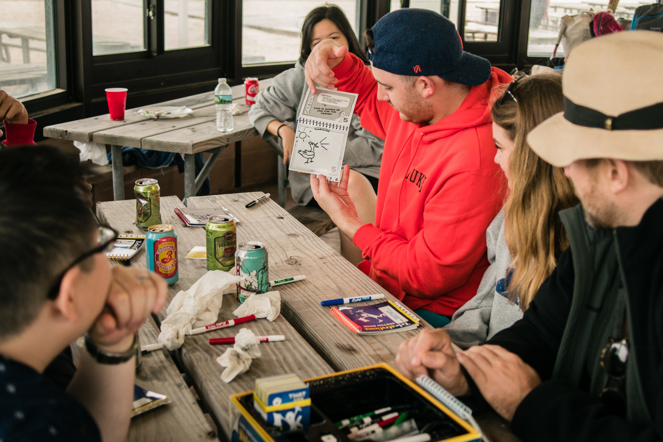
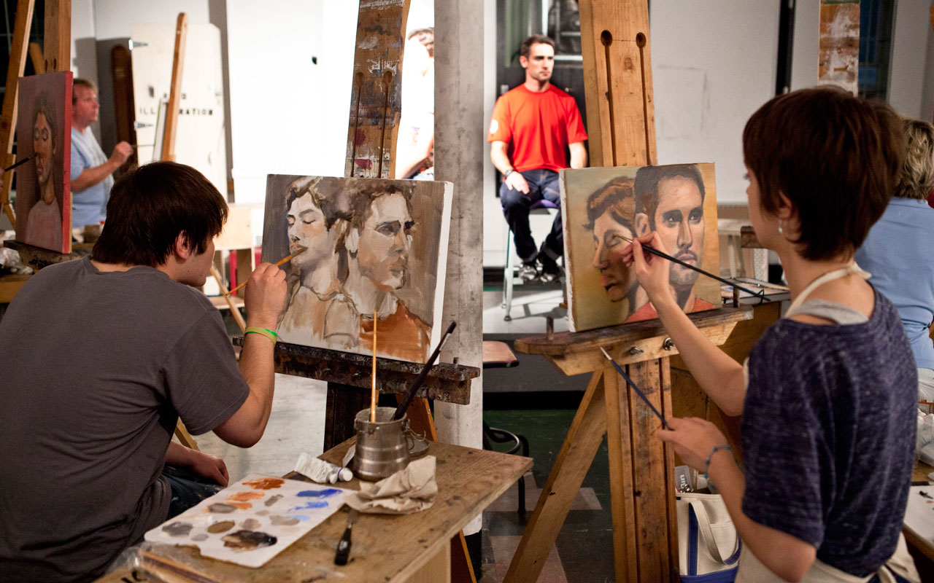
Created Personal
Development
Budget

Slide 34
Overhauled Benefits
401(k), health coverage, $500 medical stipend, and more

Slide 35
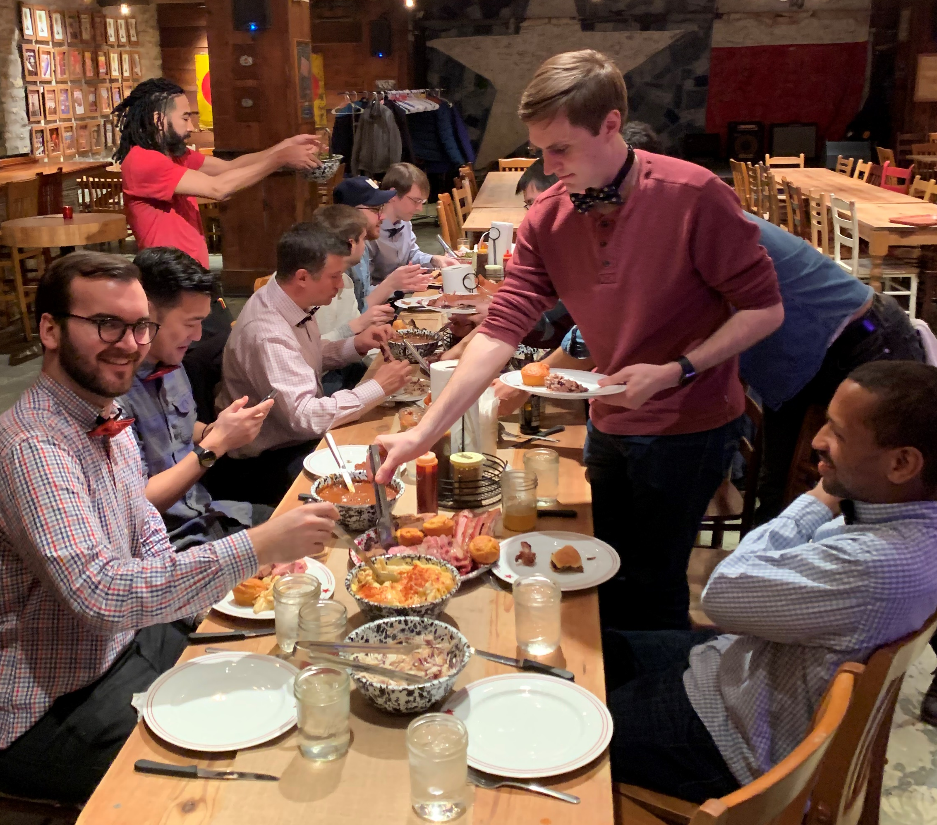
Started Monthly
Connection Lunches

Slide 36
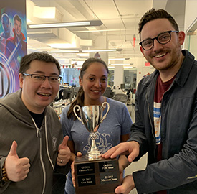
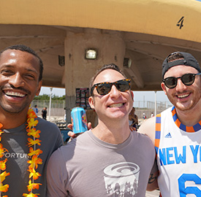
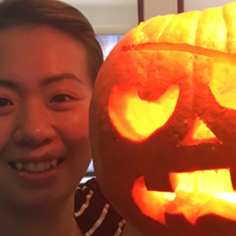
Investing In
Our Future
Notes:
SLOW IT DOWN

Slide 37
By Investing in Ourselves
Arkadium buys out
VC investor to focus
on long-term strategy
September 19, 2018

Slide 38
Thank You
Thank You
“If your end game is having a business that you love, continuing to thrive, and making careers for people, then I’m winning.”
-Jess
The New York Times
January 11, 2019
Notes:
SLOW REVEAL OF FACES

Slide 39
Thank You

