Slide 1
Small giant within a giant
May 1, 2019
Ray brown
Sr Director, Pricing and Contracting, USA
Medtronic mitg

Slide 2
agenda
What to expect
Intro—Ray Brown, Hannah Edwards
Medtronic MITG
Pricing and Contracting: Who are we?
Our Journey as a “Company Within a Company”
What we did, and What Results we saw
Toolkit for Success and Call to Action

Slide 3
Disclaimer!
Hannah Edwards and I do not speak on behalf of Medtronic (nor on anyone else’s behalf for that matter).
Therefore, all the comments and opinions you hear from us during the Summit and any other times we’re together are solely our own.

Slide 4
Medtronic mission
THE MEDTRONIC MISSION. To contribute to human welfare by application of biomedical engineering in the research, design, manufacture, and sale of instruments or appliances that alleviate pain, restore health, and extend life.

Slide 5
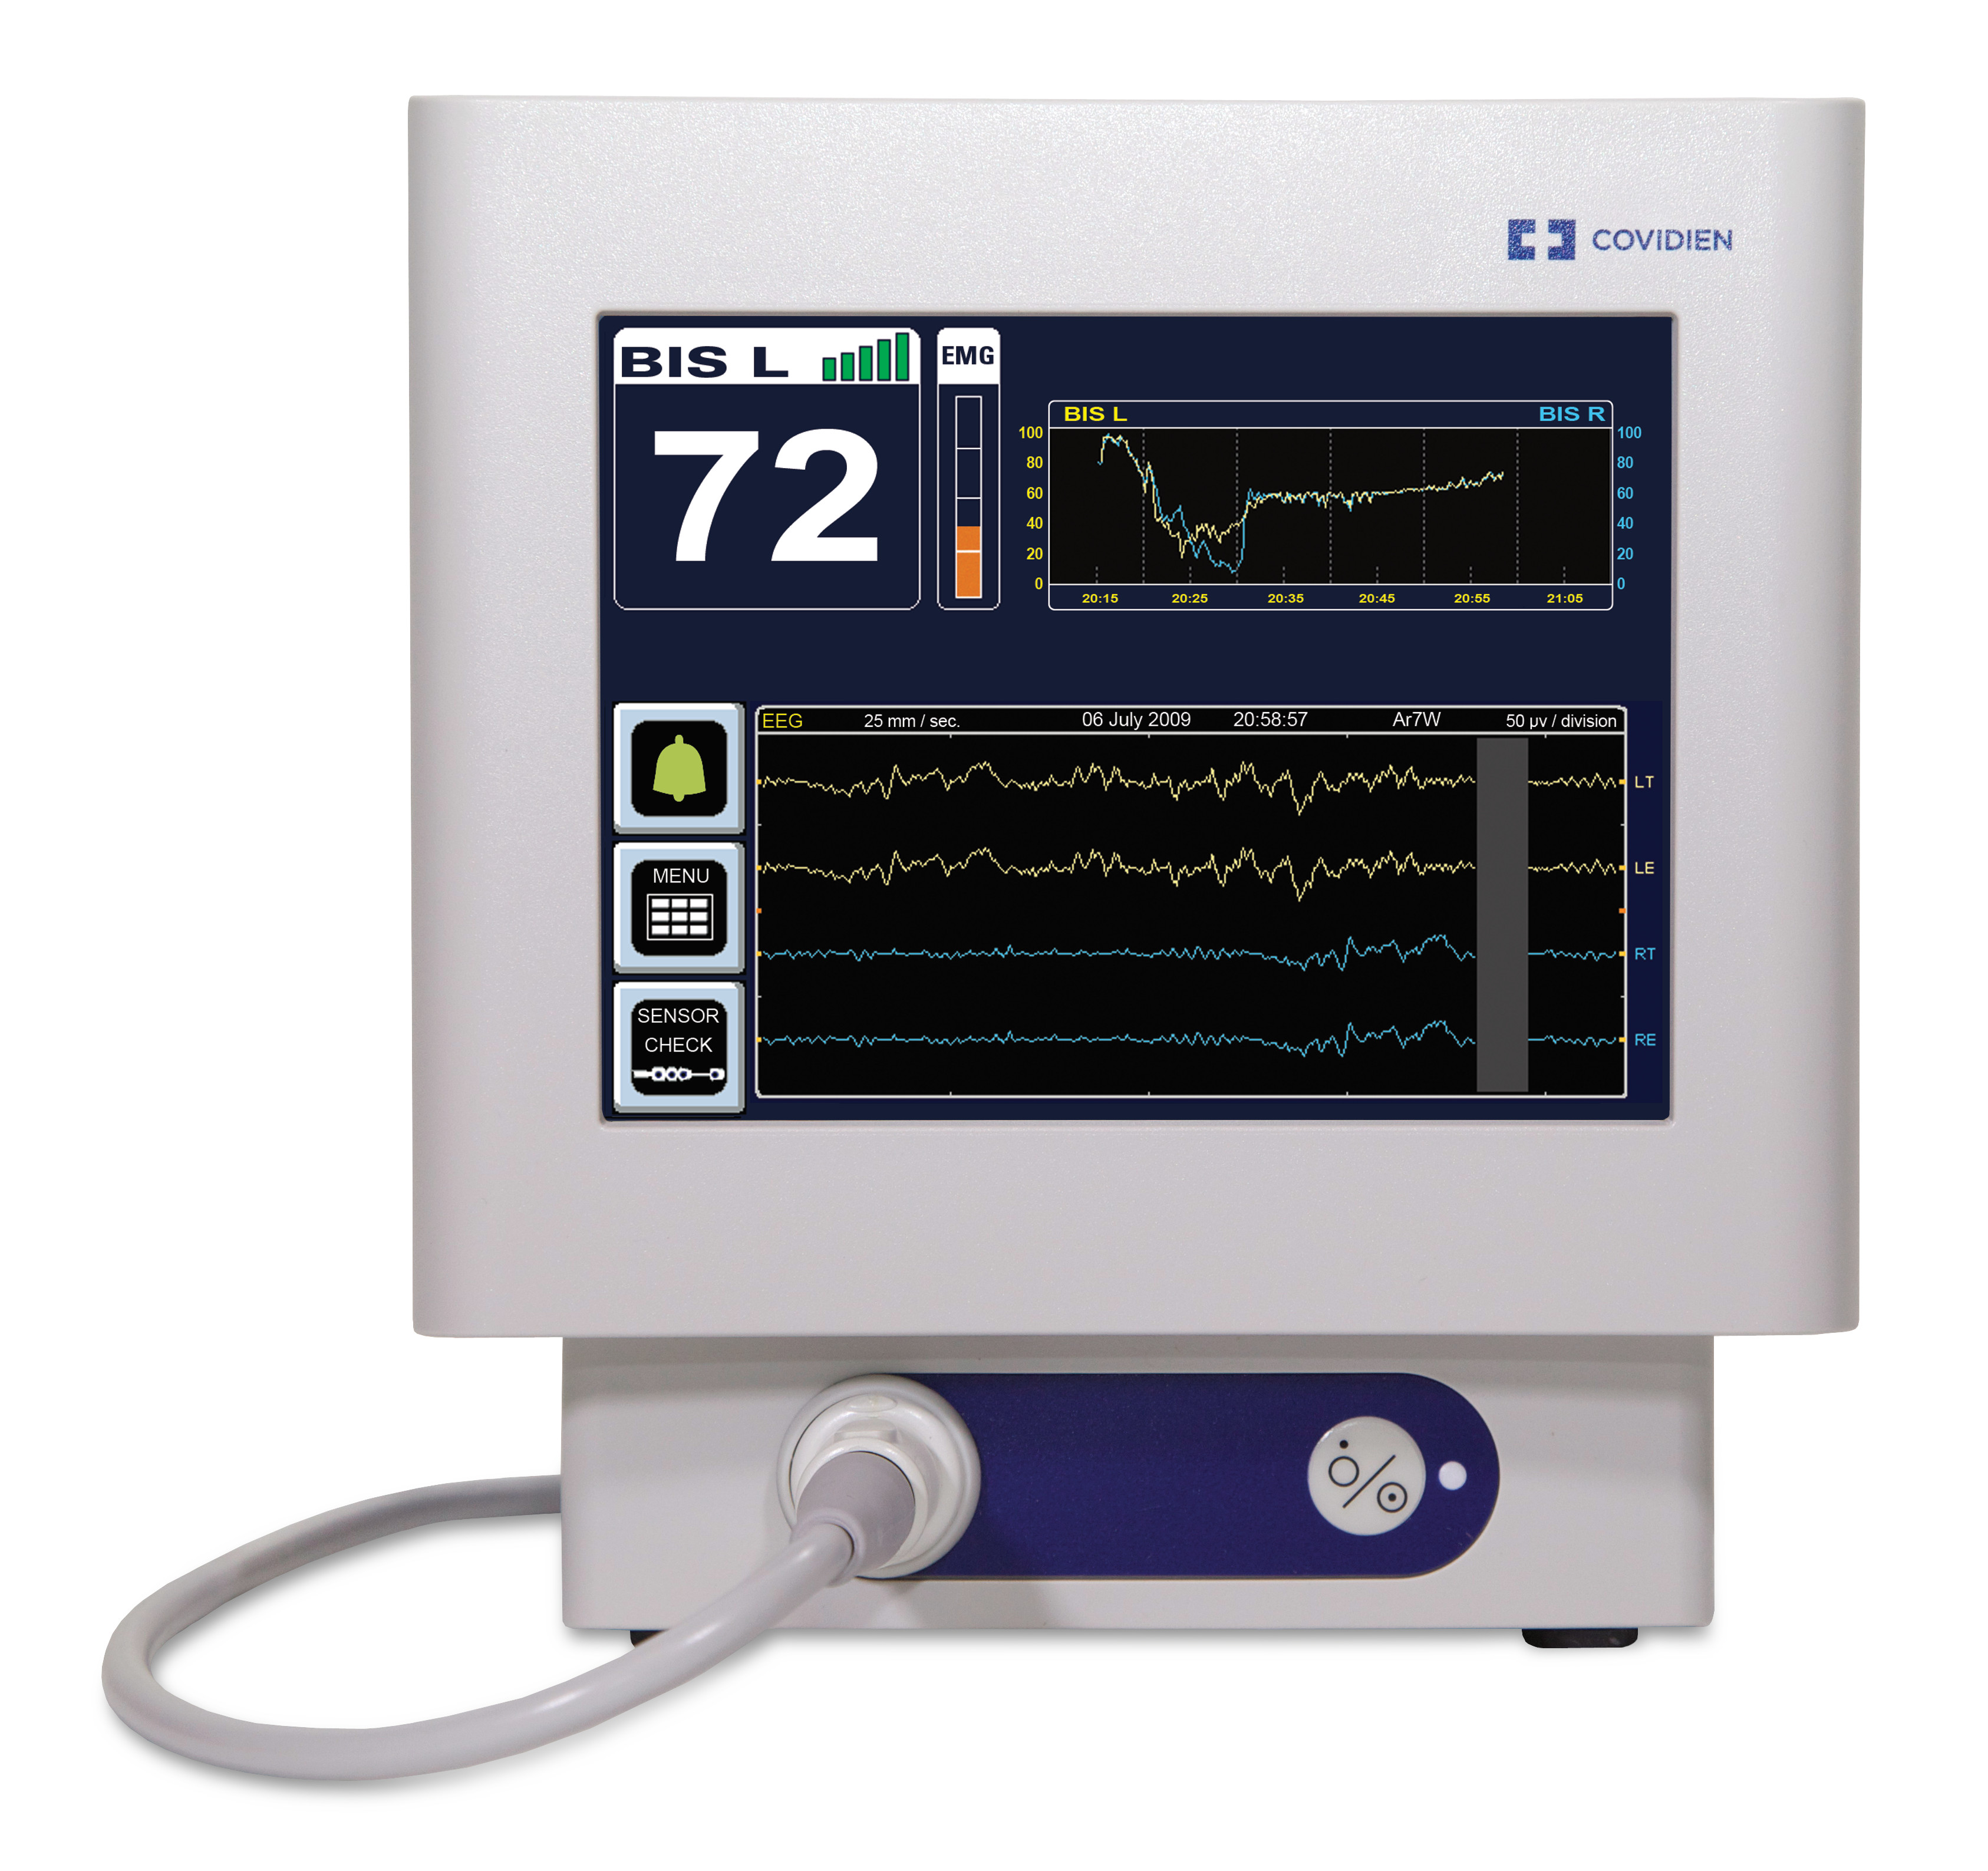
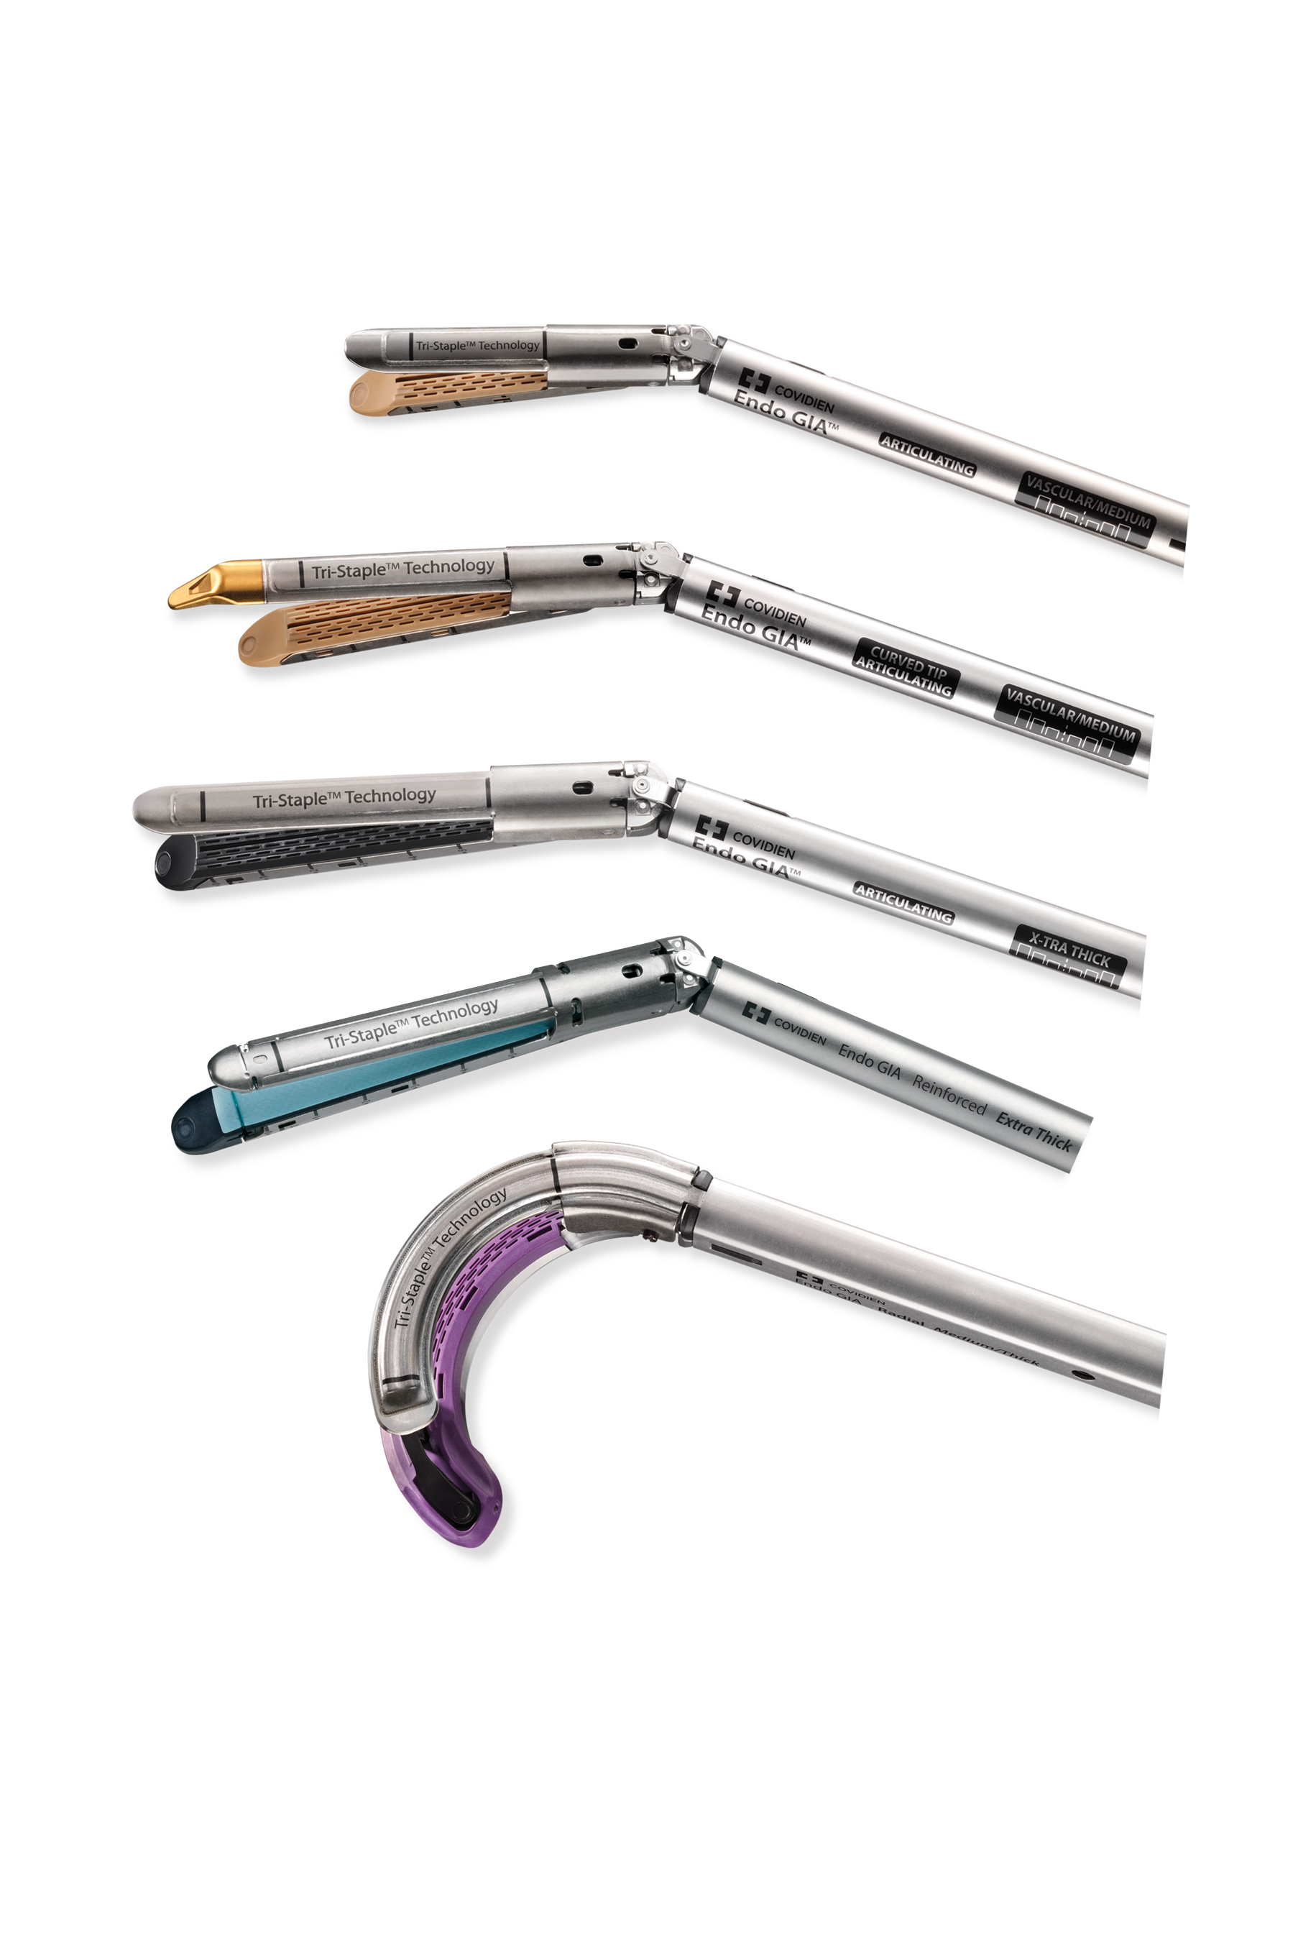
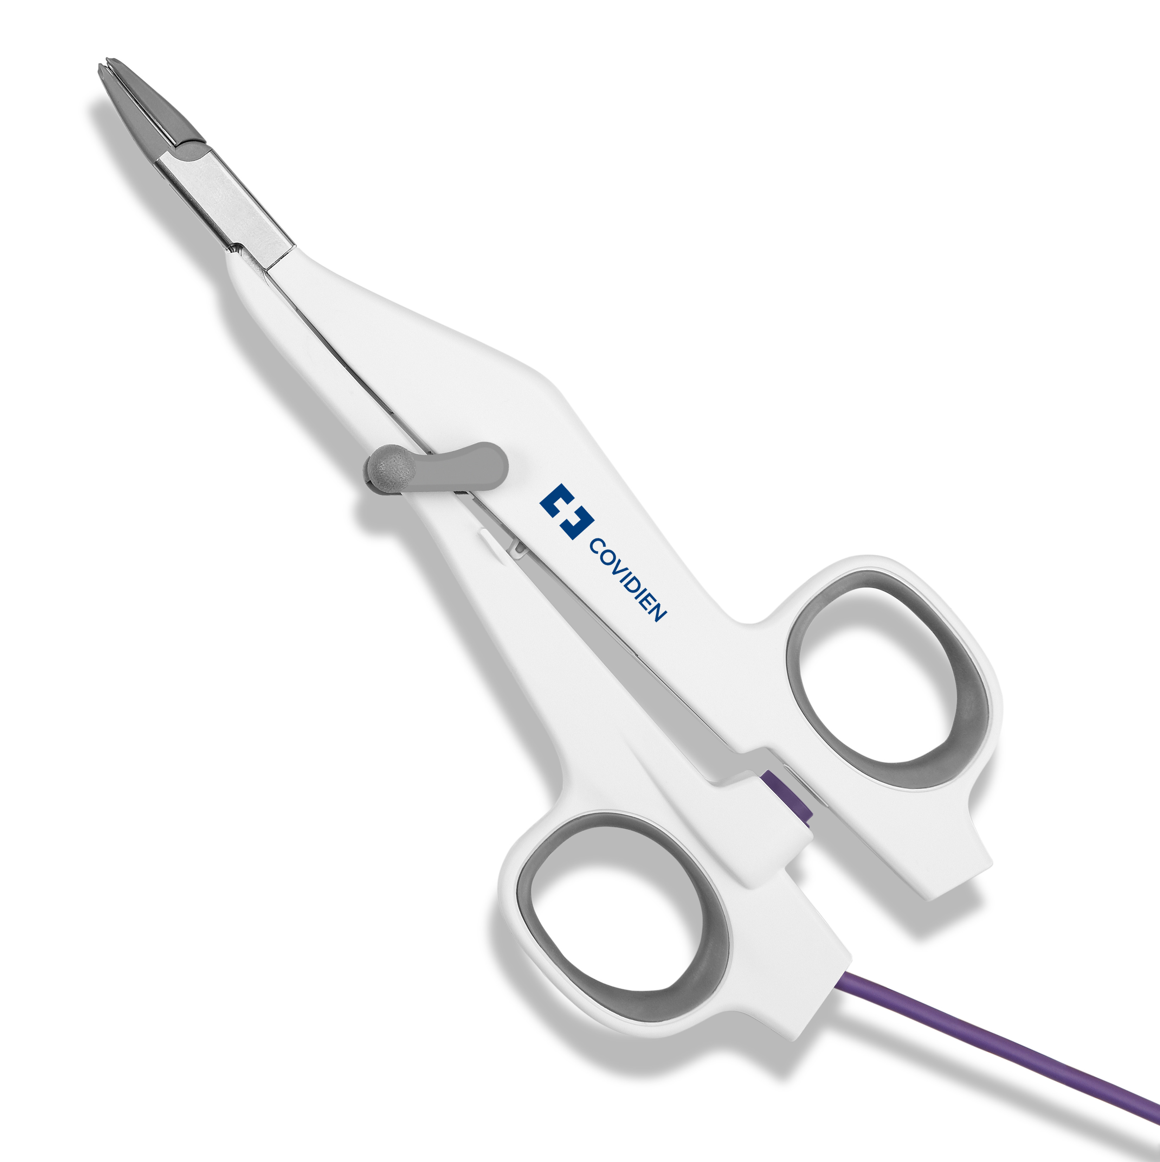
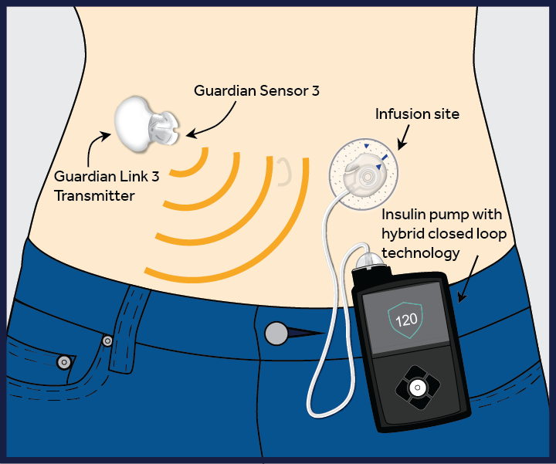
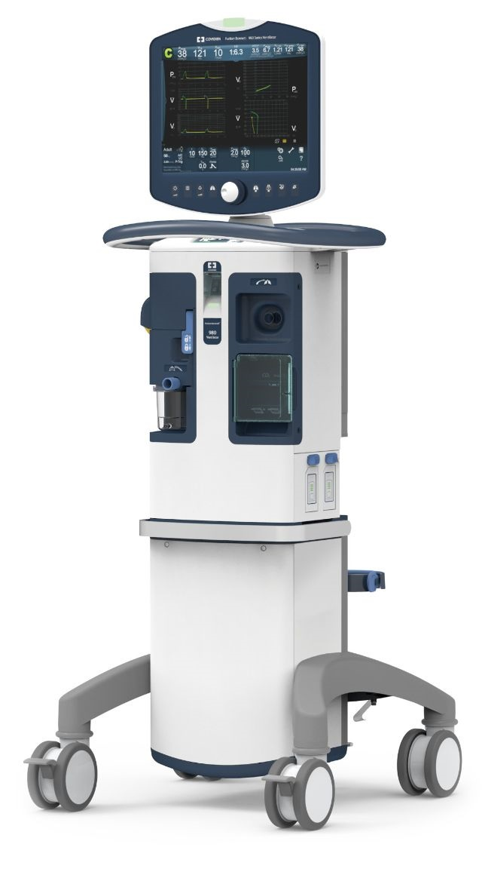
Medtronic Minimally invasive therapies group (MITG)

Slide 6
Where the team fits

Slide 7
Why this matters
Team has an outsized influence on MDT’s ability to fund the mission
The performance of every single person matters—both positively and negatively
10.6% > 7% we spend on R&D
Scale is necessary to put technology within reach of the people who need it
We ought not ignore these environments
It will take courageous leaders in these companies to change them
There is power in numbers
The good news is that given most big company environments, it’s fairly easy to make a significant difference. Purpose-driven leadership is effective leadership. We have grown from 2 people to 55 in 3 years because we put people first.
Results in proportion to company size and bad practices displaced

Slide 8
What did we do?
It doesn’t make sense to hire smart people and tell them what to do;
We hire smart people to have them tell us what to do.”
--Steve Jobs
Empowered people throughout the organization
OD empowerment on about $5B/year in opportunities
Inverted approval ratio from 0% to 70%
Invested in tools and training for them. We give them objectives and hold them accountable for results
Offer Development (Transactional Pricing Group)
Returns to Business by Month
Lots
5000000
4000000
3000000
NPV
2000000
1000000
Little
0

Slide 9
What did we do?
“
Measure and manage work quantitatively
Implemented Kaizen
Rolled out Kaizen tools gradually, beginning with the Bowler Chart
Assigned articles and videos to the team
Used Kaizen tools in recurring Ops Reviews
Included leadership in effort
Report out results regularly
Created a culture of accountability to each other and to the larger MDT organization
Promoted a sense of each individual’s role in the mission
Train people well enough so they can leave
Treat them well enough that they don’t want to
– Richard branson

Slide 10
How can this be done elsewhere?
A toolkit for implementation
A few ideas on HOW TO!
Start small if you can. We started with 2 people in a $900M business unit. Sounds like a lot, but it was about 3% of the company’s revenue, so nobody got too worked up over our experiments
Be willing to pilot a lot of stuff
Be tolerant of the occasional failure that is an inevitable part of innovating. Encourage people to fail fast
Try to not do it in a fishbowl. This is threatening to some people
Be aware that other leaders’ people will see the difference between groups and ask why their leadership isn’t committed to creating the same kind of positive environment for them. This can cause friction for you
People fear what they don’t understand, so be a patient ambassador and educator for the approach. You may even gain some allies!
Deliver wins and publicize them. Then use those to attract investment and use that as a means of developing and retaining talent. We adopted an “internally entrepreneurial” mindset focused on using the higher performance of our team to solve problems in adjacencies. I’ve found that once you give them a mission and empower them, they will be just as enthusiastic as you are about doing this
Be equally transparent about both victories and setbacks. Your credibility is essential to success
Be clear about your commitment to Purpose Driven Leadership with your leadership team. You’ll need their support for this to be successful
Implement greater empowerment in conjunction with quantitative methods of measuring and managing work (Kaizen, Lean)
Engage, engage, engage! Spend a lot of time with your people and make sure they understand that what comes with this is a commitment to them and to their success. And reinforce that you cannot be successful unless they are
Then be a tireless advocate for your people and for creating a better, more fulfilling environment for them. It will be worth it
Join us!

