Slide 1

How to Expand into Sales Services
HubSpot Agency Partner Training
Q1 2017

Slide 2
AGENDA
Definition: Sales Services
ROI: Why Sales Services Matters to Agencies and Their Clients
Selling: How to Identify a Good Fit Prospect for Sales Services
Pricing and Packaging: How Agencies Price/Package Sales Services Today
Delivery: How Agencies Can Deliver Sales Services with HubSpot
Next Steps for Partners

Slide 3
DEFINITION
What Are Sales Services?

Slide 4
WHAT ARE SALES SERVICES?
DEFINITION:
Sales Services are are any service that directly influences or accelerates revenue for a business, usually improving a sales team’s efficiency and productivity.
HubSpot technologies tied to these services include: HubSpot Free CRM, Sales Free, Sales Pro, Reporting Add On, and the API Add On.

Slide 5
OVERVIEW: THE FOUR CORE INBOUND SALES SERVICES
INBOUND SALES SERVICES
CRM Implementation
Implementing the HubSpot CRM in order to manage and analyze customer interactions and data throughout the customer lifecycle
HubSpot Site Page
Sales & Marketing Alignment
Integrating operations and enhancing communications between sales and marketing teams with the shared goal of increased revenue generation
Sales Enablement
Sales enablement is the technology, processes, and content that empower sales teams to sell efficiently at a higher velocity
HubSpot Site Page
Sales Coaching
An interactive process to help sales team members develop more rapidly and produce better results

Slide 6
DRILL DOWN: THE FOUR CORE INBOUND SALES SERVICES
CRM Implementation
Sales & Marketing Alignment
Sales Enablement
Sales Coaching
Define deal stages, custom fields
Initial CRM Data Migration
Lead Routing and Ongoing Audits
Build Custom Views for Reps
Build Custom Reports for Managers
CRM Data Ongoing Cleanup
Buyer profiles
Buyer personas
Define MQLs/ SQLs
Define Lead Stages
SLA and Reporting
Develop supporting content plan
Establish a feedback mechanism
Email template creation and optimization
Sequence creation and optimization
Sales document library
Case study creation
Prospecting automation with Meetings Links
Implement Messages App
Candidate sourcing
Interviewing
New hire onboarding
Sales management training
Inbound Sales Training
Rep progress tracking and PIPs

Slide 7
RECURRING vs. NONRECURRING INBOUND SALES SERVICES
CRM Implementation
Sales & Marketing Alignment
Sales Enablement
Sales Coaching
Define deal stages, custom fields
Initial CRM Data Migration
Lead Routing and Ongoing Audits
Build Custom Views for Reps
Build Custom Reports for Managers
CRM Data Ongoing Cleanup
Buyer profiles
Buyer personas
Define MQLs/ SQLs
Define Lead Stages
SLA and Reporting
Develop supporting content plan
Establish a feedback mechanism
Email template creation and optimization
Sequence creation and optimization
Sales document library
Case study creation
Prospecting automation with Meetings Links
Implement Messages App
Candidate sourcing
Interviewing
New hire onboarding
Sales management training
Inbound Sales Training
Rep progress tracking and PIPs
Orange = Recurring Service

Slide 8
ROI
Why Sales Services Matter

Slide 9
ABOUT THIS DATA…
Over the course of December 2016 and January 2017, HubSpot surveyed 50 Platinum and Diamond Agency Partners who have been offering Sales Services for at least one year or more.
This is what they told us about what type of impact bringing Sales Services to their clients has on their business…

Slide 10
PART 1: AGENCY ROI
Why Sales Services Matter for Agencies

Slide 11
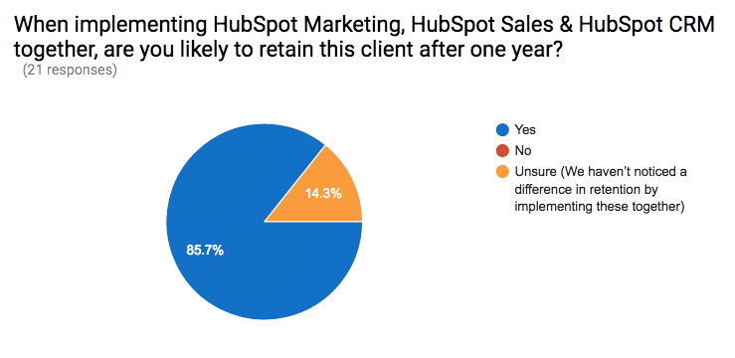
CLIENT RETENTION ROI

Slide 12
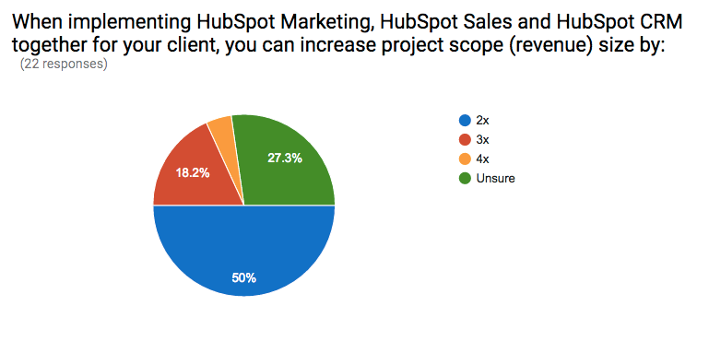
REVENUE GROWTH ROI

Slide 13
PART 2: CLIENT ROI
Why Sales Services Matter for Agencies’ Clients

Slide 14
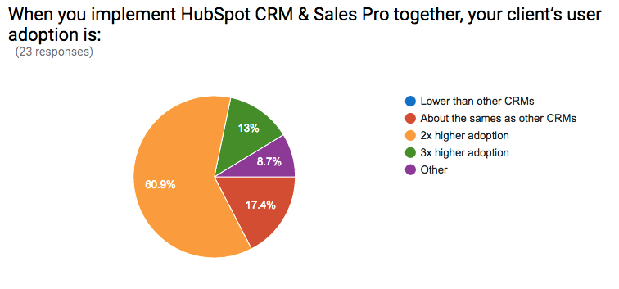
CLIENT CRM ADOPTION RATE

Slide 15
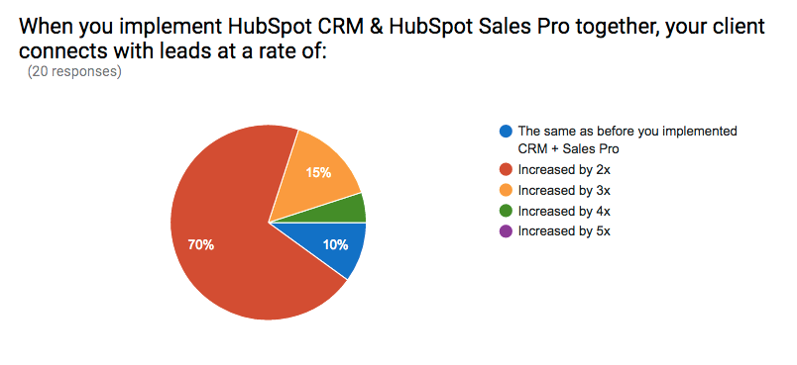
CLIENT PROSPECTING & PIPELINE ROI

Slide 16
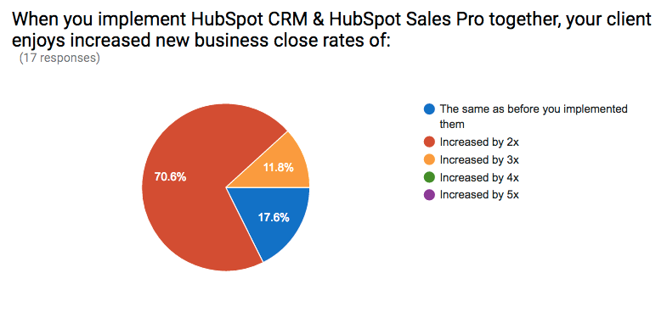
CLIENT NEW BUSINESS WIN RATES

Slide 17
SELLING
How to Identify Good Fit Prospects

Slide 18
The Buyer Personas For Sales Services and HubSpot Sales Software

Slide 19
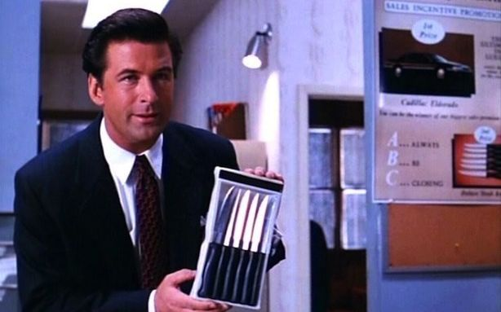
PERSONA #1: Sales Leader Larry
Demographics:
35-50 years old
VP/Director of 6+ person sales team, responsible for hitting company’s revenue growth targets
Worked in sales his whole life, grew up in outbound sales era (cold calling, outside sales)
Struggles/Goals:
Lack of insight into day to day team activity
Poor rep adoption of CRM/no CRM
Wants to make team more productive
Worried opportunities are “slipping through the cracks”

Slide 20

PERSONA #2: Account Rep Alex
Demographics:
25-32 years old
Account Exec/Inside Sales Rep on larger sales team
Responsible for closing a certain amount of business every month/quarter/year
Struggles/Goals:
Extra manual work, trainings, processes that take away from time he needs to hit his number
Wants to get over uncertainty of “will I hit this month?”

Slide 21
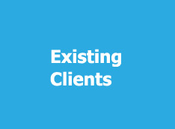
WHAT’S THE RECOMMENDED APPROACH?
Already familiar with the agency
Already familiar with HubSpot software
Much lower resistance to EVERYTHING
Key to getting wins early and often for the Partner

Slide 22
PART 1: WHAT DOES A “GOOD FIT” LOOK LIKE? IDENTIFYING PAIN
IF CUSTOMER PAIN IS AROUND...
...A NEED TO ORGANIZE...
Customer typically does not have a CRM, uses XLS spreadsheets, or uses a homegrown CRM
Customer expresses pain about:
  Duplicate data
  Non-standard data
  Lack of visibility into anything happening with Sales
...A NEED TO IMPROVE PRODUCTIVITY...
Customer may or may not already have a CRM, but expresses pain about things like:
Sales reps struggle to connect with enough prospects
Sales reps struggle to respond to leads quickly
Sales reps are letting leads fall through the cracks/ forgetting to follow up over time
Sales reps spending too much time doing non-sales activities
… recommend HubSpot CRM.
… recommend HubSpot Sales Pro.

Slide 23
PART 2: WHAT DOES A “GOOD FIT” LOOK LIKE? QUALIFYING FRAMEWORK
ROLE
Do they fit one of the two target personas - Larry or Alex?
Do they have decision making/implementation power?
TECH FIT
Do they use Google Apps/ Outlook 365?
Do they currently use the HubSpot CRM?
EMPLOYEES
Do they have 2 - 50 sales employees?
SALES
Do they have a sales process? Can it be measured/ improved?
GOALS
If goals don't fit, it's not a good fit.

Slide 24



PART 3: WHAT DOES A “GOOD FIT” LOOK LIKE? TECHNICAL LIMITS
OR
+
TECHNICAL REQUIREMENTS:
Must be able to install JavaScript on their site for tracking
Must be using Outlook of GMAIL

Slide 25
PRICING
How Agencies Price Sales Services

Slide 26
A NOTE ON WHAT YOU’RE ABOUT TO LEARN…

Slide 27

PRICING FOR SALES SERVICES IS EVOLVING

Slide 28
… BUT THIS IS WHAT WE’VE LEARNED SO FAR

Slide 29
FOUR MAIN PRICING MODELS FOR SALES SERVICES
INBOUND SALES SERVICES PRICING MODELS
HOURLY
Billed hourly
Minimum commitment of one month at a time
Typically ranges from $100-200/ hour
Ref: Media Junction
PROJECT-BASED
Duration typically 90-days minimum
Cost ranges from $5,000-$30,000
Ref: Measured Results Marketing
RETAINERS
Quarterly commitment minimum
Cost ranges from $1,000-$10,000/ mo.
Most start at $3,000-$5,000
Ref: Huify
POINTS-BASED
Certain activities are worth certain “points”
Client can consume a certain amount of “points” in a month
Once points run out, work stops or client buys more points
Ref: Imagine, LLC

Slide 30
ADDITIONAL KEY LEARNINGS ON PRICING SALES SERVICES
Are Agencies Struggling to Sell Sales Services?
No -- if anything, they are concerned about under-pricing their services. They do not report having any issue introducing the services SO LONG AS the CEO/ Business Owner is in the conversation.
What Are Agency Owners Concerned about When It Comes to Selling Sales Services?
Not charging enough for their services. Based on the research we’ve done so far, I would agree with this concern. Agency owners need to remember that the Sales Org is going to be LESS sensitive to price than their marketing counterparts.
Which Types of Businesses or Clients Are Agency Owners Targeting?
Heavy Bottom of the Funnel -- If this is true for a client, then reps are likely lying about their deals which means there’s no real sales process in place.
Low lead-to-close rates -- More detail here: https://wiki.hubspotcentral.com/display/Sales/How+Agencies+Price+and+Package+Sales+Services

Slide 31







PRICING/ PACKAGING EXAMPLES
https://www.newbreedmarketing.com/solutions/inbound-sales-enablement
https://www.mediajunction.com/inbound-sales
http://www.measuredresultsmarketing.com/services/
https://www.revenueriver.co/sales-enablement
https://www.fullfunnel.co/sales-services
https://www.square2marketing.com/what-is-inbound-sales
https://www.saleshub.ca/sales-enablement

Slide 32
DELIVERY
How Agencies Can Deliver Sales Services with HubSpot

Slide 33
HOW TO GET UP TO SPEED ON SALES SERVICES DELIVERY
INBOUND SALES SERVICES DELIVERY: RECOMMENDED EDUCATION
CRM Implementation
Sales & Marketing Alignment
Sales Enablement
Sales Coaching
Sales Services Webinar Series - Link
HubSpot CRM Cert - LIVE
Role-Based Training - FEB 2017
Sales Services Webinar Series - Link
Role-Based Training - FEB 2017
Sales Services Webinar Series - Link
HubSpot Sales Pro Training - NOW LIVE - LINK
Role-Based Training - FEB 2017
TRAINING IN DEVELOPMENT - Q2 2017
Inbound Sales Methodology Cert - LINK
Team up w/ Sales Partners: Contact Sam BELT

Slide 34


UNDERSTANDING WHAT WORLD-CLASS SALES SERVICES LOOK LIKE
2016 SALES ENABLEMENT IMPACT AWARD WINNERS
Click on Agency Partner logos to see the client case study!

Slide 35
WE ALSO LEARNED A LOT FROM TOP-TIER PARTNERS ABOUT HOW TO DELIVER SALES SERVICES AT THE 2016 SALES ENABLEMENT ADVISORY COUNCIL (Pre-INBOUND)…

Slide 36
DELIVERY: BONUS RESOURCE
The Agency Owner’s Field Guide to Offering Sales Services

Slide 37
SALES ENABLEMENT
SERVICES IMPLEMENTATION PILLARS
HIRING
MARKETING
PRICING
Sales Ops Expert: understands CRMs and sales org structure
Strategist: focused on communication between client’s sales & marketing leaders
Technologist
Content Creator (email templates, content offers)
Target Persona is VP Sales
  “Are you on track to hit your annual sales goals?”
Companies with aggressive growth goals (companies that just landed VC funding)
Small - 3-100 reps
$5-10K/ mo for 12 months
Equivalent cost of sales mgr
Large - 100+ reps
$100/ rep/ month
SALES STRATEGY
ORG STRUCTURE
SERVICE PRICING INCLUDES…
What it takes to help the sales manager hit their sales goals
Process - documented sales process
System - reporting and SLA against metrics
Technology - budget $18k
Content - email templates and organization of marketing content
Focus sales and marketing on the entire sales funnel:
Lead generation
Nurturing and qualification
Sales qualified
Process for closing sales

Slide 38
SALES & MARKETING ALIGNMENT
SERVICES IMPLEMENTATION PILLARS
HIRING
MARKETING
PRICING
Consultant
Sales Person
Marketing Person
Target: Existing customers & companies with 10-50 sales reps
Pain: “Our sales and marketing teams are not aligned”
Content: Alignment “Grader”
Model:
3-mo. roadmap for development and implementation
Quarterly review and optimization
Ranges $5-50K; use Value base
SALES STRATEGY
ORG STRUCTURE
Target existing customers, companies with 10-50 salespeople
Use answers from Sales Alignment Grader to pinpoint sales discussion
Determine the value we can bring in terms of ROI
This service fits into existing agency structure because it’s more of an ‘add-on’ service rather than a stand alone one.

Slide 39
CRM IMPLEMENTATION
SERVICES IMPLEMENTATION PILLARS
HIRING
MARKETING
PRICING
First 3 hires should be:
Sales: Subject matter expert
Tech/ Implementation specialist
Project manager
Target audience = CFOs
  CFO often has no idea what revenue is coming in each quarter, powerful for sales managers as well
Content idea: “Gaining monthly forecast visibility”
Basic: $2500
Deal stages and fields only
Advanced: $5500
Consulting on sales process, deal stages, reporting
SALES STRATEGY
ORG STRUCTURE
Recommended to do a Sales Process Audit
Example questions:
How many contacts do you have now?
How old is that data?
Sales POC, Project Manager, Tech Expert should all be involved in client communications

Slide 40
SALES COACHING AND TRAINING
SERVICES IMPLEMENTATION PILLARS
HIRING
MARKETING
PRICING
Salesperson to sell the coaching and training services
Trainer (service provider)
Account manager (also does marketing)
Target Personas:
Manager and Director level
Sales Ops (enterprise only)
CEO (small companies)
Value prop: Decreasing the sales cycle with a more hands on approach
Base fee + per salesperson who is getting trained
Offer training as part of the webinar
In-person workshops work well as it’s a more tangible service for clients (as opposed to all virtual training)
SALES STRATEGY
ORG STRUCTURE
Current customers: especially ones using hubspot CRM already
Inbound Leads (webinar event with a needs analysis assessment)
Outbound (lists, LinkedIn, events, etc)
The three hires work together to set goals and stay on the same page
Within that, marketing will focus on marketing, sales on sales, and trainer on executing the coaching

Slide 41
TECHNOLOGY ASSESSMENTS
SERVICES IMPLEMENTATION PILLARS
HIRING
MARKETING
PRICING
Sales Consultant & Growth Strategist
Technical Marketing & Sales Analyst
Sales / BDR
TOFU CTA
Webinar: How to Shorten Your Sales Cycle and Create a Predictable Pipeline: A Case Study; Broken down into different webinar tracks for specific technologies
BOFU CTA
Initial offer: Mini Audit with mini recommendation to our existing customers
Retainer model with a set-up period
Lead in with an audit/assessment (month 1)
SALES STRATEGY
ORG STRUCTURE
Monthly data analysis and recommendations (ongoing)
Integration of multiple technologies into single data; e.g.: Analyzing call to appointment ratios, sales cycle
Recommendations will include how to better utilize the tools based on the data
The value of this is the ability to have a predictable pipeline, and have gradual improvement over time
Growth Strategist / Consultant is the project manager and oversees the strategic recommendations and how to apply the analysis
  They digest it and spit it out
Analyst analyzes and comes up with iteration points and technology recommendations
Salesperson sells

Slide 42
NEXT STEPS
Your Calls-to-Action for Agency Partners

Slide 43
NEXT STEPS: HOW TO OFFER SALES SERVICES
AGENCY PARTNERS
Activate HubSpot CRM and Sales Free (minimum)
  Recommended: Purchase Sales Pro
Complete CRM Certification
Complete Sales Pro Training Modules - http://academy.hubspot.com/sales-training
Review this deck with your CAM or CC
Identify 5 good fit installed base clients OR 5 good fit new prospects

Slide 44
APPENDIX

