Slide 1
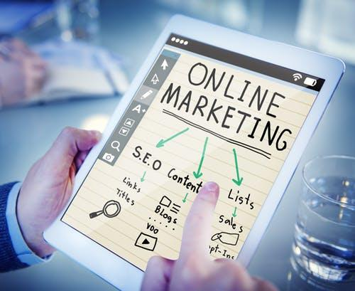
The Beginners Guide to Generating Inbound Leads
Company Logo
Notes:
Source: https://blog.hubspot.com/marketing/beginner-inbound-lead-generation-guide-ht

Slide 2
Contents
Overview………………………………..3
What is Lead Generation?...................4
How to Generate Leads……………….6
How to Qualify Leads………………...11
Lead Generation Benchmarks……….15
Lead Generation Strategies………….18
Lead Generation Campaign Tips…....21
Conclusion……………………………..26
Company Logo

Slide 3
Overview
We've all been through it. You know, the moment you're about to dig into the best darn pile of spaghetti and meatballs you've ever seen. Just as you twist your fork in the pasta, spear a mouth-watering meatball, and go in for the first savory bite ... the phone rings. "May I speak to Lindsay Kow-low-witch?" asks the telemarketer on the other end. "This is an important message about your oven preferences." This frustrating interruption is exactly why we're here to discuss inbound lead generation. What is inbound lead generation? It's a solution that can save your business or organization from being that annoying, disruptive cold caller who is ruining spaghetti nights for pasta lovers all over the world.
Let's start with defining a lead, and then we'll cover what online lead generation is, why you need lead generation, how you qualify someone as a lead, how you generate leads, and why inbound lead generation is much more effective than simply buying leads.
Company Logo

Slide 4
What is Lead Generation
What is a Lead?
A lead is a person who has indicated interest in your company's product or service in some way, shape, or form. As a lead, you'd hear from a business or organization with which you've already opened communication instead of getting a random cold call from someone who purchased your contact information.
For example, maybe you took an online survey to learn more about how to take care of your car. If you got an email from the auto company that hosted the survey on their website about how they could help you take care of your car, it'd be far less intrusive and irrelevant than if they'd just called you out of the blue with no knowledge of whether you even care about car maintenance, right?
And from a business perspective, the information the auto company collected about you from your survey responses helps them personalize that opening communication to address your existing problems.
Company Logo

Slide 5
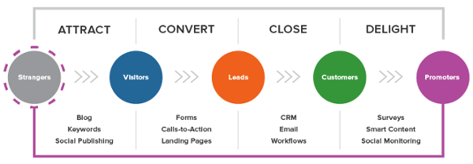
What is Lead Generation
Lead generation is the process of attracting and converting strangers and prospects into someone who has indicated interest in your company's product or service. Some examples of lead generators are job applications, blog posts, coupons, live events, and online content.
Whenever someone outside the marketing world asks me what I do, I can't simply say, "I create content for lead generation." It'd be totally lost on them, and I'd get some really confused looks. So instead, I say, "I work on finding unique ways to attract people to my business. I want to offer them enough goodies to get them naturally interested in my company so they eventually warm up to the brand enough to want to hear from us!" That usually resonates better, and that's exactly what lead generation is: It's a way of warming up potential customers to your business and getting them on the path to eventually buying.
Company Logo

Slide 6
How to Generate Leads
Now that we understand how lead generation fits into the whole inbound marketing methodology, let's walk through the steps of the lead generation process. First, a visitor discovers your business through one of your marketing channels, such as your website, blog, or social media page.
That visitor then clicks on your call-to-action (CTA) — an image, button, or message that encourages website visitors to take some sort of action.
The CTA takes your visitor to a landing page, which is a web page that is designed to capture lead information in exchange for an offer.
An offer is the content or something of value that's being "offered" on the landing page, like an ebook, a course, or a template. The offer must have enough perceived value to a visitor to merit providing their personal information in exchange for access to it.
The form on your landing page consists of a series of fields (like in our example above) that collect information in exchange for the offer. Forms are typically hosted on landing pages, although they can technically be embedded anywhere on your site. Once a visitor fills this out — voila! — you have a new lead! (That is, as long as you’re following lead-capture form best practices.)
Company Logo

Slide 7
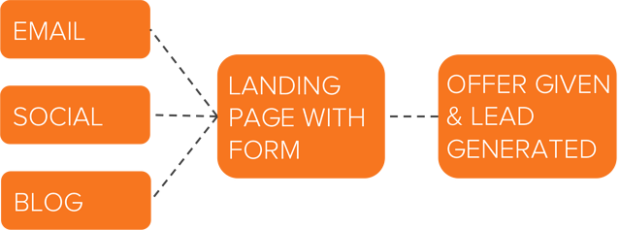
Lead Generation Marketing
Once you put all these elements together, you can use your various promotional channels to drive traffic to your landing page to start generating leads. But what channels should you use to promote your landing page? Let’s talk about the front-end of lead generation — lead gen marketing. If you’re a visual learner, this chart shows the flow from promotional marketing channels to a generated lead.
There are even more channels you can use to get visitors to become leads. Let’s go into depth on these and talk about a few others.
Company Logo

Slide 8
Content
Content is a great way to guide users to a landing page. Typically, you create content to offer visitors useful, free information. You can include CTAs anywhere in your content — inline, bottom-of-post, in the hero, or even on the side panel. The more delighted a visitor is with your content, the more likely they are to click your call-to-action and move onto your landing page.
Email
Email is a great place to reach the people who already know your brand and product or service. It’s much easier to ask them to take an action since they’ve previously subscribed to your list. Emails tend to be a bit cluttered, so use CTAs that have a compelling copy.
Ads and Retargeting
The sole purpose of an ad is to get people to take an action. Otherwise, why spend the money? If you want people to convert, be sure that your landing page and offer match exactly what is promised in the ad, and that the action you want users to take is clear.
Company Logo

Slide 9
Blog
The great thing about using your blog posts to promote an offer is that you can tailor the entire piece to the end goal. So, if your offer is an instructional video on setting up Google Search Console, then you can write a blog post about how to select your marketing metrics … which would make your CTA highly relevant and easy to click.
Social Media
Social media platforms make it easy to guide your followers to take action, from the swipe up option on Instagram stories to Facebook bio links to bitly URLs on Twitter. You can also promote your offerings on your social posts and include a call-to-action in your caption.
Product Trials
You can break down a lot of barriers to a sale by offering trials of your product or service. Once a prospect is using your product, you can entice them with added offers or resources to encourage them to buy. Another good practice is to include your branding in your free versions so you can capture other potential customers, too.
Company Logo

Slide 10
Why Not Just Buy Leads?
Marketers and salespeople alike want to fill their sales funnel — and they want to fill it quickly. Enter: The temptation to buy leads. Buying leads, as opposed to organically generating them, is much easier and takes far less time and effort, despite being more expensive. But, you might be paying for advertising anyway … so, why not just buy leads? First, any leads you've purchased don't actually know you. Typically, they've "opted in" at some other site when signing up for something, and didn't actually opt in to receiving anything from your company.
The messages you send them are therefore unwanted messages, and sending unwanted messages is intrusive. (Remember that disruptive call I got when I was trying to eat my spaghetti? That's how people feel when they receive emails and other messages from people they didn't ask to hear from.)
If the prospect has never been to your website and indicated an interest in your, products or services, then you’re interrupting them. Plain and simple. If they’ve never opted in to receive messages from you, then there’s a high chance they could flag your message as spam, which isn’t good for business. It’s always better to generate leads organically than to buy them.
Company Logo

Slide 11
How to Qualify a Lead
As we covered in the first section, a lead is a person who has indicated interest in your company's product or service. Now, let's talk about the ways in which someone can actually show that interest. Essentially, a sales lead is generated through information collection. That information collection could come as the result of a job seeker showing interest in a position by completing an application, a shopper sharing contact information in exchange for a coupon, or a person filling out a form to download an educational piece of content.
Company Logo

Slide 12
How to Qualify a Lead
Gauging a Lead’s Level of Interest
Below are just a few of the many ways in which you could qualify someone as a lead. Each of these examples shows that the amount of collected information used to qualify a lead, as well as the lead level of interest, can vary. Let's assess each scenario:
Job Application: An individual that fills out an application form is willing to share a lot of personal information because he/she wants to be considered for a position. Filling out that application shows their true interest in the job, therefore qualifying the person as a lead for the company's recruiting team — not marketing or sales teams.
Coupon: Unlike the job application, you probably know very little about someone who has stumbled upon one of your online coupons. But if they find the coupon valuable enough, they may be willing to give you their name and email address in exchange for it. Although it's not a lot of information, it's enough for a business to know that someone has interest in their company.
Content: While the download of a coupon shows an individual has a direct interest in your product or service, content (like an educational ebook or webinar) doesn’t. So to truly understand the nature of the person's interest in your business, you'll probably need to collect more information to decide whether the person is interested in your product or service and whether they're a good fit.
Company Logo

Slide 13
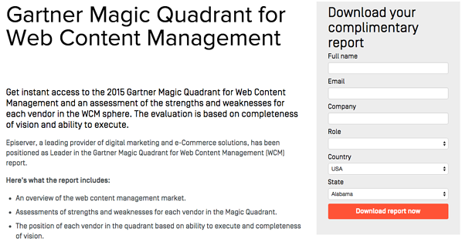
These three general examples highlight how lead generation differs from company to company, and from person to person. You'll need to collect enough information to gauge whether someone has a true, valid interest in your product or service — how much information is enough information will vary depending on your business.
Let's look at Episerver, for example. They use web content reports for lead generation, collecting six pieces of information from prospective leads.
Episerver offers a great example for what to ask for in a lead gen form:
Full Name: The most fundamental information needed to personalize your communication with each lead.
Email: This serves as a unique identifier and is how you will contact your lead.
Company: This will give you the ability to research your lead’s industry and company and how the lead might benefit from your product or service (mainly for B2B).
Role: Understanding an individual's role will help you understand how to communicate with them. Every brand stakeholder will have a different take and perspective on your offering (mainly for B2B).
Country: Location information can help you segment your contact by region and time zone, and help you qualify the lead depending on your service.
State: The more detailed information you can get without sacrificing conversions, the better. Knowing your leads state can help you further qualify them.
Company Logo

Slide 14
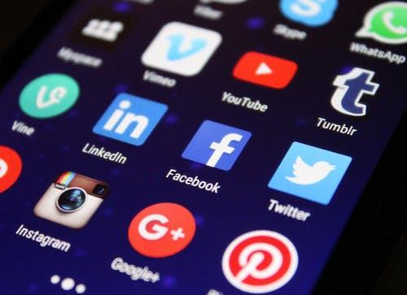
Lead Scoring
Lead scoring is a way to qualify leads quantitatively. Using this technique, leads are assigned a numerical value (or score) to determine where they fall on the scale from “interested” to “ready for a sale”. The criteria for these actions is completely up to you, but it must be uniform across your marketing and sales department so that everyone is working on the same scale.
A lead’s score can be based on actions they’ve taken, information they’ve shared, their level of engagement with your brand, or other criteria that your sales team determines. For instance, you may score someone higher if they regularly engage with you on social media or if their demographic information matches your target audience.
Borrowing from the examples above, you might give a lead a higher score if they used one of your coupons — an action that would signify this person is interested in your product.
The higher a lead’s score, the closer they are to becoming a sales-qualified lead (SQL), which is only a step away from becoming a customer. The score and criteria is something you may need to tweak along the way until you find the formula that works, but once you do, you’ll transform your lead generation into customer generation.
Company Logo

Slide 15
Lead Generation Benchmarks and Trends
So ... you're getting web traffic and generating leads. But how are you doing compared to other companies in your industry? How many leads should you really be generating? It's tough to figure out if your lead generation strategy is working if you aren't looking at industry data. HubSpot partnered with Qualtrics to survey more than 900 marketers from all different industries in North America and Europe to create a demand generation report with data on website visitors, leads, opportunities, customers, and revenue. Did you know that 74% of companies that weren’t exceeding revenue goals didn't know their visitor, lead, MQL, or sales opportunities numbers? How about that over 70% of companies not achieving their revenue goals generate fewer than 100 leads per month, and only 5% generate more than 2,500 leads per month? These are just a few examples of what you’ll find in the report.
Company Logo

Slide 16
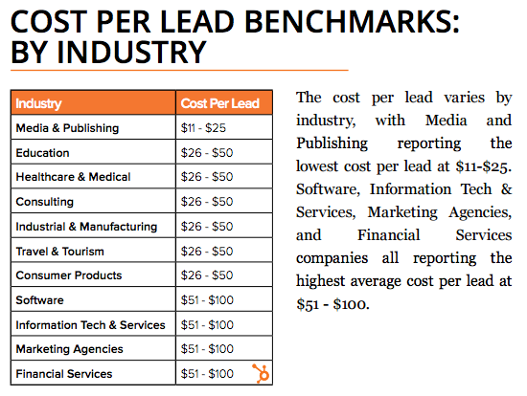
Cost per lead by industry
The media and publishing industries report the lowest cost per lead at $11 to $25. Software, information technology and services, marketing agencies, and financial services companies all report the highest average cost per lead at $51 to $100.
Leads Generated per month, by annual revenue
Unsurprisingly, the more revenue a company has, the more leads they generate. The differences are most drastic at the highest and lowest end of the spectrum: 82% of companies with $250,000 or less in annual revenue report generating less than 100 leads per month, whereas only 8% of companies generating $1 billion in annual revenue report less than 100 leads per month.
Company Logo

Slide 17
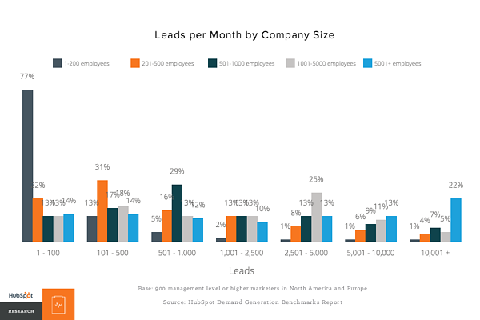
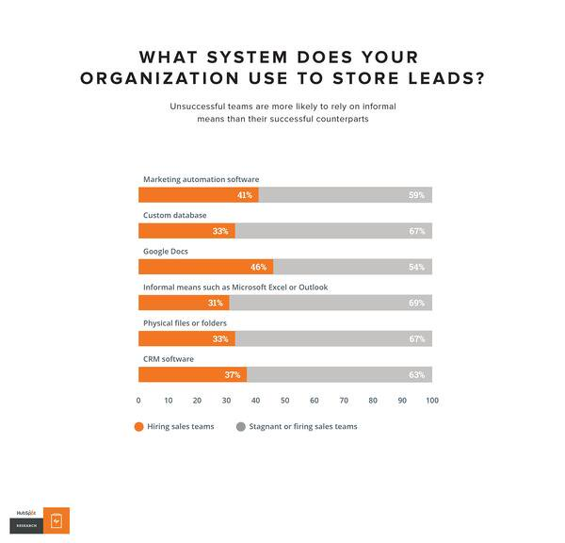
Leads per month
HubSpot found that 58% of companies generated 500 leads per month or fewer, and 71% generated 1,000 or fewer. But as we saw previously, the companies having the most success are also the ones generating the most leads. Here's how the data broke down by company size:
Lead Generation Software
HubSpot found that the most successful teams use a formal system to organize and store leads: 46% use Google Docs, 41% use marketing automation software, and 37% use CRM software. (Hint for HubSpot customers: Google Drive integrates with both HubSpot Marketing Hub and HubSpot CRM.)
Company Logo

Slide 18
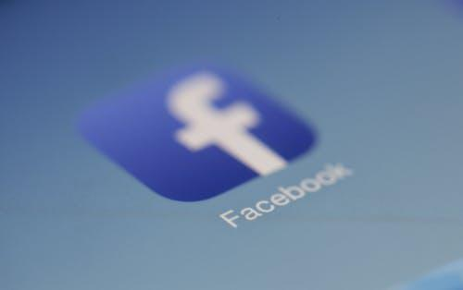
Lead Generation Strategies
Online lead generation encompasses a wide range of tactics, campaigns, and strategies depending on the platform on which you wish to capture leads. We talked about lead capture best practices once you have a visitor on your site … but how can you get them there in the first place? Let’s dive into lead generation strategies for a few popular platforms.
Facebook Lead Generation
Facebook has been a method for lead generation since its start. Originally, companies could use outbound links in their posts and information in their bios to attract strangers to their websites. But when Facebook Ads was launched in 2007, and its algorithm began to favor accounts that used paid advertising, there was a major shift in how businesses used the platform to capture leads. Facebook created Lead Ads for this purpose. Facebook also has a feature that lets you put a simple call-to-action button at the top of your Facebook Page, helping you send Facebook followers directly to your website.
Company Logo

Slide 19
Lead Generation Strategies
Twitter Lead Generation
Twitter has Twitter Lead Gen Cards, which let you generate leads directly within a tweet without having to leave the site. A user's name, email address, and Twitter username are automatically pulled into the card, and all they have to do is click "Submit" to become a lead. (Hint for HubSpot users: You can connect Twitter Lead Gen Cards to your HubSpot Forms. Learn how to do that here).
LinkedIn Lead Generation
LinkedIn has been increasing its stake in the advertising space since its early days. When it comes to lead generation, LinkedIn created Lead Gen Forms, which auto-populate with a user’s profile data when they click a CTA, making it easy to capture information.
Company Logo

Slide 20
Lead Generation Strategies
PPC Lead Generation
When we say pay-per-click (PPC), we’re referring to ads on search engine result pages (SERPs). Google gets 3.5 billion searches a day, making it prime real estate for any ad campaign, especially lead gen. The effectiveness of your PPC campaign relies heavily on a seamless user flow, as well as your budget, target keywords, and a few other factors.
B2B Lead Generation
LinkedIn has been increasing its stake in the advertising space since its early days. When it comes to lead generation, LinkedIn created Lead Gen Forms, which auto-populate with a users profile data when they click a CTA, making it easy to capture information.
Company Logo

Slide 21
Tips for Lead Generation Campaigns
In any given lead generation campaign, there can be a lot of moving parts. It can be difficult to tell which parts of your campaign are working and which need some fine-tuning.
What exactly goes into a best-in-class lead generation engine? Here are a few tips when building lead gen campaigns.
Use the right lead generation tools
As you saw in our data, the most successful marketing teams use a formal system to organize and store their leads. That's where lead generation tools and lead generation software come into play. How much do you know about the people visiting your website? Do you know their names or their email addresses? How about which pages they visited, how they're navigating around, and what they do before and after filling out a lead conversion form?
If you don't know the answers to these questions, chances are you're having a hard time connecting with the people who are visiting your site. These are questions you should be able to answer — and you can with the right lead generation tools.
Company Logo

Slide 22
Use the right lead generation tools
There are a few different tools and templates out there that'll help you create different lead gen assets to use on your site:
CTA Templates: 50+ free, customizable call-to-action (CTA) templates in PowerPoint that you can use to create clickable CTA buttons to use on your blog, landing pages, and elsewhere on your site.
Lead Generation Software Tools: This free tool from HubSpot includes lead capture and contact insights features, which will scrape any pre-existing forms you have on your website and add those contacts to your existing contact database. It also lets you create pop-ups, hello bars, or slide-ins — called "lead flows" — that'll help you turn website visitors into leads immediately.
Visitor Tracking: Hotjar has a heatmap tool — a virtual tool which creates a color-coded representation of how a user navigates your site — that helps you understand what users want, care about, and do on your site. It records visitors and tells you where they spend the most time on your site. You can use it to gather information on your lead generation forms, feedback forms and surveys, and more.
Company Logo

Slide 23
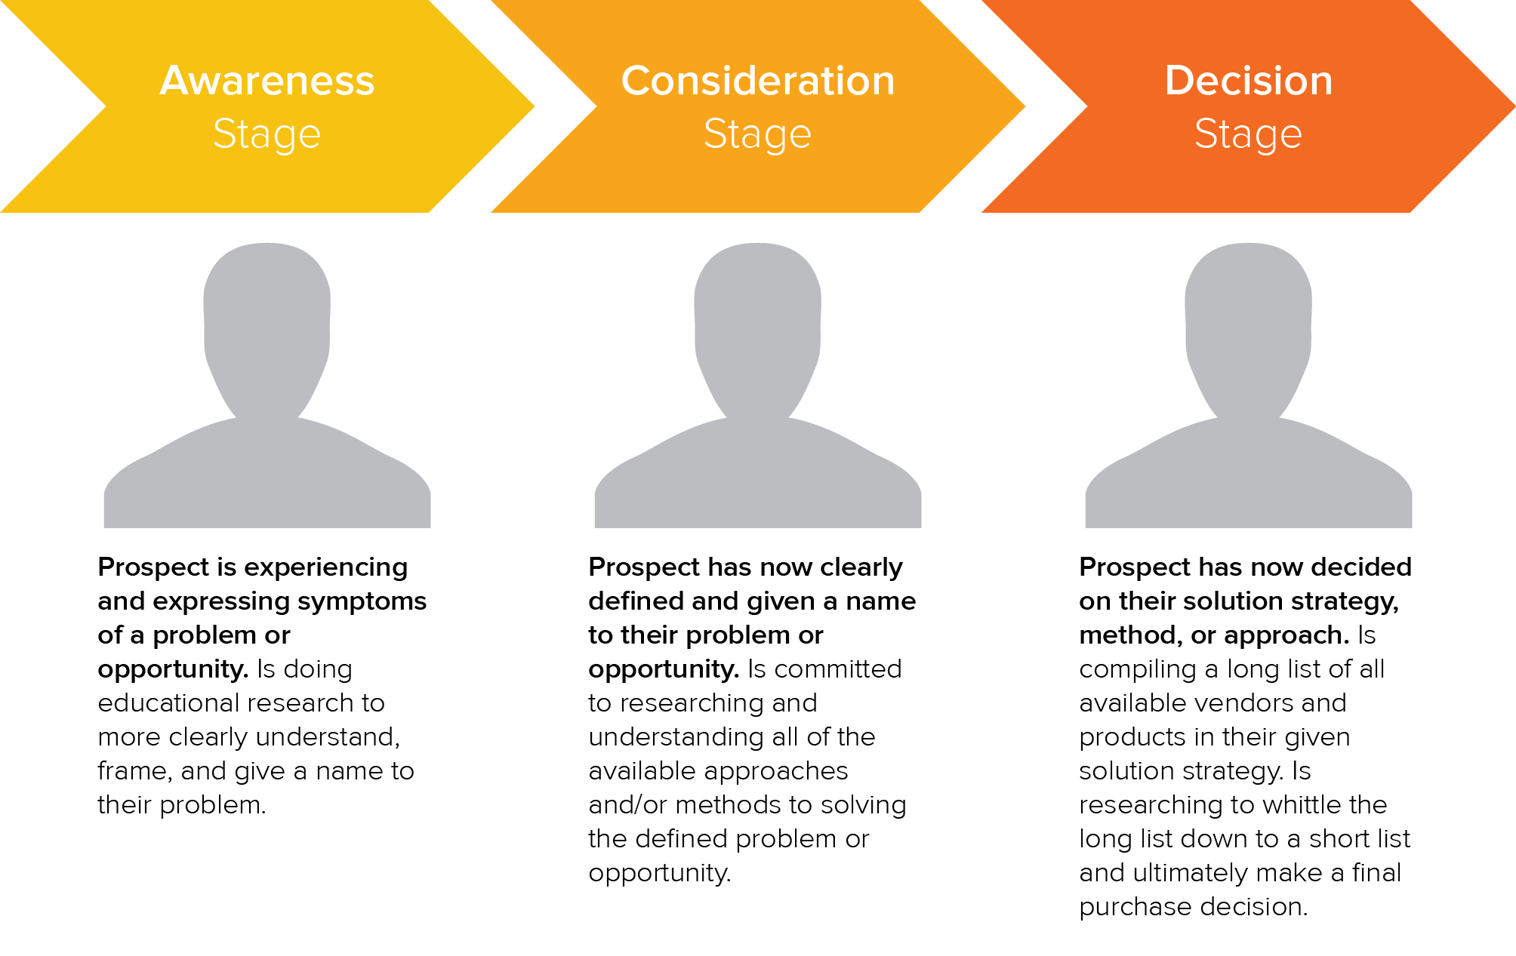
Create amazing offers for all stages
Not all your site visitors are ready to talk to your sales team or see a demo of your product. Someone at the beginning of the buyer's journey might be interested in an informational piece like an ebook or a guide, whereas someone who's more familiar with your company and near the bottom of the journey might be more interested in a free trial or demo.
Make sure you're creating offers for each phase and offering CTAs for these offers throughout your site. Yes, it takes time to create valuable content that teaches and nurtures your leads down the funnel, but if you don't offer anything for visitors who aren't ready to buy, then they may never come back to your website. From checklists to templates to free tools, here are 23 ideas for lead generation content to get you started.
If you want to take personalization a step further — which will help boost your conversion rate — try using smart CTAs. Smart CTAs detect where a person is in the buyer’s journey, whether they're a new visitor, a lead, or a customer, and display CTAs accordingly. Personalized CTAs convert a whopping 42% more visitors than basic calls-to-action.
Company Logo

Slide 24
Keep your messaging consistent and deliver on your promise
The highest-converting lead gen campaigns are the ones that deliver on what they promise and create a seamless transition from ad copy and design to the deliverable itself. Make sure that you’re presenting a consistent message throughout the process and providing value to everyone that engages with your lead capture.
The aspects of your lead gen campaign should mirror everything else on your website, on your blog, and within the product that you will eventually try to sell. If not, you’ll have a difficult time getting your lead to the next lifecycle stage. Your campaign should be about more than just obtaining an email address — it should be about developing a new customer.
Link your CTA to a dedicated landing page
This may seem obvious to you, but you'd be surprised how many marketers don't create dedicated landing pages for their offers. CTAs are meant to send visitors to a landing page where they can receive a specific offer.
Don't use CTAs to drive people to your homepage, for instance. Even if your CTA is about your brand or product (and perhaps not an offer like a download), you should still be sending them to a targeted landing page that's relevant to what they are looking for and includes an opt-in form. If you have the opportunity to use a CTA, send them to a page that will convert them into a lead.
Company Logo

Slide 25
Get your sales team involved
Remember when we talked about lead scoring? Well, it isn’t exactly doable without your sales team’s input. How will you know what qualifies a lead for sales without knowing if your defined SQLs are sold? Your marketing and sales teams need to be aligned on the definitions and the process of moving a lead from MQL to SQL to opportunity before you even begin to capture leads. Also, be open to evolving your relationship with sales and how you guide leads along your funnel. Your definitions will likely need to be refined over time; just make sure to keep everyone involved up-to-date.
Use social media strategically
While marketers typically think of social media as best for top-of-the-funnel marketing, it can still be a helpful and low-cost source for lead generation as shared in the lead gen strategies above. The key is using social media strategically for lead generation. Start by adding links directly to the landing pages of high-performing offers within your Facebook, Twitter, LinkedIn, and other social media posts. Tell visitors that you're sending them to a landing page. That way, you're setting expectations.
Company Logo

Slide 26
Conclusion
There you have it, folks. Now that you know more about how to generate leads for your business, we recommend you try HubSpot's free lead generation tool. Use it to add simple conversion assets to your site (or scrape your existing forms) to help you learn more about your site visitors and what content prompts them to convert.
Interested in learning more about how our services can help your marketing?
[Insert CTA to a landing page with agency contact form]
Company Logo

