Slide 1


+
HUBSPOT CRM

Slide 2
The story of a deal in HubSpot CRM

Slide 3
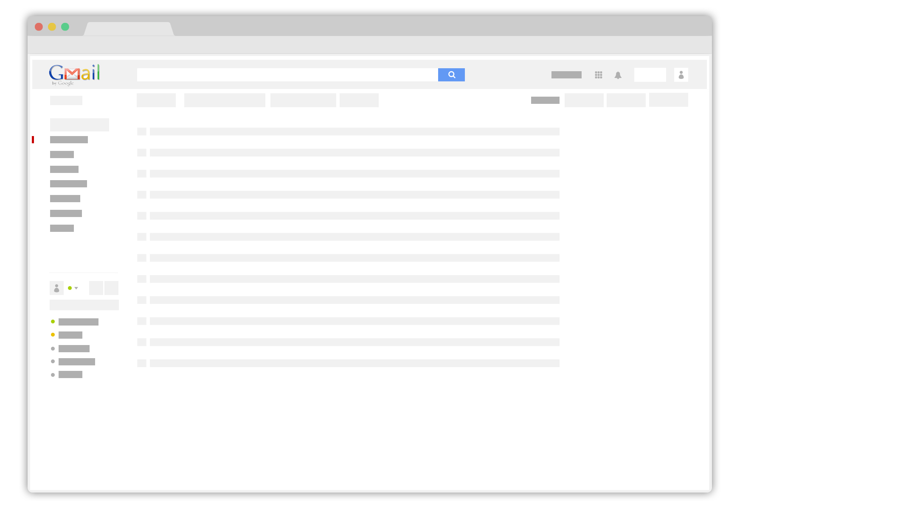
Notes:
It all starts in my inbox

Slide 4
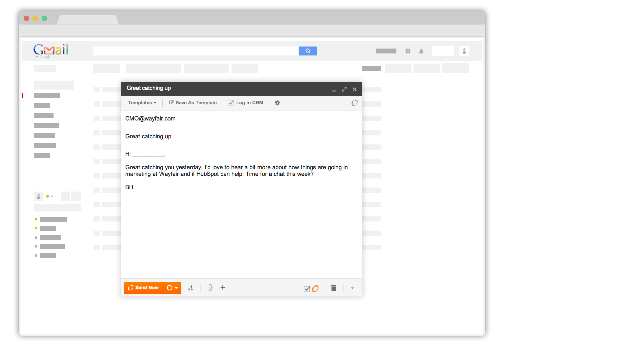

Notes:
Sending an email to Wayfair CMO

Slide 5
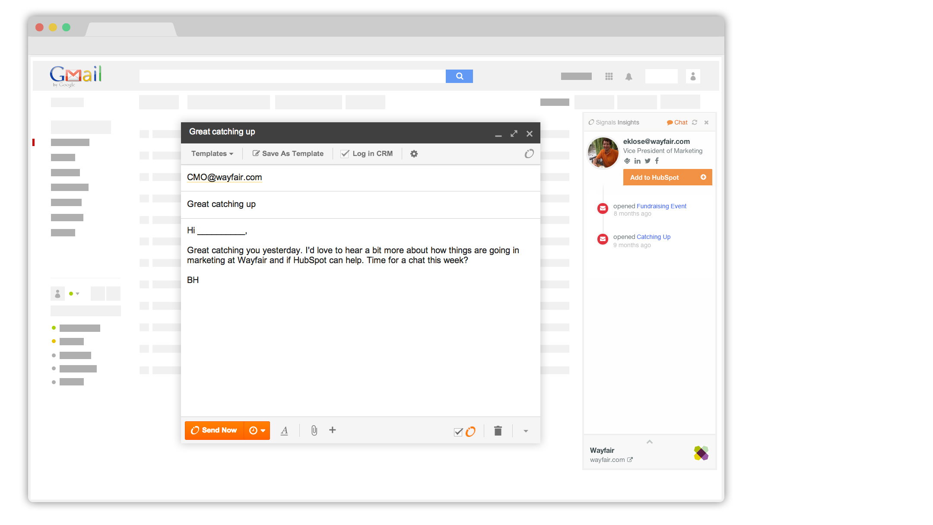
Notes:
Insights pops up. I can see some basic details about Eric, and the history of messages I’ve sent him... what he’s opened, what he’s clicked.

Slide 6
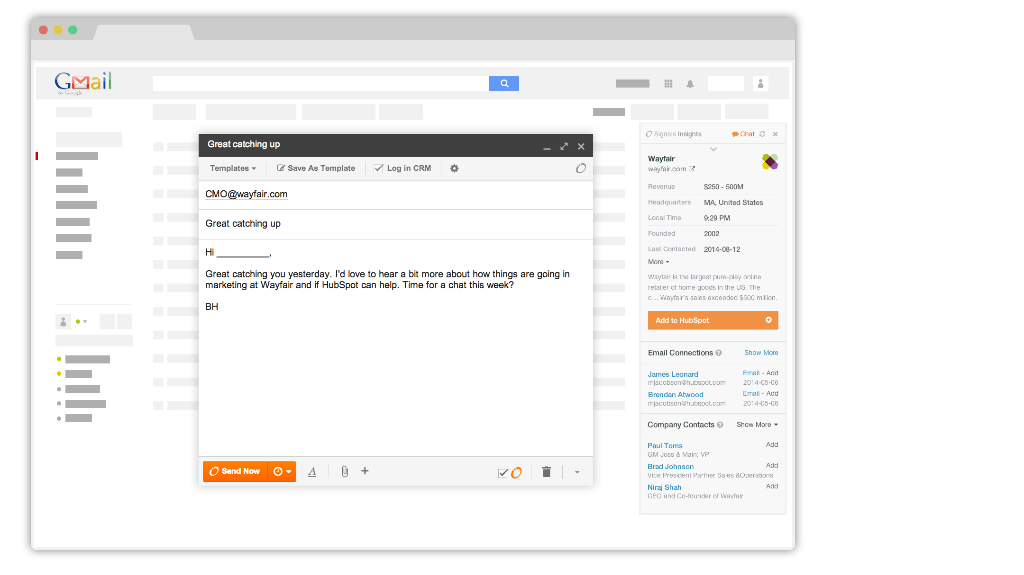
Notes:
I can click insights to see some useful details on the company. Looks like they aren’t in my CRM system yet, but a few folks here at HubSpot have corresponded with folks at Wayfair in the past (“email connections”.)

Slide 7
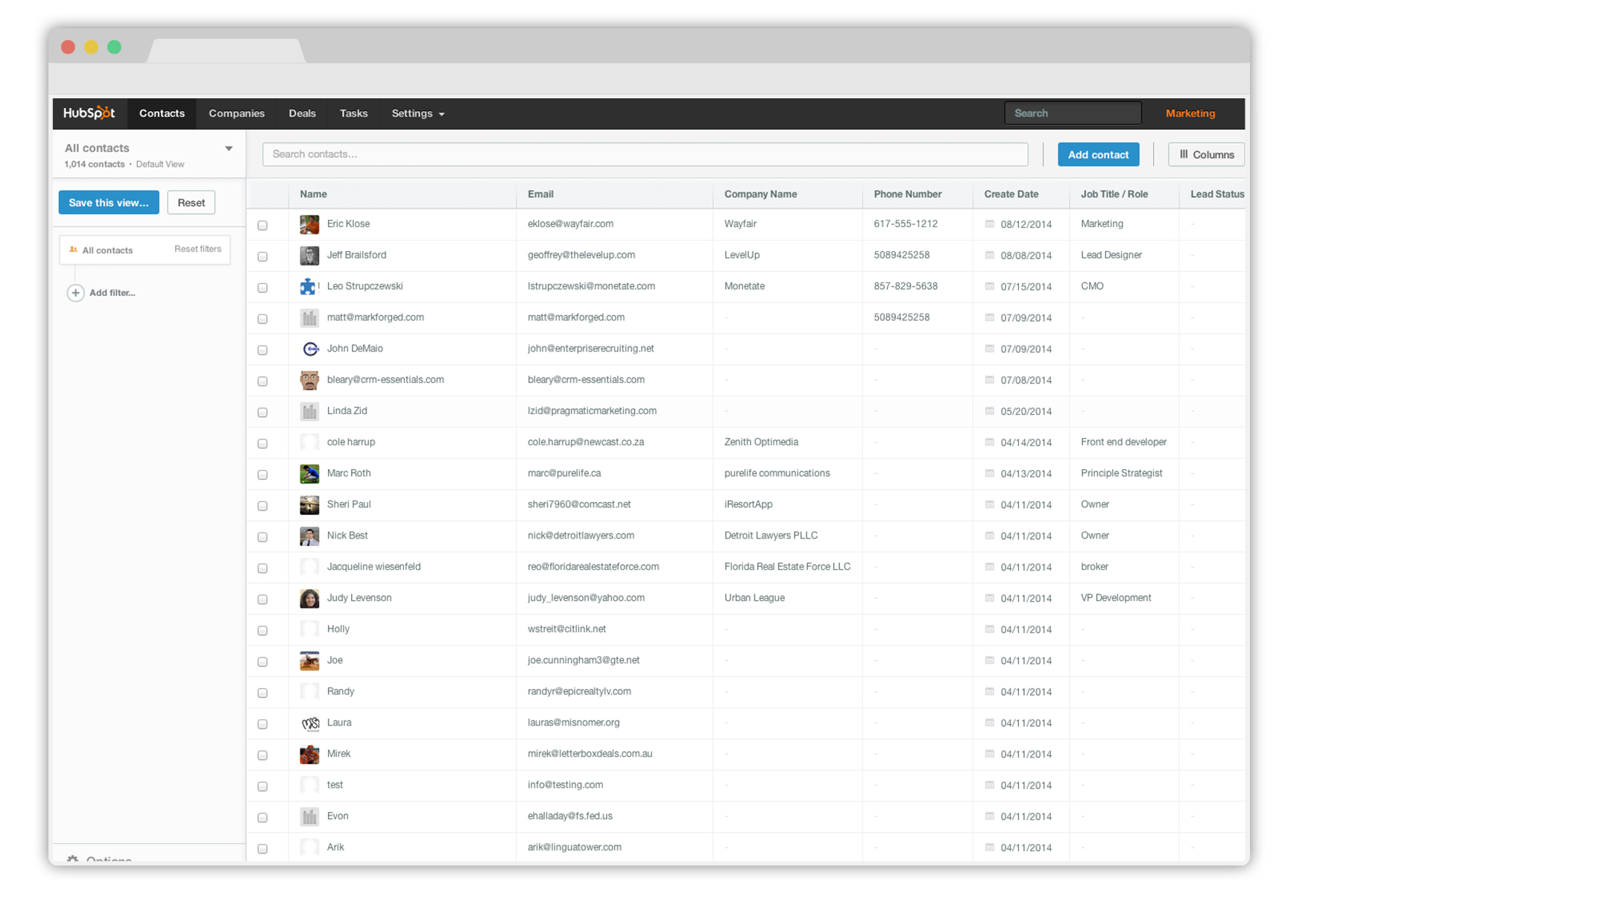
Notes:
Let’s jump over to CRM.

Slide 8
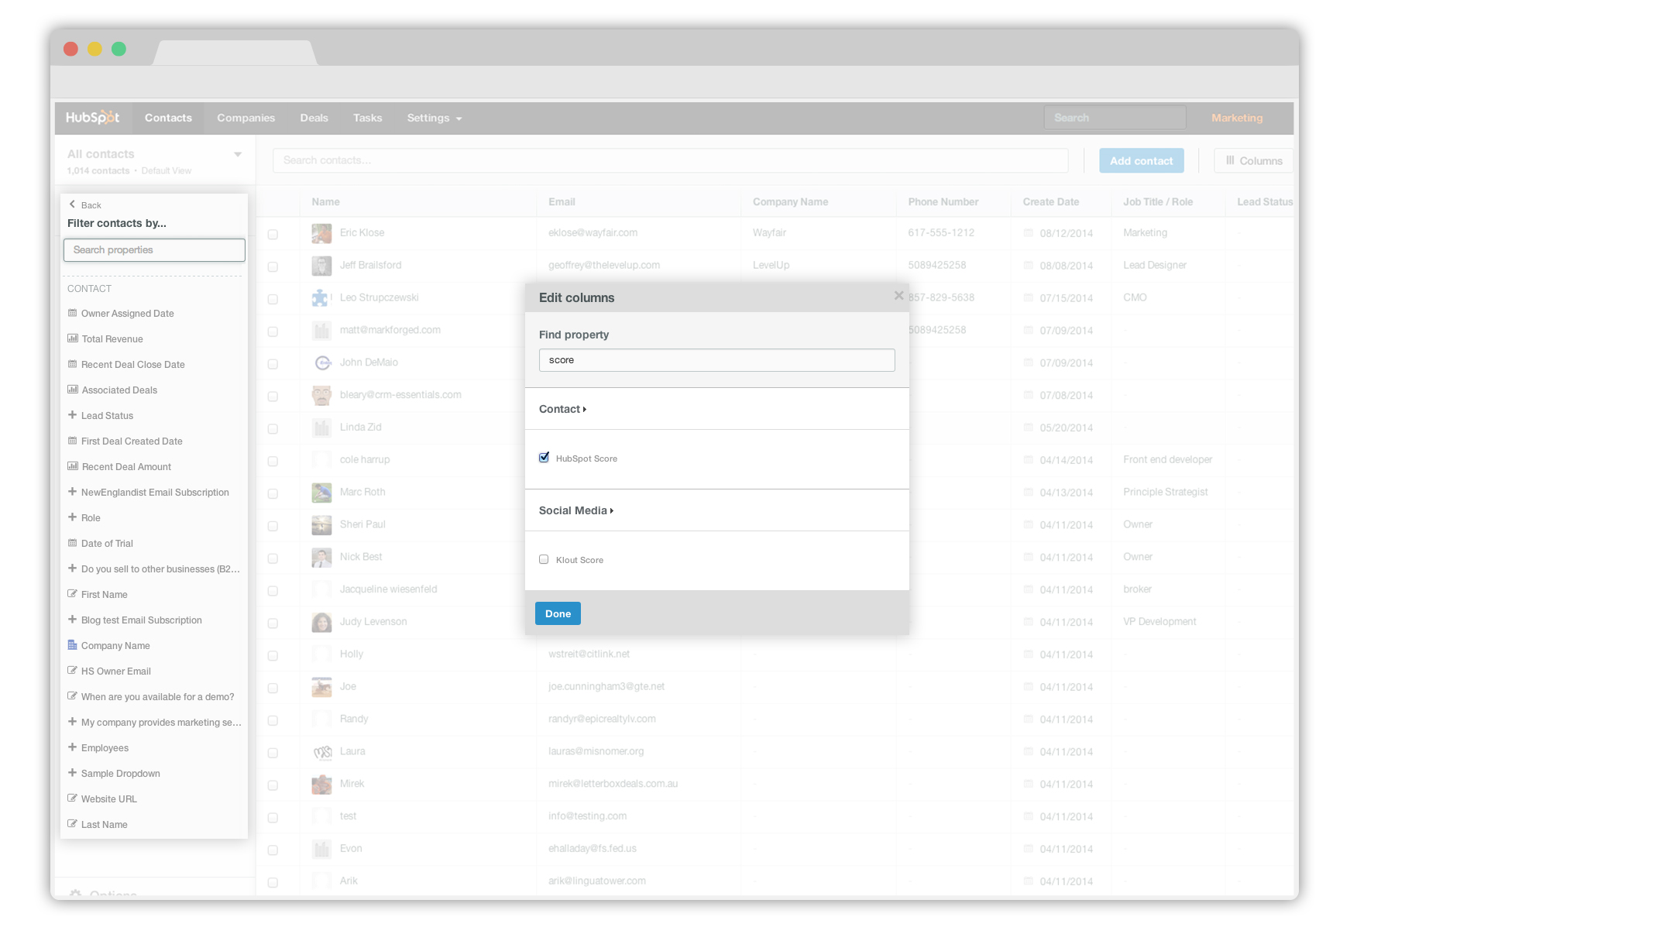
Notes:
We are looking at a table of contacts. Editing this view is easy. I can filter it based on any kind of criteria, add and rearrange any columns I want. Changing my view and sorting is instant.

Slide 9
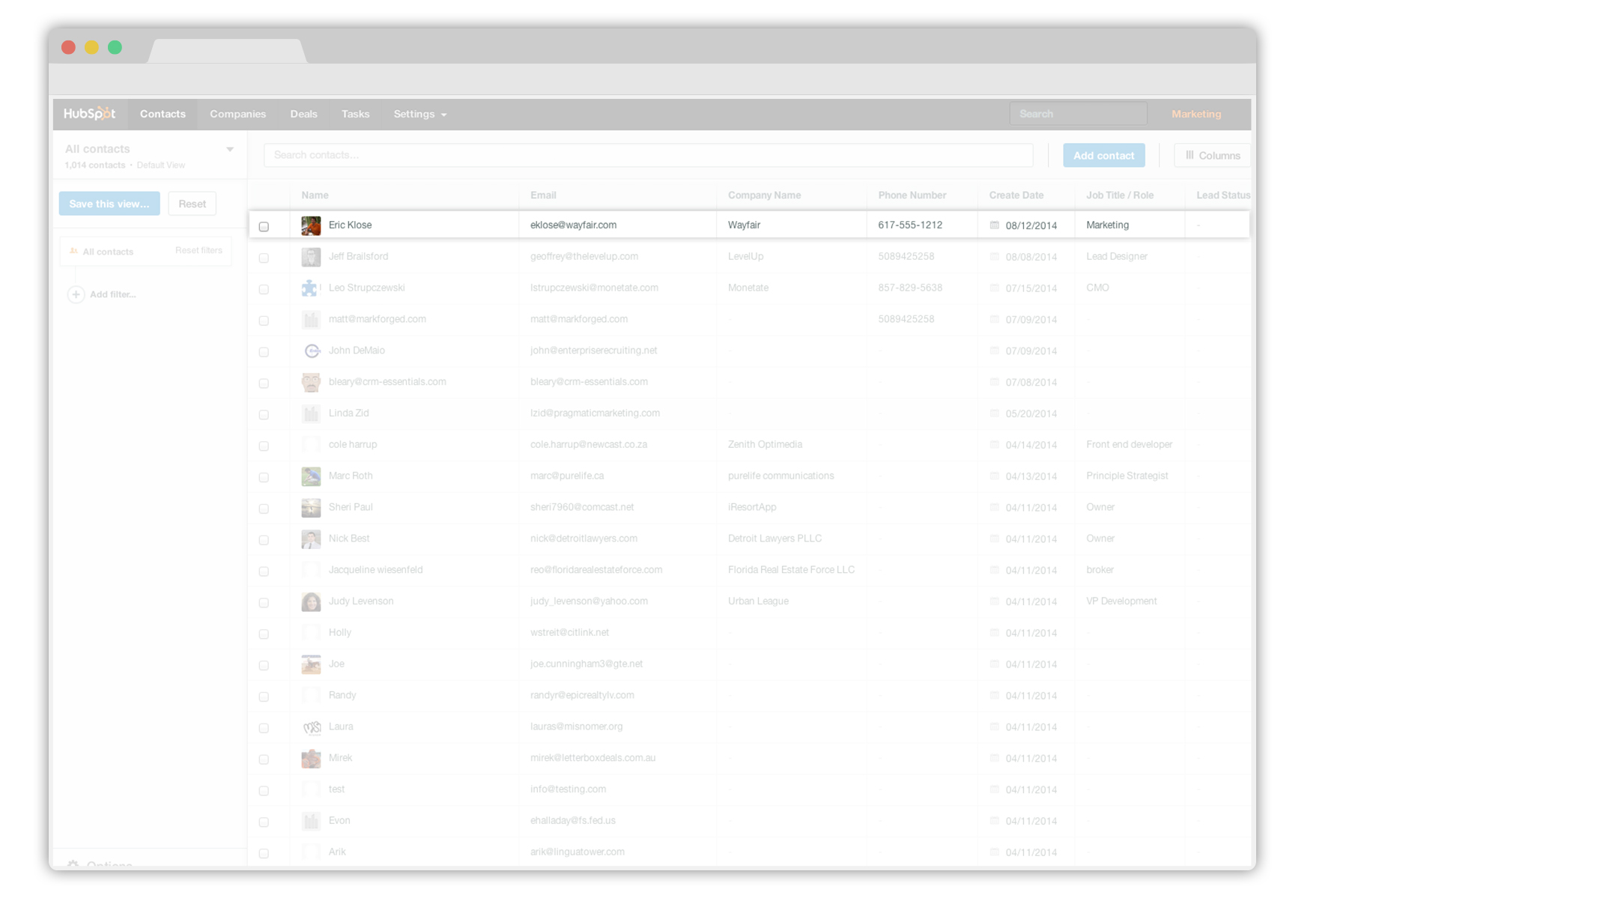
Notes:
There’s Eric. He wasn’t in my CRM, but HubSpot CRM detected the email I sent him and created a record for him automatically.

Slide 10
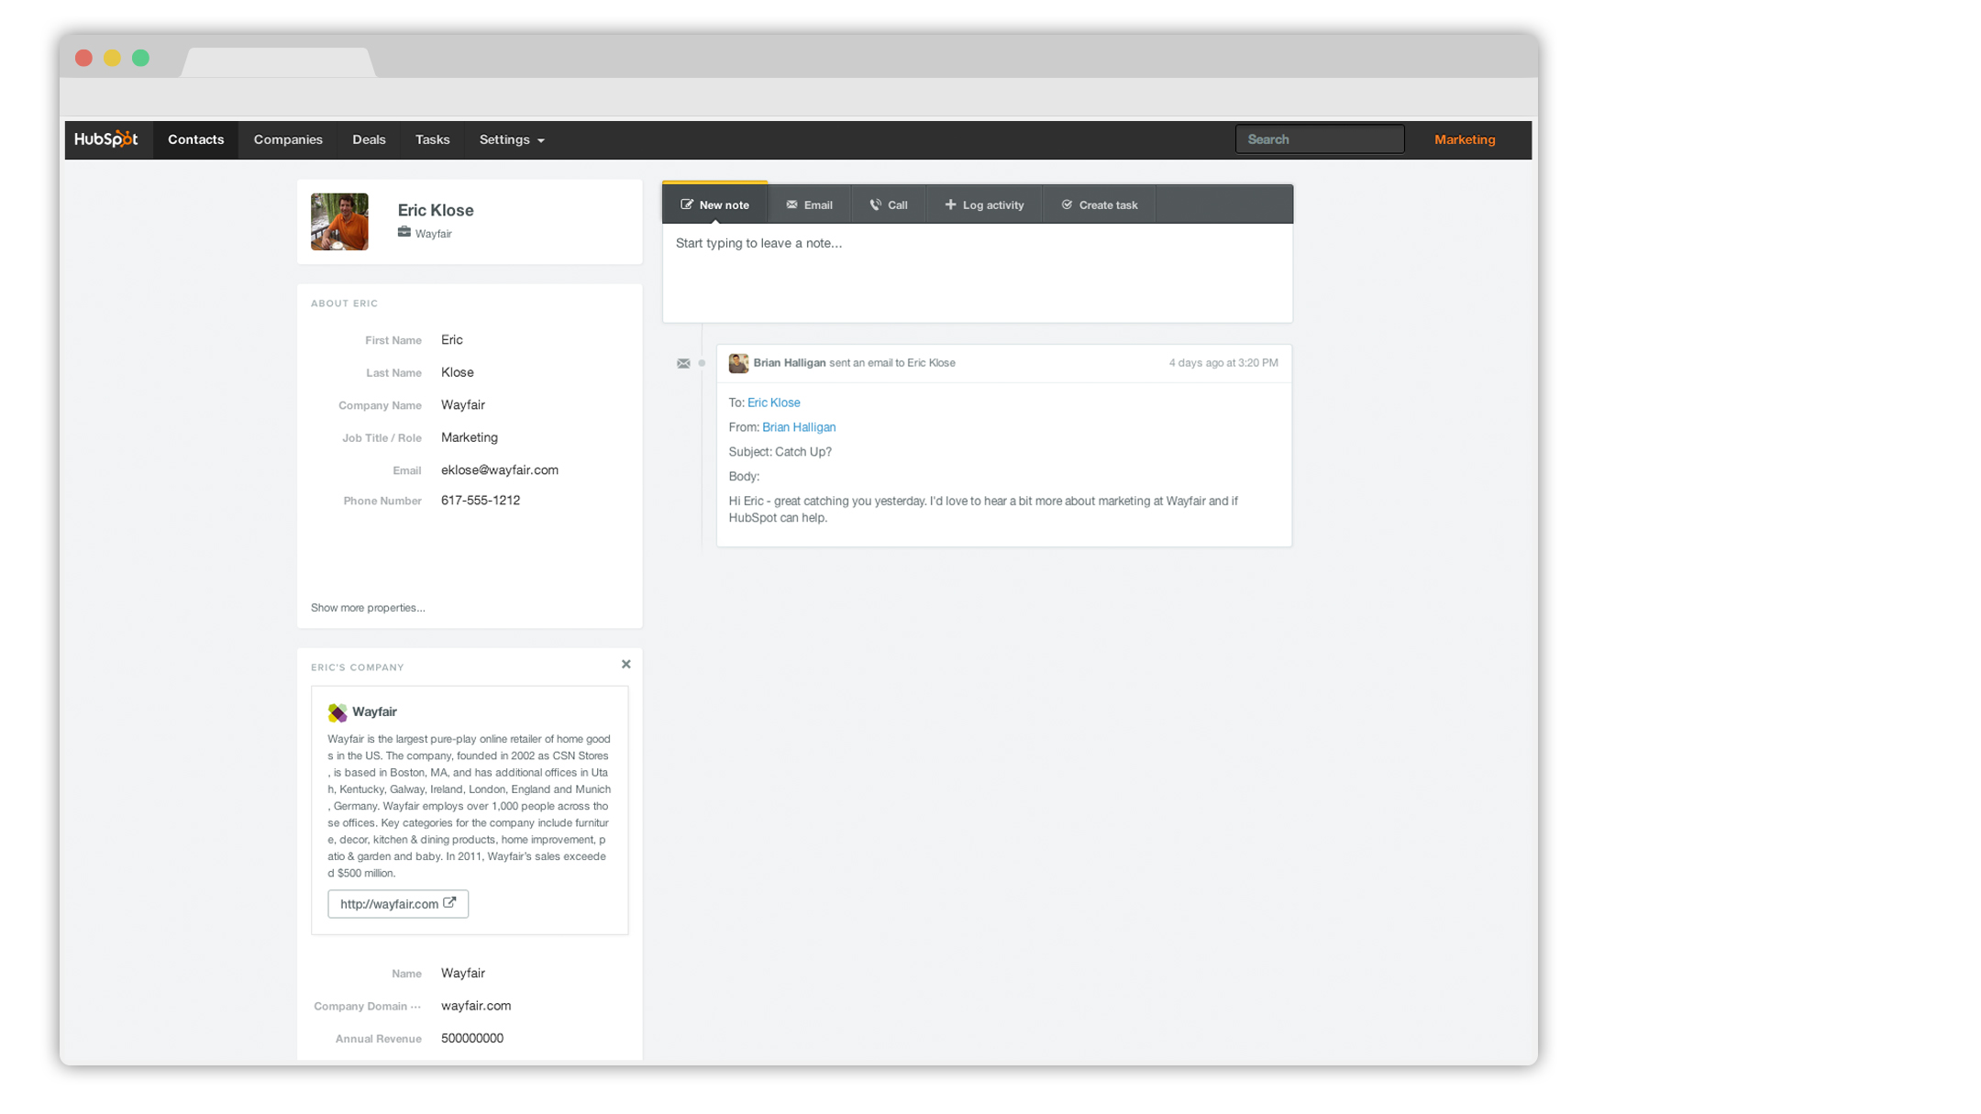
Notes:
Here’s his contact record. The email was logged in the timeline automatically.

Slide 11
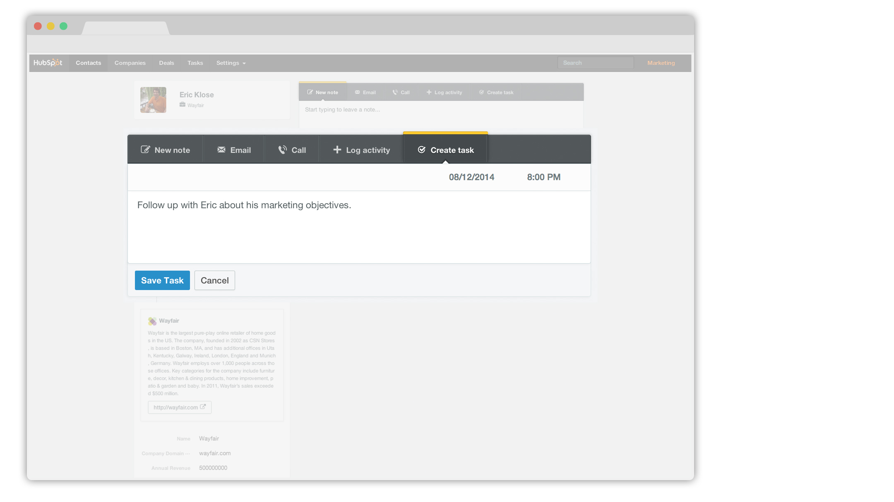
Notes:
I’m going to set a task for myself to follow up with Eric next week.

Slide 12
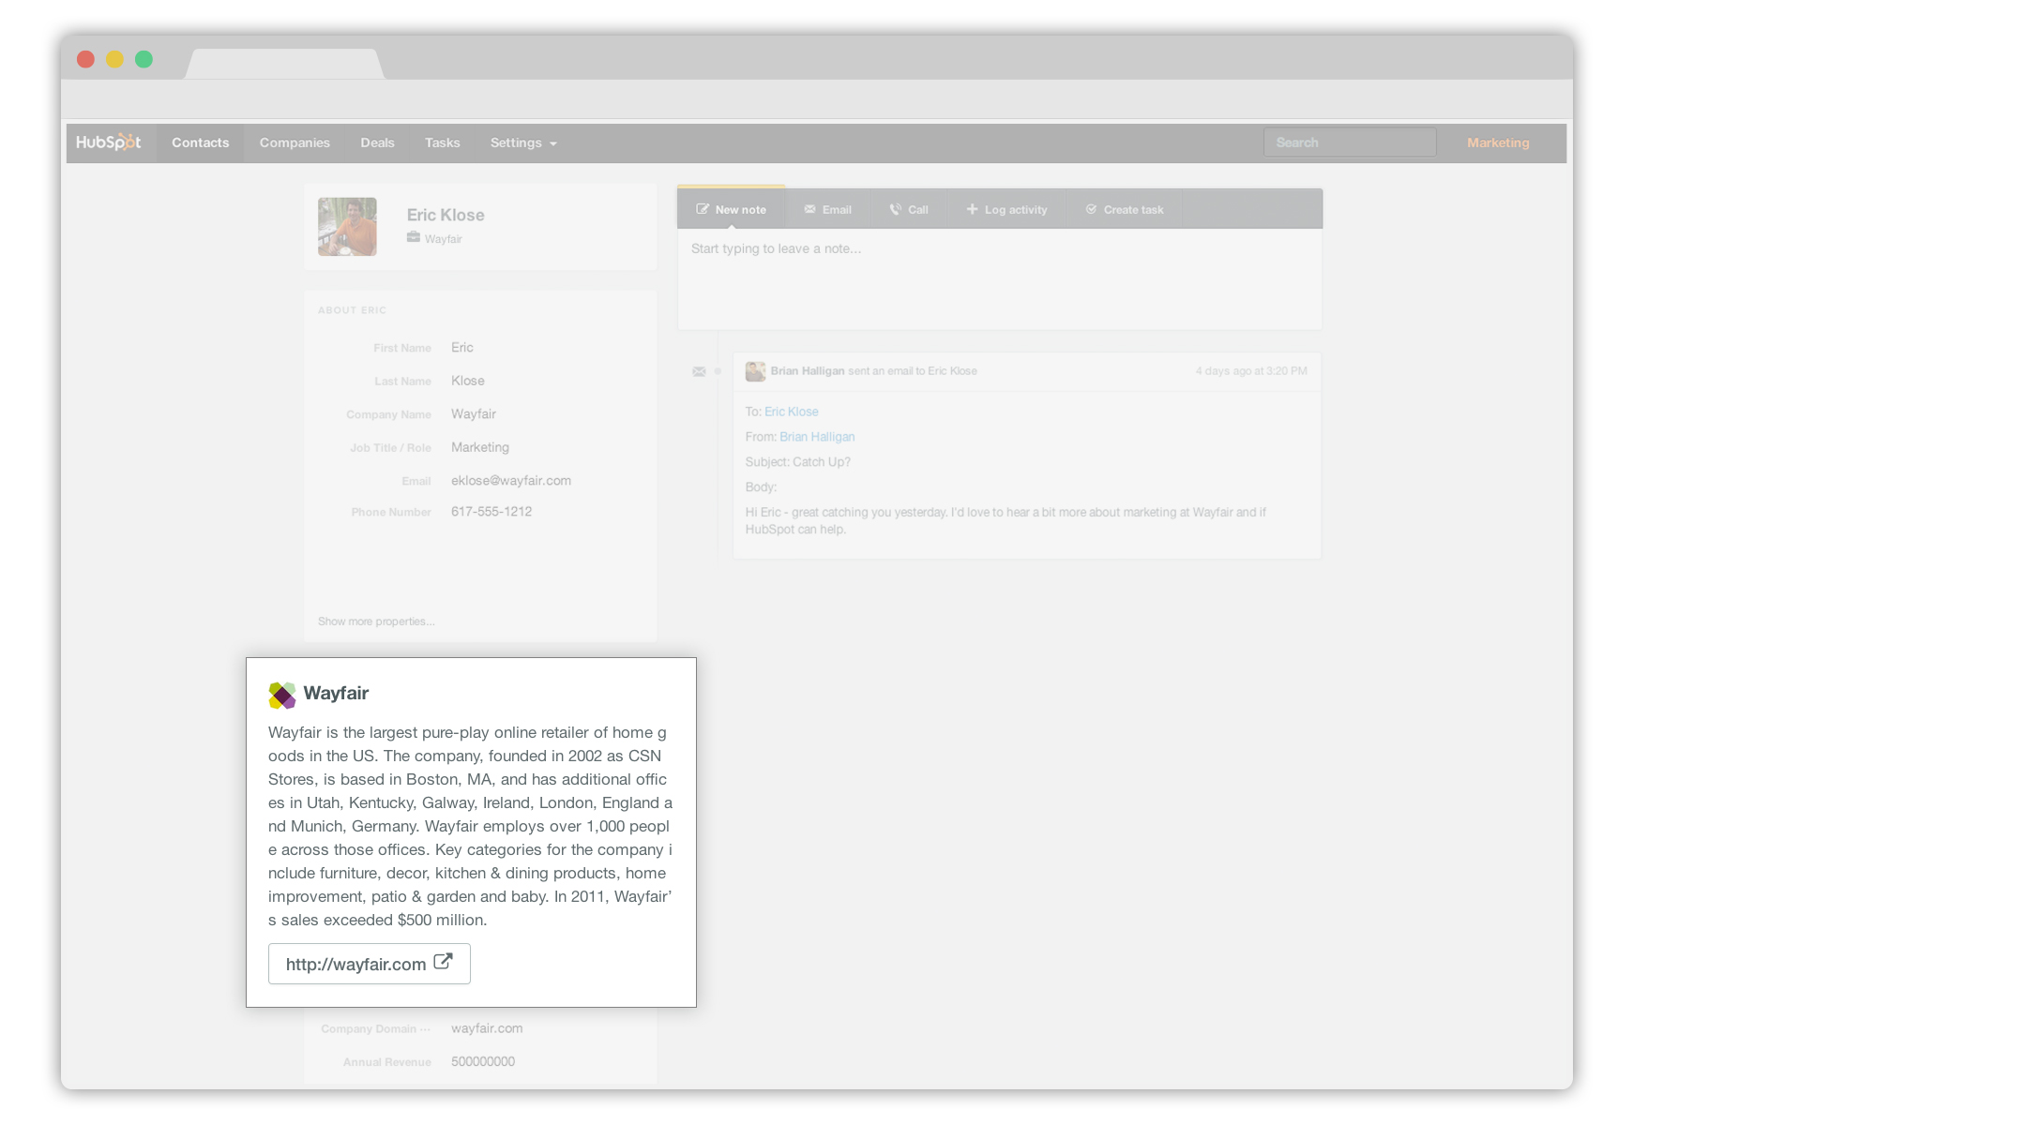
Notes:
HubSpot CRM even created a record for Eric’s company. Let’s click to his company profile and take a look.

Slide 13
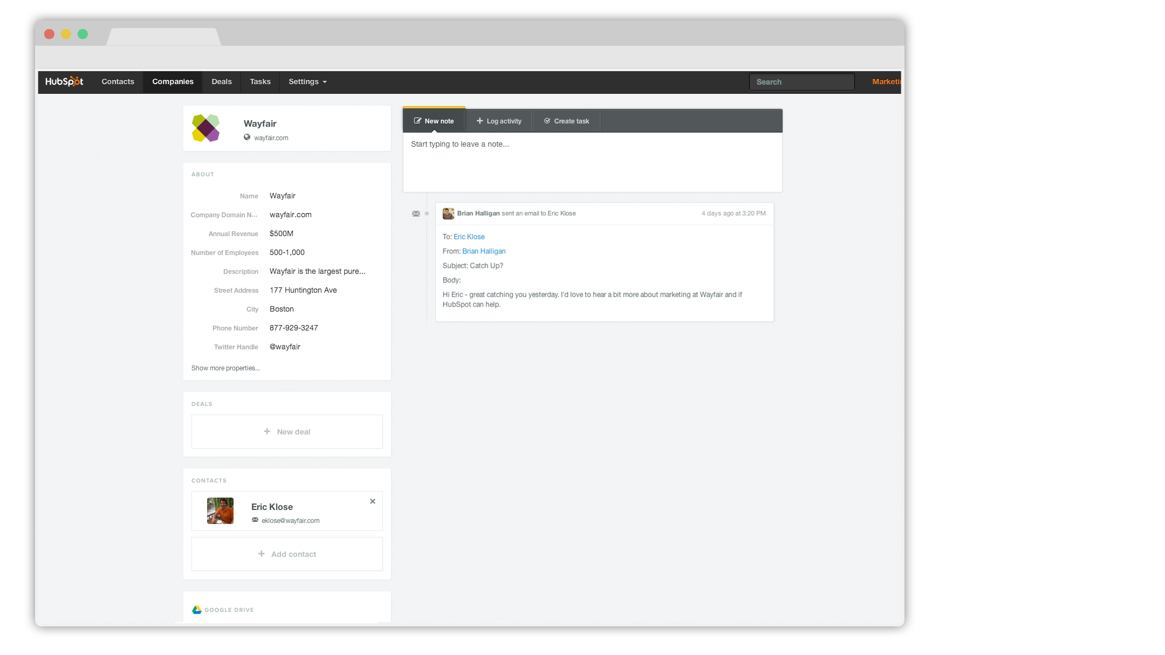
Notes:
Here’s our record for Eric’s company.

Slide 14
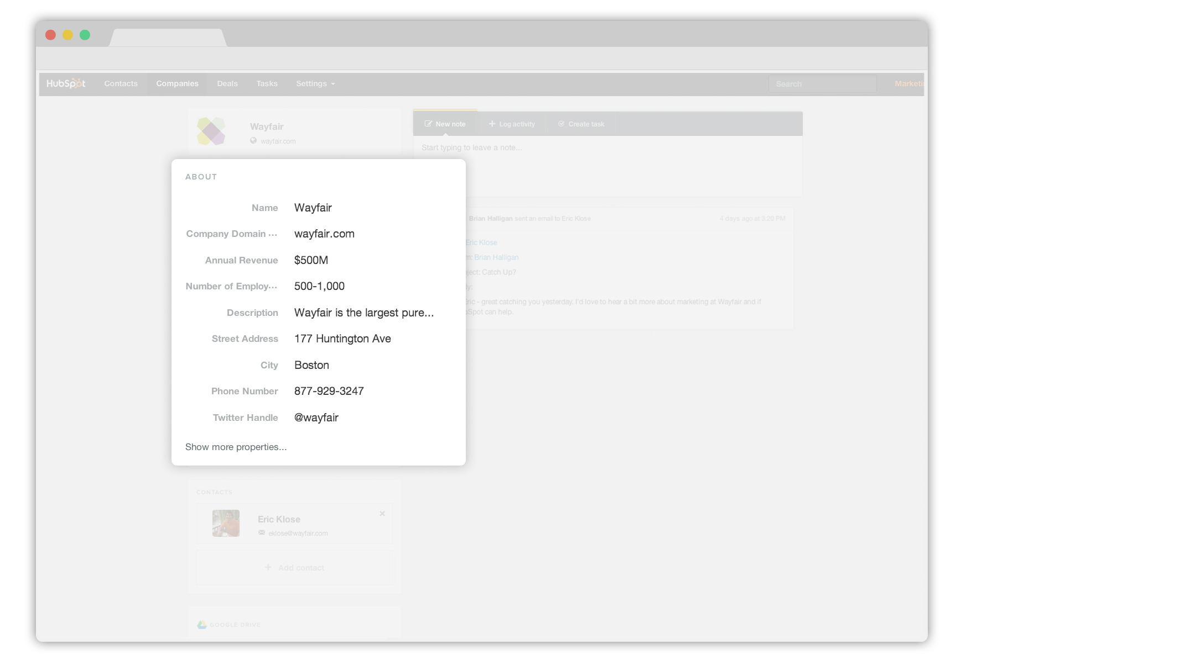
Notes:
HubSpot CRM automatically filled in some useful details about his company the second I emailed Eric. Social media information on his company, even their main phone line.

Slide 15
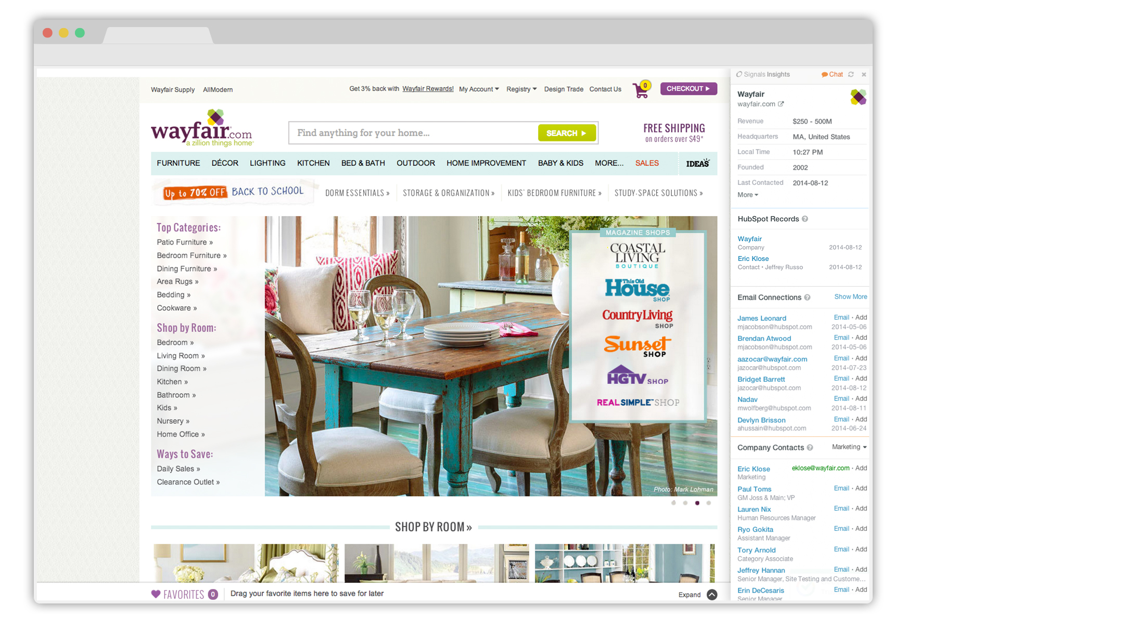
Notes:
I’ll click over to his company website. HubSpot CRM follows me everywhere I go through HubSpot Sales.

Slide 16
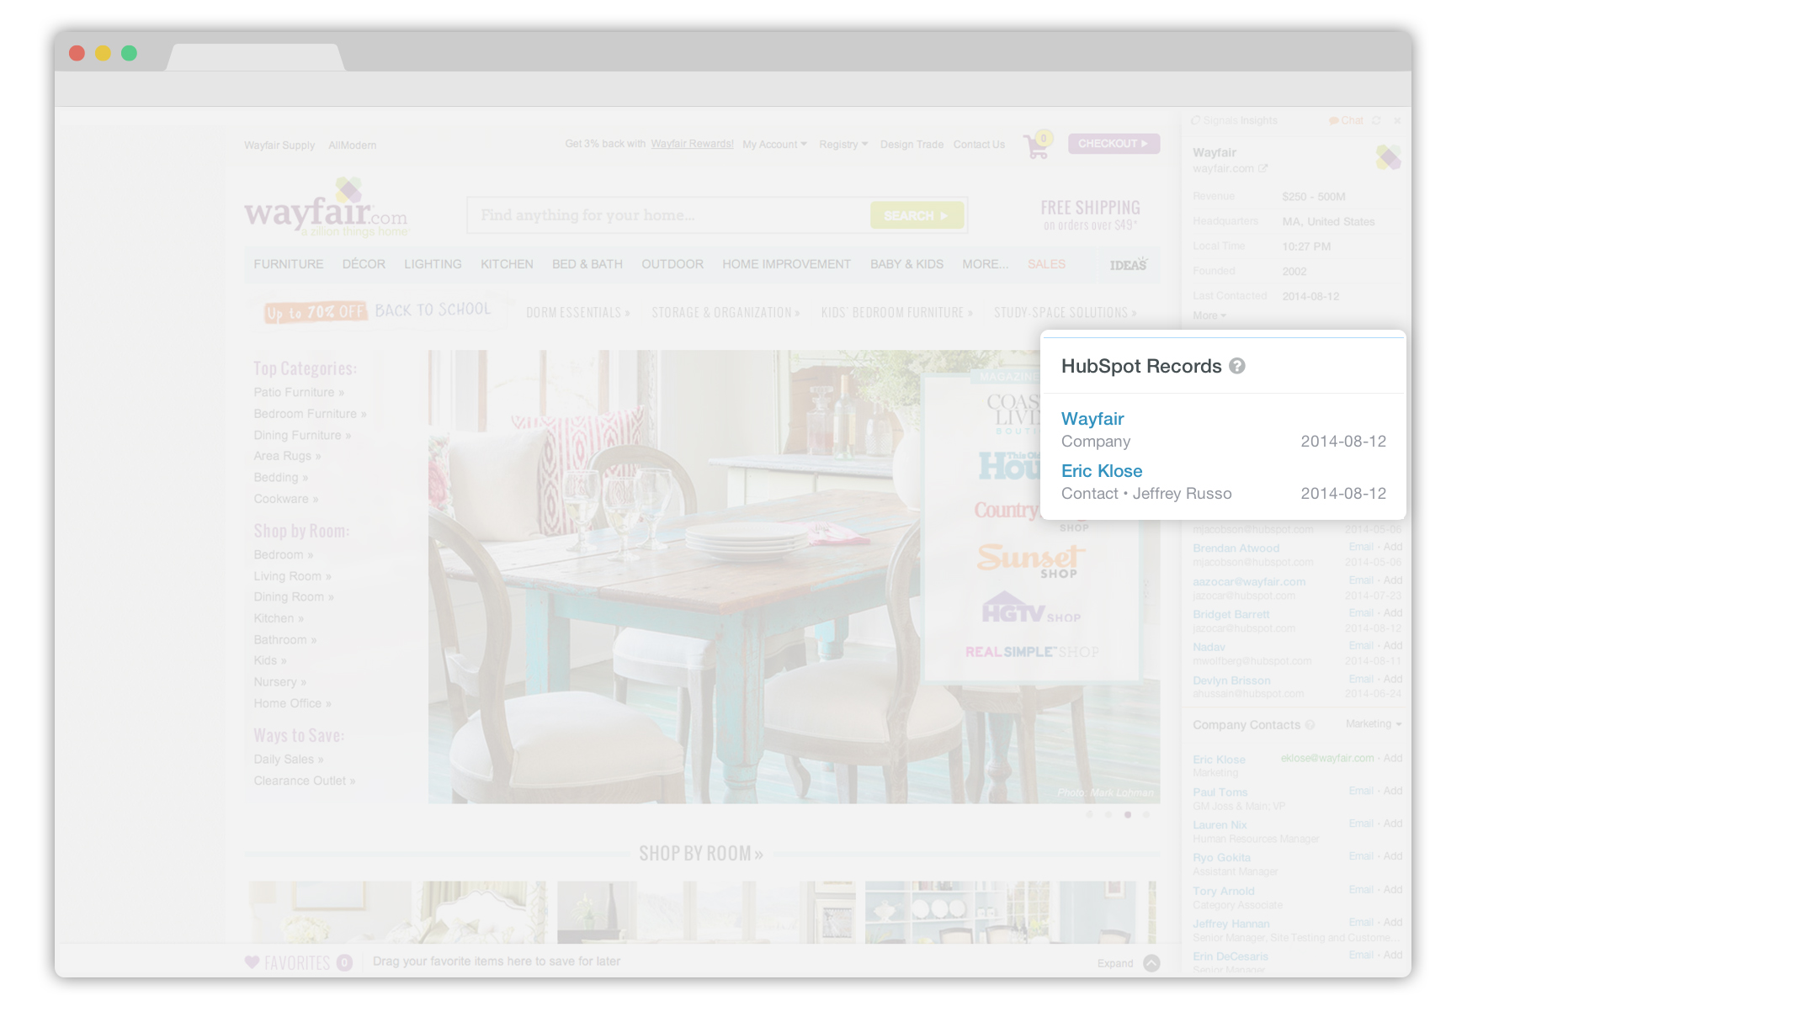
Notes:
I can see the new record for Wayfair and the new record for Eric in HubSpot CRM right here.

Slide 17
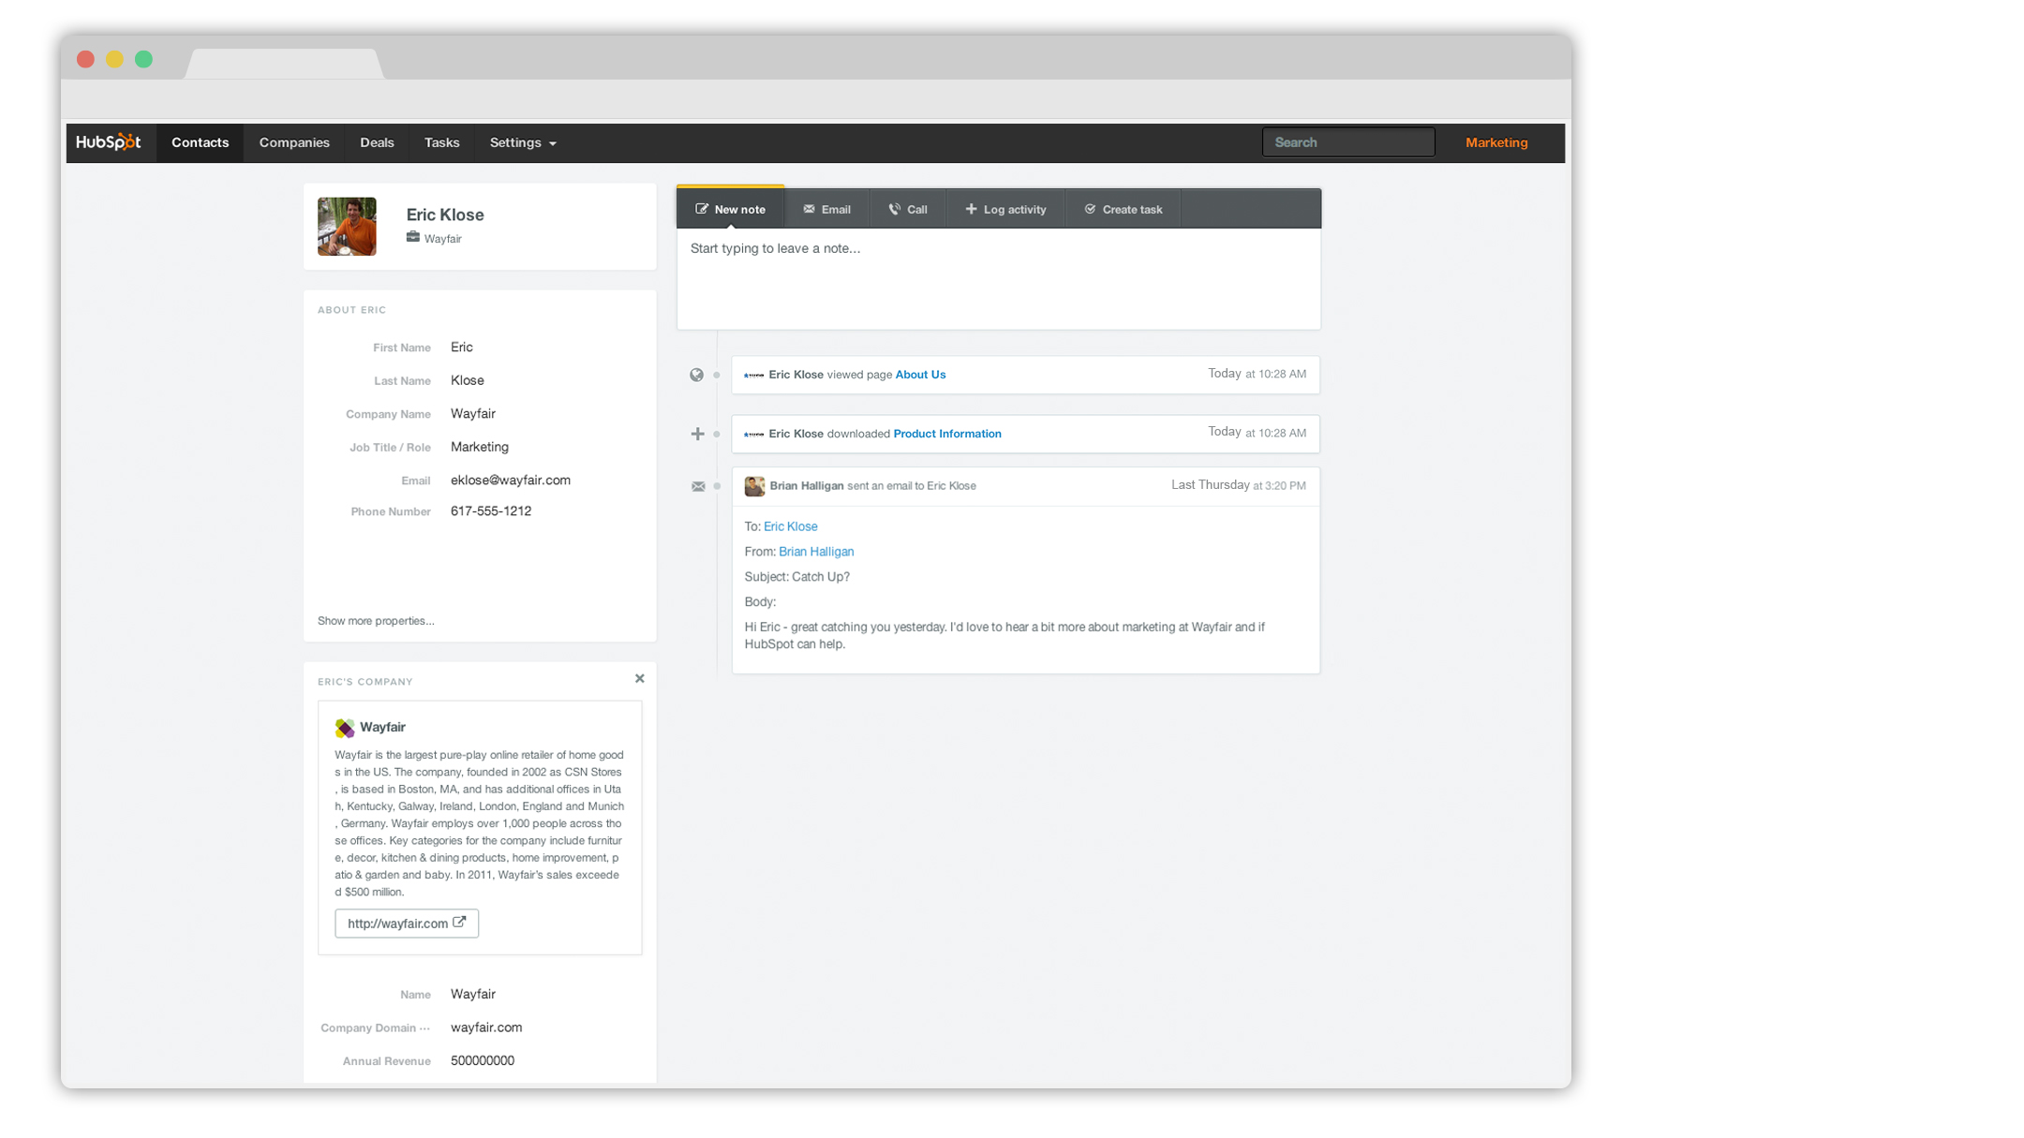
Notes:
A week has passed by... Eric has been on my website. I was alerted by HubSpot Sales, and I see it here in the timeline.

Slide 18
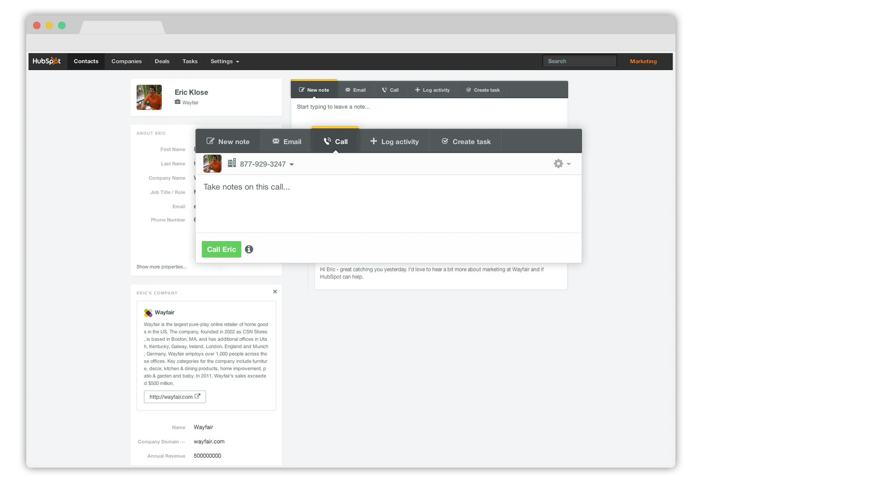
Notes:
It probably makes sense for me to give Eric a ring. I can do that right from my CRM! I don’t have his phone number, but with one click I can connect to the main line.

Slide 19
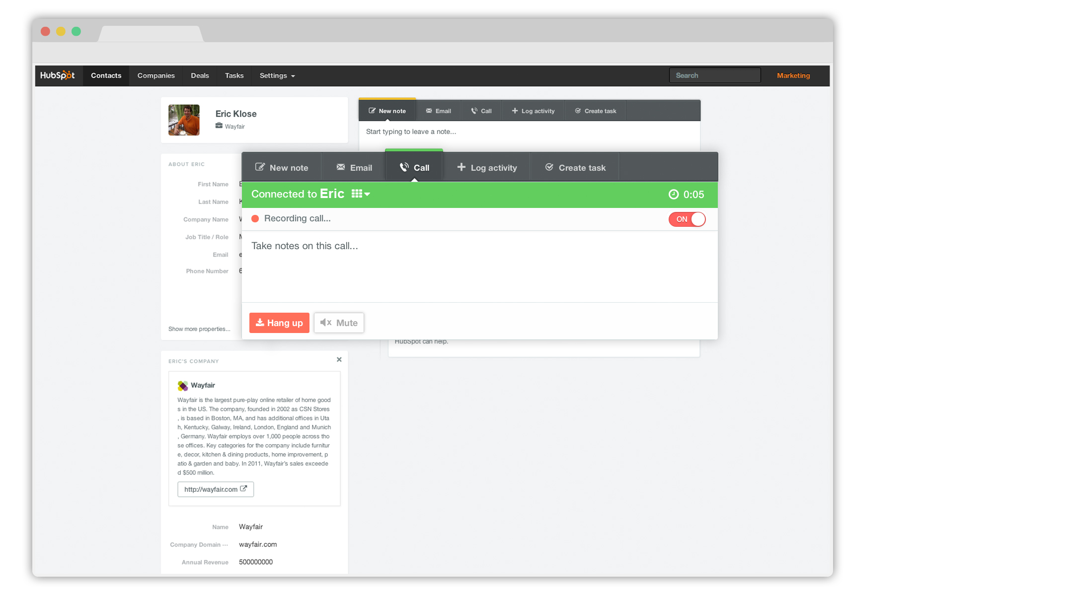
Notes:
The call is recorded while I’m talking to Eric. (Optional. It is your responsibility to be aware of local and state laws in your state, and the state you are calling to.)

Slide 20
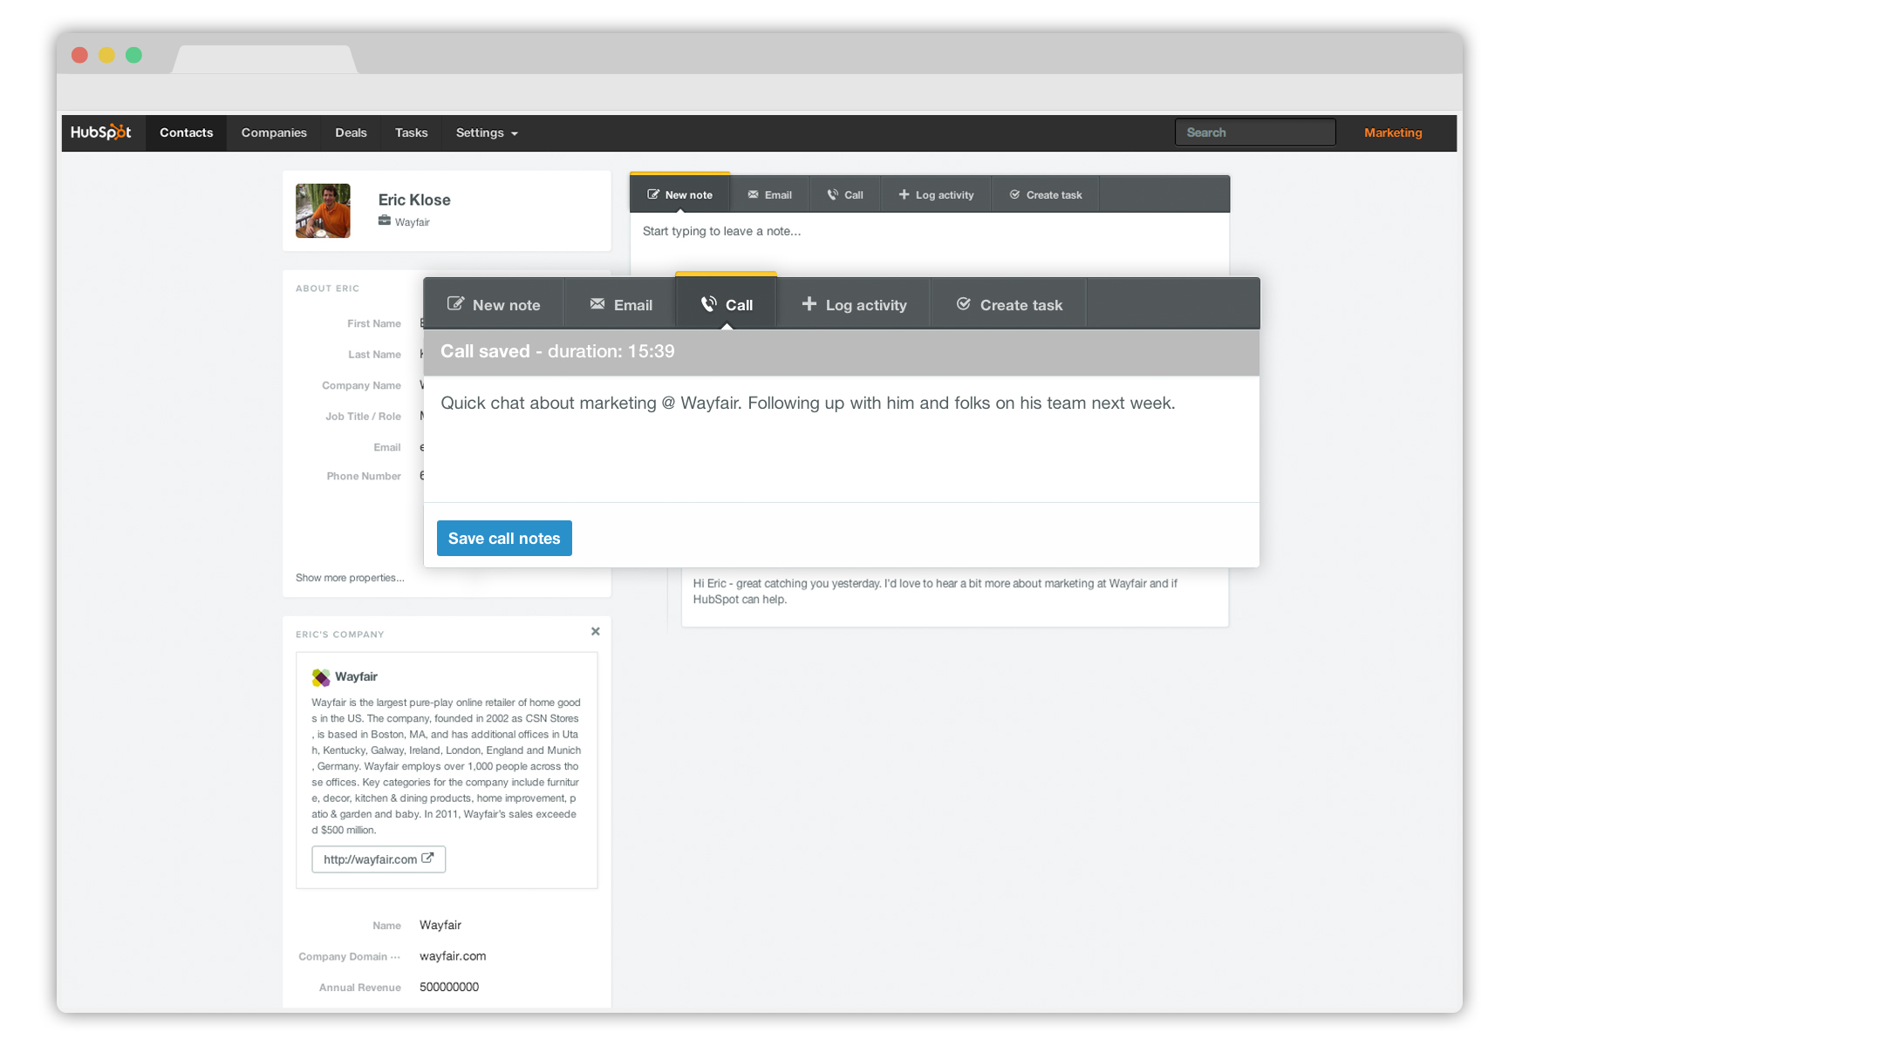
Notes:
Great call. I’ll take a few notes...

Slide 21
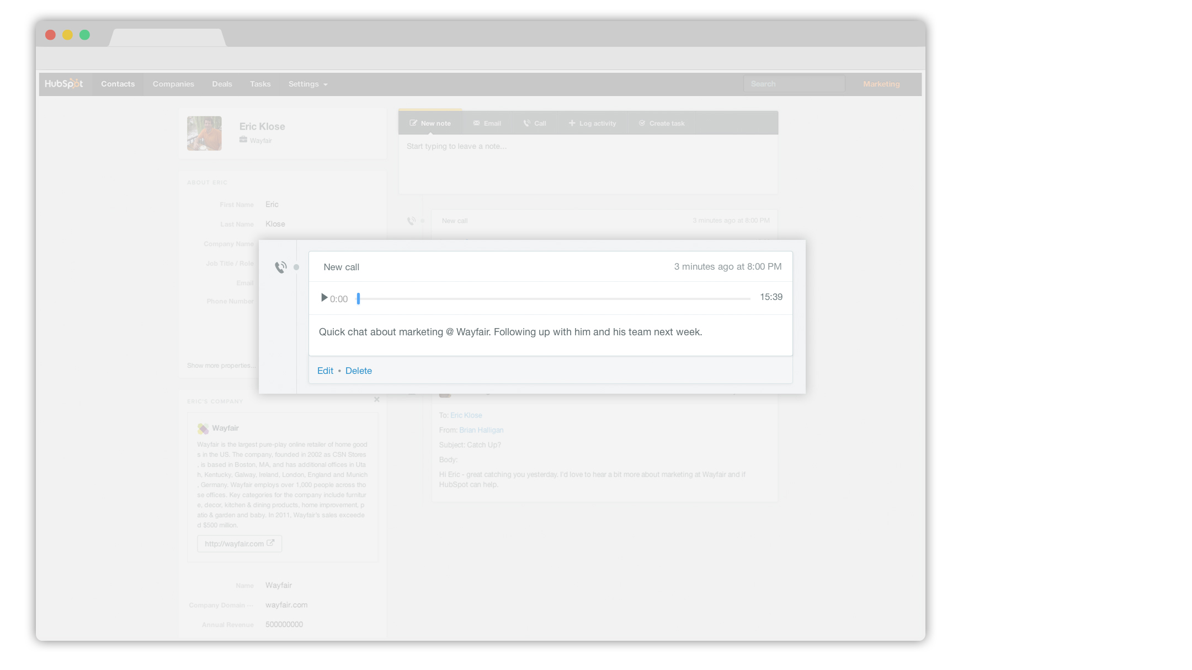
Notes:
And when I hang up, the call is logged, along with a full recording.

Slide 22
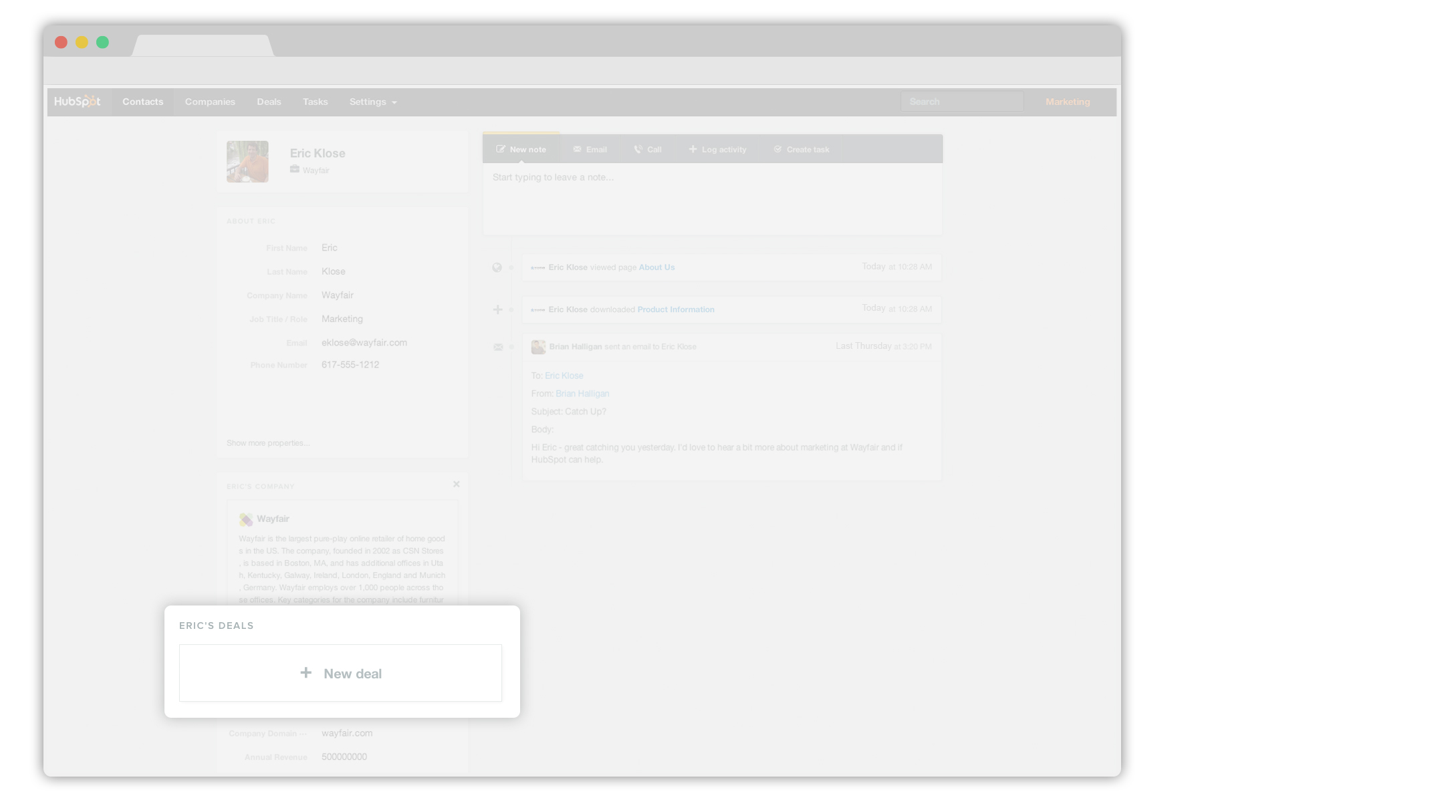
Notes:
The call went well, so I’m going to add a deal.

Slide 23
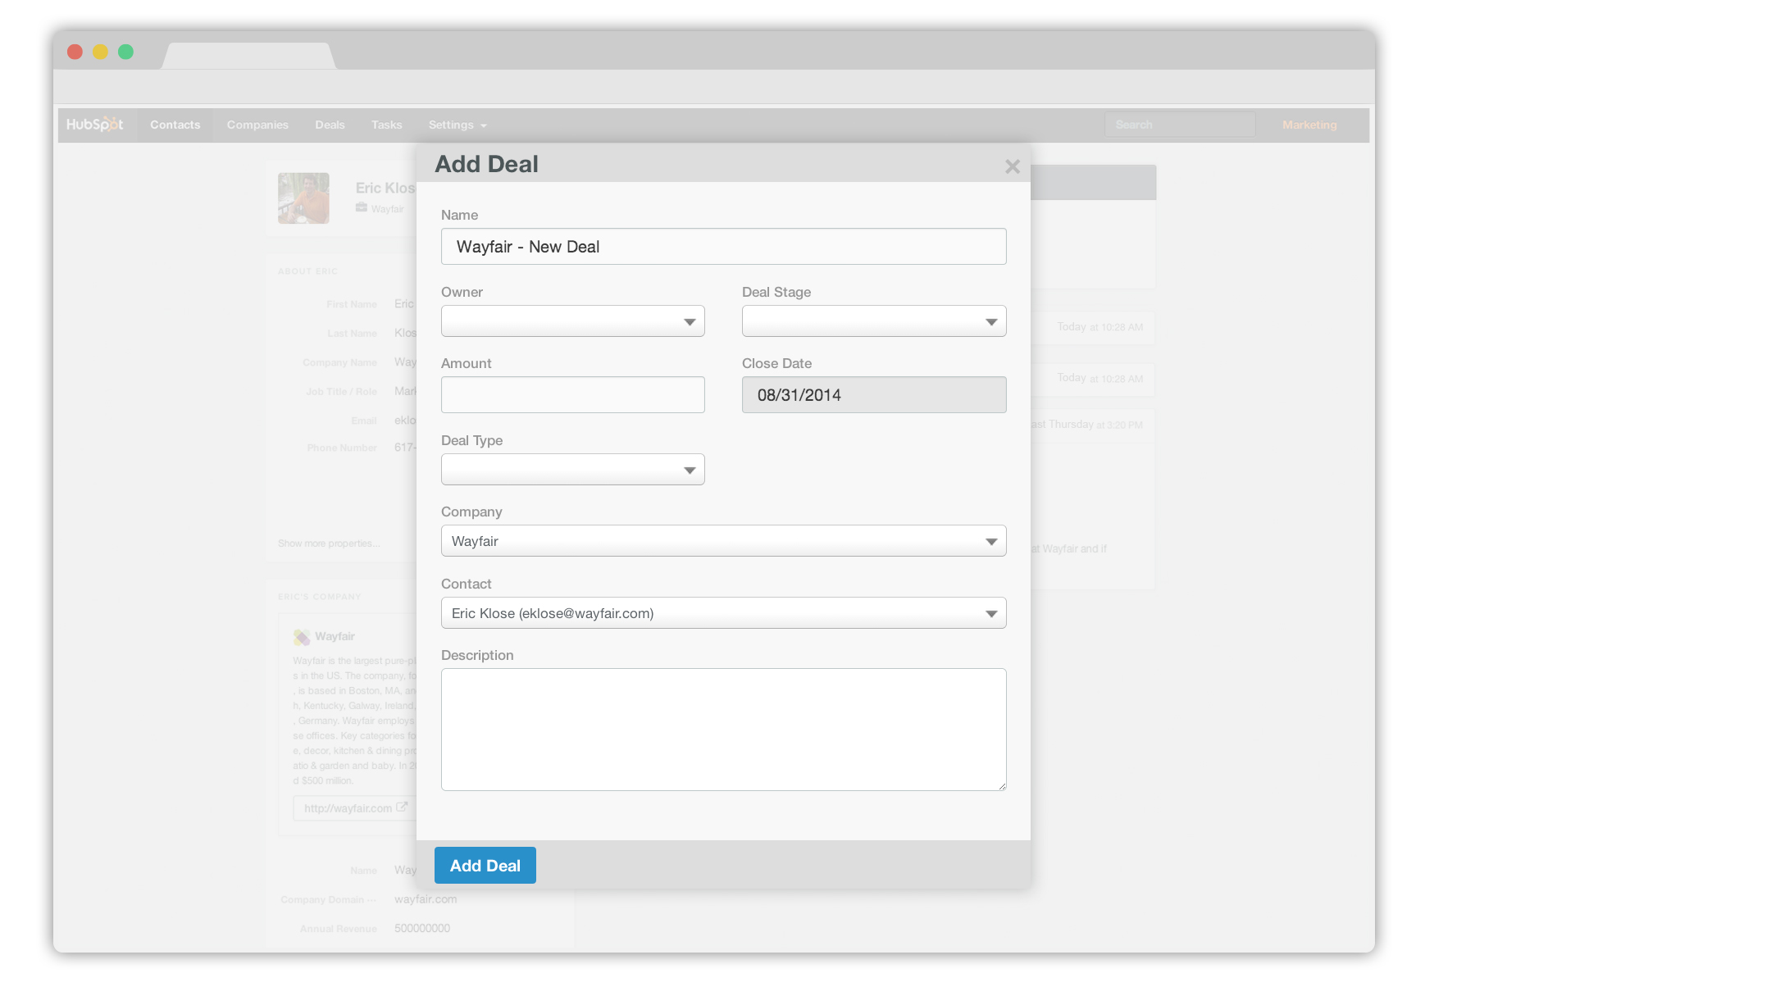
Notes:
Fill in some details about the deal...

Slide 24
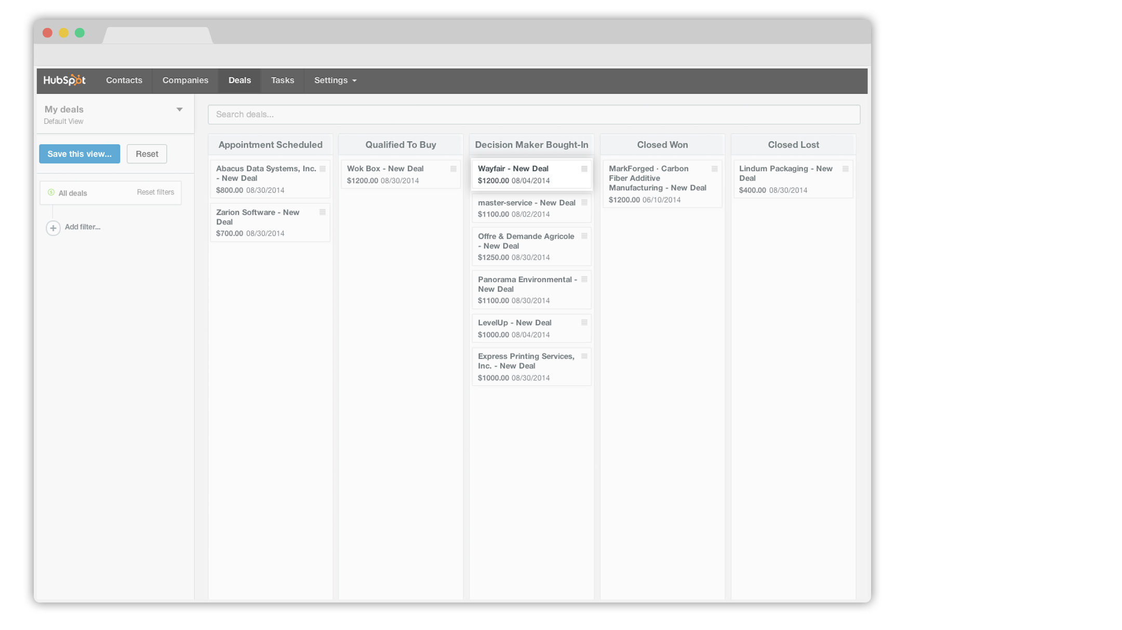
Notes:
And track the deal in this intuitive board view. As the deal progresses to closed won, all I need to do is drag it across my stages.

Slide 25
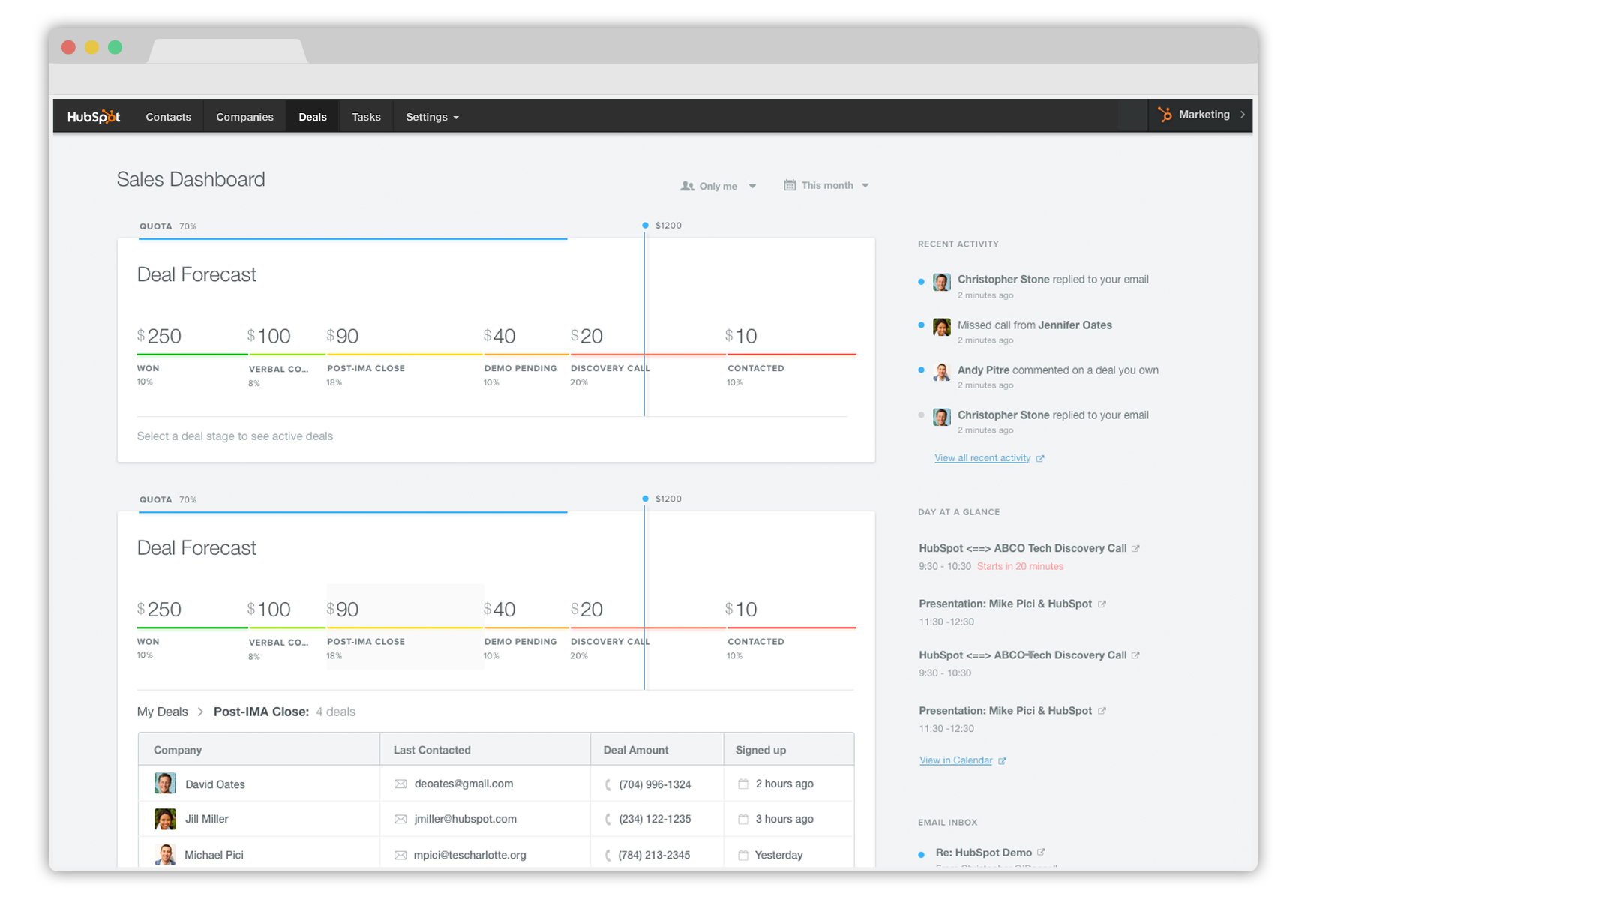
Notes:
Deal was won, and it’s reflected in my reporting.

