Slide 1
Helping [Company Name]
Grow with HubSpot
Attract, understand and delight your customers
Presenter name
Your Agency’s Logo Here
Notes:
Introduce yourself to get things started.

Slide 2
John Smith
Job Title, HubSpot
@TwitterHandle
Notes:
Introduce yourself to get things started.

Slide 3
Agenda
Inbound Marketing & HubSpot
HubSpot vs. Traditional Marketing Automation
Expected Results and ROI
The HubSpot Marketing Platform
The HubSpot Sales Platform
Services & Support
Customer Success Stories

Slide 4
1
Inbound Marketing & HubSpot

Slide 5
What is inbound marketing?

Slide 6

Over the past decade, there’s been a fundamental shift in the way companies reach their audience.
Notes:
Then: Brands were in control. Buyers were constantly bombarded with billboards, commercials, and cold calls trying to sell them a product.
Now: The customer is in control. Buyers are tuning out to loud, interruptive advertising and consuming information online.

Slide 7




The old
marketing playbook
is
BROKEN.
94%
skip TV ads
94%
unsubscribe
from email
27%
direct mail is never opened
50%
are on do not call lists
Base: Varied bases, minimum 598 global consumers
Source: HubSpot Global Interruptive Ads Survey, Q4 2015 – Q1 2016.
Notes:
The old marketing playbook is broken [run through stats].
Source: HubSpot Global Interruptive Ads Survey, Q4 2015 – Q1 2016.

Slide 8


Technology has changed how people search and buy, but marketing has not caught up.
Traditional
Inbound
vs.
Cold Calling
Cold Emails (SPAM)
Interruptive Ads
Marketer - Centric
SEO
Blogging
Attraction
Customer - Centric
Notes:
The way people shop and buy has changed dramatically. If companies want to connect with their audience today, they have to update the way they market and sell.
Traditional marketing is becoming less and less effective. That’s where inbound comes in.

Slide 9


Your customers now start
their search online.
Inbound Helps You
Get Found:
Website pages
Blog articles
Social media messages
All optimized to drive qualified leads to your site
Content

Slide 10
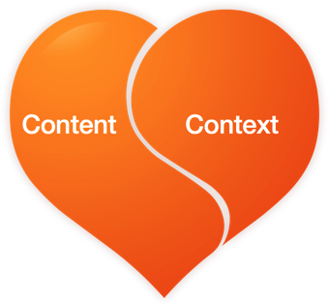
Reach them with personalized,
relevant and helpful content
Inbound Helps You Get Found:
Website pages
Blog articles
Social media messages
All optimized to drive qualified leads to your site
Understand Your Buyers:
Personalize your marketing
Identify buyer needs
Understand what content pulls leads through sales funnel

Slide 11
Now, why do inbound marketing with HubSpot?

Slide 12





Opens Singapore Office
HubSpot’s Rapid Growth
Named Best Place to Work
Announces HubSpot Sales
IPO
Opens European Office
Announces HubSpot CRM
Named #2 Fastest Growing Software Company
Opens Australia Office
Acquires Marketing Automation Company
Number of HubSpot Customers:
20,000+
Raises $32 Million in Funding
as of August 2016
Founded

Slide 13

More customers use HubSpot than
any other marketing platform.
Marketing automation market share by # of companies
Source: Mintigo, 2015
Notes:
From article: http://venturebeat.com/2015/01/27/marketing-automation-surprise-eloqua-top-market-share-10-penetration/

Slide 14





























More customers use HubSpot than
any other marketing platform.

Slide 15

HubSpot ranked #1 for Marketing Automation
by G2 Crowd 2016
“HubSpot has helped transformed our marketing organization into a data-driven, customer nurturing, lead generating machine. There is a definite commitment to keep their platform and their customers always moving forward.”

Slide 16
Creating a movement
HubSpot has more social media followers
than any other marketing software.
655,000
FOLLOWERS
928,000
LIKES
132,000
FOLLOWERS

Slide 17
2
HubSpot vs. Traditional Marketing Automation

Slide 18
Traditional marketing automation software
doesn’t address your whole marketing funnel.

Slide 19






It only serves one or two
stages of the marketing funnel.
Strangers
Visitors
Leads
Traditional email marketing / marketing automation tools (like Eloqua or MailChimp)
Customers

Slide 20
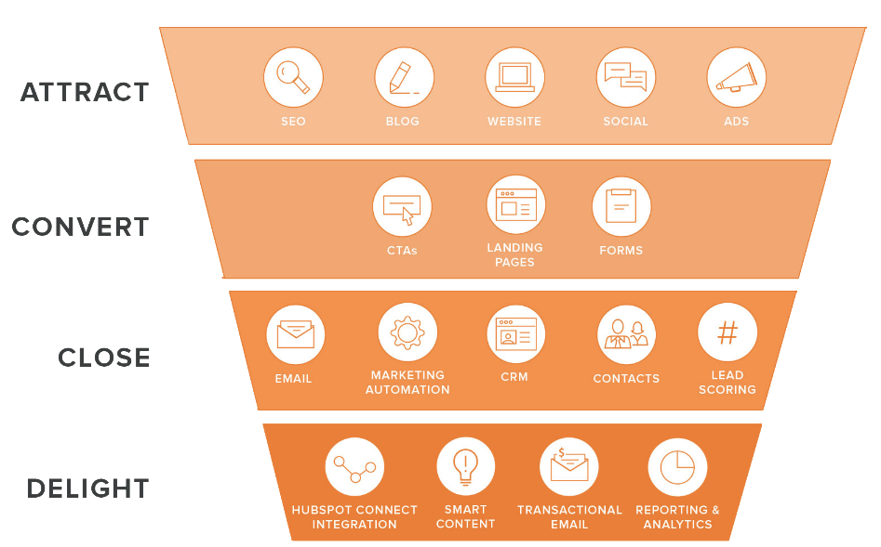
HubSpot is an inbound marketing platform
designed to generate more traffic, leads and customers.
It doesn’t help if your problem is here.
Email marketing automation helps here.

Slide 21
3
Expected Results & ROI

Slide 22

Average customer ROI after
using software for 1 year
Attracting Visitors
4.1x
Average Increase in
Monthly Website Visitors
Converting Leads
3x
Average Increase in Monthly Leads
Closing Customers
79%
Report Growth
in Revenue
Source: MIT Sloan graduate student study
available at HubSpot.com/ROI

Slide 23
4
The HubSpot Marketing Platform

Slide 24



Tools to Attract Visitors
Blogging
Easily create remarkable content that will help your business get found
Social Inbox
Publish and see Social Analytics across Facebook, LinkedIn, Twitter and other networks
SEO
Improve your search rankings and get found by quality leads
& More...

Slide 25

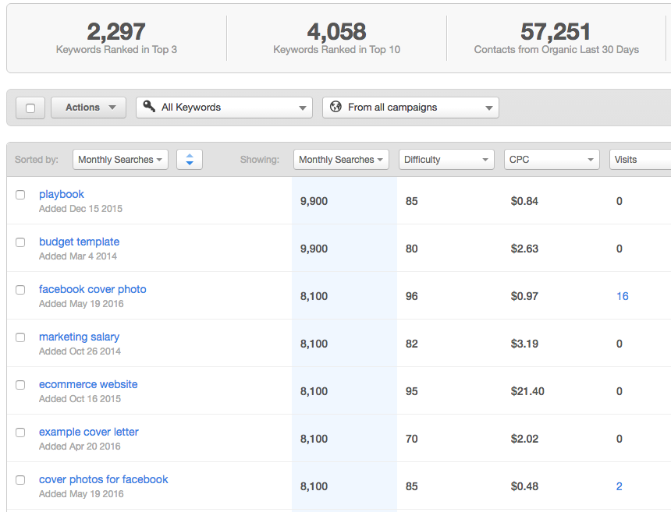
Keywords
Discover which keywords will bring the best organic traffic to your site and analyze your paid search campaigns.
Track which keywords drive the best visitors and leads.
View difficulty, search volume, and paid search metrics like Cost per Click (CPC).
Get recommendations for low-hanging fruit and long-tail keywords.
Compare your marketing to competitors.
Notes:
“The Keywords tool helps you start to understand the best words and phrases your prospects use when they are searching for solutions to their problems and challenges that your products/services can address.
HubSpot collects keyword data from around the internet and not only aggregates it in one dashboard view, but uses it to automatically organize your keywords so you can identify where your best opportunities to rank are. So you can focus your efforts on those keywords that will help you rank and build authority for your domain.
Most marketers spend too much time on a small number of keywords that are hard to rank for. How can we find and focus on our best opportunities?”

Slide 26
Ads (Add-on)
The easiest way to create ad campaigns, measure their conversion ROI and follow best practices built-in to the product.
Create Ad Campaigns in HubSpot
The easiest way to create LinkedIn and AdWords campaigns that tie into your existing marketing efforts.
Measure Conversions not Clicks Connect the dots by combining paid with HubSpot. You’ll know what clicks convert into leads and customers, for each ad.
Leverage Ads w/ Best Practices We’ve built expert knowledge right into the tool. Empowering you to become the ads master.

Slide 27
Blogging
Create long-lasting marketing assets by publishing blog articles optimized to get found and generate leads.
Create content to develop your thought leadership and get found online.
View detailed SEO recommendations for improving your content as you type.
Automatically publish to your social media accounts.
Automatically optimized for mobile devices with responsive design.

Slide 28
Page Performance
View recommendations in key SEO areas for optimizing your pages and generating quality inbound links.
Crawl your pages for SEO on-the-spot.
See detailed SEO reports for each of your pages.
Receive specific recommendations for improving your pages.
View metrics on page views, inbound links, clicks, and social media.

Slide 29
Calendar
Coordinate, plan, and delegate all your marketing activities from a shared Calendar.
Schedule content right from your calendar.
Filter the calendar view based on content or campaign based on your preference.
Click in to see details about the content scheduled on your calendar.
View your content by day, week, month, or in a list.

Slide 30
Tasks
Coordinate, plan, and delegate all your marketing activities from a shared Calendar.
Create tasks for your teammates right from the calendar for HubSpot content or any offline marketing campaign.
If your task involves creating a blog post, email, or landing page, HubSpot will automatically create a draft form of that content for you.
Both task assignee and assigner will receive a notification email regarding the task creation and completion.

Slide 31
Social Media Publishing
Publish and track messages across multiple platforms and accounts with suggested times for increasing reach.
Publish across multiple accounts and social media sites.
Bulk upload social messages in advance.
Schedule multiple posts at a time.
See suggested times for increasing engagement.
Shorten and track links automatically.
View click and engagement data for your leads.

Slide 32

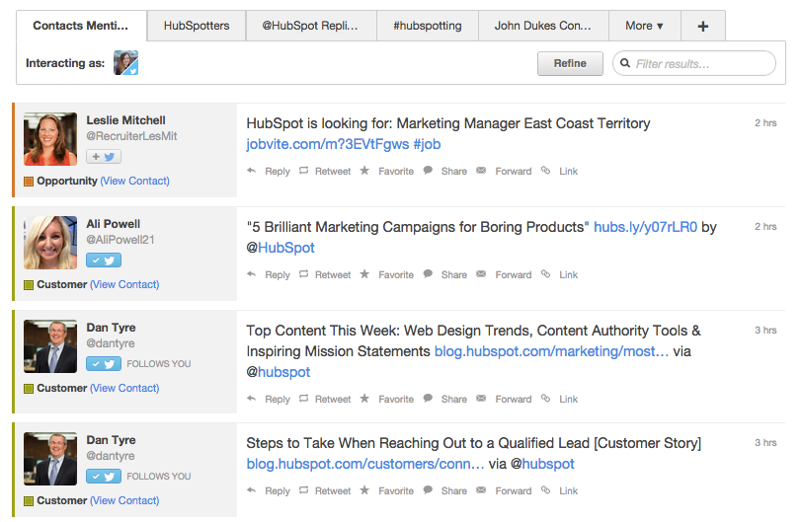
Social Media Monitoring
Monitor the social activity of your leads and customers.
Color-coded tweets highlight the strangers, leads, and customers in your social media feed.
Create monitoring streams of targeted contacts, such as a sales reps list of leads or leads who are unresponsive over email.
View your history of interactions.
Get more information about who the person is before responding.
Get pre-populated suggested streams for you to monitor.

Slide 33
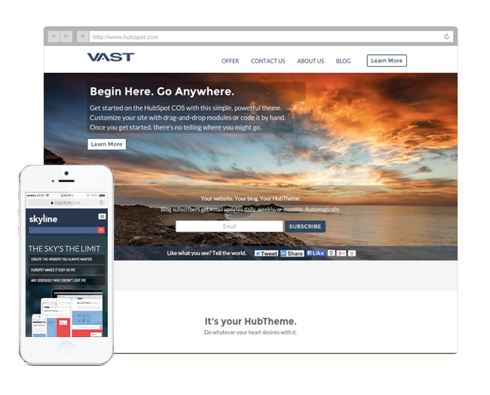
Website Platform Tool (Add-on)
Take control of your website and personalize content to your leads with HubSpot's integrated website management platform. Easily create sites that look great on any device.
Spin up pages without IT or developers.
Easy-to-use WYSIWYG editor.
Tailor pages based on who is viewing your site.
Automatically optimized for all mobile devices with responsive design.
SSL and a content staging environment included at no additional cost with the add-on.

Slide 34
Themes
Create a beautiful website with the click of a button so you can focus on your content. “Out of the box” website themes include everything needed for a website (templates, stylesheets, navigation, etc.)
No coding required to create or integrate.
Easily customize your website with drop-and-drop modules.
Launch in no time by simply filling in your content.

Slide 35





Tools to Convert Leads
Calls-to-Action
Build beautiful buttons and
callouts to convert traffic
to leads in a snap
Landing Pages
Create more pages that improve conversion rates and
generate leads
Forms
Ask the right questions at the
right time to optimize
lead conversions
Lead Management
Segment leads based on their
activity across your site
and other channels
& More...

Slide 36
Calls-to-Action
Build professional CTAs in minutes to convert your visitors into leads, complete with A/B testing and personalized Smart CTAs.
A/B test CTAs and track results.
Display Smart CTAs based on contact properties.
Analyze clicks and conversions on CTAs for increased conversion opportunities.

Slide 37
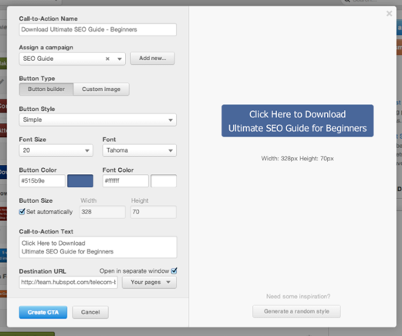
Calls-to-Action
Build professional CTAs in minutes to convert your visitors into leads, complete with A/B testing and personalized Smart CTAs.
Build CTAs inside of HubSpot without a designer, or upload your own custom images.
Attach CTAs to Campaigns to see how they affect high-level campaign goals.
Display CTAs inside of any HubSpot Blog, Landing Page, Site Page, Email, or attach to your existing website.

Slide 38
Landing Pages
Capture inbound leads through your website with landing pages that are easy to customize, A/B test, personalize, and track.
Build optimized Landing Pages in minutes without a developer.
Choose from multiple, already-optimized templates, hire a HubSpot certified designer, or have HubSpot match the look and feel of your existing site.
Integrate with your CTAs, Contacts, Smart Content, and Social Media accounts easily.

Slide 39
Landing Pages (Analytics)
Understand where your Landing Page traffic is coming from and which sources convert into leads.
A/B test your Landing Pages and track the results.
View detailed conversion and source analytics for your Landing Pages.
See which channels bring your Landing Pages the most views, leads, and customers.
See which pieces of content bring in the most viewers, new contacts and customers.

Slide 40

Forms
Create and insert forms into Landing Pages that drive leads.
Build optimized forms with custom fields for collecting data on your leads.
Hide fields if data has been captured previously.
Use drag-and-drop progressive profiling for increased conversions.
Set new lead notifications and sync data with your CRM.
Embed forms on any page.

Slide 41




Tools to Close Customers
Email
Personalize your emails with any field from your
marketing database
Marketing Automation
Use marketing automation
to trigger timed follow up
emails to your contacts
Analytics
See which traffic sources are generating the most leads,
plus other insights
Salesforce Sync
Use Salesforce data to segment contacts, personalize email,
and more
& More...

Slide 42
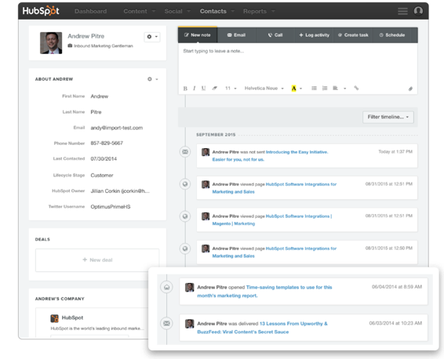
Contacts Database
Manage all of your contacts and leads in one, centralized database complete with robust profiles containing CRM data, website, email, and social media history and more.
View a detailed timeline of every interaction a lead has had with your brand.
Sync this data with your existing CRM.
Use this data to segment, personalize your marketing, and create lead scoring.

Slide 43
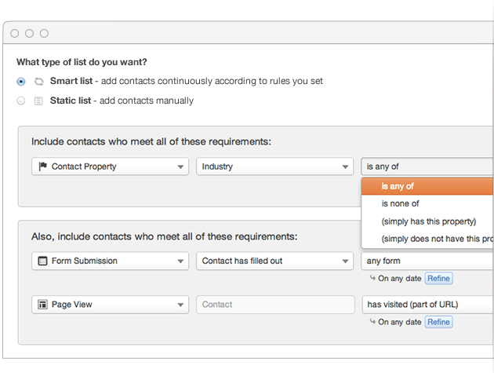
List Management and Segmentation
Target your leads by segmenting based on information they’ve given you and how they’ve engaged with you for truly personalized marketing.
Segment your leads based on a contact’s demographic information from forms or behavioral data from all of your marketing channels.
Segment on social behaviors, site analytics, and more.
Score leads off of the same criteria.
Create static and dynamic Smart Lists.
Choose which leads get synced to Salesforce.

Slide 44
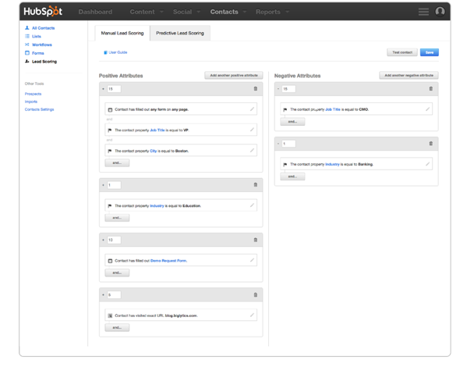
Lead Scoring (Manual)
Customize your lead scoring model with the attributes and behaviors that matter most to your business.
Choose which behaviors and attributes you want to score on.
Add or subtract points from the lead score based on these attributes.
Help your sales team prioritize who they follow up with and when.
Sync these scores to your CRM, or use it to segment your database and use those lists around the rest of your marketing apps.

Slide 45
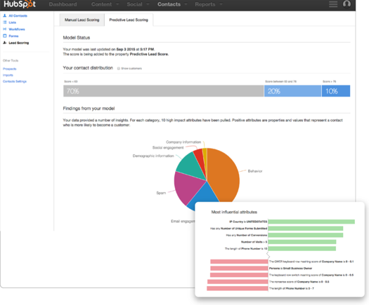
Lead Scoring (Predictive)
Click one button and HubSpot scores your entire leads database with a predictive score that you can segment on and use around the rest of your marketing apps.
Builds a scoring model unique to your database, based on the attributes and behaviors of your contacts that leads them to become customers.
See the breakdown of your top scoring leads, second tier and lowest scoring leads.
Get suggestions on what to do with each of these groups of people.
Get visibility into what attributes affected your lead scoring model.

Slide 46
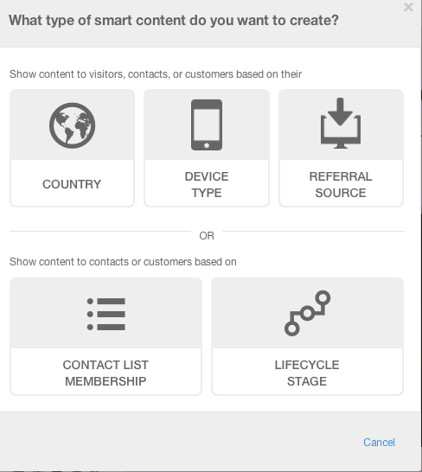
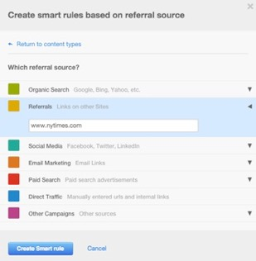
Anonymous Personalization
Personalize your content from the moment someone sets foot on your site by device, country, or referral source.
Show different content to your visitors from the moment they set foot on your site.
Personalize your content, forms, and CTAs based on country, device, or referral source.
Show your visitors different content based on specific source data (Twitter, referring URLs, email campaigns).
Use personalization across email, webpages, and landing pages.
Easily edit Smart Content in a WYSIWYG editor – no coding or embedding required.

Slide 47
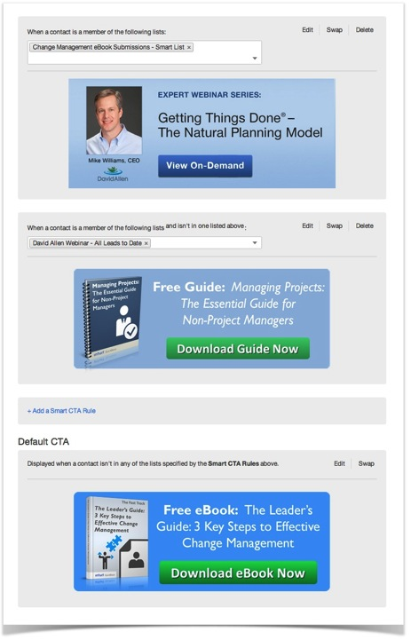
Smart Content
Change the content of your website to reflect the needs and interests of your leads, personalizing the message you send to help guide your leads down the funnel.
Adapt content to anonymous visitors, lifecycle stages or any characteristic in the contact database.
Use personalization across email, webpages, and landing pages.
Easily edit Smart Content in a WYSIWYG editor – no coding or embedding required.

Slide 48
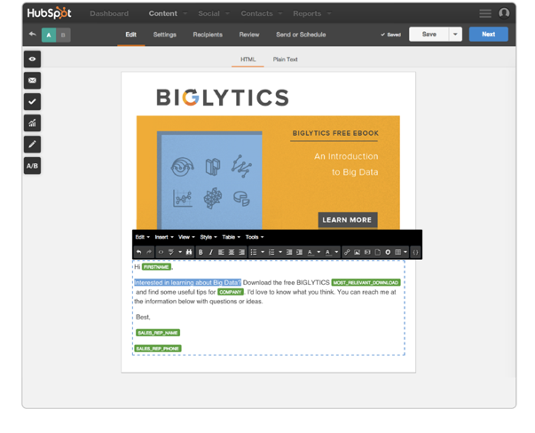
Email
Send personalized, beautiful emails that your prospects will look forward to receiving and measure which messages are most effective.
A/B test elements to optimize open and click-through rates.
Personalize your message, sender, and subject lines.
Preview in other email client inboxes.
Choose from a variety of pre-tested, mobile optimized templates.

Slide 49
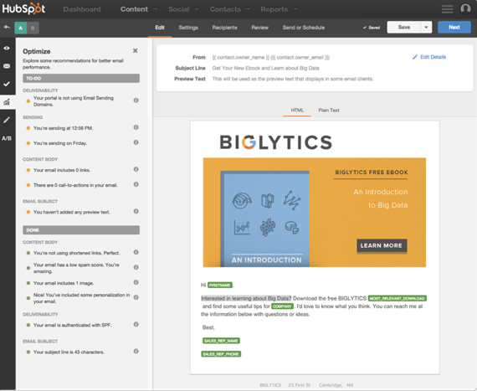
Email Optimizer
Send personalized, beautiful emails that your prospects will look forward to receiving and measure which messages are most effective.
Get suggestions on how to improve your emails right from the email editor.
After you gather data on your email performance, HubSpot will provide recommendations for the timing of your emails based on your data.
Use the Optimizer as a checklist to make sure you included every email optimization before sending.

Slide 50
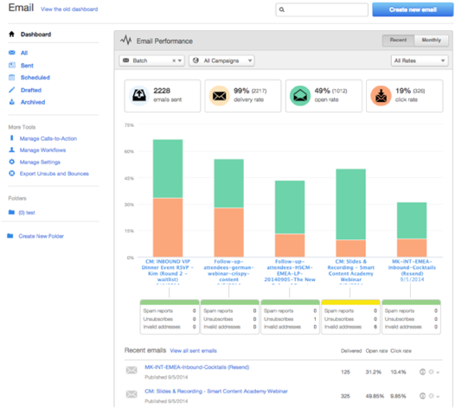
Email Analytics
Access all of your email tools from one screen while also getting an overview of all your important email metrics.
Access everything related to email in one centralized location.
Keep track of all important email metrics including spam reports, unsubscribes, and contact churn.
Compare emails to one another by graphing their performance.
Filter your emails based on campaign and email type to segment your results.

Slide 51
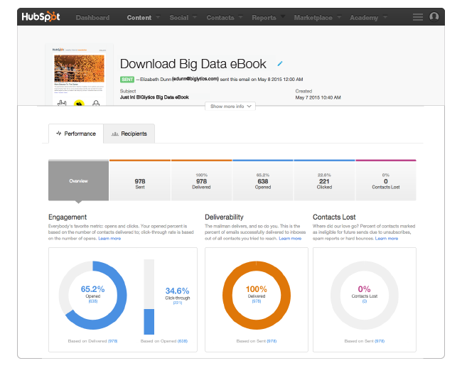
Email Analytics
See a high-level overview of your email’s performance, broken down into the key categories of engagement, deliverability, and contacts lost.
See key email performance metrics at a glance in the Overview tab.
Drill down to details on sent, delivered, opened, clicked, and contacts lost.
Track your email’s engagement (opens and clicks) over time, and break it down by email client and device.

Slide 52
Email Analytics
See a high-level overview of your email’s performance, broken down into the key categories of engagement, deliverability, and contacts lost.
Find out how recipients engaged with your email, and save lists for future nurturing.
Filter recipient list to dig into each type of engagement (opened, clicked, etc).
See detailed email events for each recipient, including specific link clicks and email client and device information.

Slide 53
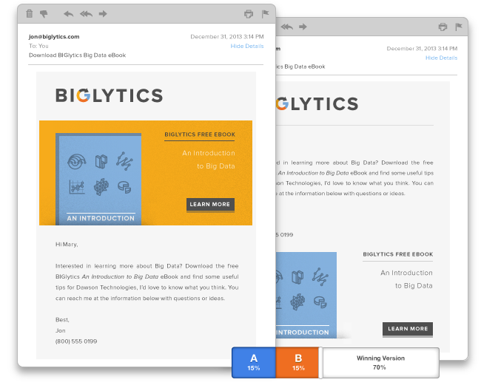
Email A/B Testing
Test variations of your emails to make data-driven decisions about the content you send to your database.
Test any element of your emails, including both content and design.
Choose which metric decides the winner of your A/B test.
HubSpot automatically sends the winner to the rest of your list.

Slide 54
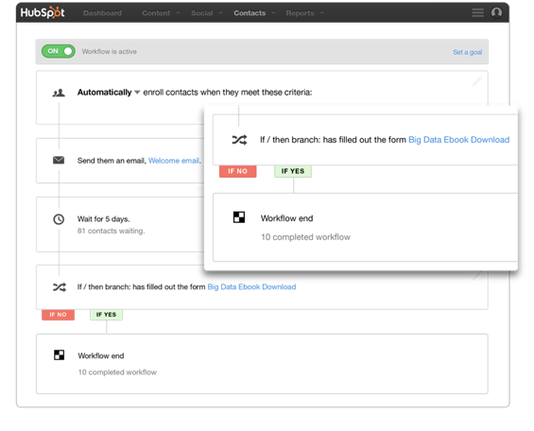
Marketing Automation
Trigger email messages and activities within your contact records, CRM or other 3rd party software to personalize and automate your marketing strategies.
Base your automation campaigns on goals, such as becoming an opportunity or customer.
Move leads easily in and out of campaigns as they achieve the goals you’ve set.
View detailed engagement data for each Workflow step.
Create conditional checks against every workflow step for optimization (commonly known as branching).

Slide 55
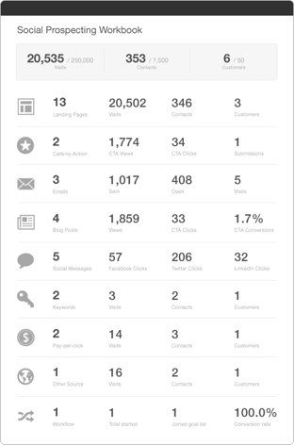
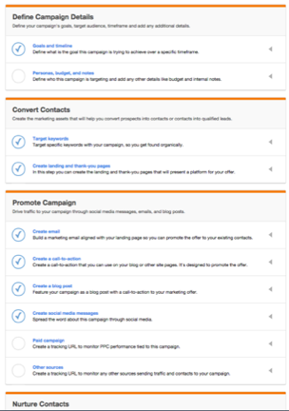
Campaigns
View every asset in your inbound marketing campaign in one screen and report on it’s progress across every channel.
Set high-level visit, contact and customer goals for your campaign.
Get a guided tour of creating a campaign in HubSpot.
Create, organize manage and analyze your campaign from one central place.
Understanding of how each component of a marketing campaign affects your top-level goals.
Better inform your future marketing campaigns with historical at-a-glance data.

Slide 56
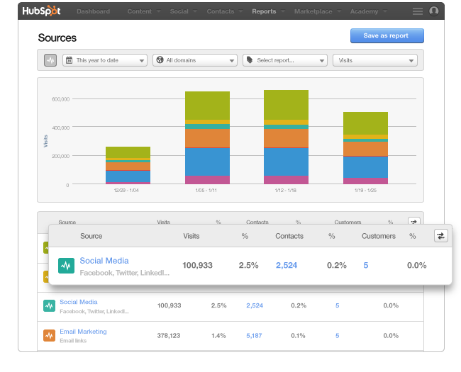
Sources
Analyze which of your marketing activities are driving the highest ROI in terms of visits, leads, and customers.
Track how your marketing is performing in terms of visitors, leads and customers.
Measure the ROI of your marketing campaigns.
Drill into detailed reports on your performance.
Compare the effectiveness of your marketing channels.

Slide 57
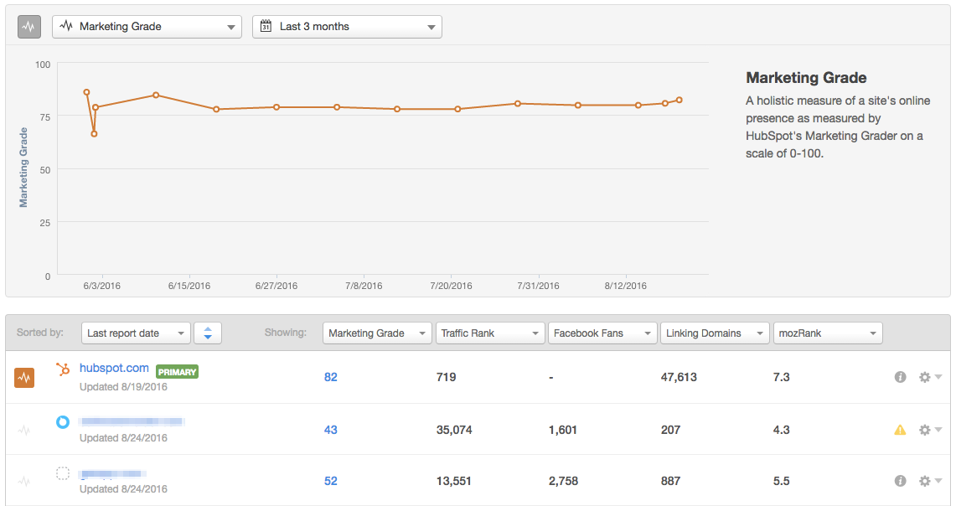
Competitors
Compare how your marketing performance stacks up to your competitors’ on key metrics over time.
Track and compare your progress against your competitors.
View detailed Marketing Grader reports to measure your marketing.
Track your progress over time across key metrics.
Drill-down into what’s causing fluctuations in marketing performance.

Slide 58
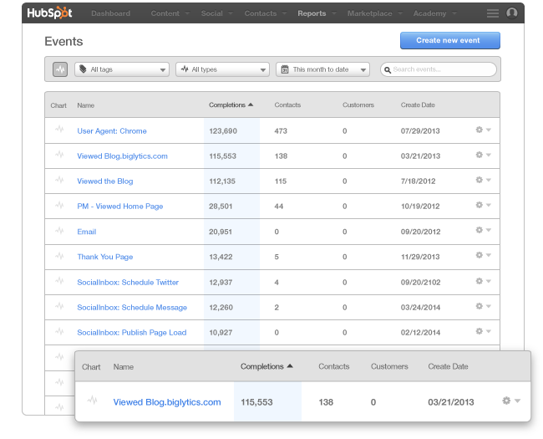
Event Analytics
Track visitor activity on specific events on your site with detailed reports on visitor history and progression.
Create custom events to track activities on and off your site.
Integrate with your 3rd party sites like Twitter and ZenDesk.
View Lifecycle reports to see first touch, last touch and assists reports for your events.

Slide 59
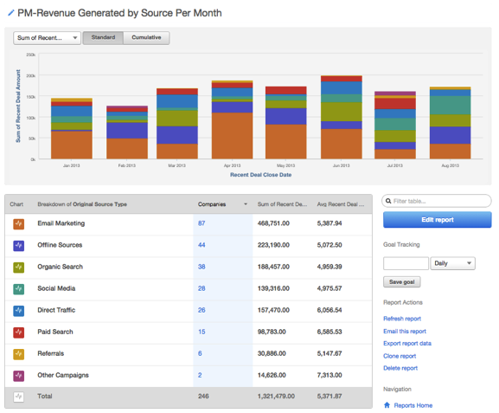
Revenue Reporting
Tie any marketing channels and content offer back to the revenue generated for the company.
Close the loop on your reporting by understanding the revenue generated based on sources or pages on your website.
Understand what marketing efforts generate the most revenue in your database.
Report on revenue based on contacts or companies in your database.

Slide 60
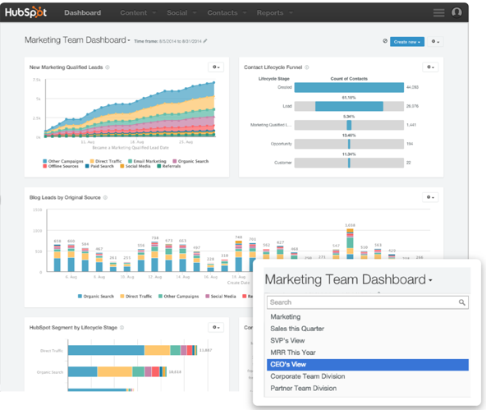
Reporting Dashboard (Add-on)
Easy-to-create drag-and-drop dashboards for every member of your team.
One dashboard – all of your reports.
Report on data from across every tool in the HubSpot Marketing Platform in one place.
Create new reports from scratch or used canned recipes.
Customize dashboards for all your stakeholders.

Slide 61
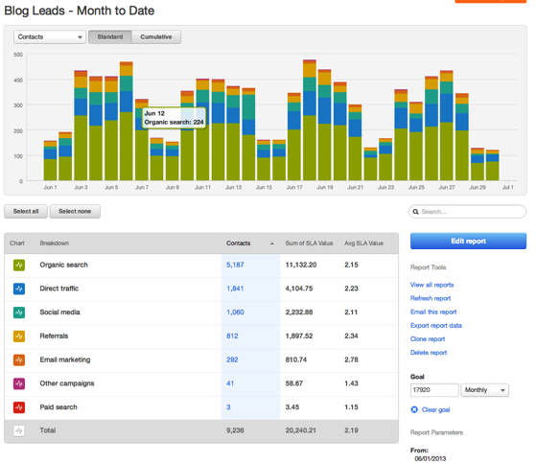
Contacts Reporting
Create customized reports on your contacts database on your entire funnel. Slice and dice your segments to gain key insights on your contacts database.
Create custom reports on any list to report on your contacts database.
Measure the results of your marketing segments.
Slice and dice your data to uncover the key information you need to improve your marketing.

Slide 62
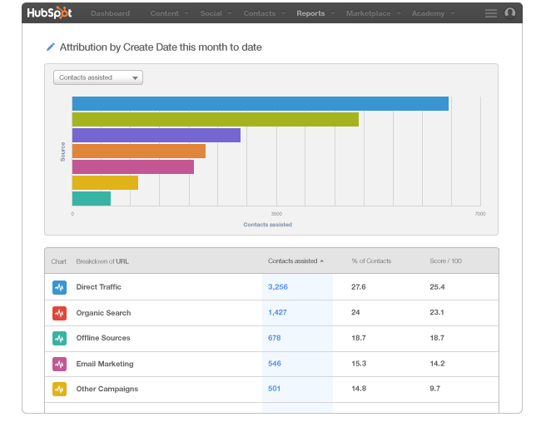
Attribution Reporting
Understand which pages on your site and sources are the most effective in driving conversions throughout your funnel.
View which pages and sources are influential in driving conversions.
Create different attribution reports based on someone’s first interaction, last interaction, time decay, and all interactions.
Learn what content nurtures your prospects through the sales funnel.

Slide 63
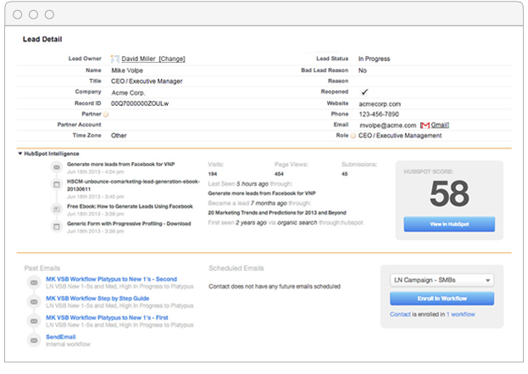
Salesforce Integration
Improve your marketing with data from Salesforce. Put valuable lead intelligence from HubSpot in the hands of your sales team.
Fully Bi-Directional Sync
HubSpot effortlessly syncs the right leads and contacts in both directions, so that the data you need is always right where you need it.
Better Personalize Your Marketing
Leverage any of your Salesforce data to segment, personalize and hone your messaging.
Lead Intelligence for Sales
Help your sales team close more business by giving them easy access to valuable lead intelligence data generated by HubSpot.
Blazing Fast Syncing of Leads
Get the right leads into the hands of your sales team more quickly with HubSpot.

Slide 64
5
HubSpot CRM &
HubSpot Sales

Slide 65
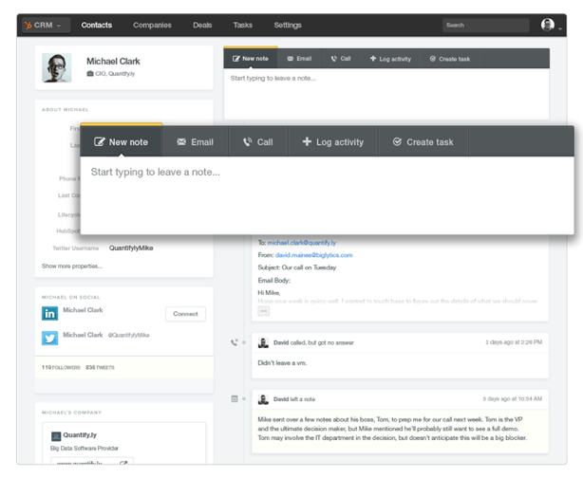
HubSpot CRM (free!)
Say goodbye to manual tasks and confusing features. HubSpot CRM is the easy to use CRM system your sales team will love. Turn it on in your existing HubSpot account, or sign up for free at hubspot.com/crm.
Contacts & Companies
Every detail and every interaction with your prospects & customers, organized automatically on beautiful contact & company profiles.
Deals & Tasks
Track deals through customized stages of your sales process. Track the progress of individuals or your entire team on the dashboard. Easily assign & track tasks.
Timeline & Insights
View a detailed timeline that shows every interaction between a contact and your company. Every profile is enriched with useful details about a contacts’ company for free.

Slide 66
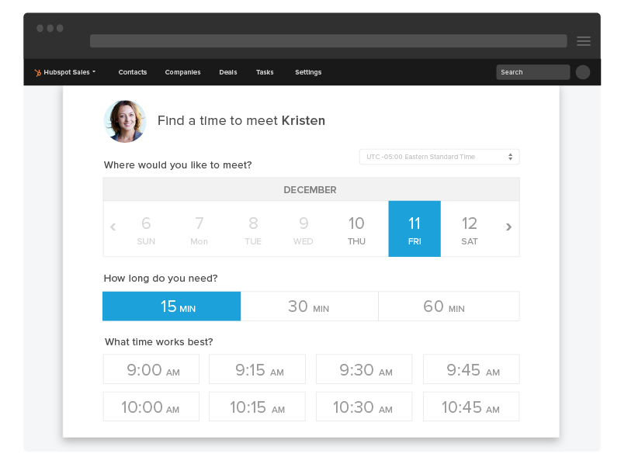
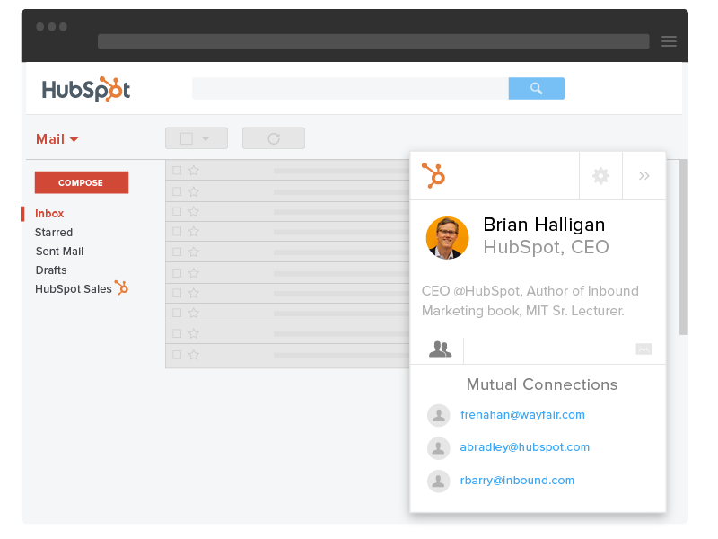
HubSpot Sales Free & Professional
Bring useful information about the contacts and companies you work with to your inbox and everywhere you go on the web with HubSpot Sales.
Keep your pipeline full with Prospects.
Prospects helps you identify the companies
who are visiting your site right now.
Identify your best performing email templates and sales content.
Personalize messages quickly and learn which templates are performing the best. Easily share the best performing templates across your team.
Follow up in a relevant, efficient way.
Sequences allows salespeople to schedule a series of highly targeted, timed emails to nurture a prospect over time.
Book meetings in half the time.
Stop the email back and forth and put the power to book meetings in the hands of your prospects.

Slide 67
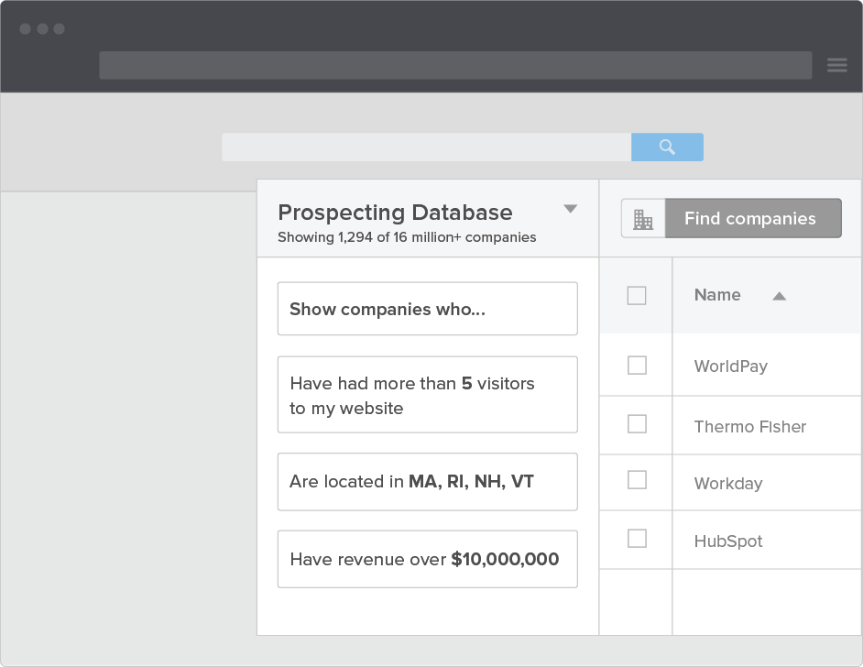
HubSpot Sales– Prospects
Fill your pipeline with warm prospects.
Prospects helps you fill your pipeline with warm leads.
Know who is on your site, what they are doing, and how your connected to that person.
Prospects empowers you to know what is happening and act Intelligently. No more guessing.

Slide 68
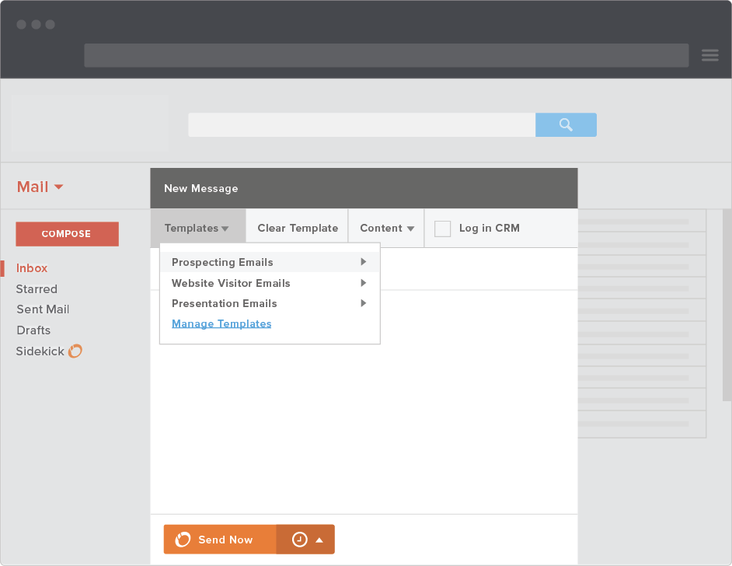
HubSpot Sales – Templates
Figure out your best performing sales emails.
Email templates in HubSpot Sales allow you personalize messages extremely quickly so you see what is performing the best.
You can easily share the best performing templates across your team to ensure the best emails are being sent all the time.
Templates are compatible with Gmail, Outlook, and are also easily accessible in HubSpot CRM.

Slide 69
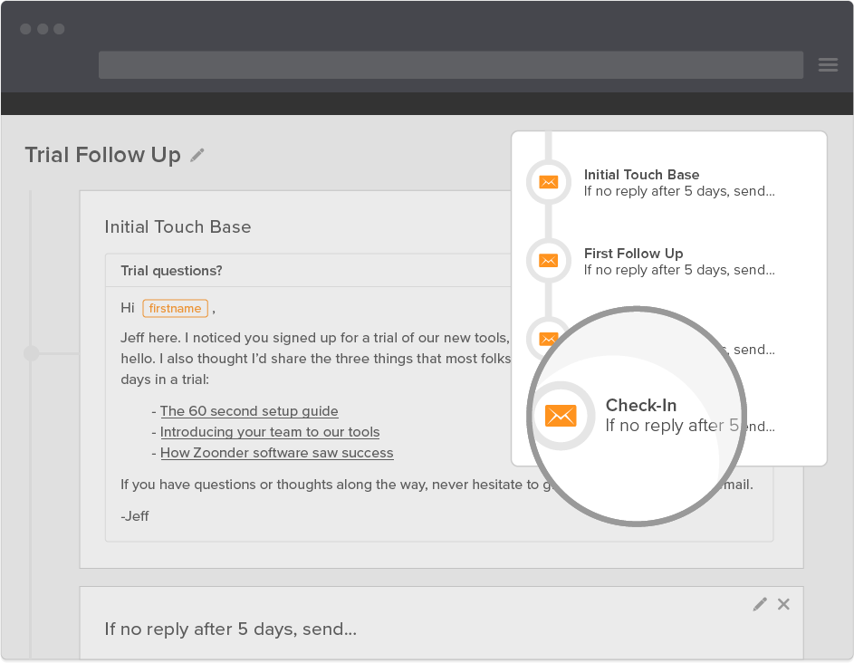
HubSpot Sales – Sequences
Follow up in a relevant, efficient way.
Sequences allows salespeople to schedule a series of highly targeted, timed emails to nurture a prospect over time.
Edit individual details to make each message feel personal, and schedule right from your inbox with HubSpot Sales.

Slide 70
HubSpot Sales – Meetings
Save time and keep your calendar full by putting the power to book you in your prospects’ hands.
Meetings connects to your calendar and allows you to set your availability and share a personalized booking link with your prospects. When they book a meeting, you are both notified and scheduled automatically.
Easily drop in your meetings link from Gmail, Outlook, or even include a lead owners’ meetings link when sending marketing emails from HubSpot Marketing.

Slide 71
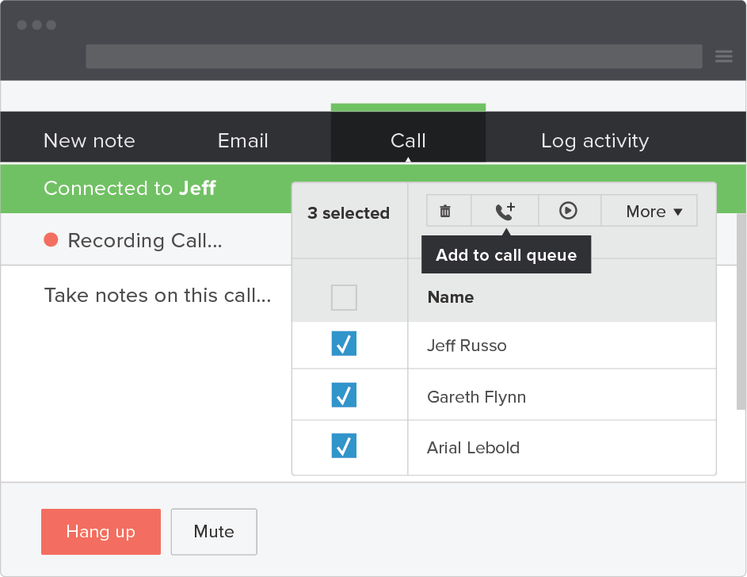
HubSpot Sales– Calling
Double your connect rate with Calling.
No need to touch a phone – HubSpot Sales connects you right from your browser, and even records the call (if you choose).
At the end of your call, everything is automatically logged in your CRM system.

Slide 72
6
Services & Support

Slide 73



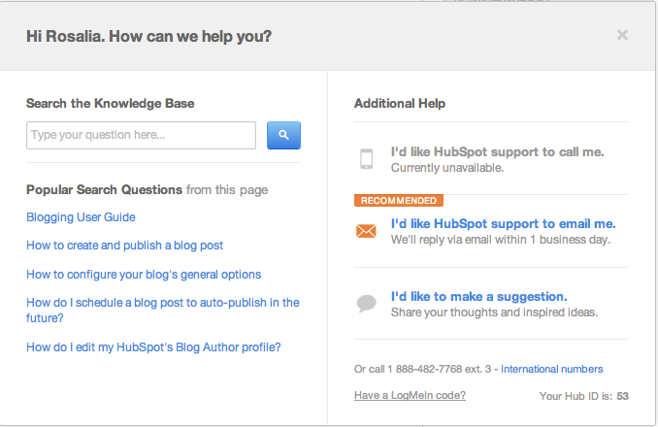
Support
Unlimited phone and
email support for
ALL customers, for life
Search the Knowledge Base for user guides
and help docs
Connect with other HubSpot users through the HubSpot Forums or User Groups

Slide 74
Support
HubSpot ranked #1 in user satisfaction
by G2 Crowd in 2015.
Customers even tweet about their support experiences.

Slide 75

Our team of Inbound Marketing Professors hold 8+ live training sessions daily on every part of your marketing and sales funnel.
Join the team or watch the recordings on your own time.
Example of weekly Schedule
Monday | Tuesday | Wednesday | Thursday | Friday
COS Site Pages | Content Creation | Training Convert and Close | Lab: Email | Training: Workflows
Salesforce and Lead Scoring | Site Pages | Lab: Blogging | Training: Attract - Integration | Training: Creating A Comprehensive Sales
Training: Intro to Workflows | Forms | Training: Goal Setting | Training: Buyer Personas | Lab: Campaigns
Training: Ultimate Sales and Marketing Alignment | Live Lab: Keywords | Training: Social Monitoring | Lab: Landing Pages | Training: Calls-to-Action
+ 4 More | + 4 More | + 4 More | + 4 More | + 4 More
Notes:
www.hubspot.com/services for details by package

Slide 76
7
Customer Success Stories

Slide 77
Utility Bill Management Software Company EnergyCAP Uses HubSpot to Increase Leads 6.5X
6.5x
61%
6.3x
Increase in leads
within 6 months
Increase in traffic
within 6 months
Increase in marketing offers
within 6 months
“
Our content strategy is empowered through the content development, management and publishing tools that HubSpot offers. We couldn’t run our marketing program and meet our marketing goals without HubSpot.
”
Chris Heinz
VP of Marketing
EnergyCAP
Full story: www.hubspot.com/customers/energycap
Notes:
Due to the complexity of their product offerings, Thermo Fisher Scientific has a long sales cycle in which customers do extensive research before purchasing lab equipment. The marketing team within the Chromatography division was looking for a ways to influence the sales cycle by leading the scientific conversation, improving brand recognition, and converting more leads online.
Thermo Fisher Scientific is a leader in the worldwide separations industry with customers in the environmental testing, food safety testing, pharmaceutical and biopharmaceutical, biotech, hospital, research and government regulatory agency labs.

Slide 78

HubSpot's Salesforce Integration Revitalizes Mimio's Marketing
40%
70%
#1
Amount they are exceeding monthly leads goals
Increase in year-over-year web traffic
Page rank of target keywords
“
HubSpot helps us to improve our entire lead process from increasing acquisition, to enabling segmentation, to sending them off to our sales organization in a more qualified state than we were able to do before.
”
Dawn Augiar
Senior Manager of Digital Marketing
Mimio
Full story: www.hubspot.com/customers/mimio
Notes:
Mimio was using multiple platforms for their marketing strategy. They tried unsuccessfully for over a year to integrate their Salesforce CRM with their other marketing tools, an effort that drained developer resources better spent on their actual product.
Mimio designs and develops educational technology hardware and software for elementary, high school, and university classrooms.

Slide 79


AmeriFirst Brings Its Relationship Based
Strategy Online
3.8x
51.7X
5%
More monthly website traffic after 1 year
More monthly leads after 1 year
Increase in sales after 2 years
“
I love HubSpot software because the tools are in one place. Instead of piecing it all together slowly with multiple sources, I get to do it all with fewer people and one platform.
”
Dan Moyle
Creative Director of Marketing
AmeriFirst Home Mortgage
Full story: www.hubspot.com/customers/amerifirst
Notes:
AmeriFirst Home Mortgage had a traditional marketing strategy that revolved around direct mail and a few phonebook ads. They knew they were leaving money on the table because they didn't have a strong online strategy and weren’t measuring their marketing results. They were looking for a way to complement their relationship-based way of doing business with an online presence, along with tools to track results.
AmeriFirst Home Mortgage is a community mortgage banker with 30 years in the business. First time homebuyers are their specialty. From conventional loans to government-backed programs, they are committed to finding the right mortgage for any homebuyer.

Slide 80

Questions?

Slide 81
Thank you

Slide 82
Appendix

Slide 83

HubSpot Website Platform was voted #1 in User Satisfaction from G2 Crowd
Notes:
EXTRA QUESTIONS
Why have you / haven’t you moved to the COS?
How would you articulate the difference between “life before” being on the COS versus “life after”?

Slide 84
Note to Presenter
The following are optional slides to place in the goals section if the prospect is particularly focused on any of the following areas:
Content creation
Personalization
Social media
Aligning marketing & sales
Analytics

Slide 85









Create and share optimized content to attract quality inbound visitors to your website.
Create Content to Generate Inbound Leads
Attract more qualified, inbound visitors to your site, convert them into leads, and nurture them with personalized content into paying customers.
Visitors
Gate marketing assets behind a landing page form to generate leads.
Leads
Nurture them with personalized, multi-channel marketing automation.
Customers

Slide 86



Adapt Your Marketing to Your Visitors
Plug your content into your contacts database to personalize your marketing based on who your leads are and where they are in your sales funnel.
Marketing to a New Prospect VS. Warm Lead
Visitor A: New Prospect
Goal: Convert to a Lead
CTAs: How-to Guides, Whitepapers, ebooks
Personalized Emails: Top-of-Funnel Offers
Workflow: Generate new leads
List: Cold Leads
Context
Number of Conversions = 0
Lifecycle Stage = Subscriber
Requested Consultation? = No
Viewed Pricing Page? = No
Visitor B: Warm Lead
Goal: Nurture for Sales
CTAs: Request a Consultation, Schedule a Demo
Personalized Emails: Middle-of-Funnel Offers
Workflow: Warm up existing leads
List: Warm Leads
Context
Number of Conversions = 3
Lifecycle Stage = Marketing Qualified
Requested Consultation? = No
Viewed Pricing Page? = Yes

Slide 87
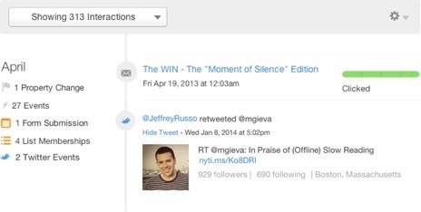
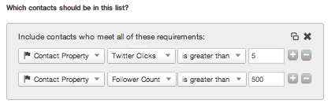
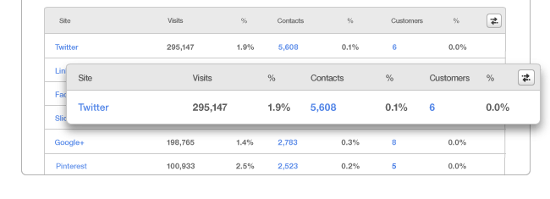
Social Media Marketing for More Leads and Customers
TOFU
Automatic Social Publishing
Social Prospecting
Social Reach
MOFU
Social Lead Intelligence
Social Segmentation
Social Monitoring
Reporting
Social Analytics
Social Reach
Social ROI

Slide 88

Empower Your Sales Team
Pass valuable lead intelligence to your sales team for faster follow-ups, better connects, and warmer leads.
360° View of Your Leads
Who are they on social media?
What companies are visiting our site?
What emails have they opened?
What pages have they viewed?
When are they on
our site?
What have they converted on?
What is their lead score?
How engaged are they?

Slide 89
Analyze Your Marketing ROI
Understand which of your marketing activities are driving the best visitors, leads, and customers to your business.
Visitors
Leads
Customers
Keyword Rankings
Page Views
Blog Visits & Readership
Competitive Analysis
Social Media Reach
Social Media Message Analytics
Highest lead generating channels for
  Landing Pages
  Email
  Blogs
  Site Pages
Contacts database size
Number of sales qualified leads
Blog subscribers
Sources ROI
Number of customers
Lifecycle summary

Slide 90
Premier Services
Premier Services gives you access to HubSpot experts who will work with you to build long-term inbound marketing success. A variety of packages are available including:
Monthly access to an Inbound Consultant
Quarterly strategy reports
Ongoing access to a named Support Representative
Ongoing access to an Inbound Consultant
Ongoing access to a Technical Consultant
“
HubSpot and Premier Services have allowed me to dream big. No idea is too small. It sounds cliché, but we pushed HubSpot to its limits and beyond and I am grateful for their their support.
”
Denise Huynh
Marketing Manager
Lostgolfballs.com
Full story: www.blog.hubspot.com/customers/online-assessment-increases-website-conversion
Notes:
www.hubspot.com/services for details by package

Slide 91
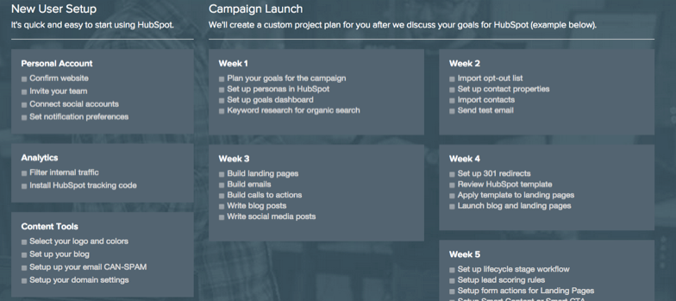
Onboarding
Technical set-up help and assurance for a first successful campaign launch
Receive technical set-up assistance
Build a campaign project plan
Work with a one-on-one implementation specialist*
Get personalized assistance launching your first campaign*
Sample onboarding plan *For Professional and Enterprise packages
Notes:
www.hubspot.com/services for details by package

