Slide 1
Sales Training: Prospects
April 2015

Slide 2
Agenda for today
About the changes to Prospects
Overview & Demo
FAQs
Resources
Questions

Slide 3
Changes to Prospects
Moving from the marketing platform to the CRM

Slide 4
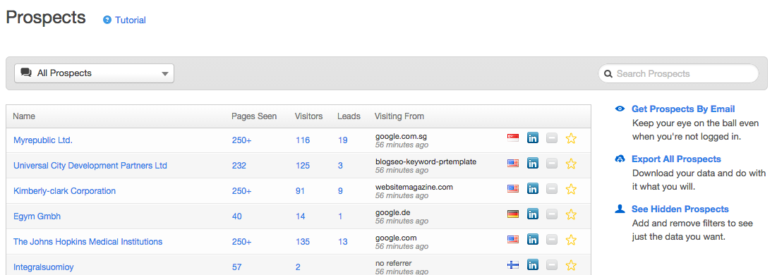
Key takeaways from today
Prospects will not be available for marketing portals created after April 15
If you want to demo Prospects to a prospect after that, turn on the CRM for them
After April 15, we’ll be back with a plan to remove Prospects for existing customers

Slide 5
Prospects in the CRM
Overview

Slide 6
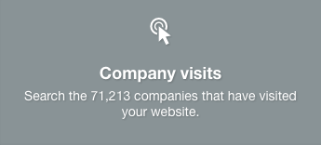
Exciting news about Prospects in the CRM
Solves for the primary user of the report
Has more data due to placement in CRM
Better data than what’s available now
More features that help sales reps prospect

Slide 7
Cool (AMAZING) new stuff in CRM Prospects
Ability to browse a database of millions of companies for easy prospecting
Filter by industry, revenue, company size, and lots more
None of our competitors offer this data FOR FREE!
MUCH better filtering options when browsing prospects that have visited your website
Can now build and save views of prospects in specific regions, or who meet other specific criteria (e.g., company size, revenue, industry)
An experience designed for a sales rep
Familiar interface for reps who have used a CRM before
Eliminates any confusion about giving reps limited access to the marketing product

Slide 8
Prospects in the CRM: Demo
Live demo by Lia Cefalu

Slide 9
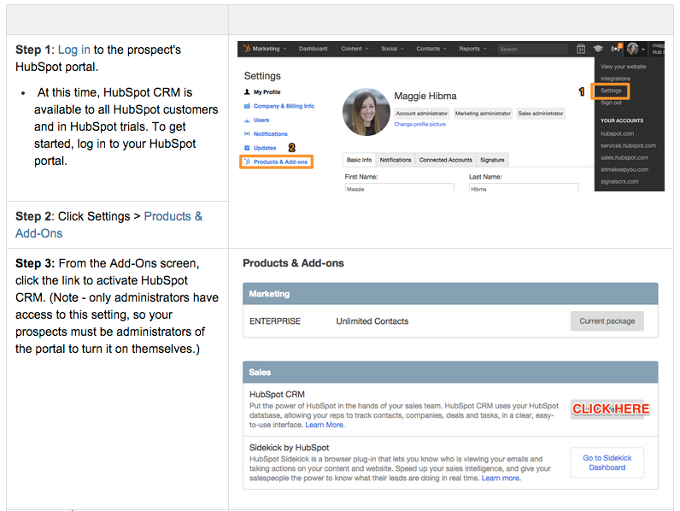
Turning on the CRM in a trial portal

Slide 10
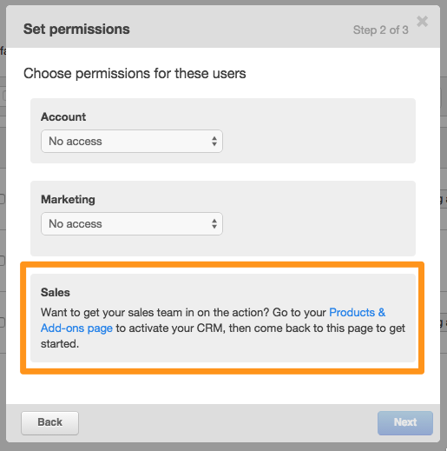
Sales Rep User Role Now Lives in CRM
To add a Sales Rep User Role, you will have to enable the CRM first. You’ll see a notification in a trial portal asking you to do that when you try to add a Sales Rep User Role.

Slide 11
But I was using the Prospects Report to...
I used to use the Prospects Report to... | You can still do that by..
Show time-to-value in a trial | Showing Prospects in the CRM
“Wow” execs on executive demo | Saved views with more specific prospecting criteria Business intelligence each company is enriched with
Show anonymous website visits | See number of visits from a company in the CRM
Bridging outbound methods to our inbound methodology | Using the HubSpot Database in the CRM to find prospects that are a good fit for your business based on what you know for existing customers
Connecting with the right people at the right time | Filtering Prospects by “Last Seen” property for given timeframe & finding them on LinkedIn
Figure out what content is working | Use Page Analytics on your content to view performance and compare to find what works best

Slide 12
Differences between old & new Prospects
Ability to export Prospects information
How to solve: Create saved views of Prospects to filter for what you’re looking for, as opposed to exporting then filtering
See the pages viewed on your site by companies*
This feature does not exist in the CRM
See which leads in your database have visited your site (# pages seen, etc)
How to solve: Create a view of contacts with filter “Time Last Session” = Today
See anonymous visitors that have visited your site (# of pages seen, etc)
How to solve: Use “Number of Visitors” field in CRM

Slide 13
FAQs about Prospects
Top 5 Questions

Slide 14
What if the trial doesn’t buy & I turned on the CRM?
Their portal will automatically convert to a free CRM portal
(the marketing features will leave, CRM features stay)
This means that even if they don’t buy HubSpot, they can still use the HubSpot Database in the CRM for prospecting, even if they use another CRM, like Salesforce.

Slide 15
Where are we getting the data in the HubSpot database?
We built a service that scans the web for this publicly available information
To be very clear, we are not sharing our customer’s data AT ALL.

Slide 16
Do I have to turn on the CRM in a trial?
Nope. Only if you want to show Prospects after April 15.

Slide 17
What about the about the Daily Prospects Email…?
This feature is in beta currently.

Slide 18
What is the plan to remove it for existing customers?
This blue info box now appears in any portal with the CRM enabled
After 4/15, we’ll get together and devise a plan for removal for existing customers
Gradual change
Heavily communicated

Slide 19
Resources for April 15
Collateral on using Prospects in the CRM

Slide 20
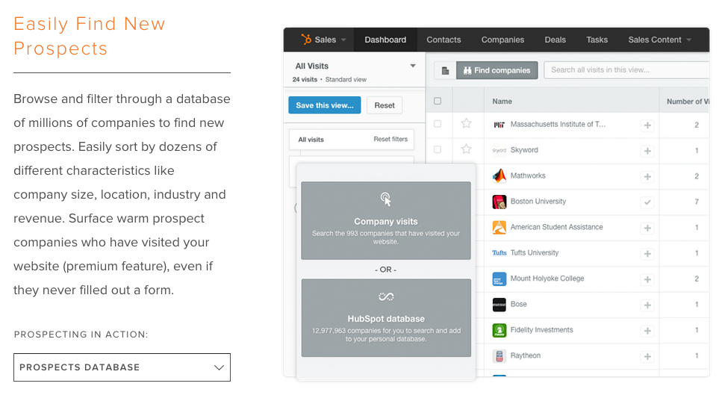
Updated CRM product page - ready now!
Link
Notes:
Updated http://www.hubspot.com/products/crm#prospecting

Slide 21
Feature by feature comparison
Features of Marketing Prospects Report | Available in Prospects in the CRM? | You can see what it looks like...
See which companies visit your website | Yes | Here
Get Prospects by email | Yes | TBD, but will be available April 15
Add and remove filters to find Prospects | Yes (Now with saved views!) | Here
See unique visitors from a company | Yes | Here
See # of total pageviews for that company | Yes | Here
Get a “First Seen” date for site visitors | Yes (and last seen!) | Here
See which campaigns brought this company to your site | Yes | Here (explanation)
See what keywords were searched to find your site | Yes | Here (explanation)

Slide 22
Feature by feature comparison
Features of Marketing Prospects Report | Available in Prospects in the CRM?
See which pages are being viewed on your site by a company | No
See which known leads in your database are visiting your site | No
See anonymous visitors visiting your site | No
Export Prospects data | No
Get a timeline view of a company’s page view activity | No

