Slide 1
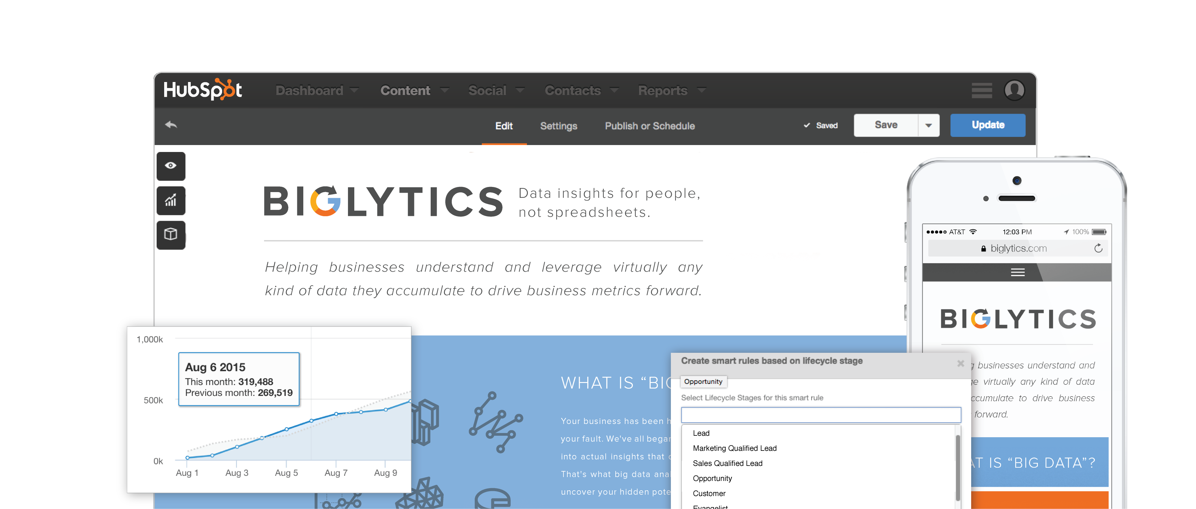
PUT YOUR WEBSITE TO WORK

Slide 2



All the benefits you’ve expected from your website, but never had.
Responsive Design, Personalization & SEO
to keep you relevant
Intuitive Tools, All in One Place
to let you focus on delivering results
Unparalleled Speed, Security & Reliability
to keep you sane

Slide 3
Intuitive Tools, All in One Place
to help you focus on delivering results

Slide 4
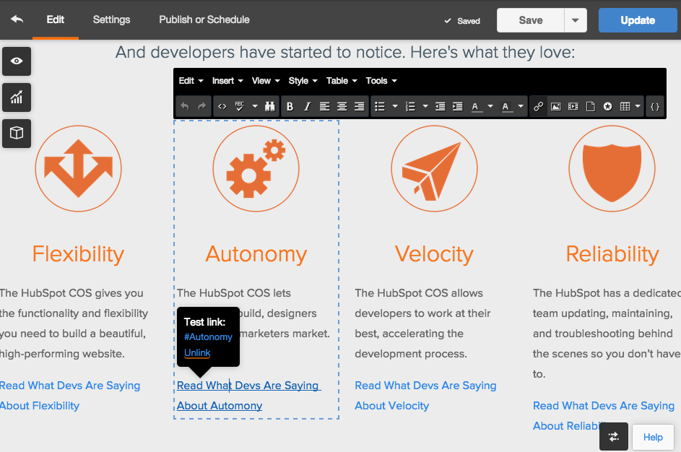
HubSpot offers inline editing and a flexible design center
INLINE EDITOR
Create pages in moments without needing code. Build your content, preview it across devices, and publish away.
TEMPLATE BUILDER
Create and easily preview new layouts and page structures using a simple drag-and-drop template builder.
STYLE EDITOR
If they’d prefer, designers can dive directly into the design center to build and instantly preview CSS stylesheets and sophisticated websites.

Slide 5
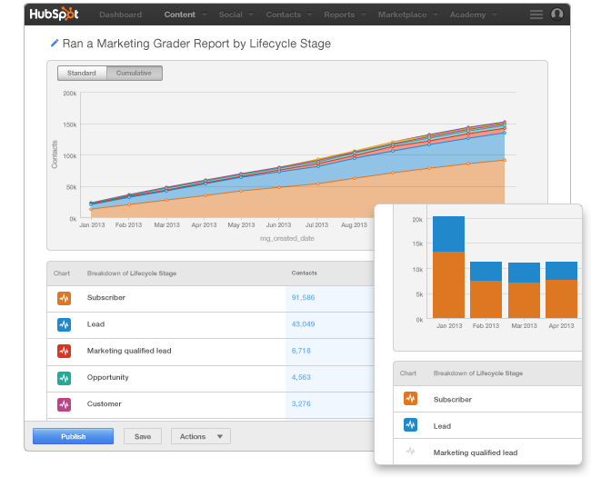
HubSpot gives you full-funnel marketing analytics – all in one place
PAGE PERFORMANCE
Find out what channels are driving people to your pages, and see a breakdown of each page’s performance. Diagnose problem pages and get clear instructions on how to improve them for SEO.
CUSTOM ANALYTICS
Event reporting at the enterprise level helps you analyze which of your website pages are influencing your leads to take the next step, whether it's clicking a button or submitting a form.

Slide 6
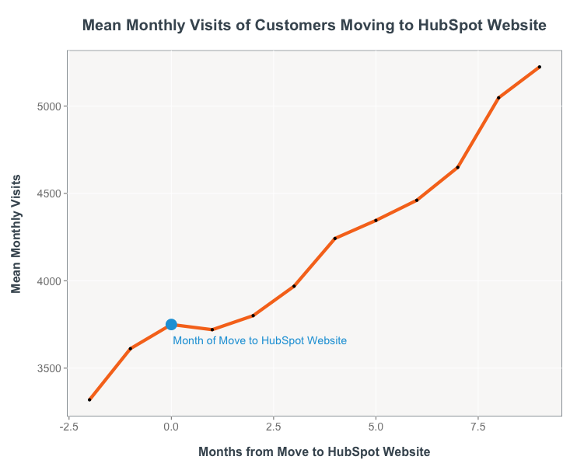
Going all-in by moving to HubSpot Website will accelerate marketing results
Customers who go all-in by moving to HubSpot Website see:
visits rise by 39% overall
visits from organic search rise by 70%
landing page submissions increase by 47%
On these metrics, HubSpot Website customers outperform their peers by 10-20%.

Slide 7
Responsive Design, Personalization & SEO
to keep you relevant

Slide 8
62%
Of adults expect a mobile-friendly website.
74%
Of consumers get frustrated when visiting a site and the content has nothing to do with their interests.
Notes:
Talking points:
73% of the global population owns a smartphone
2.08 Billion have smartphones

Slide 9
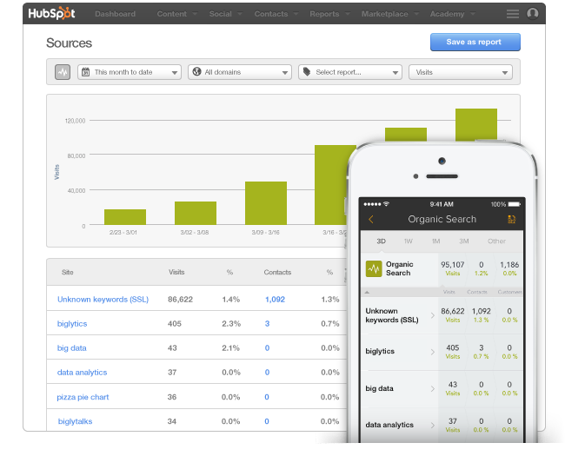
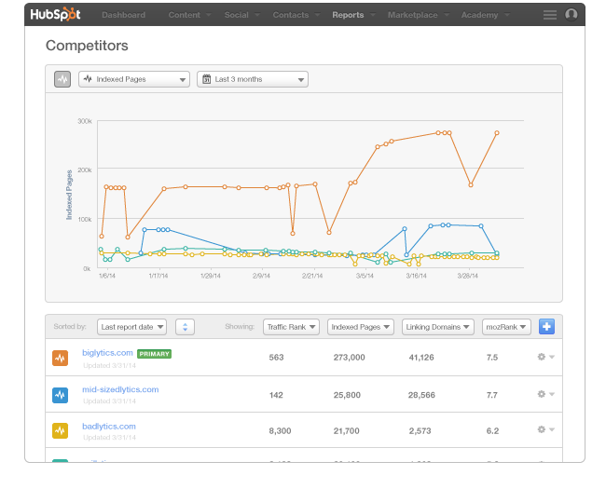
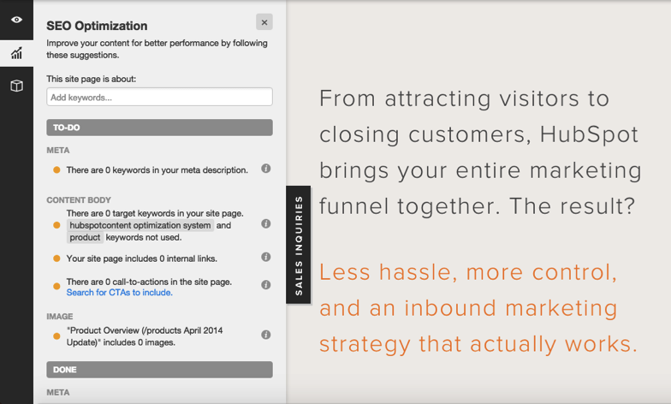
HubSpot’s SEO recommendations enable you to act quickly and smartly
NATIVE SEO
Search for SEO tools today and you’ll find a myriad of plug-ins. With HubSpot, SEO features are native and maintained so you don’t have to think about it.
AS-YOU-TYPE ADVICE
As you create blog posts, landing pages, and website pages, HubSpot will give you as-you-type advice to improve the content you’re creating so it’s optimized to rank well.
ANALYZE YOUR SEO
You’ll be able to track organic traffic growth and diagnose pages that aren’t fully optimized using built-in analytics.

Slide 10
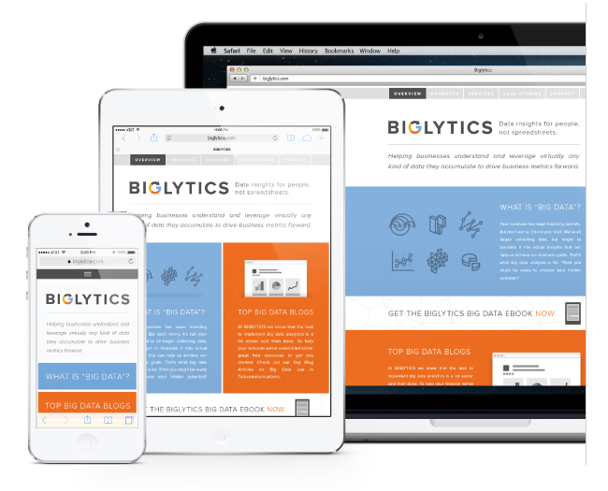
HubSpot makes your website look great on any device
Automatically optimized for Google mobile search
No code needed
Preview your content on any device, in any orientation

Slide 11
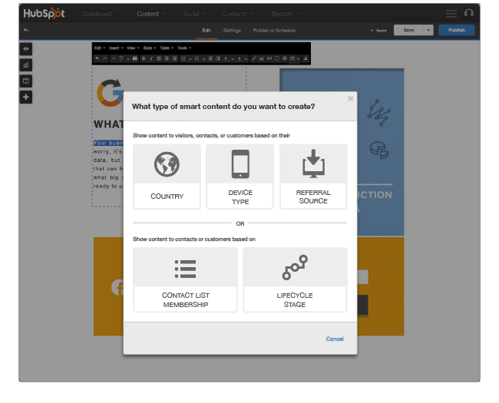
Your visitors aren’t one-size-fits-all. Your website shouldn’t be either.
PERSONALIZE BY LOCATION, SOURCE & DEVICE
Personalize your content from the moment someone sets foot on your website. Tailor your content based on location, source, or device.
PERSONALIZE BY LIFECYCLE & INDUSTRY
Personalize based on where a visitor is in their buying process. Create different homepage messages for the primary industries or personas you serve.
CONDUCT A/B TESTS
Test any element on a page. See which version of your page drives the most conversions, new leads, and customers.

Slide 12
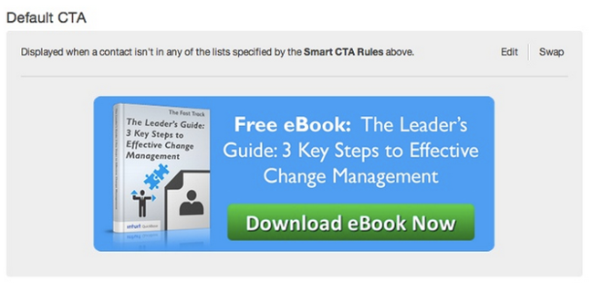
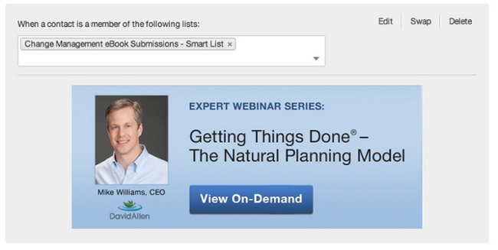
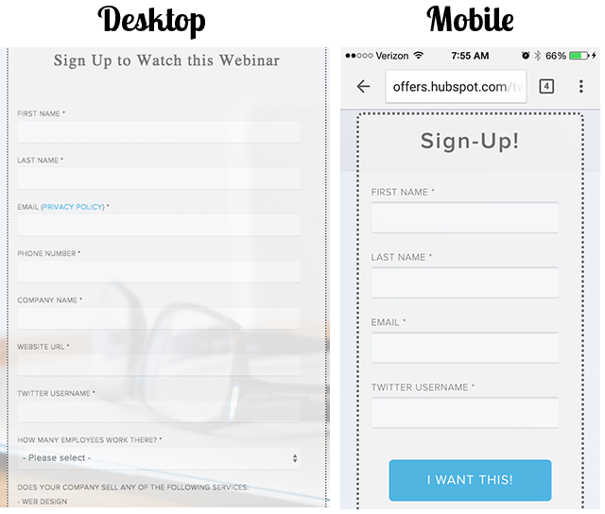
Personalization can mean adapting part of a site or displaying completely different content
Intuit Uses Adaptive CTAs to Drive Engagement
In 2014, Intuit saw clickthrough rates above 10% on personalized CTAs and click-to-submissions rates of close to 100%.
HubSpot Uses Smart Forms to Increase Lead Generation
In 2015, HubSpot began shortening the forms seen by mobile visitors. Lead generation from mobile increase by 5x over a 2-week period.

Slide 13
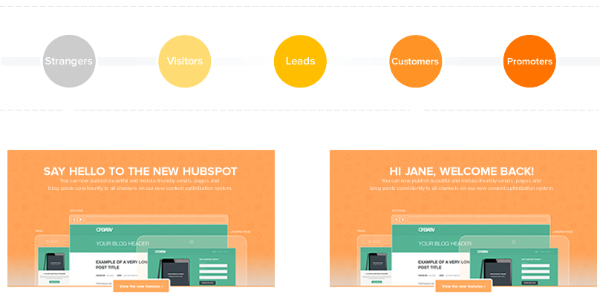

Marketers are seeing high ROI from personalization
After looking at data from more than 93,000 calls-to-action, HubSpot found that CTAs targeted to the user had a 42% higher view-to-submission rate than calls-to-action that were the same for all visitors.
A Monetate/eConsultancy study found that in-house marketers who are personalizing their web experiences see, on average, a 19% uplift in sales.

Slide 14
Unparalleled Speed, Security & Reliability
to keep you sane

Slide 15


HubSpot uses powerful security tools to defend customers against outside attacks
HubSpot has a security team on alert 24/7.
In the last year, HubSpot achieved 99.99% uptime and defended against numerous attacks, keeping customer sites safe and active.
WordPress alone does not offer strong security and faces a high volume of attacks.
In July 2015, users with the Wordfence security plugin saw a total of over 16,000 attacks / min.
Read more about security at HubSpot
Notes:
EXTRA QUESTIONS
Why have you / haven’t you moved to the COS?
How would you articulate the difference between “life before” being on the COS versus “life after”?

Slide 16
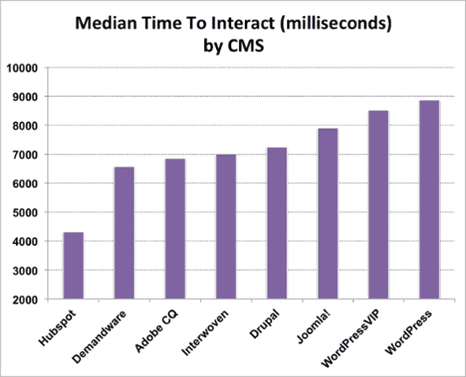
The HubSpot COS is one of the fastest content platforms.
“Despite nearly a 250% increase in weight from the 2013 CMS sample, there was no performance degradation of note... COS websites outperformed our control sample by a considerable margin.” (July 2015)
~ Brendan MacArthur, Content Marketing Manager (Yottaa). Read more here.
(2013)
“HubSpot sites absolutely rock for performance.” (July 2013)
~ Alex Pinto, Digital Marketing Manager (Yottaa). Read more here.
Notes:
EXTRA QUESTIONS
Why have you / haven’t you moved to the COS?
How would you articulate the difference between “life before” being on the COS versus “life after”?

Slide 17
Increasing the speed of your website can increase your ROI.
✜ 1 in 4 people will abandon a website if it takes longer than 4 seconds to load. ✜
✜ A one second delay in load time can result in a 7% loss in conversions and 11% fewer page views. ✜
✜ After a year long performance redesign project that sped up page loads by 5 seconds, Shopzilla realized a 25% increase in page views and a 7-12% increase in revenue. ✜
Read more on the HubSpot Design Blog.
Notes:
EXTRA QUESTIONS
Why have you / haven’t you moved to the COS?
How would you articulate the difference between “life before” being on the COS versus “life after”?

Slide 18
Why not just use WordPress instead?

Slide 19













Couldn’t I just build HubSpot Website on WordPress?
To Mimic the HubSpot COS
$0 / mo
$5.75 - $29 / mo
$5.75 - $29 / mo
$0 - $0.67/ mo
$0 - $7.40 / mo
$0 - $8.25 / mo
$0 / mo
$3.25 - $8.45 / mo
$0/ mo
To Mimic HubSpot’s Hosting, Security, & Speed
$29 - $249/ mo
$0 - $3.90/ mo
$5 - $50 / mo
$0 / mo
$49 - $199 / mo
Note: this assemblage will not recreate HubSpot’s Landing Pages, Social Inbox, Email Tool, Contacts & Lead Management, Integrated Analytics & Optimization, and Interconnected Marketing Automation. Read more at bit.ly/FrankenSpot

Slide 20










The true cost of cobbling together functionality around WordPress is large
These items will likely be more manually intensive, more difficult, and more frustrating if you choose to use WordPress instead of HubSpot:
SUPPORT
MAINTENANCE
INTEGRATION
AGGREGATION
& REPETITION
BLOAT FIXING
REDUNDANCY
OBSOLESCENCE
STYLING
EDUCATION
EVALUATION &
DECISION-MAKING
ACCOUNT
MANAGEMENT
BUG FIXING
Read more about these trade-offs at bit.ly/FrankenSpot

Slide 21
But doesn’t WordPress have a big open-source community behind it?

Slide 22
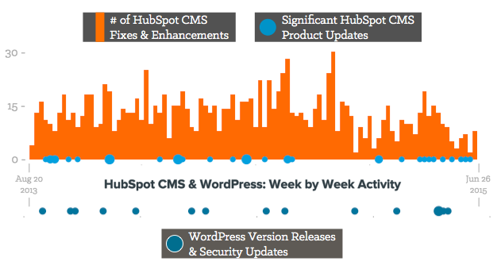
The HubSpot COS has a driven, responsive team dedicated to its development
There have been over 1600 updates, fixes, and enhancements over the last two years.
These fixes and enhancements are rolling out daily to our customers, with no need for them to manually update.
Read more about the life of the HubSpot COS: http://bit.ly/HubSpotCMSDev

Slide 23
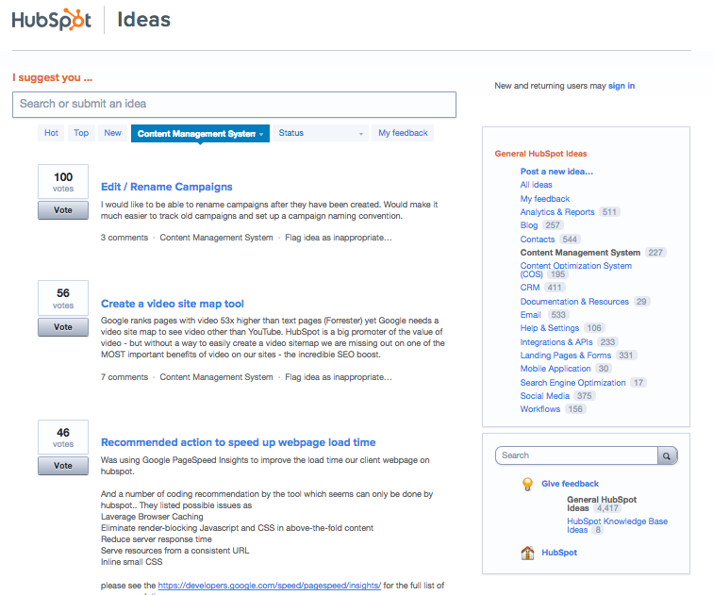
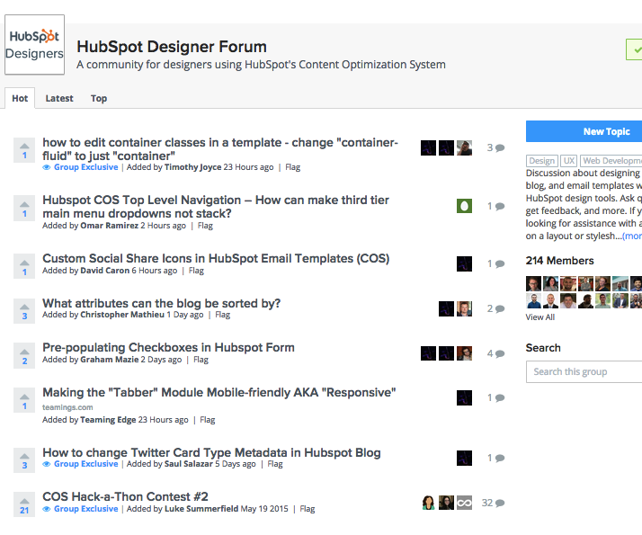
The HubSpot team actively solicits ideas and an engaged designer/developer community exists to provide support
Ideas.HubSpot.Com
Developer / Designer Community
Notes:
EXTRA QUESTIONS
Why have you / haven’t you moved to the COS?
How would you articulate the difference between “life before” being on the COS versus “life after”?

Slide 24
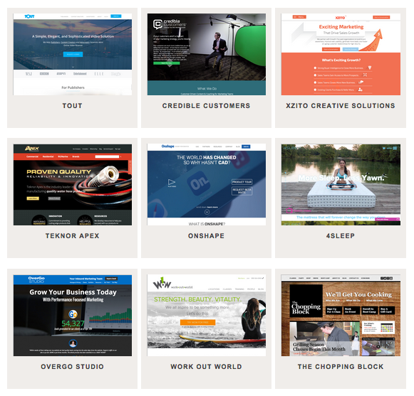
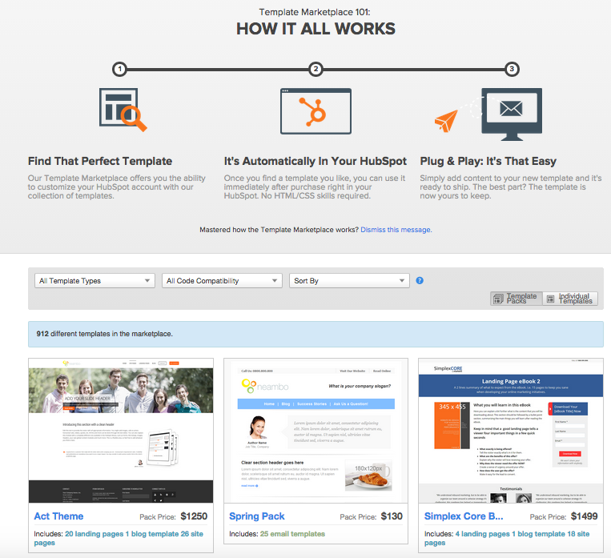
Customers are building gorgeous website examples and designers are daily offering new themes and templates
Inspire.HubSpot.Com
Template Marketplace
Notes:
EXTRA QUESTIONS
Why have you / haven’t you moved to the COS?
How would you articulate the difference between “life before” being on the COS versus “life after”?

Slide 25

HubSpot Website Platform was voted #1 in User Satisfaction from G2 Crowd
Learn More
Notes:
EXTRA QUESTIONS
Why have you / haven’t you moved to the COS?
How would you articulate the difference between “life before” being on the COS versus “life after”?

Slide 26
This seems great for marketers, but I’m a developer…

Slide 27




Developers tend to highlight four reasons they love the HubSpot COS
FLEXIBILITY
AUTONOMY
VELOCITY
RELIABILITY
The HubSpot COS gives developers the functionality and flexibility they need to build a beautiful, high-performing website.
The HubSpot COS let’s developers build, designers design, and marketers market.
The HubSpot COS allows developers to work at their best, accelerating the development process.
HubSpot has a dedicated team updating, maintaining, and troubleshooting behind the scenes so you don’t have to.
Read more about what developers love about HubSpot COS: bit.ly/WhyDevsLoveHS

Slide 28
What developers love about the COS – in their own words:
“The COS allows for any kind of web design and custom code we throw at it!.”
~ Larry Levenson, Chief Inbound Officer, Sensible Marketing
“[Sites can] be modified by the someone using the COS who lacks website design knowledge, while retaining the branding elements.”
~ Laura Amézquita, CEO, Brandca
FLEXIBILITY
“clients can fulfill minor demands without having to impose on developers who can in turn dedicate more time on major site development and more complicated site issues.”
~ Aaron Wagner, Lead Developer, Adhere Creative
“With several ready-to-use widgets, powerful customization and access to HubSpot API, I've been able to develop ready-to-deploy products very efficiently with great results.”
~ Santiago Restrepo, Head of Development, Brandca
AUTONOMY

Slide 29
What developers love about the COS – in their own words:
“With the COS you have access to a wide variety of tools that would typically only be accessible over many different platforms or services.”
~ Luke Desroches, Web Designer, Kula Partners
“They’ve got all hands on deck to help fix any problems... It’s like a Swiss Army knife that spontaneously grows more tools as you need them.”
~ Robin Earle, Designer/Developer, New Breed Marketing
VELOCITY
“Updates are invisible and don’t break your site. (Shocker!)”
~Gabe Wahhab, Owner & Web Developer, Savvy Panda
“With the HubSpot COS’ instant preview feature, developers can check for potential errors or changes they may want to make as they are working on specific sections.”
~ Aaron Wagner, Lead Developer, Adhere Creative
RELIABILITY

Slide 30
HubSpot is actively building developer-focused tools
Tools Developers Love:
In-App HubL (HubSpot Markup Language) Documentation
Style Manager
Visual Template Builder
Automatic XML Site Maps
Coming Soon:
Website Migration Engine
Greater alignment with Growth Driven Design principles

Slide 31
Try HubSpot Website Free for 14 Days

