Slide 1
How to Use This Deck
This deck has been created to enable HubSpot Agency Partners to sell the HubSpot growth stack to prospects and clients.
The growth stack is HubSpot’s marketing, sales, and CRM software. You can learn more about the growth stack here:
https://www.hubspot.com/products/growth-stack
https://www.hubspot.com/company-news/hubspot-looks-to-the-future-introduces-growth-stack-of-powerful-connected-tools-at-inbound16
Please note this deck requires the following customization:
Slide 25 – add agency services
Slides 27 and 28 – add customer case studies or testimonials
Slide 31 – add agency name
Slide 32 – add pricing
Slide 33 – add agency name and relevant HubSpot Partner tier logo
Slide 34 – add agency contact details
You should also delete this slide before sending it to a prospect or client. Changes to the design of the deck can be made within the Slide Master.
Have feedback on this sales collateral? Please share your suggestions, views and ideas here:
https://goo.gl/forms/jxsjafJpjeZobG353

Slide 2
The HubSpot
Growth Stack

Slide 3
The HubSpot Growth Stack
HubSpot
Marketing
HubSpot
Sales
HubSpot
CRM
BRING YOUR TEAM, TOOLS, AND DATA TOGETHER, ALL IN ONE PLACE.
HubSpot Marketing is everything you need to increase traffic, convert leads, and prove ROI – backed by a team that helps you grow.
SELL IN AN EFFICIENT, MODERN, HUMAN-FRIENDLY WAY.
HubSpot Sales brings useful information about the contacts and companies you interact with right to your inbox. Time saving productivity tools help you sell in an efficient, modern way.
THE-EASY-TO USE FREE CRM SYSTEM YOUR SALES TEAM WILL LOVE.
Say goodbye to manual tasks and confusing features. HubSpot CRM is a real, free CRM system that organizes every detail about your contacts and customers in a single place.

Slide 4
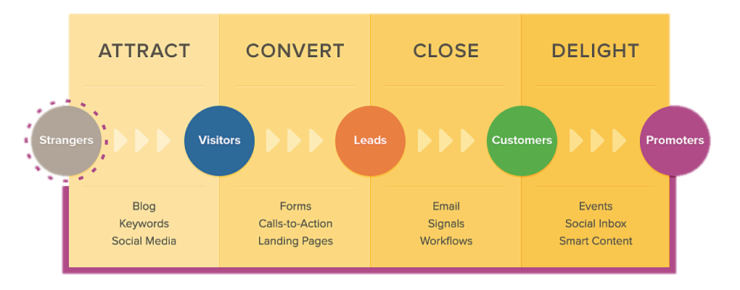
Overview
HubSpot Marketing is everything you need to increase traffic, convert leads, and prove ROI – backed by a team that helps you grow.
Bring your marketing team, tools, and data together, all in one place.

Slide 5
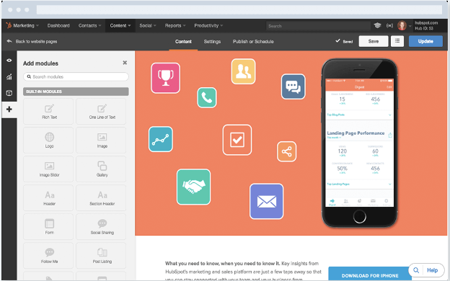
Website Builder
Build and modify your website without IT.
Build and host your entire site with HubSpot’s website platform. Drag and drop website builder. Personalize content for every visitor, and publish mobile-optimized content all from within a single interface.
A report card for every page of your website implement recommendations to boost your search engine rankings.
Page Performance

Slide 6
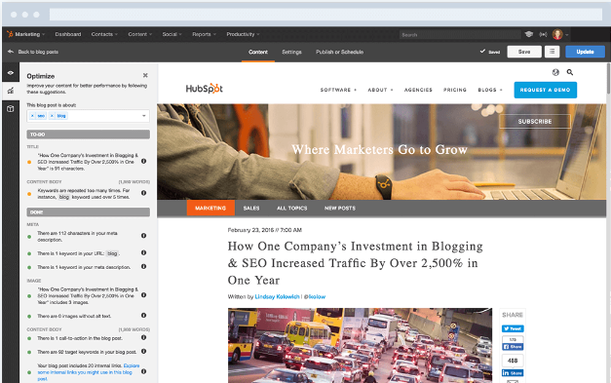
Blog
Get your content in front of the right people.
Create and optimize content with keyword recommendations and measurement data to identify the articles that make the most impact (in terms of visitors, leads & customer acquisition).
3.3X more visitors per month within one year
3.5X more leads per month within one year
79% Increase in sales revenue within one year
Companies That Blog See:

Slide 7
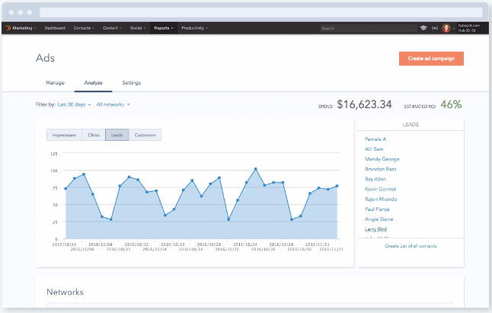
Keywords
Discover which keywords will bring the best organic traffic to your site, track your organic rankings & benchmark rankings relative to competitive sites. Get as-you-type keyword suggestions and on-page SEO advice so you can outrank your competitors.
Using Google AdWords, Facebook Ads, or LinkedIn Sponsored Updates? The Ads add-on in HubSpot shows you not only impressions and clicks, but leads, customers, and the actual ROI of your campaigns.
Ads

Slide 8
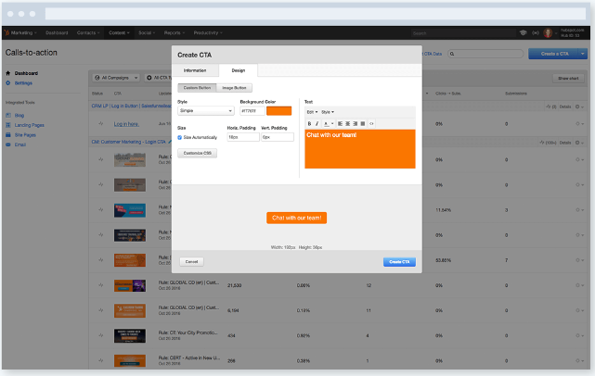
Call to Actions (CTAs)
Drive more traffic to key landing pages.
Convert your visitors into leads with professional call-to-action buttons (that drive to a landing page) that you can build and add to your site in minutes.
Swap out you CTAs within emails, blog posts, or on your website for a unique user experience based on lists, contact properties, sources, and more.
Personalization

Slide 9
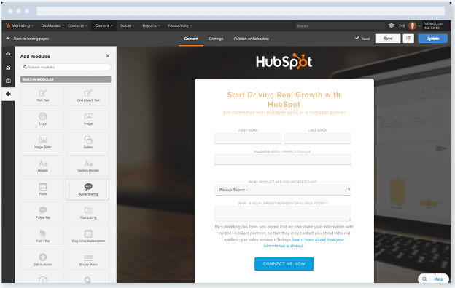
Convert more visitors into qualified leads.
Capture inbound leads through your website with landing pages that are optimized for your brand, easy to customize and track .
See real-time traffic and conversion performance, along with source data. Analyze and A/B test landing pages in real time to optimize for visits and conversions.
Landing Pages
Analyze in Real Time

Slide 10
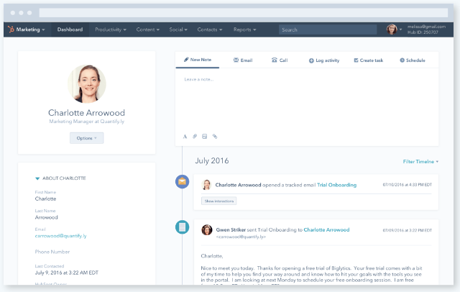
Lead Management
All your contact details, all in one place.
Organize all your contact details and interactions in one centralized, integrated database, create segmented lists, and score leads so sales can prioritize their outreach.
Get an up-to-the-minute view of your entire sales funnel on a clean, visual dashboard. Create new deals with a single click, then drag and drop them from stage to stage as they progress.
HubSpot CRM

Slide 11
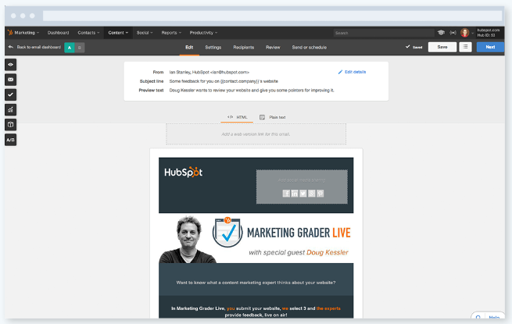
List Management & Segmentation
Zero-in on the right contacts. Target your leads by segmenting based on their contact information and how they’ve engaged with you for truly personalized marketing. Use these hyper-targeted segments to send emails, personalize website content, and power marketing automation campaigns so you can effectively nurture your leads further down the funnel.
Email Marketing
Create high-performance emails without designers
or IT. Send personalized, beautiful emails that your prospects will look forward to receiving and measure which messages are most effective. Count on unmatched deliverability and best-in-class email analytics.

Slide 12
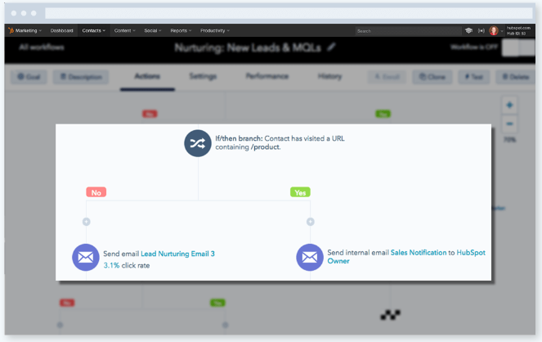
Marketing Automation
Automate your marketing beyond email.
Trigger a campaign of email messages based on any criteria you choose – examples include a form submission, a site revisit, a video view, a particular page visit. Automate responses based on important lead/customer activity and set up alerts for your sales reps as necessary.
64% of marketers say they saw the benefits of using marketing automation within the first six months of its implementation.
Nurtured leads produce, on average, a 20% increase in sales opportunities versus non-nurtured leads.

Slide 13
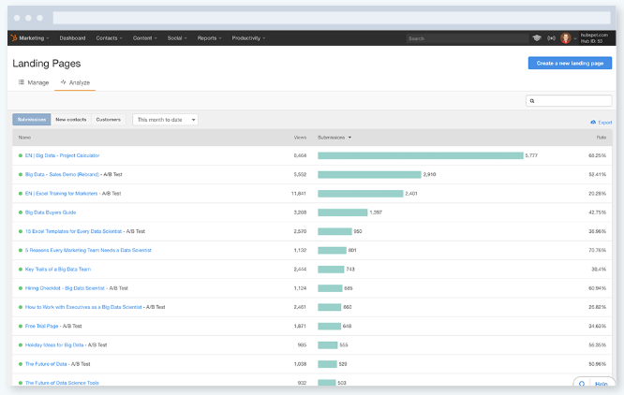
Reporting Dashboard
Track customers and report your impact on the bottom line.
Create beautiful, custom reports to export on virtually any metric from HubSpot Marketing, any record from HubSpot CRM, or data from any integrated apps you may be using via HubSpot Connect. Use closed-loop reporting to determine the ROI of your work.
Marketers that calculate ROI are 1.6X more likely to receive higher budgets.
43% of marketers say proving the ROI of their marketing activities is their top marketing challenge.

Slide 14
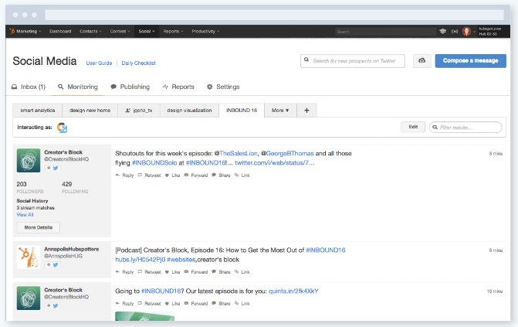
Social Inbox
Monitor social mentions and connect with people who matter.
Links social interactions to real people in your database, so you can see deep context and prioritize conversations.
See every interaction with your messages, and create custom keyword monitoring streams for everyone on your team to surface the interactions. Never miss an opportunity to engage with followers, nurture leads, or delight your customers.

Slide 15
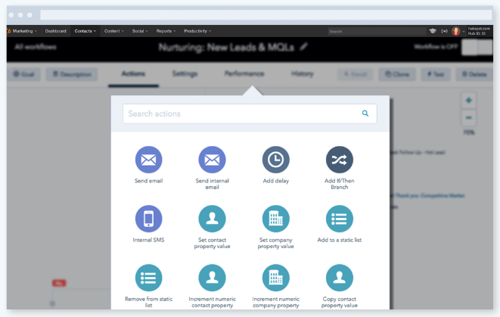
Marketing Automation
Segment your customers from your prospects to upsell, retain, and delight.
Turn customers into excited advocates and promoters by continuing to deliver value post purchase. Upsell and encourage customer referrals from your happiest customers, or help unhappy customers turn the situation around by giving them the content and help they need to experience the value they paid for.
With marketing automation, tailoring your content and campaigns to increase referrals, upsells, and loyalty is not only possible.

Slide 16
HubSpot Sales
HubSpot CRM
+
SELL IN AN EFFICIENT, MODERN, HUMAN-FRIENDLY WAY.
HubSpot Sales brings useful information about the contacts and companies you interact with right to your inbox. Time saving productivity tools help you sell in an efficient, modern way.
THE-EASY-TO USE CRM SYSTEM YOUR SALES TEAM WILL LOVE.
AND IT’S FREE. FOREVER.
Say goodbye to manual tasks and confusing features. HubSpot CRM is a real, free CRM system that organizes every detail about your contacts and customers in a single place.

Slide 17
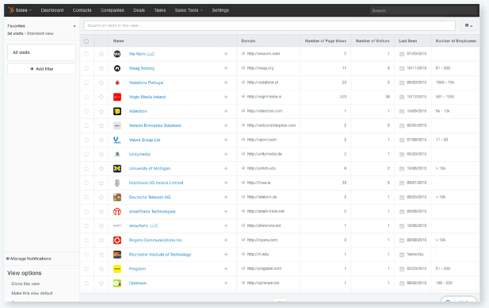
Prospects
Identify engaged prospects and focus on closing the warmest leads.
Prevent prospects from slipping through the cracks, without the busywork. Send a series of timed emails to your prospect so you never lose touch. Choose from a list of messages, and enroll a contact right from your inbox.
Use personalization tokens to tailor the emails in your sequence with contact and company details from HubSpot CRM or Salesforce. Then add specific details to each message to connect with your prospects like only a human can.
63% of prospects are “somewhat” or “not at all” knowledgeable about a company before a sales rep makes the first contact.
43% of salespeople struggle most with prospecting.

Slide 18
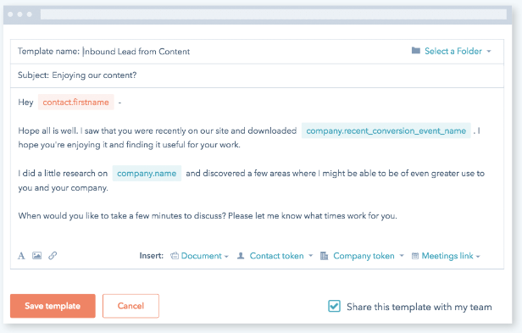
Templates
Use data to identify the best-performing Sequences.
Personalize messages extremely quickly so you see what is performing the best. Close more deals by sharing your best email templates with your entire team.
Email Tracking
Use notifications to follow up seconds after a lead opens an email, clicks a link, or downloads an important document such as a proposal.
A built-in activity stream automatically logs each lead’s history inside your browser or HubSpot Sales. Open, click, and reply data helps you hone in on which email templates and sequences are most effective, so you can optimize your emails to get the best results.

Slide 19
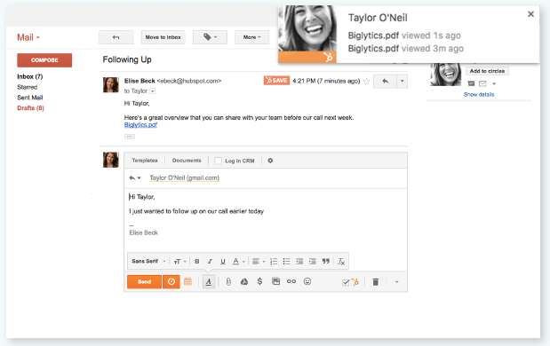
Document Tracking
Know what content closes deals.
Build a library of helpful sales content for your entire team, share documents right from your Gmail or Outlook inbox, and see which content closes deals.
When a lead clicks an email link to open your document, or shares it with a colleague, we’ll notify you instantly on your desktop. Get aggregate data about how your sales content is helping to move your sales process forward.

Slide 20
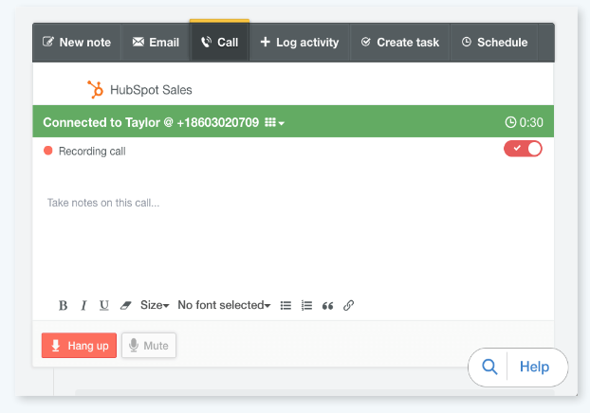
Call Tracking
Spend less time dialing and more time selling.
Use data from your HubSpot CRM to prioritize your best calls, and set up a daily calling queue. Just one click connects you to a prospect through Voice Over IP or your desk phone.

Slide 21
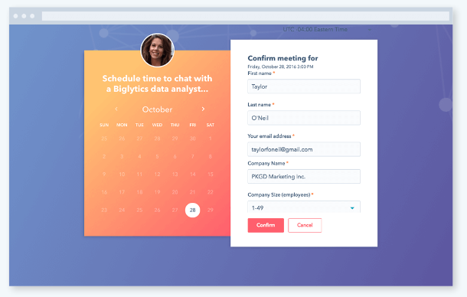
Meetings
Put the power to book meetings in the hands of your prospects. Meetings sync to your Google or Office 365 calendar, so your schedule is always up-to-date. As prospects book meetings, automatically create new records or log the activity in your CRM.

Slide 22
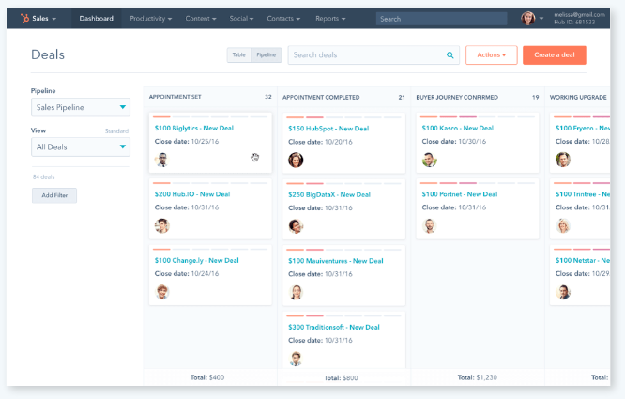
HubSpot CRM
Manage your pipeline and close more deals.
Get an up-to-the-minute view of your entire sales funnel on a clean, visual dashboard. Create new deals with a single click, then drag and drop them from stage to stage as they progress.
You can sort deals won and lost, appointments scheduled, and contracts sent over any time period. Plus, track performance against quotas you set.
Sort deals by name, owner, amount, or stage with custom filters for actionable intel in a fraction of the time.

Slide 23
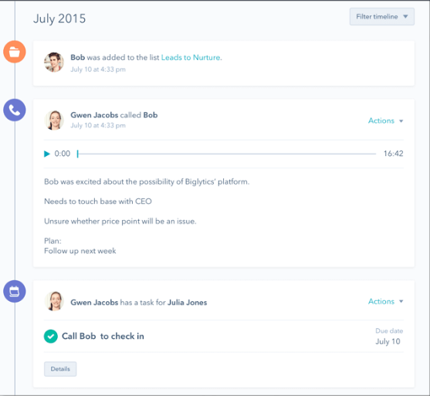
HubSpot CRM
See everything about a lead in one place.
Go way beyond names and job titles. Every interaction with a lead is stored in a tidy timeline, including calls, emails, meetings, and notes.
You’ll never need to dig through a messy inbox or spreadsheet to figure out where a relationship left off.
Sync up with HubSpot Marketing, and you’ll know which content your lead has consumed so you can personalize your approach.
40% of salespeople say getting a response from prospects is getting harder.
29% of salespeople are spending an hour or more on data entry each and every day.

Slide 24
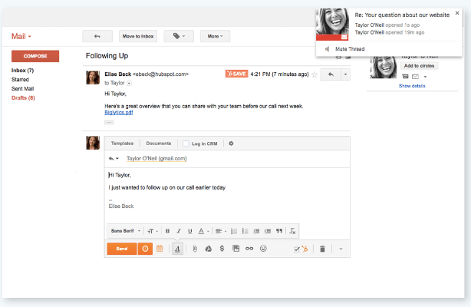
HubSpot CRM
Log sales activity automatically.
HubSpot CRM tracks customer interactions automatically – whether they’re in an email, across social media, or on a call.
HubSpot CRM works seamlessly with HubSpot Sales, so you can log sales activity automatically. HubSpot Sales syncs with G Suite and Office 365 so you can track customer interactions automatically - whether they’re in an email, across social media, or on a call. s for actionable intel in a fraction of the time.

Slide 25
[YOUR AGENCY NAME]
Agency Services
Inbound Marketing [summary of their services] | Content Marketing [summary of their services] | Website Design [summary of their services]
Sales Enablement [summary of their services] | CRM Implementation [summary of their services] | Sales & Marketing Alignment [summary of their services]

Slide 26
What Others Are Saying About HubSpot
#1 in Marketing Automation (Summer 2016 Report) #1 Web Content Management Software (2017) | Top Marketing Automation Platform (2016) | #1 in Marketing Automation (October 2016) GetApp #1 in Content Marketing (October 2016)
More people use HubSpot than any other marketing platform.

Slide 27
What Others Are Saying About HubSpot Marketing
[“Quote to be added here. Quote to be added here. Quote to be added here. Quote to be added here. Quote to be added here. Quote to be added here.”]
[XYZ% Increase in website traffic] | [XYZ% Increase in leads] | [XYZ% Increase in sales/revenue]
[Client’s name, Client’s job title Client’s company]

Slide 28
What Others Are Saying About HubSpot Sales
[“Quote to be added here. Quote to be added here. Quote to be added here. Quote to be added here. Quote to be added here. Quote to be added here.”]
[XYZ% Rep’s time saved per day] | [XYZ years Highest revenue in XYZ years] | [XYZ% Increase in sales/revenue]
[Client’s name, Client’s job title Client’s company]

Slide 29
The All-in-One Marketing Software for Your Entire Team
BLOGGING Publish relevant, engaging, conversion-optimized content with tools that speed up creation, keep formatting consistent, and make it easy to optimize for search. | LANDING PAGES Launch landing pages that look perfect across devices, add forms optimized for completion in one click, and automatically change content based on who’s viewing your page. | EMAIL Create stunning email templates, automatically personalize subject lines and content for each recipient, and run A/B tests to improve open rates and click-throughs. | MARKETING AUTOMATION Let your leads find their own path to purchase to close more deals. With marketing automation, you can use each lead’s behavior to tailor emails, content, offers, and outreach at scale.
CRM Access each contact’s information and see every interaction you’ve already had. Use this data to create hyper-targeted campaigns that close more deals. | ANALYTICS Gain insight into your entire funnel to see which marketing assets are working the hardest, and to show how marketing impacts the bottom line. | WEBSITE Drag and drop your way to a responsive, SEO-friendly, and fully integrated website. Save your best designs as templates to launch pages even faster. | SOCIAL MEDIA Monitor brand mentions and relevant conversations, track engagements automatically, and schedule your socials posts to be published when the right people will see them.
SEO Find high-traffic keywords, then optimize your blog posts, landing pages, and website with as-you-type SEO suggestions, and measure your impact with integrated tracking. | CALLS-TO-ACTION Design CTAs visitors can’t help but click, know who clicks which CTAs, and measure performance to optimize click-through rates over time. | ADS Track the ROI of your Facebook, AdWords, and LinkedIn advertising with precision and accuracy, and stop struggling to justify your paid ad spend. | SALESFORCE INTEGRATION Bi-directional sync with Salesforce means a record of every email open, CTA click, and form submission is at your fingertips. Use this data to score leads and create segmented lists.

Slide 30
The All-in-One Sales Platform Your Team Will Actually Use
EMAIL SEQUENCES Put prospecting on autopilot to keep them from slipping through the cracks and to free up more time to close warm leads. | EMAIL TEMPLATES Turn your most effective and repetitive sales emails into templates you can access inside your inbox and share with your team. | EMAIL TRACKING Know the second a lead opens an email, clicks a link, or downloads an attachment – then send a perfectly timed follow-up.
EMAIL SCHEDULING Schedule emails to send at times your leads will actually read them. | PROSPECTS Know which companies are visiting your website and which pages they spend time on. | DOCUMENTS Optimize your documents and personalize your pitch by seeing who views each document and which pages they spend time on.
MEETINGS Share a link that gives leads the power to choose a time that works for everyone. Works with Google Calendar, Outlook Calendar, and HubSpot CRM. | PIPELINE MANAGEMENT Deal boards to manage pipeline, as well as sort deals won and lost, appointments scheduled, and contracts sent. | CALLING Queue up a list of sales calls, make them from inside your browser, log calls to your CRM automatically, and record calls with a single click.

Slide 31
Results
[Agency name] and HubSpot is where all of your marketing and sales comes together.
Here’s how [agency name] and HubSpot will help your team grow traffic, convert leads, increase sales and track your entire funnel in one place.
Build and modify your website without IT
Convert more visitors into qualified leads
Turn leads into customers with less effort
Track customers and report your impact on the bottom line
Increase productivity of sales by automating manual tasks
Manage sales pipeline in a CRM that sales reps actually want to use
The ROI Companies See From HubSpot
With inbound marketing and HubSpot organisations increase lead generation, reduce costs, and grow new markets. Based on data from HubSpot, companies can expect the following results within one year:
3.3X increase in website visitors
3.5X increase in leads
2X increase in new business close rate
79% of respondents saw an increase in sales revenue

Slide 32
[YOUR AGENCY NAME]
Pricing
[Services to be added] [Services to be added] [Services to be added] [Services to be added] [Services to be added] [Services to be added] [Services to be added] [Services to be added]
Total cost | [Total cost to be added]

Slide 33
[AGENCY NAME] & HUBSPOT
Use relevant HubSpot Partner tier logo:
https://www.hubspot.com/partners/badges

Slide 34
[YOUR AGENCY NAME]
Get in Touch
[Agency employee’s name]
[Agency employee’s job]
[Company Name]
[Email address]
[Agency employee’s telephone number]
[Agency employee’s Twitter handle]

