Slide 1
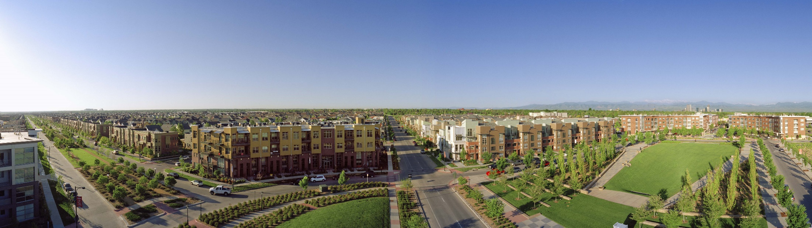
Annual Members Meeting
November 12, 2014

Slide 2
AGENDA
Introductions
Governance
Financials
Draft Budget
Delegate Election

Slide 3
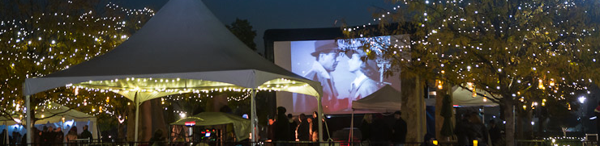
MCA Mission & HISTORY

Slide 4
Mission Statement
The Stapleton MCA is a 501(c) 4 non-profit community organization whose mission it is to create and sustain a “sense of community” within Stapleton through investing in current community assets, efficiently operating community facilities and providing comprehensive community programming.

Slide 5
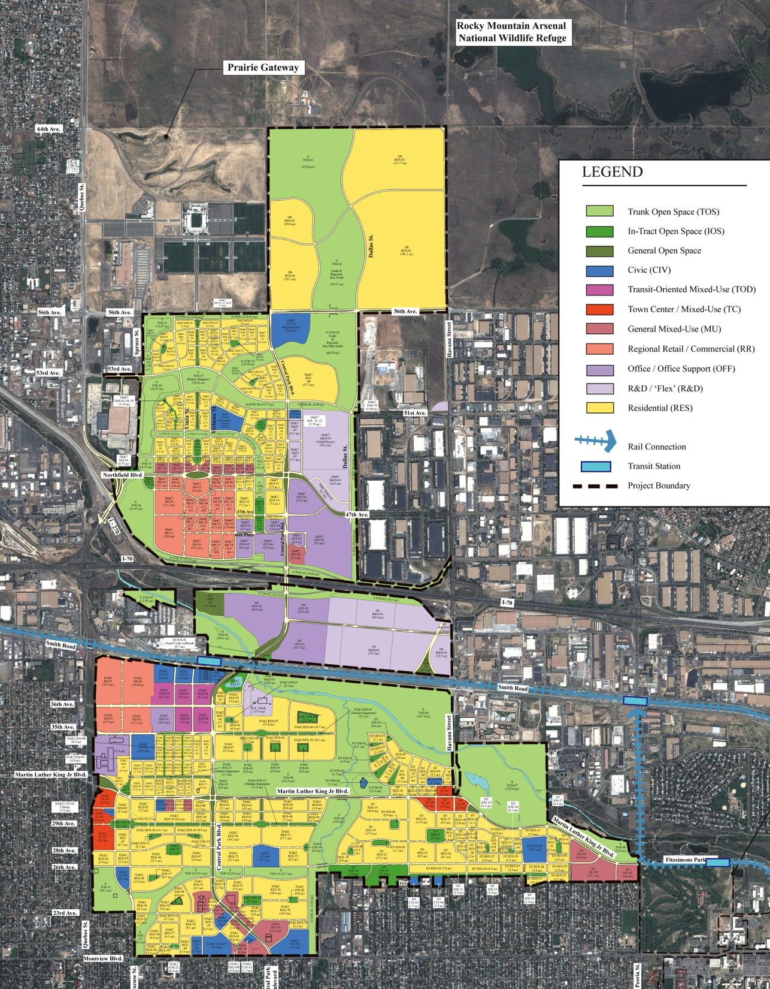

Slide 6
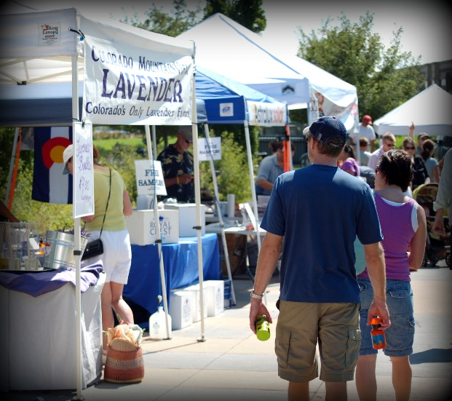
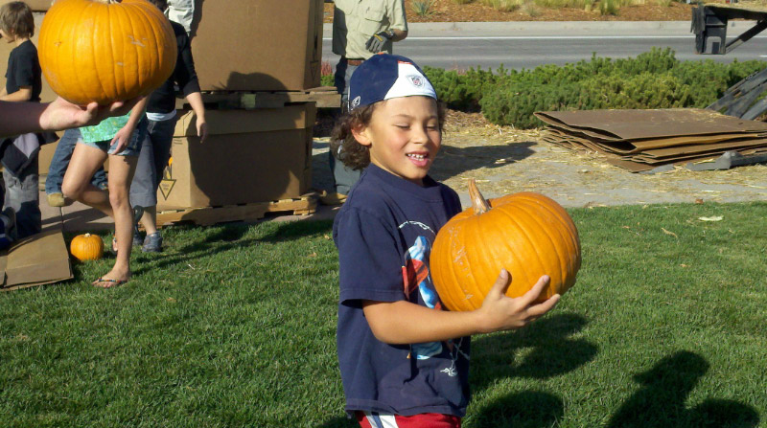
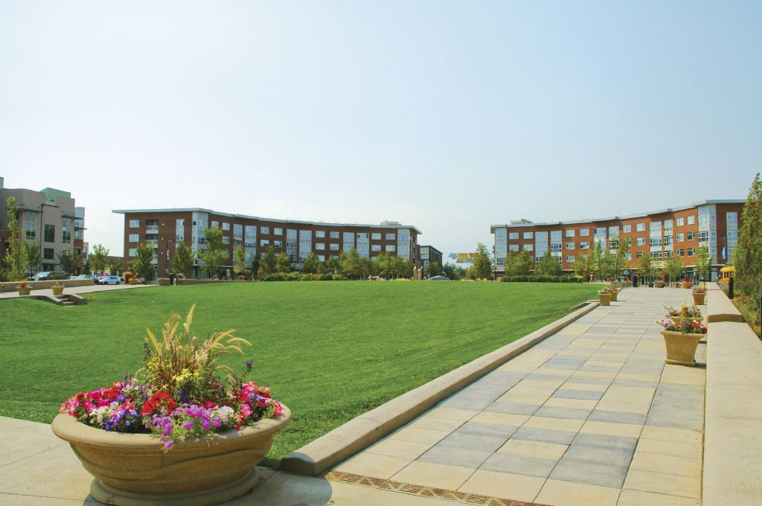
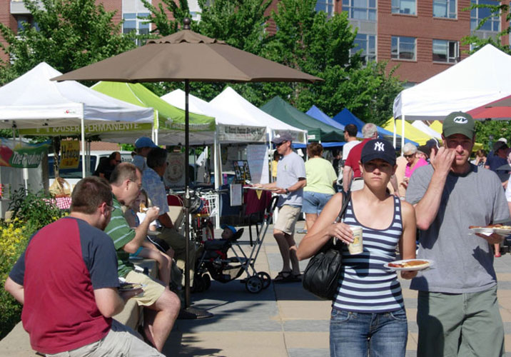
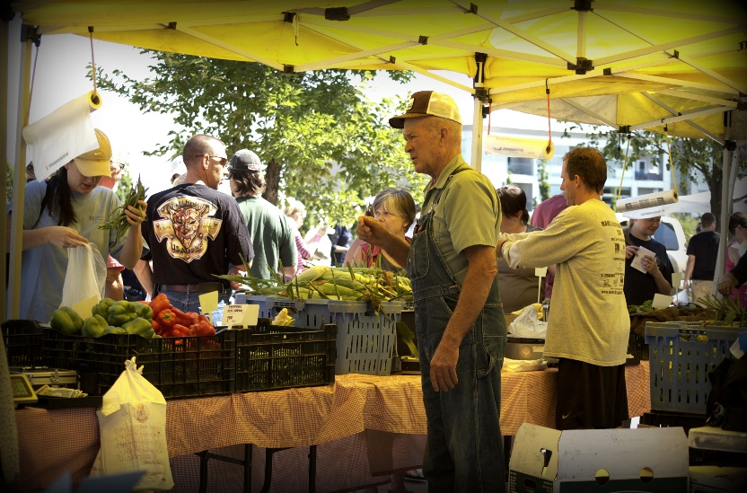
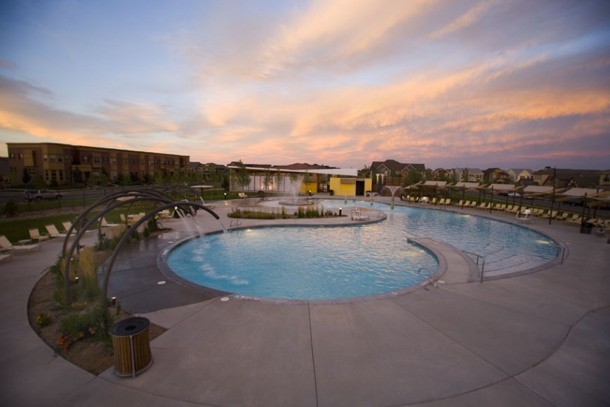
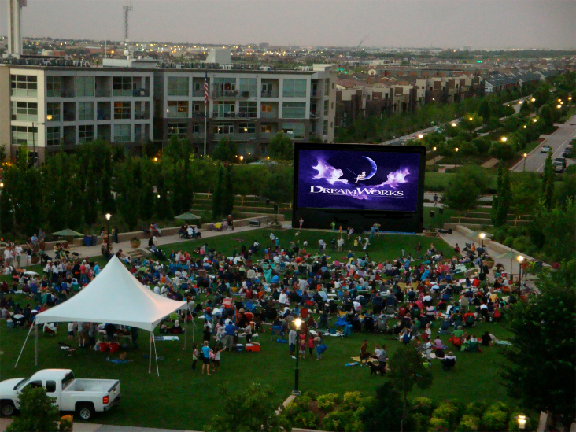
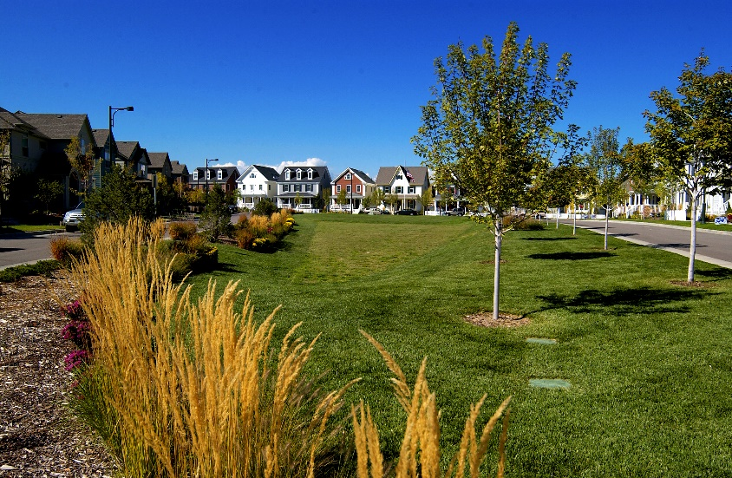
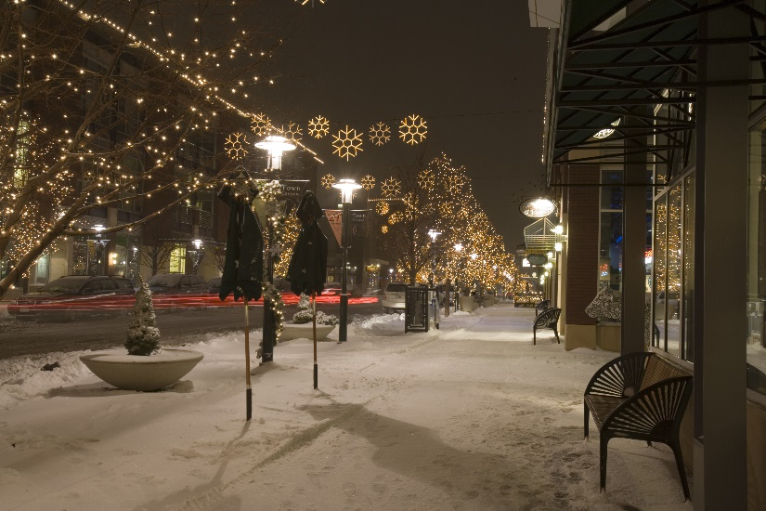
What we do…
Parks
Pools
Programming
Creating Community
Adding Value

Slide 7
Zillow Home Value Index
 | Stapleton | Denver
Average Home Price | $467,500 | $279,800
One Year Change | +13.6% | +11%
One Year Forecast | +4.2% | +3.8%
Market Health | 9.9 | 9.3

Slide 8
How we do it…
Executive
Board (5)
MCA
Staff (9)
Community
Delegates (8)

Slide 9
Revenue History

Slide 10
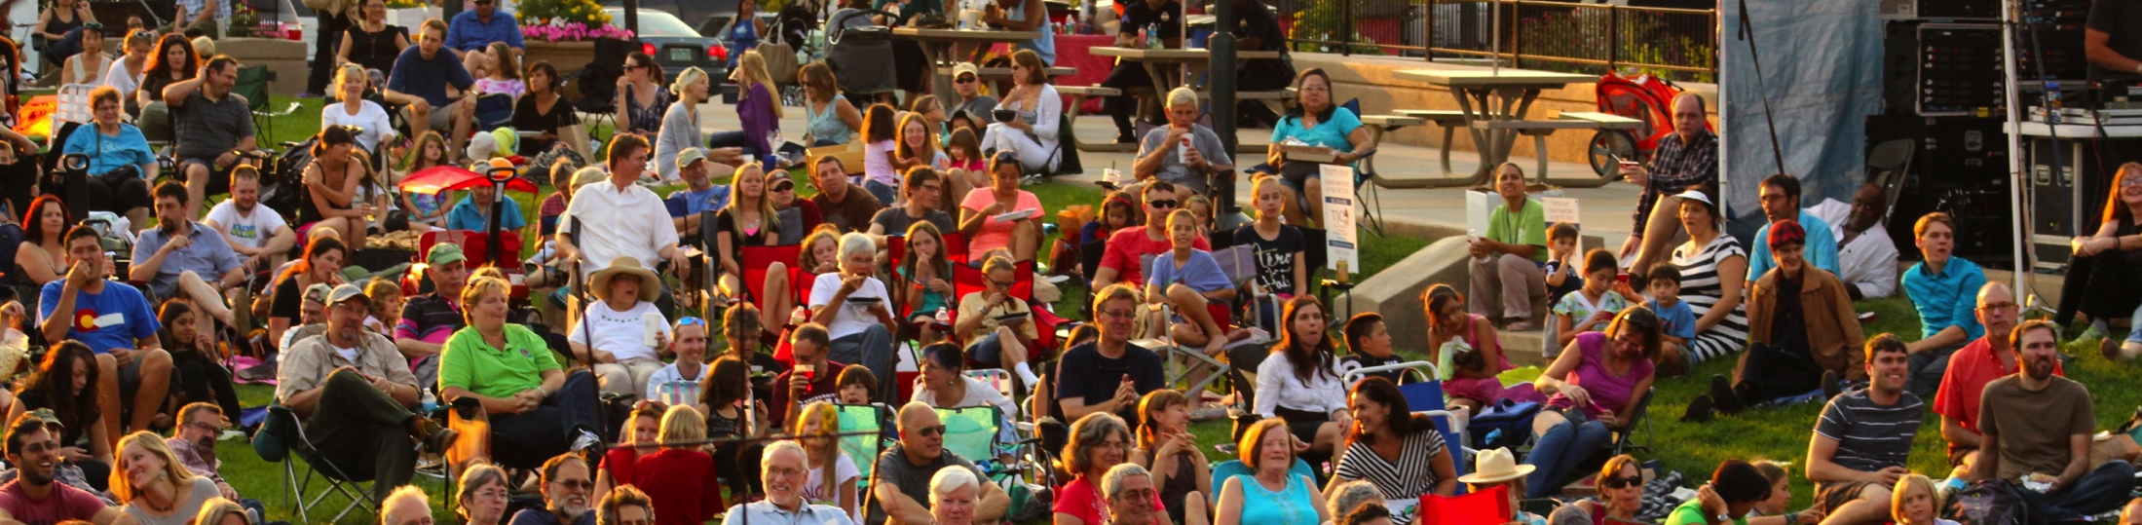
2014 results

Slide 11
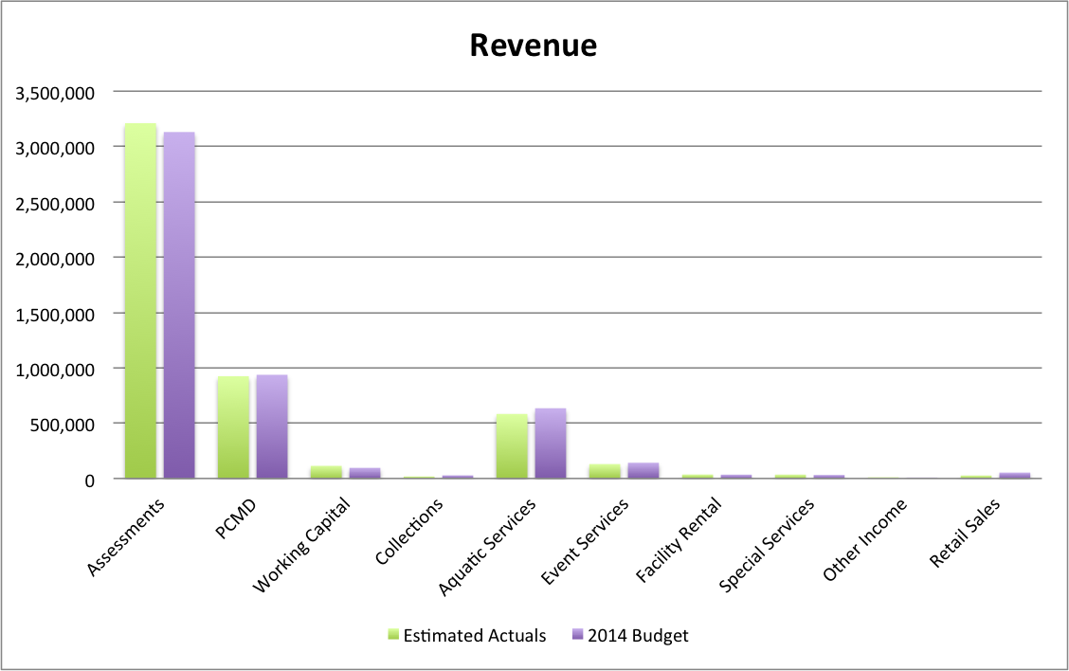

Slide 12
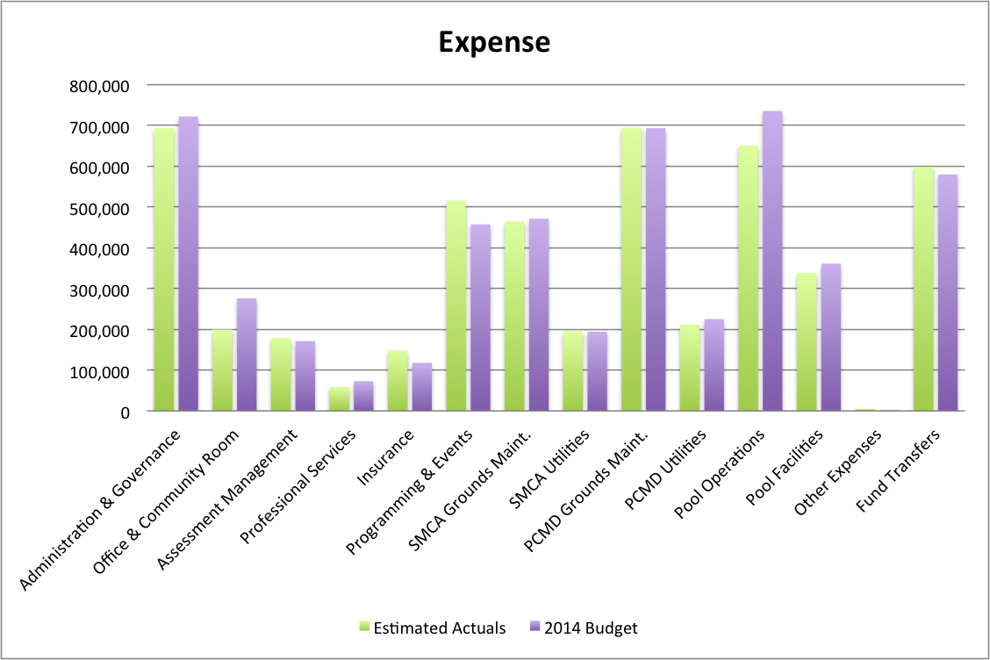

Slide 13
2014 Year To Date
JAN-SEP RESULTS
TOTAL REVENUE = 100%
TOTAL EXPENSE = UNDER 3%
NET YTD INCOME = OVER 15%
NET AQUATIC EXPENSE = UNDER 10%
NET EVENT EXPENSE = OVER 22%
UTILITY SAVININGS = UNDER 8%
SEPTEMBER 2014 YOY MCA GROWTH = 28%

Slide 14
Estimated Year End Activities
Jan – Dec 2014 | Est. Actual Millions | Budget Millions | $ | %
Income | 5.08 | 5.08 | .01 | 0%
Expense | 4.95 | 5.08 | .16 | -3%
Net Activity | .13 | 0 | .13

Slide 15
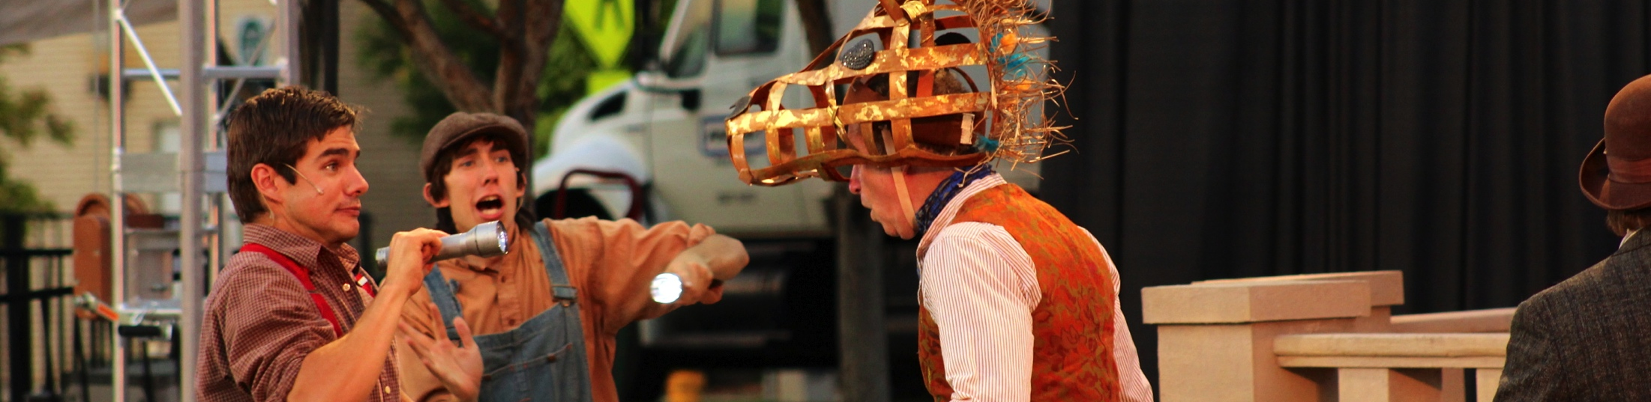
2015 OUTLOOK

Slide 16
Stapleton by the Numbers
Estimated Population = 16,750 (+1,500)
Number of Households = 5,500 (+600)
Number of Apartments = 1,247 (+460)
Number of Commercial Businesses = 100 (+10)
Aquatic Facilities = 6
Community Parks = 45 acres
Parkway Maintained = 5 Miles / 14 acres
ROW & Open Space = 65 acres
Alley Miles = 42
Mosquitos Counted = 12,397

Slide 17

Core Funding
2015 vs. 2014

Slide 18
Core Spending
2015 vs. 2014

Slide 19
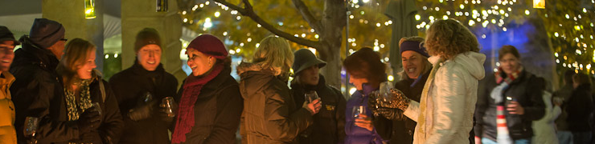
MCA Management

Slide 20

Master Community Association
Jenifer Graham
Administration
& HR
Diane Deeter
Community Programs
Paula Deorio
Aquatic Programs
Keven Burnett
Executive Director
Gretchen
Membership /
AP Tech
Facilities
Communications
& Event Coordinators
Aquatics
Training &
Programs Coord.
Part-time
POOLS
(John Baake)
Parks, ROW &
Open Space
(CTM)
Front Desk
Summer Event
Staff
Summer Aquatic
Staff
(120 Days)
Buildings, Fences & Structures
Seasonal FD/Admin Support
Seasonal Pool Managers
(6 Mo)
Event Committees & Volunteers
2015 Staffing

Slide 21
2015 Revenue Assumptions
Residential & Commercial Assessments will remain level
Stapleton will continue to see 35-45 new sales per month
New Resident Cards will remain $20 annually
Resident cards can be renewed online for $10
Non-resident fees will remain$8. All Non-Residents fees on weekends and holidays will remain $10
Unlimited Guest cards will remain $80 each (4 max)
Most swim program fees will remain the same

Slide 22
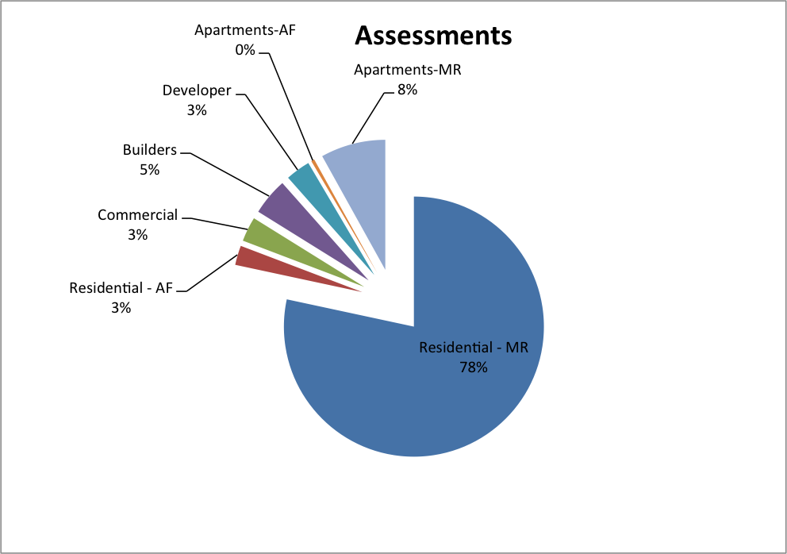

Slide 23
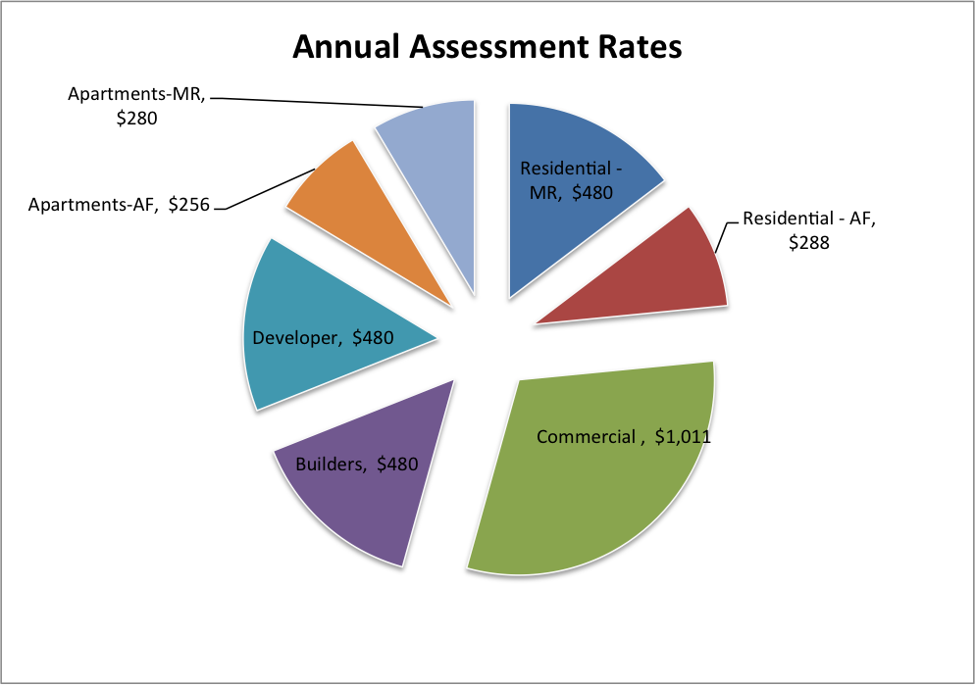

Slide 24
Expenditure Assumpions
Maintaining 40+ Community Parks
Operating 6 Pools – Memorial to Labor Day
Relocating MCA & South Community Room to 7350 E. 29th Ave (doubling our space)
Expanding Community Programming up to Conservatory Green
Continued long-range Community Facility Planning - North
Continue to Repair, Replace & Improvement of Greens, Pools, Parks, Parkways & Alleys.

Slide 25
AQUATICS & RECREATION
Enhancing everyday experiences through high quality community pools & facilities
Safety  Operating hours ● Lessons ● Programs ● Concessions ● Rentals

Slide 28
Pools & Aquatics
$610K
$1.09M
COST = $489K

Slide 29
COMMUNITY PROGRAMMING
Creating vibrancy through Cultural Programming
Music, Movies, Markets & More
Comprehensive  Diverse  Cultural  Unique  Organic

Slide 32
Community Programming
$142K
$519K
COST = $377K

Slide 33
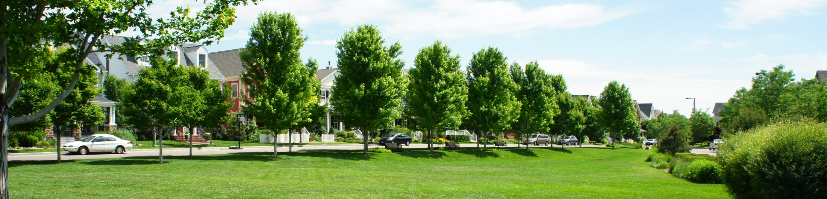
Parks & FACILITIES
Constant attention to detail throughout our community.
Trees  Trails  Structures  Alleys  Amenities

Slide 35
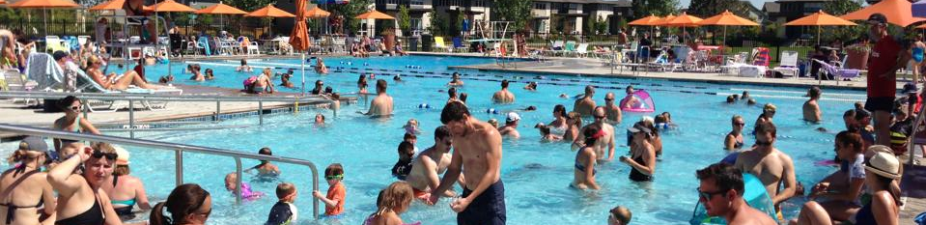
2015 draft budget

Slide 36
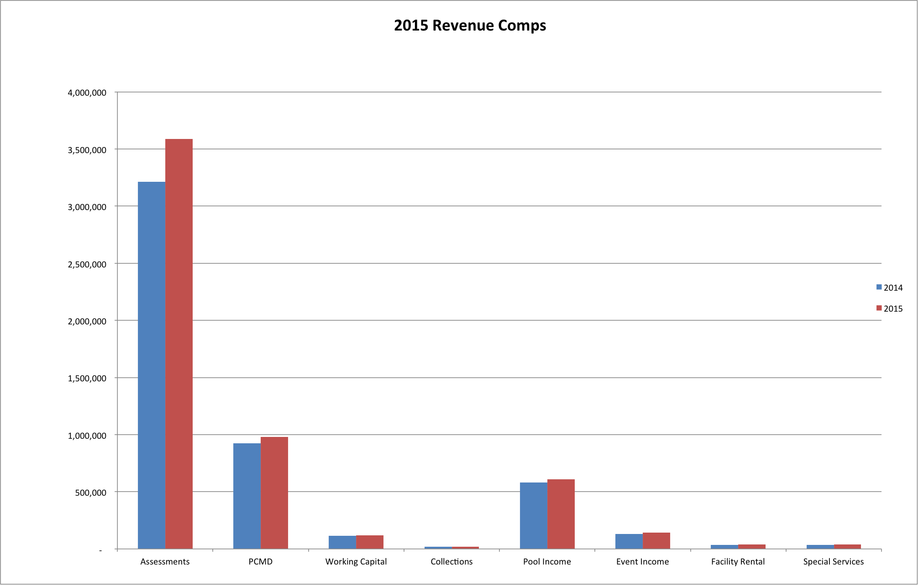
Revenues Comps

Slide 37
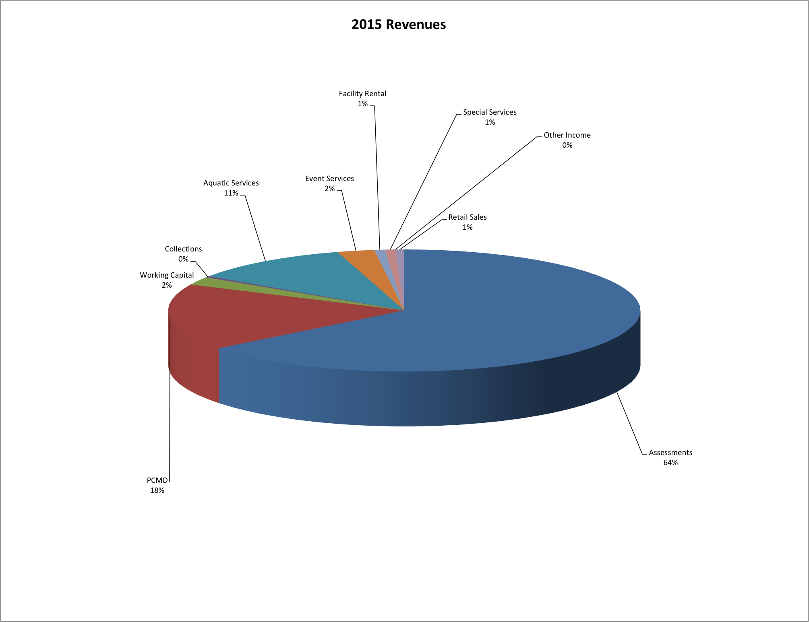
Revenue Pie

Slide 38
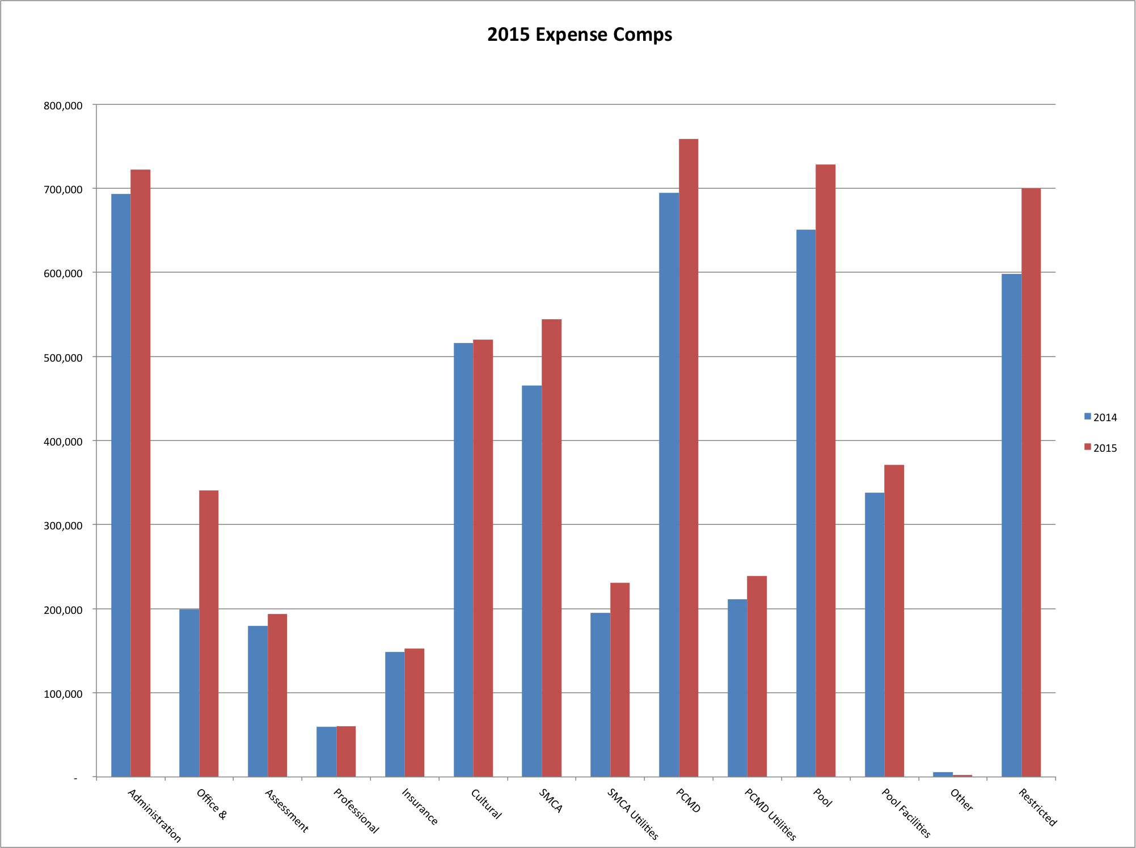
Expense Comps

Slide 39
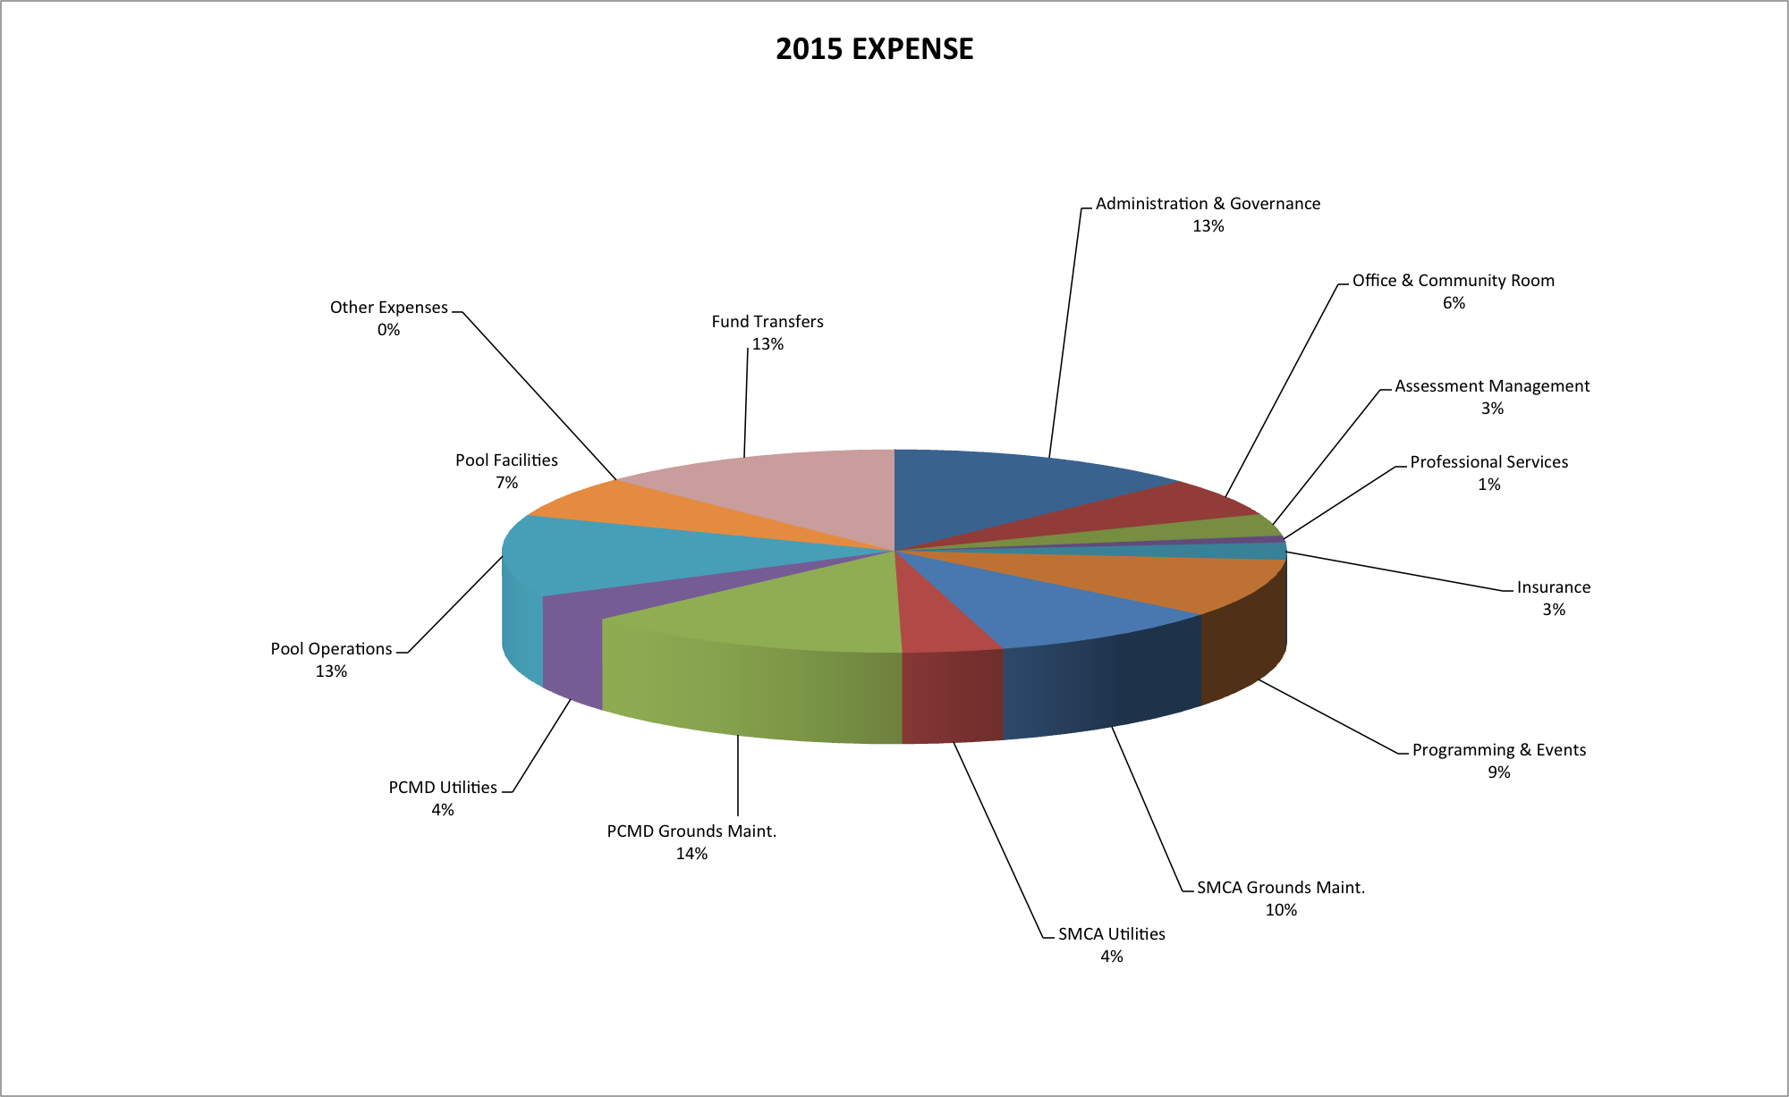
Expense Pie

Slide 40
Proposed Budget
 | 2014 | 2015 | $ | %
Estimated Revenue | 5,089,340 | 5,575,380 | 486,039 | 10%
Estimated Expenditures | 4,955,114 | 5,564,454 | 609,340 | 12%
% Future Funding | 12% | 13%

Slide 41
Next Steps…
Nov 19 – Annual Executive Board & Delegate Meeting
  Noon - 2 pm Stapleton Community Room (2823 Roslyn St)
  2014 Delegates must approve 2015 Budget
  Member input: delegates@stapletoncommunity.com
Updated Meeting Information & Dates www.StapletonCommunity.com

Slide 42
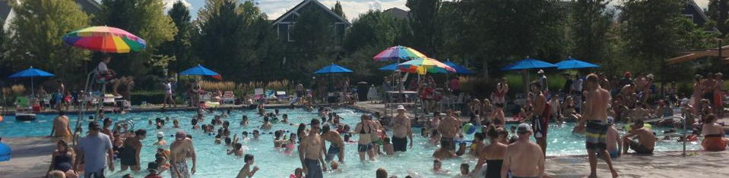
District delegates

Slide 43
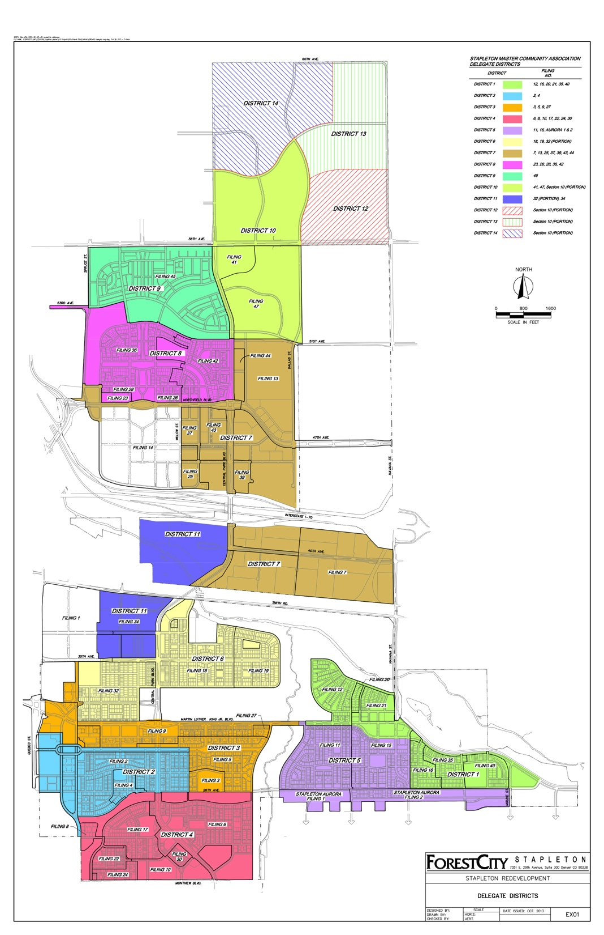

Slide 44
District Delegates
Stapleton property owners annually elect 8 district delegates to serve as the community voice to the MCA
Delegates approve 2015 MCA annual budget and assessment schedule
Delegates elect any open executive board seats
Delegates serve as primary advisory committee to staff and executive board.
Delegates serve as the design review committee for remodeling, renovations and improvements

Slide 45
2015 Meeting Calendar
Month | Meeting | Time | Location
January 21 | Delegates | Noon | Community Room
February 18 | Executive Board | Noon | Community Room
March 18 | Delegates | Noon | Community Room
April 15 | Delegates | Noon | Community Room
May 20 | Executive Board | Noon | Community Room
June 17 | Delegates | Noon | Community Room
July 15 | Delegates | Noon | Community Room
August 19 | Executive Board | Noon | Community Room
September 16 | Delegates | Noon | Community Room
October 21 | Delegates | Noon | Community Room
November 11 | Annual Members Meeting | 6:30 PM | Community Room
November 18 | Annual Delegate & EB | Noon | Community Room
December 16 | Delegate Election Final | Noon | Community Room

Slide 46
2015 Delegate Election
Additional Nominations?

Slide 47
2015 Delegate Election
District 1 (Filings 12, 16, 20, 21, 35, EB TC) OPEN
District 2 (Filings 2, 4) Gregg Looker*
District 3 (Filing 3, 5, 9) Dana Elkind
District 4 (Filings 6, 8, 10, 17, 22, 24, 30) Jessica Ostermick
District 5 (Filings 11, 15, A1, A2) Tim Wilson
District 6 (Filings 18, 19, 32) Thomas Atwood
District 7 (Filing 7, 25,37,39,43) Lee Ferguson*
District 8 (Filing 23,26,28,36,42) Brandy Bishop
*Delegate is also a member of the Executive Board
Election Results Finalized December 19th at Noon Decembers Delegate Meeting

Slide 48
MCA Contact Information
MCA Office & Community Room
7350 E. 29th Ave Third Floor
Winter Hours M-F: 9 am – 4pm
Phone: 303-388-0724
Fax: 303-388-1673
Email: info@stapletoncommunity.com
Web: www.stapletoncommunity.com

Slide 49
THANK YOU ALL FOR YOUR ATTENDANCE TONIGHT

