Slide 1
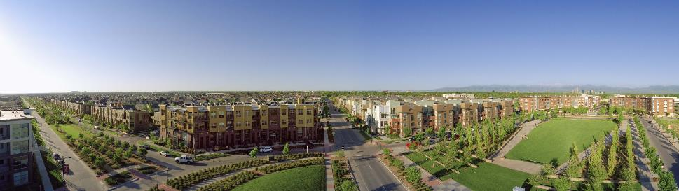
Annual Members Meeting
November 9, 2016

Slide 2
Agenda
Community Comments
Purpose & History
Governance Structure
2016 Performance & Activities
2017 Draft Budget
2017 Delegate Election

Slide 3
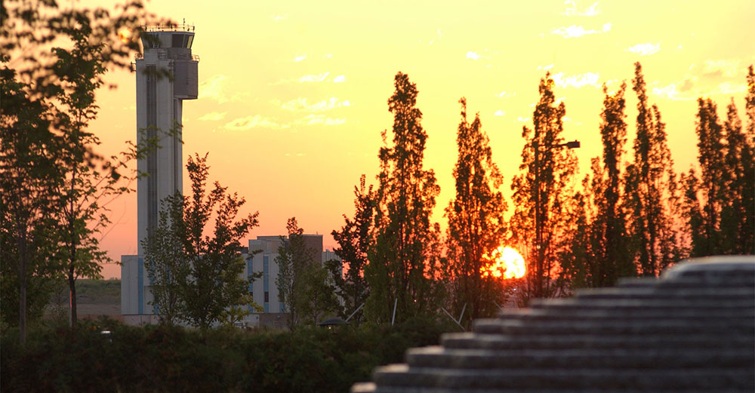
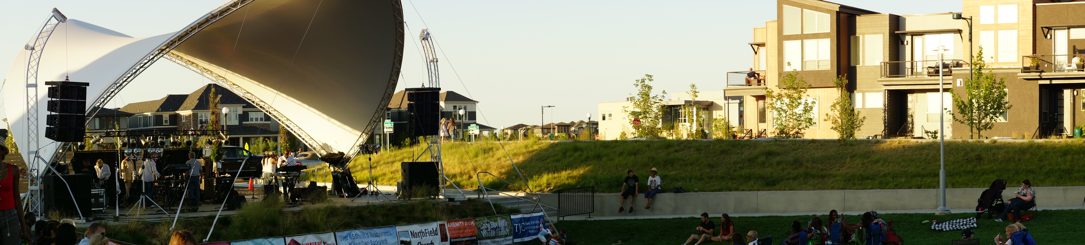
MCA HISTORY & Purpose

Slide 4
MCA History
We were created in 2001
We are the 3rd fastest growing development in the US today.
Our boundary is entire 4500 acre development
Our authority is established through CCIOA
We are regulated through DORA
We are responsible for covenants and community owned and operated assets of the Park Creek Metro District
We provide for Parks, Pools & Programming.
Plus Alleys, Parkways and Storm water

Slide 5
Boundary & Facilities

Slide 6
MCA Covenants & Rules
Covenants
  Section 7: Maintenance
  Section 9: Design Review
What is not in the MCA Covenants
  Restrictive rules on private property
MCA Provides Rule Making for:
  Community Parks
  Community Pools
  Community Alleys

Slide 7
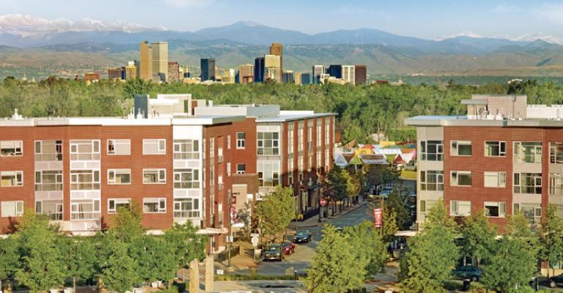
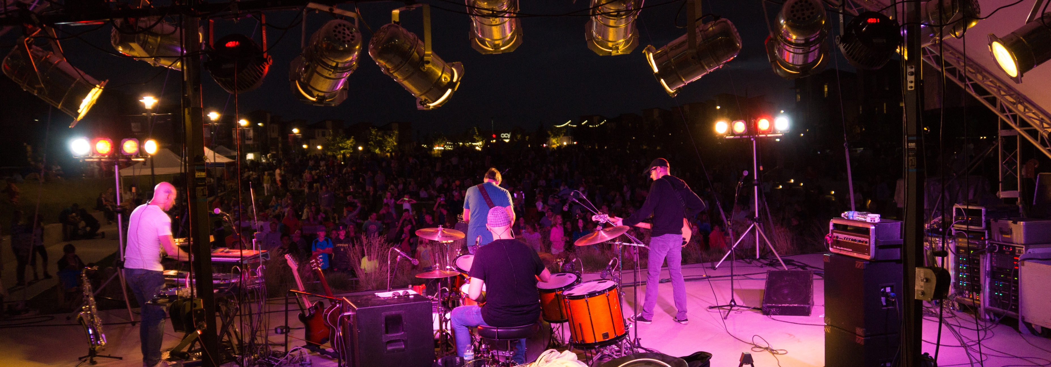
Governance & Management

Slide 8
Mission Statement
The Stapleton MCA is a 501(c) 4 non-profit community organization whose mission it is to create and sustain a “sense of community” within Stapleton through Investing in community assets, Operating community facilities and providing comprehensive community Programming.

Slide 9
How the MCA is Funded

Slide 10
MCA Core Spending

Slide 11
MCA Governing Structure
*Executive
Board (5)
MCA
Staff (12)
Community
Delegates (9)
*Executive Board is developer controlled through 2017

Slide 12
MCA OPERATING STRUCTURE
Jenifer Graham
Administration
& HR
Diane Deeter
Community Programs
Paula Deorio
Aquatic Programs
Keven Burnett
Executive Director
Gretchen
Membership /
AP Tech
Facilities
Communications
& Event Coordinators
Aquatics
Training &
Programs Coord.
Part-time
POOLS
(John Baake)
Parks, ROW &
Open Space
(CTM)
Front Desks
Summer Event
Staff
Summer Aquatic
Staff
(120 Days)
Buildings, Fences & Structures
Seasonal FD/Admin Support
Seasonal Pool Managers
(6 Mo)
Event Committees & Volunteers

Slide 13
Revenue History

Slide 14
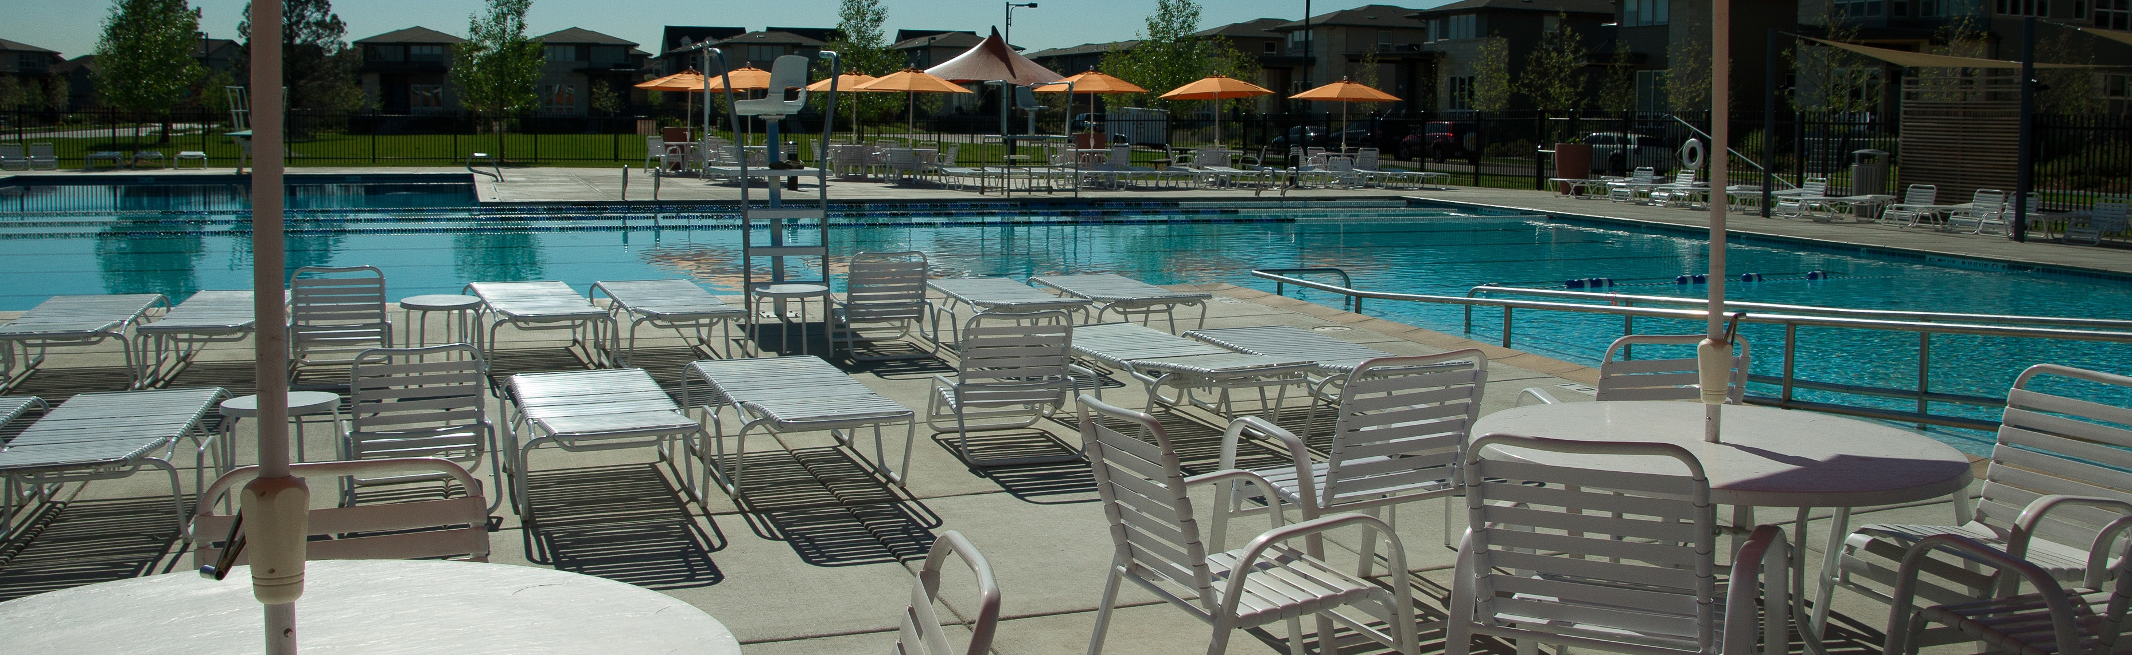
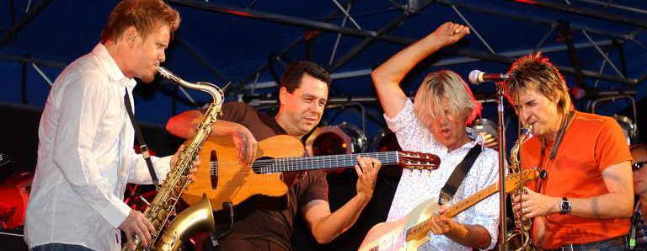
2016 ACTIVITY

Slide 15
AQUATICS & RECREATION
Operate 6 outdoor pools
Maintain 4 public water features
Hire & Train 160 seasonal staff
Serve 150,000 residents & guests
Provide learn to swim programs
Run 2 competitive swim teams
Offer adult oriented programs like “masters” and “tri training”
Rent facilities for “after hour” events
Safety  Operating hours ● Lessons ● Programs ● Concessions ● Rentals

Slide 16
AQUATICS & RECREATION
$650K
$1.1M
COST = $450K

Slide 17
COMMUNITY PROGRAMMING
$180K
$630K
COST = $450K

Slide 18
COMMUNITY PROGRAMMING
Comprehensive  Diverse  Cultural  Unique  Organic

Slide 19
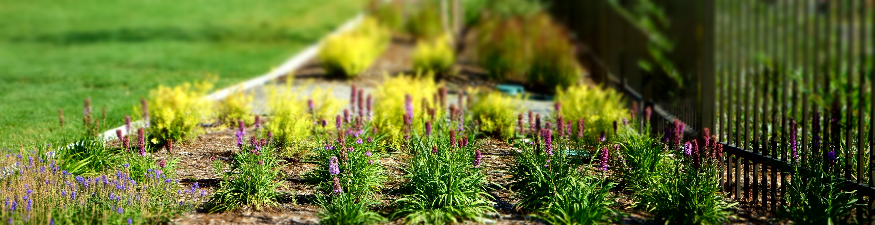
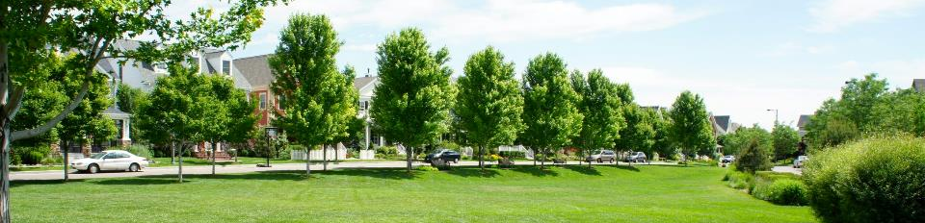
Parks & Facilities
Maintain 80 acres and 55 Parks
Maintain 40 acres of Medians & ROW
Manage 55 Miles of Alleyway
Provide snow removal on all public parcels
Maintain pedestrian lighting & park structures
Provide trash removal & dog stations
Manage mosquito control programs & storm water facilities
Trees  Trails  Structures  Alleys  Amenities

Slide 20
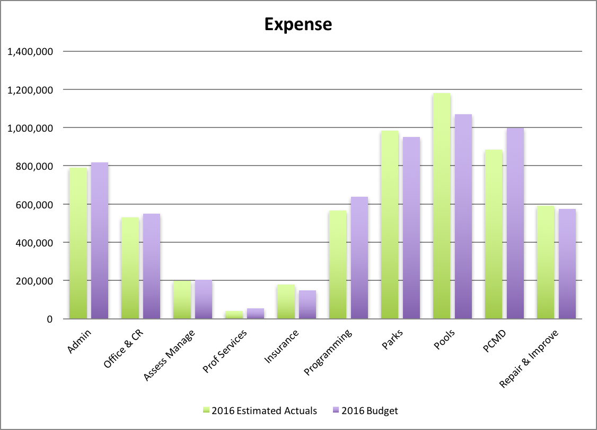
Estimated Actual Expenses

Slide 21
Estimated Year End Activities
Jan – Dec 2016 | Est. Actual $Millions | Budget $Millions | $ | %
Income | $5.95 | $6.00 | $.04 | -1%
Expense | $5.95 | $6.00 | $.06 | -1%
Net Activity | .0 | 0

Slide 22
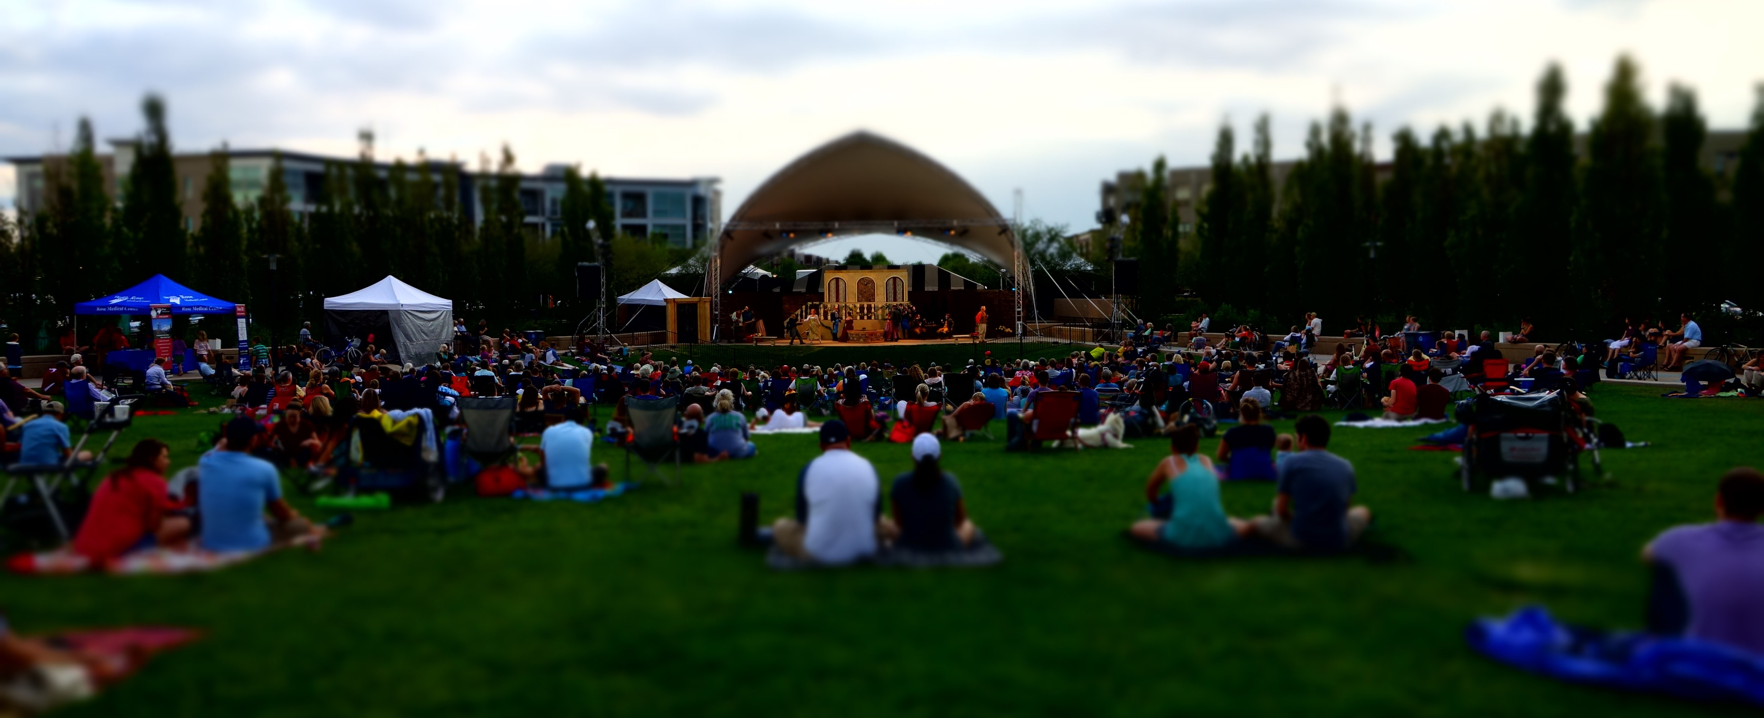
2017 draft budget

Slide 23
MCA Projections

Slide 24
Revenue Assumptions
Residential assessments remain $40/mo
We will continue to see 50-60 new units a month
Development will continue north of 56th & Aurora
Developer & Builder inventory consistent w/2016
Rental Units will increase by 250
Commercial units will increase by 200
Commercial rates will remain the same
Affordable rates (for sale & rental) will remain the same

Slide 25
Revenue

Slide 26
2017 Budgeted Revenue

Slide 27
Expenditure Assumptions
Maintaining 60 Community Parks
Operating 6 Pools – May to September
MCA “CUBE” at Conservatory Green
Expanding Community Programming at both Conservatory Green and Founders Green
Continued Repair, Replace & Improvement of Greens, Pools, Parks, Parkways & Alleys.

Slide 28
2017 Core Spending

Slide 29
2017 Budgeted Expense

Slide 30
Proposed Budget by the Numbers
 | 2016 estimated | 2017 budgeted | $ | %
Estimated Revenue | 5,957,006 | 6,403,344 | 446,338 | +7%
Estimated Expenditures | 5,941,829 | 6,397,714 | 455,885 | +7%
% Future Funding & Improvements | 10% | 9%

Slide 31
Next Steps…
Nov 16 – Annual Executive Board & Delegate Meeting
  Noon - 2 pm Stapleton Community Room (7350 E. 29th Ave)
  2016 Delegates must approve 2017 Budget & Assessment Schedule
  Member input: delegates@stapletoncommunity.com
Updated Meeting Information & Dates www.StapletonCommunity.com

Slide 32
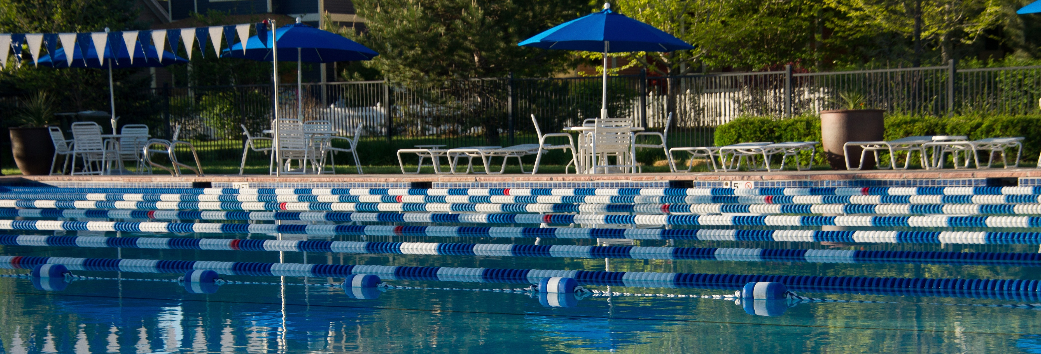
District delegate Election

Slide 33
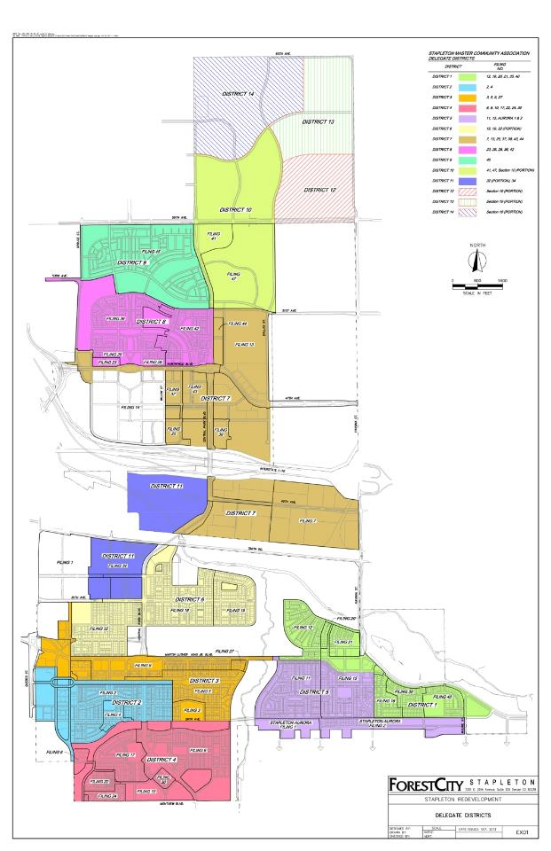
District Delegates
represents 850 owners
are elected annually
meet monthly
approve MCA annual budget
elect open executive board seats
serve as primary advisory committee
serve on the design review committee
serve on the compliance committee

Slide 34
2017 Delegate Election
District | Neighborhood | Current Delegate | Addition Nominations
1 | Bluff Lake/Sand Creek | Tim Hampton | NO
2 | 29th Avenue | OPEN | 2
3 | Westerly Creek | Dana Elkind* | NO
4 | South End | Christie Spilsted | NO
5 | Eastbridge | Andrew Bartlett | NO
6 | Central Park | Thomas Atwood | NO
7 | Northfield | Lee Ferguson* | NO
8 | Conservatory Green | OPEN | 1
9 | Willow Park | Michael Vilegas | NO
*Delegate is also a member of the Executive Board
Election Results Finalized December 14th at Noon Decembers Delegate Meeting

Slide 35
2017 Delegate Election
Additional Nominations?

Slide 36
MCA Contact Information
MCA Main Office
7350 E. 29th Ave (Third Floor)
Winter M-F: 9 am–4pm / Summer M-F: 9am-5pm
MCA CUBE
8371 E. 49th Place
Winter T-F: 12-6 pm / Summer T-S: 12-6 pm
Phone: 303-388-0724
Email: info@stapletoncommunity.com
Web: www.stapletoncommunity.com

Slide 37
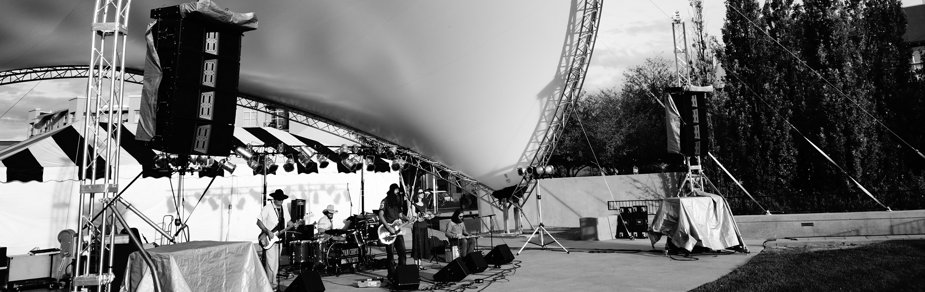
THANK YOU ALL FOR YOUR ATTENDANCE TONIGHT
www.stapletoncommunity.com

