Slide 1
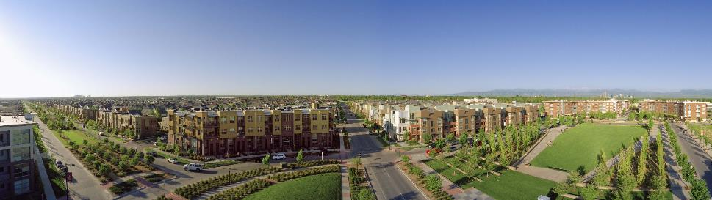
Annual Members Meeting
November 14, 2018

Slide 2
Agenda
Roll Call of Districts
Community Comments
Purpose & History
Governance & Structure
Delegate Election
Activities & 2019 Budget

Slide 3
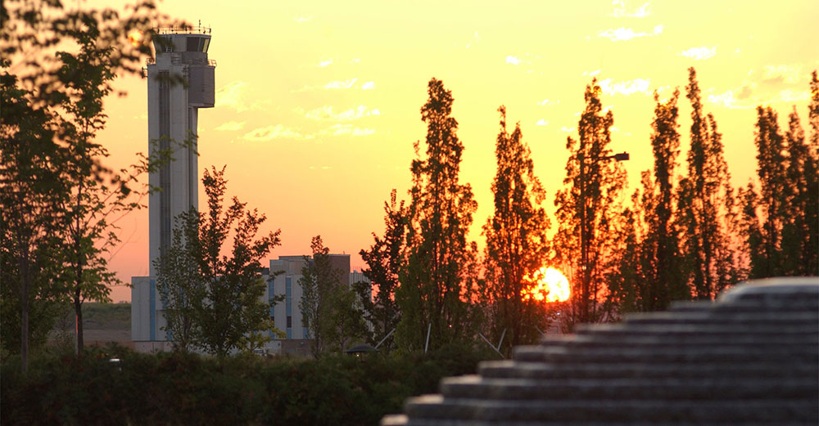
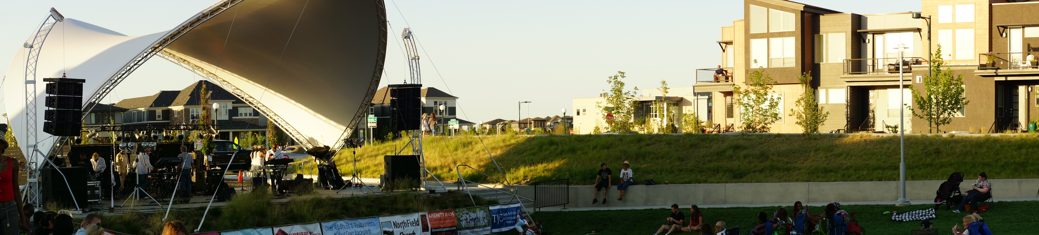
MCA HISTORY & Purpose

Slide 4
Mission Statement
The Stapleton MCA is a 501(c) 4 non-profit community organization whose mission it is to create and sustain a “sense of community” within Stapleton through Investing in community assets, Operating community facilities and providing comprehensive community Programming.

Slide 5
MCA History
MCA was created in 2001 as the primary POA for the operation and maintenance of Stapleton
MCA became Self Managed organization in 2006
MCA became a 501(c)4 Non profit organization in 2008
MCA is regulated through the State of Colorado
MCA continues to be the fastest growing community in Colorado and the largest in city of Denver

Slide 6
Boundary & Facilities
Our boundary is the 4500 acre old airport site.
We provide for the long term operation, maintenance, improvement and replacement of all community owned assets
We produce a full range of diverse and unique programming
We are responsible for community wide covenant and rule enforcement

Slide 7
Master Community Association
2019 Facilities
MCA ADMIN
Brixx
8351 Northfield Blvd
South Satellite Front Desk
7350 E. 29th Ave
MCA Programming
The CUBE
8371 Northfield Blvd
South Green @ Founders
North Green @ Conservatory Green
Fountains
& Plazas
West Crescent
Conservatory Green
Buffalo Wallow
Beeler Park
TOD Center*
Pools & Buildings
Aviator
PJ
F15
Jet Stream
Runway 35
Maverick
Filing 54*
Maintenance
Dallas Yard
Facilities HQ
5100 Dallas St
Athletic Fields
Jet Stream East
F15 East
Runway 35 North
Aurora Ball Fields (2)
In-tract Parks
Parkways
& Alleys
29th Ave
35th Ave
32nd Ave
Central Park Blvd
Martin Luther King Blvd
Valentia
Beeler**
District 1 Parks (5)
District 2 Parks (4)
District 3 Parks (2)
District 4 Parks (4)
District 5 Parks (5)
District 6 Parks (7)
District 7 Parks (1)
District 8 Parks (5)
District 9 Parks (5)
District 10 Parks (6)
59th Ave**
MCA Community Room
7350 E 29th Ave.
Martin Luther King Bridge
CPB Bridge @ 26th
CPB Bridge @ Sand creek
IC2 @ Northfield
IC4 @ I70
Bridges & Storm water
Neighborhood Alleys
(338 @ 3.5M S
Filing 54 Ball Fields*
District 11 Parks*
The Mint
Public Restrooms
East West Greenway
Westerly Creek
Bluff Lake
F18 Ponds
Northfield Ponds
Prairie Meadows**
Filing 54/57 Ponds*
Aurora Channels
Quebec Blvd
Smith Road
40th Ave
Havana
MCA Truck Fleet (4)
MCA Bobcats (2)
MCA Trailers (2)
*In Construction
**In Warranty

Slide 8
MCA OPERATING STRUCTURE
Jenifer Graham
Administration
& HR
Diane Deeter
Community Programs
Paula Deorio
Aquatic Programs
Keven Burnett
Executive Director
Membership /
Accounting Tech
Facilities
Communications
& Event Coordinators
Aquatics
Training &
Programs Coord.
(6 MO)
POOL
Mechanics
Parks, ROW &
Open Space
(CTM)
Front Desks
Summer Event
Staff
Summer Aquatic
Staff
(120 Days)
Buildings, Fences & Structures
Seasonal FD/Admin Support
Seasonal Pool Managers
(4 MO)
CUBE

Slide 9
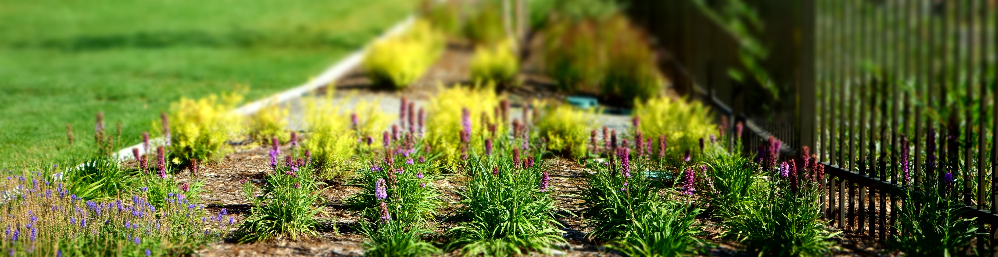
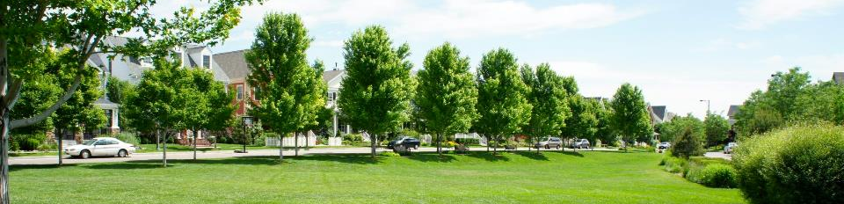
Parks, Parkways & Open space
Maintains 45 Parks & Parkways (200 acres)
Maintains Medians, Alleys & Bridges
Provides snow removal on most public spaces
Maintains pedestrian lighting & park structures
Provides trash removal, recycling & dog stations
Manages mosquito control program
Manages storm water facilities
Trees  Trails  Structures  Alleys  Amenities

Slide 10
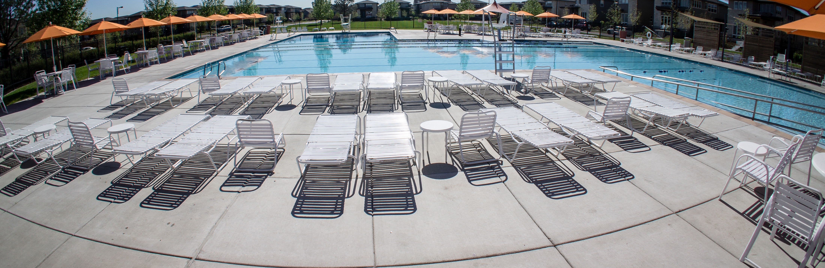
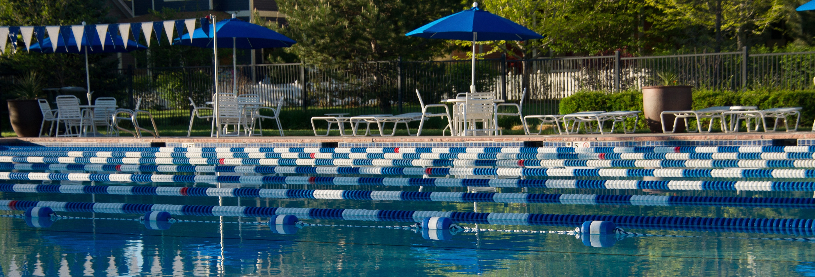
POOLS & AQUATICS
Operates 7 outdoor pools
Operates 5 public water features
Hires & trains 135 seasonal staff
Provides learn to swim programs
Provides competitive and recreational swim programs
Rents facilities for “after hour” events and parties.
Safety  Operating hours ● Lessons ● Programs ● Concessions ● Rentals

Slide 11
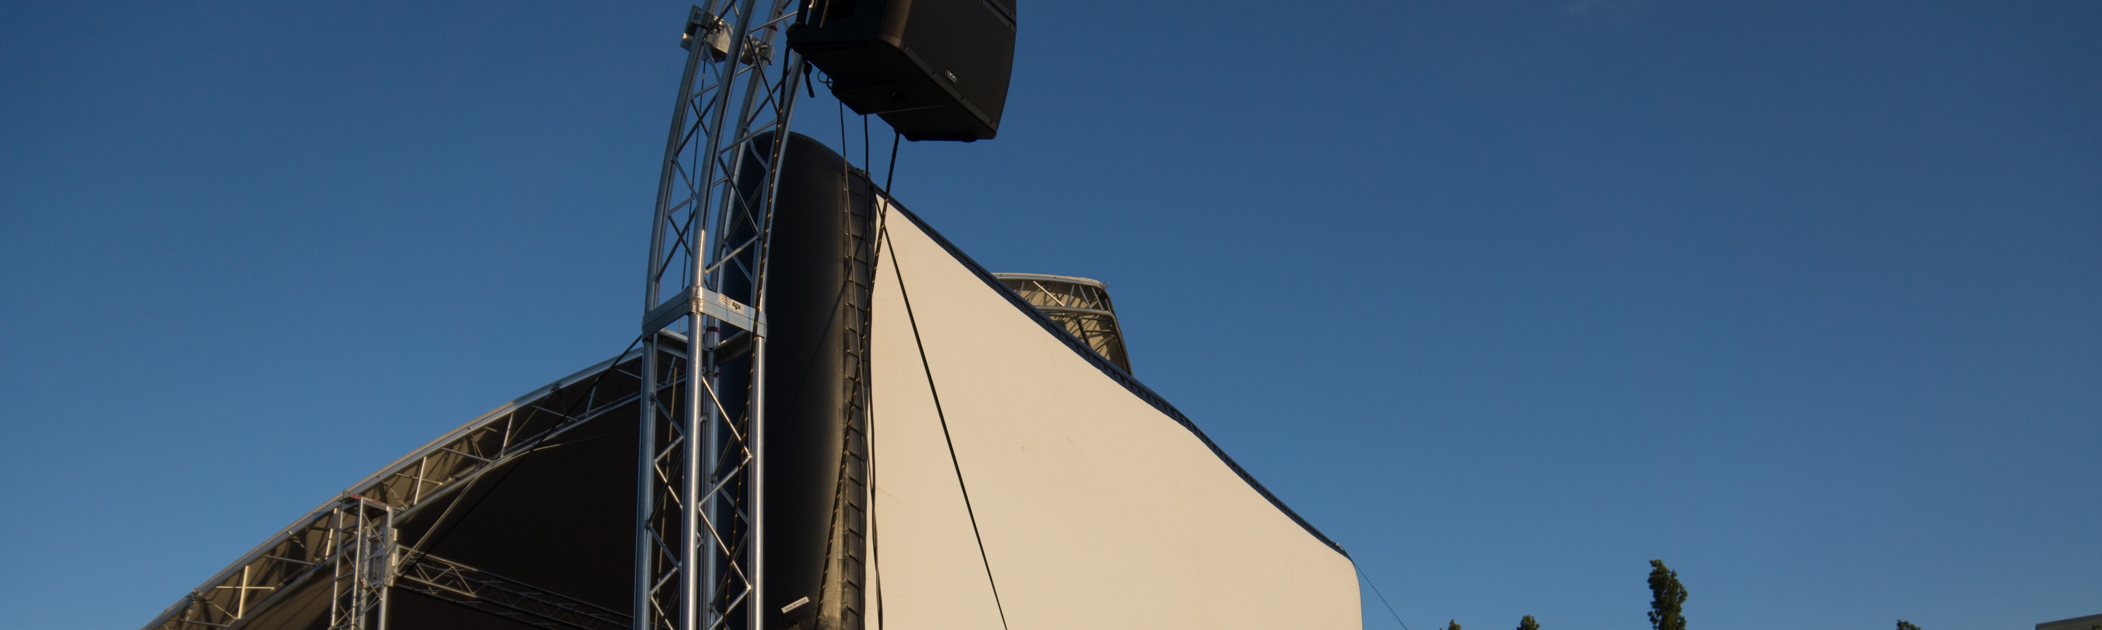
COMMUNITY PROGRAMMING
Programs 2 outdoor amphitheaters & 1 indoor cultural community center with Movies, Concerts, Markets, Community Theater & Festivals
Develops unique indoor programming designed for the Cube
Provides educational events such as First Friday Flights and Active Minds.
Provides recreational events such as the Kids Triathlon & CO State Swim Meets
Supports youth sports programming such as baseball & softball programs
Partners with Sam Gary Library and Central Park Rec Center the Foundation to support other community programming
Comprehensive  Diverse  Cultural  Unique  Organic

Slide 12
MCA Covenants & Rules
Section 7: Maintenance obligation of Landscaping and Buildings
Section 9: Design Review
MCA Provides Rules & Enforcement for:
Community Parks, Pools & Alleys
The MCA DOES NOT Enforce
Restrictive rules on private property
Streets and Parking
Animal Control issues

Slide 13
Community Support
Community Investment Fund
  Collected through every property sale
  Contributes over $1,000,000 per year
    Affordable Housing
    Workforce Development
    Education Support
    Sustainable Development
    Community Outreach and Neighborhood Connections
  95% supports the Foundation for Sustainable Urban Communities
  5% provides additional support to neighborhood schools, BLNC, Urban Farm, & Denver Public Library

Slide 14
Name of the Community
Article 1 of the Community Declaration sets the name of the Community as “Stapleton” (after the former Airport site which it is located)
MCA Delegates have the right to put forth a new name of the community and refer it to the Executive Board
The Executive Board then has the right to refer a name change to the Developer (cur. Forest City)
If the Developer accepts a new name, then the community declaration is amended and the new name is used going forward.
W/O the developers consent, 51% of the members would need to vote to approve a change of name.

Slide 15
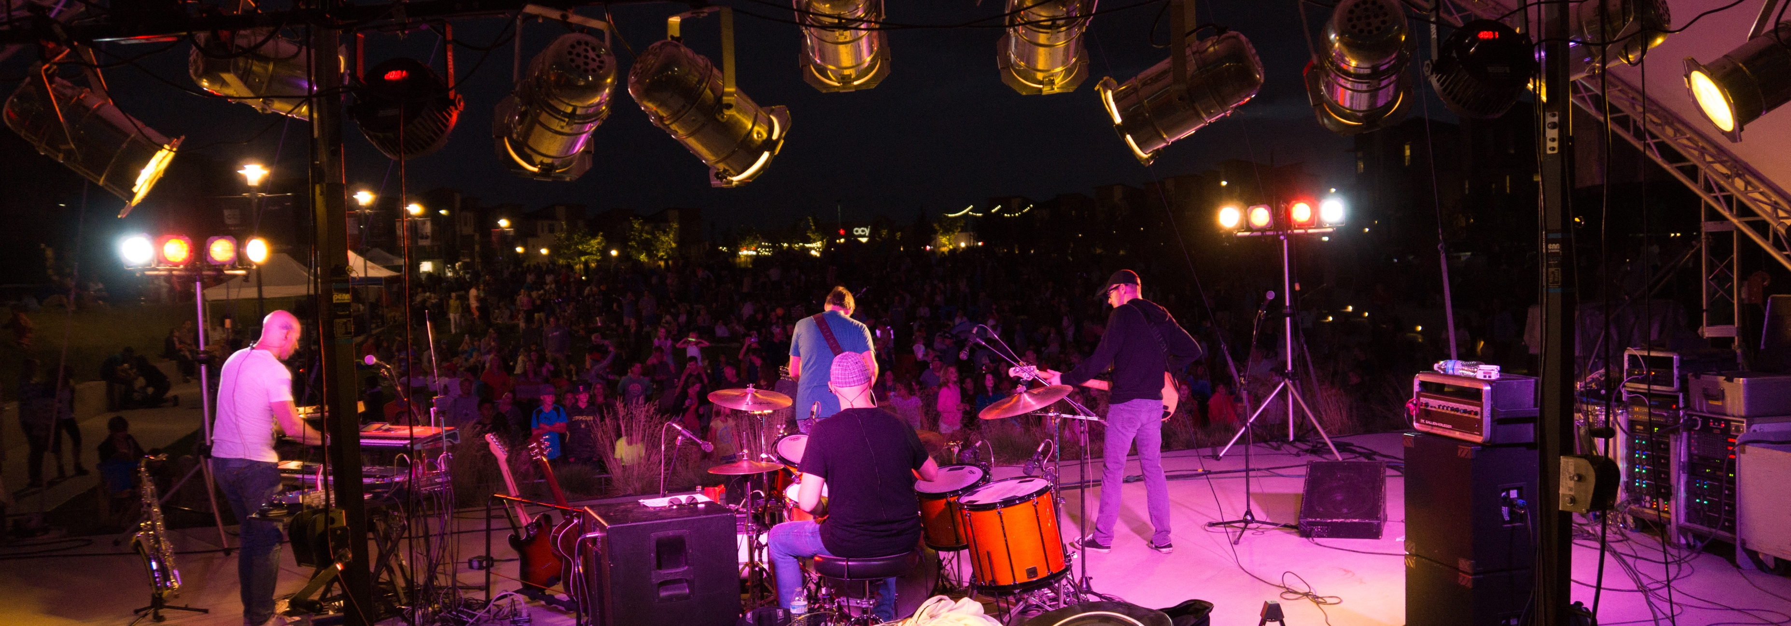
Governance

Slide 16
MCA Governing Structure
Executive
Board (5)
MCA
Executive
Director
Community
Delegates (10)

Slide 17
District delegate Election

Slide 18
What is a Delegate
elected annually
represents approx. 700-1,200 households
meets monthly with MCA ED and senior staff
meets quarterly with the MCA Executive Board
ratifies the annual budget and assessment schedule
nominates & elects open executive board seats
serves as primary advisory committee to MCA Board & Staff
serves on design review and compliance committees
has the authority to initiate a name change for the
community

Slide 19
District Delegates

Slide 20
2019 Delegate Nominations
District | Neighborhood | Candidate 1 (Incumbents) | Candidate 2
1 | Bluff Lake/Sand Creek | Tim Hampton* | Jamie Bower
2 | 29th Avenue | Josh Nicholas* | Cora Galpern
3 | Westerly Creek | Dana Elkind* | Mandle Rousseau
4 | South End | Christie Spilsted | Cristin Welle Hughes
5 | Eastbridge | Andrew Bartlett | Tom Downey
6 | Central Park | Gary Smy | Michael McMurry
7 | Northfield/Centerfield | Lee Ferguson
8 | Conservatory Green | Amanda Dorotik | Caley Orr
9 | Willow Park | Eric Wood | Laura Reynolds
10 | Beeler Park | Yuri Tavbin
*Delegate is also a member of the Executive Board
W/O quorum election results will be finalized December 20th at Noon @ December’s Delegate Meeting

Slide 21
Delegate Election
Please cast any remaining ballots and give them to office in the Great Hall

Slide 22
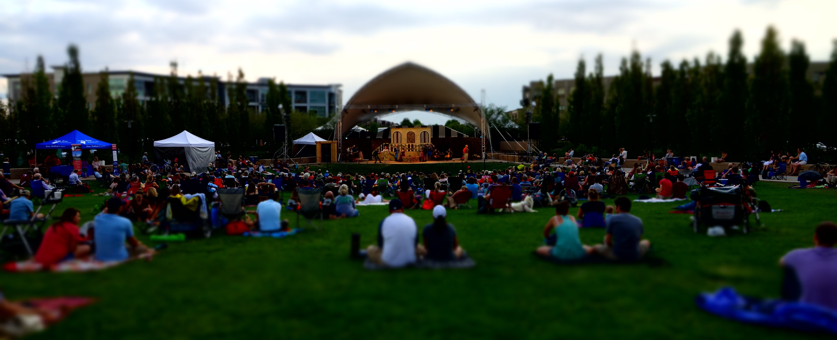
MCA Activities &
draft budget

Slide 23
Budget Assumptions
Estimated Community Population………………........27,500
Number of Residential Properties……………………....8,540
Number of Rental Properties……………………………...2,196
Total Commercial Units ……………………………….....1,787
Park & Parkway Acres Managed……………………......200 Acres
Total Alley Surface Maintained…………………………... 35 Miles
Pool/Aquatic Facilities Operated ……………………......7 + 5
Pool Cards Issued………………………………………….........16,500
Programmed Outdoor Amphitheaters…………………… 2
Indoor Meeting & Event space…………………………. 8,000 s.f.
Leased Office space……………………………………….........4,000 s.f.
FT/PT Employees……………………………………...............12-15
Summer Employees……………………………...................150

Slide 24
Revenue History & Forecast

Slide 25
Estimated Actual Revenue vs Budget

Slide 26
Estimated Actual Expenses vs Budget

Slide 27
Proposed Budget by the Numbers
 | 2018 estimated | 2019 budgeted | $ | %
Estimated Revenue | $7.6M | $7.7M | $169,492 | +2%
Estimated Expenditures | $7.4M | $7.7M | $371,219 | +5%
% Future Reserves & Improvements | 9% | 10%

Slide 28
Proposed Assessment Schedule
Unit Type | Description | Assessment | Change
For Sale Regular Residential | Individually Owned dwelling units sold at market rate prices | $43.00/month | No Change
For Sale Affordable Residential | Individually owned dwelling units subject to restrictions under the Workforce Housing Program | $25/month | No Change
For Rent Residential Market Rate | Apartments / Multi family rental units | $26/month | No Change
For Rent Residential Affordable | Apartments / Multi family rental units subject to restrictions under the Workforce Housing Program | $12/month | No Change
Filing 2 & 36 Commercial | Units used for commercial, retail, office, industrial, or public or private recreational use | $14/month | No Change
Filing 7 & 13 Industrial | Units used for commercial, retail, office, industrial, or public or private recreational use | $4.85/ month | No Change
Filing 10 Mixed Use | Units used for commercial, retail, office, industrial, or public or private recreational use | $9.25 + $15 /parcel | No Change
All other Commercial | Units used for commercial, retail, office, industrial, or public or private recreational use | $9.25/month | No Change

Slide 29
18 vs 19 Revenue

Slide 30
2019 Core Revenue

Slide 31
Budgeted Expense

Slide 32
2019 Core Spending

Slide 33
Next Steps…
Nov 28 – Annual Executive Board & Delegate Meeting
  Noon - 2 pm Stapleton Community Room (7350 E. 29th Ave)
  Delegates must approve 2018 Budget & Assessment Schedule
  Member input: delegates@stapletoncommunity.com
Updated Meeting Information & Dates www.StapletonCommunity.com

Slide 34
MCA Contact Information
MCA CUBE & Front Desk North
8371 Northfield Blvd
MCA Community Room & Front Desk South
7350 E. 29th Ave 3rd Floor
MCA Administrative Office
8351 Northfield Blvd
Phone: 303-388-0724
Email: info@stapletoncommunity.com
Web: www.stapletoncommunity.com

Slide 35
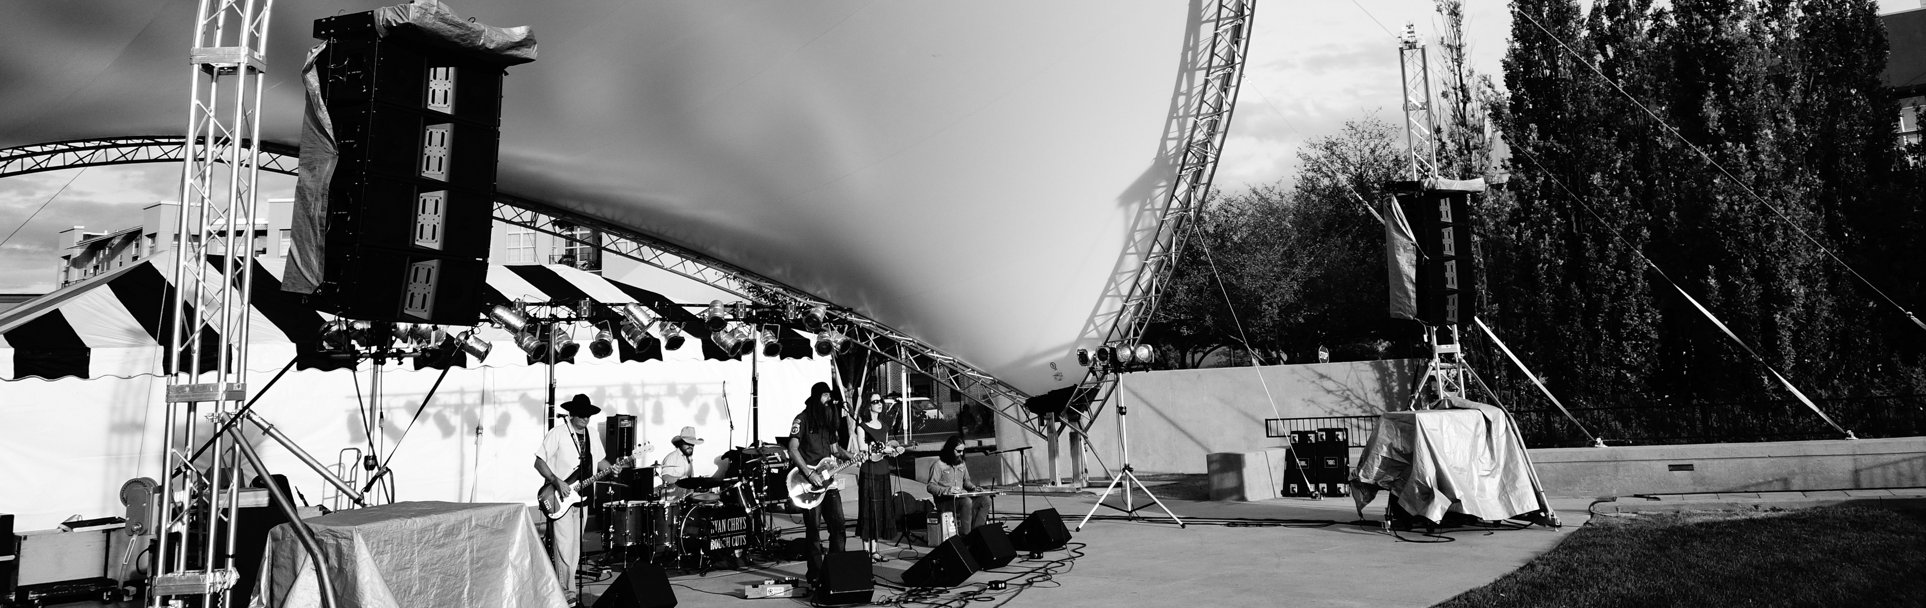
THANK YOU ALL FOR YOUR ATTENDANCE TONIGHT
www.stapletoncommunity.com

Slide 37
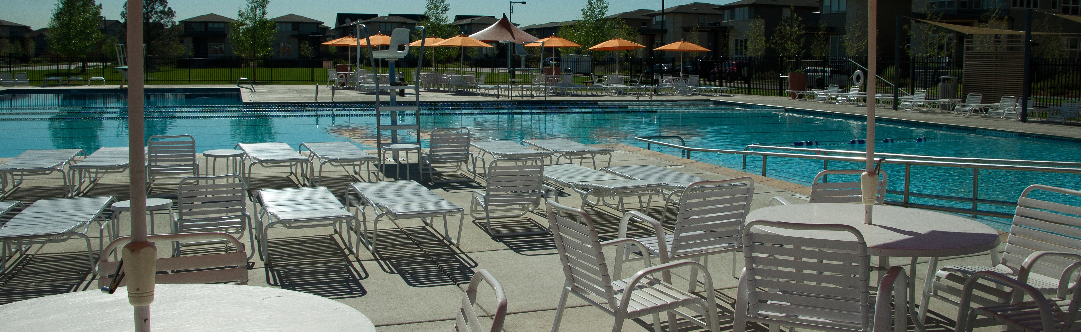
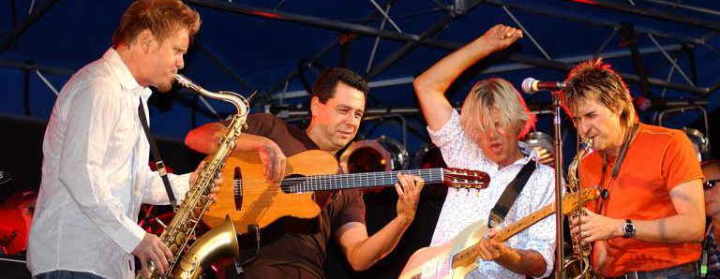
MCA 2018 Activities

Slide 38
What We Do
Public Works
  Parkways and ROW Maintenance
    All Pedestrian and Architectural lighting
    Parkway Medians
    Residential Alleys
    Bridges (CP, MLK, SC, I70, Quebec)
    Storm water
    Cluster boxes
    Public trash, recycling and dog stations

Slide 39
What is happening now
Denver City Council and the Mayor have said that they will support whatever direction the community wishes to pursue in regards to the name
The current MCA Delegates approved a community wide referendum to determine level of support.
We expect this to be by far the biggest sampling of the community on this question.

Slide 40
Estimated Year End Activities
Jan – Dec 2018 | Est. Actual $Millions | Budget $Millions | $ | %
Income |  |  |  | 4%
Expense |  |  |  | 3%
Net Activity

