Slide 1
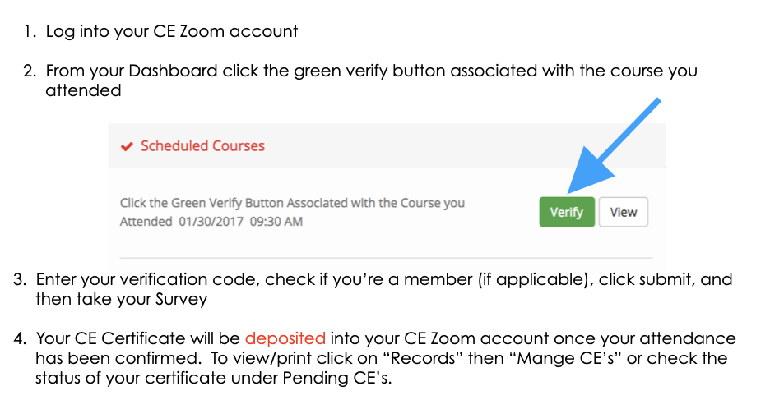
Your CE Zoom Verification Code for the following course
Course Title & Presenter
VERIFICATION CODE:

