Slide 1
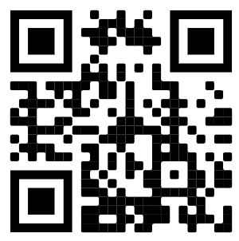
Course Title | Presenter
Code:
Enter code here
How to Receive your CE Certificate:
Enter registration link below into your browser or scan the QR code to register/verify. CE Zoom members log in - New CE Zoom members will have to fill out a registration form.
Enter the verification code
Check all member associations (if applicable)
Click Submit
Take any required surveys
Your CE Certificate will be deposited into your CE Zoom account once your attendance has been confirmed. To view/print click on “Records” then “Mange CE’s” or check the status of your certificate under Pending CE’s
https://www.cezoom.com/registration/xxxxxxxx
.

