Slide 1

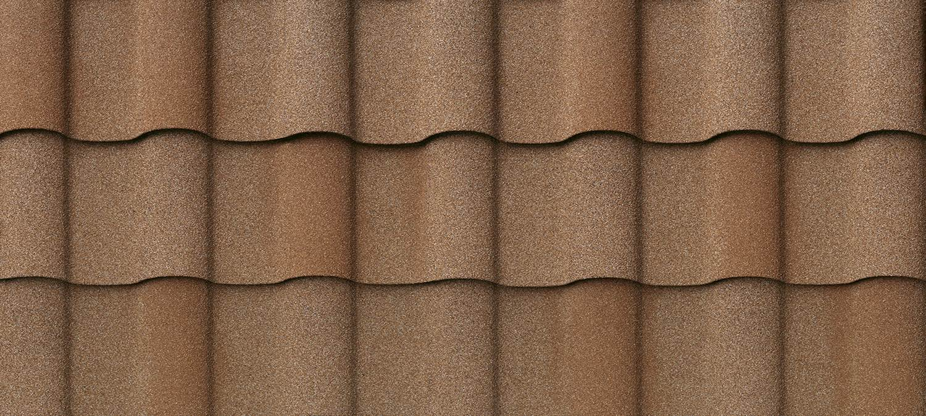
Experience the Difference
Direct to Deck Installation Details
Villa Tile

Slide 2
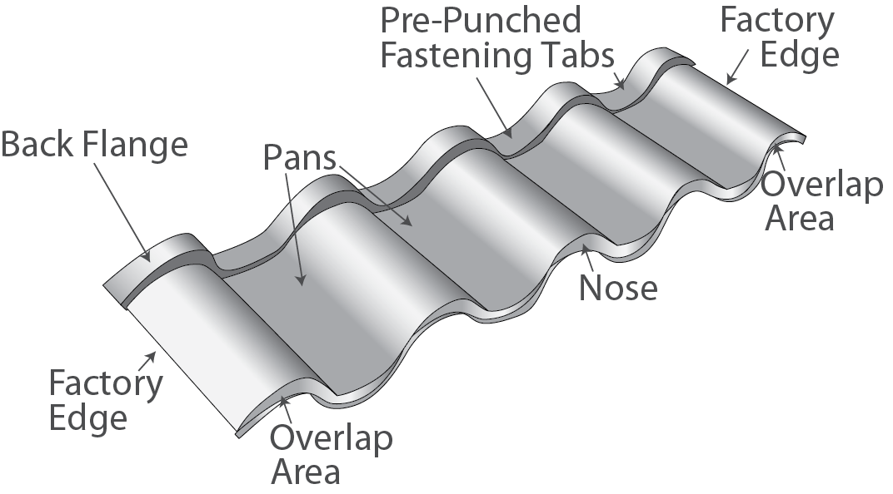
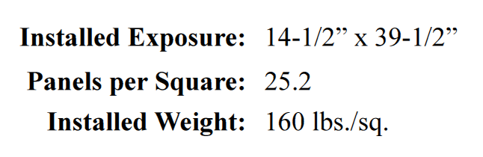
DECRA Villa Tile Panel – Detail

Slide 3
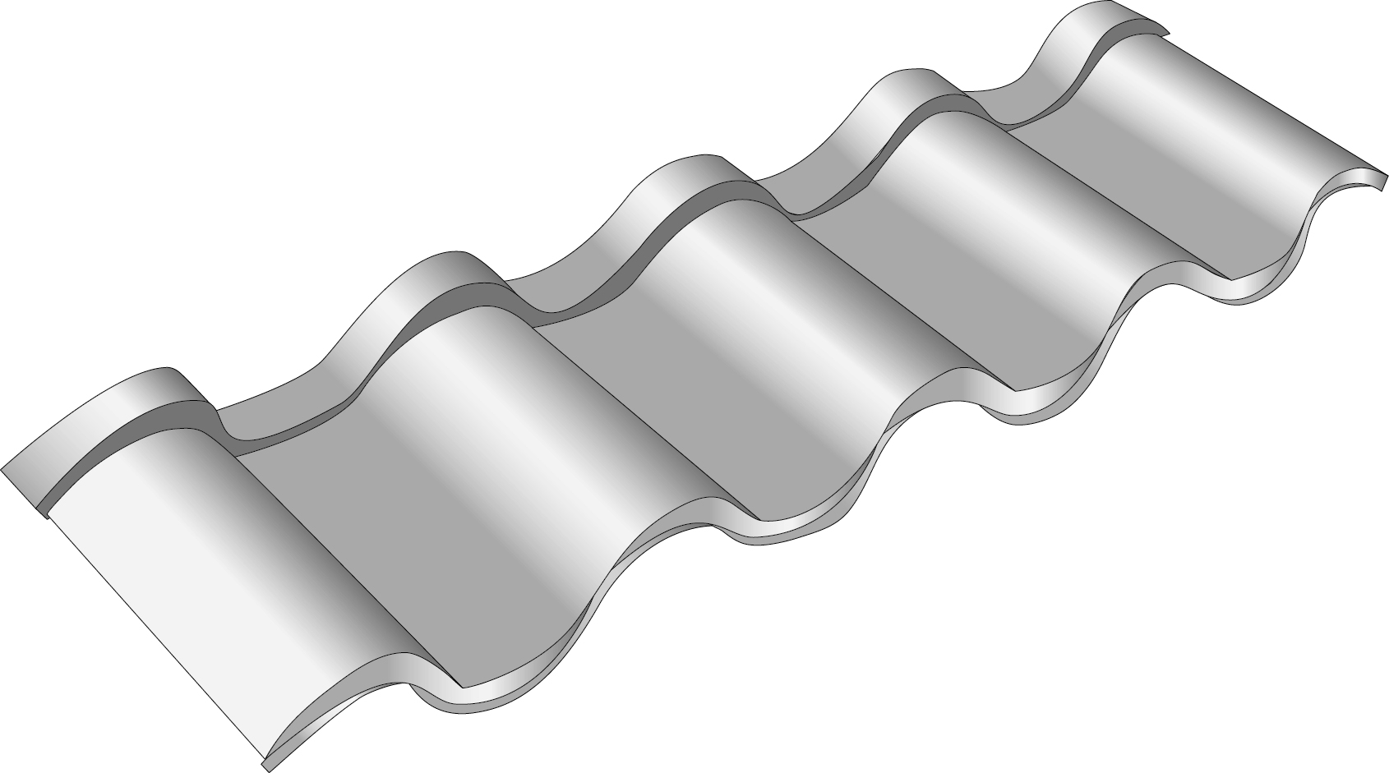
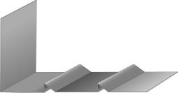
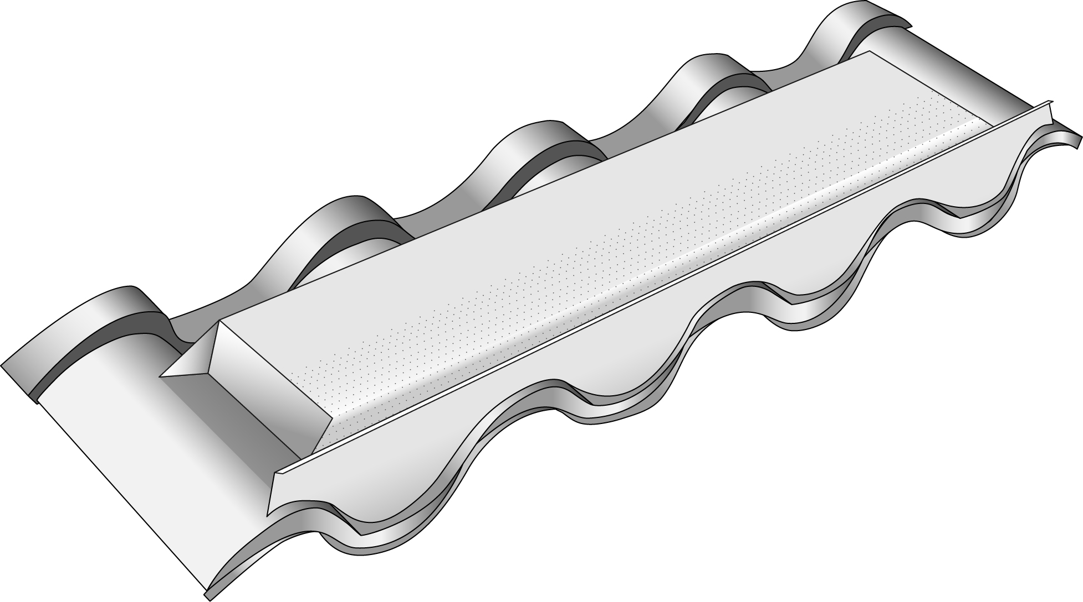
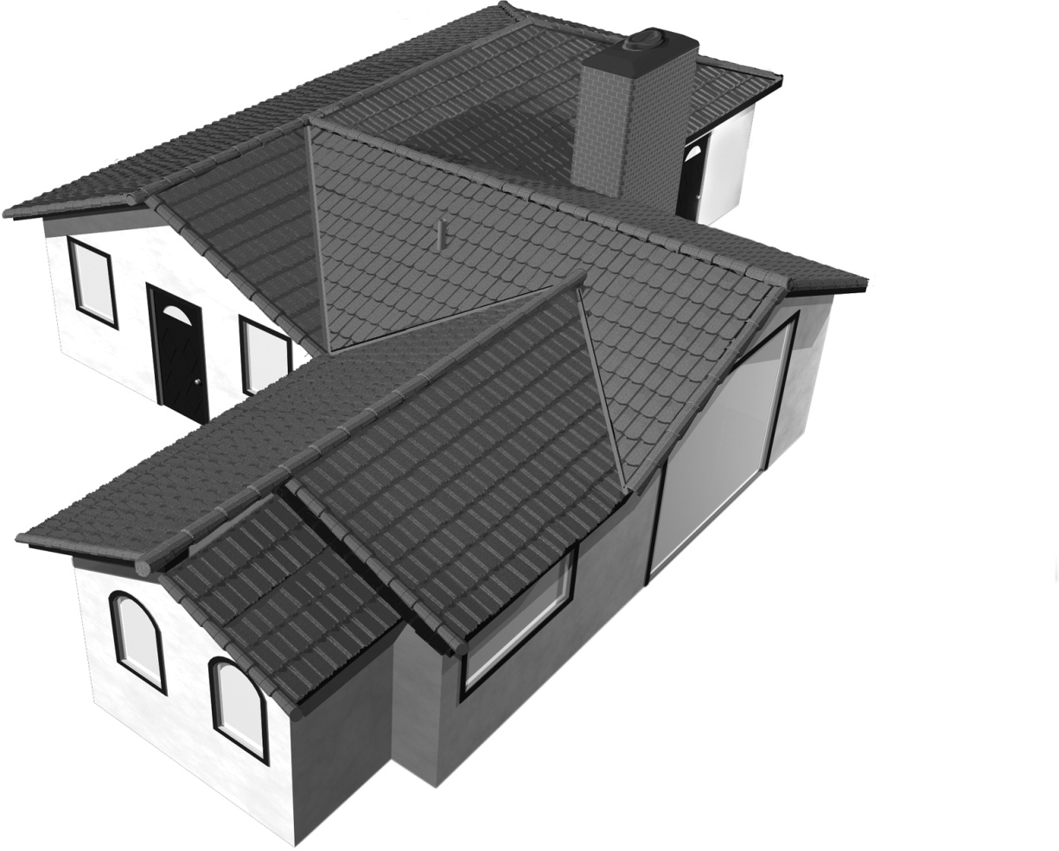
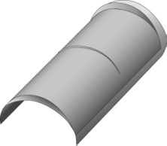
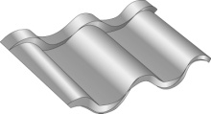

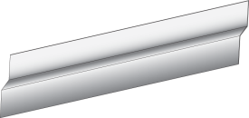
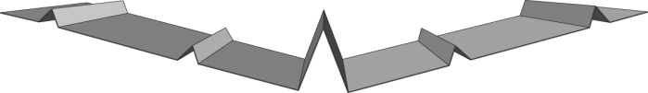
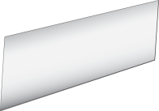




DECRA Villa Tile Roof – Detail
Villa Channel
(both sides of hip)
DECRA Villa Tile Panel
Tile Hip & Ridge
(at hips and ridges)
DECRA Villa Tile Panel Vent
Tile End Cap
Villa Underpan
Villa Valley
Side Flashing
Flat Sheet
Villa Bird Stop-Ridge (both sides of ridge)
DECRA Ridge Vent
Villa Channel
(at rake and roof-to-wall)
Villa Bird Stop-Eave
Notes:
Need final pre-punched hole positions

Slide 4
DECRA Villa Tile Installation
These instructions, drawings and photos are intended as a guide for the installation of DECRA Villa Tile
Adhere to recommended safety practices
Refer to local codes and/or ICC Reports – see links available at www.decra.com
Roof slopes of less than 3:12 are considered decorative and panels must be applied over a roof system complying with local codes

Slide 5
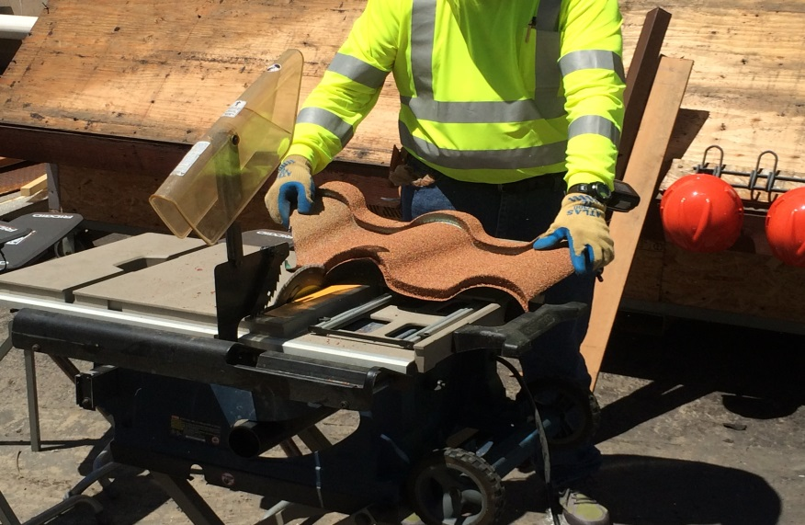
Measuring & Cutting Panels
Measurements are made on roof and panels are marked and usually cut on the ground.
Panels may be cut with a tin snips or circular saw with metal cutting blade.
A hand bender is used to bend the cut edge of the panel for hips, ridges, and valleys.
Safety equipment should be worn during the installation process.
Notes:
Need to update the text and photos with correct cutting equipment

Slide 6
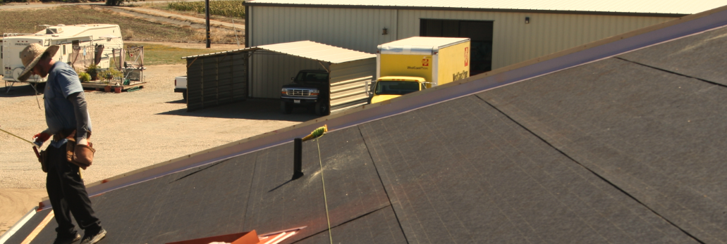
Deck Preparation – New Construction
Prepare roof deck to meet local building codes - Underlayment is required
Underlayment shall comply with ASTM D 226, Type I or Type II, ASTM D 4869, Type I or Type II or ASTM D 1970.
Check local code requirements as ice and water shield and additional requirements may apply.

Slide 7
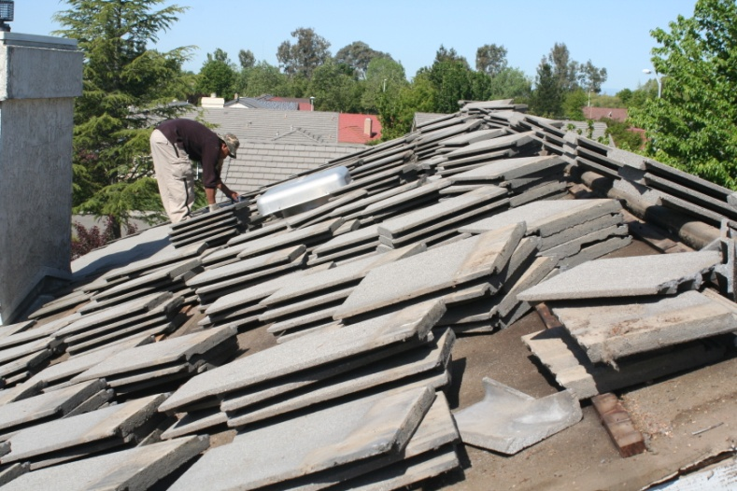
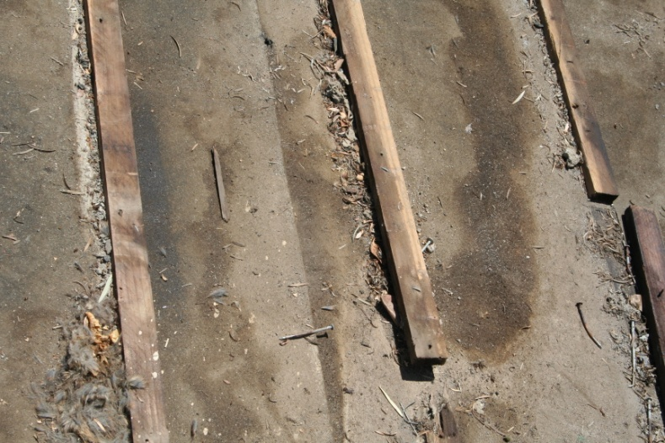
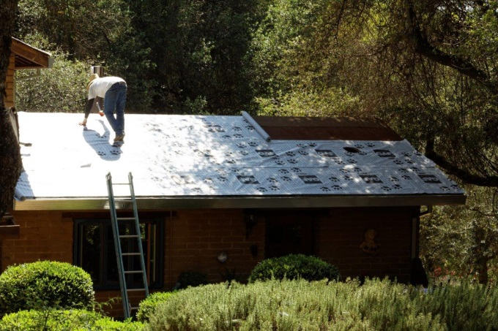
Deck Preparation – Tear-off / Re-roof
Tear of old roofing, clean, and prepare roof decking to meet local building codes.
Underlayment shall comply with ASTM D 226, Type I or Type II, ASTM D 4869, Type I or II or ASTM D 1970 – or greater if required by local code.
Check local code requirements as ice and water shield and additional requirements may apply.

Slide 8
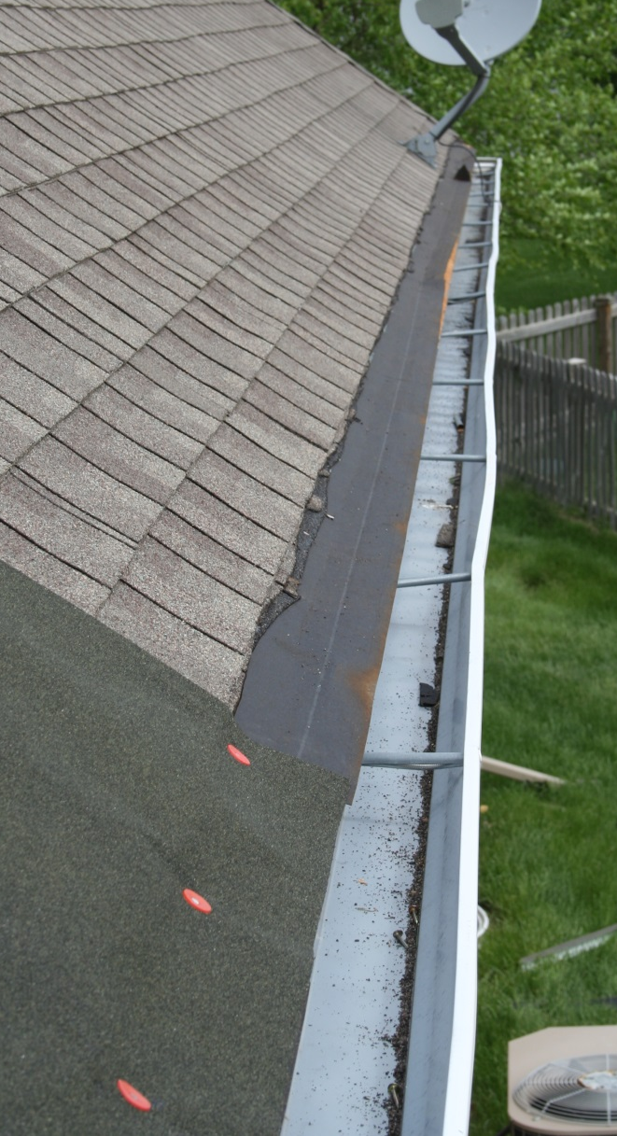
Deck Preparation – Roof Over Asphalt
Villa Tile may be installed over existing asphalt shingle. Cut shingles back 8” from eaves and rakes/gable edges.
Can be installed over 2 layers of shingle, heck local code.
Remove existing hip and ridge materials.
Underlayment shall comply with ASTM D 226, Type I or Type II, ASTM D 4869, Type I or II or ASTM D 1970 – or greater if required by local code.

Slide 9
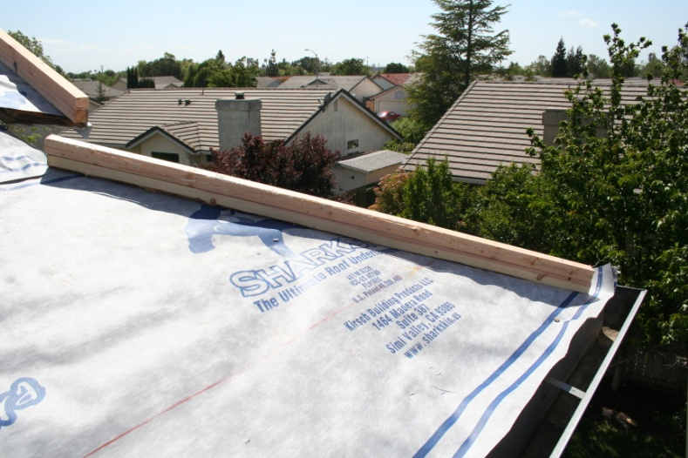
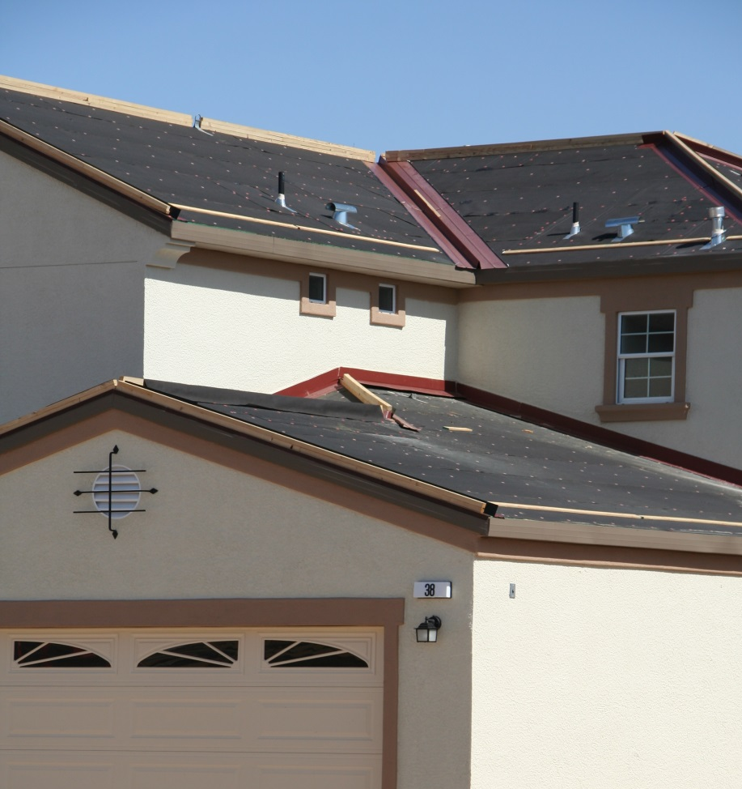
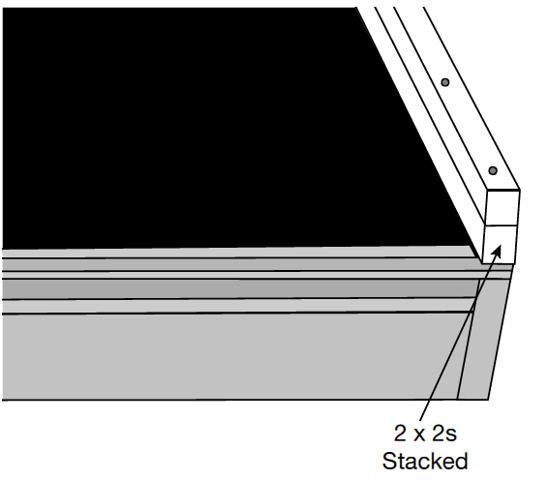
Install Stacked 2 X 2’s
Over prepared deck, position two stacked 2 x 2s flush along rake/gables, up the center of the hips and along ridges.

Slide 10
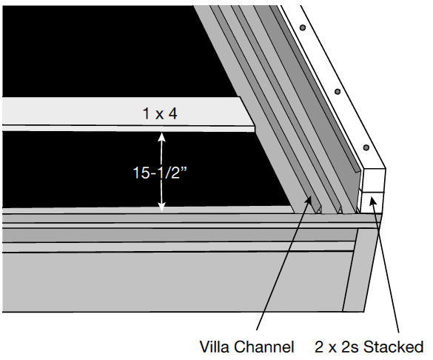
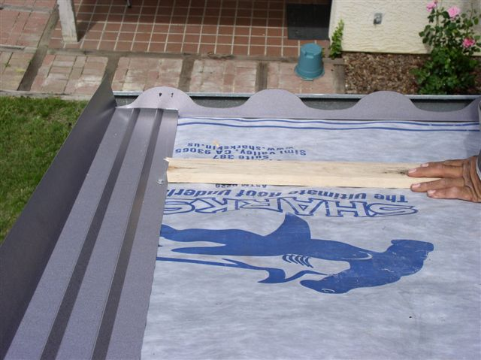
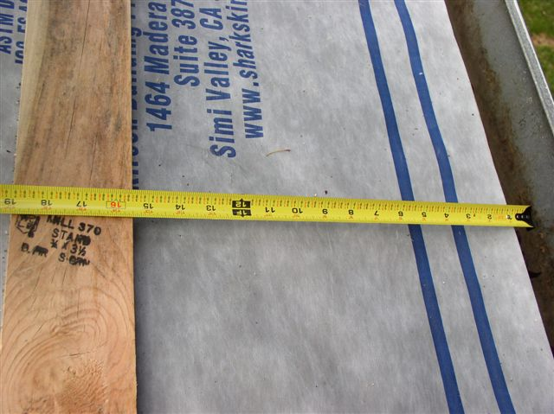
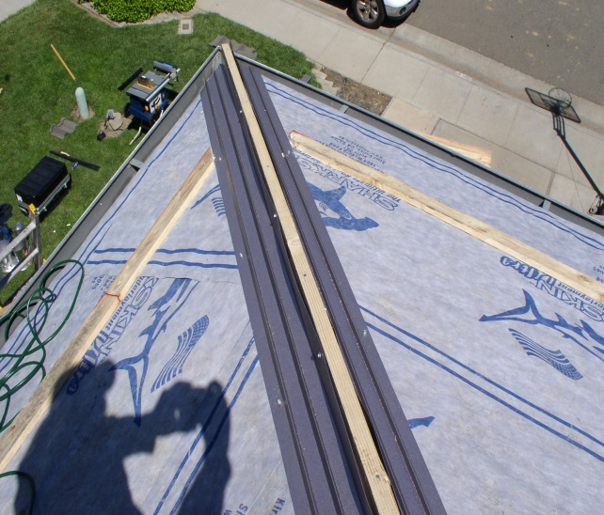
1 x 4 at First Course
Install the front edge of a 1x4 15-½” from the edge of the fascia.
Fasten this to the deck using screws that will fit flush to the 1x4 and long enough to penetrate the deck securely.

Slide 11
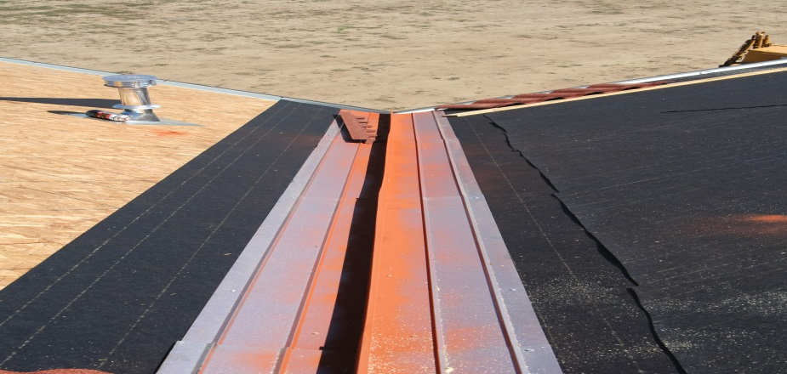

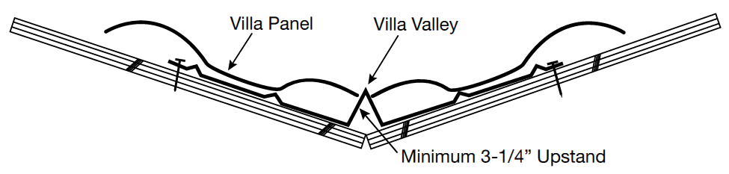
Villa Valley
Valley pieces should overlap minimum 6” – fasteners should be positioned outside the last rib on either side – paint the valley before installing panels.
Use Villa Valley or standard concrete valley metal – minimum 26 gauge pre-finished aluminum-zinc alloy coated steel, minimum 16” wide with a minimum 3-1/4” center upstand.
Ices and Water Shield recommended for freeze/thaw conditions.

Slide 12

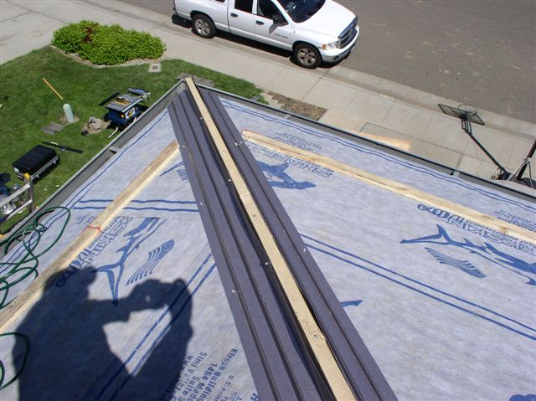
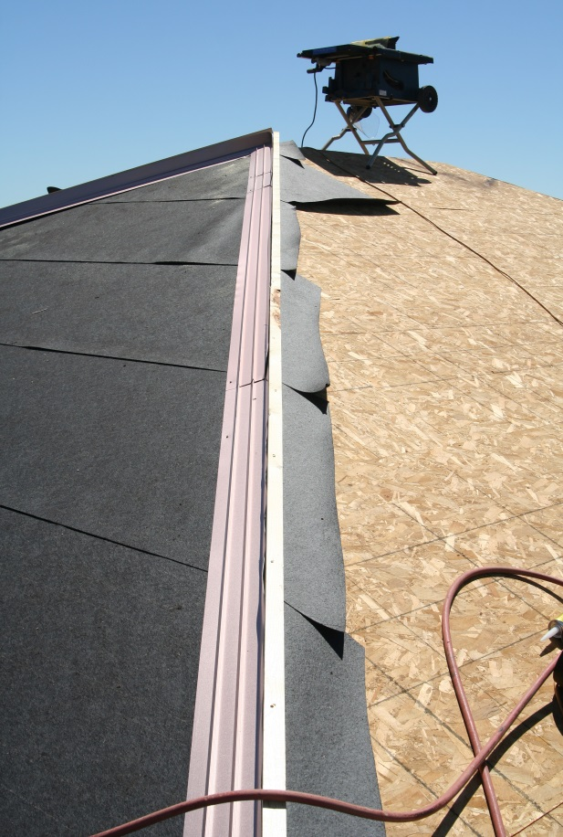
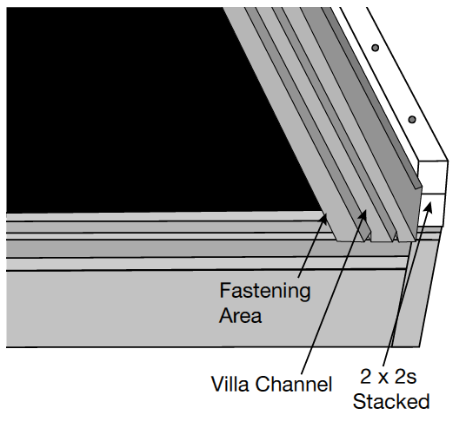
Villa Channel
Install Villa Channel at rake/gable, roof-to-wall, and along both sides of the 2 x 2s at the hip.

Slide 13
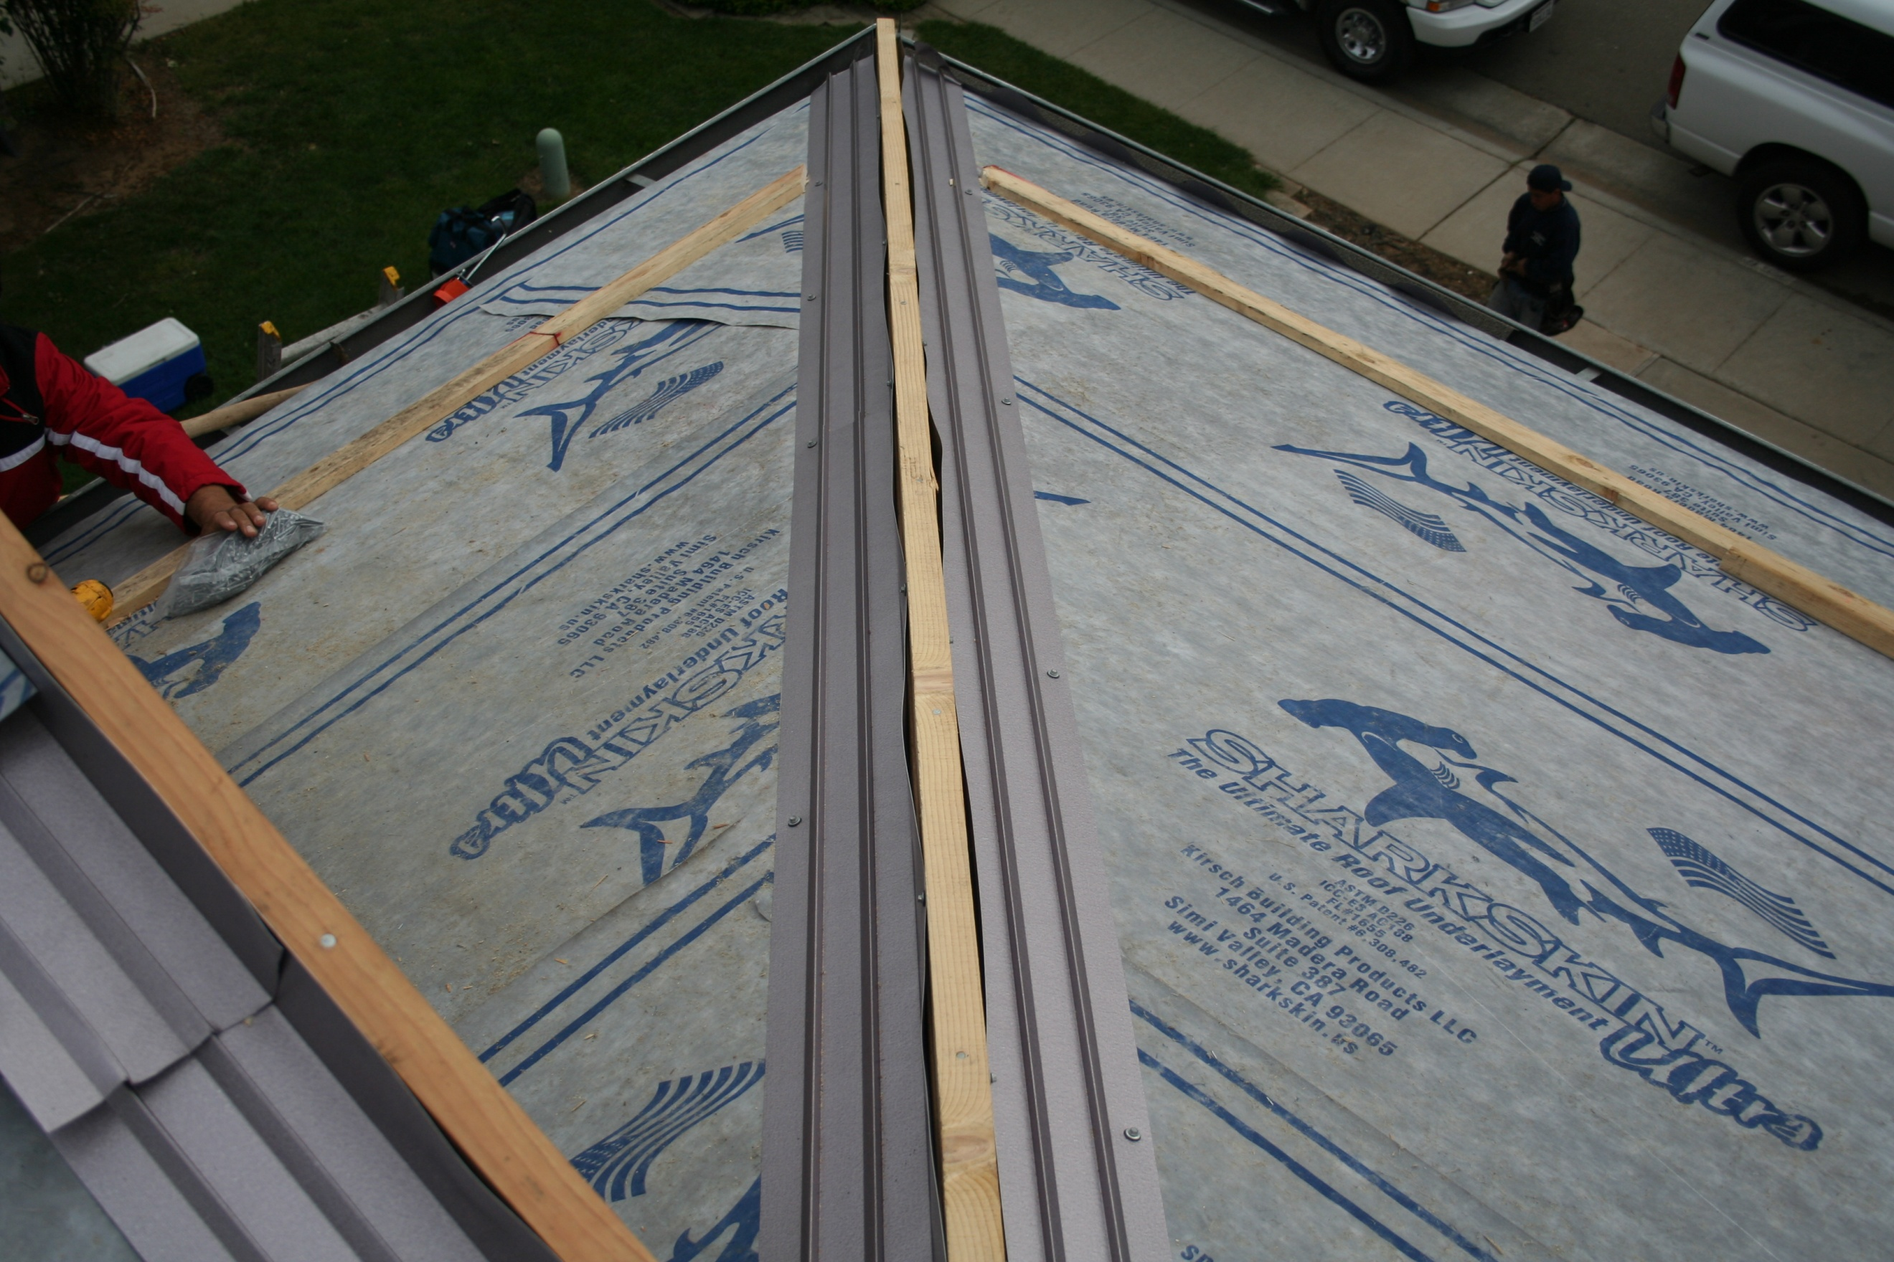
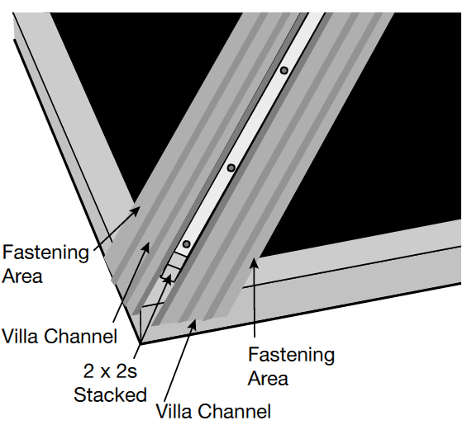
Villa Channel - Fastening
Overlap a minimum of 6” – fasteners are positioned outside the last rib.

Slide 14
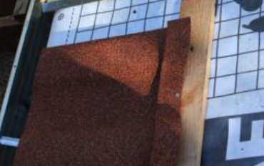
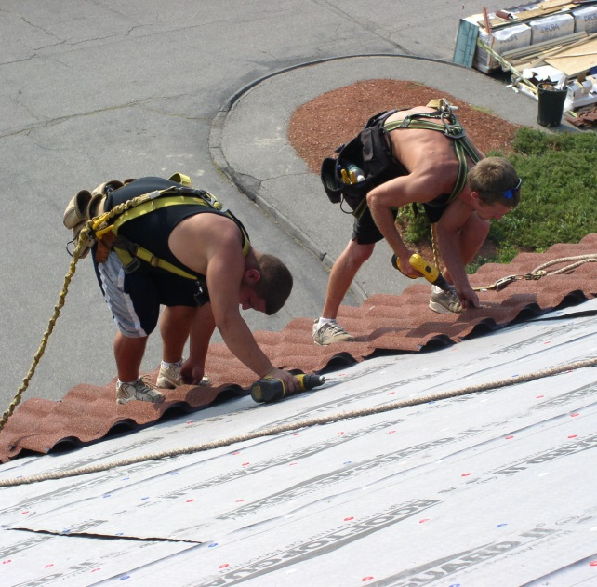
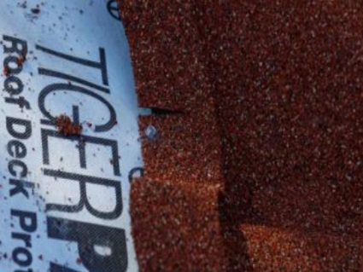
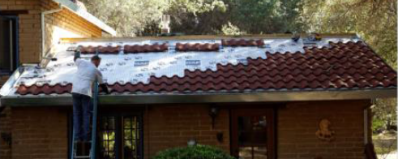
Panel Installation
First course of panels will be fastened at the back of the panel. The nose of the panel will be fastened during Bird Stop – Eave Installation.
Lay out panels and fasten as you go along - start at the fascia and work towards the ridge.
Driving Screws straight down perpendicular to the deck will ensure a tight finish and a straight alignment.

Slide 15
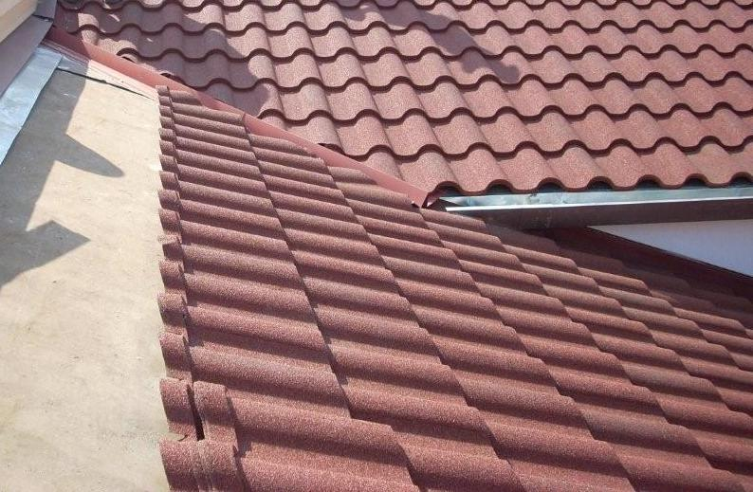
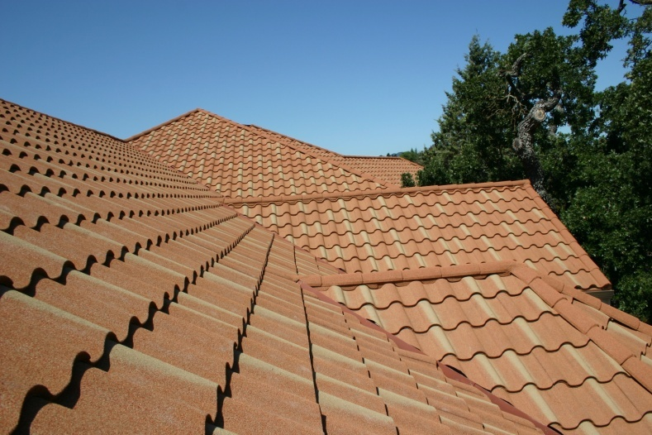
Panel Installation
Start at fascia and work up to the ridge. Start the first course with a full panel and the second course with a cut panel measuring 24.5”.
Measure panels and make cuts so the cut edge starts or ends in valley or channel metal.
Panels can be laid right to left or left to right – overlap area must be covered by overlapping panel.
Periodically check alignment by snapping a chalk line at 14-1/2” intervals.

Slide 16
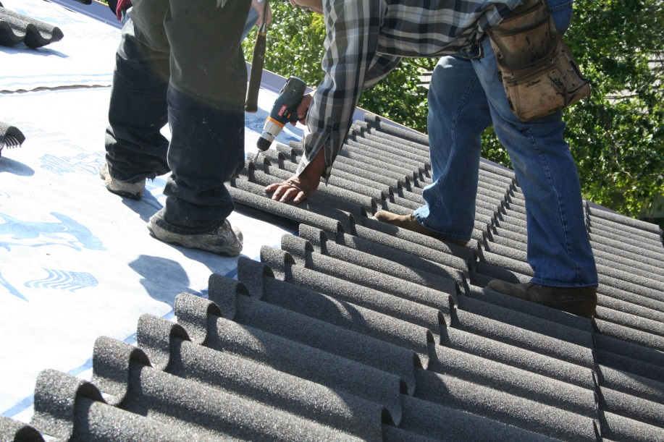
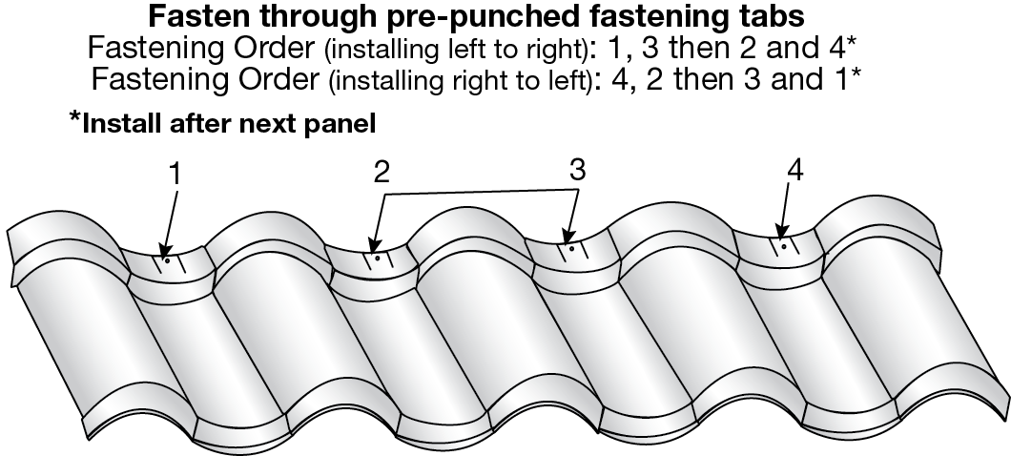
Fastening Panels
Attach second and subsequent courses of panels by locking the front of each panel into the back of the panel below.
Drive screws straight down into the deck to draw panels tight.
Fasteners: Minimum #9 Hex (1/4” diameter) x 1.5” Long.

Slide 17
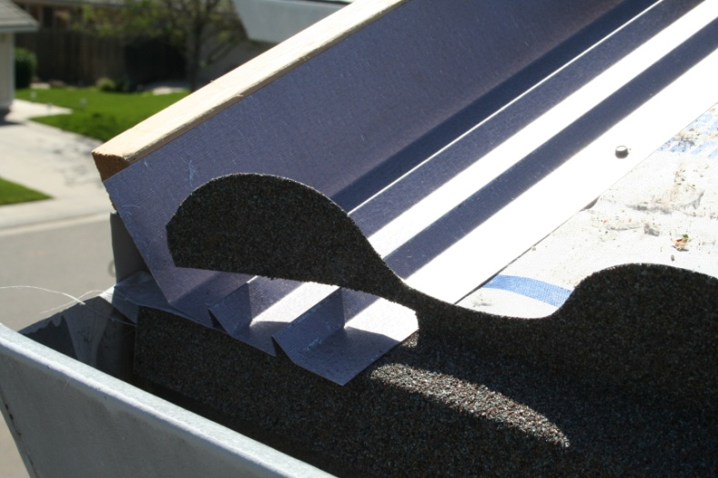
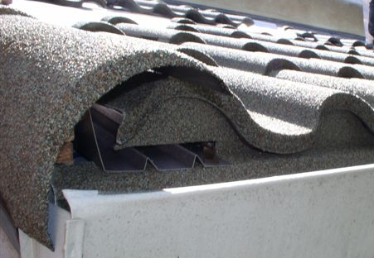
Villa Bird Stop - Eave
Install and fasten Villa Bird Stop – Eave after installing a minimum of two courses above the eave. (Required along the fascia)
Villa Bird Stop – Eave must be notched where it terminates into the Villa Channel – fasteners placed every 10”. Right and left edges notched in the same manner.

Slide 18
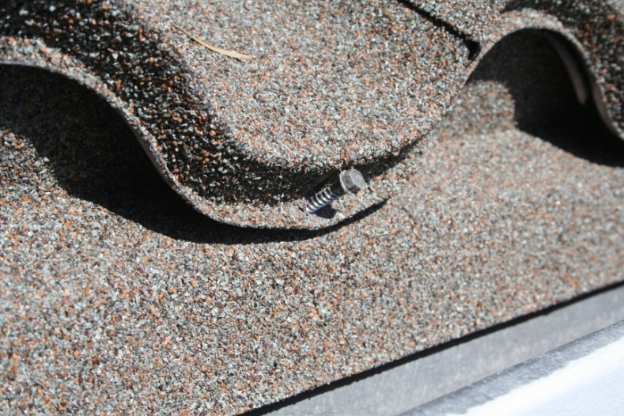
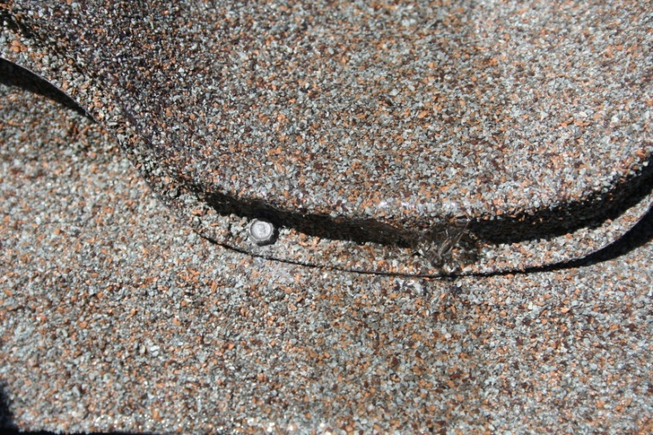
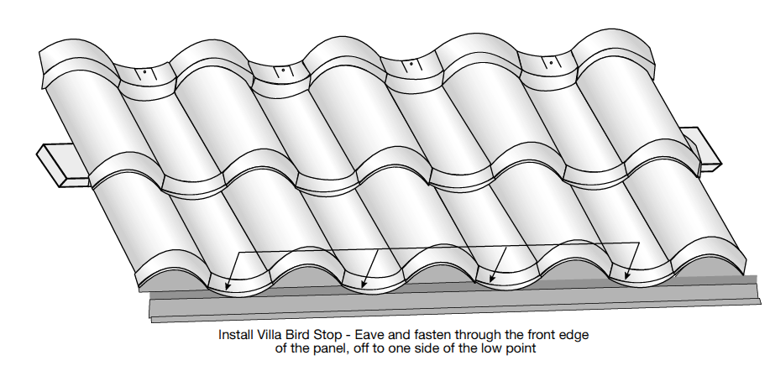
Eave Fastening
Fasteners will go through the nose of the panel and the Villa Bird Stop – Eave into the deck.
Ensure the Villa Bird Stop – Eave fits tight to the first course of panels without gaps.

Slide 19
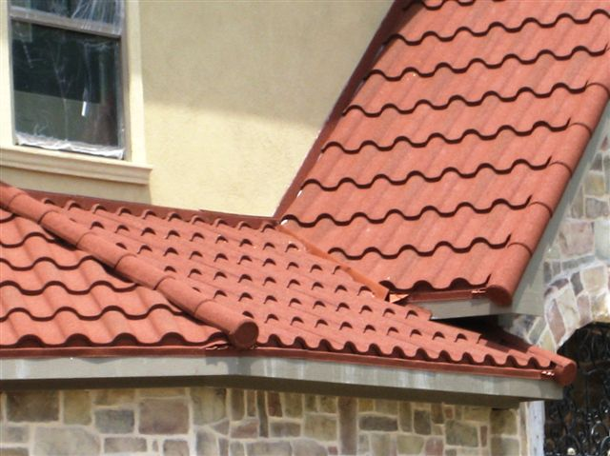
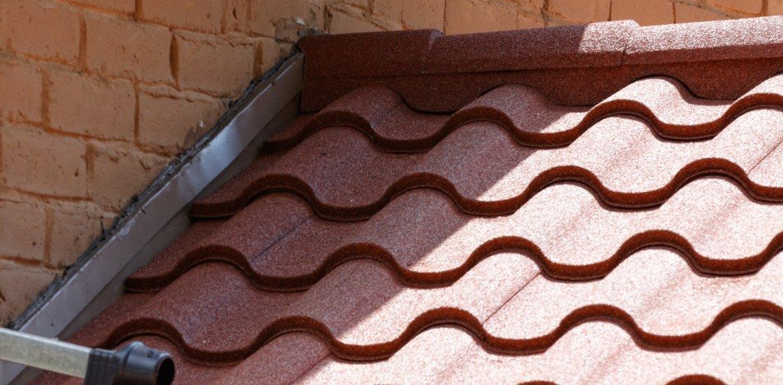
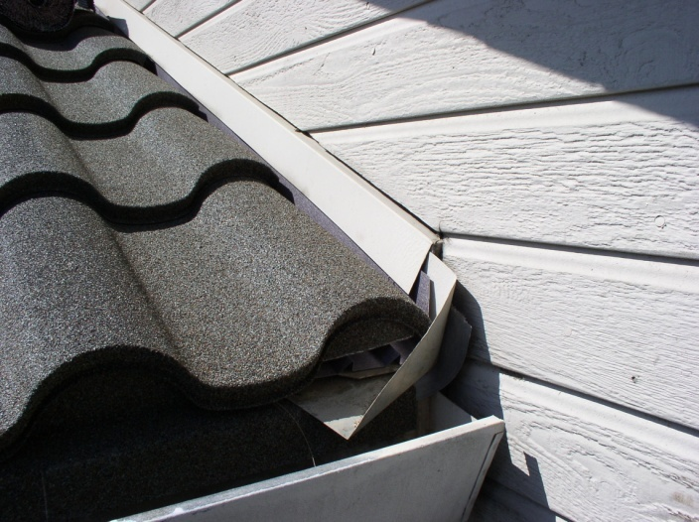
Panel Installation - Roof-to-Wall
Install panels up to the wall cutting the back of the last course so it fits tight – install Bird Stop – Ridge.
If wall flashing is present, tuck Villa Channel behind existing flashing – cut panel into the Channel.

Slide 20
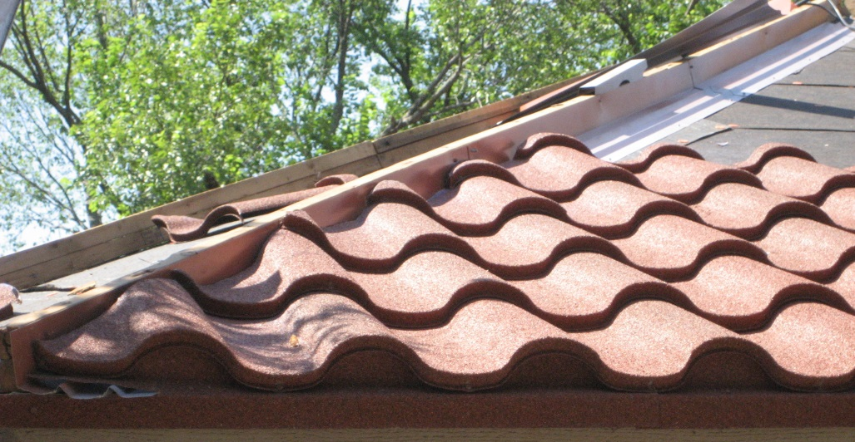
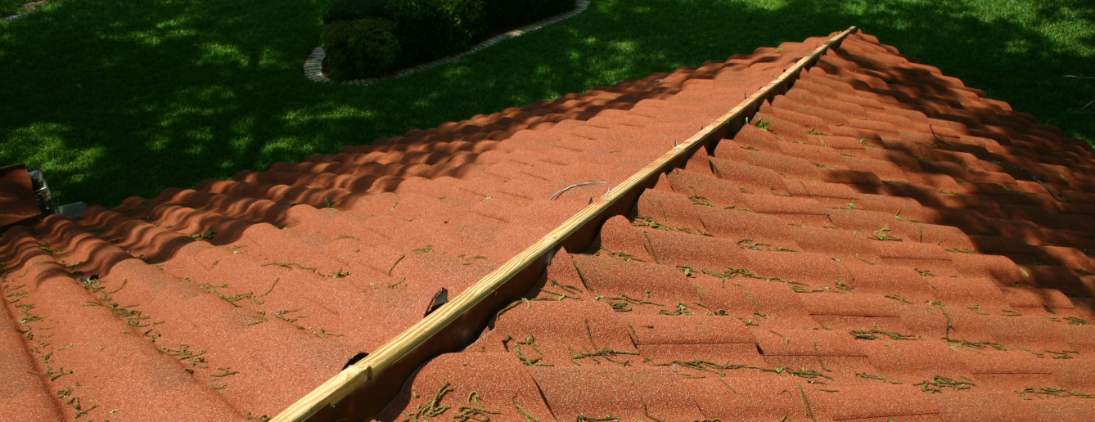

Panel Installation – Valley & Hip
Be sure to paint Villa Channel prior to installing panels.
On Both sides of the hips or valley, cut panels to fit into the Villa Channel.
Fit the panels into place and screw down.

Slide 21




Panel Installation - Ridge
Install panels up to the 2 x 2s at the ridge – cut the back of last course so it fits tight against the stacked 2 x 2s – use a hand bender to turn up the pan portion.
Install the Villa Bird Stop-Ridge by lining up with the back of the cut panel and attaching it to the stacked 2 x 2s – overlapping the last course.

Slide 22




Hip & Ridge
Install Hip and Ridge pieces along the rake/gables, hips and ridges. Overlap and fasten through top down into stacked 2x2s.
Use a Tile End Cap to cover open end of Hip & Ridge pieces at fascia/Villa Bird Stop – Eave.

Slide 23


Venting Preparation – Ridge Venting
If using DECRA Ridge Vent material, prepare the deck for ridge venting (without center beam) by cutting both sides of the plywood 3/4” from the center of the ridge to expose attic space, or as required by local codes.
Refer to Venting section or DECRA Ridge Venting wrapper for additional installation details.

Slide 24

Ridge Venting
If a vented ridge is desired, stack 2 x 2 battens and install along the length of the ridge, number of 2 x 2s will be determined by roof pitch. Use DECRA Ridge Vent and fasten to both sides of battens along the length of the ridge.
Install Villa Bird Stop – Ridge along the ridge and attach to 2 x 2s fastening through the Ridge Vent material. Attach DECRA Ridge Vent along the top of Villa Bird Stop – Ridge.
Cover the ridge with Tile Hip & Ridge.

Slide 25


Venting Preparation – Panel Vent
Calculate the number of DECRA Villa Tile Panel Vents* and estimate the approximate location.
Continue with the installation process until you reach the approximate panel vent location.
*DECRA Venting Calculator available at DECRA.com

Slide 26


Panel Vent - Installation
Install DECRA Villa Tile panels until you reach the approximate panel vent location. Carefully measure, mark and cut a rectangle hole 29” x 5” in the roof deck to match the opening of the underside of the DECRA Villa Tile Panel Vent. Install the panel vents as you would normal DECRA Villa Tile panels.
Notes:
Replace photo with photo of installed panel vent

Slide 27




Penetrations
Roof penetrations should be flashed with standard roof jacks over a Villa Underpan which drains over the panel immediately below.
Cut the Villa Underpan to fit tightly around penetration. Fit the pipe flashing apron to the underpan applying roofing grade sealant to both sides.
Finish by measuring and cutting panel to fit tight over flashing. align panel and seal around base. Use touch up kit as needed.

Slide 28



Chimney, Skylights & Dormers
Starting below the chimney, Cut Panels to fit the area. Bend up and fasten panels – See Ridge Installation. Use Bird Stop Ridge at the back of the cut panels below the chimney.
Use Villa Channel both sides and counter flash with side flashing or existing flashing.
Area above the chimney must be flashed and counter flashed. Use a chimney saddle bent to fit around the chimney.

Slide 29


Short Course
A short course is inserted by cutting off the back shelf of the lower panel and running the full panel above over the top – fasten through the nose into the high point of the panel below.

Slide 30


Pitch Change – Low to Steep
Install panels as normal up to the pitch change.
Cut panels and bend up to match steeper pitch. Fasten panel to deck through bent panel.
Install a 1x4 parallel to the ridge 14-1/4” from the pitch change.
Install first course on new pitch over the cut panels. Use closure foam or other sealing materials between panels.
Place a screw through the nose of the panel into the barrel of the cut panel to secure.

Slide 31



Pitch Change – Steep to Low
Install panels as normal up to the pitch change.
Cut panels 1” past pitch change.
Install a 1x4 parallel to the ridge 13-1/2” from the pitch change.
Install first course on new pitch over the cut panels. Use closure foam or other sealing materials between panels.
Place a screw through the nose of the panel into the barrel of the cut panel to secure.

Slide 32

Additional Installation Details
Where possible, Roofing Grade (Polyurethane) sealant / adhesive should be covered by roofing materials or by a matching stone granules.
Sealant should not be used to refinished damaged panel surfaces.
After Installation is completed, be sure to clean off ALL debris, ESPECIALLY any metal shavings.
DECRA Touch Up Kits are available in all matching colors and should be used where it is necessary to touch up or repair panel finishes.

Slide 33




DECRA Villa Tile Capri Clay
DECRA Villa Tile Amalfi Sand
DECRA Villa Tile Pompeii Ash
DECRA Villa Tile Venetian Gold

Slide 34






Helpful Online Tools
MyDECRA App is available for free download at the Apple Store and Google Play
Eagleview Premium Reports are available at gold level pricing through MyDECRA.
Comes with FREE DECRA Material list for ALL profiles.

Slide 35


Helpful Tools
DECRA Villa Tile Estimating Sheet
Call DECRA for additional details
800-258-9740
Support Materials available at www.decra.com

Slide 36





Code Compliance
Code compliance information can be found at http://www.decra.com/technical/product-evaluations

Slide 37
Ordering
DECRA Manufactured
  DECRA Villa Tile panels 25.2/Sq.
  Tile Hip & Ridge Piece
  Villa Channel
  Ville Bird Stop – Eave
  Villa Bird Stop – Ridge
  Villa Valley
  Villa Underpan 1/penetration
  Touch Up-Kit 1/15 Sq.
DECRA Sourced
  DECRA Ridge Vent material
  DECRA Villa Tile Panel Vent
  Minimum #9 Hex (1/4” diameter) x 1-1/2” long (min 5 screws/panel)
Other Sources
  1 X 4 Lumber total eave measurement
  2 X 2 Lumber at gable, hip and ridge measurement X 2
  Or 2 X 4 lumber at gable, hip and ridge total measurement
  Standard drip edge
  Pipe flashings
  (Alum works best)
  Underlayment
  Screen Mesh
  Paint

Slide 38
Tips & Tricks
Alternate installation direction every other course.
Install panels from the middle out for long runs.
Use a stitch screw at back flange overlap to “draw up” panel.
Work into valleys and hips.
Lower batten build up and notch Hip & Ridge at high points so the barrel fits tighter at low points.
Weave jack in with paper when using Underpan.
When cutting panel, cut through the back first – metal to stone coating.

Slide 39

CONTACT YOUR LOCAL REPRESENTATIVE FOR QUESTIONS & SUPPORT.

