Slide 1
Tuesday, September 24^{4h} , 2019
Empowering Policy Research in the Age of AI, Cloud and Big Data
By Jessica Kelly, Director of Research Programming @coder_jess

Slide 2
Our MISSION IS TO OPEN MINDS, SHAPE DECISIONS, AND OFFER SOLUTIONS THROUGH ECONOMIC AND SOCIAL POLICY RESEARCH.
About Urban
Notes:
Policy research means lots of different things. For my team in particular it means, running what if scenarios, data analysis
Program evaluation, technical advice.

Slide 3
Tech and Data Science at Urban
Unlock
Analyze
Inform
Notes:
At the Urban Institute, we are leveraging the power of technology and data to transform the way we deliver value and accelerate impact.
(data/unlock) We work to fill knowledge gaps by accessing new sources and types of data,
deploying cutting-edge methodologies to unlock them for rigorous analysis. (analyze/compute) Urban is refining policy design by leveraging advanced cloud computing, Artificial Intelligence (AI), machine learning, and predictive analytics to strengthen and enhance our microsimulation and policy analysis. Lastly, Urban is making high-quality information more accessible and interactive using new communication tools and technology (DataViz, APIs and Micro services).
Bridge to cutting edge technology

Slide 4
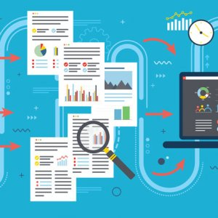
Today’s Policy Research Challenge
How to continue delivering Power through knowledge so all people can thrive in a fast-changing world.
Notes:
Facing society and trying to play a role in this question – closing knowledge gaps.
As we are informing policy, these are the challenges.
Today, how can we continue to make impact.

Slide 5
Policy Modeling Challenges at Urban
Traditional ways of working take a lot of time
Size, types and sources of input data
Complexity of modeling method and calculation
Dissemination and strategic communication of results
Reactive Urban takes a single policy proposal and evaluates the impact
Notes:
But we are up against some challenges. Going to focus in on the expertise we have in modeling and analysis. But these apply to many other areas of work.
1) Traditional ways of working take a lot of time. A policy change is proposed. Evaluate and consider how to model it, Do the coding and run the models (This running can sometimes, depending on the model, take almost a full day to run one policy alternative But on average, talking an hour or two to run one)
2) This only examine a few alternatives This analysis is reactive: Urban takes a single policy proposal and evaluates the impact
3) The size of the input data is growing. Want to use bigger data to be able to drill down into smaller areas. Instead of nation-wide, county-wide, for example.
4) Models are complex and have been developed over decades, so sometimes the complexity has been around for decades, and overcomplicated just because of the nature of software development. But also the algorithms themselves are just by their own natures complicated. Think about taxes for example, it’s not as simple as calculating income tax using tax brackets. There are all kinds of credits and options. Think about SNAP, and all the rules, and how they have changed over time around eligibility. Think about healthcare, or anything that involves a personal choice. Modeling that choice is inherently complex.
5) And then communicating the findings is also complicated, and requires different strategies and products depending on the audience.

Slide 6
Housing Market Forecaster Model Story
Notes:
But this is all also true of any model that is built from the ground up, and hasn’t been widely used in decades. So to explain the challenge further, I will tell you a story about a microsimulation model developed by Urban in the seventies: housing market forecaster:

Slide 7
In 1970’s
Notes:
In the seventies, the model was written to show what might happen if we made changes to housing stock available. What would people do in a east coast city if the type of housing units available and the cost of those units were revised? How would people in a Midwest city react? What about the west coast and the south? Would it be different? There were of course, more limitations to the computation and the application of the calculus to come up with the required probabilities. For various reasons, this model stopped being used and developed. The source code – in pascal – is lost to the ether. But given however, interest in examining these questions again at a regional level – how would changes in the city center impact and cascade out to the suburbs and exurbs? We decided to try and resurrect this model.

Slide 8
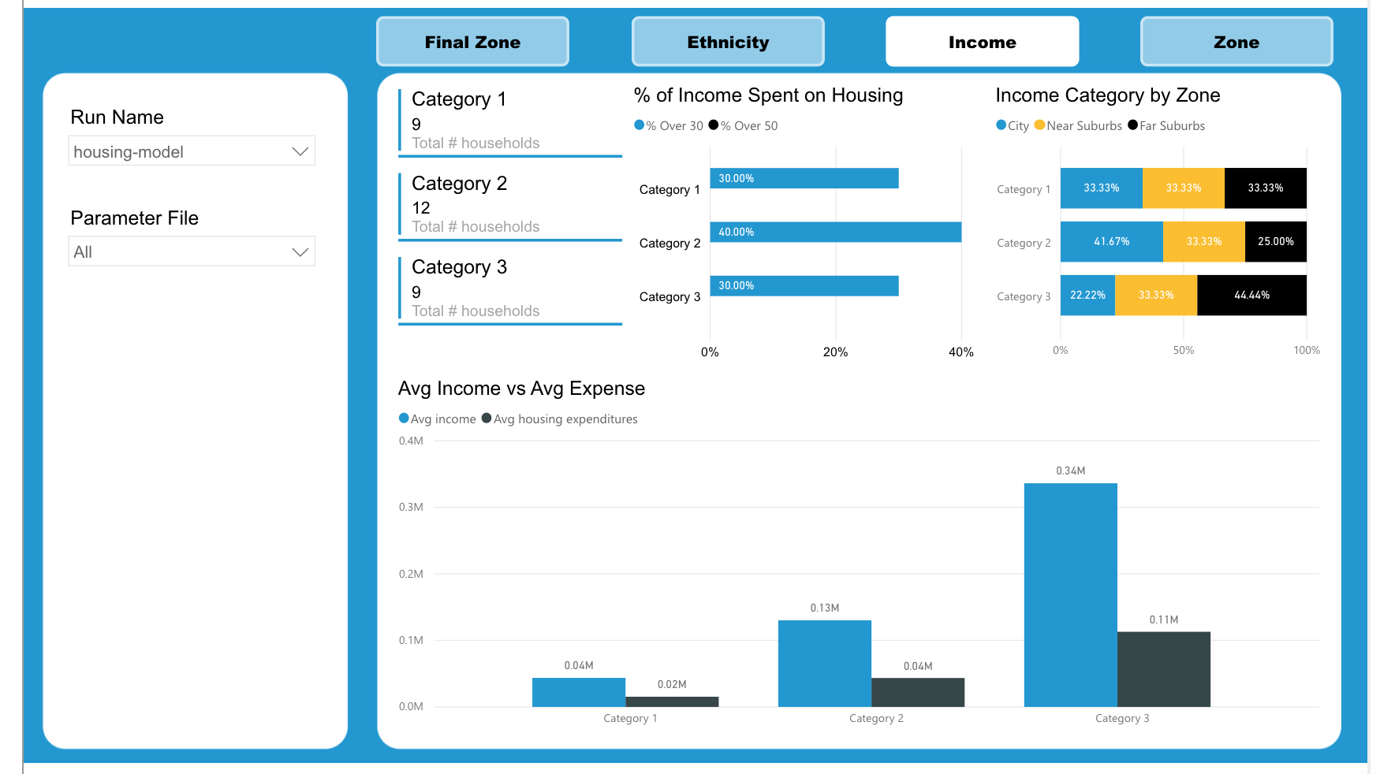
In 2019
Notes:
The math behind this model hasn’t changed. And today, the model is being re-written and we envision a dynamic set of dashboards that different types of users can use. ….
As mentioned before, one of the things we want to change is running one model or policy proposal at a time and saying what that would do. We want to Removing these barriers to flip this paradigm and be proactive: Urban first evaluates the impacts of 1000s of policies and finds which ones have the optimal outcome.
Time to react and have impactful insights is quicker
Proactive: Urban first evaluates the impacts of 1000s of policies and finds which ones have the optimal outcome
Rapid response to fast-changing policy decision needs

Slide 10
How did we get here?
Investment
Leadership
Resilient infrastructure
Cloud Computing &
Modern Architecture
Agility & Rapid Prototyping
Accelerating Innovation
Notes:
So how did we get here? There are many things that changed at Urban especially in the last five years when we embarked on our digital transformation journey: institutional investment and leadership, building resilient infrastructure and continuous operating model, migrating to the cloud, increasing agility/ adopting agile practices and rapid prototype approach , to accelerating innovation and applying cutting edge technology in policy research
The fact is, we have fixed a lot of issues/problems on the infrastructure side, and want to do the same on the technology used for research side. In the same way that an old access system running timecards is risky, so is, running model code in isolation in a researcher’s office.
For today’s presentation I will focus on three areas mainly and their impact in empowering urban and policy research :
The modernized architecture in the cloud
And the rapid prototype approach to increasing agility and Urban’s capability of rapid response to the fast- changing policy world
And touch a little on the accelerating innovation

Slide 11
Modern Architecture – Multi-layer
Data
Computing
Results
Interface
Notes:
Should also remind everyone of multitier architecture where we split data, compute and results into three distinct layers. However, here we connect them all with a set of small APIs that can get and send the information between components.

Slide 12
Separate Components, Separate Jobs
Data layer: Input and data sources
The compute layer: is all about the algorithm.
Results layer: synthesizing and creating summary and output
Interface layer: using APIs
Notes:
The data layer is simply concerned with the inputs needed. What are they?
The compute layer is all about the algorithm.
And the results layer is about synthesizing and creating summary measures
By using APIs we can design different interactions between computations that use the same data, interfaces that use the same results.

Slide 13
Rapid Prototyping
Iterative approach
Small investments at each step
Where to start? Which layer?
Notes:
That sounds great, but how does this work in practice? Two projects, each have a component of data, compute and results
Rapid prototyping: Quickly develop, validate and iterate
Start simple, add layers of complexity over time
Small investments at each step
Where to start? Data? Compute? Results?
Data wasn't even developed
Compute is complicated
Results? What is even useful?

Slide 14
Rapid Prototyping
Hierarchal
Simultaneous
Notes:
I’ll explain two different approaches to rapid prototyping, examples of each. I like to call them this:

Slide 15
Simultaneous Rapid Prototyping
Building a new housing forecaster model
Notes:
Back to that housing model

Slide 16
Building new microsimulation model
Version 1
Version N
Version 3
Version 2
Notes:
Back to that ”Where to start” question? Input? Compute? Results? I call this the “simultaneous” approach because…. – it works on all of those components at once with each version.

Slide 17
Building a new microsimulation model
Continuous development
Expand features
Create MVP
Validate Technology
Notes:
Meaning that in each step we will have a complete development cycle for the data, compute and results layer
And we will have several versions that build on each other.
Version 1. (Validate tech)
Initial input File
Compute shell
Initial output File
Validate technology - Data layer: how do we store it, what do we need to send to compute and how do we do that. Compute layer: how is the computation triggered, how do we save results, Results layer: how does the user get results. SIMPLE, working out the technology components we will use. TEST and make decisions.
Version 2 (mvp)
Input form to create file
Additional data
Some portion of the model
Display of results
Data Layer: add a form and an API to add data in and out. Add ”real” data as it is developed. Analysts working to combine sources and create this input
Compute Layer: Putting in some components of the “real” model.
Results Layer: easy viewing of tabular results
Begin to use the whole system for development as we go now. Not just a skeleton, but at this point, actually usable.
Version 3 (expand)
Edits to input form
Additional data
Revise and extend model
Initial dashboard of results
Focus here is on further development of each component and maturity/ease of use
As we use the system for development of the model, runs, figuring out what kinds of analysis are desirable make edits to each layer. Data gets revised and updated, the input form is further revised, the model itself is developed further, and the dashboard of results is revised and updated
Version N
New inputs and data
Revise and extend model
Revise tables and dashboard according to audience

Slide 18
New Housing Forecaster Model in Azure
Accomplished over the course of 4 months
Expanded capability for new housing market questions to be answered
Prototype funded by Technology for Social Impact grant from Microsoft Philanthropy
Notes:
Accomplished over the course of 4 months by leveraging a great team, partners, and a Technology for Social Impact grant from Microsoft Philanthropy
Because we had been thinking and clear on what we wanted to achieve made it easy to do the pitch and do the work.
Opening doors for new questions to be asked and answered.
Compute example and how it has changed (back to that more runs and being proactive part) and the calibration process.
The housing model is a great example of how running thousands of iterations is impactful. In the model there is a calibration process. Instead of a user manually adjusting some upfront parameters for sensitivity and mathematical assumptions, we generate a large set of these parameters that we run through the model and find the set that best calibrates the model. (ie matches the baseline. – we run 2000 to 2010 and compare to known reality.)
And another example of limitation?
Data, compute and interaction impact.
Foundation that can be used for another feature, another city etc.
And an example to show to people to understand what it is that we wanted to build. City or a region dashboard. Could put it in the hands TO USE, not just to view of someone else.
Could do this pattern for other work – other models, education calculators, and also have used for tax policy proposals. Impacts all of modeling.

Slide 19
Hierarchal rapid prototyping
Building a new data bias assessment tool
Notes:
Second way to approach it, and we’ll talk about why you would pick one over the other in a minute, is a hierarchical approach – working on one component at a time. Did this with our bias assessment tool.

Slide 20
The challenge with biased data
Governments want to make equitable policy decisions using reliable, representative data
Biased data leads to biased algorithms and biased results
Availability of data with spatial information
Notes:
Governments want to make equitable policy decisions using reliable, representative data
Representative in this context means geographically representative
Biased data leads to biased algorithms and biased results
Barriers are around:
Data needs to contain spacial information (Unlock)
Complexity of calculation (Analyze)
Communicating results (Interact)

Slide 21
Examples of policy decisions impacted by biased data
Measuring equity in allocation of local infrastructure, investments, services, and hazards
Park locations, affordable housing, building permits, trash collection centers
Measuring under/over-reporting in resident generated data
311 data, Snowplow request data
Any geographic data
Notes:
So for example. If we want to measure equity in local infrastructure we would use data on …
If we wanted to look at over/under reporting
And we can additionally think of examples using any other geographic data. We know from Census and ACS data what the population is reported to be, and we can compare our data of interest to those proportions.
But geographic data can sometimes be hard to find that’s coded properly, and with the latitude and longitude detail we need.
In general, the algorithm:
Geocode the dataset to a specific city
Pull geographic and demographic data for that city
Compute which Census tract each data point falls into
Calculate spatial equity metrics
Calculate demographic equity metric
Assess statistical significance of our equity metrics

Slide 22
Revise
Validate
Test
Develop Algorithm
Revise
Validate
Test
Develop Interface
Notes:
So what do we do -- We have this idea and we think it will be useful. Let’s find out if it is. Typical design cycle. In two steps. First develop the algorithm, validate it, and then develop the interface based on how it is used.
Algorithm takes in a CSV, does calculation and creates a CSV.
Developed some internal ideas on what the initial interface should be. (I’ll show in a second)
Next phase will be to develop the interface

Slide 23
New Data Bias Assessment Tool
Initial algorithm was built over 8 weeks summer internship
Refine algorithm overtime in iterative approach
Have working prototype with value to policy decision makers and interest in building a public interface
Notes:
Developed initial algorithm over the course of a summer internship.
Continue to refine algorithm, add to capabilities, build new geographies and make comparisons over time. Each project a small investment.
Have proven use-cases to help show value in making the tool more robust and to build out public-facing interface(s).

Slide 24
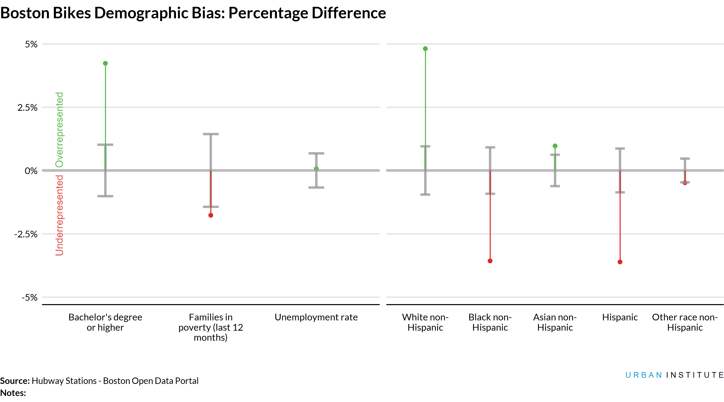
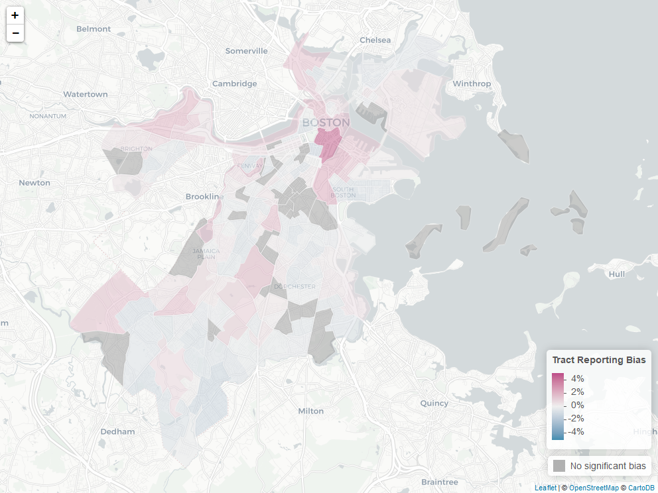
Ideate for the future
Upload Data
Export Data
Notes:
By using across projects internally, learn how people want to interact with the tool, and what results are useful. Then develop those interfaces.
And we are working on funding the second interface stage.

Slide 25
Hierarchal
Simultaneous
Vs
Small teams (1 or 2 people) | Bigger teams (3 or more)
Lots of unknowns | Experience with something similar
Weeks to develop something | Months to develop something
Notes:
This is what we learned. Not prescription, but what we have found. So when does one take the simultaneous approach? When to do things in a hierarchical manner?
Depends on the team, and depends on the time, and depends on experience.
Lots of unknowns means: For example, think the algorithm will work, but not sure. Need to prove that this idea is a good one first.
Experience means: know the algorithm works. Or have built a similar interface before.
Accelerating innovation because we want to give people choices to what to do.
Failing fast as we surface 10 ideas and what to know which is the best road.

Slide 26
Benefits of Rapid Prototyping
Answering complex questions, but doing it quickly and effectively
Collaboration at each level/layer between technologists and researchers
Comfort in change and revision
Speed and independence
Different products for different audiences possible
Components are portable
A series of small investments
Notes:
Ones I want to highlight are Collaboration and Comfort in change and revision.
So many projects can get caught up in that “what do I do first” stage. Thinking about what the prototype, first version and second version will be helps to break this habit of having to have everything perfect. Particularly, I see this in interface design, and in having all the options understood in the compute/algorithm.
Also remember that we want to empower people to do things. Doing them small, and building can also help that.

Slide 27
Impact
Rapidly unpack how predictive analytics are shaping society and respond to fast-changing policy decision needs
Transform the way policies are shaped and designed
Democratize data and improve Urban’s policy research and analysis
Reduce discrimination in policy decisions and support advocates and community groups in holding their leaders accountable
Provide companies, governments and others with guidance on what data to share and when, to best serve the public’s interest
Notes:
Become an empowered institute with experts who get technology and can rapidly unpack how predictive analytics are shaping society
Give people a quick way to build something and test and idea.
Rapid response to fast-changing policy decision needs
Transform the way policies are shaped and designed and becoming proactive by evaluating the impacts of 1000s of policies and finds which ones have the optimal outcome
How we are becoming this kind of institution:
designed and becoming proactive by evaluating the impacts of 1000s of policies and finds which ones have the optimal outcome
Democratize data and improve Urban’s policy research
Reduce discrimination in policy decisions and support advocates and community groups in holding their leaders accountable
Provide companies, governments and others with guidance on what data to share and when, to best serve the public’s interest

Slide 28
More Information jkelly@urban.org @coder_jess Data@Urban Blog medium.com/@urban_institute/

