Slide 1



Welcome
Don’t worry!
We can’t see
or hear you.
VBS is NOT Cancelled
Please take a moment to locate the chat window at the bottom of the Zoom Webinar controls. Feel free to say hello or ask your first question using the Q&A feature.
2-Day Event from
Ministry Online
A WEBINAR BY
We’re recording and will share the replay after we wrap.

Slide 2


Slide 3

Day 1:
Prepare your VBS
A WEBINAR BY

Slide 4
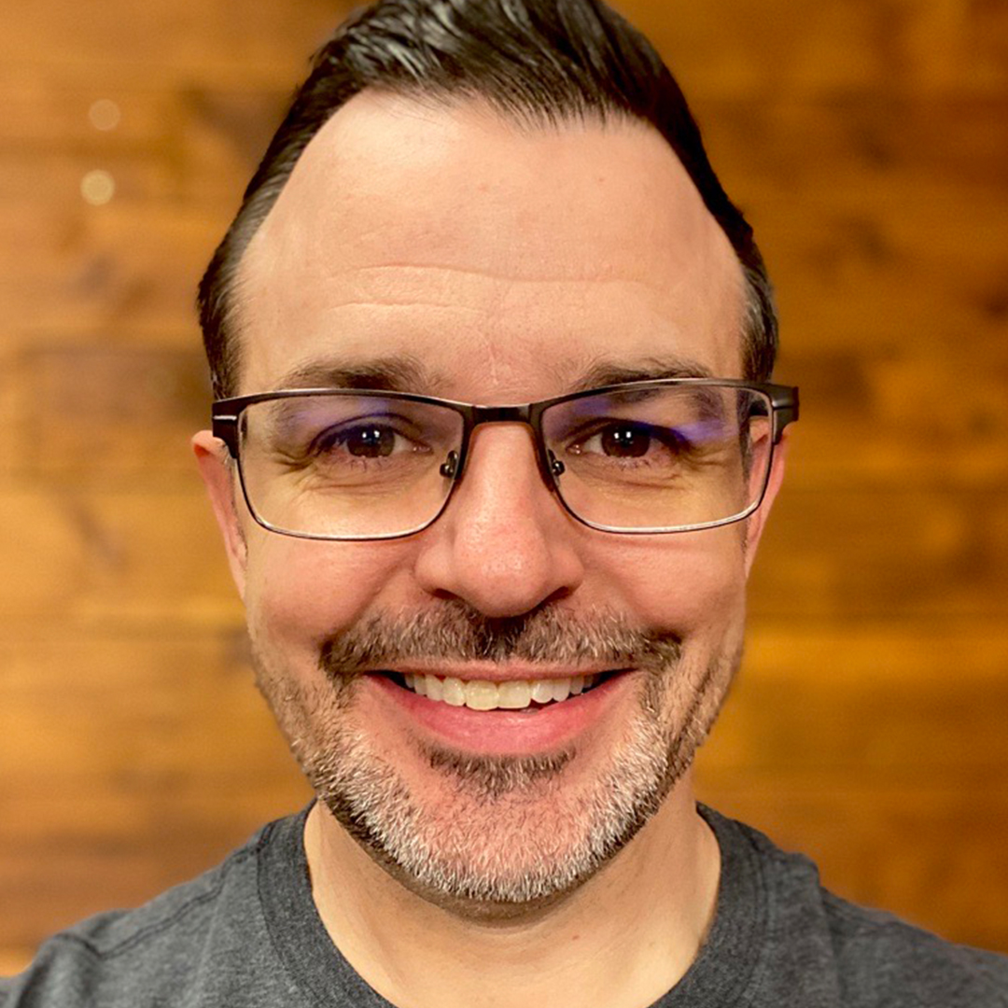

Introductions
David Choate
Timothy Cross
Sharefaith Kids
Ministry Brands Director
Sharefaith Media
Ministry Brands Director

Slide 5


Slide 6

Resources
Questions: CareTeam@ministrybrands.com
Resources: online.ministrybrands.com

Slide 7



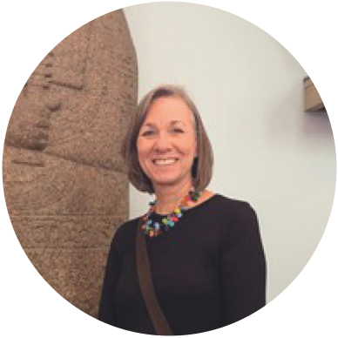


Today
Prepare Your VBS
Onboarding & screening volunteers
Online outreach & follow up communication
Managing event registration
Equipping teachers with tech
Liz Ross
CHILDREN’S MINISTRY VETERAN
Notes:
We don’t have to tell you that COVID-19 has (once again) changed the landscape of how we “do church.” That’s why we created this 2-day event. We’re here to let you know that VBS is NOT cancelled!
Today, we’ll focus on preparing for online VBS.
Liz Ross- She was in children's ministry for 20 years and works part-time for MB now. She's worked for several churches.

Slide 8


Tomorrow
Presenting Your VBS
Yancy Ministries
Notes:
We’ve got a big day planned for tomorrow, so be sure to tune in -- same place and time -- because we’re going to show you a step-by-step template of what it looks like to host a virtual VBS. We’re going to share <list resources>.

Slide 9
Day 1:
Prepare your VBS
A WEBINAR BY
Liz Ross
CHILDREN’S MINISTRY VETERAN

Slide 10
Day 1:
Prepare your VBS
A WEBINAR BY

Slide 11
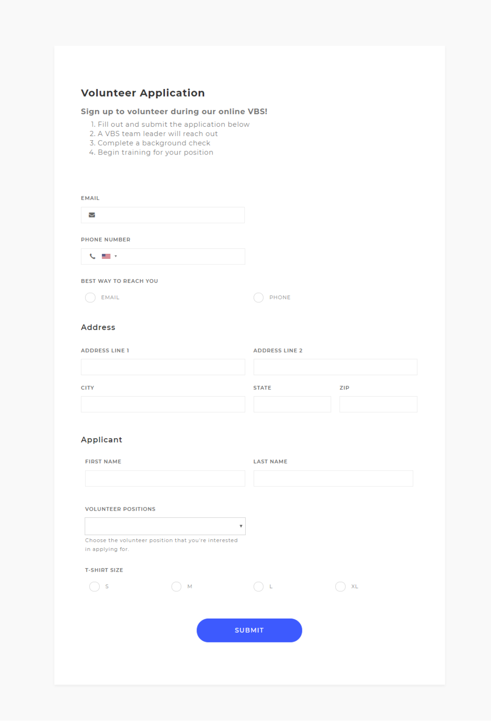

Onboarding Volunteers
Make it easy to sign up
Complete background checks
Provide a clear list of action items
Set permissions for volunteers working in your systems
Notes:
No matter how you run your VBS, volunteers play a big role, so you have to make it incredibly easy for them to sign up. If you use our giving platform or church management software, you can go to Forms in your dashboard, and customize a quick volunteer sign up form and then put that on your website. Send out an eblast to your list of your people with that link, and they can sign up from there. And you can manage all that information within those systems. We have a video that shows you how to create these types of forms.
Even though we’ve stepped out of our everyday, you still need to perform your due diligence and properly onboard volunteers.You can’t dip out of that mindset that you don’t need to complete background checks because you're online. We work with Protect My Ministry and they have a free ebook on Cyber Security that we’re going to give to you today.
Once they’re onboarded, communicate their responsibilities whether it’s running a small group in a zoom room or making VBS kits to be mailed out. If you have them working in any of your systems, be sure to set permissions, so they only access what they need, and they can’t look at financials or donor information or other sensitive information.

Slide 12
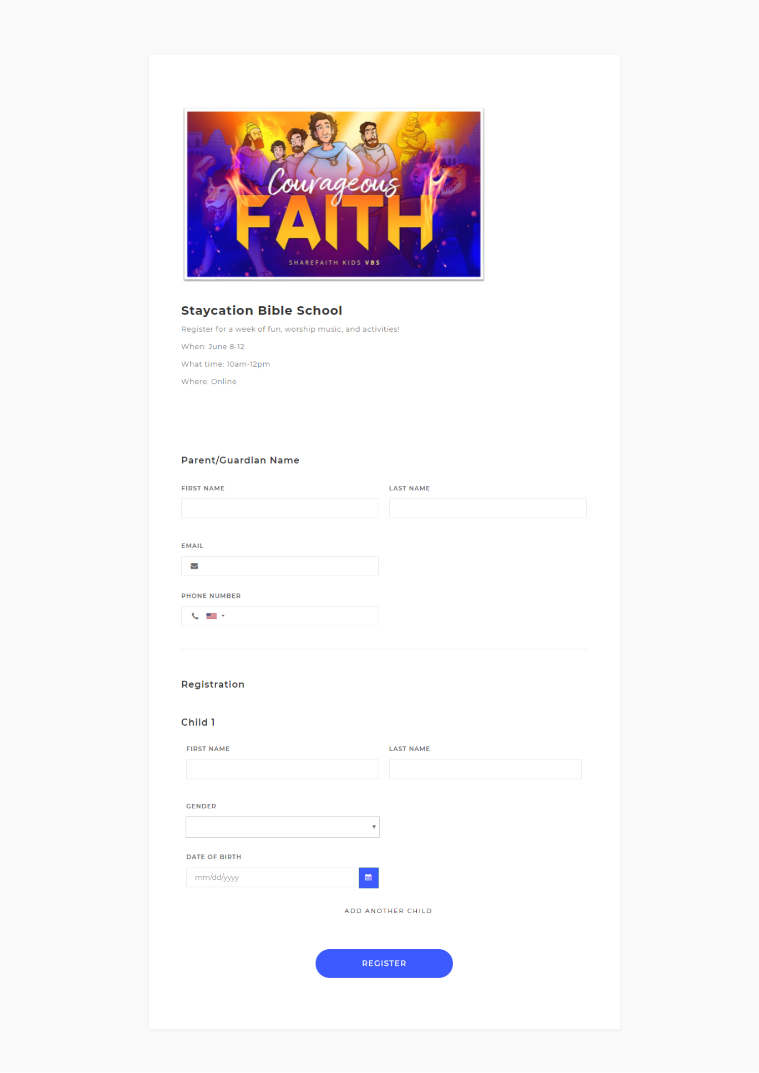

Inviting parents and kids
Send eblasts with a link to the registration form
Announce your VBS on social media
Create 2 videos
  1 for parents that details what they can expect
  1 for kids that speaks directly and gets them excited
Send mass SMS text messages
Call people on the phone
Send postcards
Notes:
While making your volunteer sign up form, you can also make your registration form, and add it to your dedicated VBS page on your website. Remember, these are super customizable, so narrow down the registration form to meet your specific needs.
For instance, if you’re offering multiple times in a day for the same session, but want to cap each group at 15 kids, you can add a field that only allows 15 to sign up per session and then it closes that timeframe out. You can also capture the information you need like t-shirt sizes or age groups. You really have endless possibilities with Forms.
Once you’ve created the registration form, it’s time to invite everyone:
Send eblasts with a link to the registration form
Announce your VBS on social media
Create two videos
one for parents that details what they can expect
one that speaks directly to kids to get them excited
Send mass SMS text messages
Call people on the phone
Send a postcard

Slide 13













Our Church Management Platforms

Slide 14











Our Giving Platforms

Slide 15
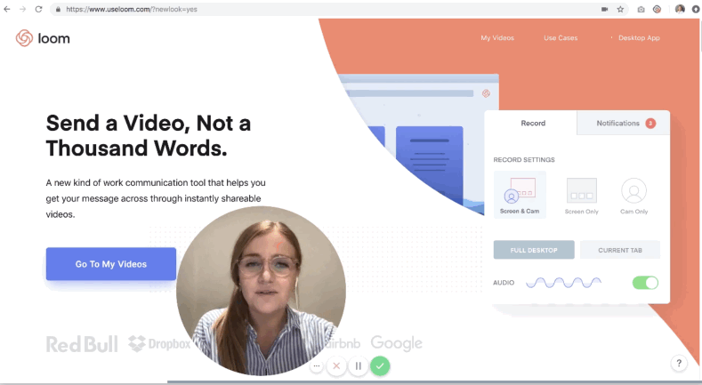
Communicating with parents
Communicate often and early
  Phone calls and emails
  Loom
  Social media
  Website
Communicate what the experience will be like
  Why is this unique from online school?
  What will you be discussing?
Communicate expectations
  How much time will it take on their part to prepare?
  Will they have to download videos or Zoom?
  How long will it last?
Notes:
Remember that parents are going through a lot right now. The most crucial part of communicating when it comes to parents, are:
Communicate often and early – Keep them in the know about your plans as early as possible, so they can make the necessary arrangements. Even though we’re all at home, it can still be stressful to get the kids settled and activities ready in the last minute.
Call or email them with updates and share your plans on social media. And always, keep your website updated. Create a dedicated VBS page that they can bookmark, and refer back to.
Communicate what the experience will be like – Emphasize what makes this experience unique from online school. Parents are growing weary, and online school can be a struggle. You want to show that this is different.
Communicate expectations – this is the basic logistics of how your online VBS will work and what they’ll have to do. You can make checklists or create videos for them to watch with instructions.
Loom is a video communication tool that makes it incredibly easy to share instructions. It can be better than writing out an email, and there’s a free version. You can create a small presentation that walks parents through the exact steps to use the platforms you’re VBS is hosted on.

Slide 16




Equipping Teachers with Tech
Pre-Recordings
Notes:
Most of you are probably getting pretty familiar with tech by now, but here are some of our favorites.
Why we like Zoom
Free for attendees to use
Free plan options (with limitations)
Meeting passwords for added security
Breakout rooms for smaller groups
Fun virtual backgrounds
Live Streaming
Live streaming or Facebook Live sessions are also great options to help break things up a bit and reach more people.
Pre Recordings
Can be made ahead of time and sent directly to parents in an email.
Church App
Live streaming and pre recordings can be made accessible on your church app, so kids can watch them from their tablet when they want, and they can watch them as much as they want.
Right now, with our $0/month giving plan, our full-featured church app is completely free.

Slide 17
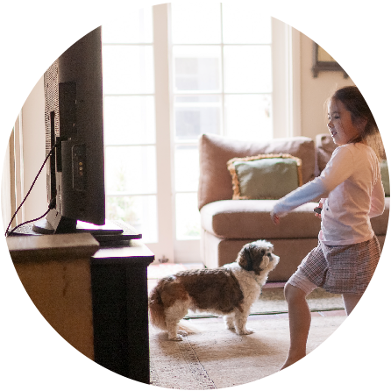
Inspiring Kids
Engaging: Video content that captivates your kids and holds their attention.
Interactive: Content that allows your kids to participate (videos/worksheets).
Personal: You are the resource that your kids need most!
Notes:
<David can speak to choosing a curriculum>
Create special messaging just for kids to let them know what activities are lined up.
Kids are asking how they can help during this time. A few ways are:
Encourage them to use good hygiene and review the best practices for hand washing (use a fun song for this)
Have them draw pictures to hang in their front windows thanking first responders like nurses, delivery drivers, and more. You can also share these pictures on social media and your website.
Keep it simple

Slide 18
Tomorrow
Presenting Your VBS
Yancy Ministries
Notes:
We’ve got a big day planned for tomorrow, so be sure to tune in -- same place and time -- because we’re going to show you a step-by-step template of what it looks like to host a virtual VBS. We’re going to share <list resources>.

Slide 19
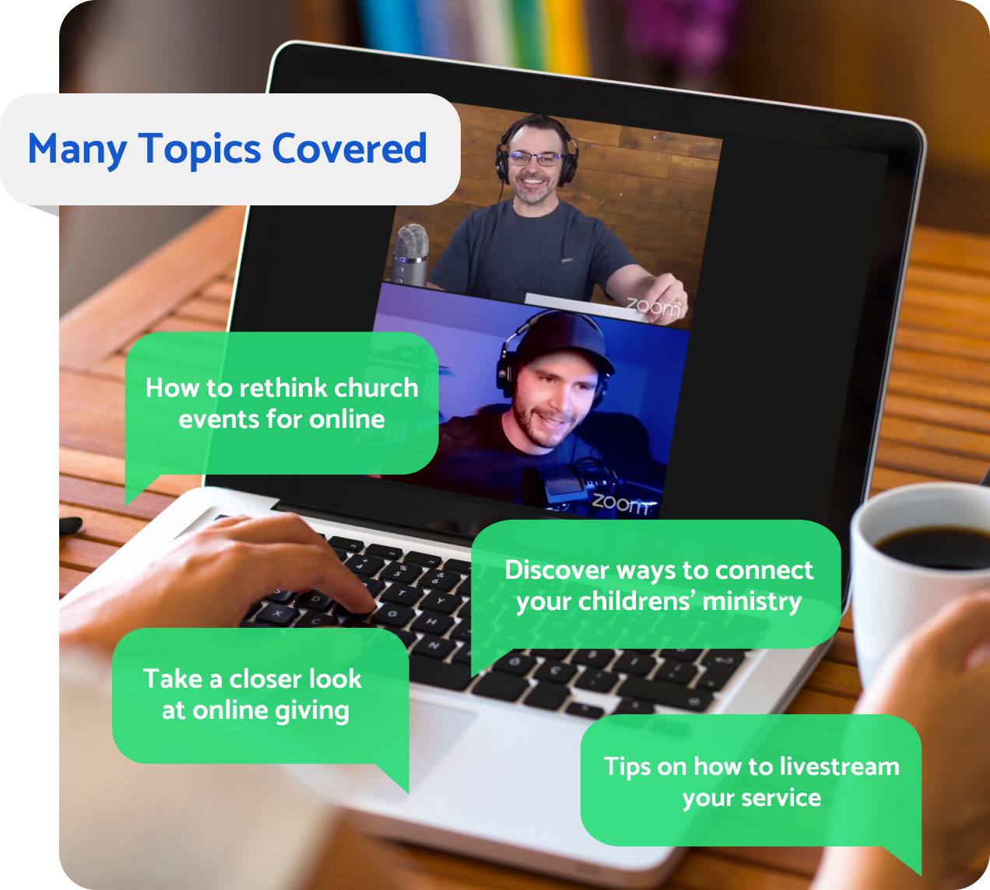
Ministry Online
A Weekly Webinar Series to Help You
Do Church During COVID-19 & Beyond
Thursdays at 2PM ET
Register Now to Access
All Trainings Live & On-Demand
A WEBINAR BY

Slide 20





Need help with tech?
Email us at CareTeam@ministrybrands.com​
Streaming
Church Management
Online & Text Giving
Mobile App
Background Checks

Slide 21
Thank you for joining us today!
Questions: CareTeam@ministrybrands.com
Resources: online.ministrybrands.com
A WEBINAR BY

