Slide 3
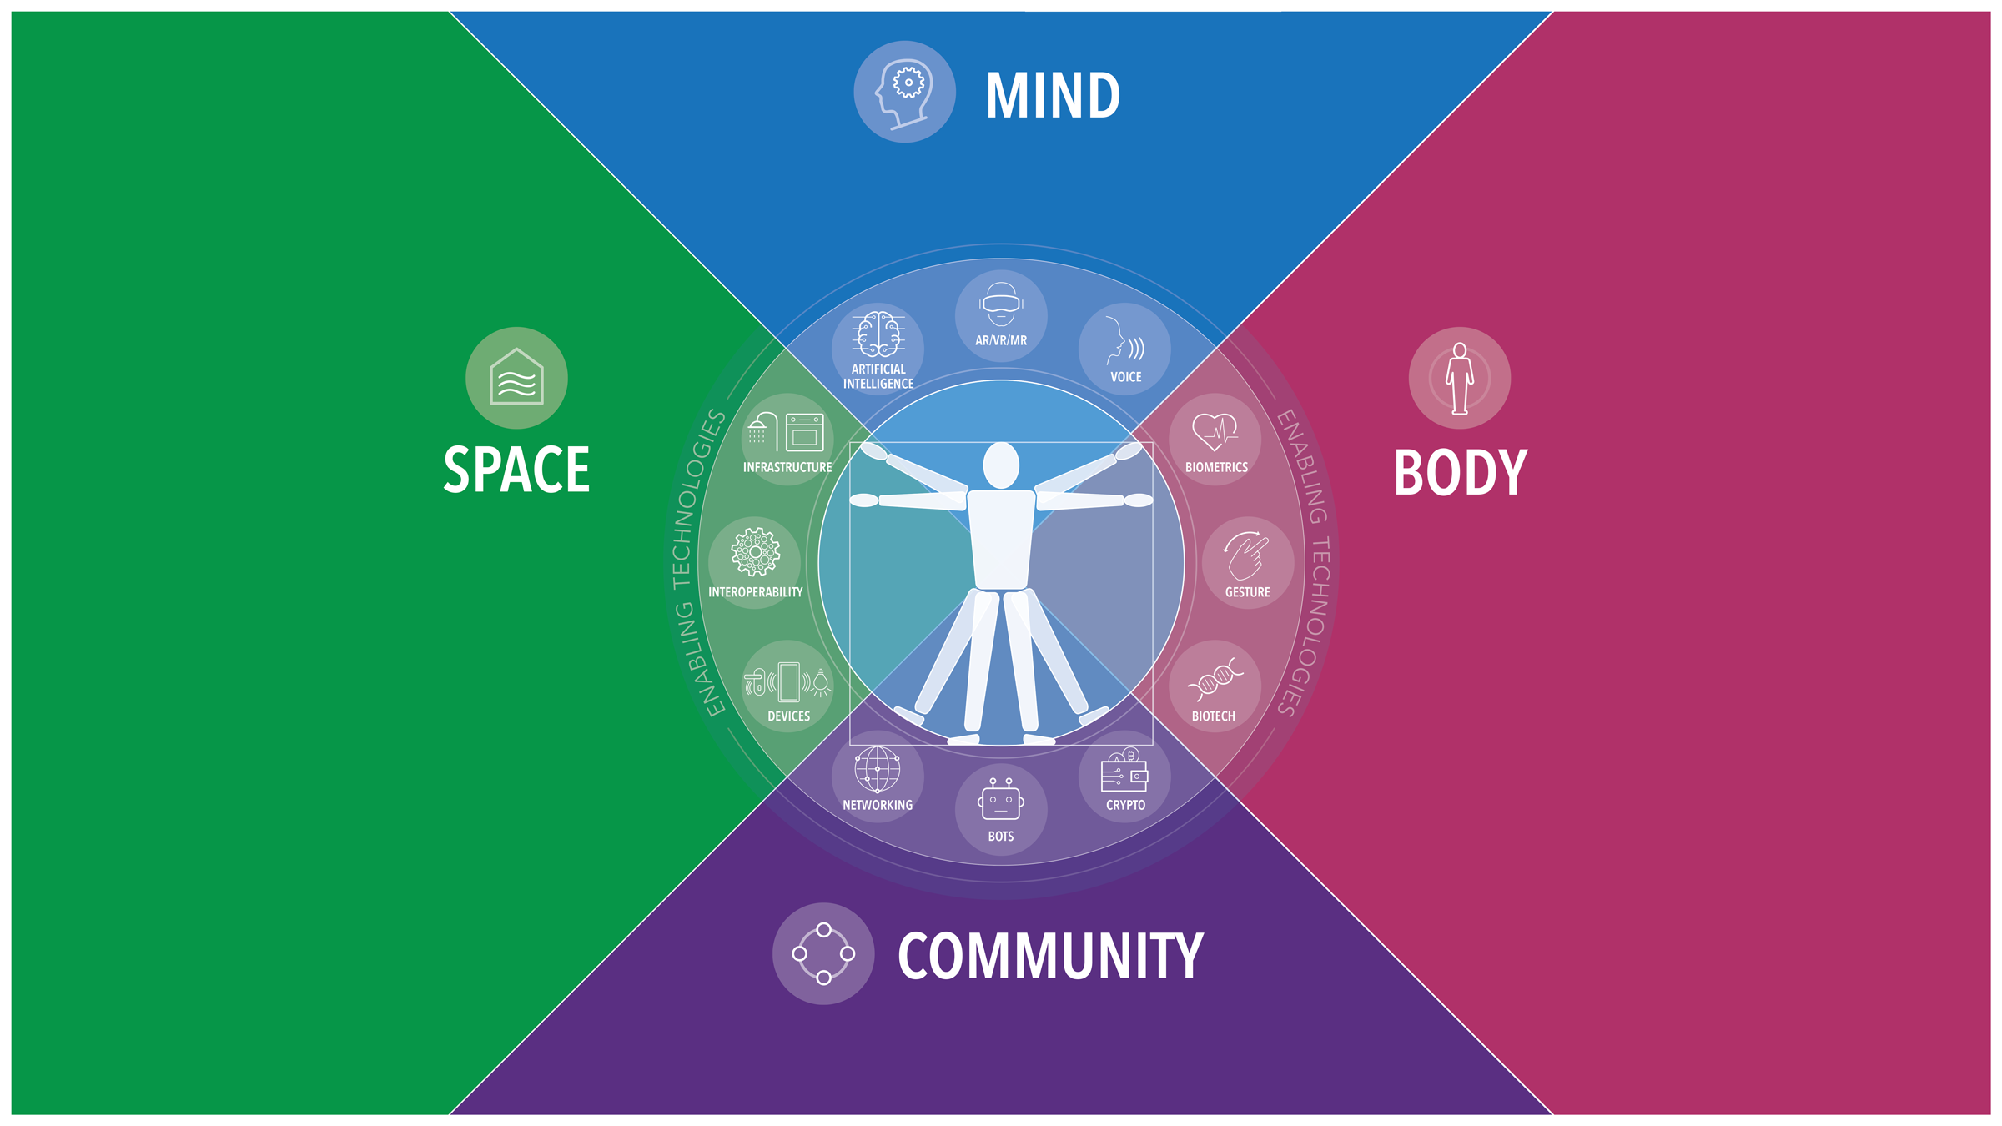

Slide 4
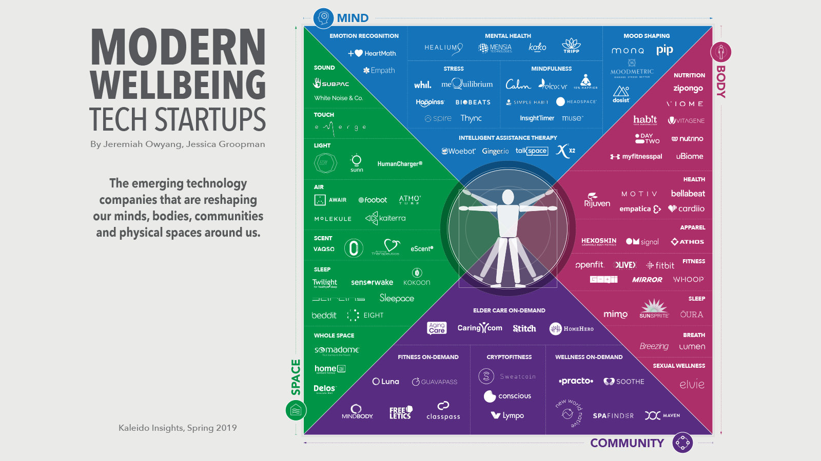
Notes:
IN every phase, simple technologies create a POWER shift.

