Slide 1
Exploratory Testing
A structured approach to exploring

Slide 2
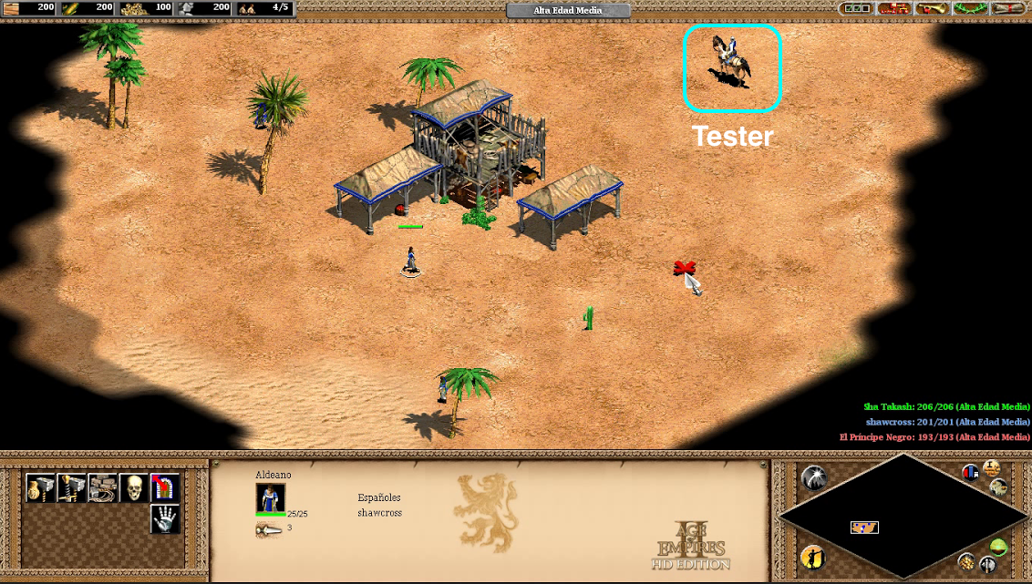

Slide 3
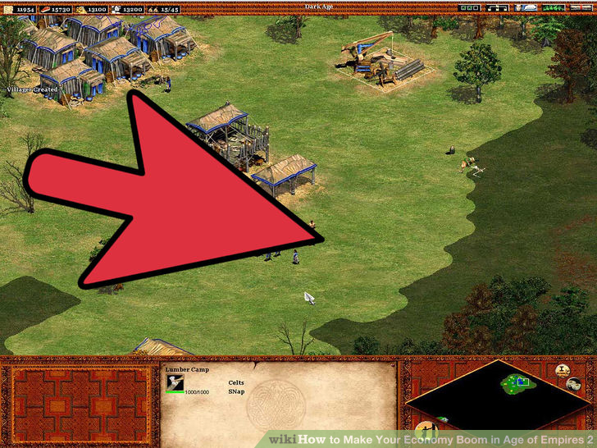
Under the fog, that was once explored, things might change again!

Slide 5
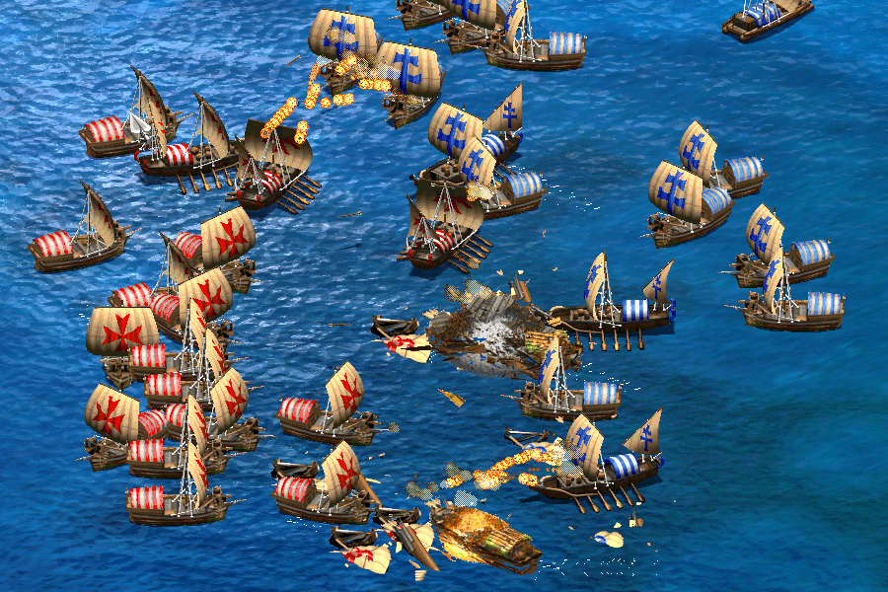

Slide 6
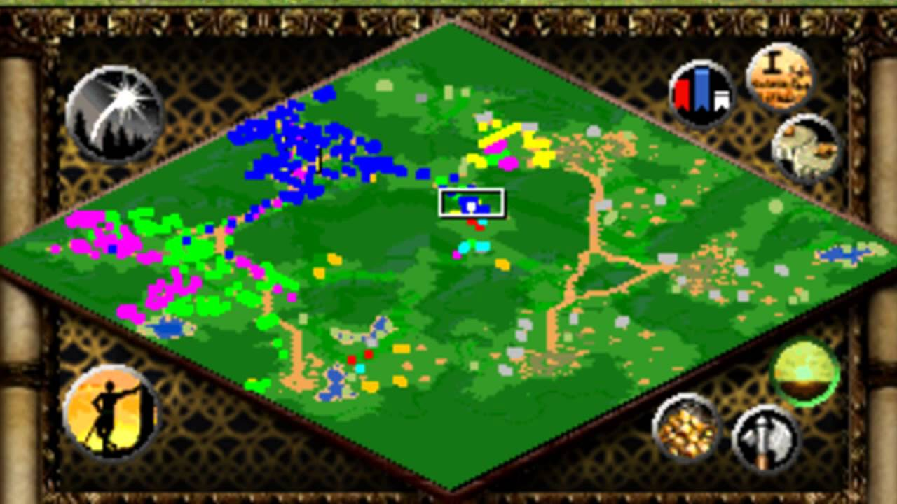
Is full exploration possible in testing?

Slide 7
Unknown unknowns
Capture everything upfront vs. building new insights
Cope with complexity, confusion, change, new insights and half answers
Classic waterfall and "command & control" get in the way of insight and creativity

Slide 8
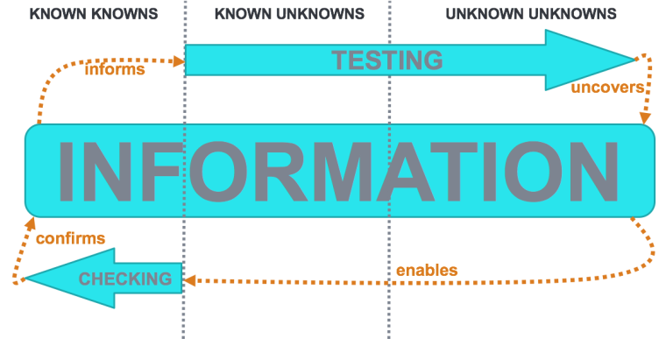
Source: https://findingdeefex.com/2016/05/20/the-testing-checking-synergy/

Slide 9
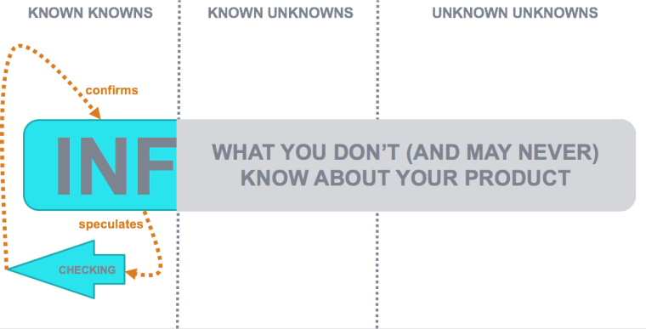
Source: https://findingdeefex.com/2016/05/20/the-testing-checking-synergy/

Slide 10
Find the pattern
Consider the following arithmetical series that appears to have
definitive continuation
2,4,6,8, …

Slide 11
Pattern
The number to the right needs to be bigger than the number on the left.
Or: the numbers ascend from left to right.
Or: 2, 4, 6, 8, who do we appreciate

Slide 12
Definition of Exploratory Testing
Simultaneously designing and executing tests to learn about the system, using your insights from the last experiment to inform the next . (Elizabeth Hendrickson)

Slide 13
Exploratory test principles
Parallel test planning, test design and execution
Can take place anywhere in the sprint
Is not only UI based
Think about potential opportunities and risks
Share knowledge – perform your tests as a team!
Flexible enough to allow for creativity, specific enough to get results

Slide 14
Exploring and Discovery
Well prepared
Cristopher Columbus

Slide 15
Exploratory Process is Structured
The structure of testing comes from many sources:
Test design heuristics
Chartering
Time boxing
Perceived product risks
The structure of the product being tested
The process of learning the product
Development activities
Constraints and resources afforded by the project
The skills, talents, and interests of the tester
The overall mission of testing

Slide 16
Exploratory Process is Structured
The structure of testing comes from many sources:
Test design heuristics
Time boxing
Perceived product risks
The structure of the product being tested
The process of learning the product
Development activities
Constraints and resources afforded by the project
The skills, talents, and interests of the tester
The overall mission of testing
Chartering

Slide 17
Exploratory Test process
Create Charter
Take Notes
Timebox
Debrief
Define your goal
Keep your structure
Keep your focus
Share, learn and improve

Slide 18
Charter: clear goal for the test session
A charter may suggest what should be tested, how it should be tested, and what problems to look for.
A charter is not meant to be a detailed plan.
General charters may be necessary at first:
“Analyze the Search functionality”
Create more detailed charters once you’ve gained knowledge

Slide 19
Charter Formatting
Explore… <target>
With… <resources>
To discover… <information>
My mission is to test <insert risk here> to <insert coverage here>
The charter is a one- to three-sentence goal or mission for a testing session

Slide 20
Taking notes
Coverage
Test Ideas
Bugs/Risks
Issues, Questions & Anomalies
It would be easier to test if you changed/added…
How does … work?
Is this important to test? How should I test it?
I saw something strange…

Slide 21
Time box: avoid loss of concentration
Short: 30 minutes (+-15)
Medium: 60 minutes (+-15)
Long: 90+ minutes

Slide 22
Debrief - PROOF
Past: What happened during the session? Reproduction
Results: What was achieved during the session? Results
Outlook: What still needs to be done? Actions
Obstacles: What got in the way of good testing? Retro
Feelings: How does the team feel about all this? Improve

Slide 23
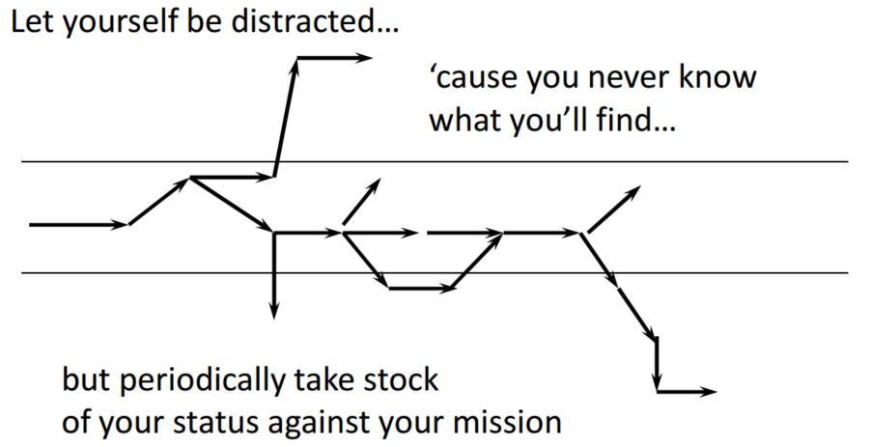
Exploratory testing flow
Test Session
Charter
Debriefing

Slide 24
Tools you could use

Slide 25
Starting tomorrow
Plan a session with your team
Explore your own application and learn new things
Make it part of your Definition of Done
Have fun and learn

