Slide 1
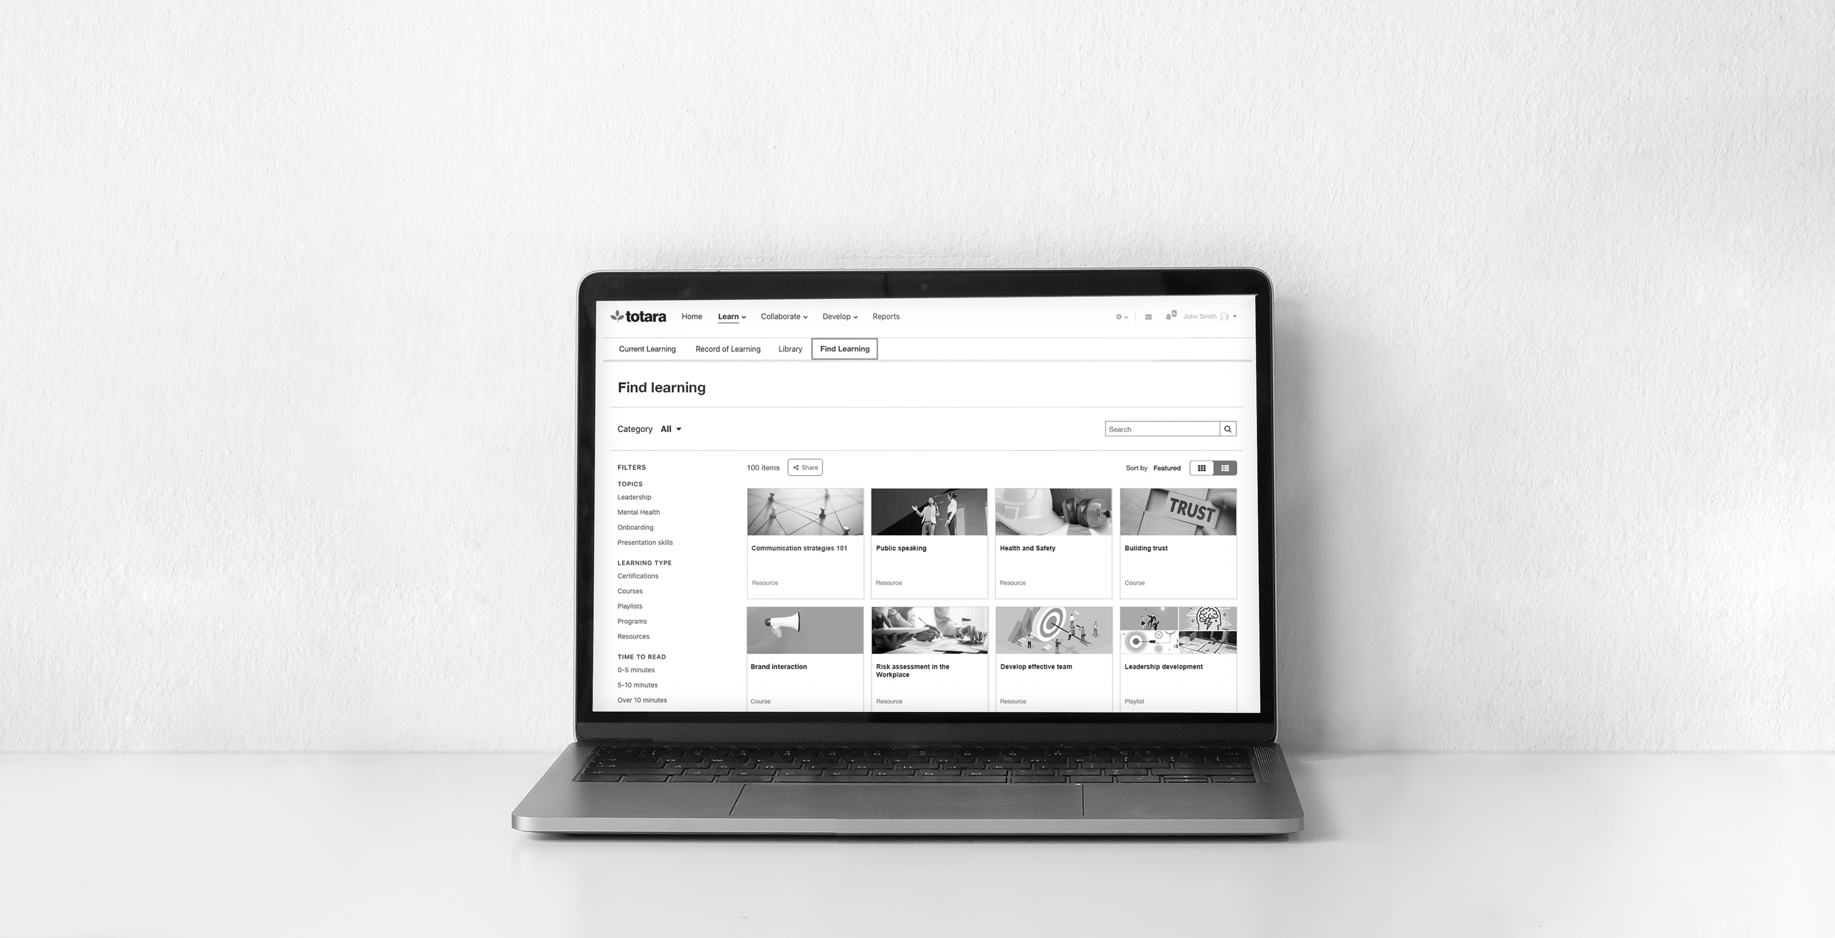


Partner product WEBINAR
In partnership with
Key selling points and demoing new functionality
Totara Learn 13
MEREDITH HENSON
Senior Solutions Consultant
IRIS VERMEREN
International Marketing Manager

Slide 2



Session info
Slides and live site references
Questions welcome
Links posted in the Chat
Recording and slides shared
with Partners
Follow up in discussion forums
Totara Learn and core features

Slide 3

Learn and groW

Slide 4

Other resources
Academy courses
Help documentation
  Version comparison table
Partner demo videos
Website product page
New marketing resources
RFP Database (coming soon)

Slide 5
Totara Learn 13 Key Features
Everything in Totara 12…
  Audiences and automation
  Compliance and mandatory training
  Custom report builder
  Theming/branding
  Course management
Personalisation
Adaptive learning
GDPR compliance
Learning Plans
Offline/external training management
Custom catalogue
Competency management

Slide 6
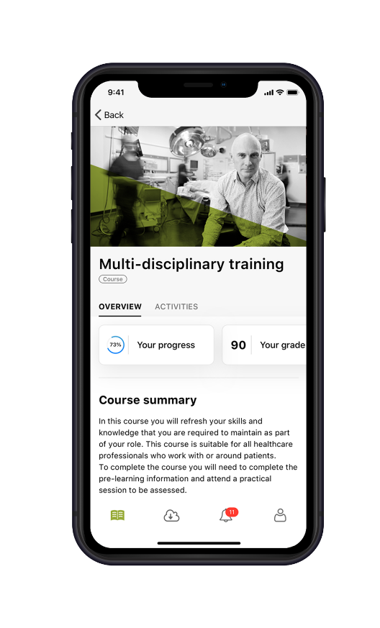
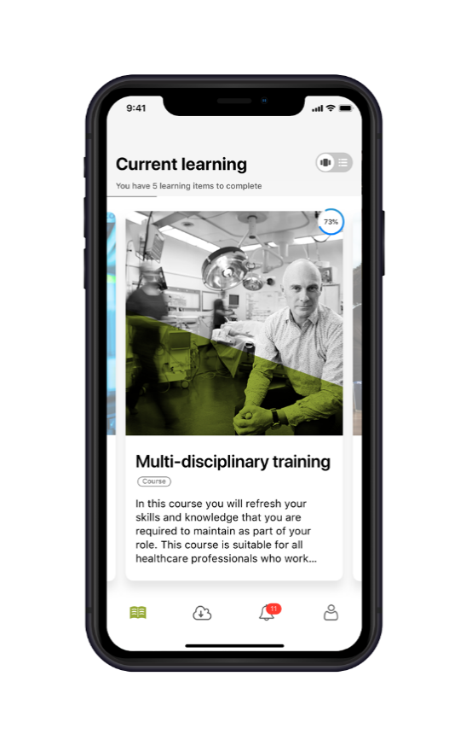
Totara Learn 13 Key Features
Enhanced multitenancy
Totara Mobile
Report Builder improvements
Updated Seminar management
New Audience rules

Slide 7
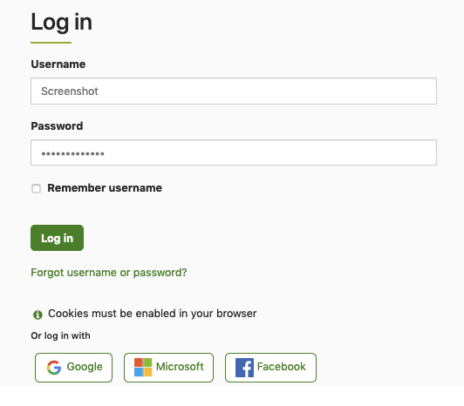
Totara Learn 13 Key Features
Open Badges 2.0
Catalogue updates
Evidence bank
Profile page updates
Improved look and feel

Slide 8
Key selling points
Enhanced Multitenancy
  Extended Enterprise solutions
  New commercial opportunities
  Dissemination of user admin rights
  Separation of courses/users
  Tailored look and feel

Slide 9
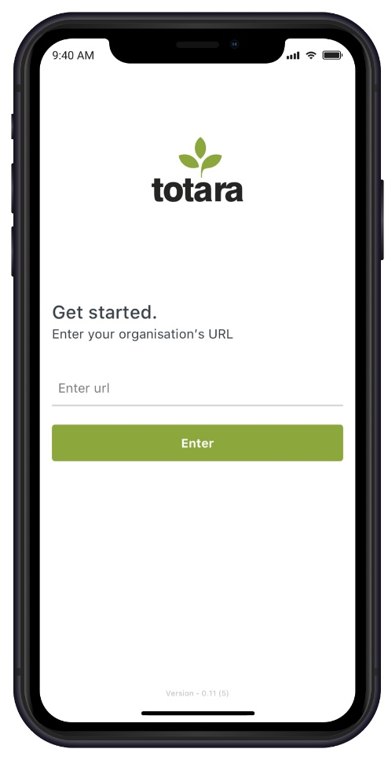
Key selling points
Totara Mobile
  Learning on-the-go
  Just-in-time learning
  Low connectivity/offline learning
  Medical, retail, manufacturing ...
  Push notifications

Slide 10
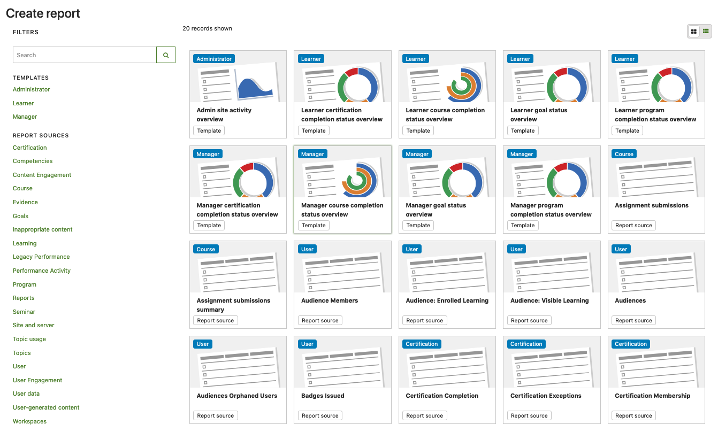
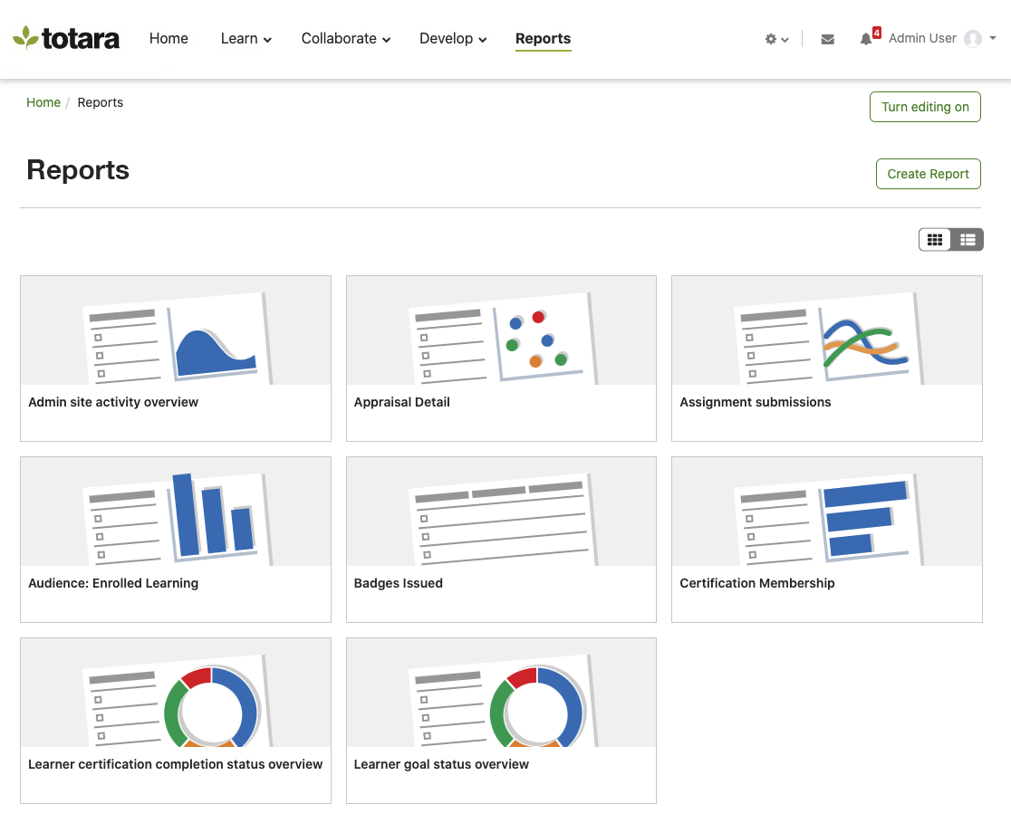

Slide 11
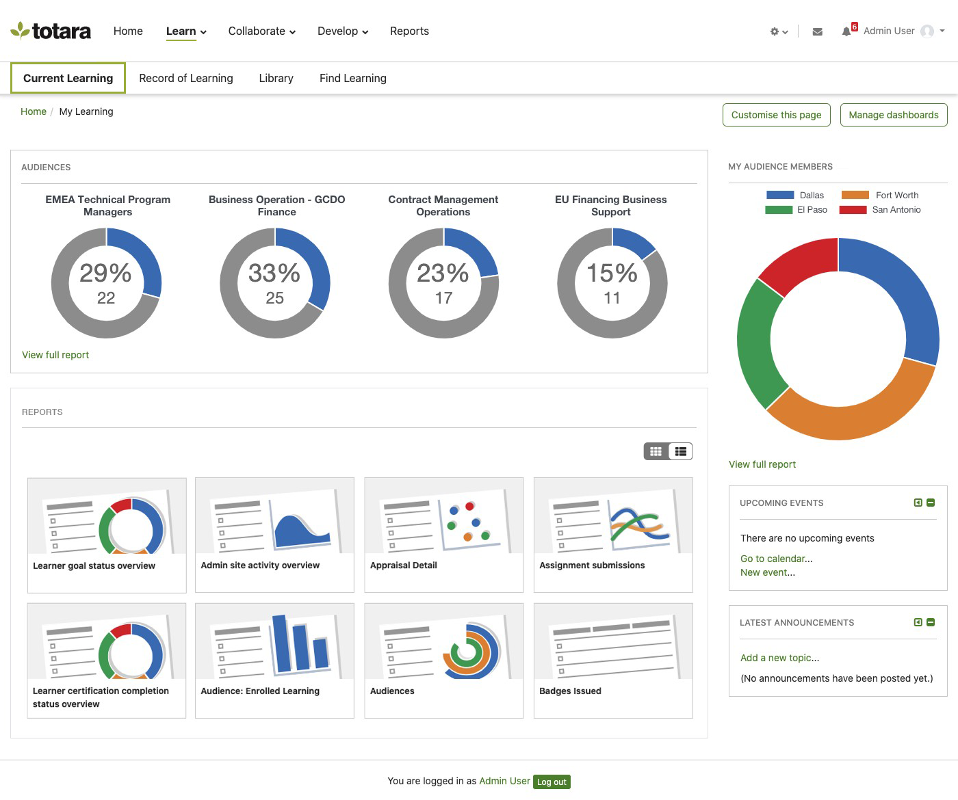

Slide 12
Key selling points
Report Builder improvements
  More accessible and appealing interface
  Reduces barriers to non-technical staff
  Modernised graphs
  Better visualisation of progress
  Template development

Slide 13
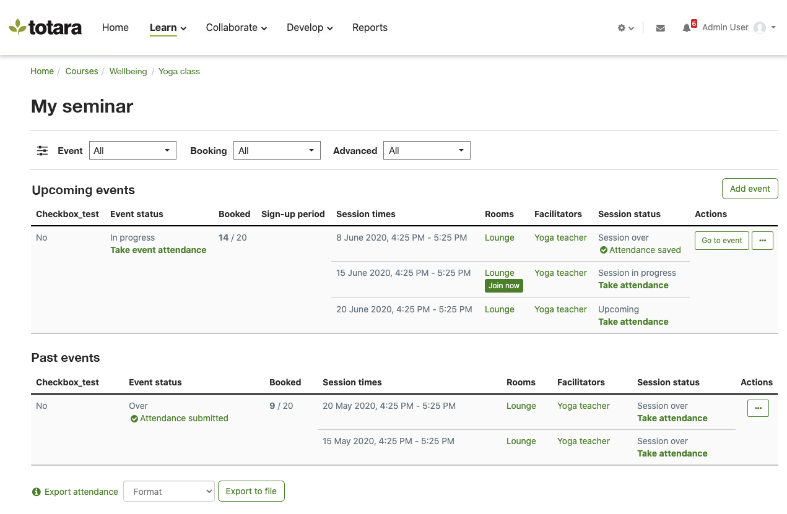

Slide 14
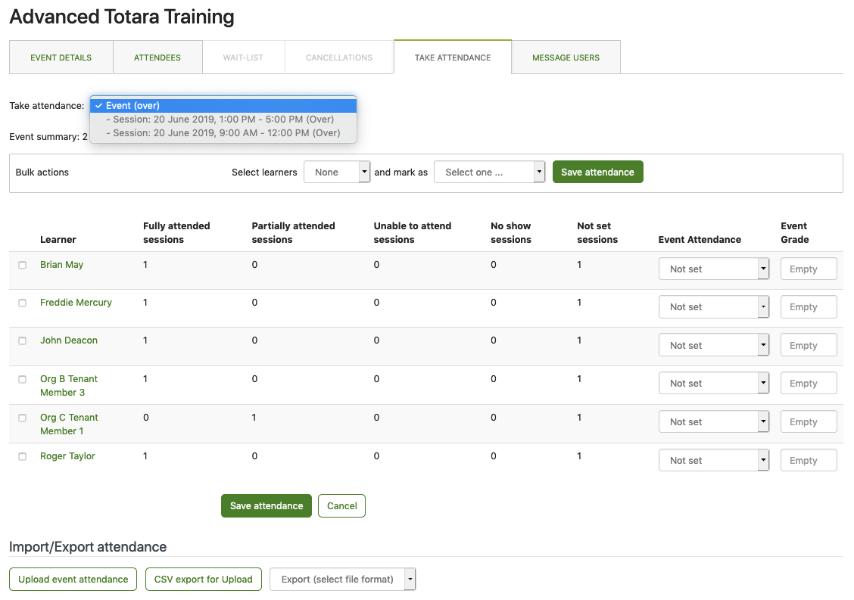

Slide 15
Key selling points
Updated Seminar Management
  More accessible and appealing interface
  New training models/options
  Engagement and contribution measures
  Quick join link to webinar software
  Accommodate large events

Slide 16
Key selling points
New Audience rules
  Targeted access to learning
  Right learning at the right time
  Featured Learning tiles
  Recommended next course/program

Slide 17


Key selling points
Open Badges 2.0
  Internal endorsements from SMEs
  Partnering with external bodies
  Increased badge value
  Badges issued in preferred languages
  Flexibility to choose own backpack service

Slide 18
Key selling points
Catalogue updates
  Include dynamic elements within catalogue
  Streamlined access to learning items
Evidence bank
  Custom forms
  Simplified workflow
  Quick capture for past and external learning

Slide 19
Key selling points
Profile page
  Information access controls
  Add other design/navigation items
Look and feel improvements
  Branded login page
  Simple customisation interface
  Accessibility driven design

Slide 20

LEARN AND GROW
Extensions
PERFORM AND SUCCEED
EFFECTIVE
LEARNING
BETTER
PERFORMANCE
Mobile app
Content
libraries
Plugins
EMPLOYEE
ENGAGEMENT
ENGAGE AND DELIVER

Slide 21
Set up for demo
Tenants
  Turn on MT
  Create multiple tenants
  Associated tenant users and permissions
  Different Dashboards for tenants
  Create Tenant only courses
  Tenant themes
  Isolation mode on/off

Slide 22
Set up for demo
Mobile
  Learn configuration settings
  Create/mark mobile friendly courses
  Add SCORM activity
  Install app on sample mobile device
Catalogue
  Add FL or HTML block
  Make home page for Example Learner

Slide 23
Set up for demo
Report Builder
  Create graphical reports
  Donut, progress donut types
Seminar management
  Create internal Facilitators
  Add Room Link field for a virtual room
  Create a ‘Seminar demo’ course
  Add Upcoming and Past events

Slide 24
Set up for demo
  Create multi-session events
  Enable manual grading
  Add multiple rooms and facilitators to events
  Book attendees
  Take attendance on one session
Profile page
  Add profile and FL blocks

Slide 25
Set up for demo
Open Badges
  Create manual issue system badge
  Add multiple versions (link via Related)
  Include multiple languages
  Add Endorsement by example internal or external expert

Slide 26
Demo workflows
Learner
  Personalisation (Dashboards, Alerts, Tasks..)
  Current Learning (Programs and Certifications)
  Browse catalogue/course access
  Inbuilt activities/resources/blocks
  Activity and course completion tracking
  Restrict access (adaptive learning)

Slide 27
Demo workflows
Learner cont.
  Seminar booking (signup, custom fields, manager approval)
  Learning Plan (view progress, request new course)
  Record of Learning
  Upload Evidence

Slide 28
Demo workflows
Manager
  Personalisation (Manager Dashboards, Alerts, Tasks..)
  Learning Plan and Seminar approvals
  Team view
  Report list
  Manager-only catalogue view (audience visibility)

Slide 29
Demo workflows
Trainer/Facilitator
  Personalisation (Dashboards, Alerts, Tasks..)
  Facilitation calendar
  Mark Seminar attendance and grading
  Create follow up activities (e.g. manual badge issue)
  Create new course

Slide 30
Demo workflows
Administrator
  Configure Catalogue (add Filter)
  Create and schedule report
  Add new Tenant and configure theme
  Add new Dynamic Audience (automation)
  Link new course to Competency
  Add new Organisation and Position and link Competency

Slide 31
questions
?
Q?

Slide 32
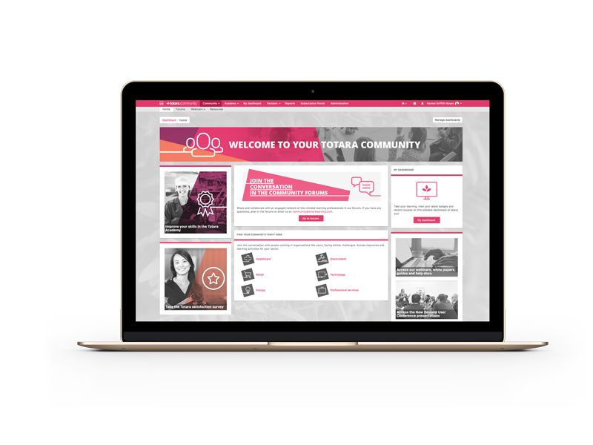




Thanks for listening
Join the totara.community (it’s free)
Follow us on social media
@TotaraLearning
WWW.TOTARALEARNING.COM

