Slide 2
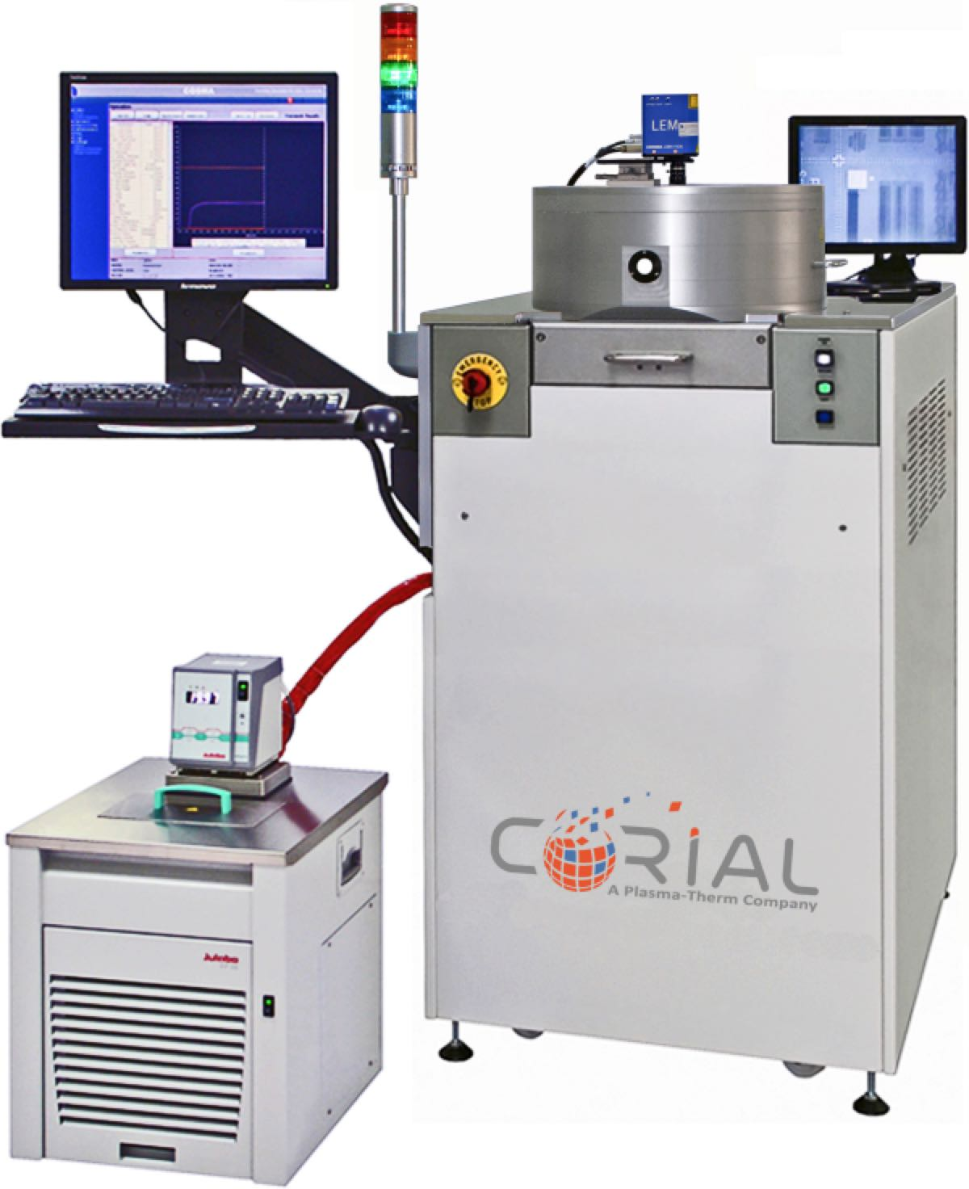
Corial 200I
Industry-leading uniformity for etching a variety of materials
ICP-RIE capabilities over a variety of materials including silicon, silicon compounds, metals, InP and polymers
Uses fluorine- and oxygen-based chemistries to provide leading edge etch rates and uniformities
Adaptable to a wide range of substrate sizes:
wafer pieces, 1x2’’ to 7x2; 1x3’’ to 3x3’’; 1x4’’; 1x6’’; 1x8’’

Slide 3
System description
Corial 200I

Slide 4
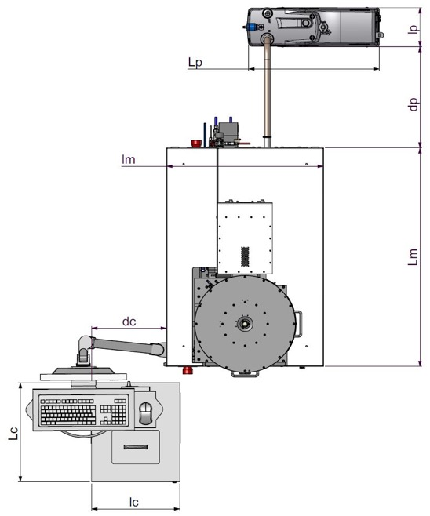
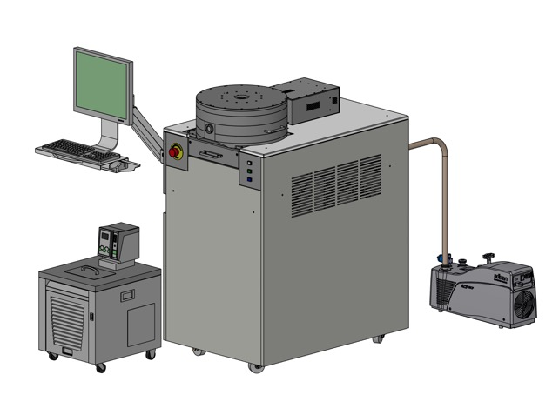
System description
General View
190
COMPACT FOOTPRINT
630
600
Low CoO
750
1080
360
490
420

Slide 5
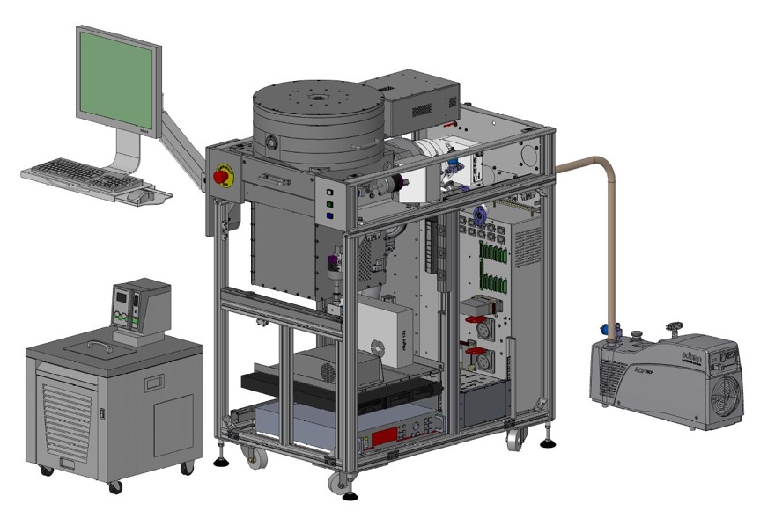
System description
Detailed View
ICP reactor
Pumping system
(TMP 500l/s and dry pump 28 m³/h)
Chiller / Heater
HV and LV power supplies
2 kW ICP generator
(2 Mhz)
300W RF generator
(13,56 Mhz)
Process controller

Slide 6
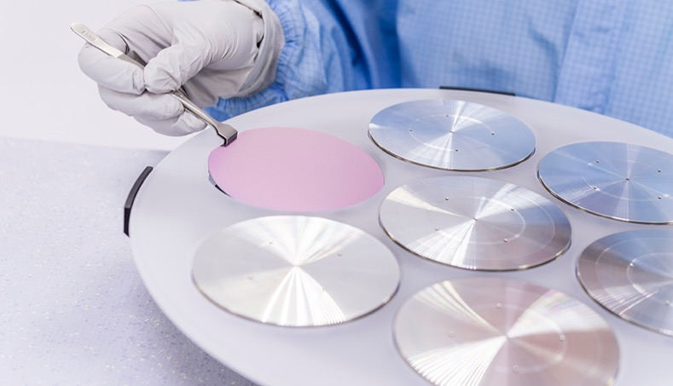
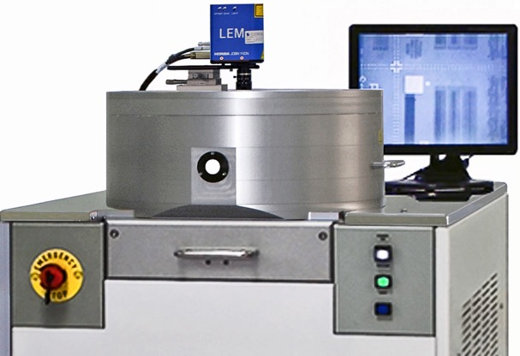
System description
Loading
Direct loading on carrier
FAST LOAD AND UNLOAD
< 210 s
LOADING TIME
Shuttle
EASY EXCHANGE BETWEEN SUBSTRATE SHAPE AND SIZE

Slide 7
Icp source corial 200I

Slide 8
Icp source
CORIAL’s latest generation of reactor
HIGH PERFORMANCE AND FLEXIBILITY
High process flexibility with wide RF power operating range from 100 W to 2000 W
Exceptional uniformity, and repeatability enabled with a unique high-power ICP reactor with helical antenna
Uniform temperature control (from -50°C) for best repeatability
Reactor’s hot walls enhance plasma cleaning efficiency and reduce particle load
Retractable liner and shuttle holding to minimize process cross-contamination
Short pump-down cycle (<3 minutes), rapid reactor clean time (<20 minutes), and shuttle loading direct on the carrier, to guarantee high system uptime

Slide 9
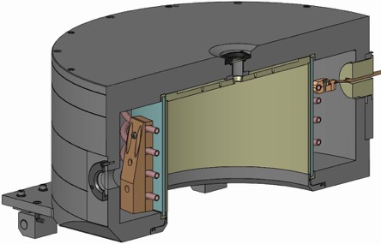
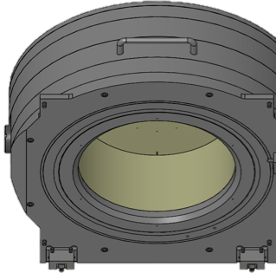

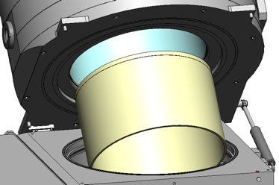
Icp source
Retractable Quartz Liner
THE LINER FOR
HARSH ICP-RIE
PROCESSES
EASY LINER replacement by a single person
5 min
Liner replacement
4 min
Pumping down to 10⁻⁴ Tor
ZERO
CROSS CONTAMINATION
1 min
Reactor Venting
5 min
Plasma cleaning

Slide 10
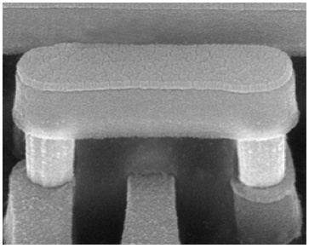
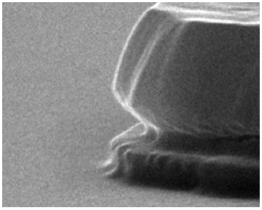
Icp source
RF coupling to ICP source
< 15
volts
Minimum parasitic capacitive coupling giving rise to low plasma potential to enable low damage etching
SiO₂ Isotropic etching with NO RF biasing
GaN Low damage etching with low RF biasing

Slide 11
Icp source
Operation Sequence
1
Shuttle Loading
Loading tool
Shuttle
Cathode

Slide 12
Icp source
Operation Sequence
Cathode Up
2
Shuttle
Cathode
Loading tool

Slide 13
Icp source
Operation Sequence
PLASMA
Plasma heats wafer and clamping ring
Shuttle
Cathode
Loading tool
Coolant OUT
Heat is transferred to shuttle and to the cooled cathode by He pressure at 5 Torr
Coolant IN
3
Helium

Slide 14
Icp source
Temperature Control
New cathode design and efficient helium back side cooling of the shuttle and substrate ensure uniform temperature control (from -50°C) during the etch process
Test based on 1 KW configuration for sapphire etching (1 X 2” wafers)
Process | Etch rate | ICP Power | RF Power
Sapphire | 300 nm/min | 1 KW | 280 W
  No resist damage when operating at
  full ICP and RF power (Novolak type photoresist baked at 110°C)

Slide 15
Icp source
Reactor Uniformity
Benchmark uniformity test: 500 nm etching of thermal oxide (8” wafers)
Process | Etch depth | Uniformity | ICP Power | RF Power
Thermal SiO₂ | 500 nm | ± 2.2% | 800 W | 150 W
  Remaining 100 nm measured by ellipsometry
  Measurement performed with 5 mm edge exclusion

Slide 16
Shuttle holding approach corial 200i

Slide 17
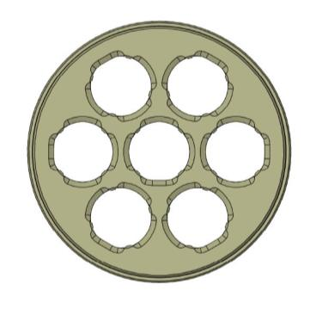
Shuttle holding approach
Benefits
Quick adaptation to sample shape and size
Optimum process conditions with NO modification of process chamber
Limited cross contamination between processes by using dedicated shuttles
Shuttles for single wafer treatment: 1 x 2”, 1 x 3”, 1 x 4”, 1 x 6”, 1 x 8”
Shuttles for batch processing : 7 x 2”, 3 x 3”
Customized shuttles are available (4” x 4”, 5” x 5”, etc)

Slide 18
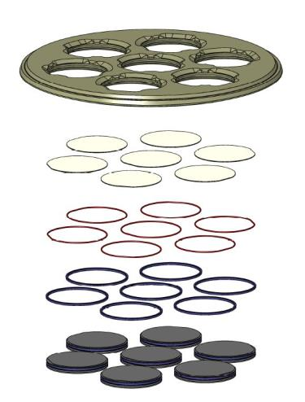
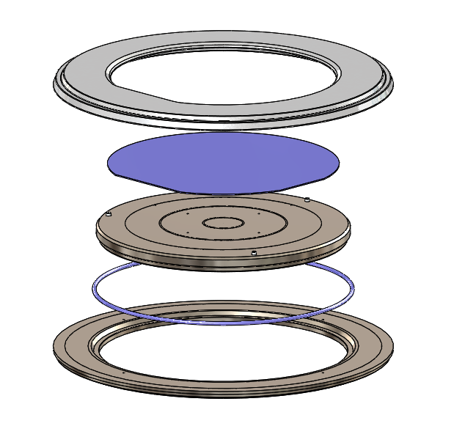
Shuttle holding approach
Portfolio
Clamping ring
Quartz shuttle
Wafers
Wafer
Moving plate
O’rings
O’ring
Aluminum table
  Guaranteed no wafer damage due to SOFT wafer clamping

Slide 19
Performances icp-rie processes
Corial 200I

Slide 20
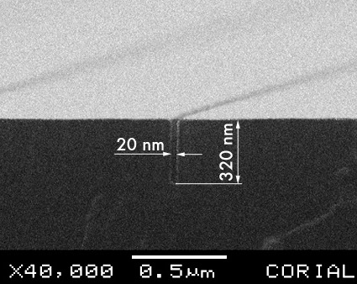
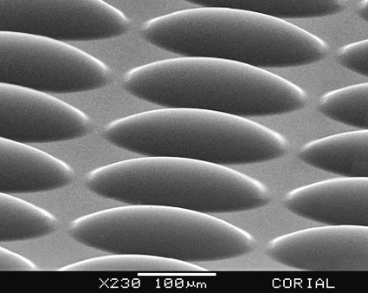
ICP-RIE of SI
Fluorinated chemistry
High Resolution ICP-RIE of Si
ICP-RIE of Si microlenses 40 µm high

Slide 21
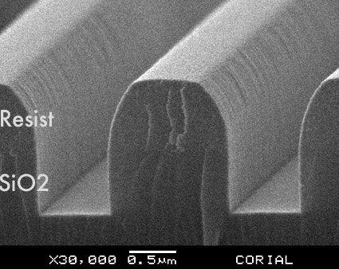
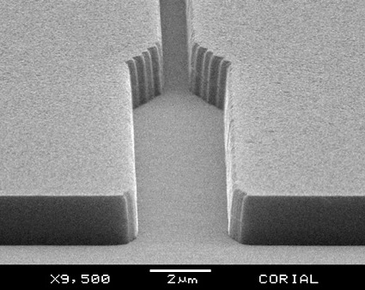
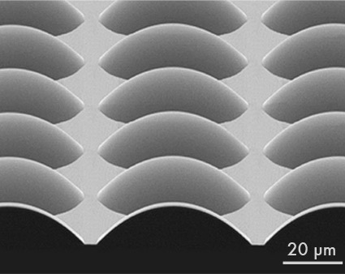
ICP-RIE OF OXIDES AND NITRIDES
Fluorinated chemistry
ICP-RIE of SiO₂
ICP-RIE of Si₃N₄
ICP-RIE of SiO₂ Microlenses

Slide 22
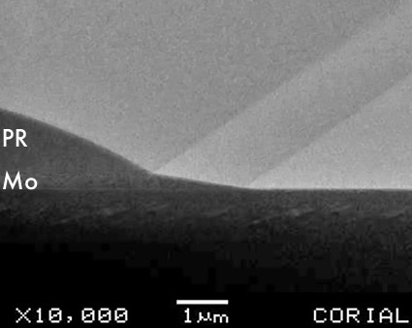
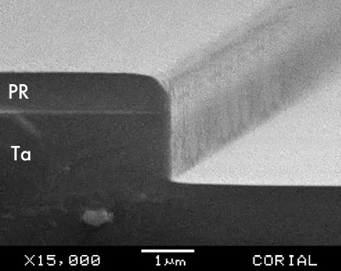
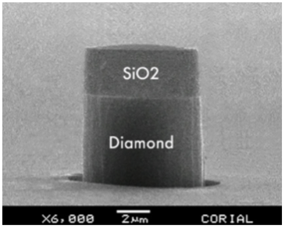
ICP-RIE OF METALS & DIAMOND
Tapered ICP-RIE of Mo
ICP-RIE of Ta
ICP-RIE of Diamond

Slide 23
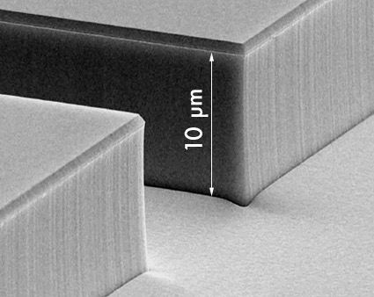
ICP-RIE of inp
CH4/H2 chemistry
RIE of InP 0.1 µm lines and spaces
Deep RIE etching of InP

Slide 24
High etch rates
Excellent Uniformities
Process | Mask | Etch rate (nm/min) | Selectivity (vs mask) | Uniformity (across wafer)
Polymers | PR | 800 | 1 | ±5%
Si | PR | 500 | > 5 | ±3%
SiO₂ | PR | 400 | > 3 | ±3%
Si₃N₄ | PR | 350 | > 4 | ±3%
Diamond | SiO2 | 500 | > 25 | ±3%
InP | SiO2 | 1200 | > 25 | ±3%
Nb | PR | 250 | > 2 | ±3%
Ti | PR | 120 | 0.3 | ±3%

Slide 25
Performances deprocessing processes corial 200I

Slide 26
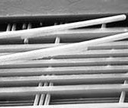
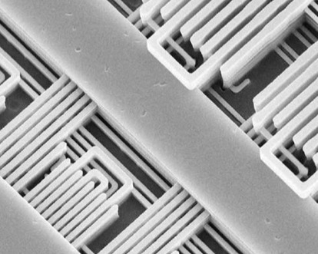
CONTROL OF SAMPLE TEMPERATURE
CORIAL’S advantage
Tight control of sample temperature with helium backside cooling of wafer, dies and packaged dies
4 METAL LAYERS REVEALED
OVERHEATING LEADS TO METAL LIFT OFF!
NO METAL LIFT
ELECTRICAL FUNCTIONALITY MAINTAINED
WITHOUT TEMPERATURE CONTROL
TEMPERATURE > 150°C
CORIAL LOW TEMP. DEPROCESSING
TEMPERATURE < 100°C
Al TECHNOLOGY

Slide 27
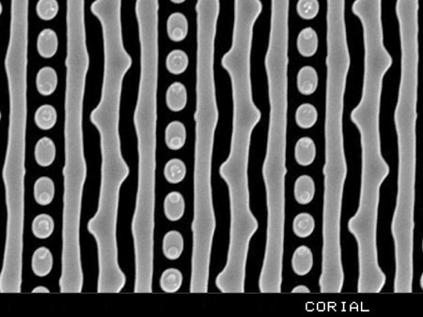
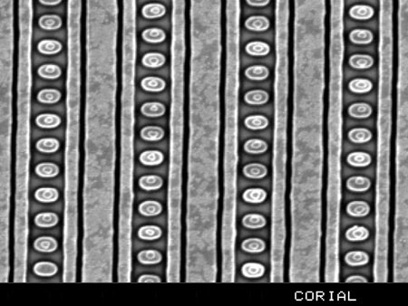
Deprocessing on wafer
Delayering for advanced technology nodes
28 NM TECHNOLOGY
20 NM TECHNOLOGY
300 NM/MIN ETCH RATE
200 NM/MIN ETCH RATE
> 50:1 SELECTIVITY TO Al/Cu MASK
> 50:1 SELECTIVITY TO Al/Cu MASK
LOW-K DIELECTRIC ETCHING
ULTRA LOW-K DIELECTRIC ETCHING

Slide 28
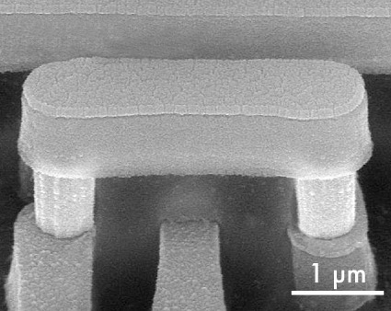
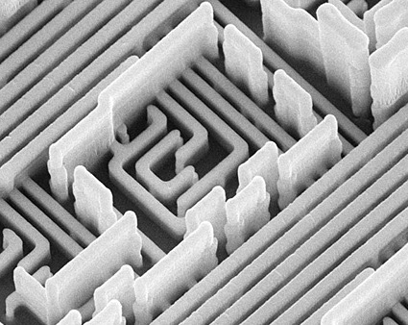
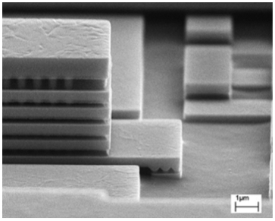
Deprocessing on wafer
Isotropic etching with NO RF biasing
Anisotropic etching with low RF biasing
Exposure of 7 metal levels (Cu technology)

Slide 29
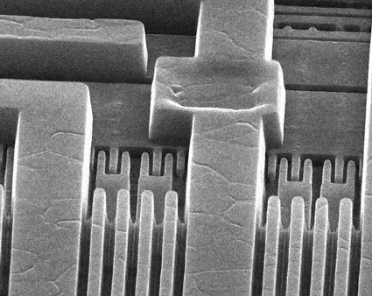
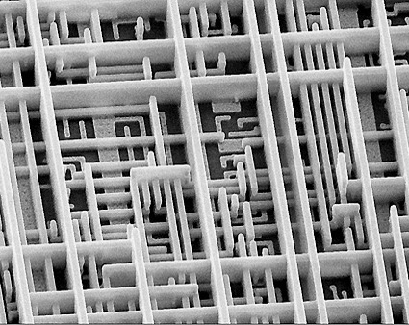
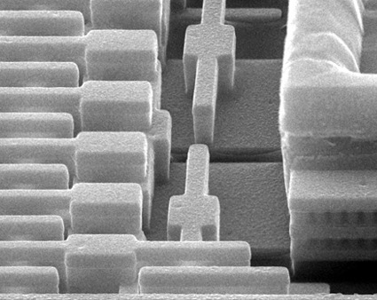
Deprocessing on wafer
3 metal level exposure (Al technology)
5 metal level exposure (Cu technology)
4 metal level exposure (Cu technology)

Slide 30
Process performances
On Wafer
200 mm wafer
Process | Underlayer | Etch rate (µm/min) | Selectivity (vs. mask)
Polyimide | Si₃N₄ | > 1 | > 50
Si₃N₄ | SiO₂ | > 0.3 | > 1.5
SiO₂ | SiO₂ | > 0.15 | -
SiO₂ / TiN | TiN | 0.05 | > 10
Aluminum (load-lock required) | SiO₂ | 1 | > 10
Titanium (load-lock required) | SiO₂ | > 0.1 | > 2

Slide 31
Performances sputter-etch processes
Corial 200I

Slide 32
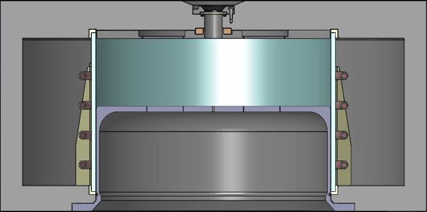
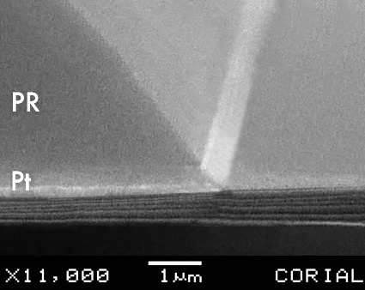
Sputter-etch
Retractable Liner
Ni COATED LINER TO COLLECT SPUTTERED MATERIALS IN
METAL RIE SPUTTER-ETCH MODE
Pt SPUTTERING WITH PR MASK

Slide 33
usability corial 200I

Slide 34

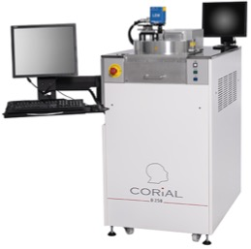
Process control software
COSMA
COSMA
CORIAL OPERATING SYSTEM FOR MACHINE
The simplest, most efficient software to develop processes, operate, and maintain CORIAL systems
DESKTOP APPLICATION
Process Editing I Process Adjustment I Process Operation I Process Tracability I System Maintenance
REMOTE CONTROL

Slide 35
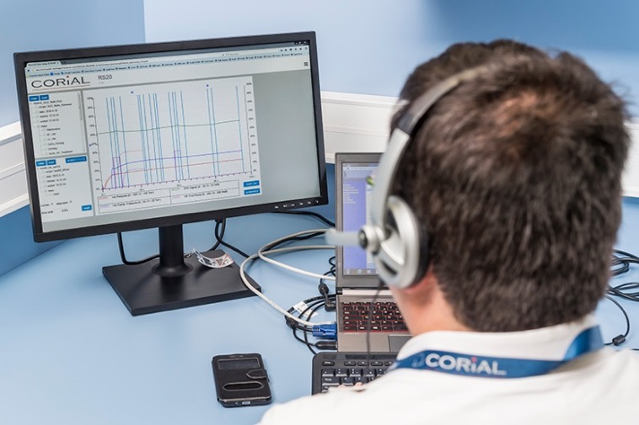
Deprocessing software
COSMA RS
DISPLAY UP TO 4
PARAMETERS FROM A RUN
Simple and efficient software to analyze process runs and accelerate process development
REMOTE
ANALYSIS OF RUNS
DRAG AND DROP
CURVES TO CHECK PROCESS REPEATABILITY

Slide 36
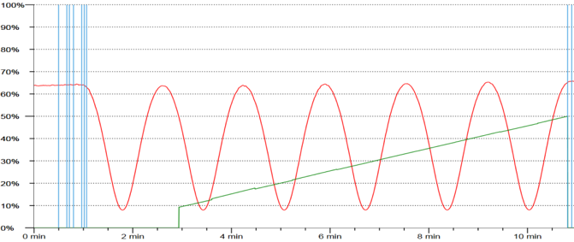
End point detection
EPD with laser
A CCD camera and laser diode, in the same measuring head, enables simultaneous visualization of the wafer surface and the laser beam impact on it. A 20 µm diameter laser spot facilitates the record of interference signals.
Real-Time etch rate measurement
Real-Time etched depth measurement

Slide 37
Corial 200I
Industry-leading uniformity for etching a variety of materials
ICP-RIE capabilities over a variety of materials including silicon, silicon compounds, metals, InP and polymers
Uses fluorine- and oxygen-based chemistries to provide leading edge etch rates and uniformities
Adaptable to a wide range of substrate sizes:
wafer pieces, 1x2’’ to 7x2; 1x3’’ to 3x3’’; 1x4’’; 1x6’’; 1x8’’

