Slide 2
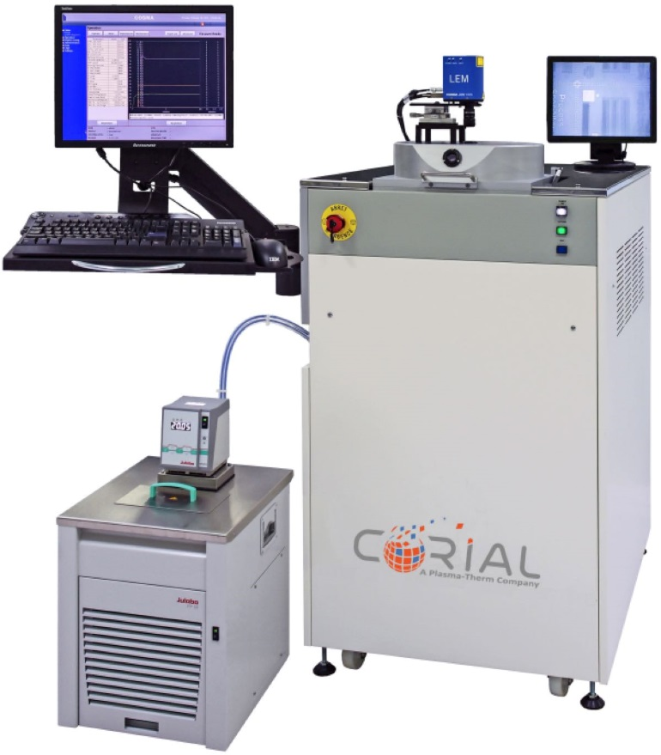
Corial 200S
Easy-to-use Reactive Ion Etching equipment
Wide process range for Si, silicon-based compounds, metals and Polymers
Rapid substrate loading and unloading
Smaller wafer pieces up to full 200 mm wafer
1x2’’ to 7x2’’ ; 1x3’’ to 3x3’’ ; 1x4’’ ; 1x6’’ ; 1x8’’

Slide 3
System description Corial 200S

Slide 4
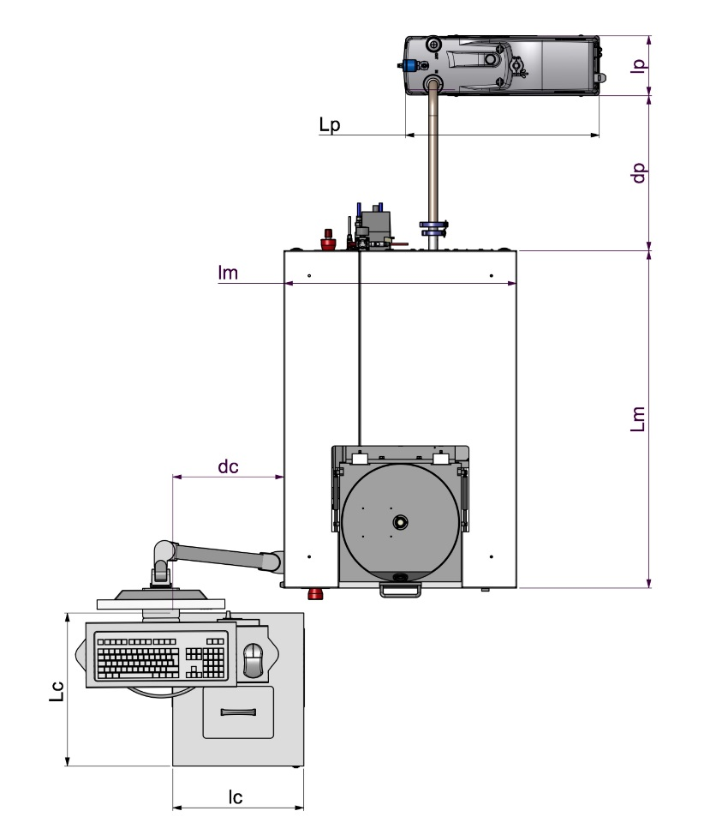
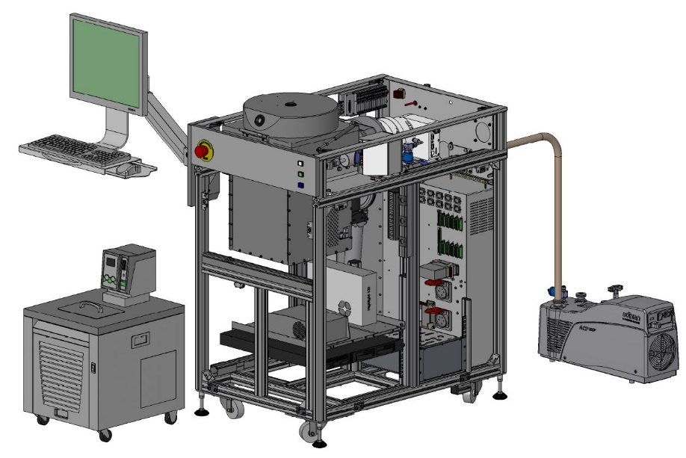
System description
General View
193
SMALL FOOTPRINT
0.81 m2
627
600
Low CoO
750
1080
357
490
420

Slide 5
System description
Detailed View
RIE reactor
Pumping system
(TMP 500l/s and dry pump 28m³/h)
Chiller / Heater
HV and LV power supplies
300 W RF generator
(13,56 Mhz)
Process controller

Slide 6
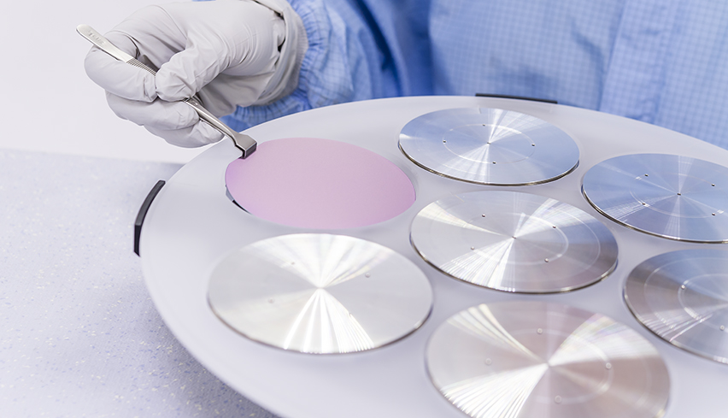
System description
Loading
< 210 s
LOADING TIME
Direct loading
FAST LOAD AND UNLOAD
Shuttle
EASY EXCHANGE BETWEEN SUBSTRATE SHAPE AND SIZE

Slide 7
Standard rie source corial 200S

Slide 8
Rie source
Easy-to-use
For fluorine-based etch processes
Excellent process control enabled by efficient substrate cooling
Retractable liner for sputter-etch increase time between cleans and reduce clean time
shuttle (carrier) design, combined with a standard cathode, for a cost-effective and fast reactor adaptation, suitable for multiple applications and substrate types
Minimized maintenance
SiO2 50 nm/min
Si3N4 60 nm/min
Nb 100 nm/min
…

Slide 9
Rie source
Operation Sequence
Substrate
holder
Laser window
200 mm wafer
PLASMA
Cathode
TMP
A He pressure at 5 Torrs maintains the substrate holder at constant temperature
Coolant IN
Helium IN
Coolant OUT

Slide 10
Performances rie processes corial 200S

Slide 11
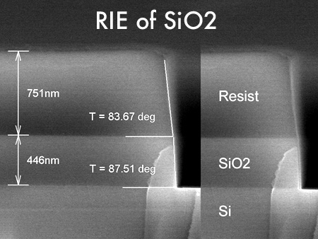
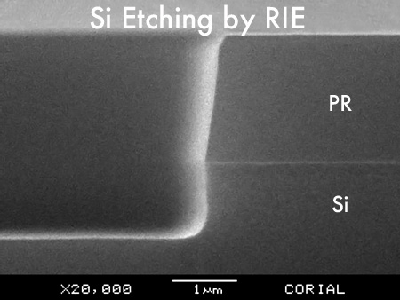
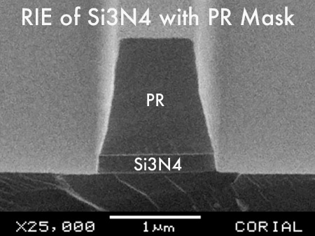
Rie of si, oxides, nitrides
Fluorinated chemistry
RIE of SiO2 with PR mask – Vertical profile – High etch uniformity
RIE of SiO2 with PR mask – 0.8 µm deep
RIE of Si – 0.8 µm deep - Anisotropic profile
RIE of Si3N4 - 0.8 µm deep

Slide 12
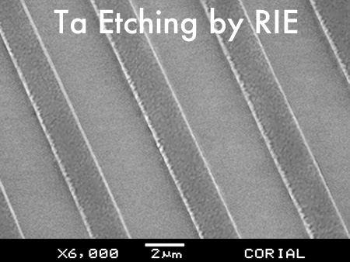
Rie of metals
Fluorinated chemistry
Nb Etching with PR mask – Anisotropic profile
TaEtching with PR mask – Anisotropic profile
RIE of Nb / Ta
Ti Etching with PR mask - Anisotropic profile

Slide 13
High etch rates
Excellent Uniformities
Process | Mask | Etch rate (nm/min) | Selectivity (vs mask) | Uniformity (across wafer)
Polymers | PR | 400 | 1 | ±5%
SiO₂ | PR | 50 | 3 | ±3%
Si₃N₄ | PR | 60 | > 2 | ±3%
Si | PR | 100 | 1 | ±5%
Nb | PR | 100 | > 0.5 | ±5%
Ta | PR | 90 | > 0.5 | ±5%
Ti | PR | 25 | 0.3 | ±5%

Slide 14
Rie source for sputter-etch Corial 200S

Slide 15
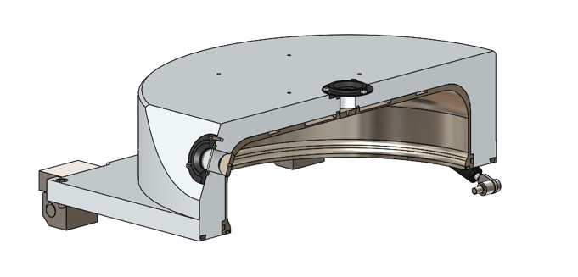
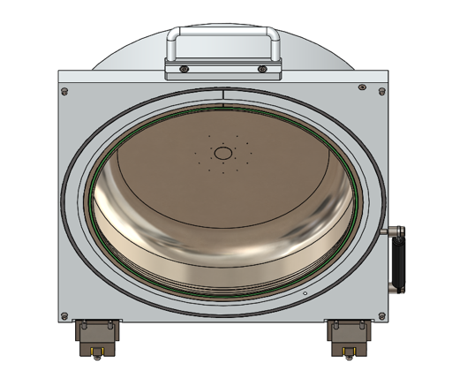
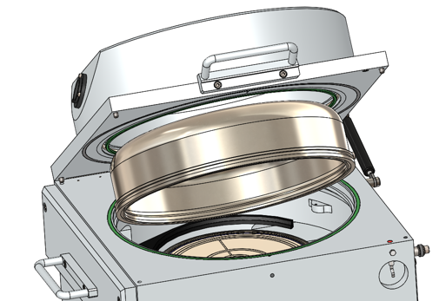
Sputter-etch
RIE Process Chamber for Etching and Sputtering
LINER TO COLLECT ETCH-BY-PRODUCTS AND SPUTTERED MATERIALS
EASY LINER replacement by a single person
5 min
Liner replacement
4 min
Pumping down to 10⁻⁴ Tor
Dedicated process chamber for
Au, Ag, Ni, Fe, Co, Pt, PZT… SPUTTERING
1 min
Reactor Venting
5 min
Plasma cleaning

Slide 16
Sputter etch
Ar chemistry
Process | Mask | Etch rate (nm/min) | Selectivity (vs mask) | Uniformity (across wafer)
Au, Pt, PZT, Fe, Co | PR | 45 | > 1 | ±5%
Back sputtering of Pt with PR mask

Slide 17
Shuttle holding approach corial 200S

Slide 18
Shuttle holding approach
Portfolio
NG20 wafer carrier
NQ200 wafer carrier
50 mm wafer
75 mm wafer
100 mm wafer
150 mm wafer
200 mm wafer
50 mm wafer
75 mm wafer
100 mm wafer
150 mm wafer
200 mm wafer

Slide 19
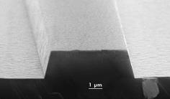
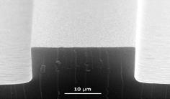
Shuttle holding approach
Impact on Performances
SiO2 etching with aSi-H mask
Conductive Shuttle
Positive slope
Thick Quartz
Negative slope
Conductive Shuttle
Optimized Quartz
Vertical slope
Conductive Shuttle

Slide 20
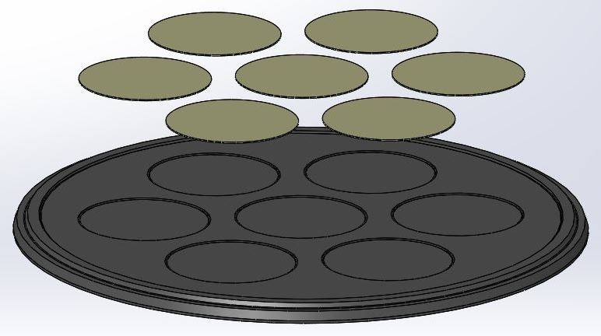
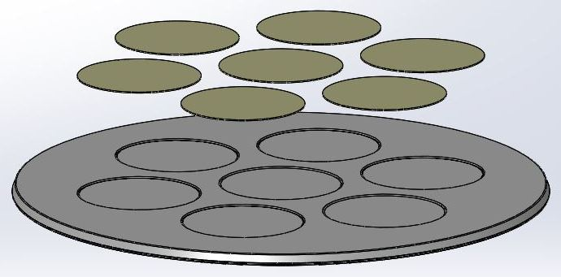
Shuttle holding approach
Benefits
Quick adaptation to sample shape and size
Optimum process conditions with NO modification of process chamber
Limited cross contamination between processes by using dedicated shuttles
2’’
Wafer carrier

Slide 21
usability corial 200S

Slide 22
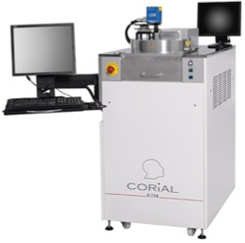
Process control software
COSMA
COSMA
CORIAL OPERATING SYSTEM FOR MACHINE
The simplest, most efficient software to develop processes, operate, and maintain CORIAL systems
DESKTOP APPLICATION
Process Editing I Process Adjustment I Process Operation I Process Tracability I System Maintenance
REMOTE CONTROL

Slide 23
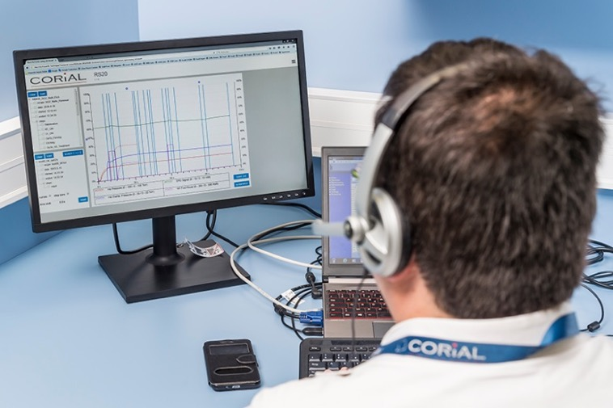
Reprocessing software
COSMA RS
DISPLAY UP TO 4
PARAMETERS FROM A RUN
Simple and efficient software to analyze process runs and accelerate process development
REMOTE
ANALYSIS OF RUNS
DRAG AND DROP
CURVES TO CHECK PROCESS REPEATABILITY

Slide 24
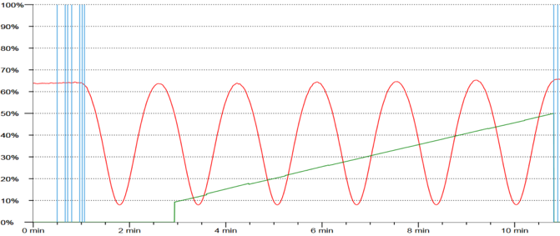
End point detection
EPD with laser
A CCD camera and laser diode, in the same measuring head, enables simultaneous visualization of the wafer surface and the laser beam impact on it. A 20 µm diameter laser spot facilitates the record of interference signals.
Real-Time etch rate measurement
Real-Time etched depth measurement

Slide 25
Corial 200S
Easy-to-use Reactive Ion Etching equipment
Wide process range for Si, silicon-based compounds, metals and Polymers
Rapid substrate loading and unloading
Smaller wafer pieces up to full 200 mm wafer
1x2’’ to 7x2’’ ; 1x3’’ to 3x3’’ ; 1x4’’ ; 1x6’’ ; 1x8’’

