Slide 1
DRIE APPLICATIONS
In Corial 210IL

Slide 2
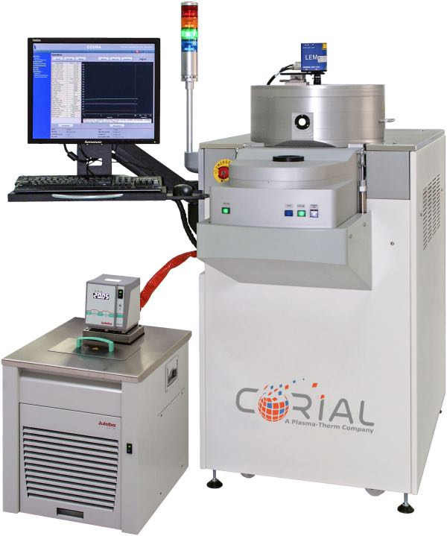
Corial 210IL
ICP-RIE equipment for deep etching applications
Wide process range for silicon, silicon carbide, glass, sapphire, and quartz deep etch
Support time-multiplexed processes (Bosch) in conventional dry etch reactor
Smaller wafer pieces up to full 200 mm wafer

Slide 3
performances glass drie process on corial 210IL

Slide 4
Drie of glass
> 800 NM/MIN
ETCH RATE
> 15 SELECTIVITY TO Ni MASK
> 100 µm ETCH DEPTH
+30% ETCH RATE IMPROVEMENT OVER STANDARD PROCESS
± 3 %
UNIFORMITY
CATHODE OPTIMIZED FOR Ni MASK CLAMPING
NO ROUGHNESS

Slide 5
performances SIC drie process on corial 210IL

Slide 6
Sic via etch process with ni mask
> 1400 NM/MIN
ETCH RATE
> 20 SELECTIVITY TO Ni MASK
SMOOTH
SIDEWALLS
> 100 µm ETCH DEPTH
± 3 %
UNIFORMITY
ANISOTROPIC ETCH PROFILE

Slide 7
performances Si drie process on corial 210IL with cosma pulse software

Slide 8
COSMA Pulse is a control software that broadens conventional tools’ process capabilities to enable time-multiplexed processes

Slide 9
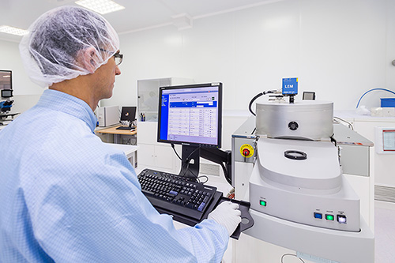
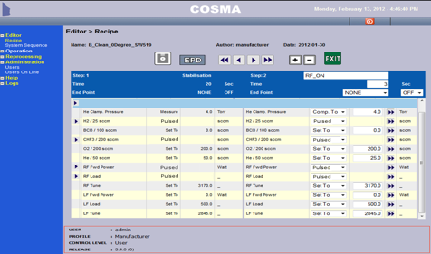
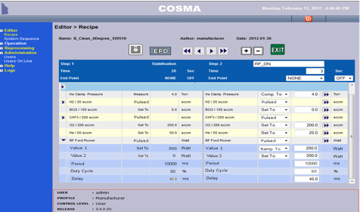
Cosma pulse description
Advanced Process Control
EASY
recipe programation
ALL PARAMETERS
CAN BE CONTROLLED AND PULSED
10 ms
DATA AQUISITION
+/-0,1%
ACCURACY
ON BIAS FINE TUNING

Slide 10
Si drie on corial 210IL
CORIAL Bosch-like process has 3 steps
step 1 - Polymer deposition by C4F8 plasma
step 2 - Polymer etching by SF6 plasma
step 3 - Silicon etching with 20W of RF power, which was used to increase the silicon etching rate
To alternate between each step,
COSMA pulse software is required for pulsing consecutively C4F8 gas flow, SF6 gas flow, LF and RF power

Slide 11
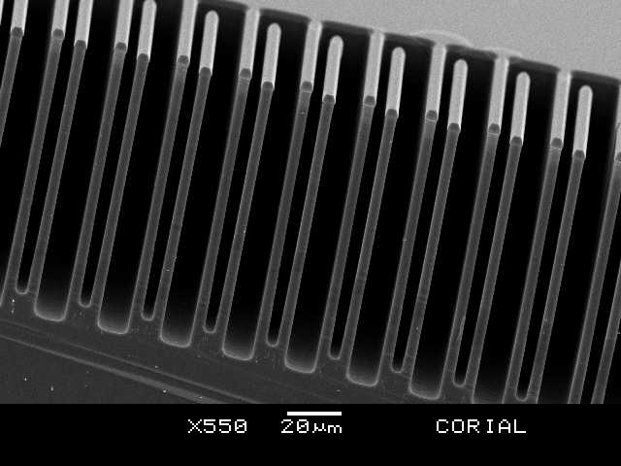
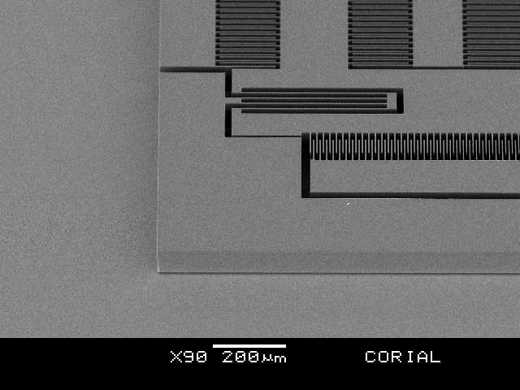
Drie of silicon
Precise control of the etch profile, fast etch rates, and excellent etch uniformity

Slide 12
Drie of silicon
Various Aspect Ratios
Feature size (µm) | Etched depth (µm) | Aspect ratio | Etch rate (µm/min) | Mask | Selectivity (vs. mask)
Ø250 | Through wafer | 1:2 | > 3.0 | SiO2 | 330
Ø100 | 515 | 1:5 | > 2.9 | PR | 85
Ø20 | 280 | 1:14 | > 1.5 | SiO2 | 155
Ø5 | 180 | 1:35 | > 1.0 | SiO2 | 100
Results obtained with 100 mm wafer, 20% Si open area

Slide 13
System description Corial 210IL

Slide 14
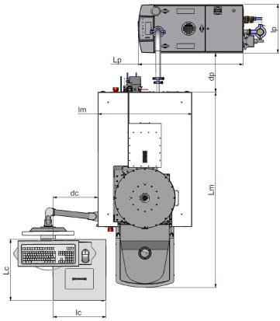
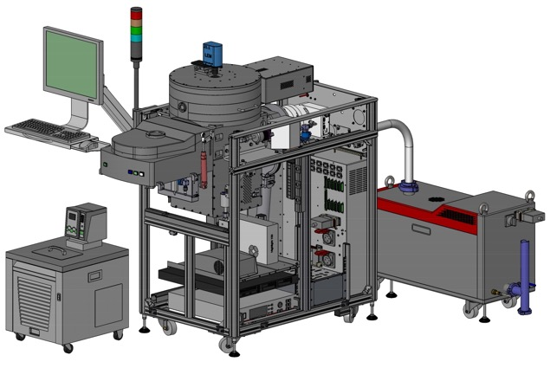
System description
General View
THE MOST
COMPACT
MACHINE
ON THE MARKET
ICP source
390
30 %
SMALLER FOOTPRINT
960
600
750
360
1570
490
420

Slide 15
System description
Detailed View
EPD with laser
ICP reactor
Load lock
Pumping system
(TMP 500l/s and dry pump 110 m³/h)
Chiller / Heater
HV and LV power supplies
ICP generator
(2 Mhz)
RF generator
(13,56 Mhz)
Process controller

Slide 16
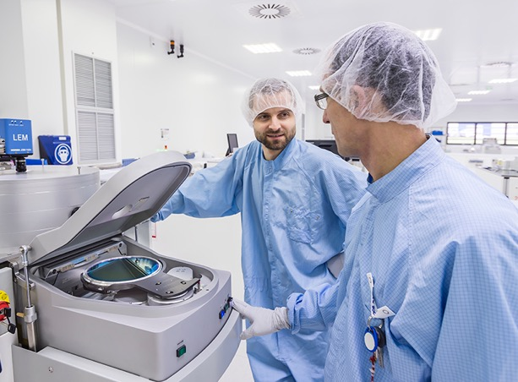
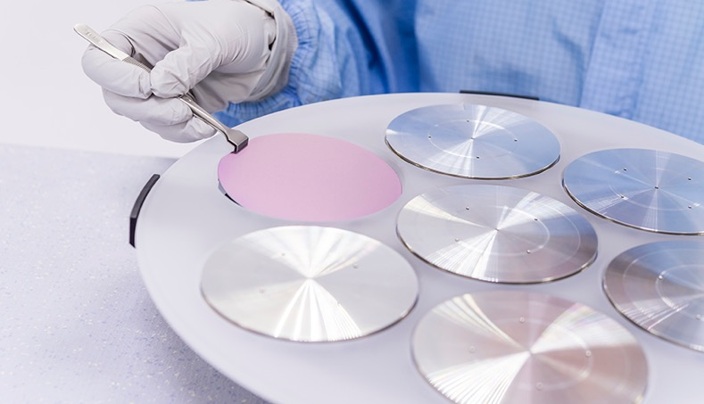
System description
Loading
< 180 s
LOADING TIME
Vacuum robot
FAST AND REPEATABLE LOAD AND UNLOAD
Shuttle
EASY EXCHANGE BETWEEN SUBSTRATE SHAPE AND SIZE

Slide 17
ICP SOURCE corial 210IL

Slide 18
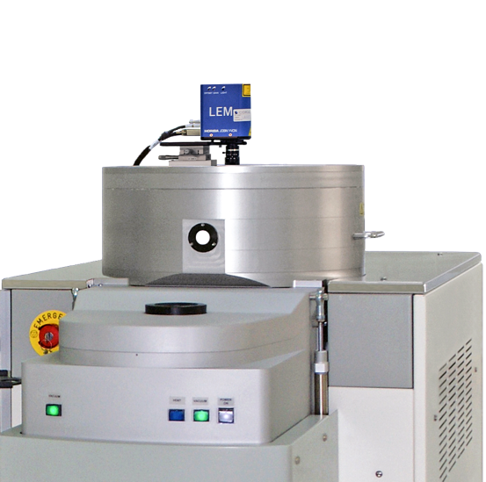
ICP source
CORIAL’s Latest Generation of Reactor
FAST AND UNIFORM ETCHING
Load lock to run fluorinated and chlorinated chemistries in the same process recipe
Load lock for stable and repeatable process conditions
RF match box with matching range up to 2000 W
Uniform temperature control (from -50°C) for best repeatability
Hot walls (>250°C) minimize polymer condensation for selective processes
Hot walls and retractable liner reduce clean time
Retractable liner and shuttle holding to minimize process cross-contamination

Slide 19
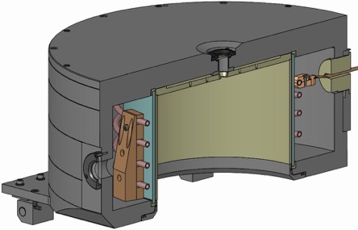
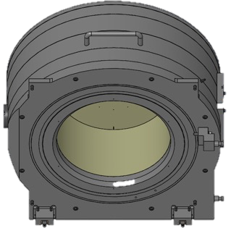
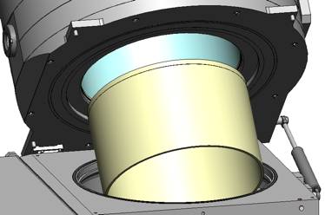
ICP Source
Retractable Quartz Liner
THE LINER FOR
HARSH ICP-RIE
PROCESSES
EASY LINER replacement by a single person
5 min
Liner replacement
4 min
Pumping down to 10⁻⁴ Tor
ZERO
CROSS CONTAMINATION
1 min
Reactor Venting
5 min
Plasma cleaning

Slide 20
Shuttle holding approach corial 210IL

Slide 21
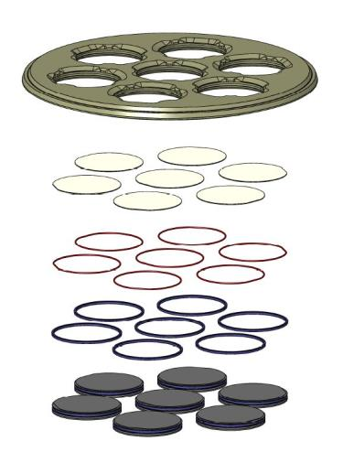
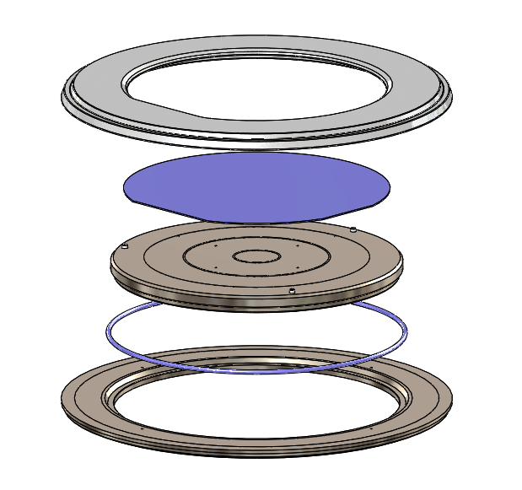
Shuttle holding approach
Portfolio
Clamping ring
Quartz shuttle
Wafers
Wafer
Moving plate
O’rings
O’ring
Base plate
Aluminum table
Guaranteed no wafer damage due to SOFT wafer clamping

Slide 22
Shuttle holding approach
Benefits
Quick adaptation to sample shape and size
Optimum process conditions with NO modification of process chamber
Limited cross contamination between processes by using dedicated shuttles
Shuttles for single wafer treatment: 1 x 2”, 1 x 3”, 1 x 4”, 1 x 6”, 1 x 8”
Shuttles for batch processing : 7 x 2”, 3 x 3”
Customized shuttles are available (4” x 4”, 5” x 5”, etc)

Slide 23
usability corial 210IL

Slide 24
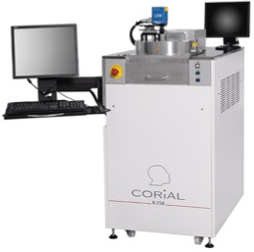
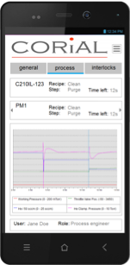
Process control software
COSMA
COSMA
CORIAL OPERATING SYSTEM FOR MACHINE
The simplest, most efficient software to develop processes, operate, and maintain CORIAL systems
DESKTOP APPLICATION
Process Editing I Process Adjustment I Process Operation I Process Tracability I System Maintenance
REMOTE CONTROL
MOBILE APPLICATION
Module & Process Follow-Up I Alarms & Warnings Connected Users
NEW
2018

Slide 25
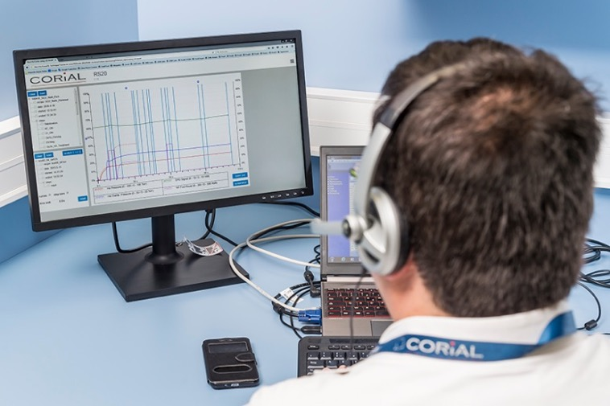
Reprocessing software
COSMA RS
DISPLAY UP TO 4
PARAMETERS FROM A RUN
Simple and efficient software to analyze process runs and accelerate process development
REMOTE
ANALYSIS OF RUNS
DRAG AND DROP
CURVES TO CHECK PROCESS REPEATABILITY

Slide 26
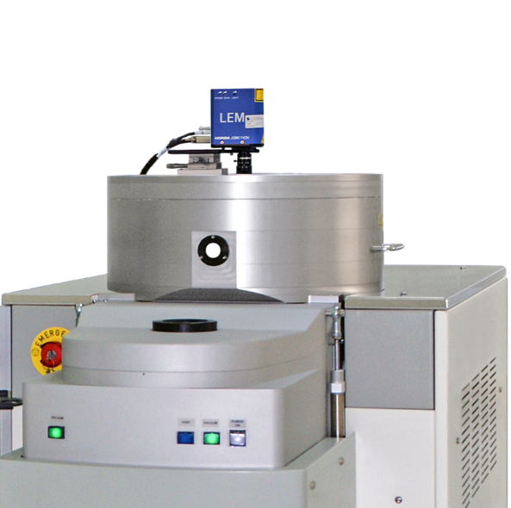
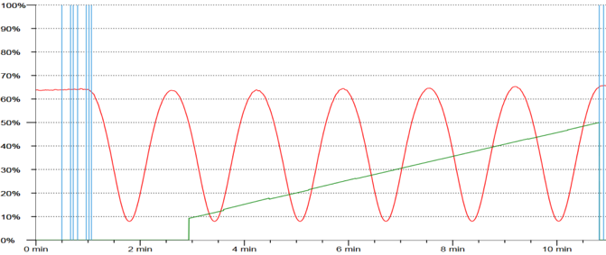
End point detection
EPD with laser
A CCD camera and laser diode, in the same measuring head, enables simultaneous visualization of the wafer surface and the laser beam impact on it. A 20 µm diameter laser spot facilitates the record of interference signals.
Real-Time etch rate measurement
Real-Time etched depth measurement

Slide 27
Corial 210IL
ICP-RIE equipment for deep etching applications
Wide process range for silicon, silicon carbide, glass, sapphire, and quartz deep etch
Support time-multiplexed processes (Bosch) in conventional dry etch reactor
Smaller wafer pieces up to full 200 mm wafer

