Slide 1
SiC DRIE APPLICATIONS
In Corial 210IL

Slide 2
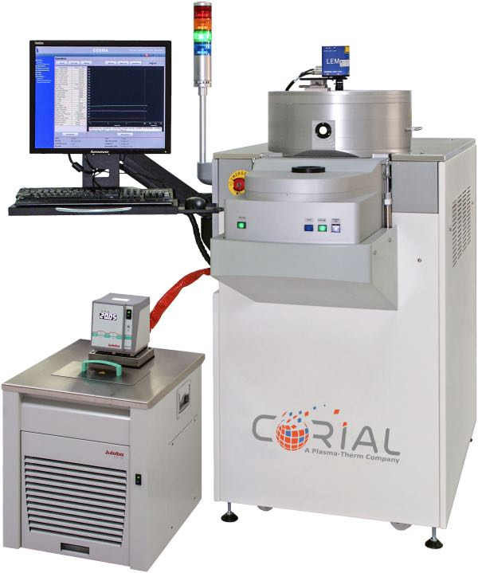
Corial 210IL
ICP-RIE equipment for deep etching applications
Manually loaded ICP system with vacuum load-lock
High power ICP source to deep etch SiC
Smaller wafer pieces up to full 200 mm wafer

Slide 3
performances SiC drie process on 3’’ wafers

Slide 4
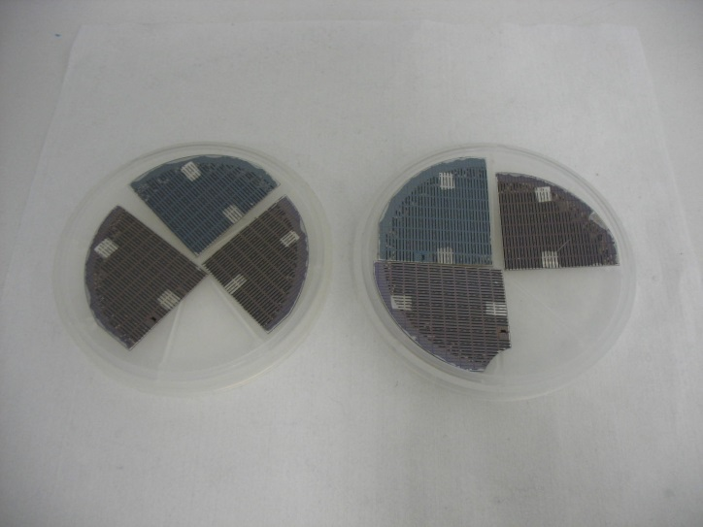
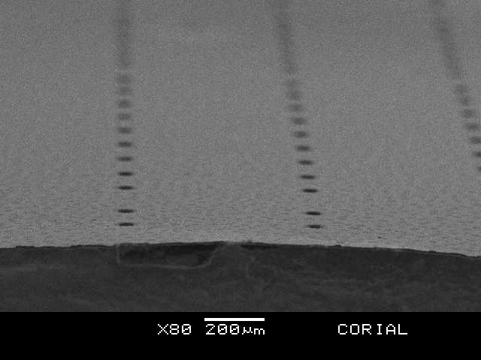
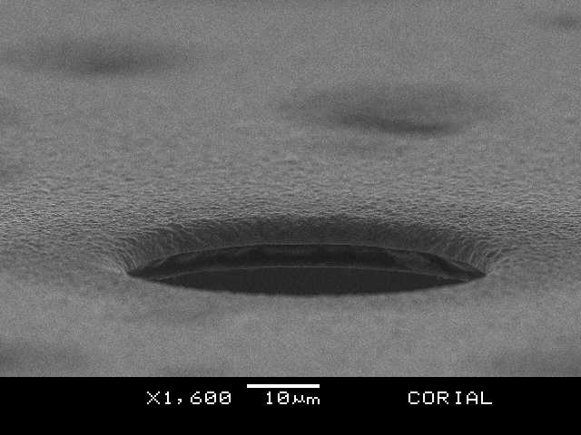
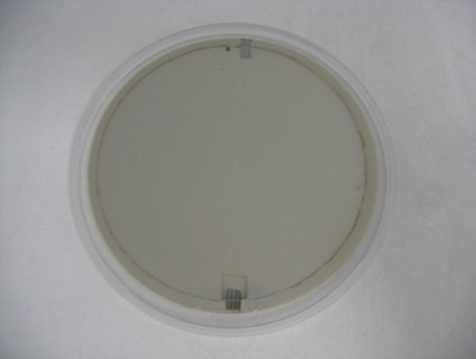
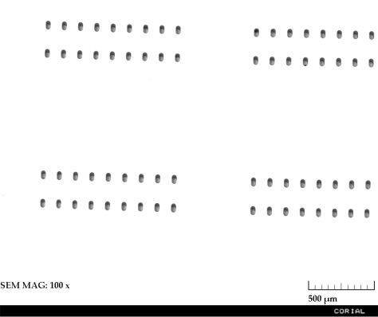
SiC wafers
Prior to SiC etching for demonstration of Corial tool capabilities, process setup was done on wafer fragments:
Fragment dimensions: quarters of 4’’ SiC wafer;
Wafer thickness: 300 µm;
GaN stack was grown on wafer frontside;
8…15 µm Ni mask was electrochemically grown on wafer backside (50 µm features separated by 500 µm).
The following wafers were used for further SiC DRIE performance demonstration:
Wafer supplier: CREE;
Wafer diameter: 76.2 mm;
Semi-insulating, 4H, epi-ready;
Micropipe density < 5 cm⁻²;
Wafers were grinded down to 100 µm thickness;
AlGaN/GaN stack was grown by MBE on wafer frontside;
6..9 µm Ni mask was electrochemically grown on the Cr/Au seed layer on wafer backside (40 x 80 µm features separated by 100, 200 & 500 µm).

Slide 5
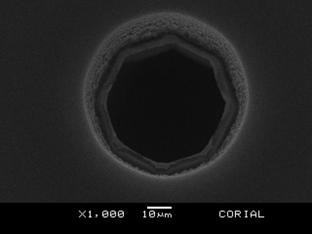
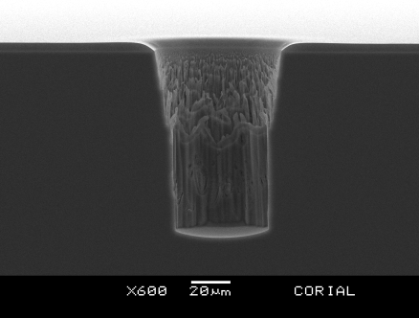
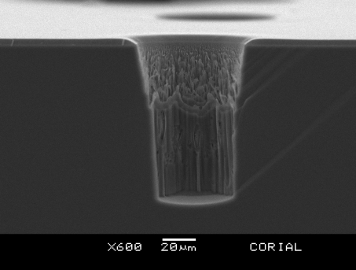
100 µm DEEP ETCHING
On 3’’ Wafer Fragments
Wafers fragments were stuck by vacuum grease on a Quartz wafer carrier.
Etch rate 1.26 µm/min, etching profile 82°, selectivity vs. Ni > 30:1, uniformity at the points spaced apart by 20 mm < 3%.
50 µm x 95 µm deep vias with zero micrompillars were demonstrated on the wafer fragments. No scallops were obtained on the sidewalls. Roughness on the top part of the vias comes from non vertical mask sidewalls.

Slide 6
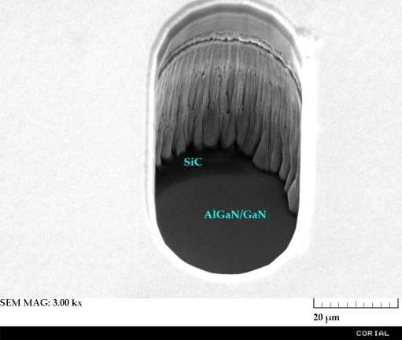
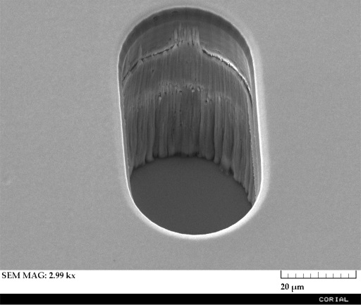
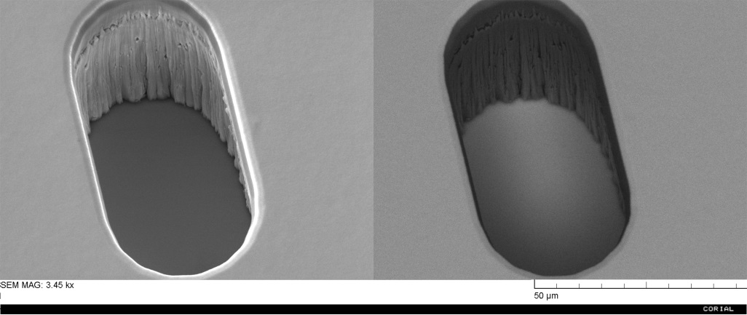
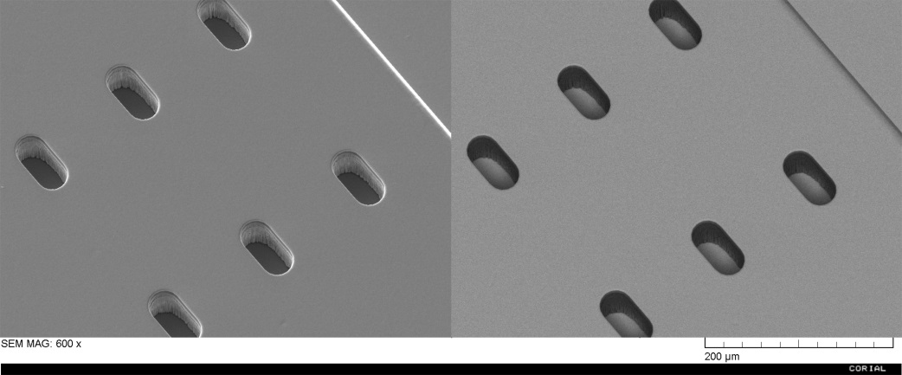
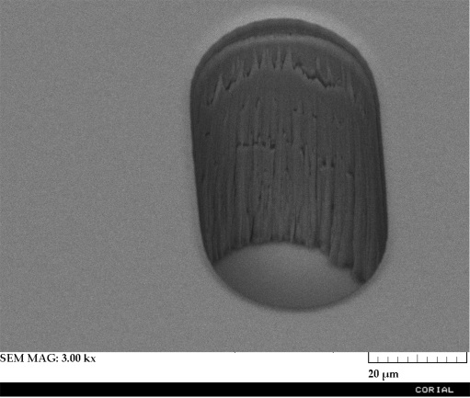
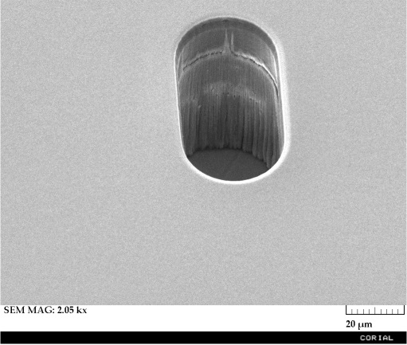
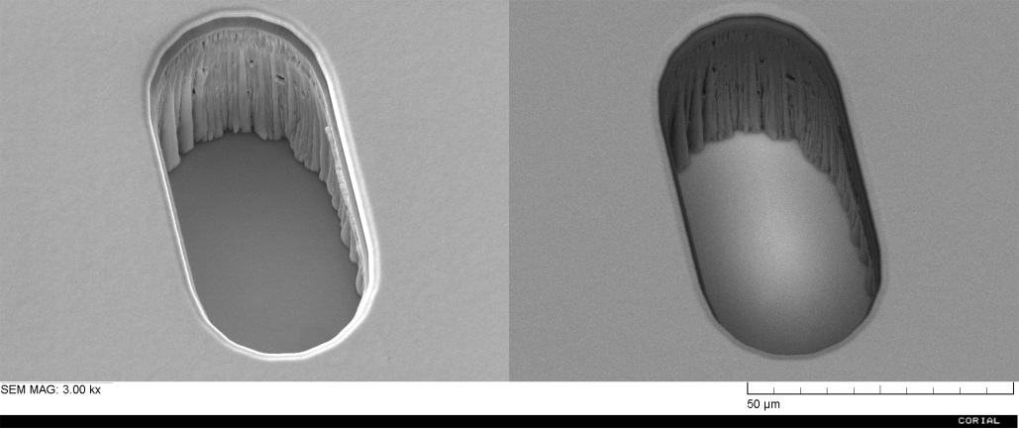
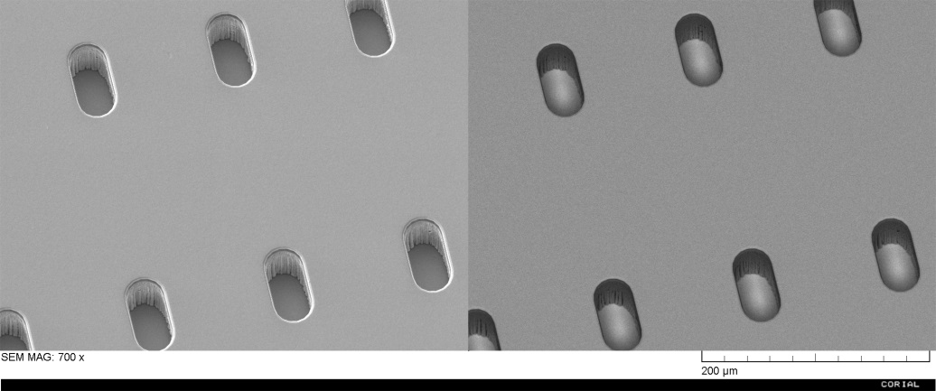
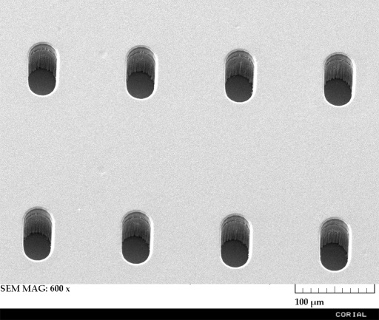
100 µm VIA-THROUGH ETCHING
On Full 3’’ Wafers
1
3
6
1
3
5
8
9
7
6
7
2
4
2
4
5
8
9
Etch rate 1.12 µm/min, etching profile - vertical, selectivity vs. Ni > 40:1, uniform etching down to the underlayer was achieved in all the points (uniformity on the wafer level < 3%).
40 µm x 80 µm x 100 µm deep via-through etching of SiC with soft landing on AlGaN/GaN was achieved. No micropillars and etching defects were found on via bottoms. Vias feature smooth sidewalls.

Slide 7
System description Corial 210IL

Slide 8
Corial equipment
Corial 210IL
This machine can be operated in both RIE and ICP-RIE modes.
For up to 200 mm substrates,
Hot quartz liners for protection of ICP reactor walls from non-volatile contamination,
High power (2 KW) ICP source producing uniform high density plasma,
High power (1 KW) RF source to ensure high etch rates,
Shuttles for efficient adaptation of the tool to different wafer sizes, and soft wafer clamping in ICP-RIE mode,
Very high conductance pumping system Adixen ATH1600M,
Helium pressure to ensure the thermal transfer between the cathode, the substrate holder and the substrates,
Laser end point detector for measurement of the etching rate and determination of stop-etch point.

