Slide 2
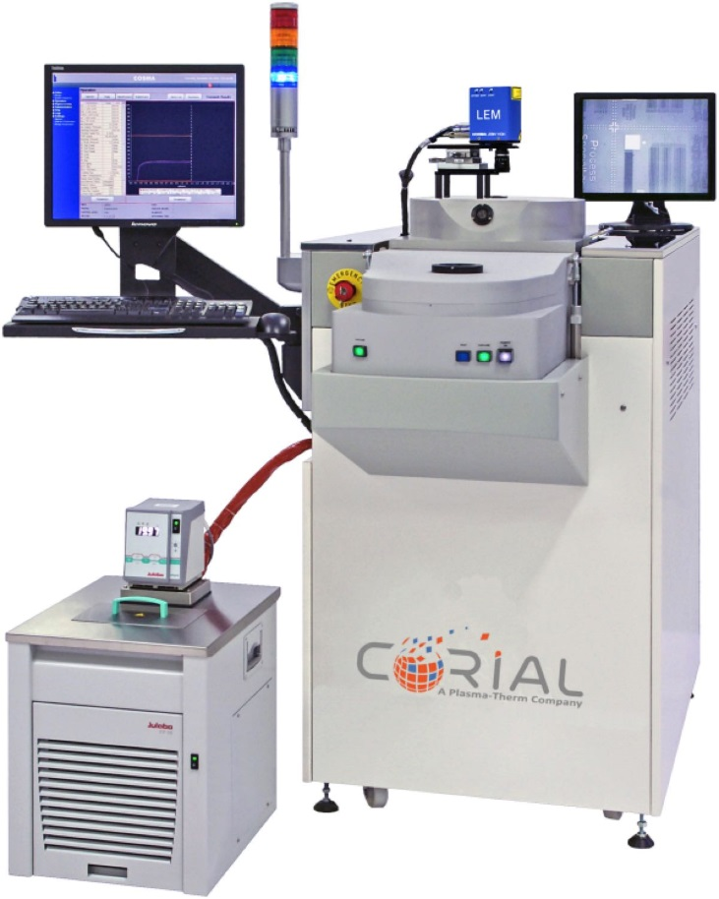
Corial 210RL
Anisotropic RIE etching supported by a wide range of processes
RIE capabilities over a variety of materials including Silicon compounds, metals, polymers, III-V and II-VI compounds
Modular design approach supporting tiered upgrades
Smaller wafer pieces up to full 200 mm wafer
1x2’’ to 7x2’’ ; 1x3’’ to 3x3’’ ; 1x4’’ ; 1x6’’ ; 1x8’’

Slide 3
System description Corial 210RL

Slide 4
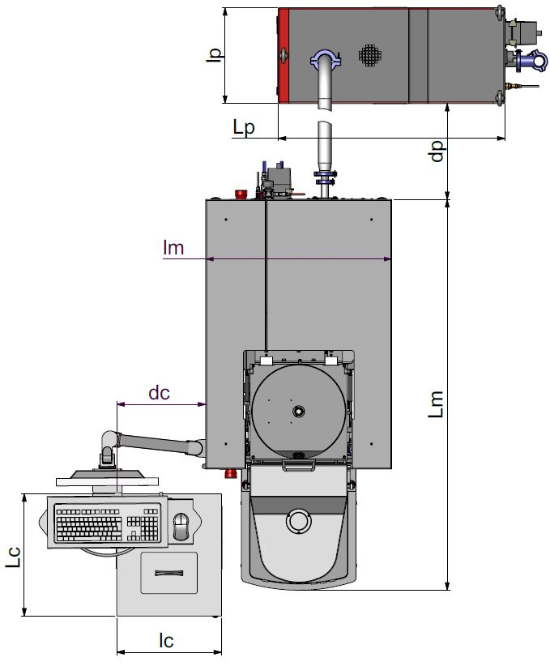
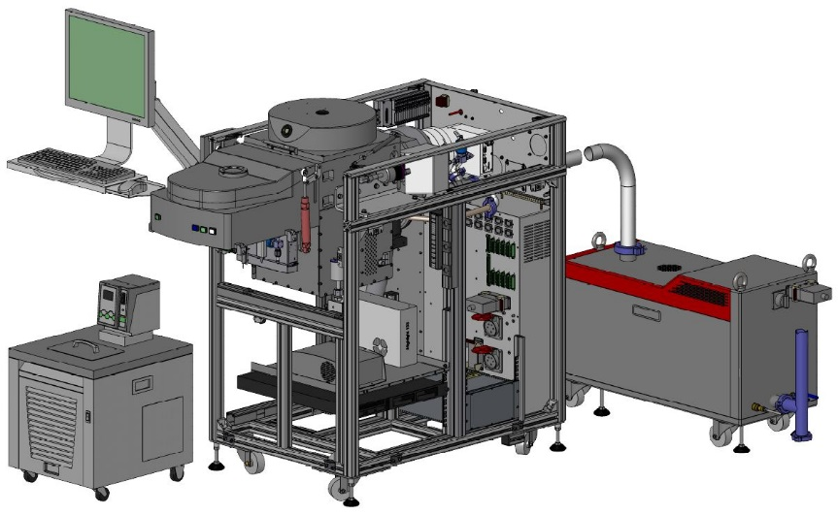
System description
General View
THE MOST
COMPACT
MACHINE
ON THE MARKET
SMALL FOOTPRINT
388
962
600
Low CoO
750
357
1570
490
420

Slide 5
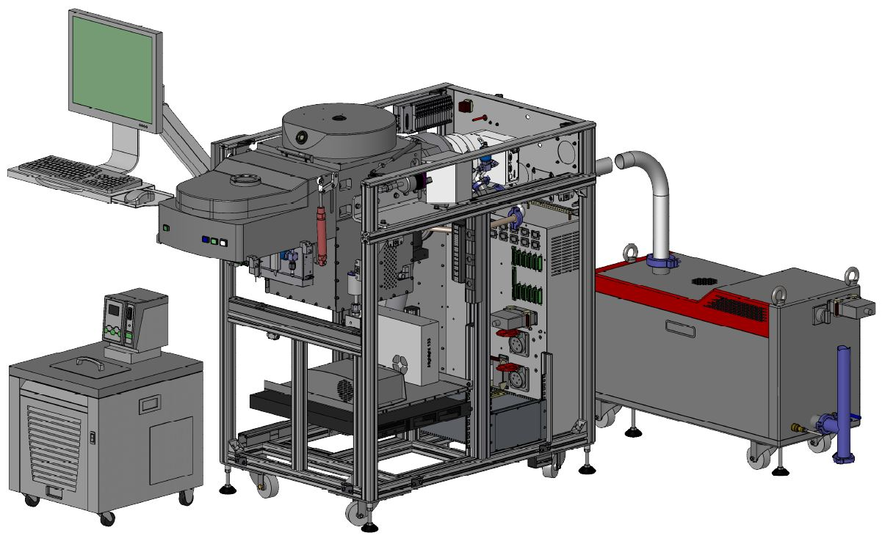
System description
Detailed View
RIE reactor
Load lock
Pumping system
(TMP 500l/s and dry pump 110 m³/h)
Chiller / Heater
300 W RF generator
(13,56 Mhz)
HV and LV power supplies
Process controller

Slide 6
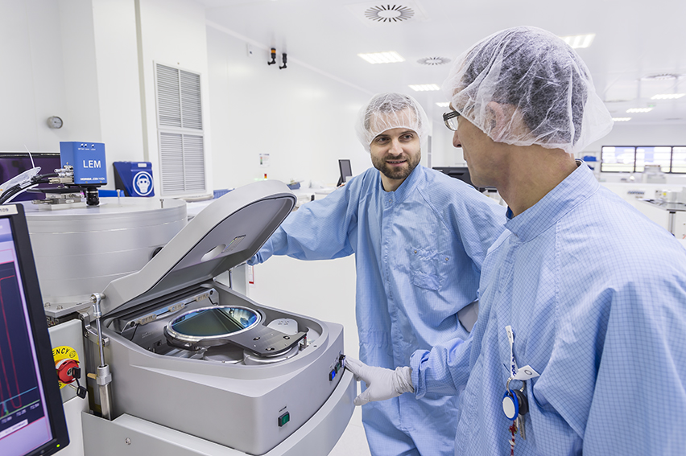
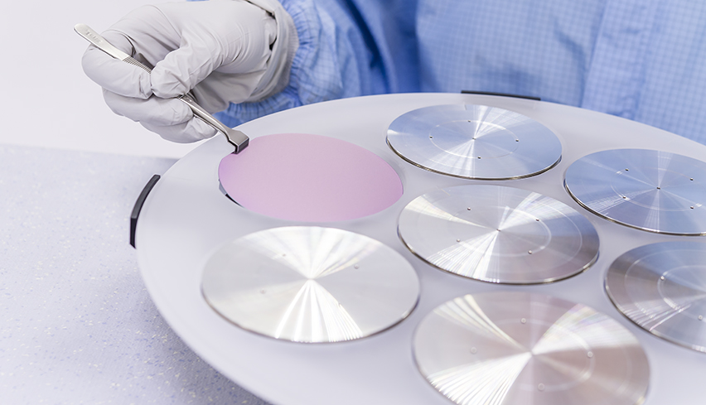
System description
Loading
< 180 s
LOADING TIME
Vacuum robot
FAST AND REPEATABLE LOAD AND UNLOAD
Shuttle
EASY EXCHANGE BETWEEN SUBSTRATE SHAPE AND SIZE

Slide 7
Standard rie source corial 210RL

Slide 8
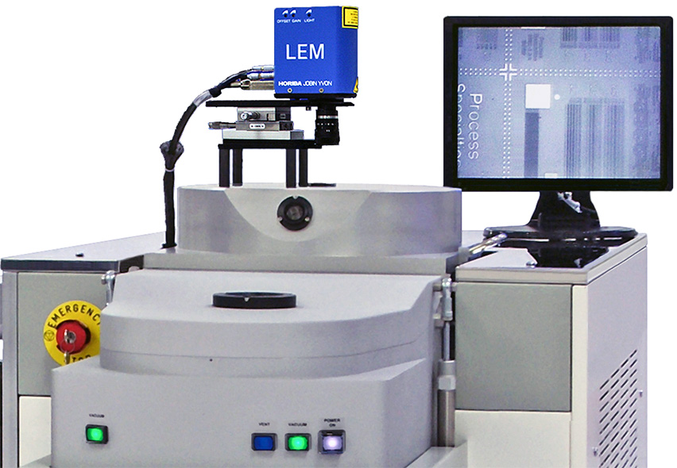
Rie source
Anisotropic RIE Etching
Flexible solution for RIE
Load lock enables using a combination of fluorinated and chlorinated chemistries in the same tool
Load lock for stable and repeatable process conditions
Uniform temperature control for best repeatability
Retractable liner for sputter etch increase time between cleans and reduce clean time
shuttle (carrier) design, combined with a standard cathode, for a cost-effective and fast reactor adaptation, suitable for multiple applications and substrate types
System can be upgraded from a basic RIE tool to an advanced ICP-RIE system
SiO2 50 nm/min
Al 250 nm/min
GaAs 300 nm/min
…

Slide 9
Rie source
Operation Sequence
1
Shuttle Loading
Loading tool
Shuttle
Cathode

Slide 10
Rie source
Operation Sequence
Cathode Up
Shuttle
Cathode
Loading tool
2

Slide 11
Rie source
Operation Sequence
Plasma heats wafer and cathode
PLASMA
Shuttle
Cathode
Loading tool
Coolant OUT
Coolant IN
Heat is transferred to shuttle and to the cooled cathode by He pressure at 5 Torrs
3
Helium

Slide 12
Performances rie processes corial 210RL

Slide 13
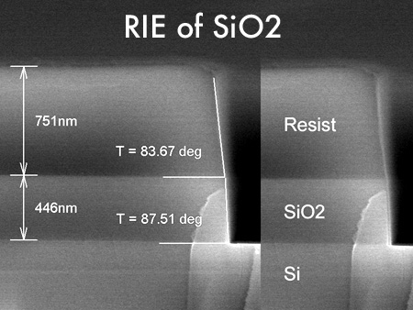
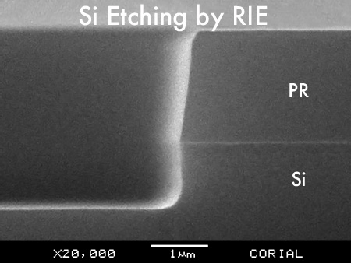
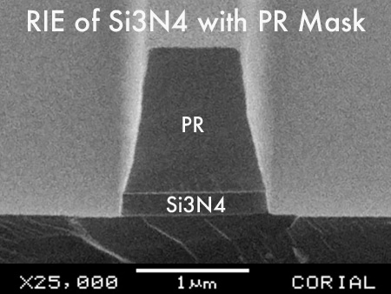
RIE OF Si, OXIDES AND NITRIDES
Fluorinated chemistry
RIE of SiO2 with PR mask – Vertical profile – High etch uniformity
RIE of SiO2 with PR mask – 0.8 µm deep
RIE of Si – 0.8 µm deep - Anisotropic profile
RIE of Si3N4 - 0.8 µm deep

Slide 14
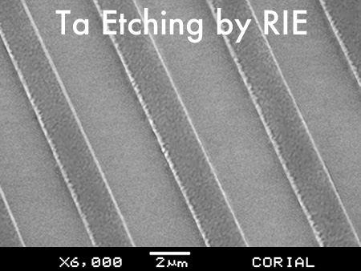
Rie of metals
Fluorinated chemistry
Nb etching with PR mask – Anisotropic profile
Ta etching with PR mask – Anisotropic profile
RIE of Nb / Ta
Ti etching with PR mask - Anisotropic profile

Slide 15
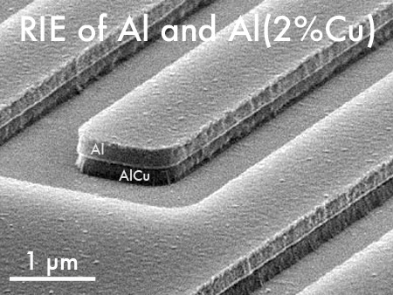
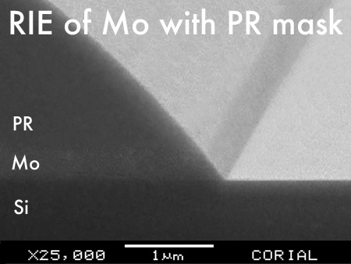
Rie of metals
Chlorinated chemistry
AlCu Etching with PR mask – Selective process
Mo Etching with PR mask

Slide 16
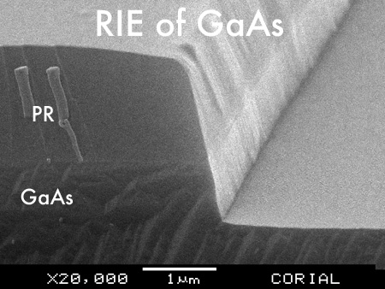
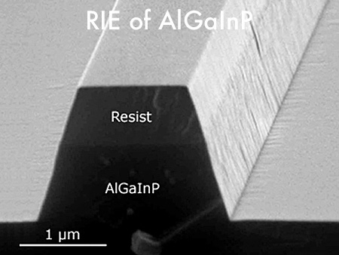
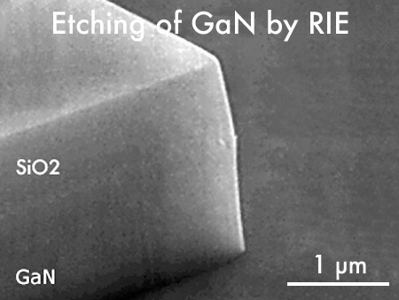
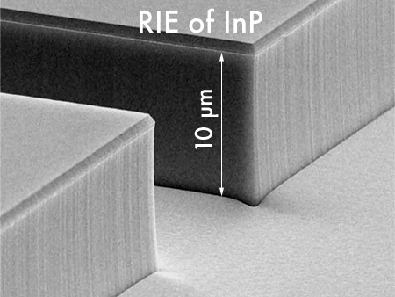
Rie of III-V compounds
RIE of GaAs – High etch rate – High selectivity
RIE of AlGaInP – PR mask
RIE of GaN – SiO2 mask
RIE of InP – High etch rate

Slide 17
High etch rates
Excellent Uniformities
Process | Mask | Etch rate (nm/min) | Selectivity (vs mask) | Uniformity (across wafer)
Polymers | PR | 400 | 1 | ±5%
SiO₂ | PR | 45 | > 2 | ±3%
Si₃N₄ | PR | 60 | > 2 | ±3%
InP | SiO2 | 80 | > 50 | ±3%
GaN | SiO2 | 200 | 5 | ±5%
GaAs | PR | 300 | 6 | ±5%
Al | PR | 180 | 1 | ±5%
Ta | PR | 90 | > 0.5 | ±5%
Ti | PR | 25 | 0.3 | ±5%
Nb | PR | 110 | > 0.5 | ±5%

Slide 18
Rie source for sputter-etch Corial 210RL

Slide 19
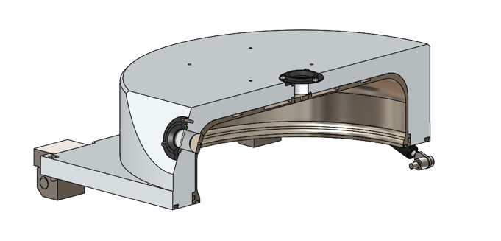
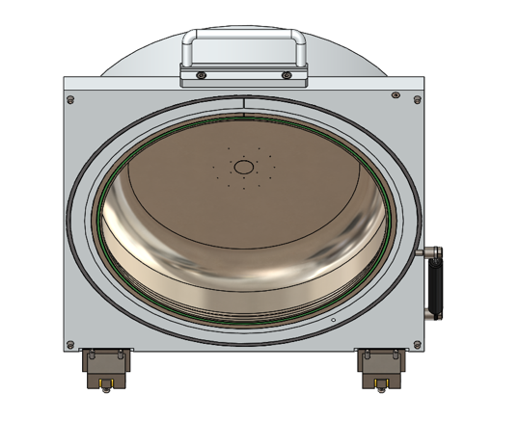
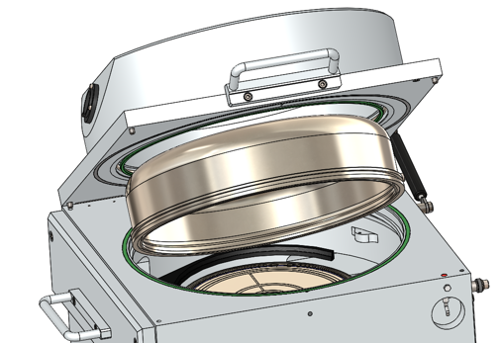
Sputter etch
RIE process chamber for etching and sputtering
LINER TO COLLECT ETCH-BY-PRODUCTS AND SPUTTERED MATERIALS
EASY LINER replacement by a single person
5 min
Liner replacement
4 min
Pumping down to 10⁻⁴ Tor
Dedicated process chamber for
Au, Ag, Ni, Fe, Co, Pt, PZT… SPUTTERING
1 min
Reactor Venting
5 min
Plasma cleaning

Slide 20
Sputter etch
Ar chemistry
Process | Mask | Etch rate (nm/min) | Selectivity (vs mask) | Uniformity (across wafer)
Au, Pt, PZT, Fe, Co | PR | 45 | > 1 | ±5%
Back sputtering of Pt with PR mask

Slide 21
Shuttle holding approach corial 210RL

Slide 22
Shuttle holding approach
Portfolio
NG20 wafer carrier
NQ200 wafer carrier
50 mm wafer
75 mm wafer
100 mm wafer
150 mm wafer
200 mm wafer
50 mm wafer
75 mm wafer
100 mm wafer
150 mm wafer
200 mm wafer

Slide 23
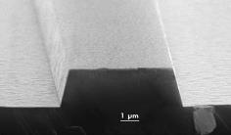
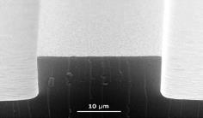
Shuttle holding approach
Impact on Performances
SiO2 etching with aSi-H mask
Conductive Shuttle
Positive slope
Thick Quartz
Negative slope
Conductive Shuttle
Optimized Quartz
Vertical slope
Conductive Shuttle

Slide 24
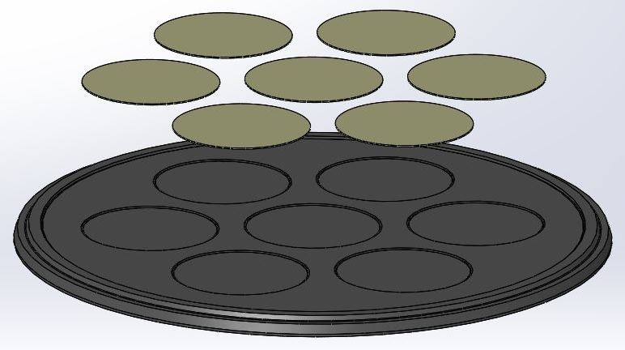
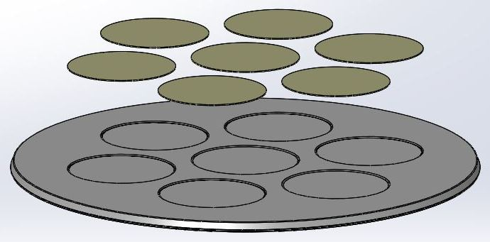
Shuttle holding approach
Benefits
Quick adaptation to sample shape and size
Optimum process conditions with NO modification of process chamber
Limited cross contamination between processes by using dedicated shuttles
2’’
Wafer carrier

Slide 25
usability corial 210RL

Slide 26
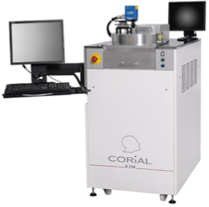
Process control software
COSMA
COSMA
CORIAL OPERATING SYSTEM FOR MACHINE
The simplest, most efficient software to develop processes, operate, and maintain CORIAL systems
DESKTOP APPLICATION
Process Editing I Process Adjustment I Process Operation I Process Tracability I System Maintenance
REMOTE CONTROL

Slide 27
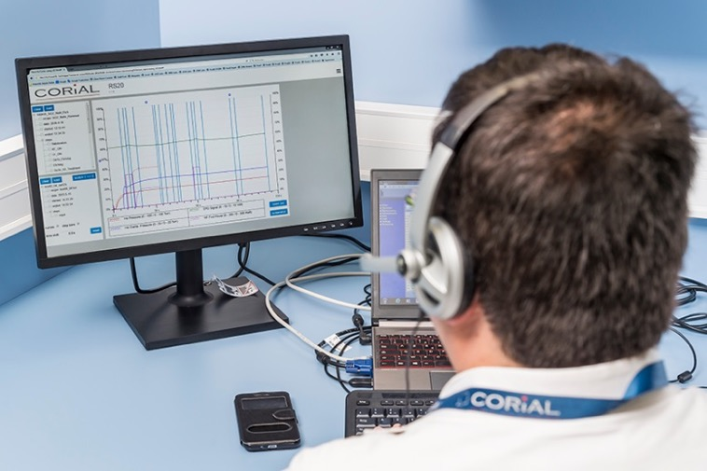
Reprocessing software
COSMA RS
DISPLAY UP TO 4
PARAMETERS FROM A RUN
Simple and efficient software to analyze process runs and accelerate process development
REMOTE
ANALYSIS OF RUNS
DRAG AND DROP
CURVES TO CHECK PROCESS REPEATABILITY

Slide 28
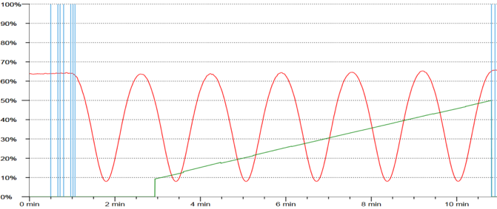
End point detection
EPD with laser
A CCD camera and laser diode, in the same measuring head, enables simultaneous visualization of the wafer surface and the laser beam impact on it. A 20 µm diameter laser spot facilitates the record of interference signals.
Real-Time etch rate measurement
Real-Time etched depth measurement

Slide 29
Corial 210RL
Anisotropic RIE etching supported by a wide range of processes
RIE capabilities over a variety of materials including Silicon compounds, metals, polymers, III-V and II-VI compounds
Modular design approach supporting tiered upgrades
Smaller wafer pieces up to full 200 mm wafer
1x2’’ to 7x2’’ ; 1x3’’ to 3x3’’ ; 1x4’’ ; 1x6’’ ; 1x8’’

