Slide 2
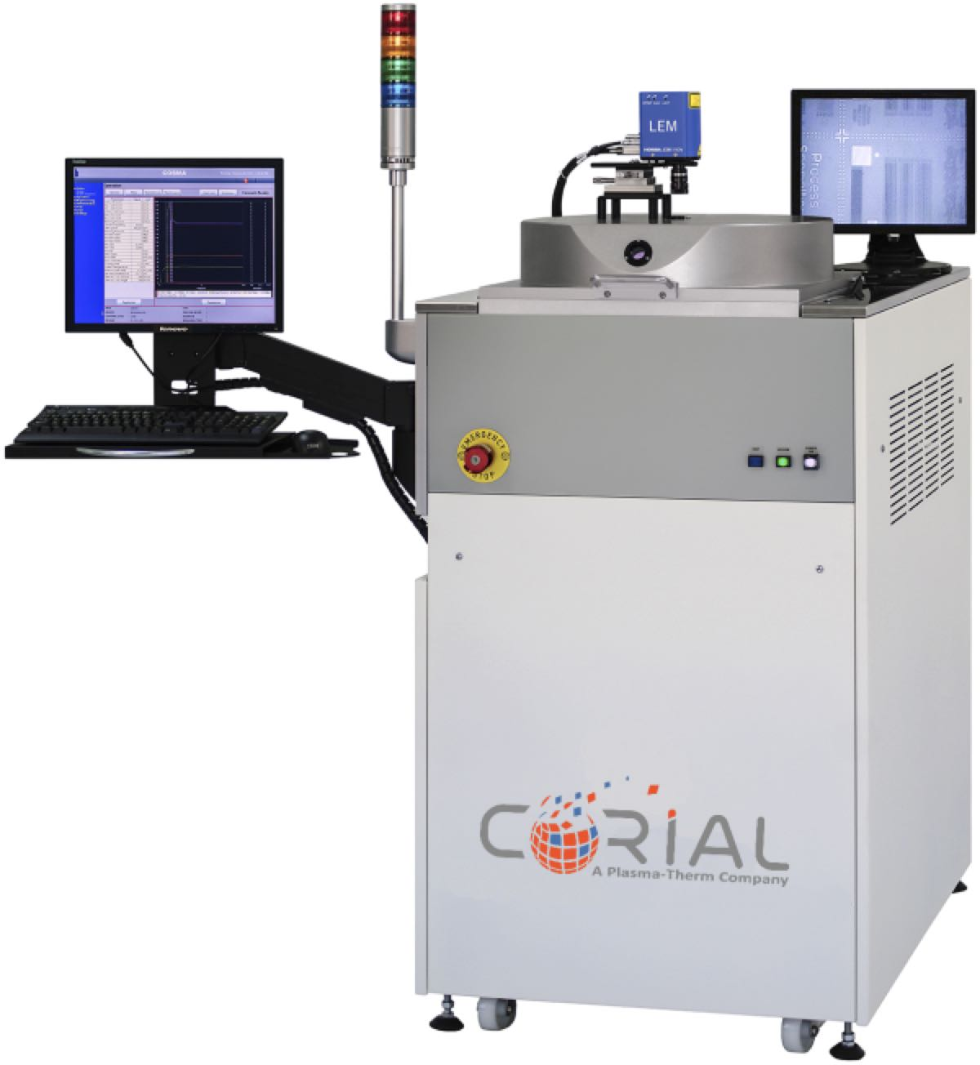
Corial 300S
Simple-to-use, manually-loaded batch RIE system
Wide process range for metal sputtering (Au, Pt, Ti),
and Si, silicon-based compounds (aSi-H, SiO2, Si3N4), polymers etching using fluorinated gases
Cost-effective mask repair technology with chrome etch capabilities using chlorinated chemistry
Rapid batch loading of wafers 12x3’’ ; 7x4’’ ; 3x6’’ ; 1x8’’
Loading of glass and quartz masks 2’’x2’’ up to 8’’x8’’

Slide 3
System description Corial 300S

Slide 4
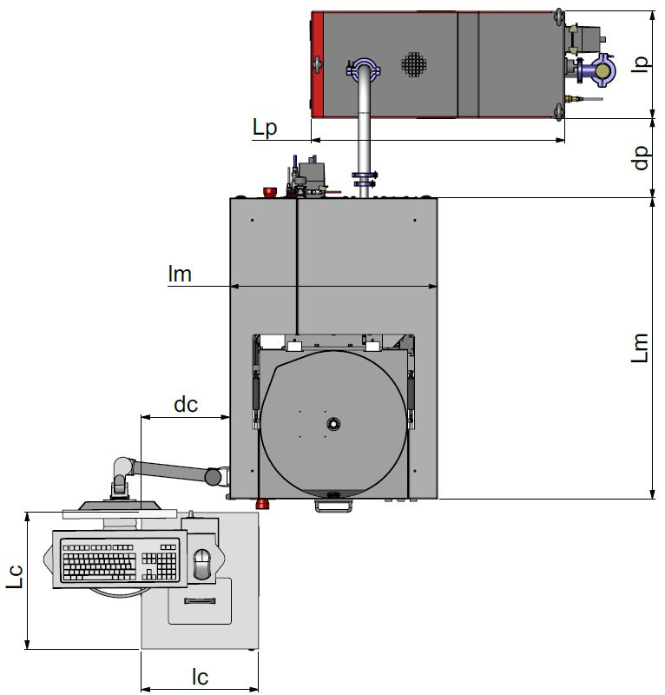
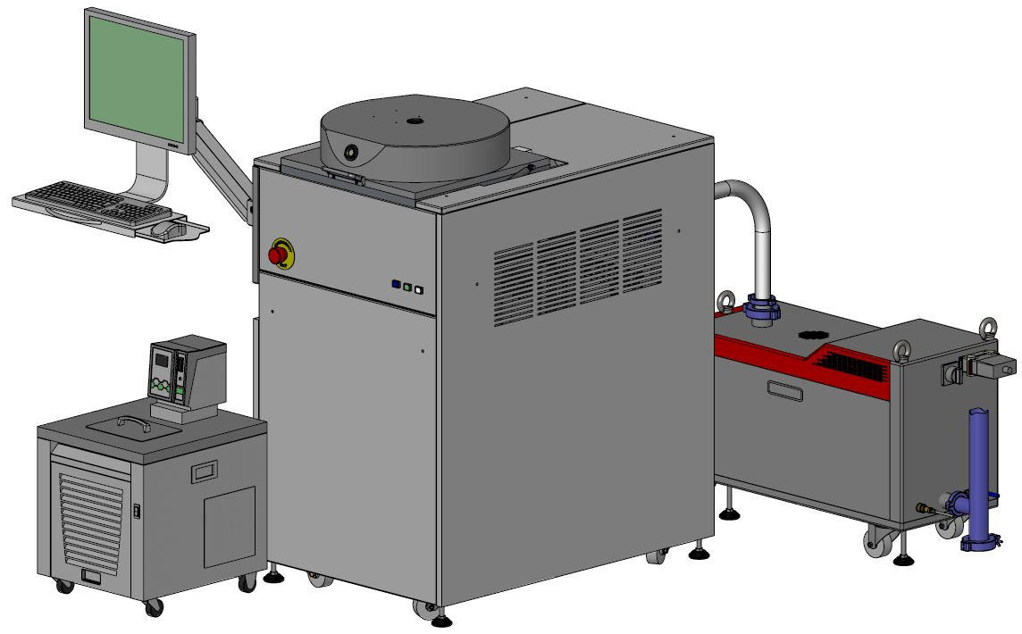
System description
General View
390
SMALL FOOTPRINT
0.81 m2
960
600
Low CoO
750
1080
360
490
420

Slide 5
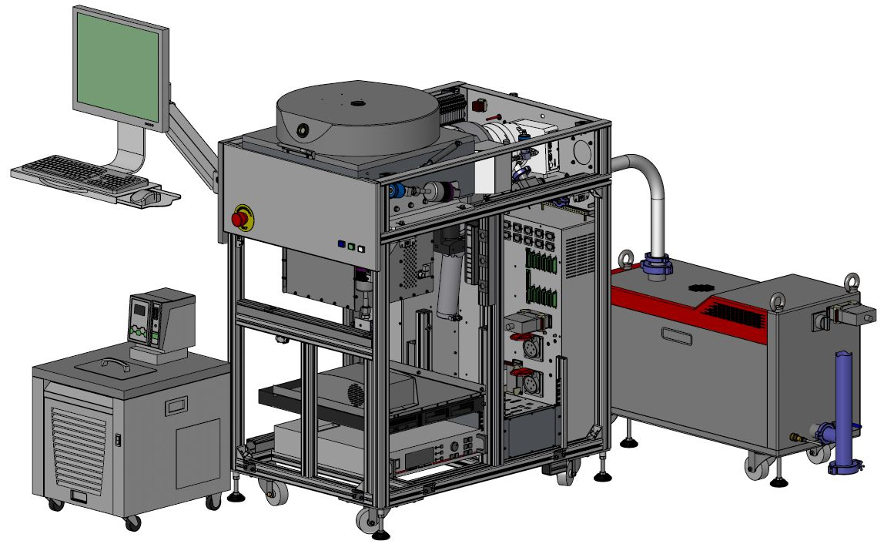
System description
Detailed View
RIE reactor
Direct loading
Pumping system
(TMP 500l/s and dry pump 110m³/h)
Chiller / Heater
HV and LV power supplies
1000 W RF generator
(13,56 Mhz)
Process controller

Slide 6
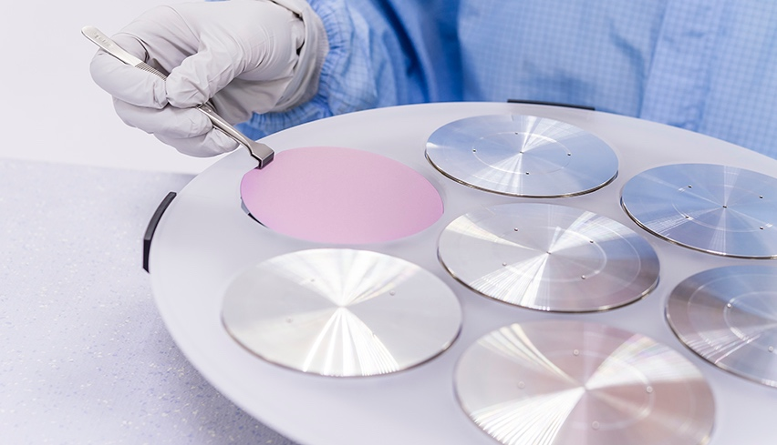
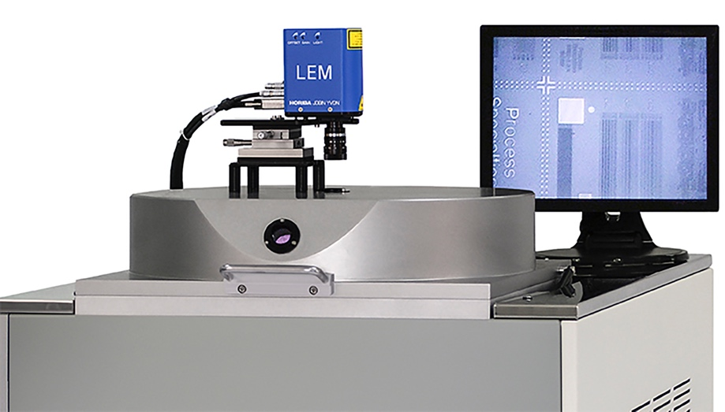
System description
Loading
< 210 s
LOADING TIME
Direct loading
FAST LOAD AND UNLOAD
Shuttle
EASY EXCHANGE BETWEEN SUBSTRATE SHAPE AND SIZE

Slide 7
Standard rie source corial 300S

Slide 8
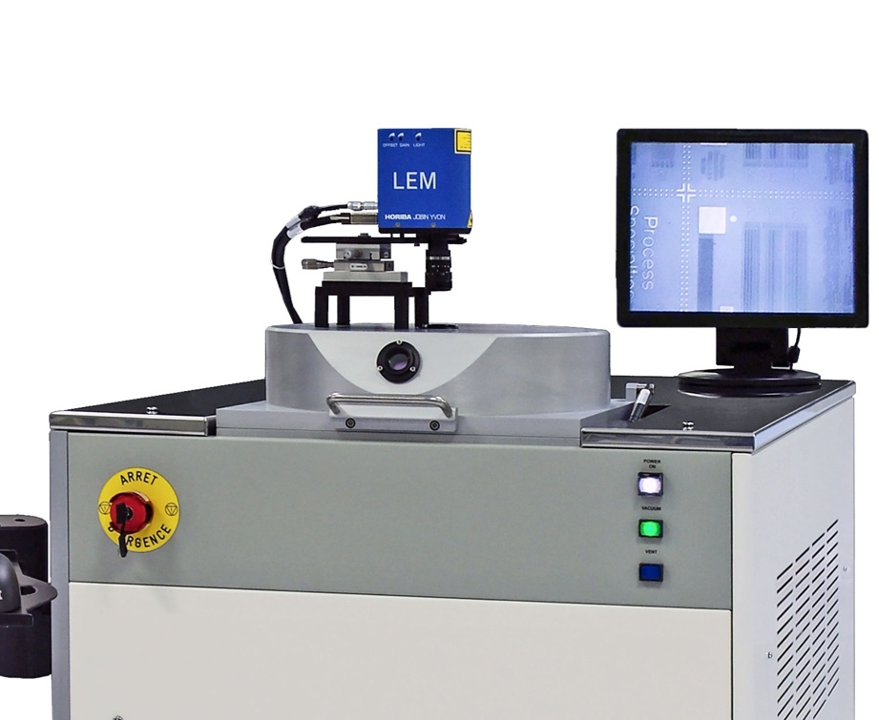
Rie source
Easy-to-use
HIGH ETCH RATE CAPABILITY
Heating of the cathode to enhance the desorption of by-products and to improve process performance
Chrome and quartz etch capabilities making the Corial 300S ideal for mask repair applications
Optional end-point detection by laser interferometry for excellent etch control and etch rate determination
Retractable liner for sputter-etch increases time between cleans and reduces clean time
Shuttle (carrier) design, combined with a standard cathode, for a cost-effective and fast reactor adaptation, suitable for multiple applications and substrate types
Simple-to-use reactor with a large cathode that facilitates substrate loading, and substrate holders simply clamped on the cathode without the need for screws or fasteners
Minimized maintenance

Slide 9
Rie source
Operation Sequence
Substrate
holder
Laser window
Photomask or wafer
PLASMA
Cathode
TMP
A He pressure at 5 Torrs maintains the substrate holder at constant temperature
Coolant IN
Helium IN
Coolant OUT

Slide 10
Performances rie processes for mask repair corial 300S

Slide 11
Rie of chrome for mask repair
Chlorinated chemistry
RIE of Cr on quartz mask
RIE of Cr mask with e-beam PR
Process | Mask | Etch rate (nm/min) | Selectivity (vs mask) | Uniformity (across wafer)
Cr | PR | 50 | 2 | ±3%

Slide 12
Performances rie processes Corial 300S

Slide 13
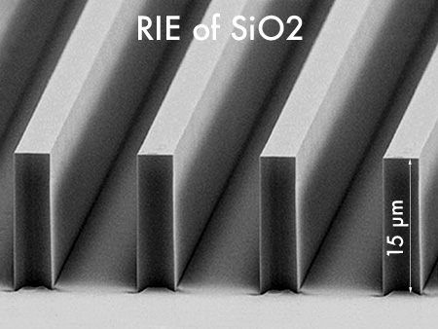
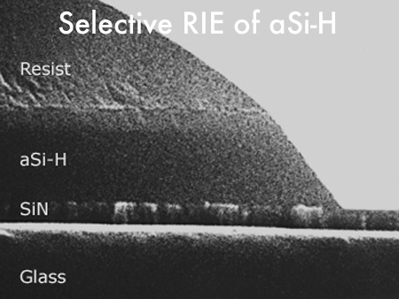
Rie of si, oxides, and nitrides
Fluorinated chemistry
RIE of SiO2 with PR mask – Vertical profile – High etch uniformity
RIE of SiO2– 15 µm deep
RIE of aSi-H – 300 nm deep
RIE of Si3N4 with PR mask

Slide 14
Rie of metals
Fluorinated chemistry
Ti Etching with PR mask - Anisotropic profile

Slide 15
High etch rates
Excellent Uniformities
Process | Mask | Etch rate (nm/min) | Selectivity (vs mask) | Uniformity (across wafer)
Polymers | PR | 400 | 1 | ±5%
SiO₂ | PR | 50 | 3 | ±3%
Si₃N₄ | PR | 60 | > 2 | ±3%
Si | PR | 100 | 1 | ±5%
Ti | PR | 25 | 0.3 | ±5%

Slide 16
Rie source for sputter-etch Corial 300S

Slide 17
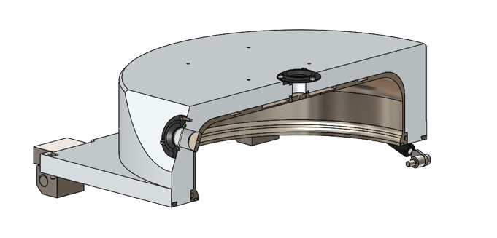
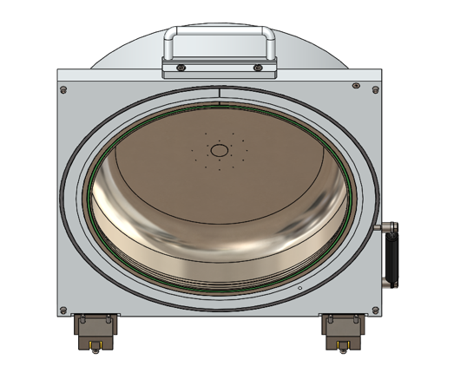
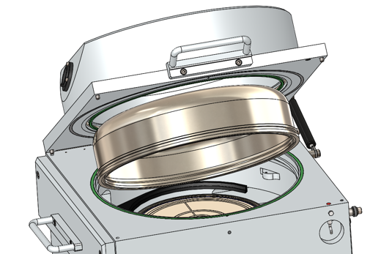
Sputter-etch
RIE Process Chamber for Etching and Sputtering
LINER TO COLLECT ETCH-BY-PRODUCTS AND SPUTTERED MATERIALS
EASY LINER replacement by a single person
5 min
Liner replacement
4 min
Pumping down to 10⁻⁴ Tor
Dedicated process chamber for
Au, Ag, Ni, Fe, Co, Pt, PZT… SPUTTERING
1 min
Reactor Venting
5 min
Plasma cleaning

Slide 18
Sputter-etch
Ar chemistry
Process | Mask | Etch rate (nm/min) | Selectivity (vs mask) | Uniformity (across wafer)
Au, Pt, PZT, Fe, Co | PR | 45 | > 1 | ±5%
Back sputtering of Pt with PR mask

Slide 19
Shuttle holding approach corial 300S

Slide 20
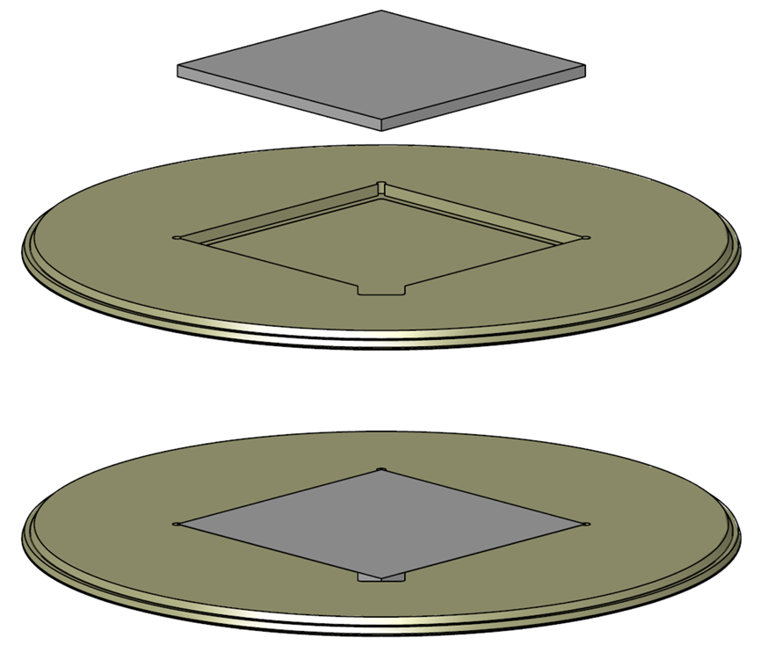
Shuttle holding approach
Benefits
Quick adaptation to sample shape and size
Optimum process conditions with NO modification of process chamber
Limited cross contamination between processes by using dedicated shuttles
Shuttles for single wafer treatment: 1 x 8”, 1 x 12”
Shuttles for batch wafer processing : 12x3’’, 7 x 4”, 3 x 6”
Shuttles for photomask repair 2’’x2’’ up to 8’’x8’’

Slide 21
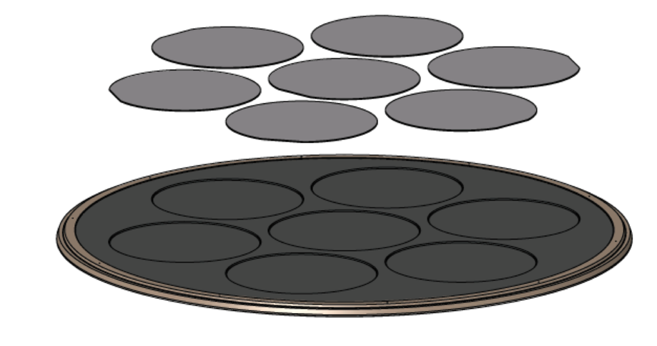
Shuttle holding approach
Portfolio
carrier for photomask
carrier for wafer
5’’x5’’ photomask
6’’x6’’ photomask
7’’x7’’ photomask
100 mm wafer

Slide 22
usability corial 300S

Slide 23
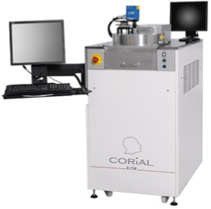
Process control software
COSMA
COSMA
CORIAL OPERATING SYSTEM FOR MACHINE
The simplest, most efficient software to develop processes, operate, and maintain CORIAL systems
DESKTOP APPLICATION
Process Editing I Process Adjustment I Process Operation I Process Tracability I System Maintenance
REMOTE CONTROL

Slide 24
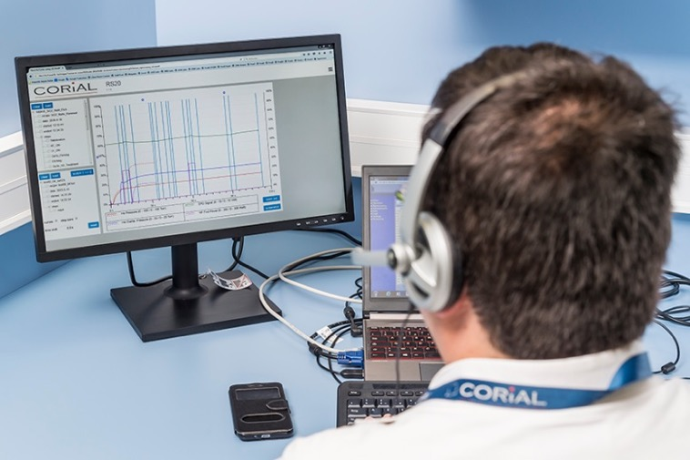
Reprocessing software
COSMA RS
DISPLAY UP TO 4
PARAMETERS FROM A RUN
Simple and efficient software to analyze process runs and accelerate process development
REMOTE
ANALYSIS OF RUNS
DRAG AND DROP
CURVES TO CHECK PROCESS REPEATABILITY

Slide 25
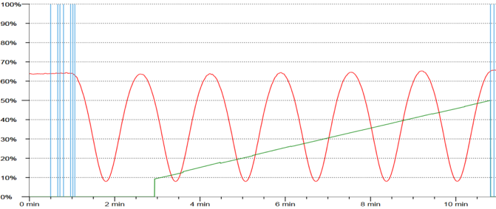
End point detection
EPD with laser
A CCD camera and laser diode, in the same measuring head, enables simultaneous visualization of the wafer surface and the laser beam impact on it. A 20 µm diameter laser spot facilitates the record of interference signals.
Real-Time etch rate measurement
Real-Time etched depth measurement

Slide 26
Corial 300S
Simple-to-use, manually-loaded batch RIE system
Wide process range for metal sputtering (Au, Pt, Ti),
and Si, silicon-based compounds (aSi-H, SiO2, Si3N4), polymers etching using fluorinated gases
Cost-effective mask repair technology with chrome etch capabilities using chlorinated chemistry
Rapid batch loading of wafers 12x3’’ ; 7x4’’ ; 3x6’’ ; 1x8’’
Loading of glass and quartz masks 2’’x2’’ up to 8’’x8’’

