Slide 2
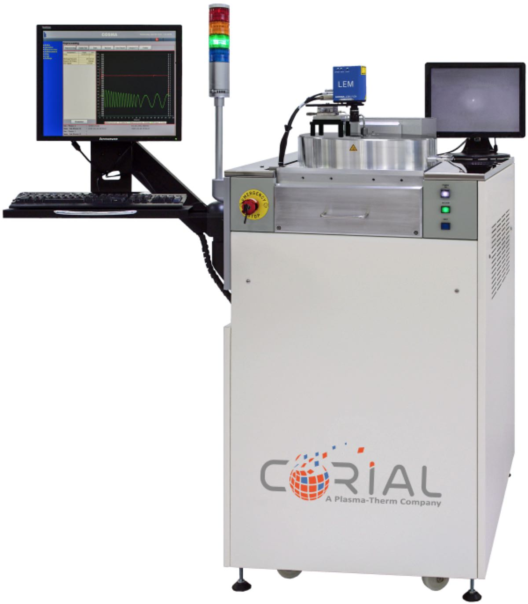
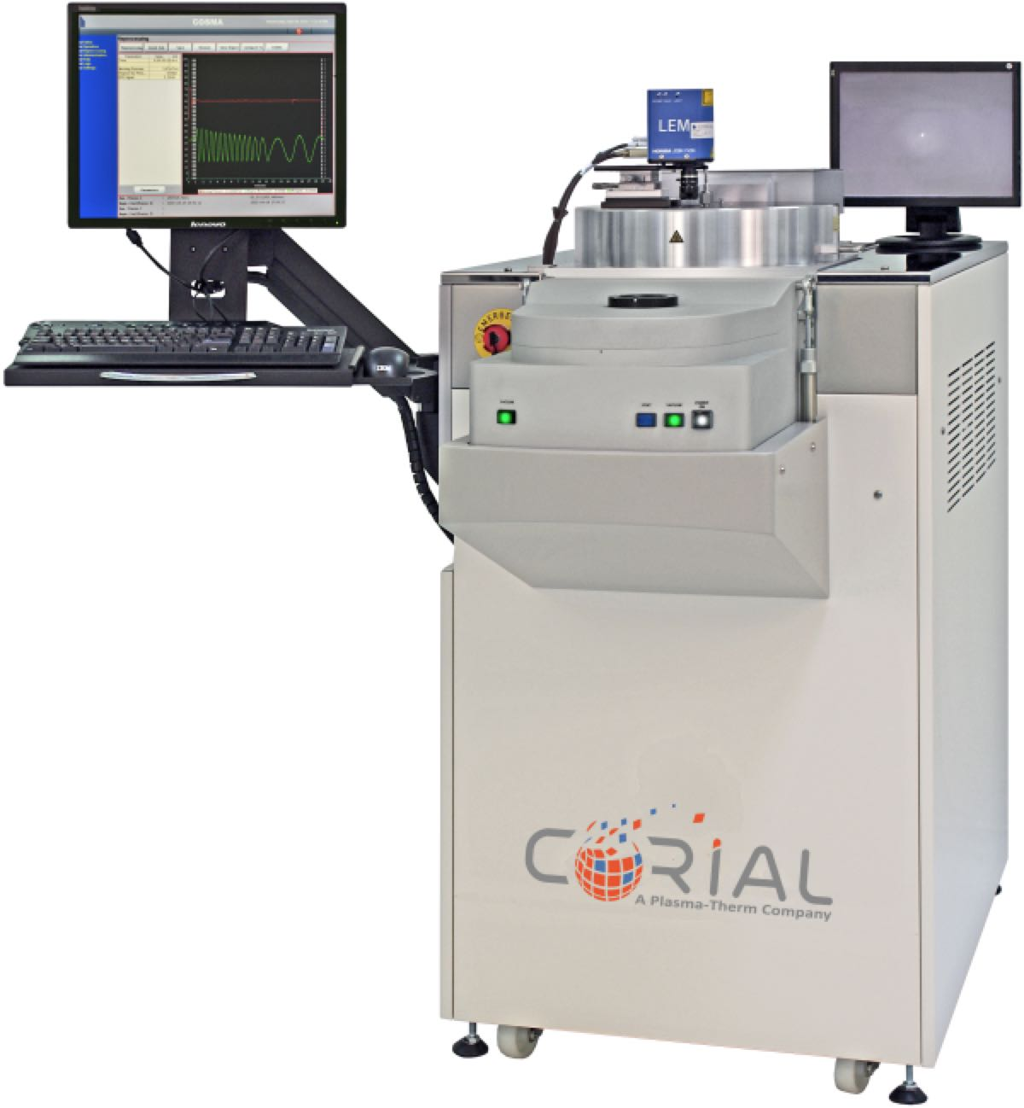
Corial D250 / D250L
PECVD equipment for wafer sizes up to 200 mm
Large process range for High & Low Temp deposition of silicon compounds
Designed for NO mechanical cleaning
Smaller wafer pieces up to full 200 mm wafer

Slide 3
System description Corial D250 / D250L

Slide 4
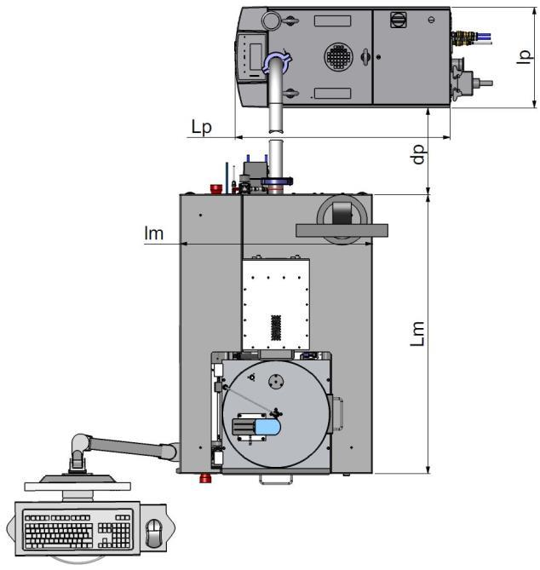
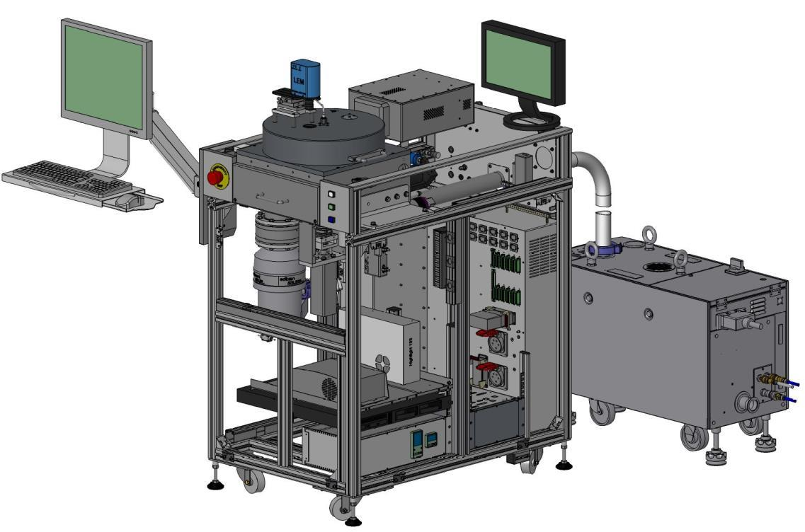
System description
General View
THE MOST
COMPACT
MACHINE
ON THE MARKET
390
30 %
SMALLER FOOTPRINT
960
600
750
1080

Slide 5
System description
Detailed View
EPD with laser
PECVD reactor
Pumping system
(TMP 350l/s and dry pump 110 m³/h)
TMP controller
Heating controller
HV and LV power supplies
300 W RF generator
Process controller

Slide 6
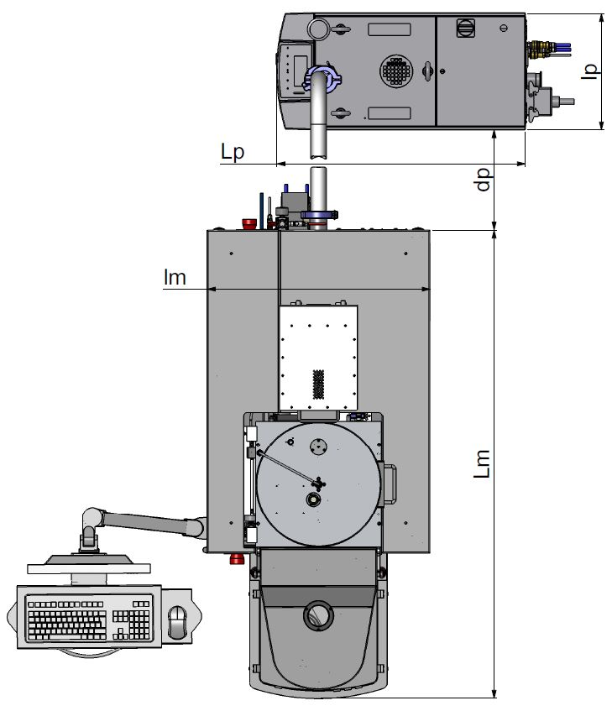
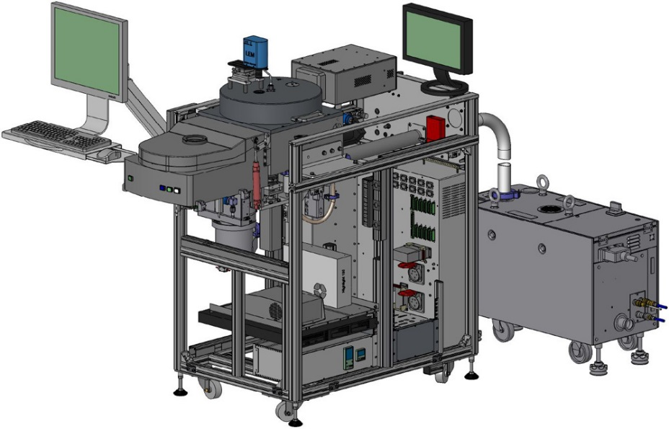
System description
General View
THE MOST
COMPACT
MACHINE
ON THE MARKET
390
30 %
SMALLER FOOTPRINT
960
600
750
1570

Slide 7
System description
Detailed View
EPD with laser
PECVD reactor
Load lock
Pumping system
(TMP 350l/s and dry pump 110 m³/h)
TMP controller
Heating controller
HV and LV power supplies
300 W RF generator
Process controller

Slide 8
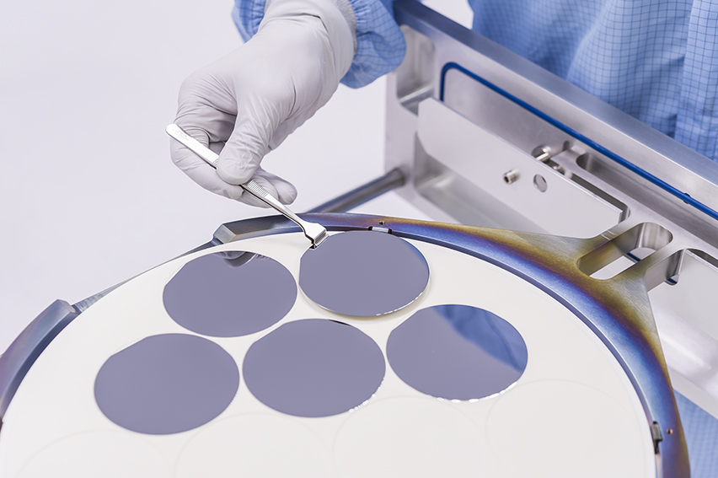
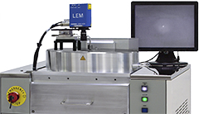
System description
Loading
Shuttle
EASY EXCHANGE BETWEEN SUBSTRATE SHAPE AND SIZE
< 180 s
VACUUM ROBOT ON Corial D250L FOR FAST AND REPEATABLE LOAD AND UNLOAD
< 240 s
LOADING TIME WITH Corial D250

Slide 9
PECVD reactor Corial D250 / D250L

Slide 10
Pecvd reactor
Precise and uniform temperature control of the substrate and reactor walls delivers excellent deposition repeatability and uniformity
Pressurized reactor ensures high-quality films free of pinholes
Optimized gas showerhead and symmetrical pumping deliver excellent deposition uniformity
High temperature, dual pumped configuration enables efficient plasma cleaning at operating temperature, with no corrosion of mechanical parts
Optimizing film stress control is simple to accomplish thanks to the reactor’s symmetrical design
System can operate for years without the need for manual cleaning
RAPID AND UNIFORM DEPOSITION
SiO₂ 520 nm/min
Si₃N₄ 250 nm/min
SiC 100 nm/minn
…

Slide 11
Pecvd reactor
Flexibility
20 TO 150°C
TEMPERATURE RANGE
120 TO 325°C
TEMPERATURE RANGE
0.2 TO 2 T
PRESSURE RANGE
≤ 65°C
VACUUM VESSEL WALLS

Slide 12
PECVD reactor
Operation Sequence
1
Cathode (Gas shower)
Vacuum
Chamber
Substrate Holder
Lift

Slide 13
PECVD reactor
Operation Sequence
Cathode (Gas shower)
Substrate Holder
2
Vacuum
Chamber
Lift
Compressed Air
TMP

Slide 14
PECVD reactor
Gas Inlet
Laser interferometer
Match Box
Operation Sequence
Heating cable
RF Generator
13.56 MHz
Cathode (Gas shower)
PLASMA
Substrate Holder
Vacuum
Chamber
Lift
Infra-red reflectors
3
Process Pump
Compressed Air
TMP

Slide 15
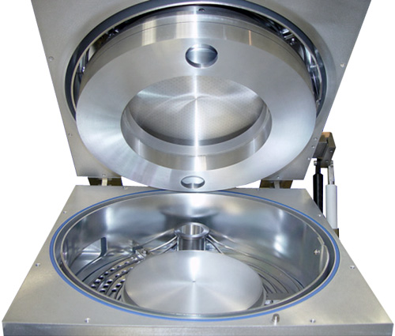
Pecvd reactor
Design
IR reflector
High pumping ring
Gas shower
Heating cable
Substrate holder
Vertical pipe

Slide 16
Pecvd reactor
Standard vs. Pressurized Reactor
Standard PECVD
CORIAL Pressurized Reactor
Cold walls
300°C
P2
PLASMA
PLASMA
P1
H₂O
H₂O
TMP
Roots
TMP
Outgasing from the cold walls leads to
film contamination
P1 >> P2 leads to
NO film contamination
(H₂O is pumped away by TMP)

Slide 17
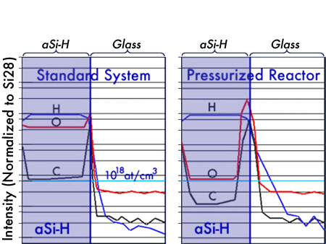
Pecvd reactor
Improved Film Quality
Very low concentration of O and C atoms in aSi-H films deposited in Pressurized Plasma Reactor
OXYGEN CONTAMINATION REDUCED BY 50 IN aSi-H FILM
10¹⁸ O atoms/cm³
CARBON CONTAMINATION REDUCED BY 5 IN aSi-H FILM
10¹⁸ C atoms/cm³
5.10¹⁷ C atoms/cm³

Slide 18
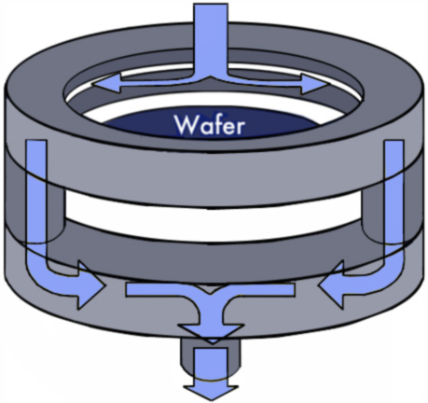
Pecvd reactor
Symmetrical Pumping
EXCELLENT DEPOSITION UNIFORMITY
Gas inlet
High pumping ring
Vertical pipe
Low pumping ring
SiO2 uniformity
< ±2 %
On 8’’ wafer
Process pump

Slide 19
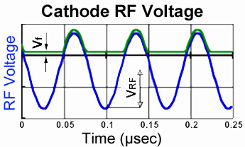
Pecvd reactor
Symmetrical Design
When an RF electric field is applied, the plasma potential adjusts itself until it is clamped on the positive portion of RF voltage (At the nearest floating potential (Vf)). The plasma potential is always higher than the highest potential of any surface in contact with the plasma
The mean plasma potential ( Vp ) and the self bias voltage (VDC) accelerate the positive ions and give them a high kinetic energy. In case of pressurized reactor the VDC is zero.
Ion energy is equal to
e∙Vp + Initial energy of positive ions
Cathode area
=
Anode area
Mean plasma potential (V_{p})
Self bias voltage (-V_{DC}).
Zero bias in case of CORIAL reactor

Slide 20
Pecvd reactor
Symmetrical Design
Standard PECVD
CORIAL Pressurized Reactor
Cathode
(13.56 MHz)
Anode
Anode area >> Cathode area
Self bias voltage on cathode (V_{DC}) >> 100 V
Mean plasma potential = (V_{RF} – V_{DC})/2 (≈ few Volts)
Low energy ion bombardment on wafers sitting on the anode (ground)
Anode area = Cathode area
Self bias voltage on cathode (V_{DC}) = 0V
Mean plasma potential = V_{RF} / 2 (Few hundred volts)
High energy ion bombardment on wafers sitting on anode

Slide 21
Pecvd reactor
Stress Control
CORIAL Pressurized Reactor
Standard PECVD
PRECISE AND SIMPLE STRESS CONTROL
Double frequency system required for stress control
13.56 MHz for compressive stress
100 to 400 KHz for stress control
Single frequency convenient for stress control
13.56 MHz for compressive & tensile stress

Slide 22
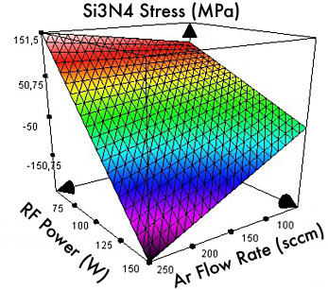
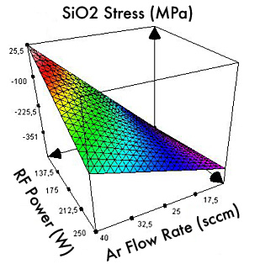
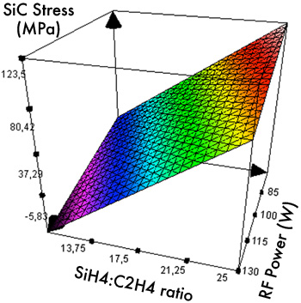
Pecvd reactor
Stress Control
Stress controlled by RF power, Ar flow rate and gas mixture
Si_{x}N_{y} with tunable stress
SiO₂ with tunable stress
SiC with tunable stress

Slide 23
Performances PECVD processes corial D250 / D250L

Slide 24
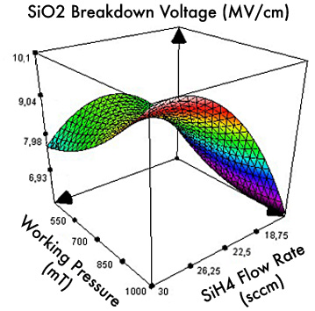
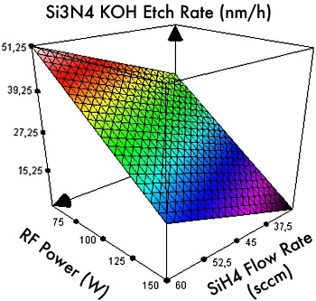
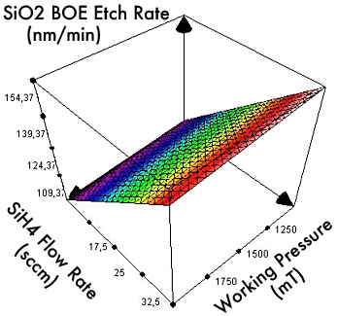
Layer specifications
MEMS
Si_{x}N_{y} with tunable stress
SiO₂ with tunable stress
SiO₂ with breakdown voltage
> 10 MV/cm
Si₃N₄ with low KOH etch rate
SiO₂ with low BOE etch rate

Slide 25
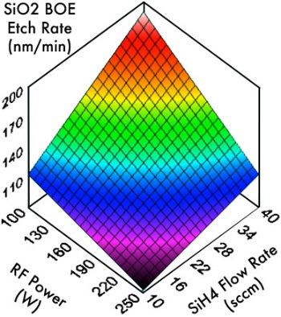
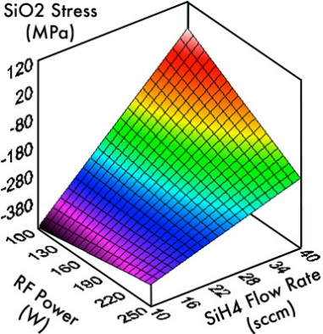
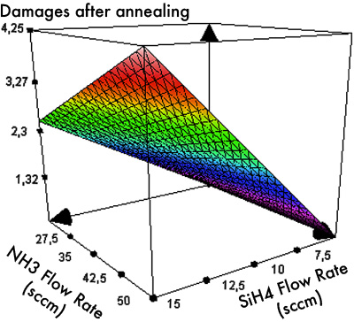
Layer specificaTions
III-V Compounds, Optoelectronics
Low SiO₂ BOE etch rate
SiO₂ with tunable stress
Si₃N₄ with low KOH etch rate
DRIE of glass
Low damaged after annealing
SiC tunable stress

Slide 26
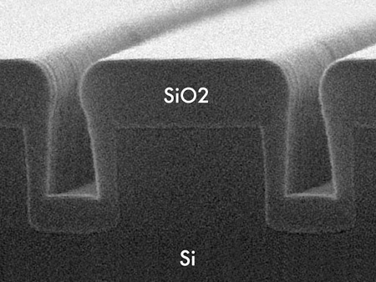
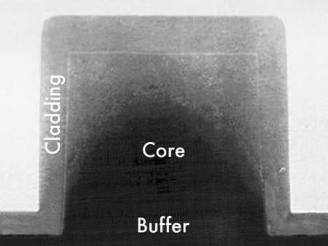
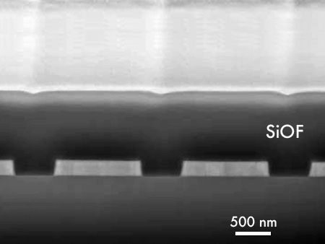
Layer specifications
Step coverage by
SiH₄ + N₂O deposition
Step coverage by
HMDSO + O₂ deposition
Self-planarized
Deposition of SiOF

Slide 27
High deposition rates
Excellent Uniformities
Process | Deposition Rate (nm/min) | Refractive Index | Stress (MPa) | Uniformity on 8” Wafers
SiO_{x} | 20 to 500 * | 1.458 to 1.478 | -300 to +50 | < ± 3%
Si_{x}N_{y} | 20 to 250 * | 1.8 to 2.1 | -300 to +150 | < ± 3%
SiOF | > 50 | 1.41 ± 0.02 | -100 to -0 | < ± 3%
SiOCH | 50 to 200 | 1.45 ± 0.02 | -100 to -20 | < ± 3%
Si_{x}C | 20 to 150 | 2.6 to 2.9 | -100 to +100 | < ± 3%
* Configuration-dependent
Measurement performed with 5 mm edge exclusion

Slide 28
Performances time-multiplexed processes Corial d250 with cosma pulse

Slide 29
COSMA Pulse is the only control software that broadens conventional tools’ process capabilities to enable time-multiplexed processes

Slide 30
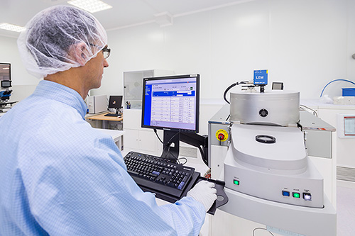
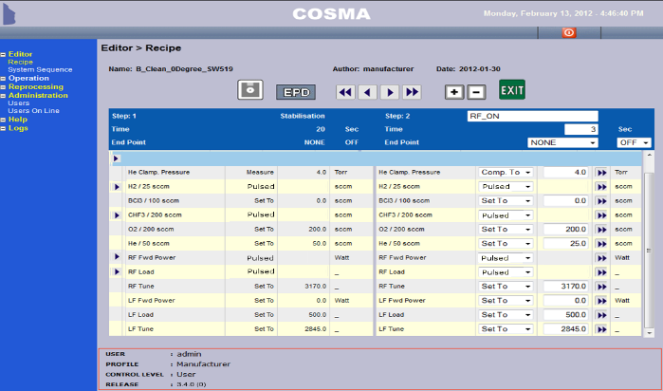
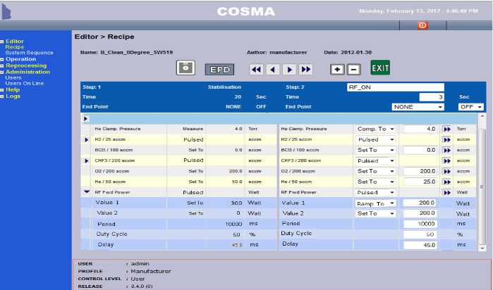
Cosma pulse description
Advanced Process Control
Show/close all the details of the pulsed parameters
Details of the pulsed parameter setting
Mode: Pulsed
Show the pulsed parameters
10 ms
DATA AQUISITION
ALL PARAMETERS
CAN BE CONTROLLED AND PULSED
UPGRADE
FOR CORIAL’S SYSTEMS ALREADY INSTALLED AT CUSTOMERS’ SITES

Slide 31
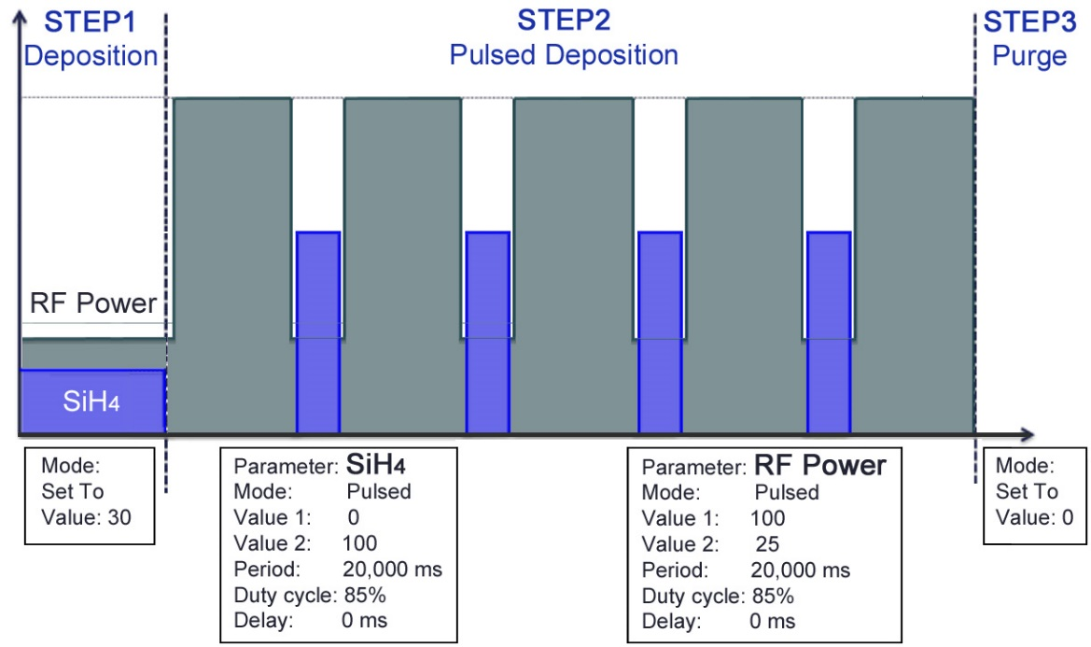
Time-multiplexed processes
Example
Enlarged process window to achieve better control of film properties, and supports Atomic Layer Deposition

Slide 32
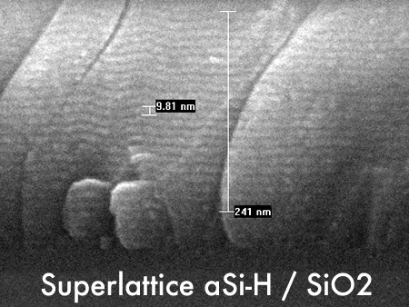
Time-multiplexed processes
Performances
Deposition of 30 periods:
6 nm SiO2 + 4 nm aSi-H`
by COSMA Pulse software

Slide 33
cleaning corial d250 / D250L

Slide 34
The 200 mm deposition system which never requires mechanical cleaning of reactor or vacuum vessel for many years of operation

Slide 35
Particle contamination
Standard PECVD
Reasons for particle contamination:
Films are deposited on cold surfaces (<100°C), giving rise to poor film adhesion responsible for film pealing (big particles, size > 50 µm)
Plasma cleaning cannot fully remove deposited films on cold surfaces, giving rise to built up of thick films and, thereby, film pealing,
Plasma cleaning leads to corrosion of metals other than Al having a high temperature (> 200°C). This corrosion is responsible for big particles (size > 50 µm),
Powders (*) in the plasma responsible for pin-holes in deposited films.
Cathode
(<100°C)
Anode (300°C)
Walls (<60°C)
(*) Powders or clusters come from fast exothermic anion-radical reactions as SinHm ⁻ + SiHm' to Sin+1Hm+m'-2q- +qH2 that can lead to nucleation of up to 10⁴ Si atoms.

Slide 36
Reactor plasma cleaning
For Particle Free Processes
HIGH UPTIME
In situ
Reactor plasma cleaning
Automatic
EPD of reactor plasma cleaning process
NO MECHANICAL CLEANING
Pressurized
Reactor Design

Slide 37
Pecvd reactor
In Situ Cleaning Sequence
1
Closed gate valve
Roots

Slide 38
Pecvd reactor
In Situ Cleaning Sequence
SF₆
Gas Inlet
P2
N2 leaks
Send N₂
2
P1
P1 << P2
Closed gate valve
Roots

Slide 39
Pecvd reactor
In Situ Cleaning Sequence
SF₆
Gas Inlet
P2
N2 leaks
Send N₂
PLASMA
Walls at 300°C
P1
P1 << P2
NO fluorine atoms in the vacuum vessel
NO corrosion
Closed gate valve
3
Walls at 300°C leads to efficient plasma cleaning and, thereby, minimum particle contamination
SiH₄ stopped while plasma still ON
NO pin holes

Slide 40
usability corial D250 / D250L

Slide 41
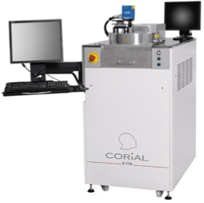
Process control software
COSMA
COSMA
CORIAL OPERATING SYSTEM FOR MACHINE
The simplest, most efficient software to develop processes, operate, and maintain CORIAL systems
DESKTOP APPLICATION
Process Editing I Process Adjustment I Process Operation I Process Tracability I System Maintenance
REMOTE CONTROL

Slide 42
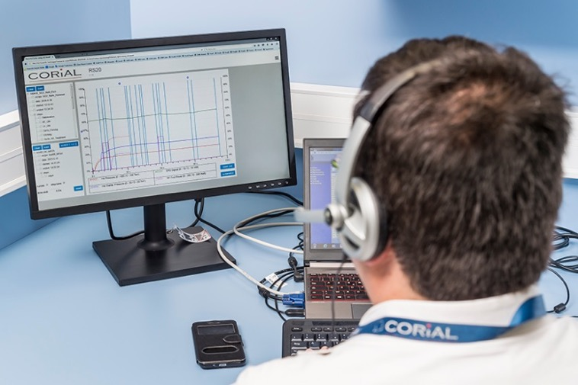
Reprocessing software
COSMA RS
DISPLAY UP TO 4
PARAMETERS FROM A RUN
Simple and efficient software to analyze process runs and accelerate process development
REMOTE
ANALYSIS OF RUNS
DRAG AND DROP
CURVES TO CHECK PROCESS REPEATABILITY

Slide 43
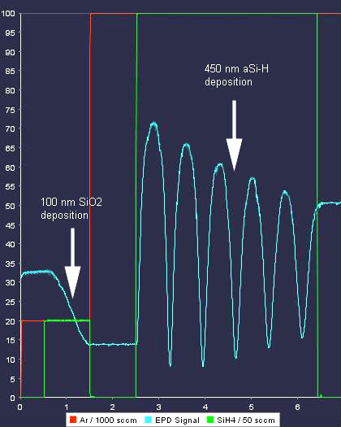
End point detection
EPD with laser
Real-Time deposition rate measurement
Real-Time deposition thickness measurement

Slide 44
Corial D250 / D250L
PECVD equipment for wafer sizes up to 200 mm
Large process range for High & Low Temp deposition of silicon compounds
Designed for NO mechanical cleaning
Smaller wafer pieces up to full 200 mm wafer

