Slide 1
CONTROL OF STRESS
In Corial PECVD SYSTEMS

Slide 2
Corial pecvd stress control

Slide 3
Mechanical stress definition
PECVD
Tensile
‘Film density’ is lower than the normal value for a selected material
The stress is ‘tensile’ or ‘positive’
‘Film density’ is higher than the normal value for a selected material
The stress is ‘compressive’ or ‘negative’
Compressive

Slide 4
Mechanical stress control
PECVD
Mechanical stress in the PECVD films is driven by the film ‘density’ and therefore can be controlled by:
Composition of films, and hence process conditions (gas composition, pressure)
Ion bombardment of films during their growth

Slide 5
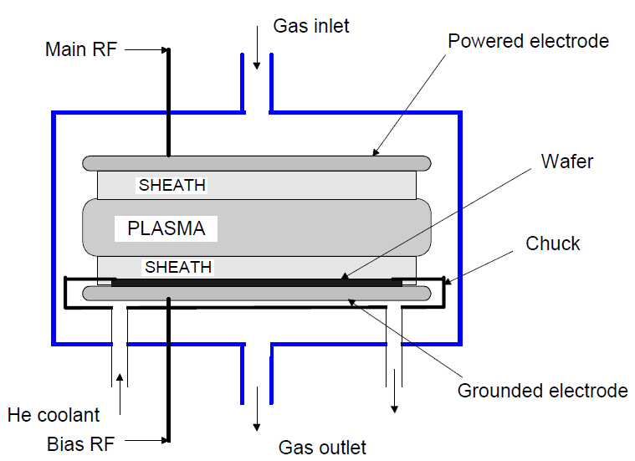
ION bombardment
PECVD
Basic PECVD reactor:
A 13.56 MHz voltage is applied between two electrodes. Electrons, accelerated by the high frequency electric field, ionize the molecules of gas

Slide 6
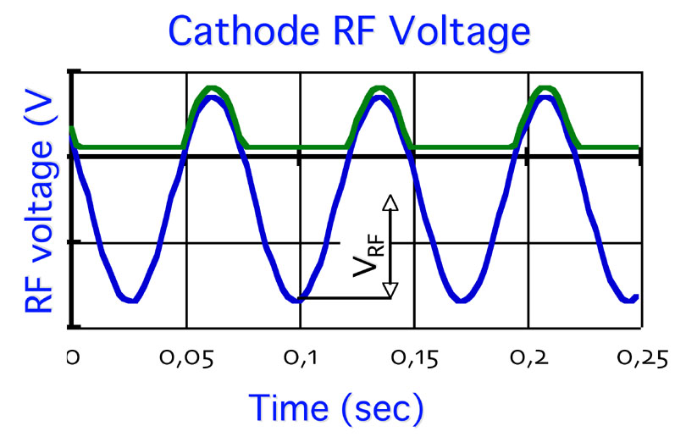
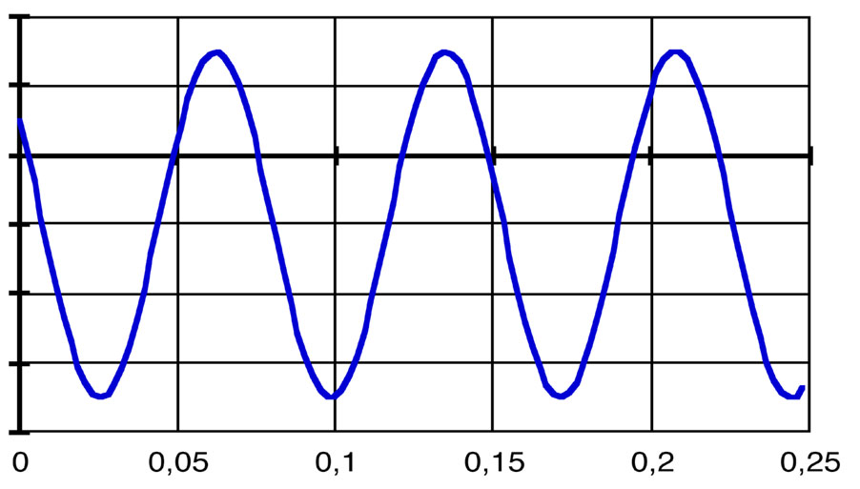
ION bombardment
PECVD
V_{plasma}
RF Voltage
RF Voltage
RF voltage (V)
Time (sec)
V_{bias}
Depending on the process conditions (pressure, gas composition, RF power) plasma volume will become positively charged to the ground (plasma potential, V_{plasma})
If RF voltage is applied to the substrate holder, then the negative bias voltage will appear (V_{bias}).
Energy of ions coming to the surface is:
E = e ∙ (V_{plasma} + V_{bias})

Slide 7
Pecvd reactor
CORIAL Symmetrical Design
Due to the similarity of cathode and anode areas in case of CORIAL reactor, the V_{plasma} value becomes high.
Simultaneously, no V_{bias} is created on the substrate holder.
As a result,
Ion energy is equal to
e∙V_{plasma}
Depending on process conditions
V_{plasma} can reach several hundreds Volt,
thus providing necessary bombardment for
stress control
Cathode area
=
Anode area

Slide 8
Corial pecvd reactor vs. Standard pecvd
Standard PECVD
CORIAL Pressurized Reactor
Cathode
(13.56 MHz)
Anode
Anode area >> Cathode area
Self bias voltage on cathode (V_{DC}) >> 100 V
Mean plasma potential = (V_{RF} – V_{DC})/2 (≈ few Volts)
Low energy ion bombardment on wafers sitting on the anode (ground)
Anode area = Cathode area
Self bias voltage on cathode (V_{DC}) = 0V
Mean plasma potential = V_{RF} / 2 (Few hundred volts)
High energy ion bombardment on wafers sitting on anode

Slide 9
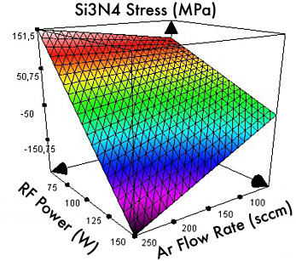
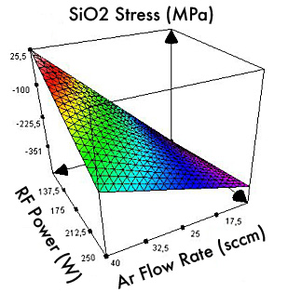
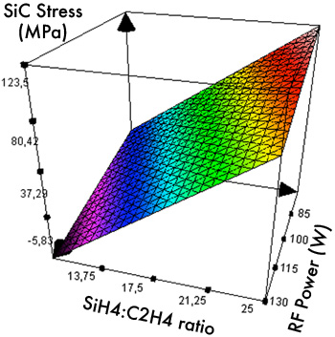
Corial pecvd reactor
Stress controlled in a wide range by RF power, Ar flow rate and gas mixture in a very simple and reproducible manner
Si_{x}N_{y} with tunable stress
SiO₂ with tunable stress
SiC with tunable stress

Slide 10
Corial pecvd stress control
Some data showing the range of mechanical stress obtained with CORIAL PECVD
Material | Substrate | Stress (MPa) | Deposition rate (nm/min) | Refractive Index | BOE rate (nm/min)
SiO₂ | Si | -484 | 79 | 1.46 | 115
 | Si | 32 | 426 | 1.48 | 190
Si₃N₄ | Si | -706 | 93 | 2.06 | -
 | Si | -365 | 80 | 2.07 | 40
 | Si | 243 | 48 | 1.91 | 144

